Slide 1
五子棋答辩
汇报人：汤亦文

Slide 2
1
请输入你的标题
please enter the text you need here. thank you for using our ppt template.
目录
2
请输入你的标题
CONTENTS
please enter the text you need here. thank you for using our ppt template.
3
请输入你的标题
please enter the text you need here. thank you for using our ppt template.
4
请输入你的标题
please enter the text you need here. thank you for using our ppt template.

Slide 3
PART 01
基础功能实现
The user can demonstrate on a projector or computer, or print the presentation and make it into a film to be used in a wider field

Slide 4
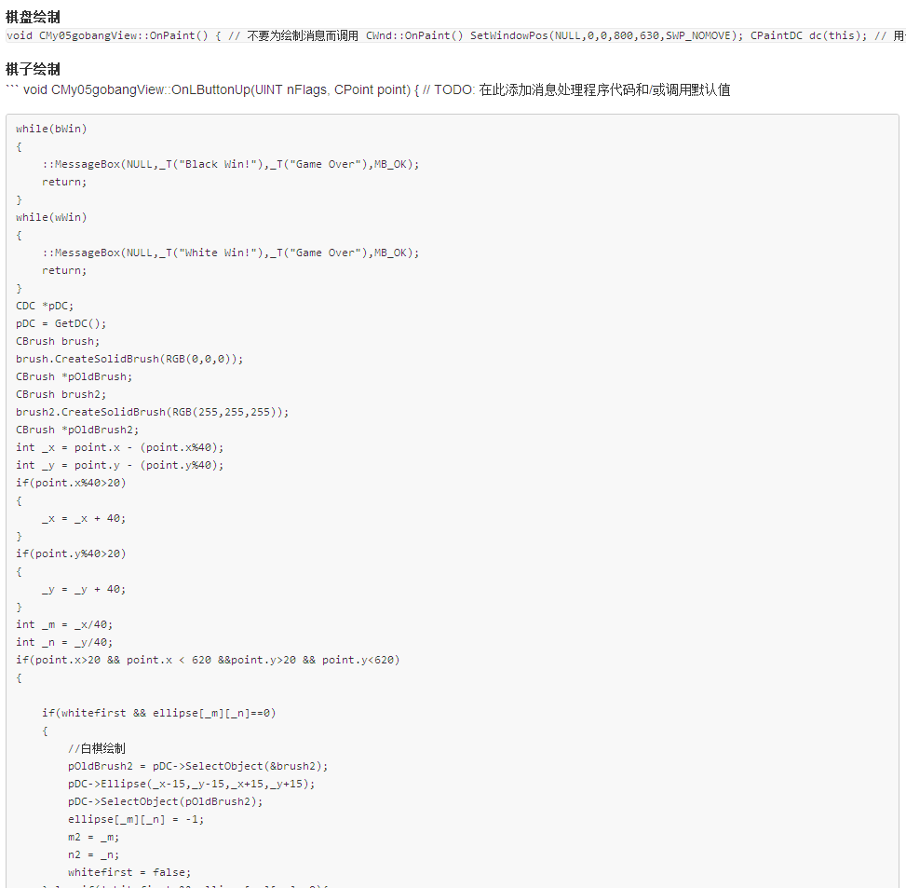
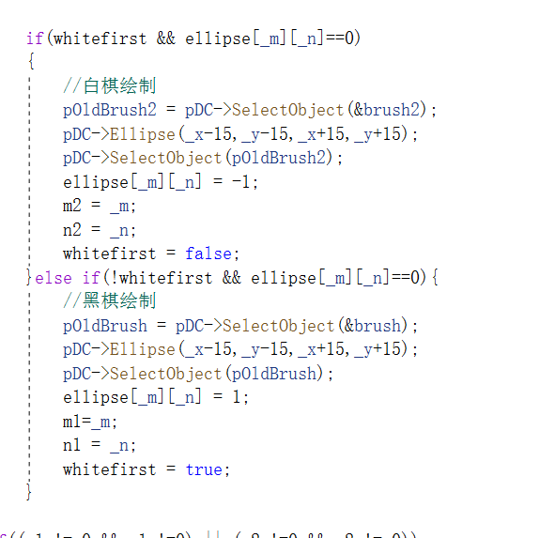
基础功能实现
The user can demonstrate on a projector or computer, or print the presentation and make it into a film to be used in a wider field
棋盘绘制：
因为增加了棋盘自定义，所以没用采用书上的位图，改为MFC绘制（先上背景色然后画出轮廓和格线）
由于美观，棋子同样采用绘制的方法
棋子绘制原理同棋盘

Slide 5
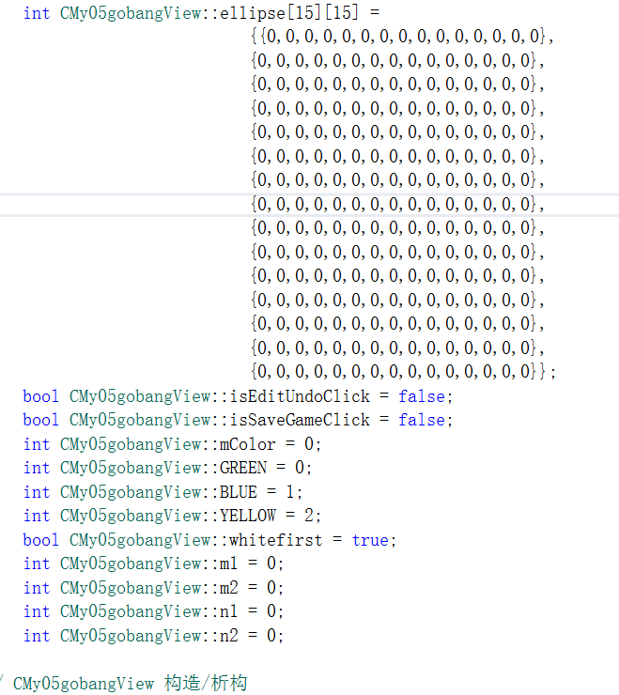
基础功能实现
The user can demonstrate on a projector or computer, or print the presentation and make it into a film to be used in a wider field
棋盘状态的储存：
二维数组，1代表白子，-1代表黑子
没有像书上那样封装棋子，而封装整个棋盘状态，程序效率更高并且写的时候更方便。

Slide 6
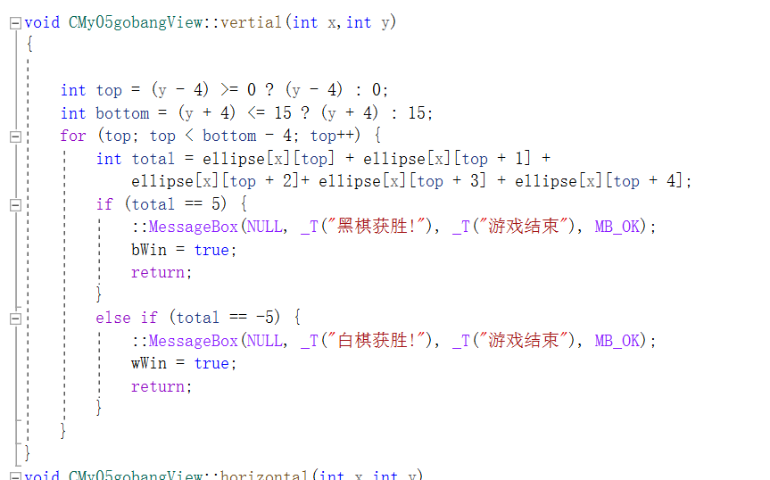
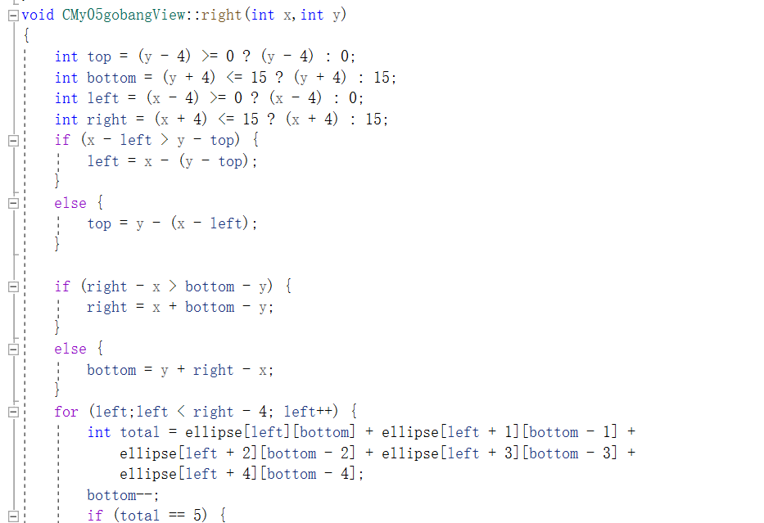
基础功能实现
The user can demonstrate on a projector or computer, or print the presentation and make it into a film to be used in a wider field
重要功能：输赢判定
主要判定垂直、水平、左斜、右斜四个方向的输赢情况
特殊：棋盘下满，游戏结束
垂直判定
右斜判定

Slide 7
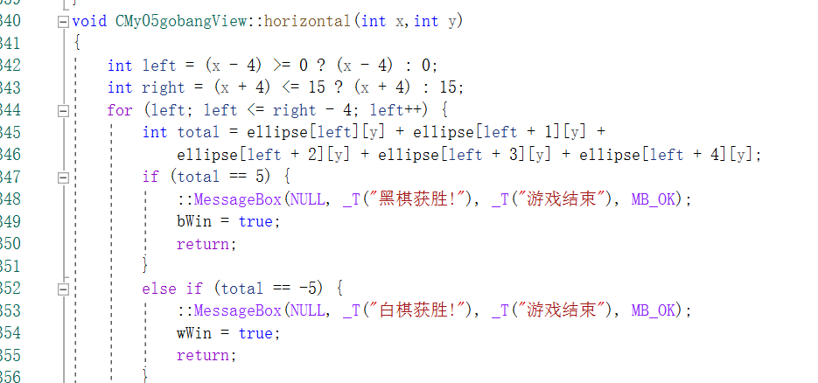
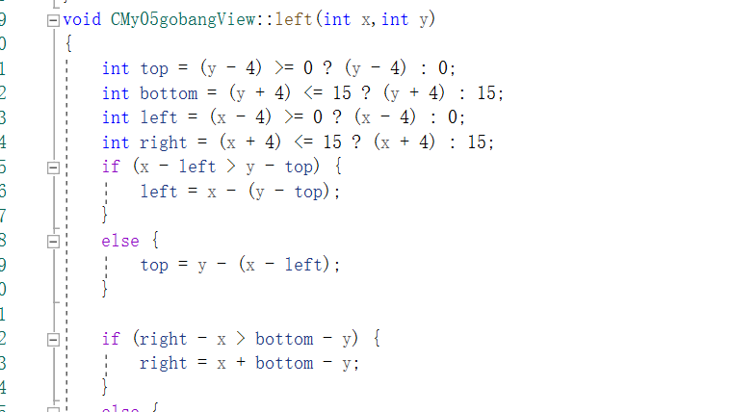
基础功能实现
The user can demonstrate on a projector or computer, or print the presentation and make it into a film to be used in a wider field
水平判定
左斜判定
一点点的小优化：书上判定时扫了整个棋盘，其实只要判断刚落下的那个子所在的行列和”/” “ \”就行了

Slide 8
PART 02
附加功能实现
The user can demonstrate on a projector or computer, or print the presentation and make it into a film to be used in a wider field

Slide 9
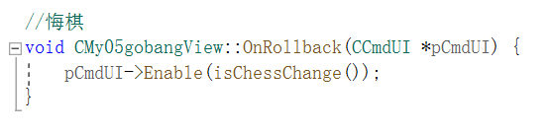
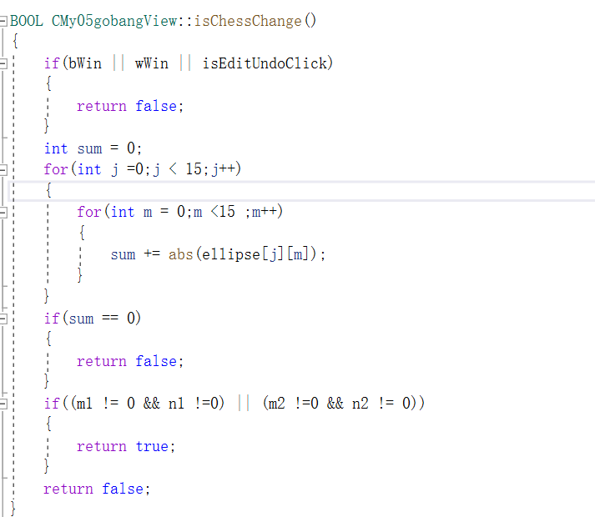
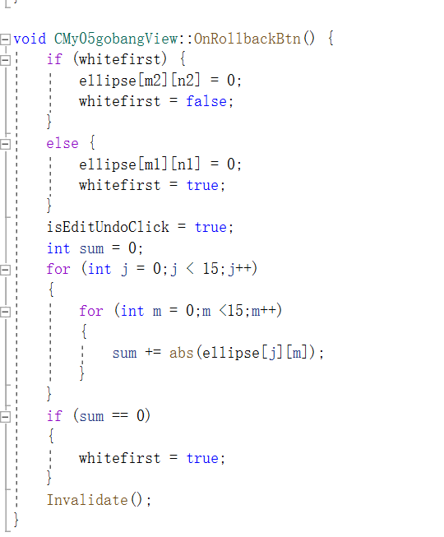
附加功能实现
The user can demonstrate on a projector or computer, or print the presentation and make it into a film to be used in a wider field
一、悔棋：
只要记录上颗子的状态，然后判断下是否已经游戏结束，没有就还原（修改棋盘数组）。

Slide 10
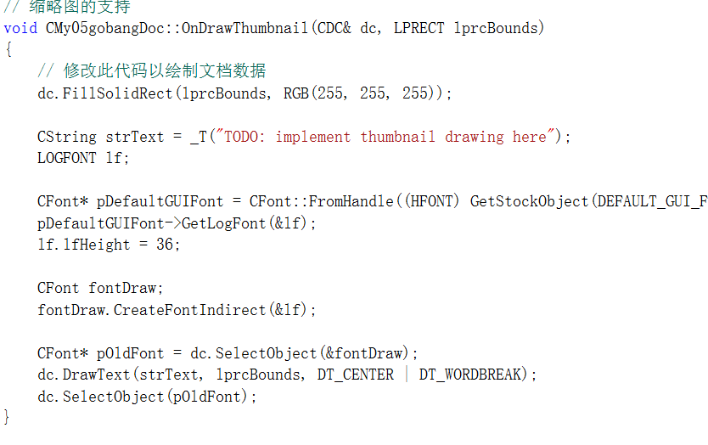
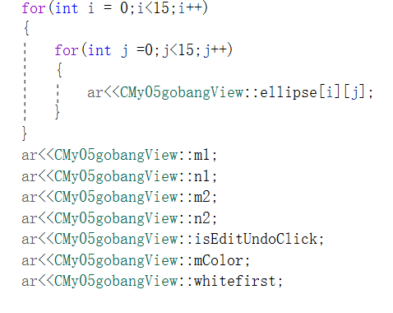
附加功能实现
The user can demonstrate on a projector or computer, or print the presentation and make it into a film to be used in a wider field
二、保存棋局。
将棋盘状态写入文档，保存二维数组等基本信息

Slide 11
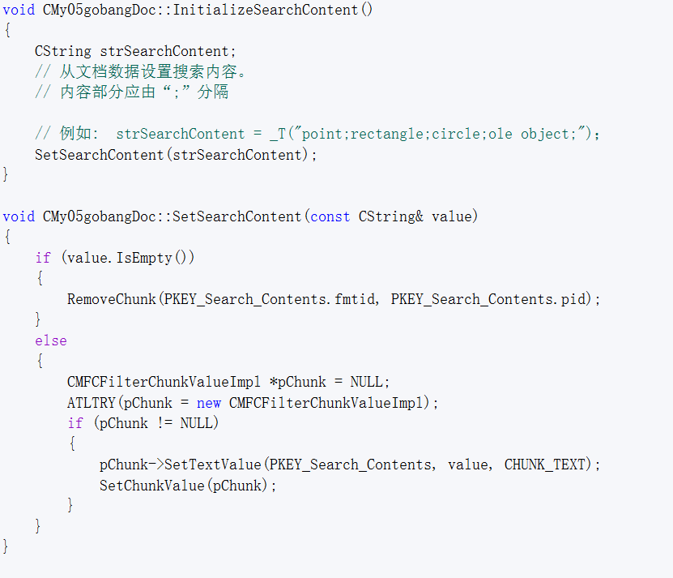
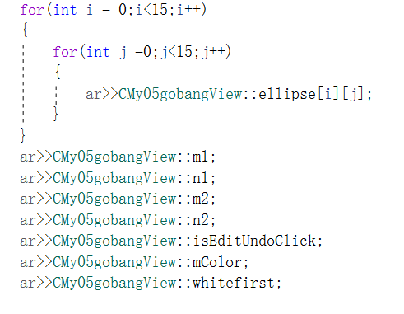
附加功能实现
The user can demonstrate on a projector or computer, or print the presentation and make it into a film to be used in a wider field
三、搜索文档并载入棋局
读取文档中的棋局状态和设置
.

Slide 12
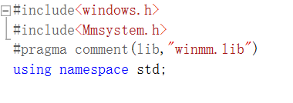
附加功能实现
The user can demonstrate on a projector or computer, or print the presentation and make it into a film to be used in a wider field
四、背景音乐
利用windows API异步播放
.

Slide 13
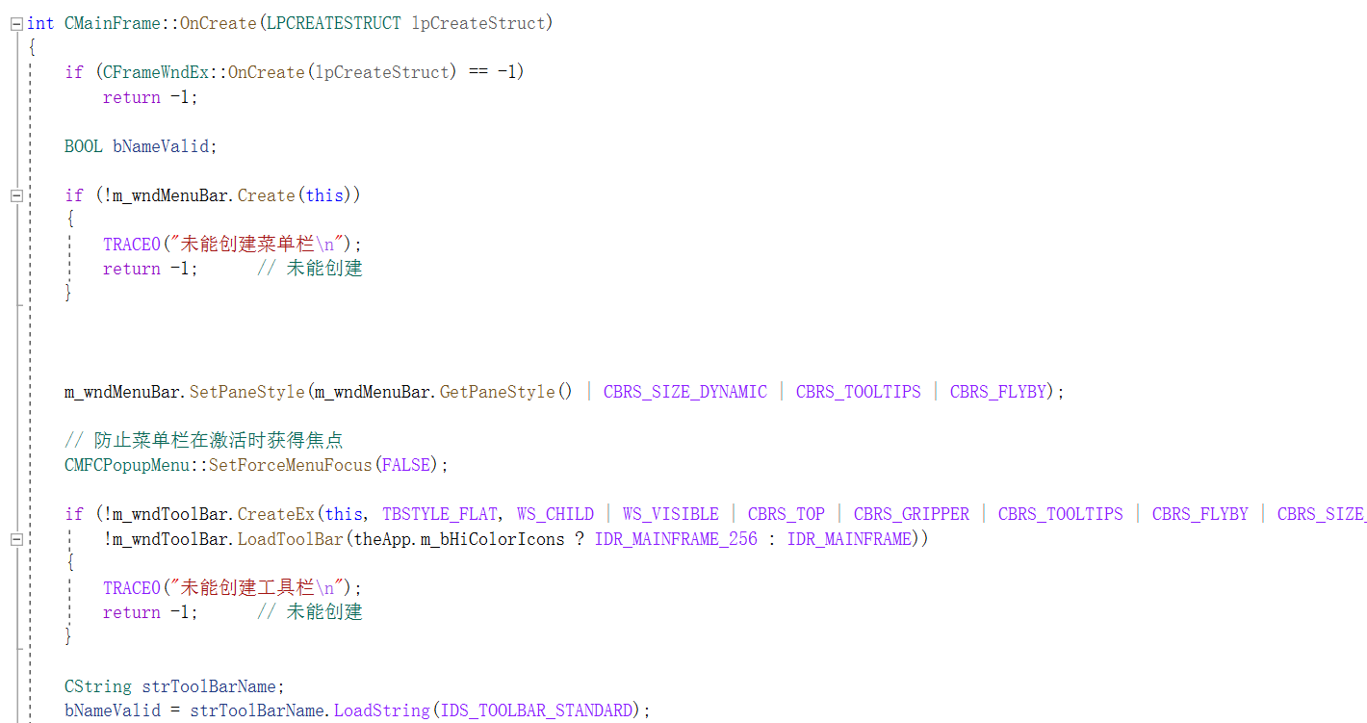
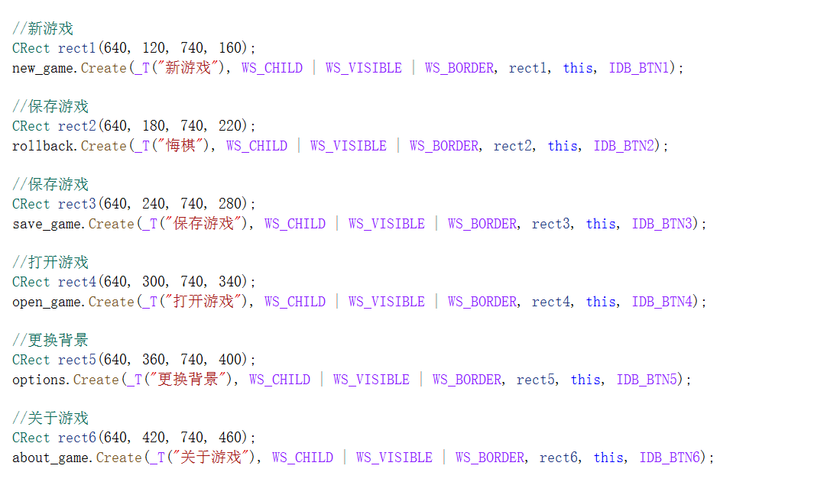
附加功能实现
The user can demonstrate on a projector or computer, or print the presentation and make it into a film to be used in a wider field
五、添加菜单栏，优化UI界面
添加MFC控件

Slide 14
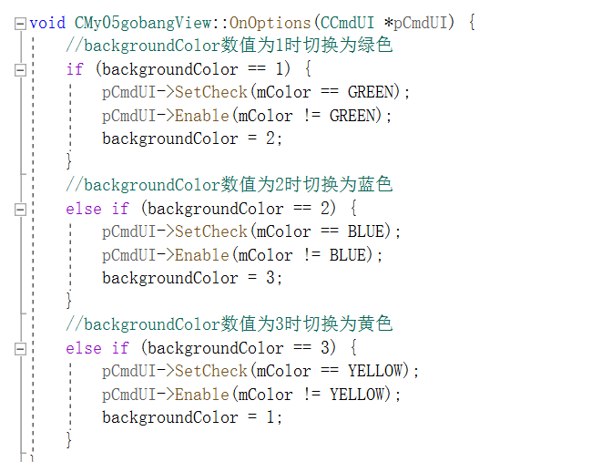
附加功能实现
The user can demonstrate on a projector or computer, or print the presentation and make it into a film to be used in a wider field
六、自定义棋盘
可以切换棋盘颜色(用不同颜色重新绘制棋盘）

Slide 15
PART 03
成功项目展示
The user can demonstrate on a projector or computer, or print the presentation and make it into a film to be used in a wider field

Slide 16
THANKS FOR YOUR
WATCHING
your content is entered here, or by copying your text, select paste in this box and choose to retain only text. your content is typed here, or by copying your text, select paste in this box.your content is entered here, or by copying your text, select paste in this box and choose to retain only text. your content is typed here, or by copying your text, select paste in this box.
汇报人：汤亦文

