Slide 1
Research Data Management Platform
Thomas Nind
(Software Architect)

Slide 2
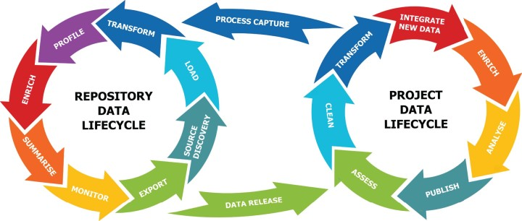

Slide 3






Historical Reality

Slide 4
Down sides
Very manual
Script needs to be updated for every extraction
Easy to miss data errors
  Missing leading 0s on chi numbers
  Duplication (i.e. forgot to add distinct)
  Patient aliases (10% of chis are aliases)

Slide 5
Refine the Approach

Slide 6

Over Time

Slide 7


Logical Progression
Project
Configurations
Database
Beautiful
User Interface

Slide 8

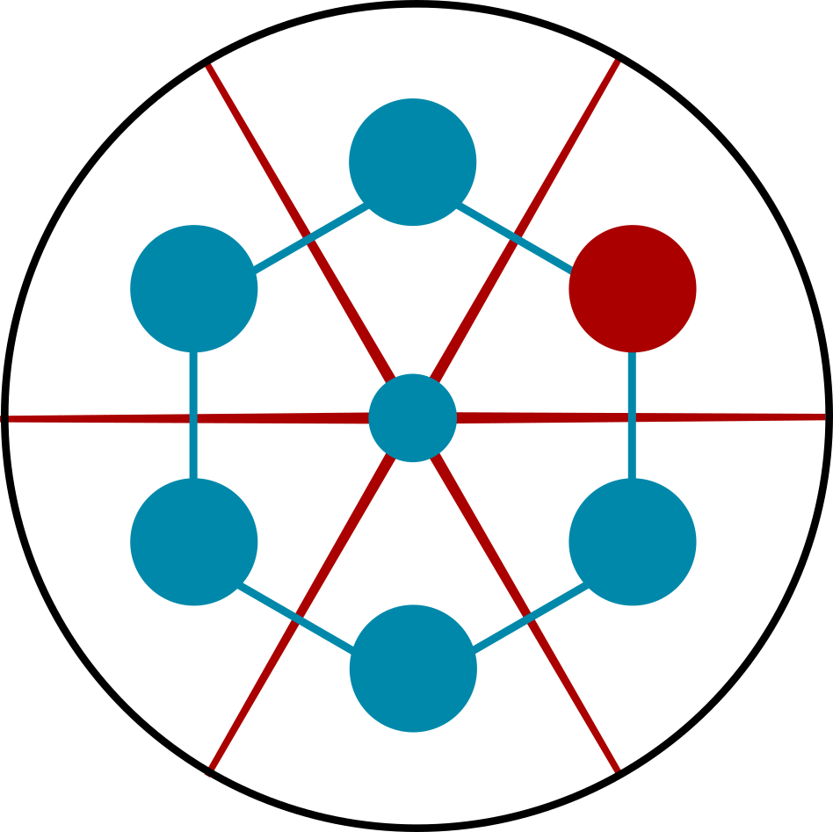
Then spend 8 years refining it
"She may not look like much, but she's got it where it counts, kid."

Slide 9
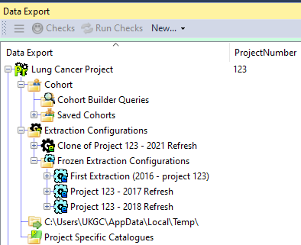
The Project
Can have multiple cohorts
  Cases / Controls
  Periodic Refreshes
Can have multiple Extraction Configurations

Slide 10
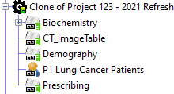
The Extraction Configuration
Has one or more selected datasets
Has a single cohort

Slide 11

The Selected Dataset
Has 0 or more filters
Has 1 or more 'linkage' column(s) e.g. chi

Slide 12
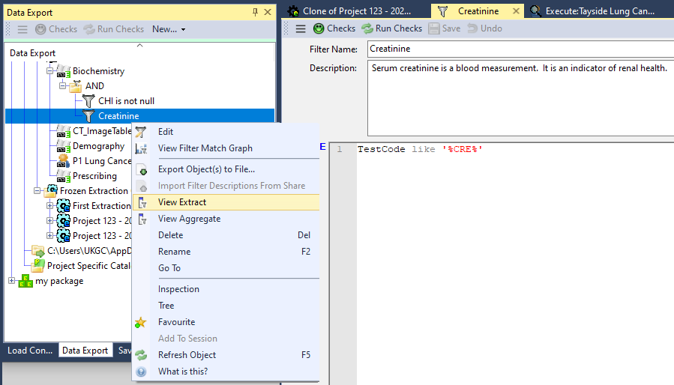
Filters

Slide 13

Features
View Extract
(TOP 100)
Master Filters
(Catalogue)
View Aggregate
(GROUP BY)
Parameter
Support
Go To
Usages
Mandatory
Filters

Slide 14
Selected Dataset
Extract
(Using Pipeline)
Track Diff
(Then vs Now)
View TOP 100
View SQL
Go To
Usages
Graph
Results

Slide 15
Selected Dataset
Clone
Freeze
Human Readable
Logs
Configuration
Level
Parameters
Extract
(Using Pipeline)
Release

Slide 16






