Slide 1

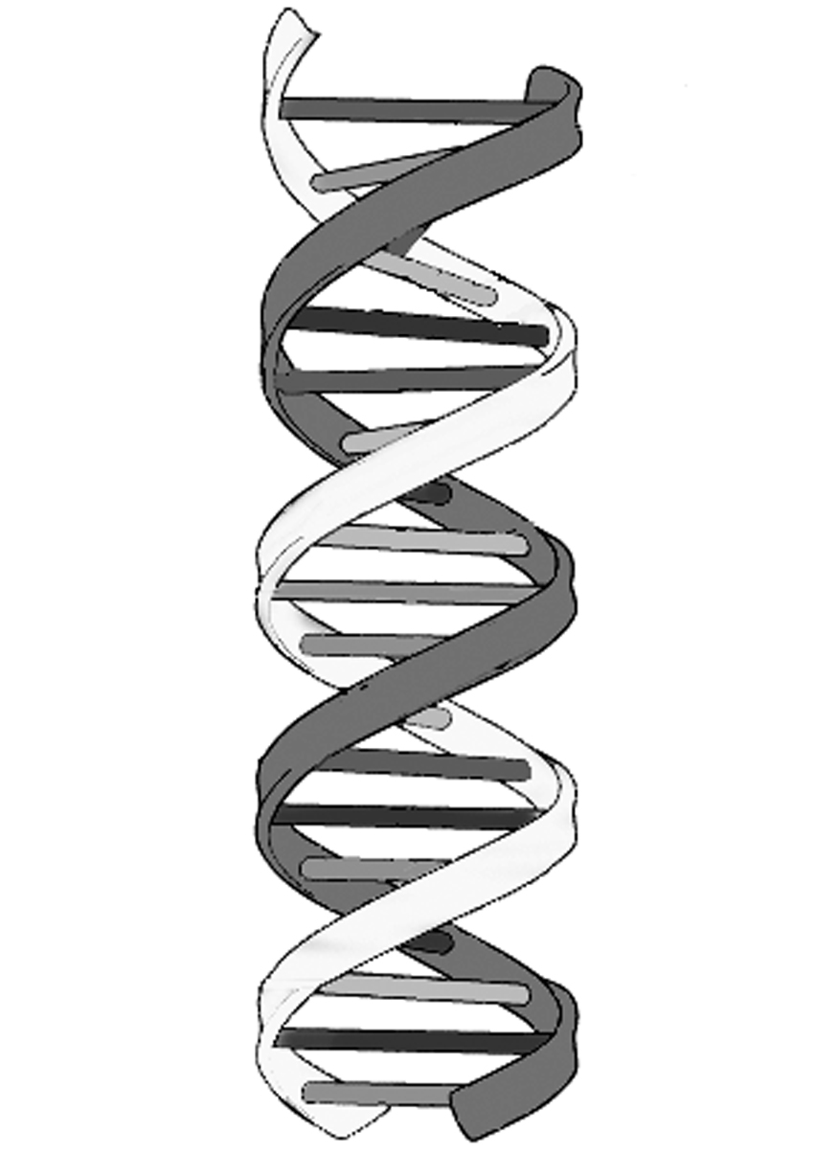
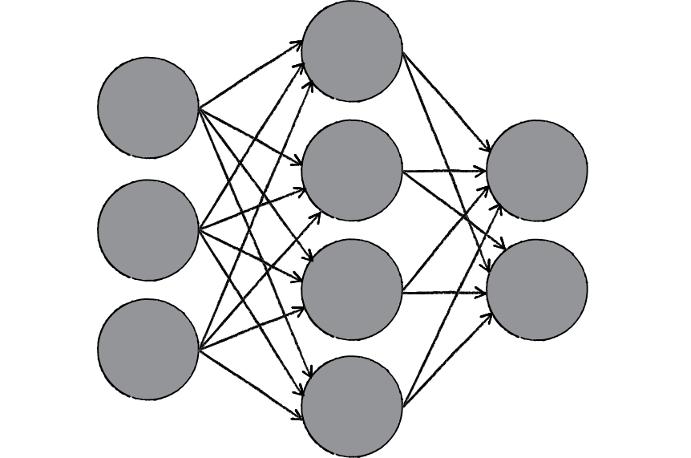

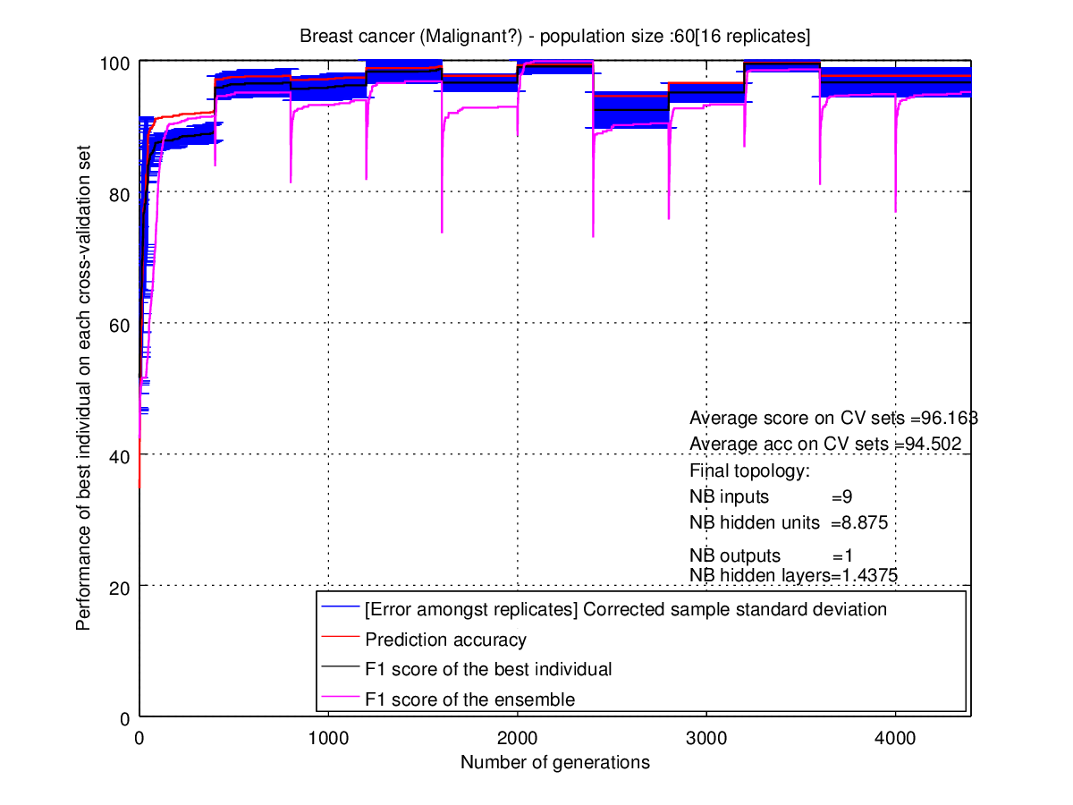
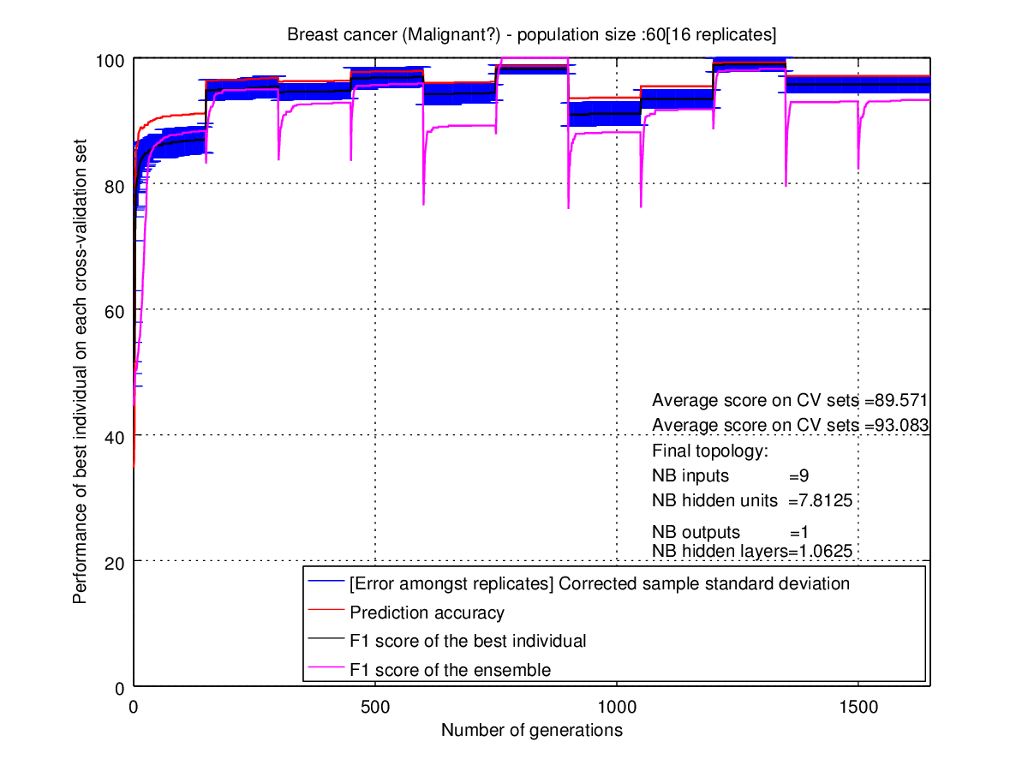
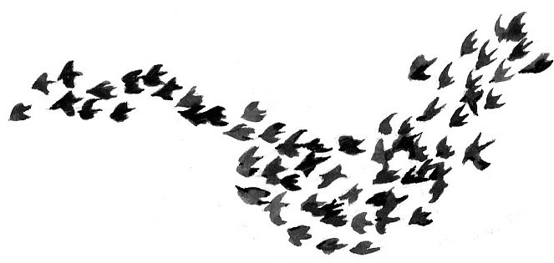
A Comparison of Algorithms for Coevolving the Weights and Topologies of Artificial Neural Networks.
Hichame Moriceau www.github.com/HichameMoriceau - 40171260
Aims and Objectives
Results
Discussion
To investigate the use of Differential Evolution (DE) and Particle Swarm Optimization (PSO) as ways to find an optimal combination of weights and architecture for an artificial neural network (ANN) and to observe the performance of the neural network ensemble at making predictions.
Overall, both algorithms can be used to simultaneously train the topology and the weights of ANNs. DE shows near state-of-the-art performances. Some limits have been observed. PSO shows signs of rapid convergence of the population, leading to it being unable to find a global optima found by DE. Also the ensemble tends to poorly perform when given new data.
DE demonstrates to be a simple but powerful optimization algorithm. The experiment raises multiple questions such as the following.
How can we automate the selection of the algorithm's parameters?
Why does the ensemble tend to over-fit the data?
Does the population of neural networks of each algorithm evolve in a diverse manner?
Why does DE perform better than PSO?
In what scenario does PSO perform better than DE?
 | DE/ANN accuracy(%) | PSO/ANN accuracy (%)
Malignancy | 96 | 93
Recurrence | 91 | 76
Survival | 73 | 51
Principle behind Differential Evolution
Methodology
Each neural network is represented by its genotype containing its weights and architecture parameters. Two different algorithms are used to train a neural network to predict whether a patient is going to develop a malignant cancer or not, whether the cancer might reappear and whether the patient is likely to die within five years.
DE is an algorithm based on Darwin's theory of evolution which trains a superior population epoch by epoch through mating of individual solutions and mutations.
PSO is an algorithm based on the cooperative nature of flock of birds that follow one or more birds which positions are closer to the target.
Principle behind Neural Network Ensemble
Further study
Particle Swarm Optimization
Multiple paths would be worth pursuing. Introducing a local search such as the back propagation algorithm or speciation techniques could be investigated in order to make the search faster.
Multitask learning neural networks with Biology inspired technique is also an area that would be worth exploring. Finally, a comparison with the NEAT (Neuro Evolution of Augmenting Topologies) would also be interesting.
Differential evolution
Principle behind Particle Swarm Optimization
Supervisor: Simon Powers, Second marker: Simon Wells, April 13th 2016

