Slide 1

COMP603
YouTutor- w12 Tim

Slide 2
第十二周
没啥特别的了就复习考试了
pass paper

Slide 3
定义类问题
无非是OOP的好处, 封装, 继承, 多态, 过载, 还有final

Slide 4
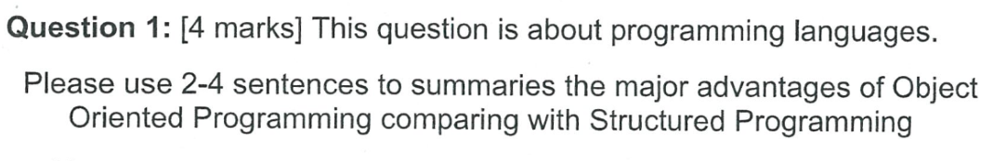

Slide 5
Major advantage : high code reusability. by use OOP’s feature like inheritance, and polymorphism, we can always reuse code in objects, so cost of coding will be reduced and easier to debug.
OOP also provide better readability, code is easier to understand.

Slide 6
解释 Inheritance
用一两句话解释Inheritance

Slide 7
Inheritance happen between super class and subclass. A subclass can inherit or extends the super class and all public method, variable and constructor from super class will be available in subclass.

Slide 8
解释 Encapsulation
用一两句话解释Encapsulation

Slide 9
Encapsulation is used in OOP, it has 3 different types access modifier for control access to method, constructor and variables in objects. Three types of access modifier: public, private, protected
When public, method, constructor and variable can be access anywhere in the program
When private, method, constructor and variable can only be access with in the same class
When protected, method, constructor and variable can be access anywhere in the same package.

Slide 10
解释 Polymorphism
用一两句话解释Polymorphism

Slide 11
Polymorphism is a method can have different behaviour even when calling the same method name.
Polymorphism happened needs inheritances and override, for example, Class A and Class B extends Class C, and A B override a method D in class C. at this time A.D() and B.D() will show different behaviour.

Slide 12
解释 Overloading
用一两句话解释Overloading

Slide 13
Overloading is methods have same name, but different parameters.
For example can be:
Public void setup(){
int a =0;
}
Public void setup(int b){
Int a=b;
}

Slide 14
解释 final class
用一两句话解释final class

Slide 15
When a class declared final, this class cannot be extends.

Slide 16
解释 final method
用一两句话解释final mothod

Slide 17
A final method cannot be overridden in the subclass.

Slide 18
解释 static member field
用一两句话解释static member field

Slide 19
Static member field has its memory space in class wide, and a static variable can be access the anywhere within object. And can be access outside of the class by it’s class name and do not need to initialize object.

Slide 20
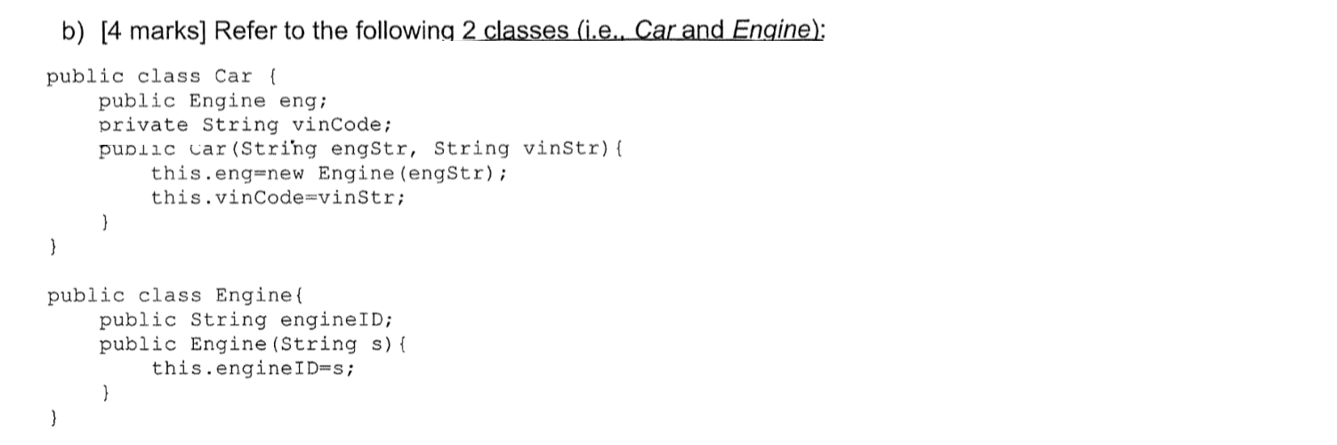
OOP 代码读题类

Slide 21
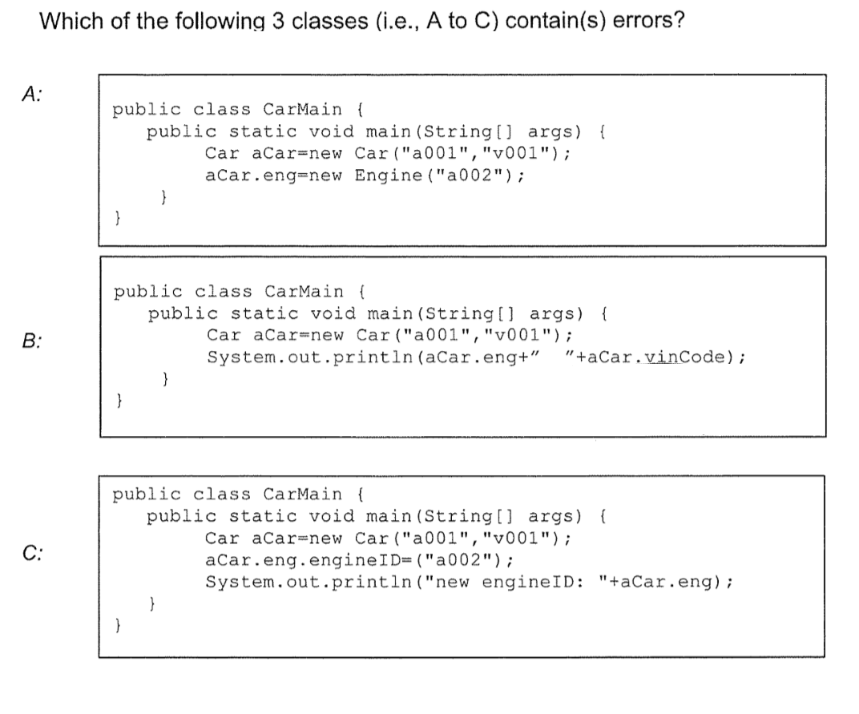

Slide 22
B - private member

Slide 23
File I/O以及JDBC类

Slide 24
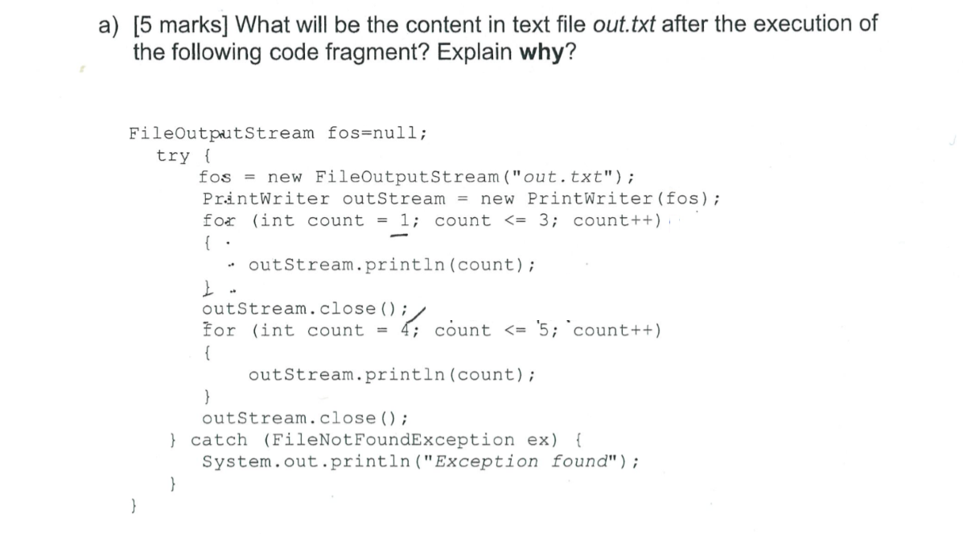

Slide 25
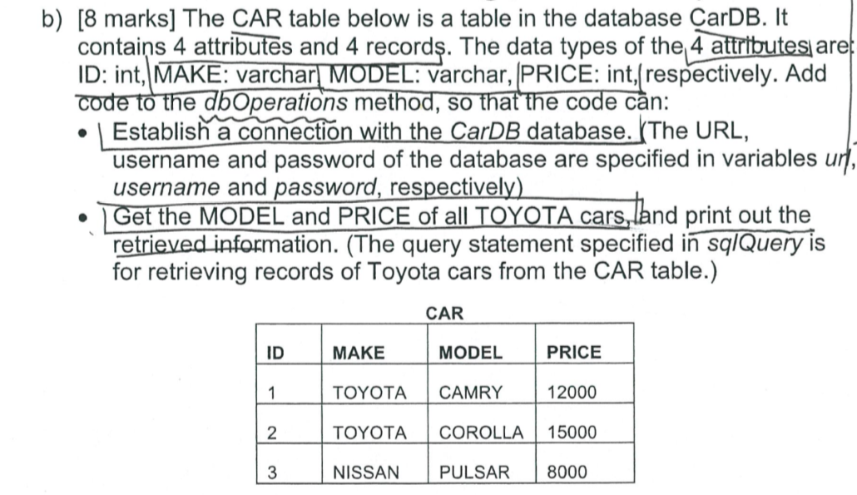

Slide 26
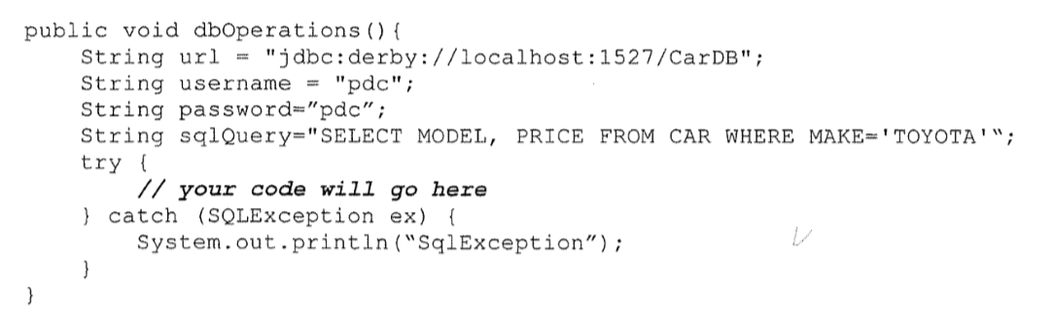

Slide 27
Connection conn = DeviceManager.getConnection(url, username,password);
ResultSet rs = conn.CreateStatement.excuteQuery(SqlQuery);
While(rs.next()){
System.out.println(rs.getString(“MODEL”)+” ”+rs.getInt(“PRICE”);
}

Slide 28
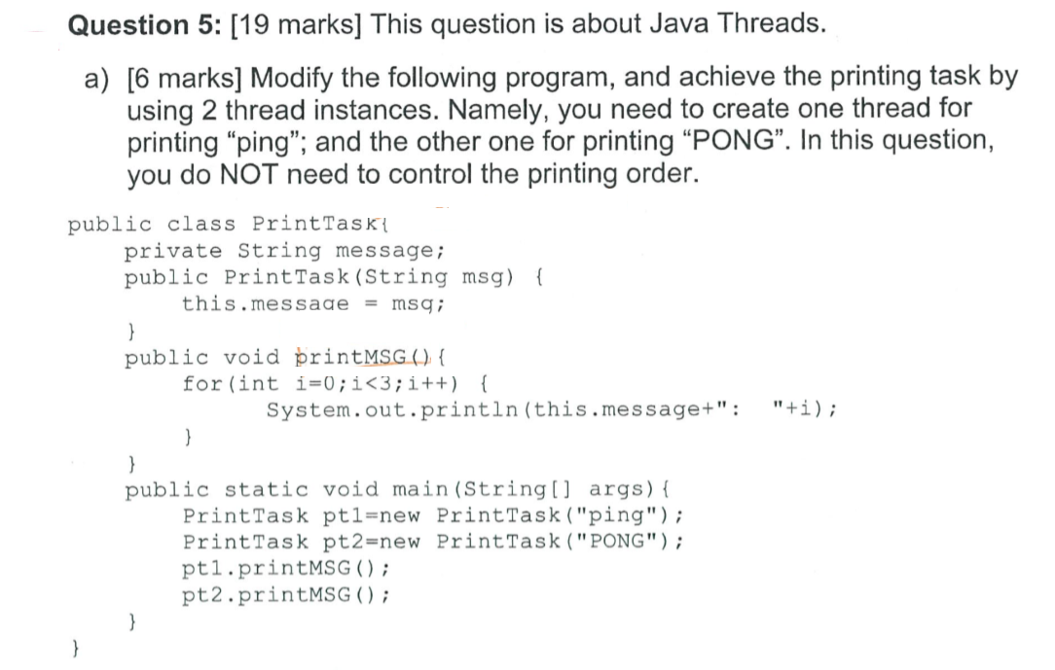

Slide 29
Extends thread,
Make run

Slide 30
State of thread
1 runnable
2 running
3 block, sleep , wait
4 wait

Slide 31
Yield 和 sleep的区别
Yield will stop a thread, let other task to run( go in to CS)
Sleep can stop a thread by a given time

Slide 32
Synchronized
When a method what declared synchronized, when it run, other thread has to wait until it finished.

Slide 33
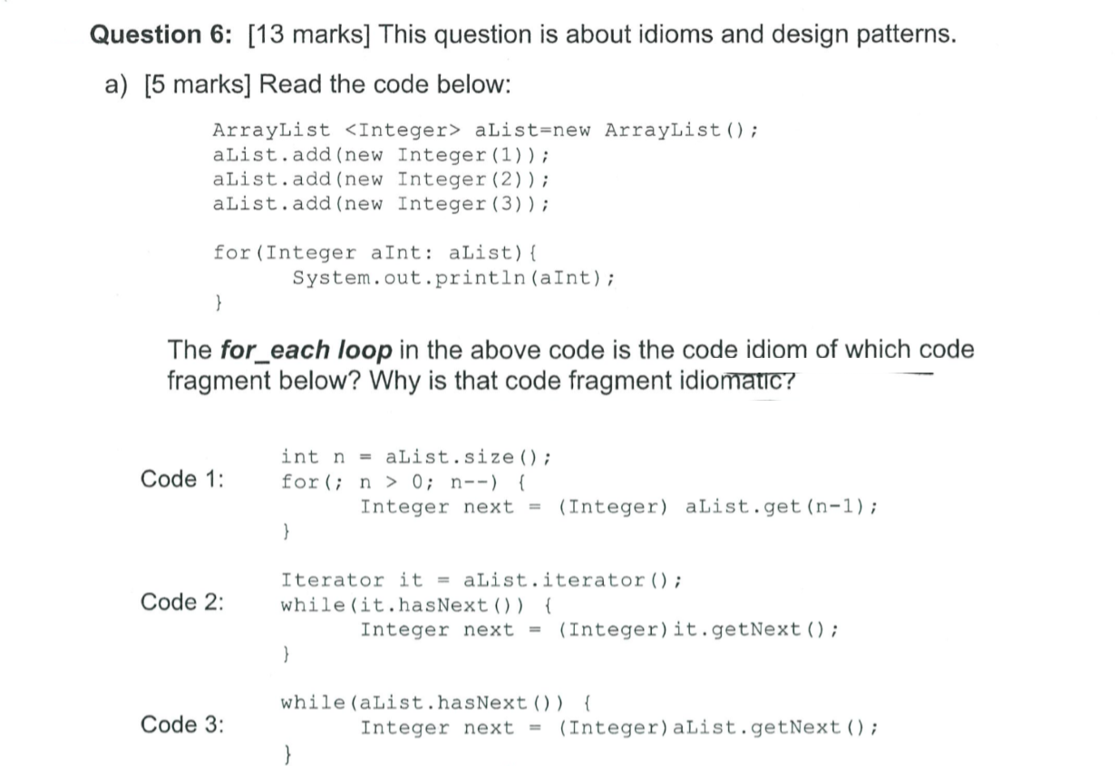

Slide 34
Code 2

Slide 35
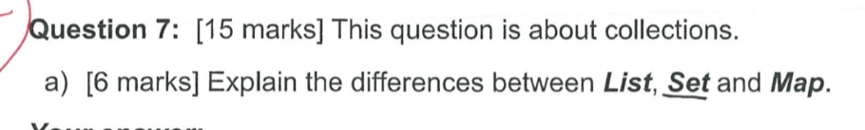

Slide 36
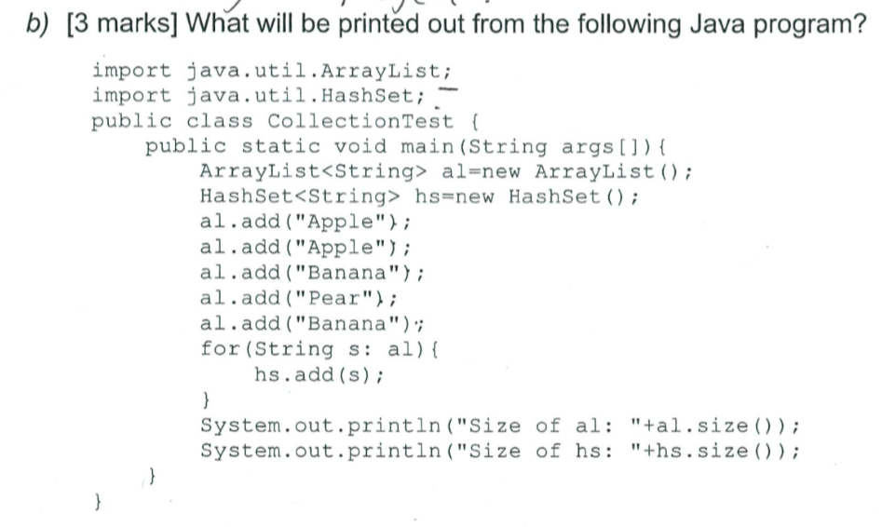

Slide 37
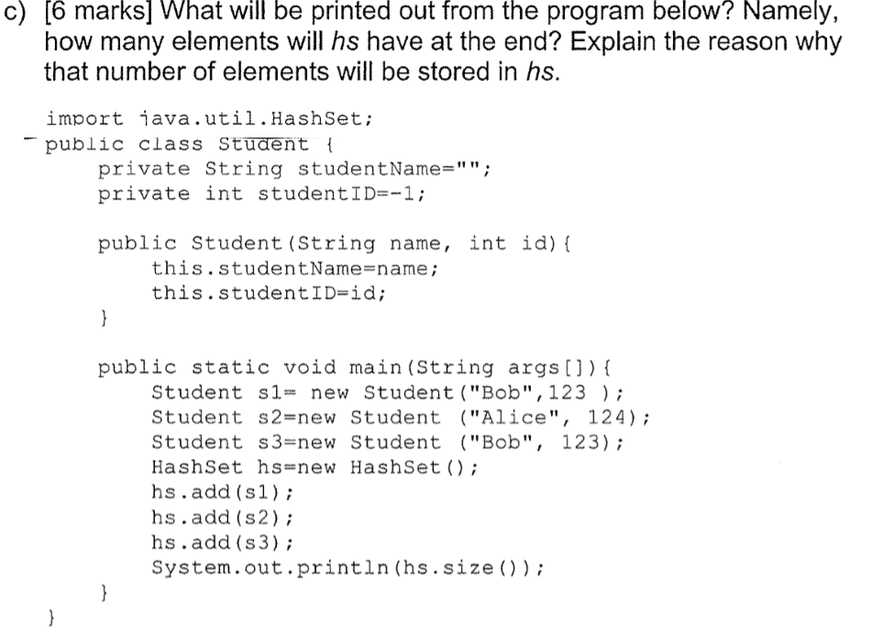

Slide 38
3 – compare problem

