Slide 1

COMP603
YouTutor- w11 Tim

Slide 2
第十一周
Assignment
passpaper

Slide 3
[4 marks] Add code to the following code fragment to: (1) establish a connection with the ClubDB database; (2) send the SQL statement, which is specified in sqlNewTable, to the database.

Slide 4
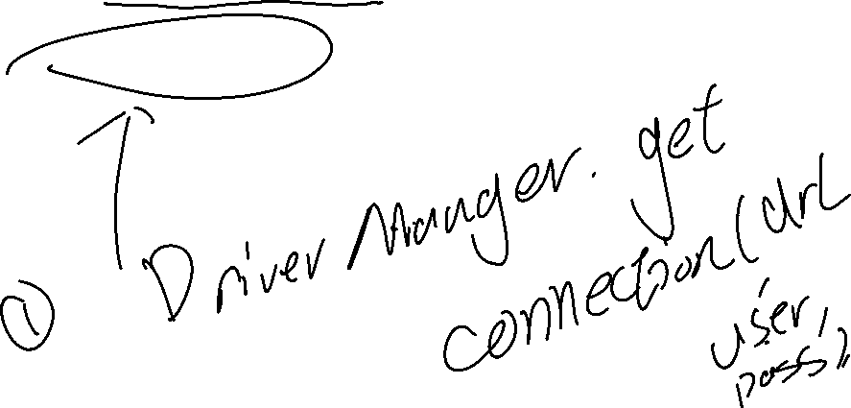
try { String url = "jdbc:derby://localhost:1527/ClubDB"; String username = "pdc"; String password=”pdc”; String sqlNewTable="CREATE TABLE ClubMember(ID INT, NAME VARCHAR(20)"; //add your code here }catch(SQLException ex) { System.err.println("SQLException: " + ex.getMessage()); }

Slide 5

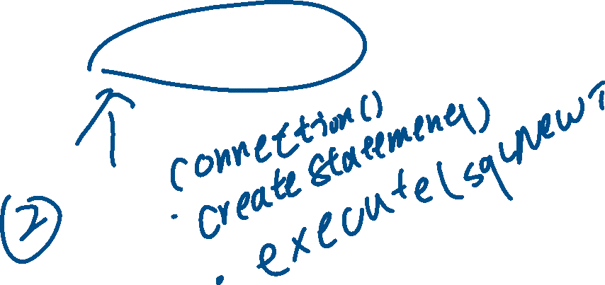
try { String url = "jdbc:derby://localhost:1527/ClubDB"; String username = "pdc"; String password=”pdc”; String sqlNewTable="CREATE TABLE ClubMember(ID INT, NAME VARCHAR(20)"; //add your code here }catch(SQLException ex) { System.err.println("SQLException: " + ex.getMessage()); }

Slide 6
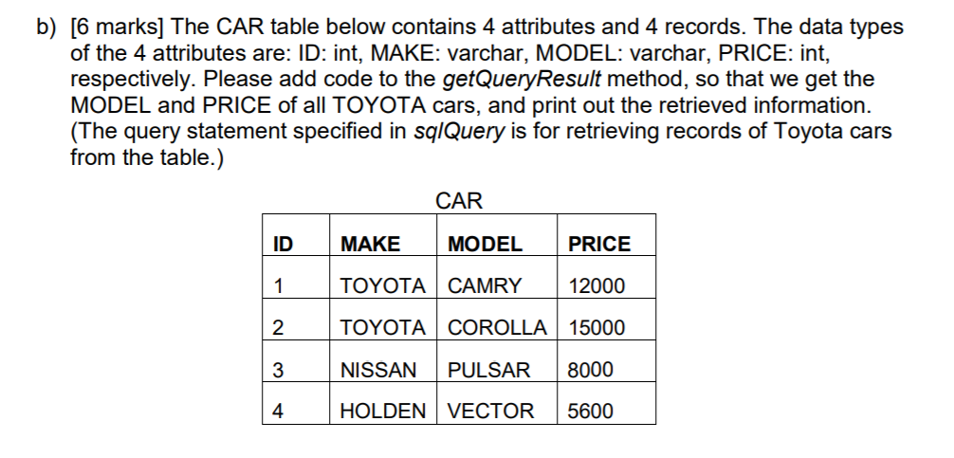



Slide 7
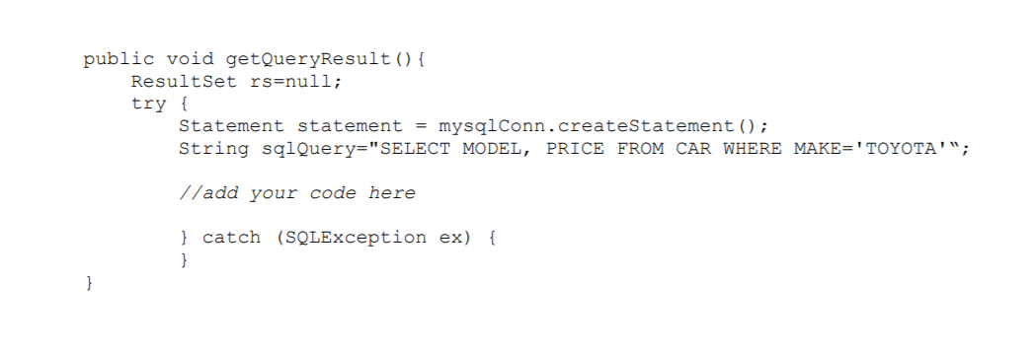
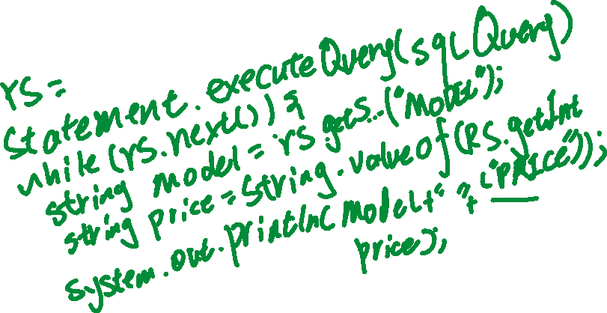

Slide 8
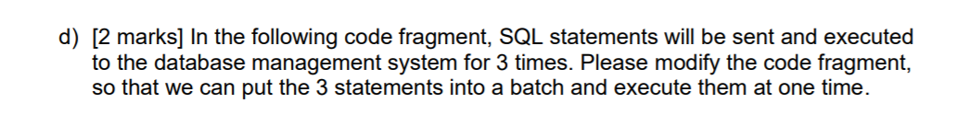

Slide 9
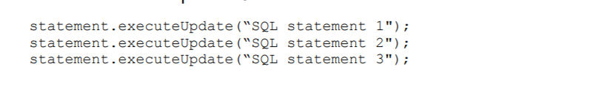
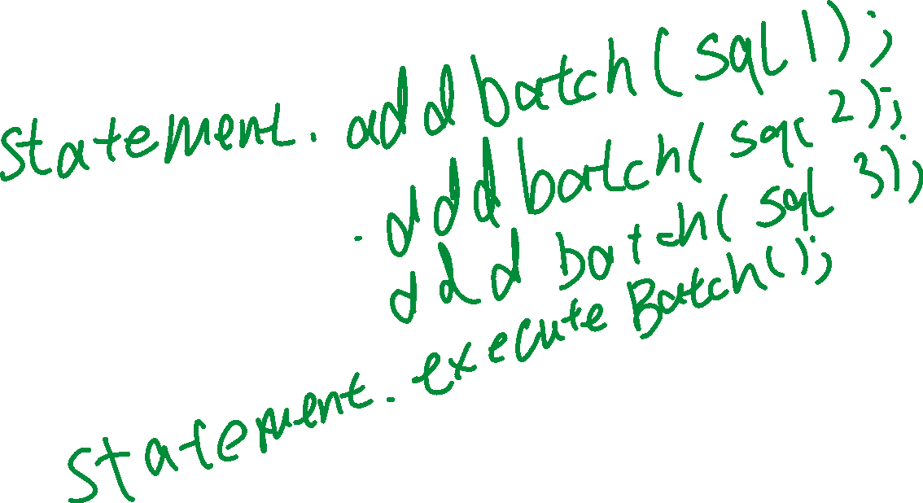

Slide 10
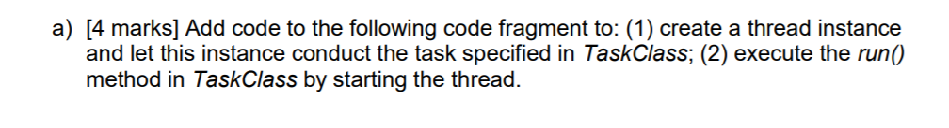

Slide 11
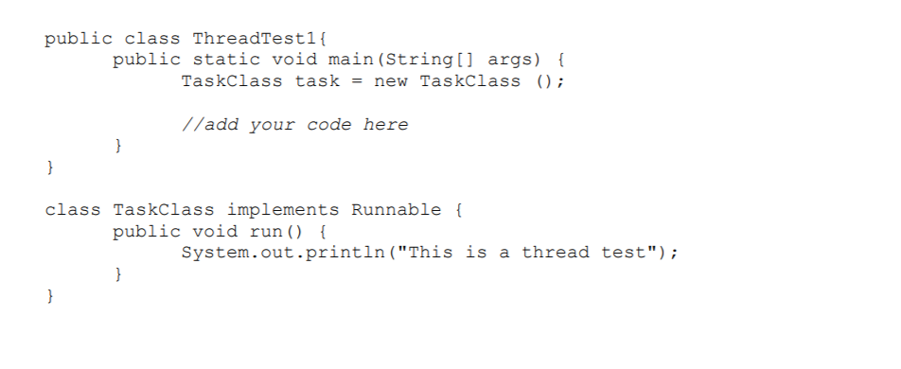
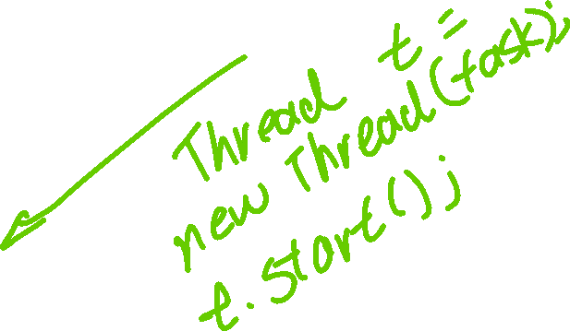

Slide 12
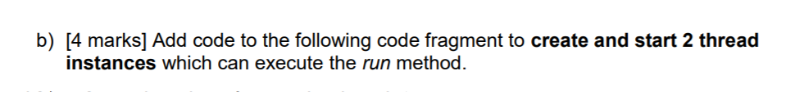

Slide 13
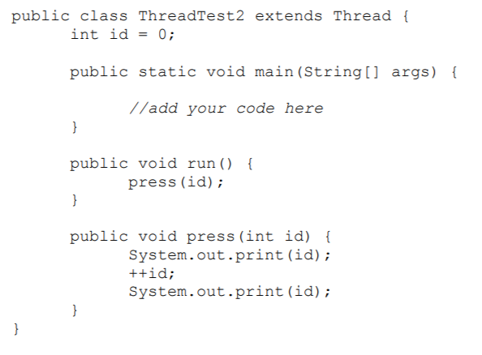



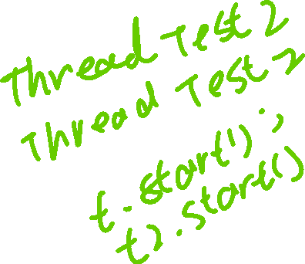




Slide 14
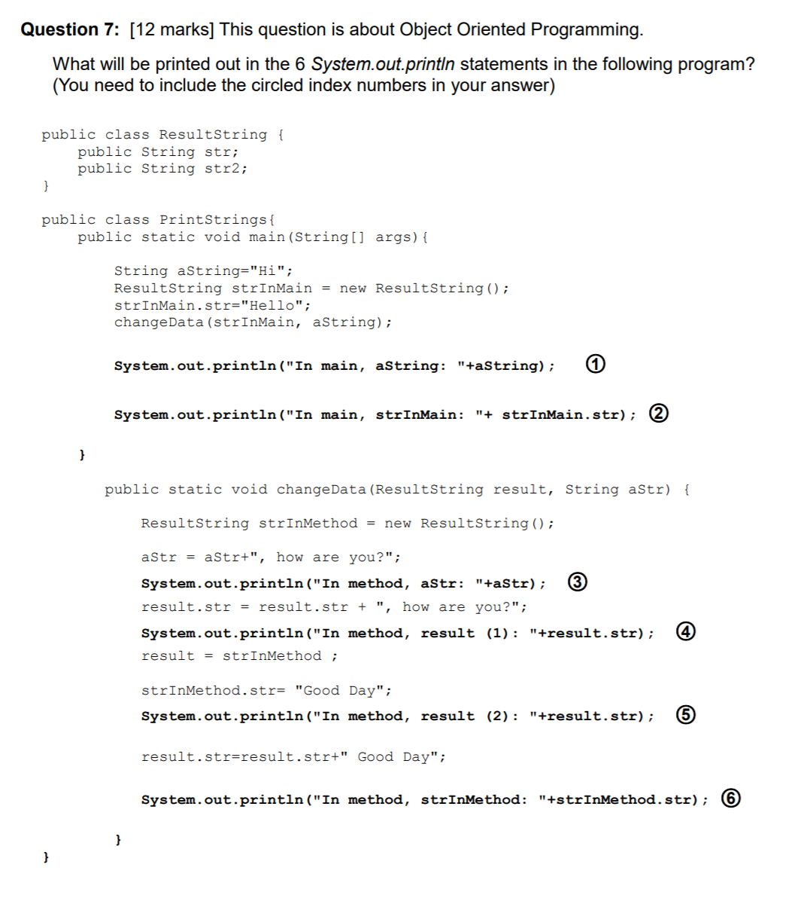

Slide 15
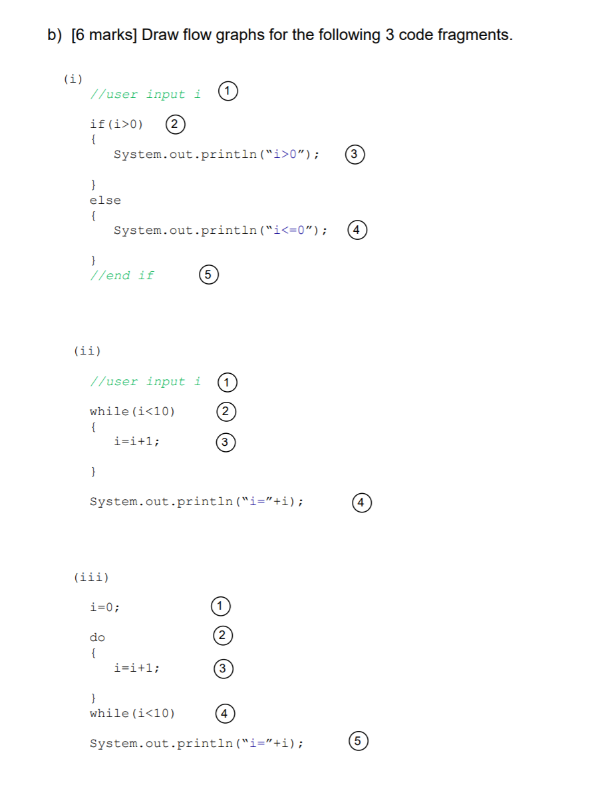
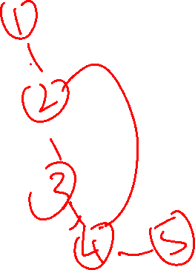

Slide 16
