Slide 1

COMP603
YouTutor- w12 Tim

Slide 2
第十二周
没啥特别的了就复习考试了
pass paper

Slide 3
定义类问题
无非是OOP的好处, 封装, 继承, 多态, 过载, 还有final

Slide 4
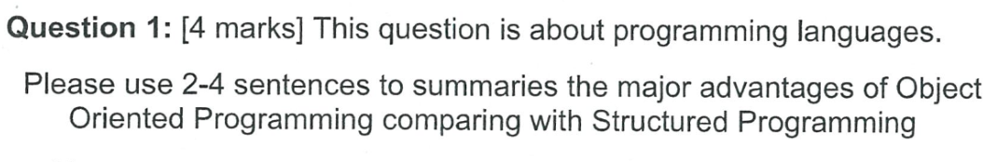

Slide 5
Major advantage : high code reusability. by use OOP’s feature like inheritance, and polymorphism, we can always reuse code in objects, so cost of coding will be reduced and easier to debug.
OOP also provide better readability, code is easier to understand.

Slide 6
解释 Inheritance
用一两句话解释Inheritance

Slide 7
Inheritance happen between super class and subclass. A subclass can inherit or extends the super class and all public method, variable and constructor from super class will be available in subclass.

Slide 8
解释 Encapsulation
用一两句话解释Encapsulation

Slide 9
Encapsulation is used in OOP, it has 3 different types access modifier for control access to method, constructor and variables in objects. Three types of access modifier: public, private, protected
When public, method, constructor and variable can be access anywhere in the program
When private, method, constructor and variable can only be access with in the same class
When protected, method, constructor and variable can be access anywhere in the same package.

Slide 10
解释 Polymorphism
用一两句话解释Polymorphism

Slide 11
Polymorphism is a method can have different behaviour even when calling the same method name.
Polymorphism happened needs inheritances and override, for example, Class A and Class B extends Class C, and A B override a method D in class C. at this time A.D() and B.D() will show different behaviour.

Slide 12
解释 Overloading
用一两句话解释Overloading

Slide 13
Overloading is methods have same name, but different parameters.
For example can be:
Public void setup(){
int a =0;
}
Public void setup(int b){
Int a=b;
}

Slide 14
解释 final class
用一两句话解释final class

Slide 15
When a class declared final, this class cannot be extends.

Slide 16
解释 final method
用一两句话解释final mothod

Slide 17
A final method cannot be overridden in the subclass.

Slide 18
解释 static member field
用一两句话解释static member field

Slide 19
Static member field has its memory space in class wide, and a static variable can be access the anywhere within object. And can be access outside of the class by it’s class name and do not need to initialize object.

Slide 20
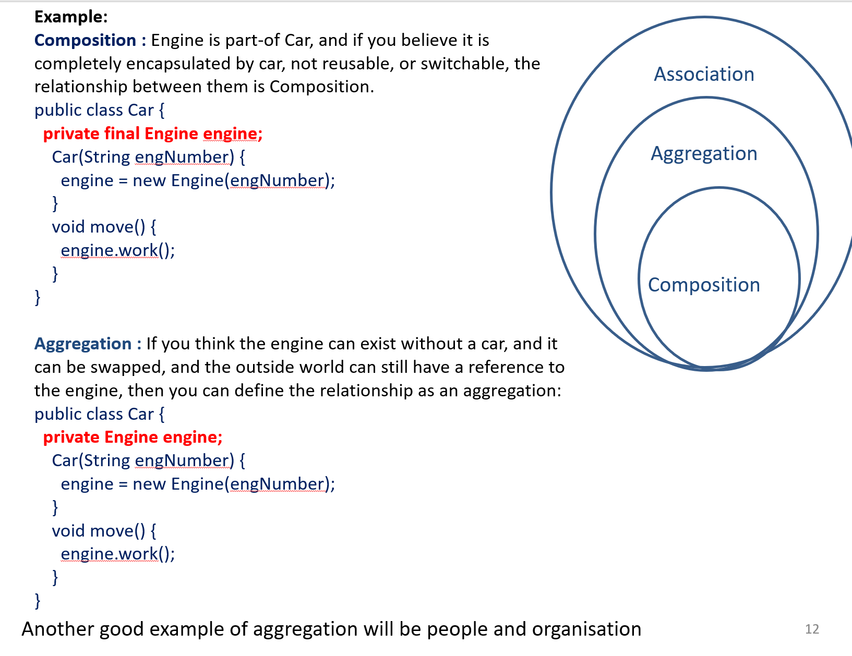

Slide 21
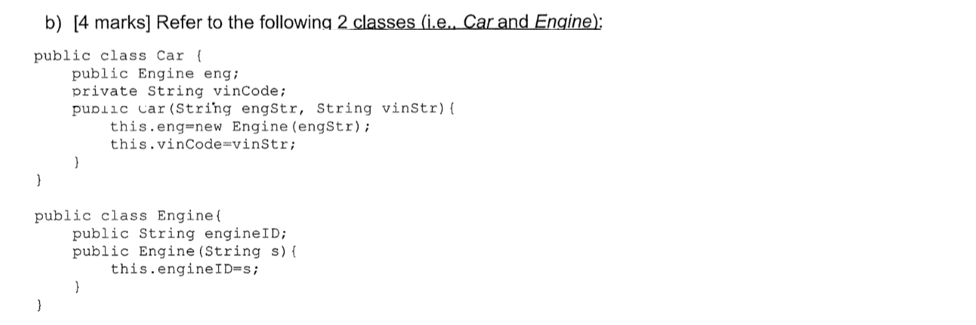
OOP 代码读题类

Slide 22
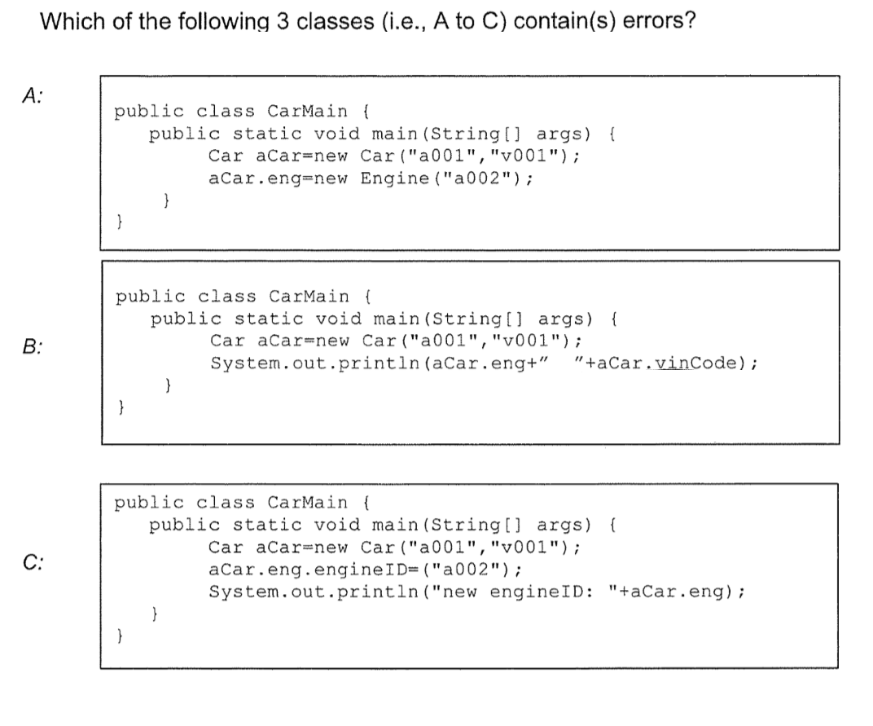

Slide 23
B - private member

Slide 24
File I/O以及JDBC类

Slide 25
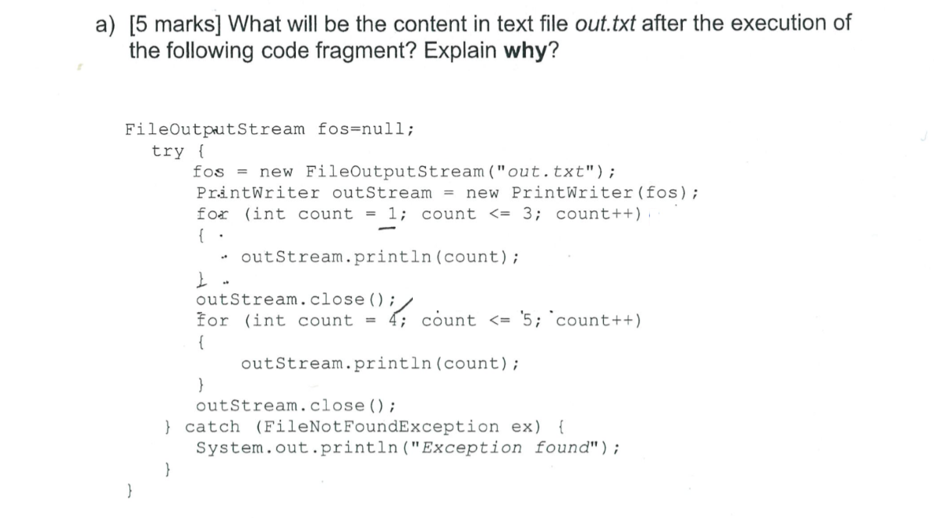

Slide 26
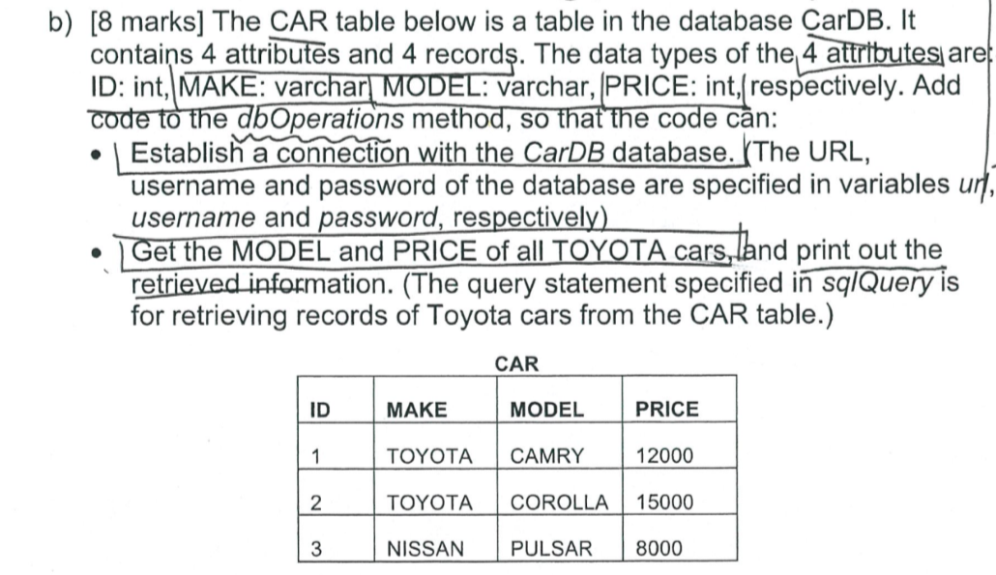

Slide 27
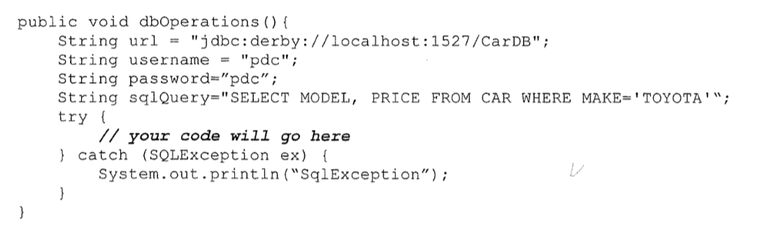

Slide 28
Connection conn = DriverManager.getConnection(url, username,password);
ResultSet rs = conn.CreateStatement.excuteQuery(SqlQuery);
While(rs.next()){
System.out.println(rs.getString(“MODEL”)+” ”+rs.getInt(“PRICE”);
}

Slide 29
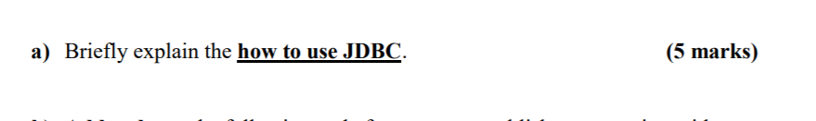

Slide 30
1 use driver manager to get connection by using connection String, user name and password
2 use connection to create statement
3 use statement to execute sql to database
4 use Result set to store the result
5 use while loop to process result (while(result.next())

Slide 31
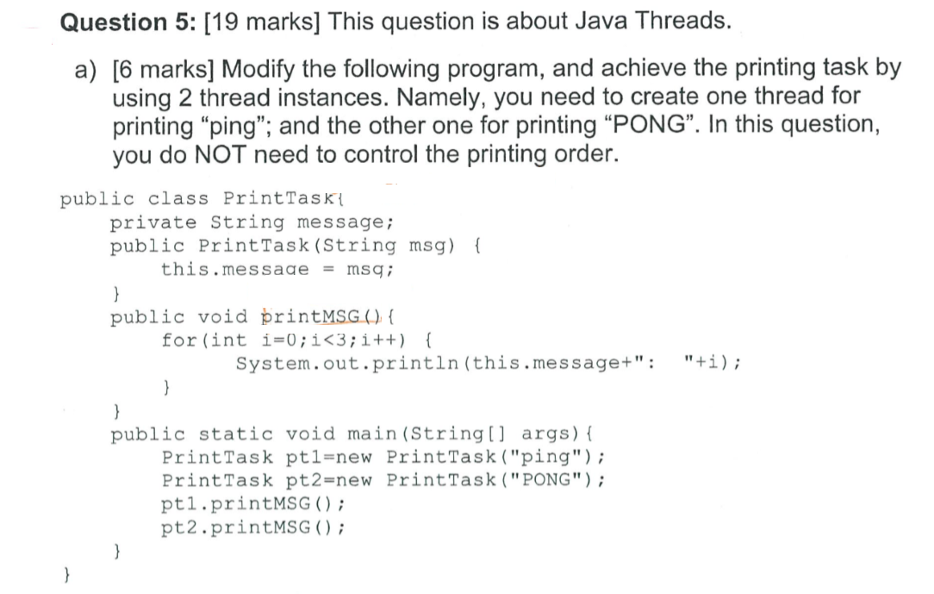

Slide 32
Extends thread,
Make run

Slide 33
State of thread
1 runnable
2 running
3 block, sleep , wait
4 die

Slide 34
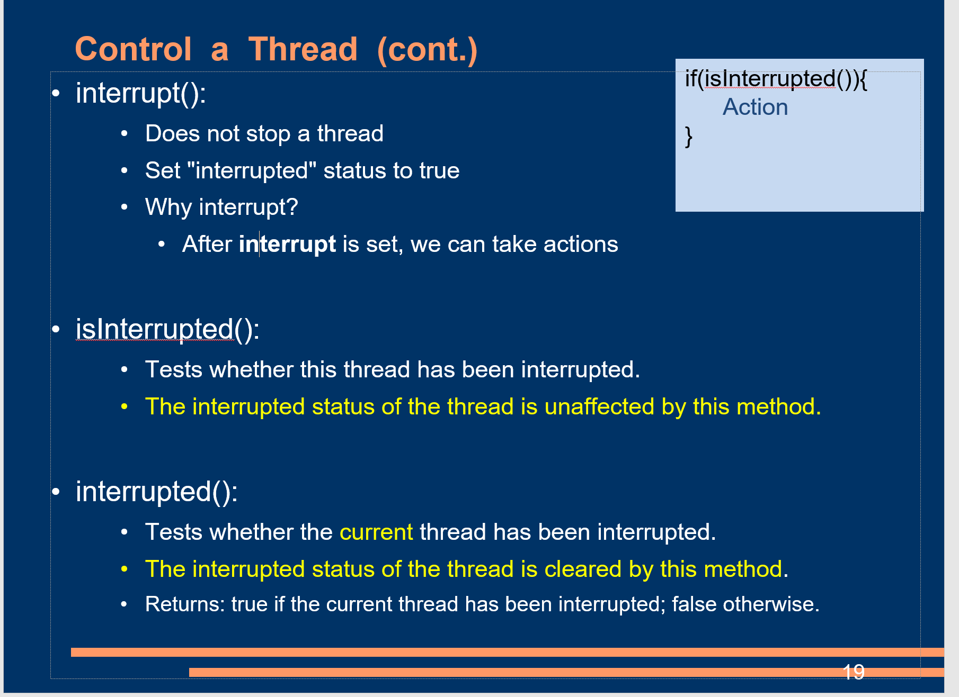

Slide 35
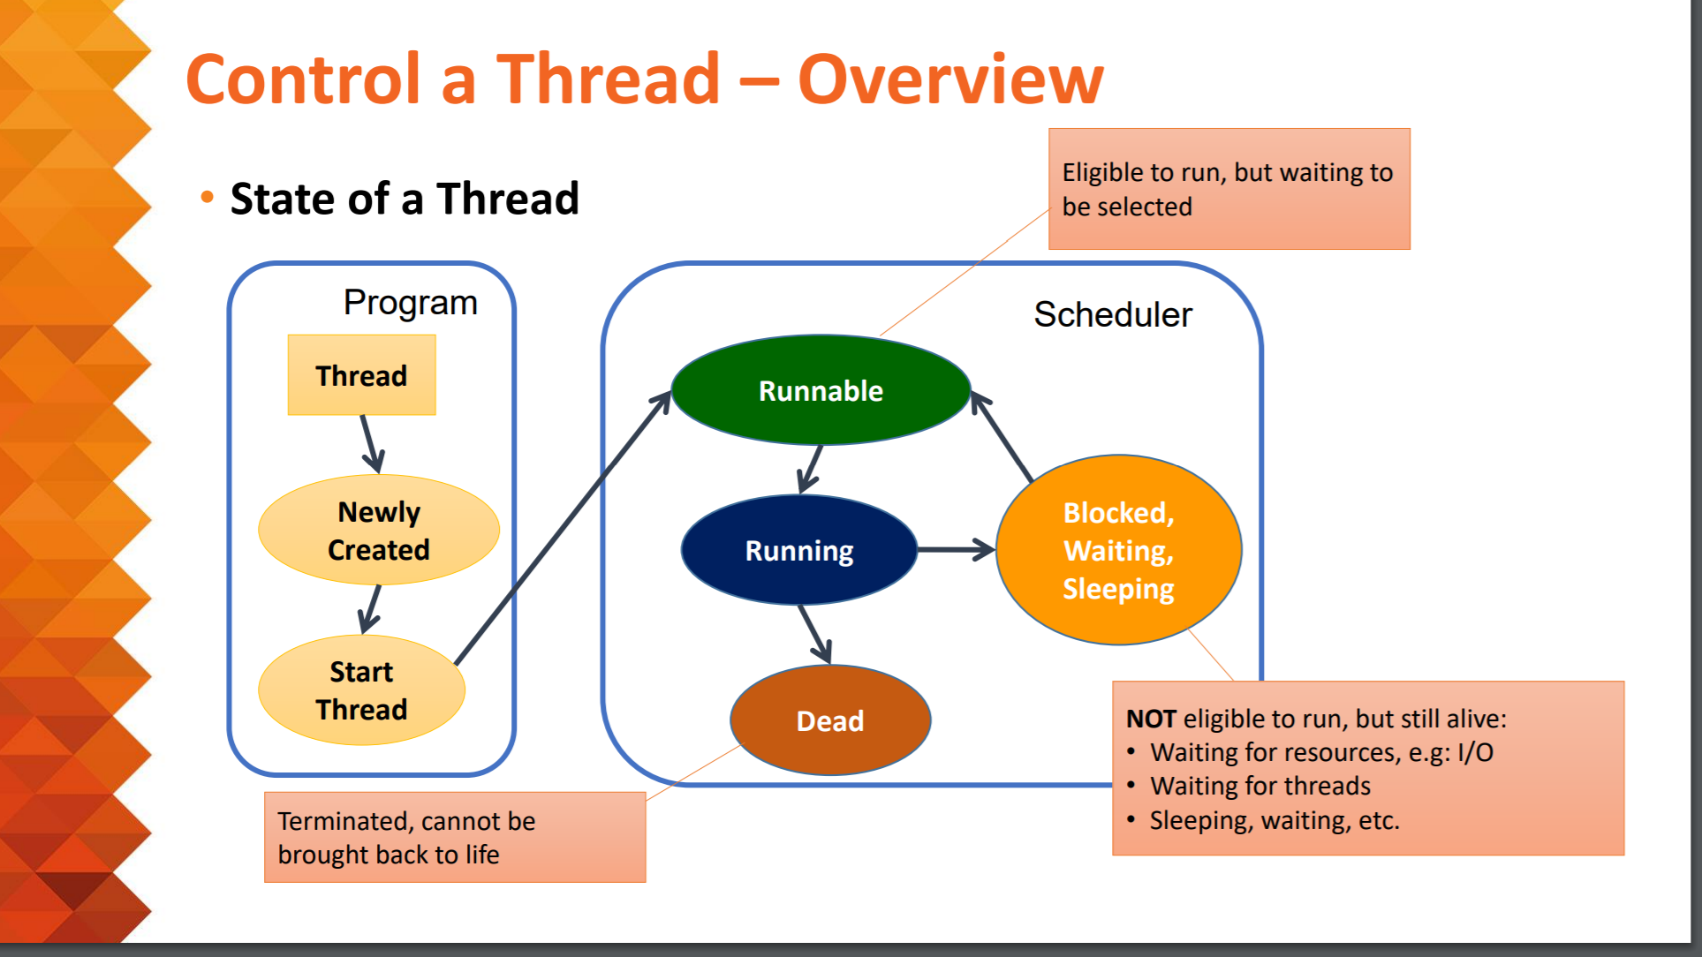

Slide 36
Yield 和 sleep的区别
Yield will stop a thread, let other task to run( go in to CS)
Sleep can stop a thread by a given time

Slide 37
Synchronized
When a method what declared synchronized, when it run, other thread has to wait until it finished.

Slide 38
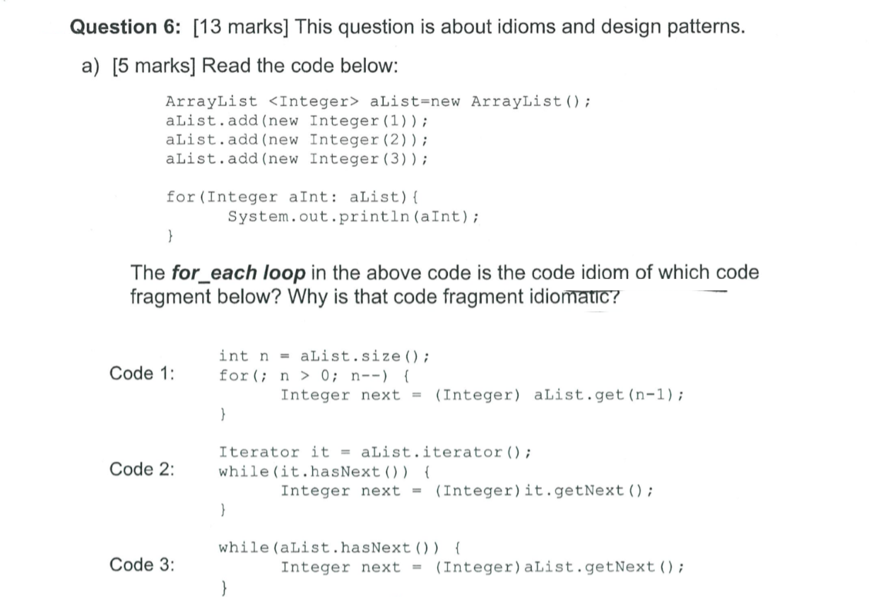

Slide 39
Code 2

Slide 40
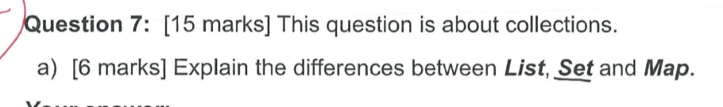

Slide 41
List is a collection of objects, they are ordered and repeatable
Set is a collection of objects, they are not ordered and not repeatable
Map is a value pair of objects, one key to one object. Key is not ordered and not repeatable, but value is not ordered and repeatable

Slide 42
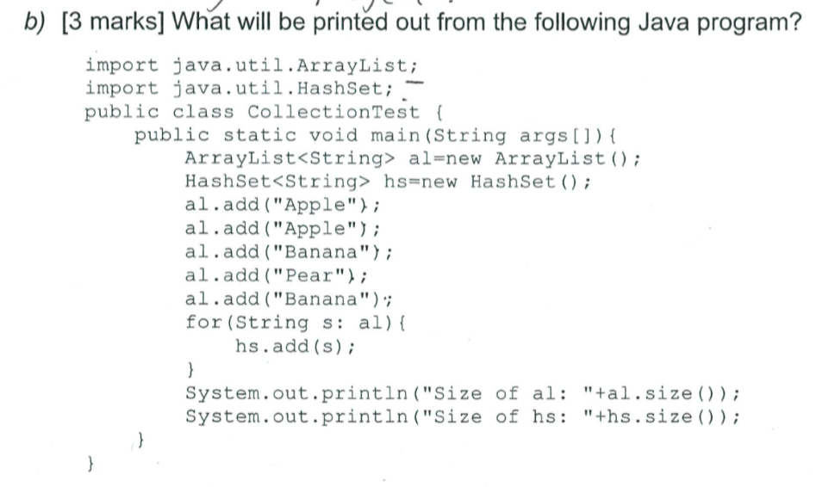

Slide 43
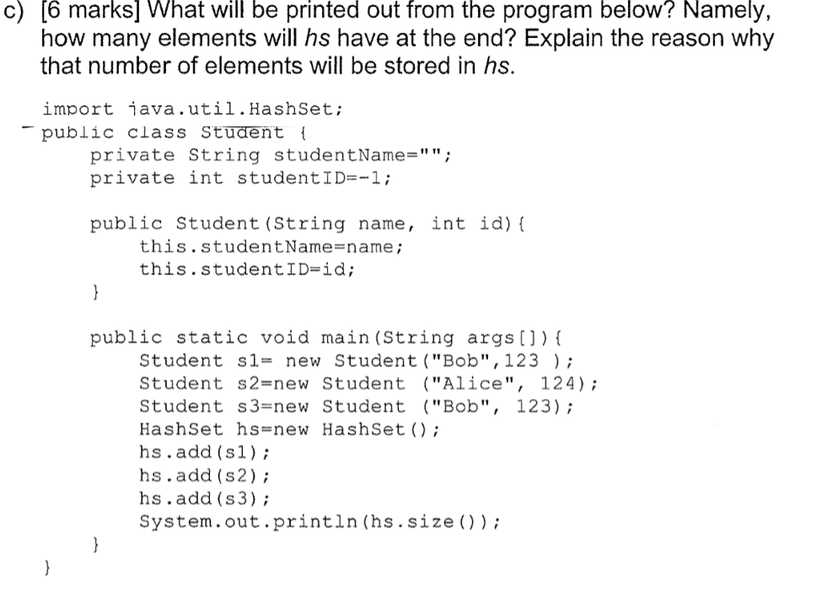

Slide 44
3 – compare problem

Slide 45
Singleton Pattern
problem
What a class only have one object maximum in program
solution
Use private constructor, and a synchronize ,static method to check if there are any “this” object exist, if any throw exception, else return a new object

Slide 46
varargs idiom
use for each not use for, because for each is more safe

Slide 47
Briefly explain EACH of following four terms:
i. System function testing
Unit testing on a function or a part of the system, to see if the function or the part having correct behaviour
ii. Usability testing
Research on how usable of the program, usually used on user interface design
iii. Performance testing
Testing programming having enough performance to output results in a prior of time
iv. Stress testing
Testing the system able to handle stress or not.

