Slide 1
Tuning convolution with
supervised classification
Flavio Vella
Paolo Sylos Labini

Slide 2
Our task
High-performance libraries offer many different implementations for the same routines.
We use supervised classification to select the best implementation
We target the convolution routine on the ARM Mali GPU.

Slide 3
Convolution on the ARM Mali GPU
Why convolution?
It is the fundamental operation in Convolutional Neural Networks (CNNs).
It is known to be difficult to optimize
In CNNs, tuning the convolution numerical precision may save time and energy with small loss in accuracy.
Why and embedded system (ARM Mali)?
They are very slow, so any speed improvement is relevant.
Since they are slow, generating a dataset for training is an interesting challenge.

Slide 4
Classifying for performance
Our approach
We test all the implementations on representative convolution operations and build a dataset
We train classifiers on this dataset to automatically recognize the best implementation.
We study the dataset and the classification results to:
Determine the best models
Extract information about the numerical precision

Slide 5
Dataset generation
Parameters determining the shape of a convolution (S)
K: kernel dimension
C-IN (-OUT) : Number of input (output) channels
W: Width
H: Height
PAD: padding amount
STR: stride
Data points
A convolution operation is characterized by:
The shape S of the convolution
The numerical precision P
The numerical entries
We used S and P to fix a data point. At the moment, the numerical entries of the convolution are ignored. We are implementing the use of aggregated features to account for entries values.

Slide 6
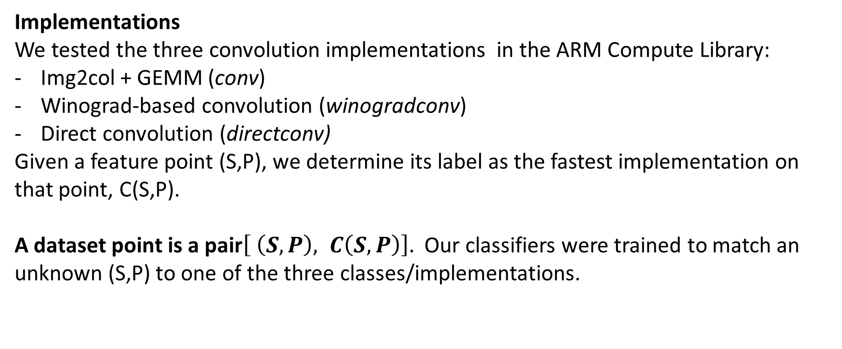
Dataset generation
Implementations
We tested the three convolution implementations in the ARM Compute Library:
Img2col + GEMM (conv)
Winograd-based convolution (winogradconv)
Direct convolution (directconv)
Given a feature point (S,P), we determine its label as the fastest implementation on that point, C(S,P).
A dataset point is a pair$\left[ \left(S,P\right), C\left(S,P\right)\right].$ Our classifiers were trained to match an unknown (S,P) to one of the three classes/implementations.

Slide 7
Model training
We trained several well-known classifiers on our dataset.
Decision Tree (DT)
Random Forest (RF)
Gradient Tree Boost (GTB)
Multi-Layered Perceptron (MLP)
Support Vector Machine (SVM)
We used 5-fold cross-validation for hyper-parameter tuning and 10-fold cross validation to estimate the training and test accuracy and its error.

Slide 8
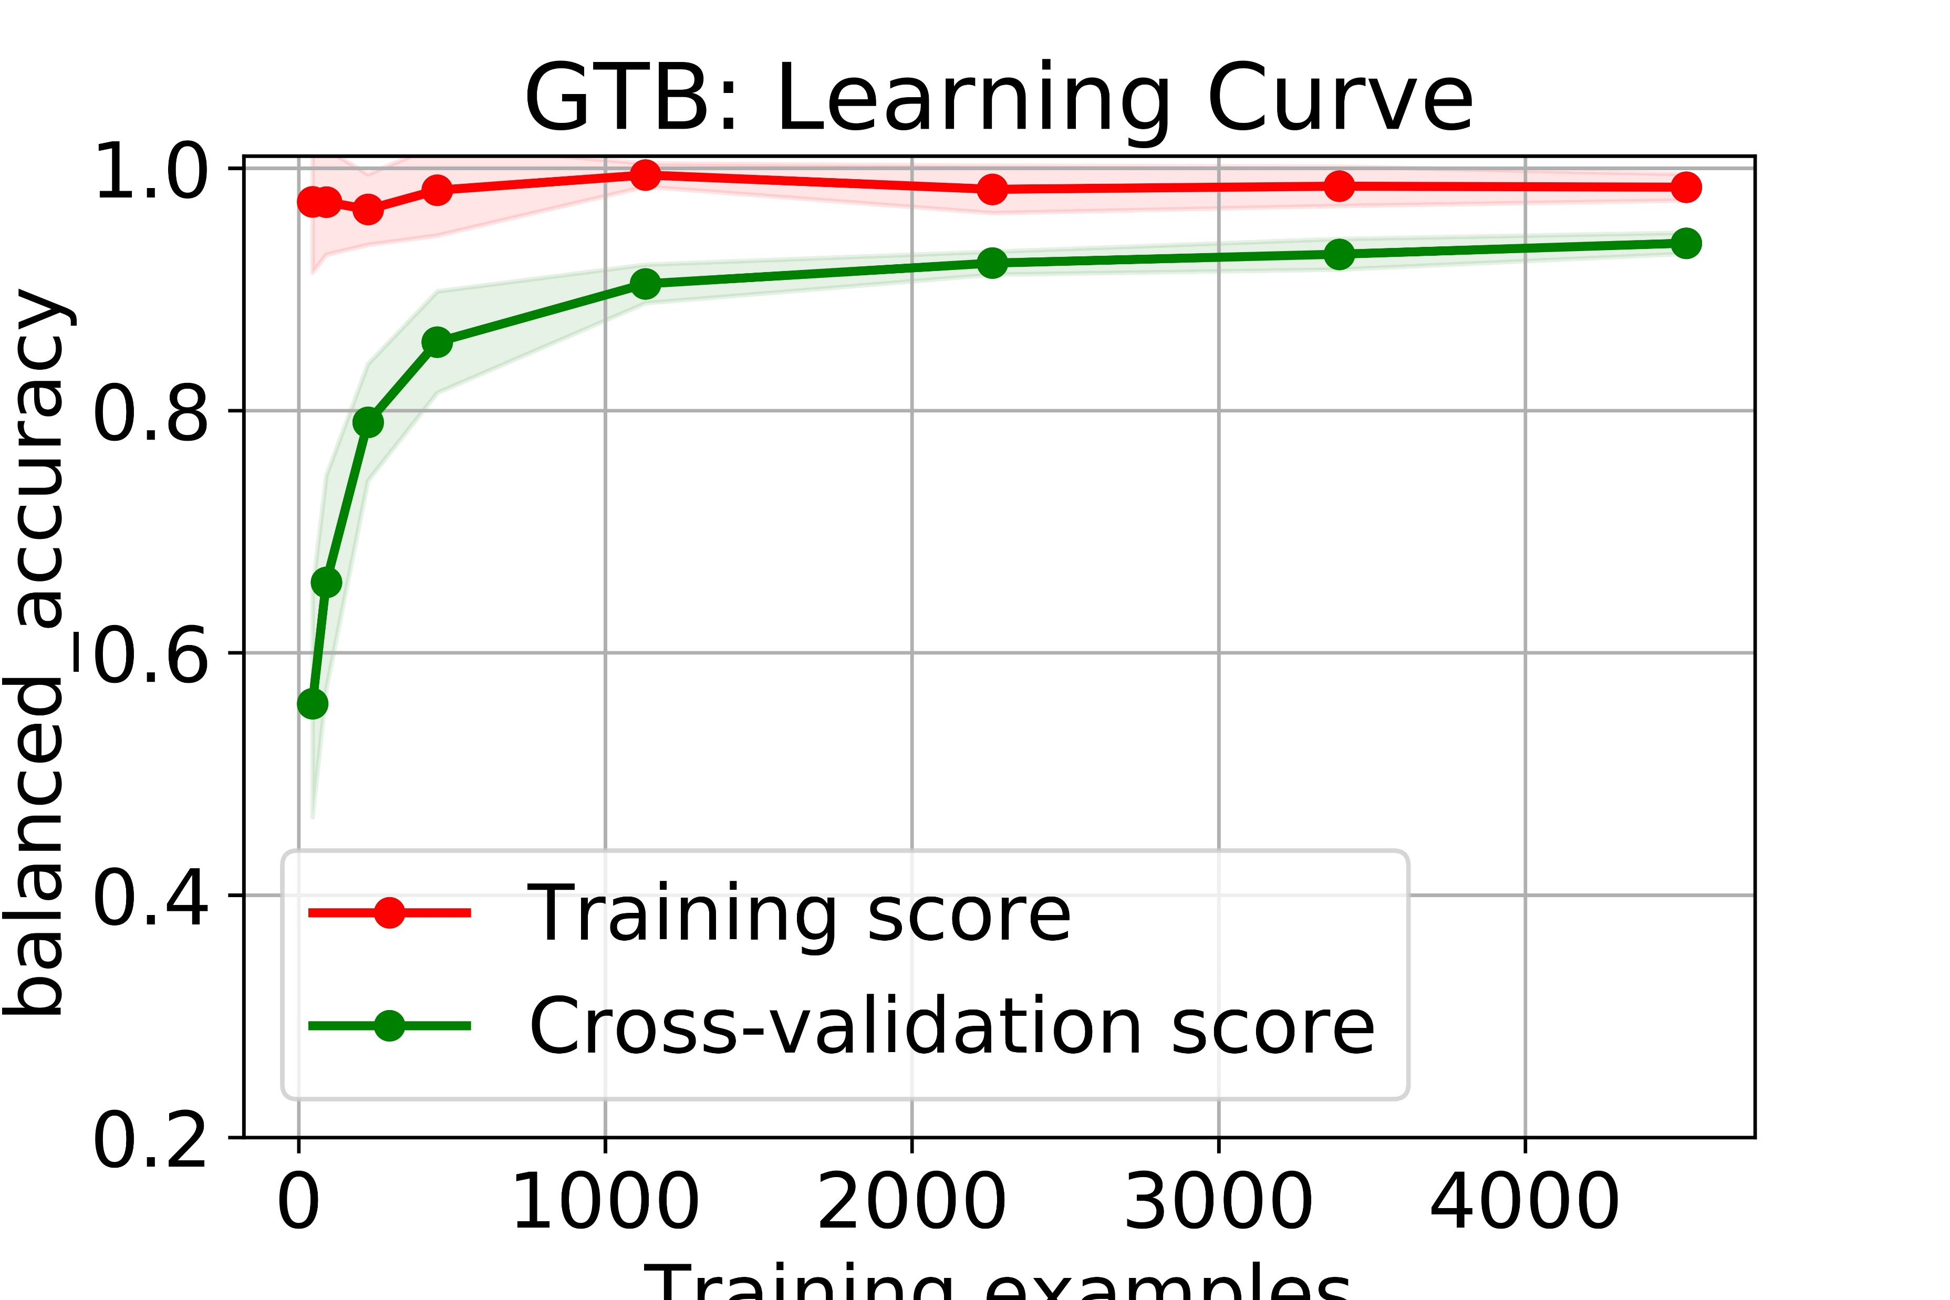
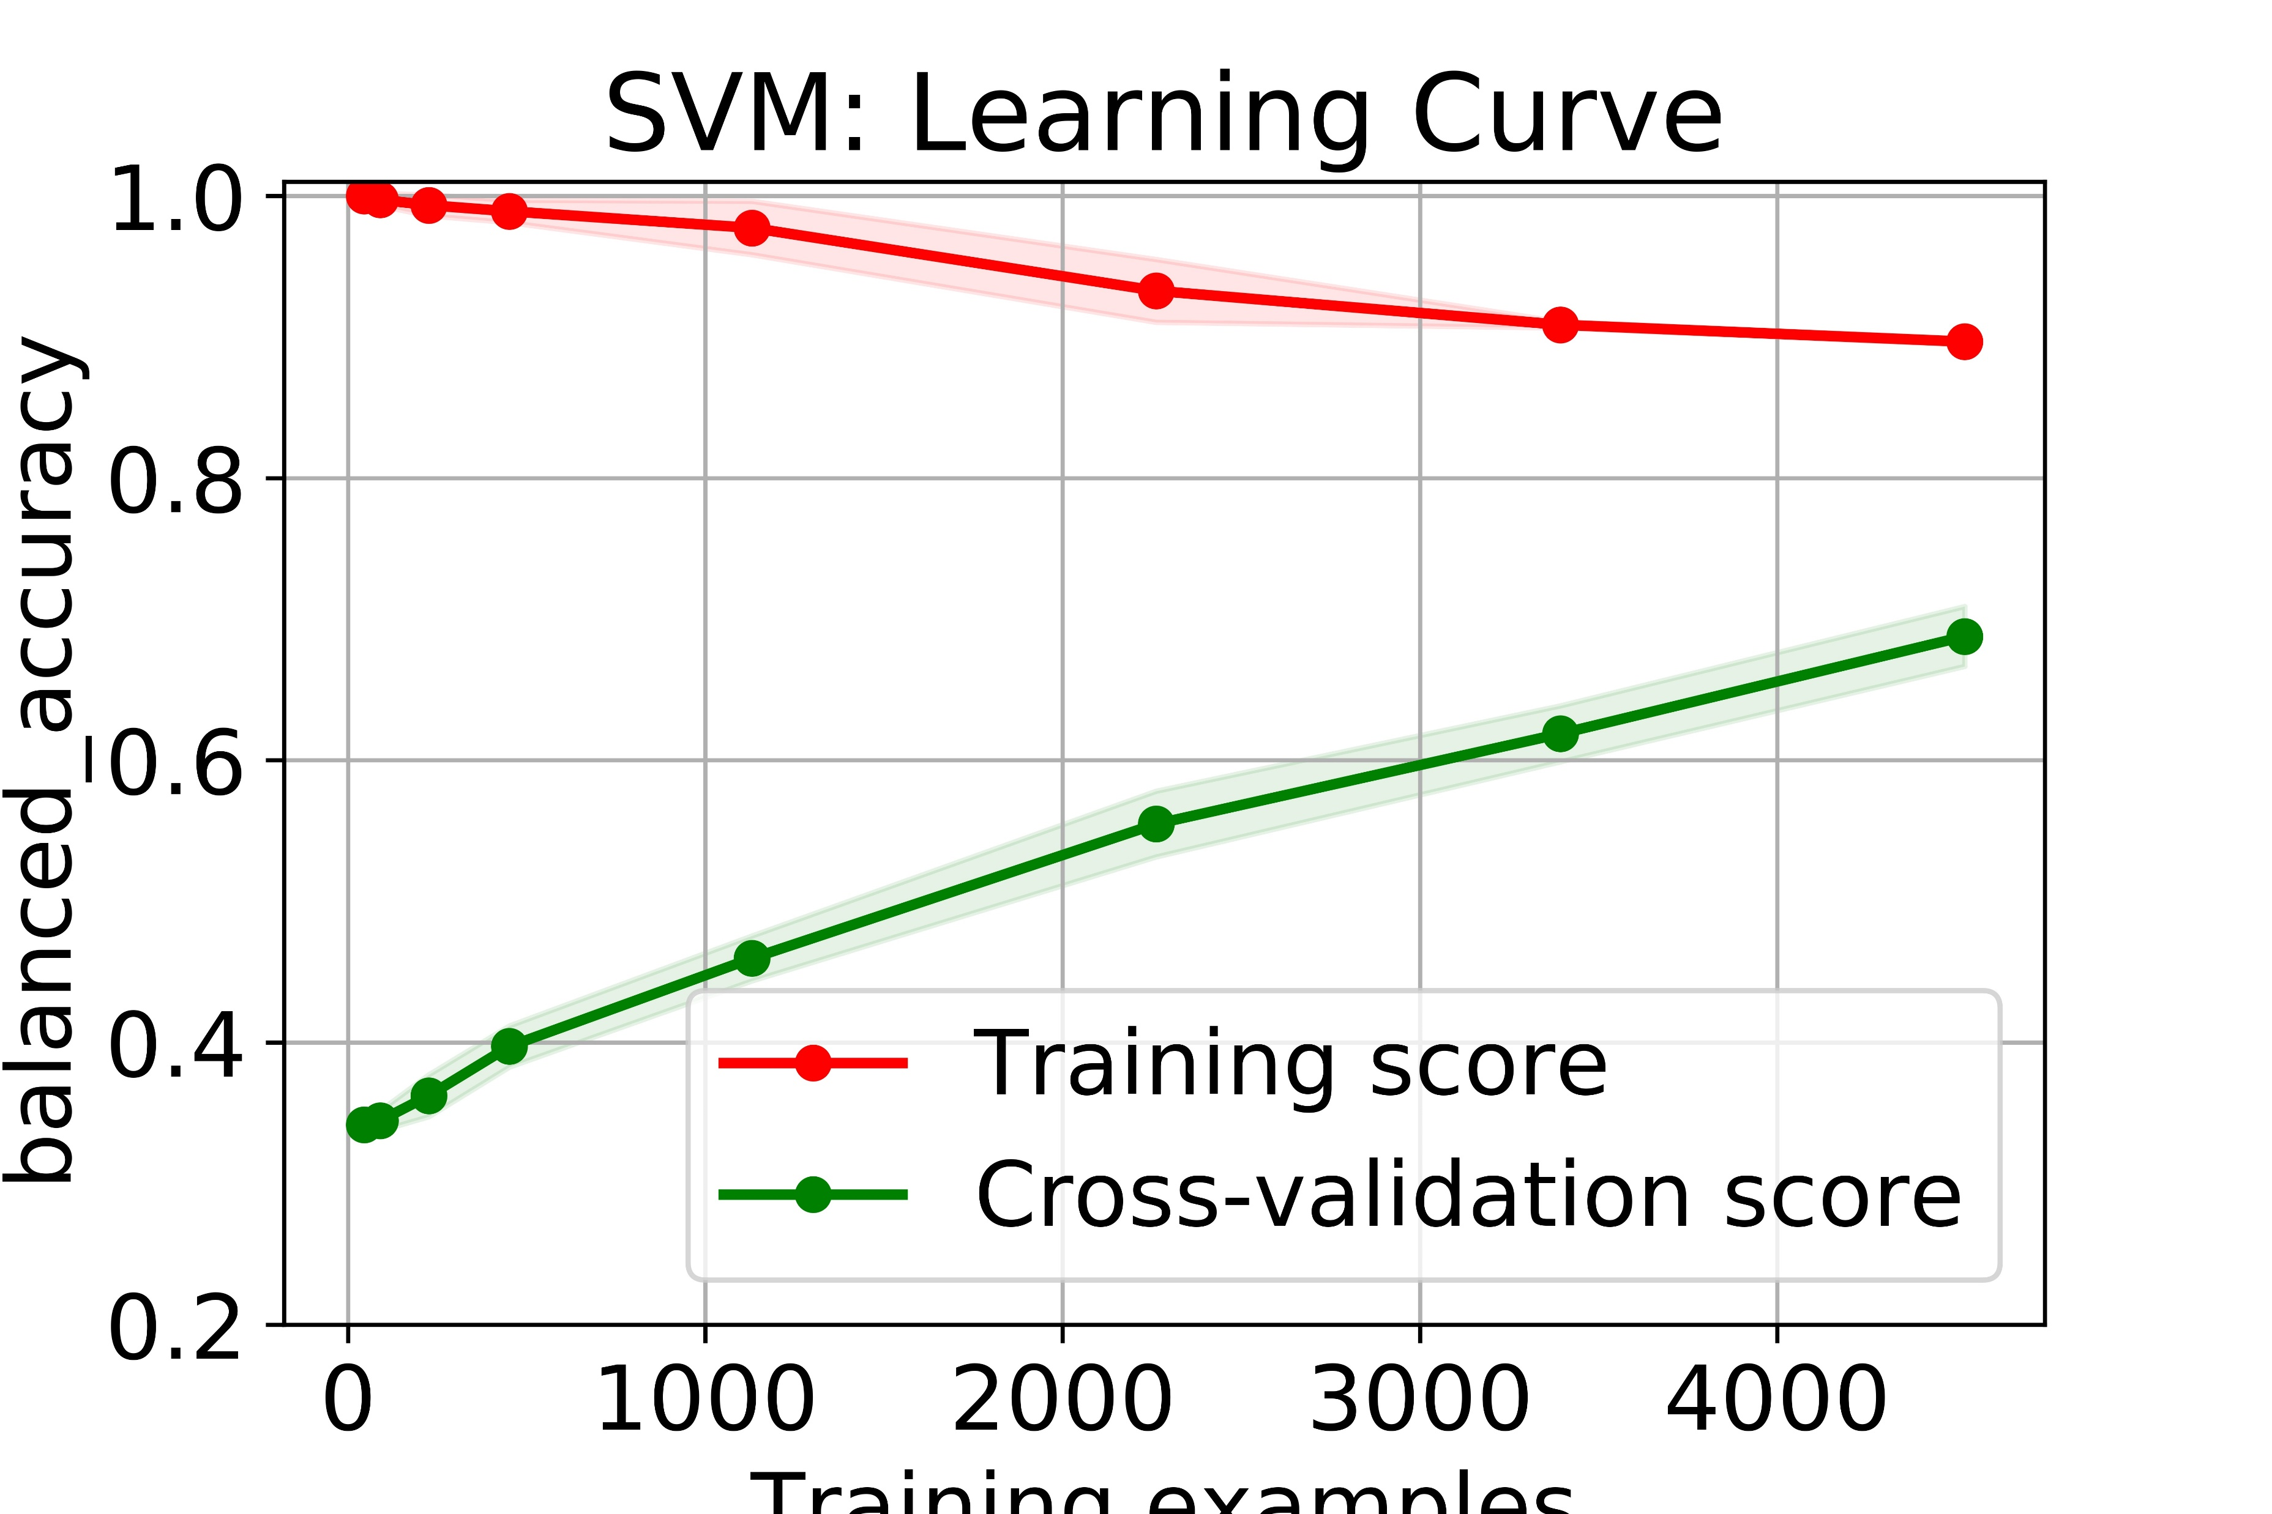
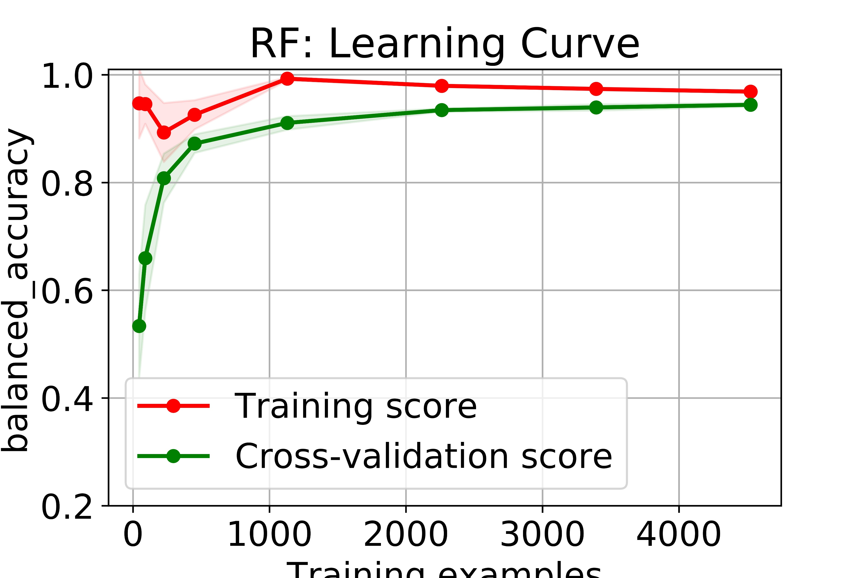
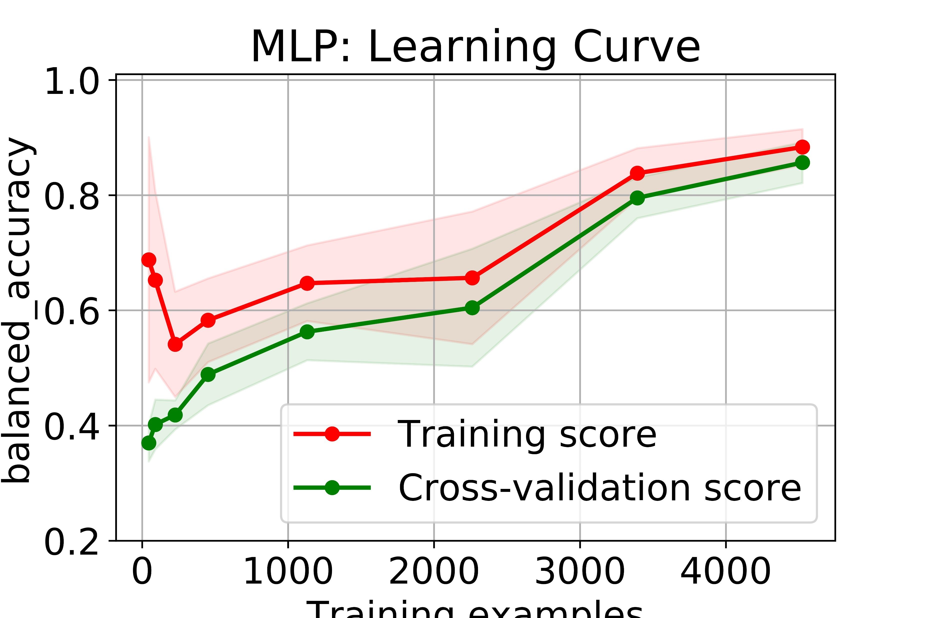
Model evaluation
We studied the learning process of our classifiers to determine the best one in terms of:
Dataset size needed for convergence
Training time
Accuracy and generalization ability
Training examples
Training examples
Training examples
Training examples

Slide 9
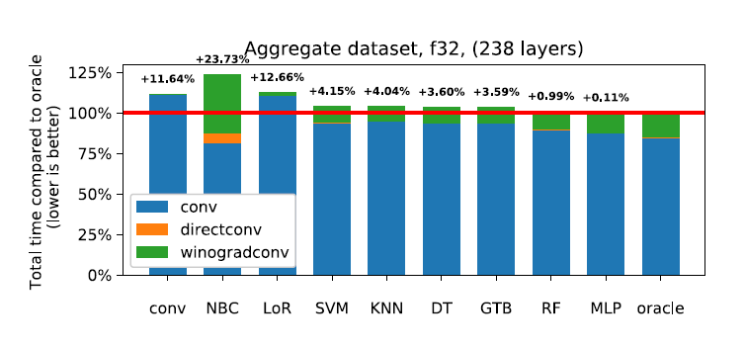
Model evaluation
We also tested our models on a ‘aggregate’ of popular CNNs: we predicted the best implementation for each convolutional layer in each of the networks, and compared it with the optimal one. Our classifiers performed close to the optimal value.

Slide 10
Making smaller datasets
The study of learning curves allows us to generate better, smaller dataset for the same problem.
We used DT and RF to determine the feature importance. This will help us shrinking the datasets, as unimportant features need less data-points.
Feature importance | K | C-IN | C-OUT | W + H | P | PAD | STR
 | 37% | 20% | 17% | 13% | 11% | 2% | 0%

Slide 11
Code and images
These partial results and the code to reproduce them are available in the AMACA repository:
https://github.com/LACSFUB/AMACA
We used the Collective Knowledge (CK) framework to improve reproducibility:
https://github.com/ctuning/ck

Slide 12
Future directions
We are working to further reduce the size of the datasets, in order to obtain a still faster training for our classifiers. Using the insights collected up to this point, we are implementing active learning techniques to adptively select the next training points.
After having studied the precision as a feature, we are also experimenting on introducing the precision as a label. This requires us to change the objective function of the classifiers that allows them to trade off the energy consuption with the convolution precision.

