Slide 1



C-ViT
A C++ Framework for Vision Transformers on Embedded Systems
Flavio Vella
Alex Pegoraro
Elisabetta Farella
Alberto Ancilotto

Slide 2
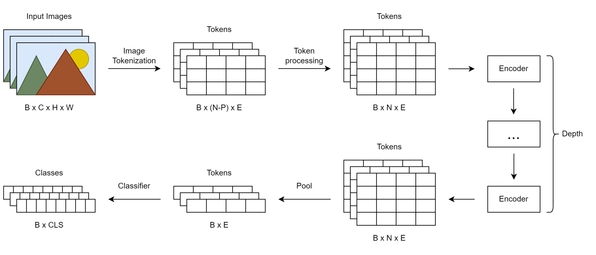
General Flow
patch_embed.cpp
block.cpp
modules.cpp
modules.cpp
vision_transformer.cpp

Slide 3
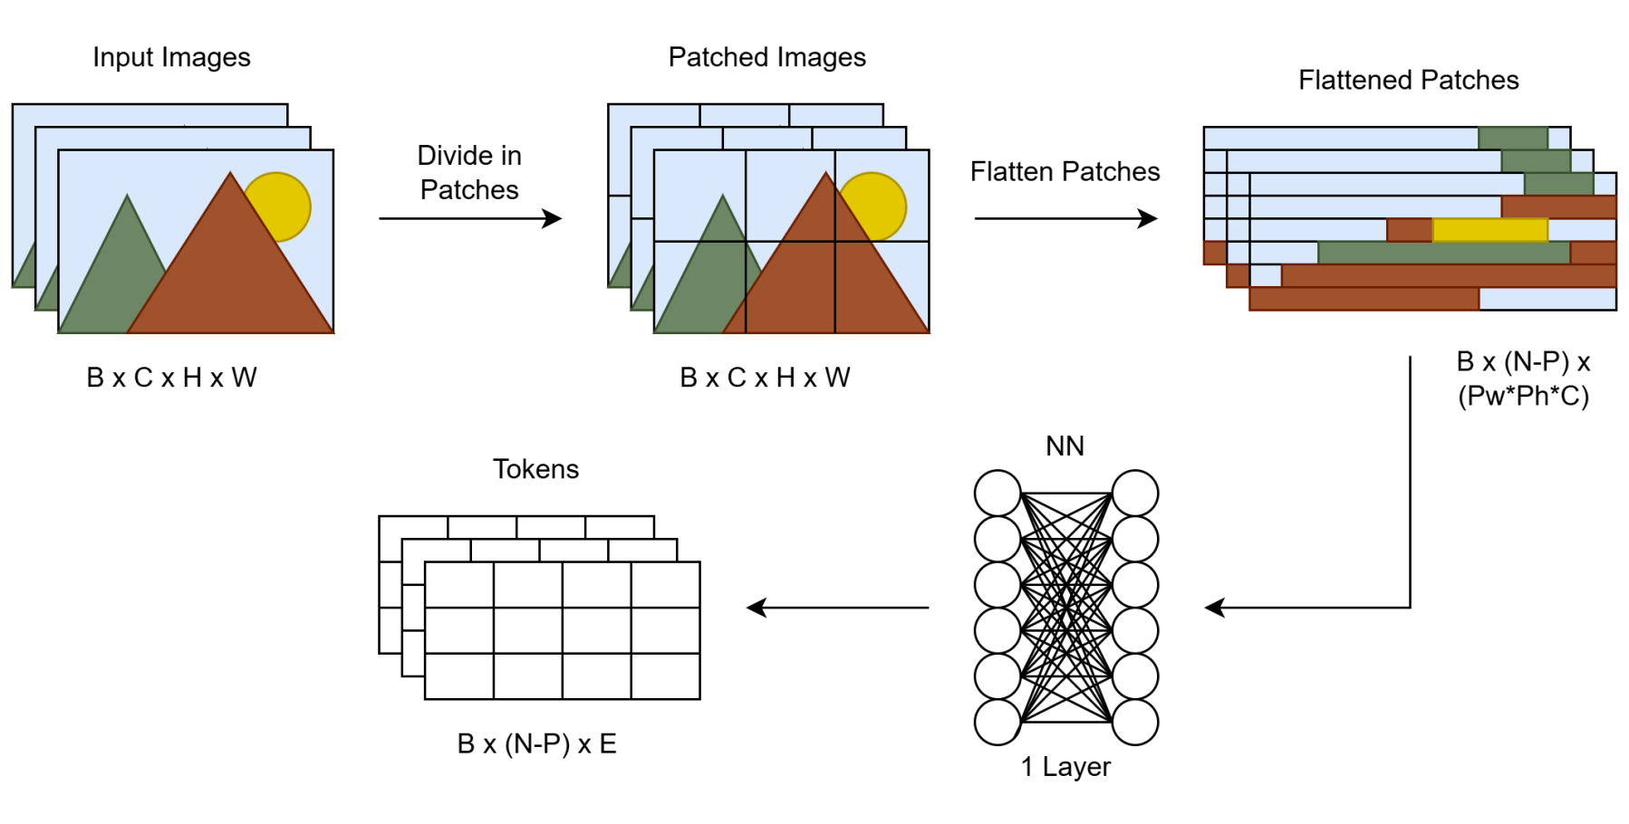
Image Processing
conv2d.cpp
patch_embed.cpp

Slide 4
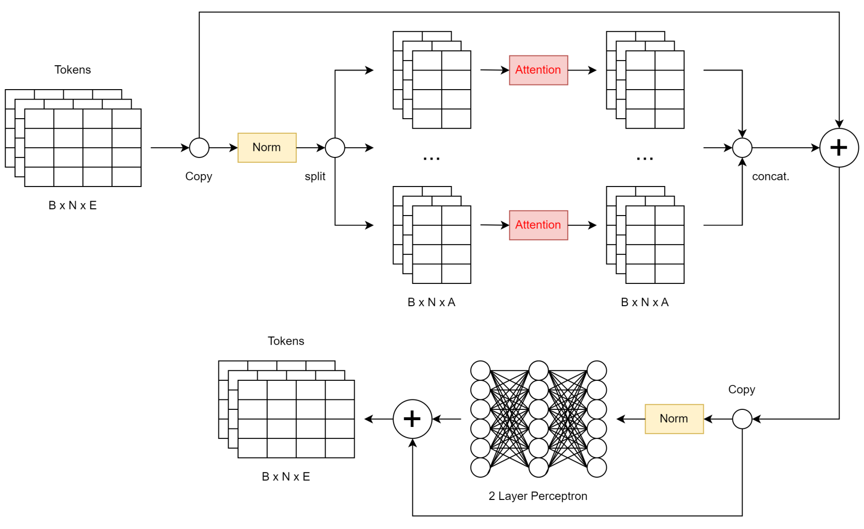
Encoding Block
attention.cpp
modules.cpp
mlp.cpp
modules.cpp
block.cpp

Slide 5
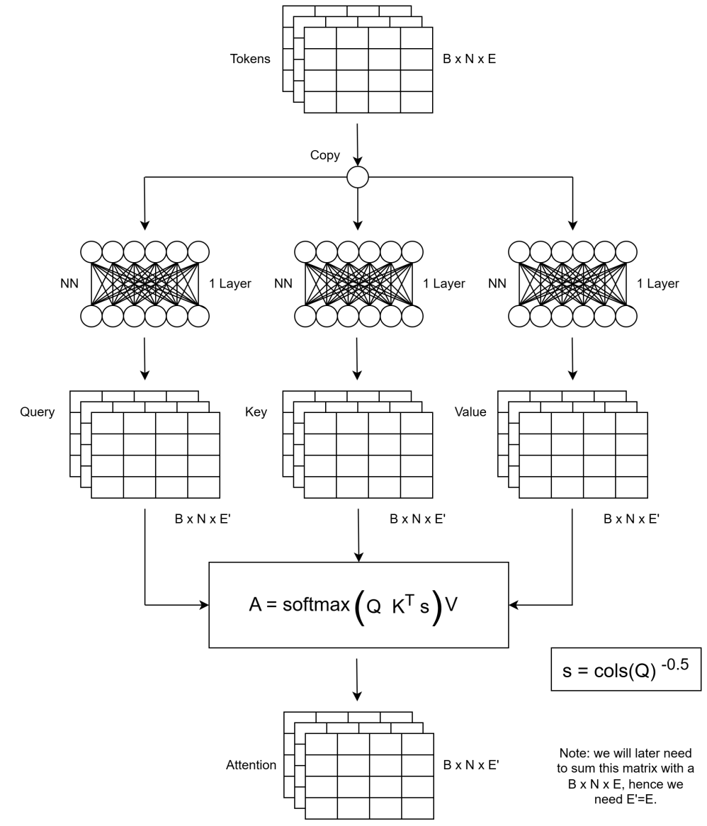
Attention layer
modules.cpp
attention.cpp

Slide 6
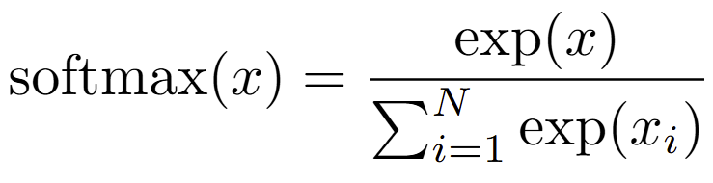
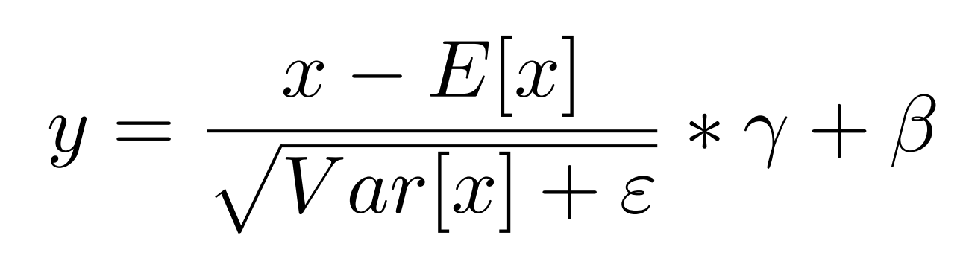
Some Formulae

Slide 7
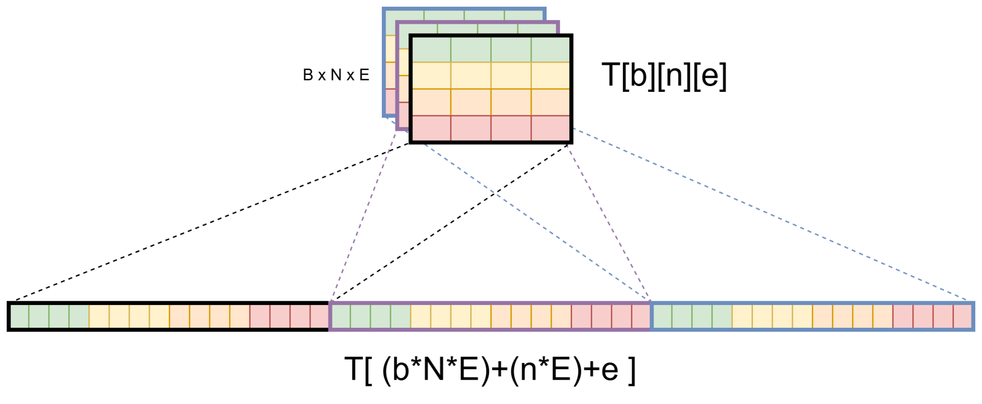
Matrix Representation

Slide 8
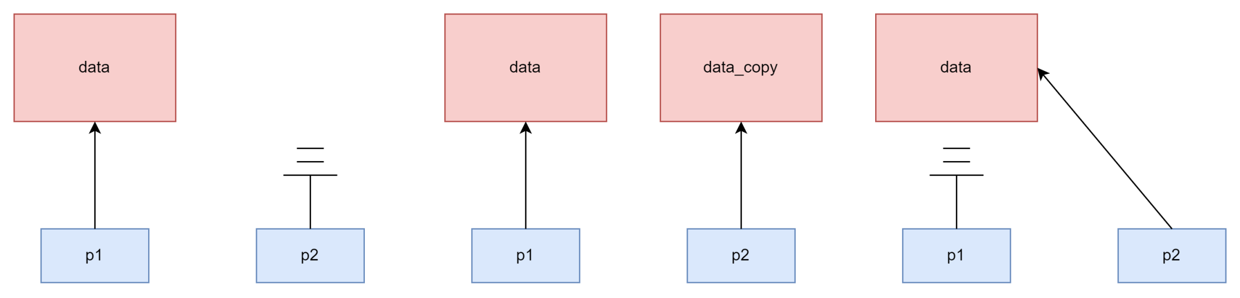
Move Semantics
Deep Copy
Move Copy

Slide 9
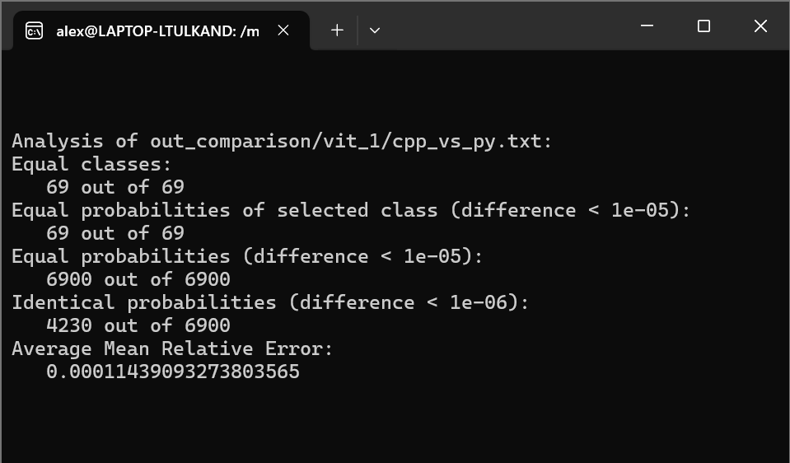
Full Model Benchmark
Three level comparison:
1) Equal output classes

Slide 10
Full Model Benchmark
Three level comparison:
2) Probability gap below a threshold
Notes:
Float32 ha 16 cifre decimali di precisione

Slide 11
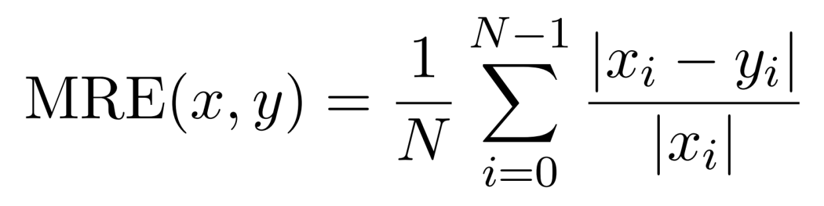
Full Model Benchmark
Three level comparison:
3) Mean Relative Error

Slide 12
Question Time

Slide 13
The End
Thanks for your attention

