Slide 1
PROJECT TITLE: PERSONALIZED AI SHOPPING COPILOT
CSE7101- Capstone Project
Review-4
Batch Number: Samsung_9
Under the Supervision of,
Dr. Nagaraja S.R.
Associate Professor -Selection Grade
School of Computer Science and Engineering
Presidency University
Roll Number | Student Name
20221CAI0002 | Hida Fathima P H
20221CSE0291 | Ruchitha A S
20221ECE0134 | Manasa B S
Name of the Program: B.Tech
Name of the HoD: Dr. Robin Rohit Vincent
Name of the Program Project Coordinator: Refer- Annexure-1
Name of the School Project Coordinators: Dr. Sampath A K , Dr. Geetha A

Slide 2
Problem Statement Number: 4
Organization: School of Computer Science and Engineering
Category (Hardware / Software / Both) : Software
Problem Description:
Existing e-commerce recommendation engines lack the conversational and multimodal capabilities that modern customers expect. They are typically limited to keyword searches and cannot understand natural dialogue or visual inputs like images. This results in a rigid, impersonal shopping experience that fails to capture a user's real-time needs for personalized recommendations, comparisons, and product bundles.

Slide 3
Content
Problem Statement
Objectives
Background and Related work for title Selection
Analysis of Problem Statement
Innovation or Novel Contributions
Git-hub Link
Timeline of the Project
References

Slide 4
Problem Statement
Existing e-commerce recommendation systems are often impersonal and rigid, relying on historical data and predefined filters.
They lack the ability to engage in natural, human-like conversations, leading to a disconnected user experience.
Current systems are primarily text-based, failing to leverage visual input (images) from users, which limits the scope and accuracy of product discovery.

Slide 5
Objectives
1. To design a multimodal AI shopping assistant that understands both text and image-based queries for product recommendations.
2. To develop a conversational chatbot using Cohere’s Command-R+ API for intelligent, context-aware dialogue and product guidance.
3. To integrate a state-of-the-art multimodal AI (Cohere Chat API) for high-accuracy semantic and visual search, replacing CLIP and Sentence-BERT.
4. To build a seamless and engaging user interface using React.js and FastAPI, powered by real-time web scraping and dynamic responses.

Slide 6
Background and Related work for title Selection
Conversational Commerce: Research shows that human-like traits in chatbots, such as empathy and social presence, significantly increase user trust and adoption (Sidlauskiene et al., 2023). This forms the basis for our conversational approach.
Recommendation Systems: Traditional e-commerce platforms (e.g., Amazon) heavily rely on collaborative and content-based filtering. While effective, these methods are not interactive and often feel like a "black box" to users.
Gaps in Existing Models:
Most current chatbots in e-commerce lack multimodal capabilities; they cannot process user-uploaded images for search.
There is a need for systems that can handle complex, conversational queries rather than simple keywords.
Few systems focus on explainable recommendations (i.e., telling the user why an item is recommended), which is a key factor in building trust.
Emerging AI Techniques: Recent advancements in models like CLIP (for aligning images and text) and LLMs (like LLaMA) make it feasible to build a system that addresses these gaps effectively.

Slide 7
Analysis of Problem Statement
Technology Stack Components:
Frontend: React.js (for dynamic UI), Tailwind CSS (for optional styling), Axios/Fetch (for API communication). Backend: FastAPI (Python 3.11+) with Uvicorn server for async API handling. Web Scraping: BeautifulSoup4 and Requests for real-time product data extraction from Amazon and Flipkart. Image Processing: Pillow (PIL) and FastAPI UploadFile for handling and preprocessing image uploads. AI Model: Cohere Chat API (command-r-plus-08-2024) for text and image understanding. Database: None (real-time scraping only).
Future enhancement: MongoDB/PostgreSQL. Development Tools: Python 3.11+, VS Code, Node.js + npm, Git, and Postman for API testing. Deployment: Vercel (frontend) and FastAPI backend on cloud or local environment.

Slide 8
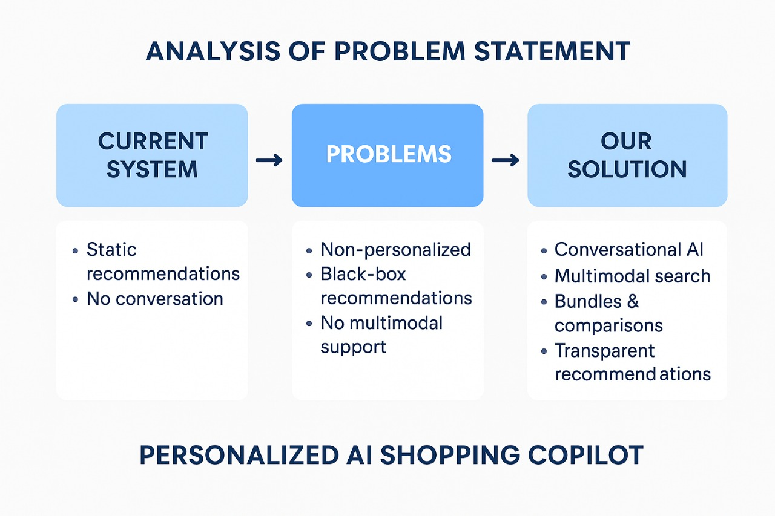
Analysis of Problem Statement (contd...)
Software and Hardware Requirements:
Software: Python 3.8+, Node.js, VS Code, Git.
Hardware: A standard development machine. For training/fine-tuning models, access to a GPU (like NVIDIA T4/V100) via Google Colab or a cloud service would be necessary.

Slide 9
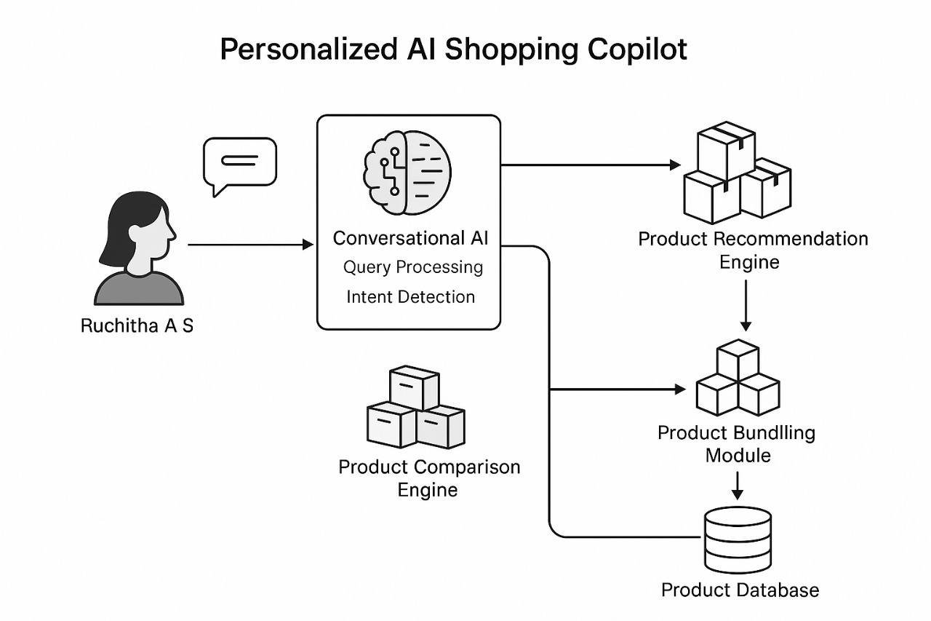

Slide 10
Innovation or Novel Contributions
1. Multimodal Intelligence: The system fuses both text and image inputs using Cohere’s Command-R+ API to understand user intent and provide highly relevant results. 2. Smart Conversational Copilot: The chatbot offers human-like assistance, handling natural dialogue, comparisons, and personalized suggestions in real time. 3. Simplified and Efficient Stack: Replaced multiple complex AI models (CLIP, SBERT, LLaMA) with a single robust API that supports multimodal understanding. 4. Focused on Explainability: Uses conversational transparency to explain product matches and enhance user trust. 5. Real-Time Experience: Live data scraping replaces static databases for up-to-date product insights and recommendations.

Slide 11
Github Link
The project is actively managed on GitHub to ensure version control and collaborative development.
The repository contains all source code, documentation, and project-related files.
Link: https://github.com/Hida-Fathima/Personalized_AI_Shopping_Copilot

Slide 12
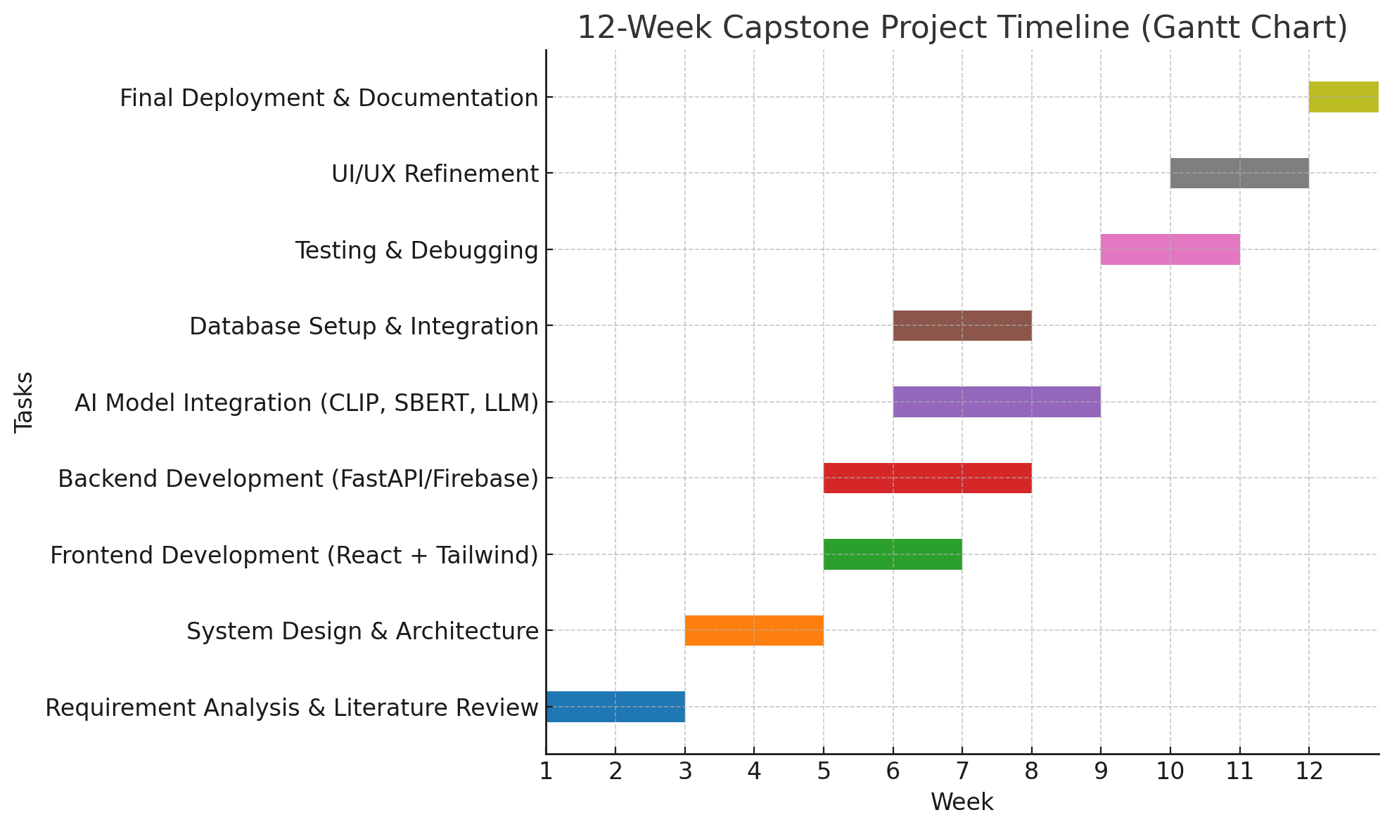
Revised Project Timeline (Gantt Overview): • Week 1–3: Requirement analysis and architecture planning • Week 4–5: Frontend setup (React.js UI) • Week 6–7: Backend API development (FastAPI + Uvicorn) • Week 8–9: Cohere API Integration & Prompt Engineering • Week 10: Web Scraper Implementation (BeautifulSoup, Requests) • Week 11: Testing, Debugging & UI/UX Refinement • Week 12: Final Review, Documentation & Deployment

Slide 13
References (IEEE Paper format)
[1] Jindi Fu, Samar Mouakket, and Yuan Sun, “The role of chatbots’ human-like characteristics in online shopping,” Electronic Commerce Research and Applications, vol. 61, p. 101304, August 2023. doi:10.1016/j.elerap.2023.101304.
[2] Sidlauskiene, Justina, Yannick Joye, and Vilte Auruskeviciene, “AI-based chatbots in conversational commerce and their effects on product and price perceptions,” Electronic Markets, vol. 33, no. 1, May 2023. doi: 10.1007/s12525-023-00633-8. Available: ResearchGate.
[3] Badave P, Bhomaj B, Bindu B, Shivarkar R, Prof Dhavase N,“E-commerce website with recommendation system including chatbot and reverse image search”, International Journal for Research in Applied Science & Engineering Technology (IJRASET), vol. 10, no. 9, pp. 1663-80., Sep, 2022. Available: Link.
[4] M. Rahevar, Maharshi, and S. Darji, “The adoption of AI-driven chatbots into a recommendation for e-commerce systems to targeted customer in the selection of product,” International Journal of Management, Economics and Commerce, vol: 1, no. 2, 128-137, 2024. Available: Link.

Slide 14
References (Contd.)
[5] Valencia-Arias, Alejandro, Hernán Uribe-Bedoya, Juan David González-Ruiz, Gustavo Sánchez Santos, Edgard Chapoñan Ramírez, and Ezequiel Martínez Rojas. "Artificial intelligence and recommender systems in e-commerce. Trends and research agenda." Intelligent Systems with Applications 24, p.200435, Dec 2024. doi: 10.1016/j.iswa.2024.200435. DOI
[6] Priya , and Dr Nidhi Bhagat, “The impact of AI-powered chatbots on shopper experience in e-commerce,” International Journal of Creative Research Thoughts (IJCRT), vol. 13, April 2025. Available: Link
[7] Dwivedi, Rohit, Abhineet Anand, Prashant Johri, Arpit Banerji, and N.K Gaur. "Product based recommendation system on amazon data." Int J Creat Res Thoughts–IJCRT, June 2020. Available: Link
[8] Illescas-Manzano, María, Sergio Martínez-Puertas, Paulo Ribeiro Cardoso, and Cristina Segovia-López. "Use of Online Shop Chatbots: How Trust in Seller Moderates Brand Preference and Purchase Intention." In International Conference on Advanced Marketing Practice, pp. 151-171. Cham: Springer Nature Switzerland, Nov 2024. DOI

Slide 15


