Slide 1
CSE7302 - INTERNSHIP Review-3 Presentation Multi-Agent MDR for AI SOC
Student Details
Name | Hida Fathima P H
Roll No | 20221CAI0002
Section | 8 SIC 01
Under the Supervision of,
Dr. Vijayakumar Adaickalam
Professor
Presidency School of CSE
Presidency University
Name of the Program: B.Tech – CSE(AI&ML)
Name of the HoD: Dr Zafar Ali Khan N
Name of the Program Internship Coordinator: Dr. Anandan B
Name of the School Internship Coordinator: Dr. Md Ziaur Rahman

Slide 2
Content
About Company or Organization
Working domain or the technology
About your team and reporting Manager
Challenges Faced in Internship
Objectives of the work
Literature Review
Proposed System
Problem Statement
System Requirements
Advantages of Proposed System/Work
System Design
System Implementation
Internship Roadmap
Github Link

Slide 3
About Company or Organization
It is a cybersecurity-focused technology consulting and services company that helps organizations strengthen their security posture and resilience against emerging threats.
Their solutions are built using advanced technologies including AI, Machine Learning, scalable analytics, and future-proof platforms to enhance detection, defense and response capabilities in real time.
The company emphasises customer-centricity, innovation, flexibility and business-aligned solutions in all its offerings.

Slide 4
Working domain or the technology
SOC (Security Operations Center): Introduced to log monitoring, incident detection, and alert triage workflows.
AI Agent Capabilities: Worked on building a Managed Detection and Response (MDR) system enhanced with AI agent–based threat analysis and automation.

Slide 5
About your team and reporting Manager
Reporting Manager: AVP – Technology & Services
Project Team: Engineering

Slide 6
Challenges Faced in Internship
Understanding and working with new tools, platforms, and advanced security workflows.
Applying theoretical concepts to real-world organizational and industry use cases.
Adapting to a new technical domain combining AI and Cybersecurity.

Slide 7
Objectives of the work
Unified Interoperability: Develop a vendor-agnostic AI agent (using MCP) that translates natural language threats into executable queries for any SIEM (Splunk, Sentinel, etc.) automatically.
Scalable Automation: Eliminate manual redundancy by implementing a "Write Once, Deploy Everywhere" framework that instantly propagates security rules across multiple tenants.
Proactive Threat Hunting: Shift operations from reactive to proactive by deploying autonomous agents that continuously search for and correlate hidden threats before alerts trigger.
Privacy-First Intelligence: Ensure strict data compliance by integrating real-time PII/sensitive data sanitization, allowing safe AI analysis without exposing client secrets.

Slide 8
Literature Review
Paper Title & Year | Focus Area | Key Innovation / Finding | Relevance to Your Project
1. "RulePilot: An LLM-Powered Agent for Security Rule Generation" (2025, arXiv) | Agentic AI & Interoperability | Proposed "RulePilot," an autonomous agent that translates high-level threat descriptions into executable rules for specific SIEMs (Splunk/Sentinel) with 95%+ syntax accuracy. | It proves that agents can handle the "translation" layer between abstract threats and vendor-specific code.
2. "Towards Small Language Models for Security Query Generation in SOC Workflows" (2025, DART Lab) | Query Generation (NL-to-Code) | Demonstrated that specialized "Small" Language Models (SLMs) combined with a "Schema Refiner" can generate accurate KQL/SPL queries cheaper and faster than giant models like GPT-4. | It shows that giving the AI the schema (context) is more important than just having a big model.
3. "Casper: Prompt Sanitization for Protecting User Privacy in Web-Based LLMs" (2025, ResearchGate) | Privacy & Sanitization | Introduced a "Gatekeeper" architecture where a lightweight local model sanitizes sensitive PII (Redact/Replace) before sending the prompt to a cloud LLM. | Thw6privacy approach is a recognized, academic best practice.
4. "LLMs in the SOC: An Empirical Study of Human-AI Collaboration" (2025, USENIX/ResearchGate) | Human-AI Collaboration | Analyzed 3,000+ analyst queries and found that analysts prefer AI for "low-level translation" (e.g., "what does this error mean?") but struggle with "contextless" answers. | Justifies your shift from "Chatbot" to "Agent." It highlights that simple chat is not enough; the AI needs context and autonomy to be truly useful in a SOC.

Slide 9
Problem Statement
Overwhelming Alert Fatigue: Security Operations Centers (SOCs) are drowning in thousands of daily network alerts and high false-positive rates, leading to severe cognitive overload and analyst burnout.
Critical Response Latency: Manual "swivel-chair" triage takes an average of 15 to 25 minutes per incident, dangerously inflating Mean Time to Detect (MTTD) and Mean Time to Respond (MTTR) against machine-speed attacks.
The Expertise Bottleneck: Translating raw attack telemetry into deployable, vendor-specific defense scripts (e.g., YARA-L, FQL) requires senior-level syntax experience, severely limiting the scalability of junior analysts.
AI Data Privacy Risks: Attempting to automate this triage by feeding logs into public Generative AI platforms exposes highly confidential corporate data, violating strict GDPR and SOC 2 compliance standards.

Slide 10
Advantages of Proposed System/Work
1.Automated Threat Detection & Response
Detects new malware patterns
Creates detection rules automatically
Deploys across all customer tenants in minutes (not hours)
2. Cross-Tenant Rule Management
One rule creation → 10 tenant deployments
Automatic customization per tenant environment
Version tracking & rollback support
3. SIEM-Agnostic Detection
Same logic works for Google SecOps and CrowdStrike
Converts rule formats automatically (UDM ↔ CrowdStrike Query)
Unified threat intelligence
4. Analyst Assistance
“Hey agent, what’s this suspicious process doing?”
“Create a rule to detect this lateral movement pattern”
“Deploy this rule to all tenants using Windows Server”
5. Threat Hunting Automation
Proactive searches across tenants
Pattern correlation across different environments
Automated reporting

Slide 11
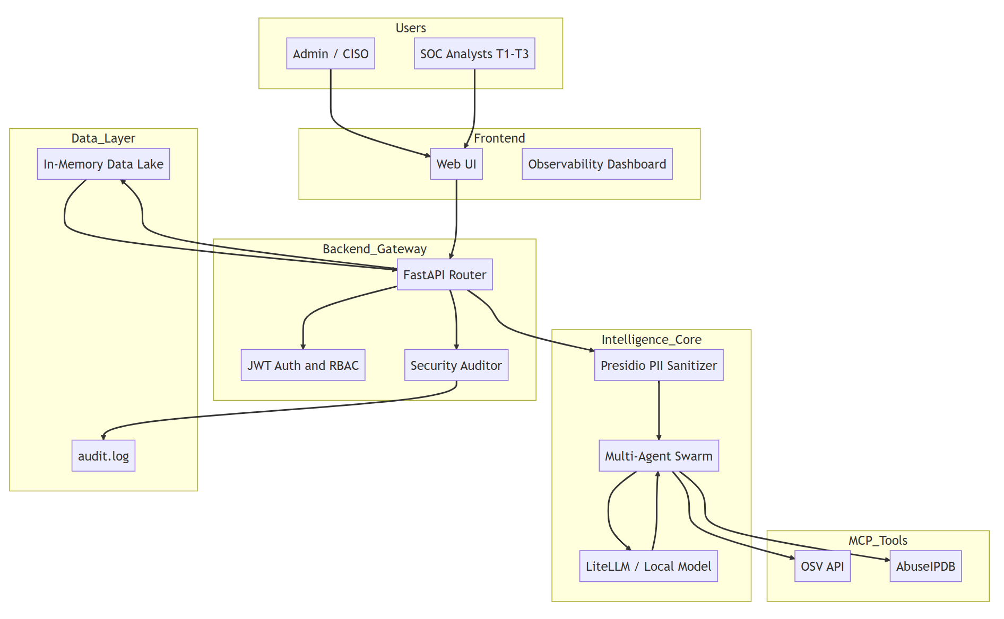
System Design

Slide 12
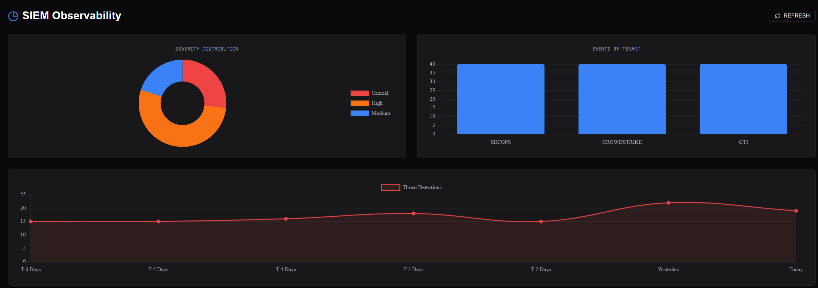
System Implementation

Slide 13
Internship Road Map
Review 1
Current Status
Review 2
Training Under Team
Review 3
Learning & Initial Implementation
Review 4
Final Review
Onboarding and orientation at Tecplix
Undergoing basic training in AI and Cybersecurity fundamentals
Learning core concepts, terminology, tools overview, and company processes.
Assigned to a team for guided technical training
Learning AI tools applied to cybersecurity use cases
Hands-on practice with basic tools, datasets, and security scenarios under mentorship
Applying learned concepts to small tasks or modules related to AI & Cybersecurity
Understanding real-world threat scenarios and AI-based detection approaches
Improving technical skills through continuous practice and team collaboration
Active Contribution
Working on assigned tasks or sub-modules within the team
Assisting in analysis, implementation, or testing of AI-driven cybersecurity solutions
Gaining practical exposure to industry workflows and best practices
Outcome
Developed a strong foundation in AI and Cybersecurity concepts
Gained practical exposure to tools, workflows, and real-world problem-solving
Improved technical, analytical, and professional skills through hands-on experience

Slide 14
Github Link
https://github.com/Hida-Fathima/sem8-CSE_7302_academics

Slide 15
Q&A

Slide 16
Thank you !!

