Slide 1
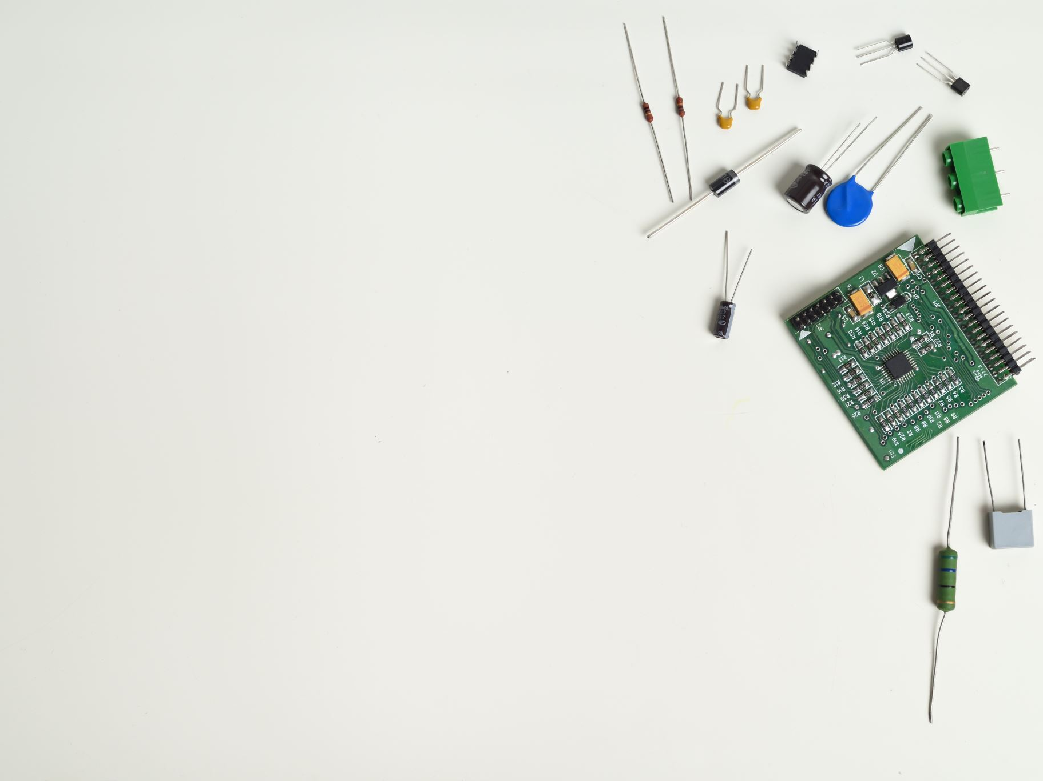
Network Security Fundamentals
ASSOC. PROF. DR NURUL AKMAR EMRAN

Slide 2

Lesson Outcomes
Upon completion of this chapter, you should be able to:
Describe the attackers profile
Describe the basic processes to secure a computer
network
Identify common devices in a computer network.
Explain the role of network devices in securing a
computer network
Illustrate a basic topology for a secured network

Slide 3
Part 1

Slide 4
Attackers Profiles
Hackers
Generic definition :
“A person who illegally breaks into or attempts to break into a computer system”
[synonymous with an attacker]
Specific definition :
“A person who uses his or her advanced computer skills to attack computers, but not with a malicious intent. Instead, hackers use their skill to expose security flaws”
[synonymous with an ethical hacker]

Slide 5
Attackers Profiles (continue)
Crackers
A cracker is a person with advanced computer skills who violates system security with malicious intent.
Crackers destroy data, deny legitimate users of service or otherwise cause serious problems on computers and networks.
The term cracker was coined around 1985 by ethical hackers who wanted to distance themselves from those who attack computer systems with malicious intent
Their motivation : “To harm systems and proud of it ”

Slide 6
Attackers Profiles (coninue)
Script Kiddies
Much like crackers, but script kiddies are unskilled users.
They do their work by downloading automated hacking software from Web sites and then using it to break into computers.
Script kiddies can be more dangerous than crackers because most of them are young computer users who have almost unlimited leisure time.
Their motivation : “Sense of self-importance”

Slide 7
Attackers Profiles (continue)
Spies
A computer spy is a person who has been hired to break into a computer and steal information. A spy possess excellent computer skills.
Spies do not randomly search for unsecured computers. Instead they targets a specific computer with sensitive information.
Their goal is to steal sensitive information without drawing any attention to their actions.
Their motivation : “Personal Financial Profit”

Slide 8
Attackers Profiles (continue)
Employees
On of the largest information security threats.
Motivation for Employees break into their company’s computer:
To show the company a weakness in their security.
Unsatisfied with the company or to show that “I’m smarter
than all of you”.
Hired by a competitor to steal sensitive information for
financial benefit.

Slide 9
Attackers Profiles (continue)
Cyberterrorist
Their attacks are often unprecedented: that is, they attack in ways that have not been used before.
Terrorist attacks network and computer infrastructure to cause panic.
Their goals are :
- Deface electronic information (such as Web sites) to spread disinformation and propaganda
- Deny service to legitimate users
Commit unauthorised intrusions that result in critical infrastructure outages and corruption of vital data
Their motivation : Ideology, for the sake of their principles or beliefs.

Slide 10
Attacker Profiles Summary
Attacker | Skill Level | Motivation
Hacker | High | Improve Security
Cracker | High | Harm systems
Script kiddie | Low | Gain recognition
Spy | High | Earn money
Employee | Varies | Varies
Cyberterrorist | High | Support ideology

Slide 11
Basic Attacks
Social Engineering
Relies on tricking and deceiving someone to access a system.
Relies on the friendliness, frustration or helpfulness of a company employee.
Requires almost no technical ability.
- “dumpster diving” : digging through trash to find computer manuals, printout or password list that have be thrown away.
- “phishing” : eg. Email message that instructs a user to click to a link which bring to a fake Website and the user is ask to update his or her account information, which the attacker then steals.
Social Engineering can be defeated by 2 ways:
1. develop strong procedures & policies .
2. educate employees to comply with the procedures & policies

Slide 12
Basic Attacks (continue)
Password Guessing
Weak password can easily be exploited by attackers.
Characteristics of weak passwords include:
- short password such as XYZ
- common word (such as blue, tiger, etc.)
- personal information (such as the name of a pet)
- same password for all accounts
- writing down passwords
- not changing passwords
Password guessing fall into 3 categories:
1. brute force
2. dictionary attack
3. software exploitation (e.g. buffer overflow)
Password guessing can be minimised by enforcing strong passwords

Slide 13
Basic Attacks (continue)
Mathematical Attack
A process of attempting to break an encrypted message.
Mathematical Attack is a type of cryptanalysis which develops a statistical analysis of the characters in encrypted text and then analyzes the statistics to discover the keys and decrypt the data.
Mathematical attack can be resisted by not sending the same encrypted message more than once

Slide 14
Identity Attacks
Man-In-The-Middle
This type of attacks makes it seem that two computers are communicating with each other, when actually they are sending and receiving data with a computer between them, or the “man in the middle”.
This attack can be active or passive.
- In passive attack message is not altered .
- In active attack message is altered
Can be prevented by installing network devices that are prohibited from forwarding redirected messages.

Slide 15
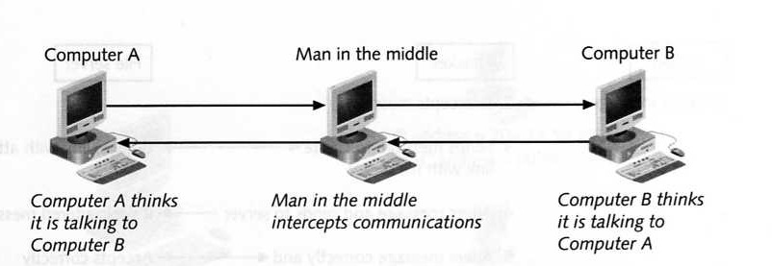

Slide 16
Identity Attacks (continue)
Replay attack
Similar to an active man-in-the-middle but only captures messages and then sends it again later.
Resending the original message enables the attacker to established a “trusted” relationship with the server.
With the trusted relationship, the attacker change the message bit by bit until he receive a response from the server and eventually decrypts the entire message.

Slide 17
Identity Attacks (continue)
TCP/IP Hijacking
The attacker sets up a device that appears to be valid and tricks other users to send their messages to it.
Using “spoofing” technique that is the act of pretending to be the legitimate owner.
On wired networks a hacker uses ARP spoofing whereby he changes the MAC address in the ARP table to redirect messages to his computer.
On wireless networks a hacker sets up his own base station (or access point) and tricks all wireless devices to communicate with it.

Slide 18
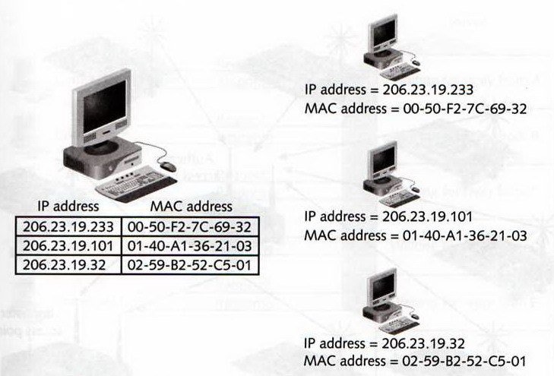
Spoofing on wired networks
Before attack

Slide 19
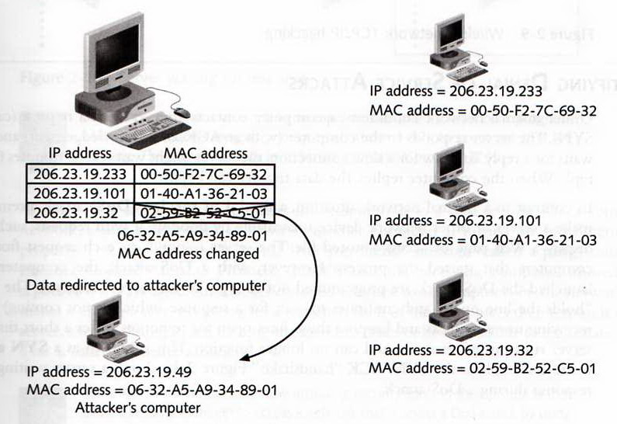
Spoofing on wired networks
After attack

Slide 20
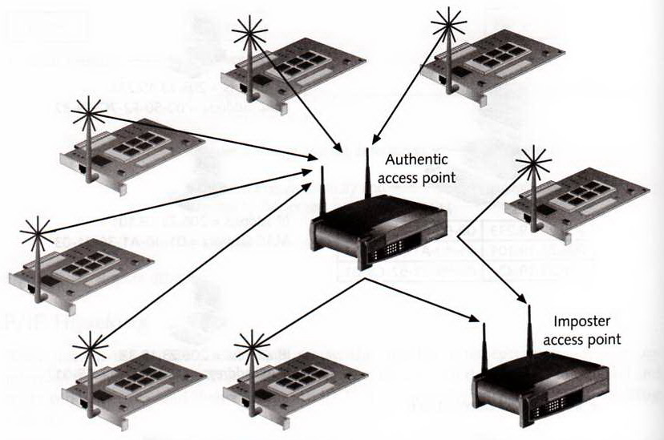
Spoofing on wireless networks

Slide 21
Part 2

Slide 22
Denial of Service Attacks
A DoS attack attempts to make a server or other network device unavailable by flooding it with requests.
The computers that launched the DoS attack are programmed not to reply to the server’s response and causes the server to “holds the line open” and continues to wait for a response which is not coming while receiving more request.
After a while the server will run out of resources and can no longer function.
This is also known as SYN attack because it exploits the SYN/ACK “handshake”.

Slide 23
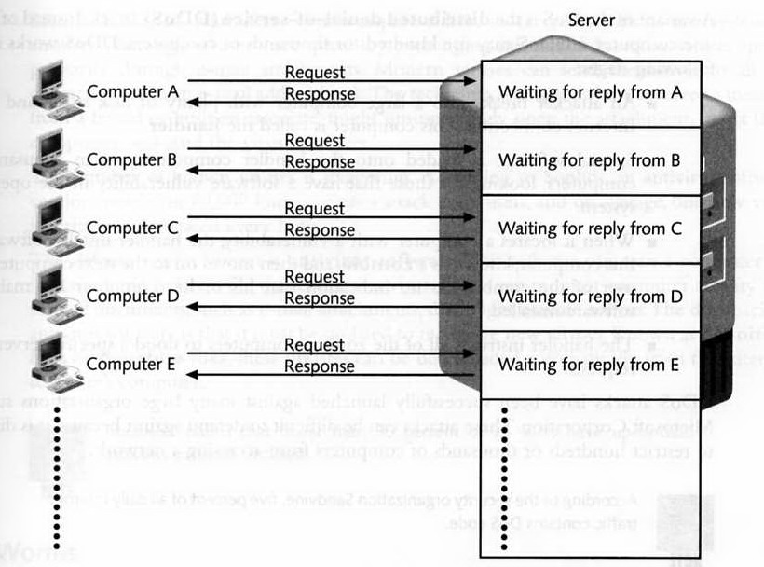
SYN Attacks

Slide 24
Denial of Service Attacks
Another DoS attack is known as Smurf attack
Smurf attack exploits the ping command by sending a request to all computers in the network as if the request is from the server.
Each of the computers then responds to the server and causing the server to crash or be unavailable to legitimate users.

Slide 25
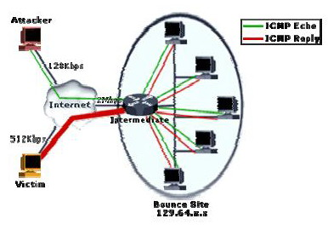
Smurf Attack

Slide 26
Distributed Denial of Service Attacks
Distributed Denial of Service (DDoS) attack is a variant of DoS attack that uses hundreds or thousands of computers.
DDoS attacks can achieve larger magnitude by launching coordinated attacks with the help of “handlers” and “agents”.
DDoS works in the following stages:
Breaks into a large computer. (the handler)
Load special software into the handler to scan thousands of computers (or agents) with O/S vulnerabilities.
When these agents are located, the handlers installs software known as zombie.
The handler instruct the zombie computers to flood a specific server with request.

Slide 27
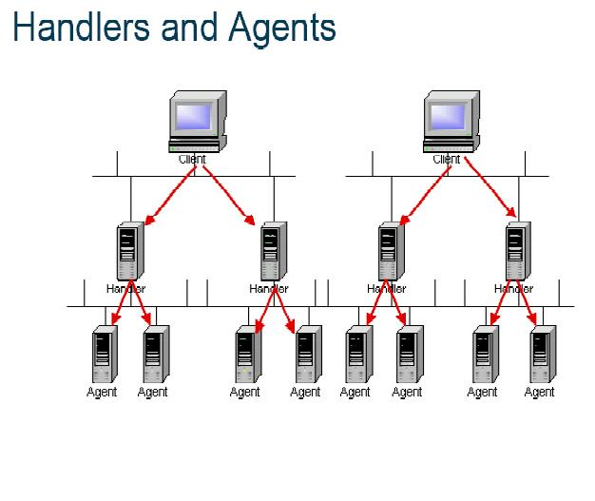
DDoS attacks

Slide 28
Malicious Code (Malware)
Viruses : program that attached to document and executes when that document is opened
Worms : self propagated and executed programs
Logic bombs : statements buried within thousands of lines of program code waiting to be executed when certain condition is met.
Trojan Horses : a program that hide its true intent and then reveals itself when activated
Back doors : a secret entrance created by viruses or worms that allow remote user to access the computer without legitimate permission.

Slide 29
Hardening Networks
To resist attacks a network must be properly configured.
The primary method is to filter data packets as they arrive at the perimeter of the network.
Packets that meet certain criteria are allowed to pass through or else they are dropped.

Slide 30
Network packet filtering
The filtering criteria is base on :
- IP address of sender or receiver
- Domain name of sender
- Protocol (such as TCP, UDP, or IP)
- Port
- Word or phrase
A network device can have more than one criterion (or rule) to filter packet.
The list of the filtering rules is known as Rule Base or Access Control List (ACL)
Recommended size for a rule base is about 40 rules.

Slide 31
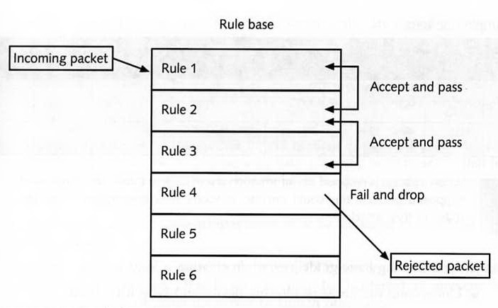
Network packet filtering

Slide 32
Rule Base (or ACL)
Rules are composed of several settings as follows :
- Rule Number
- Protocol
- Source IP
- Source Port
- Transport Protocol (TCP or UDP)
- Destination IP
- Destination Port
- Service
- Action
- Track
- Time
- Comments

Slide 33
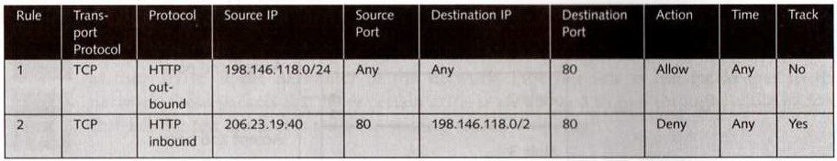
Sample Rule Base
Rule 1 is intended to allow outbound Web traffic (using protocol HTTP on port 80) to Pass through the filtering device at any time. Traffic is not logged.
Rule 2 is intended to block any HTTP packets that come from IP address 206.23.19.40 and records this information in a log file.

Slide 34
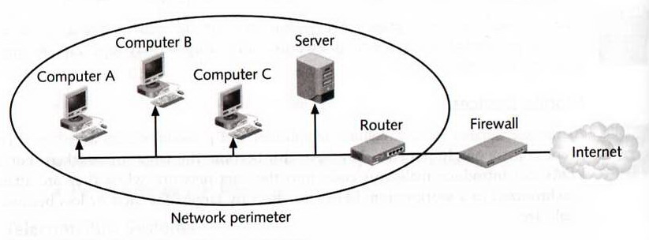
Network Security Devices
Firewalls
A firewall is typically used to filter packets
Prevents malicious packets from entering the network
Firewalls are located outside the network security perimeter. (first line of defense)

Slide 35
Firewall (continue)
Hardware firewalls are separate devices that runs their own operating system.
Hardware firewalls are designed to handle large number of packets.
Hardware firewalls are very expensive.
Firewall filter packets in one of two ways :
1. Stateless packet filtering : permits or deny packets based strictly on the rule base
2. Stateful packet filtering : records the state of connection between an internal computer and an external server and makes decision based on the connection and the rule base

Slide 36
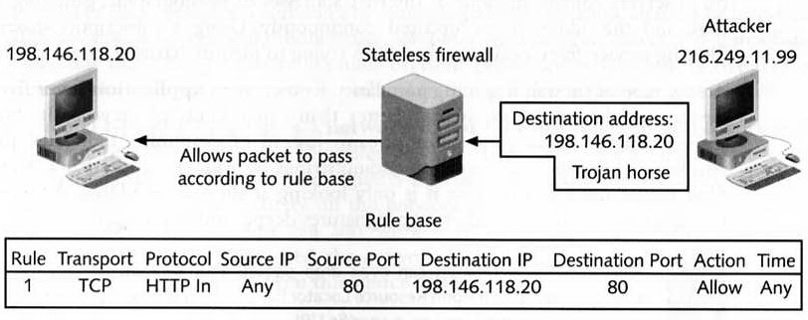
Stateless packet filtering

Slide 37
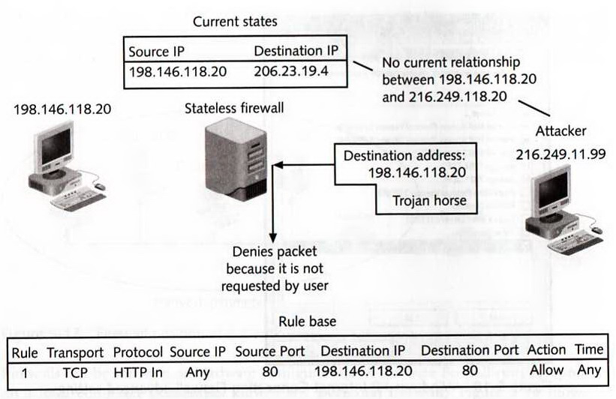
Stateful packet filtering

Slide 38
Firewall (continue)
Most firewalls today come with :
Built in virus scanning and
Content filtering (with subscription service)
New type of firewall known as Application Layer Firewall is gaining popularity.
Application layer firewall reassembles and analyzes packet streams instead of individual packets.
Application layer firewall can search viruses and worms signatures deeper inside the packets.

Slide 39
Firewall (continue)
Firewalls are critical tool for network security but do not stop all type of attacks.
Firewalls must be used with other tools such as antivirus software.
A firewall is as strong as its rule base.
Firewall must be properly configured with the rules that support an organization’s security policy.

Slide 40
Part 3

Slide 41
Network Security Devices
Intrusion Detection Systems (IDS)
IDS monitors the activity on the network and what the packets are doing.
Active IDS performs a specific function when it senses an attack such as dropping packets or tracing the attack back to a source
Passive IDS sends information about what happened but does not take action

Slide 42
Hardening Network Security Devices
Intrusion Detection Systems (IDS)
Host-based IDS continuously monitors the critical O/S file, processor and memory, and scan event logs for sign of suspicious activity.
Network-based IDS monitors all network traffic. It examines the type of data being transmitted and analyzes activity on the network to determine if an attack is occurring. When an attack is detected the system send an instruction to the firewall to block all packets from the source.

Slide 43
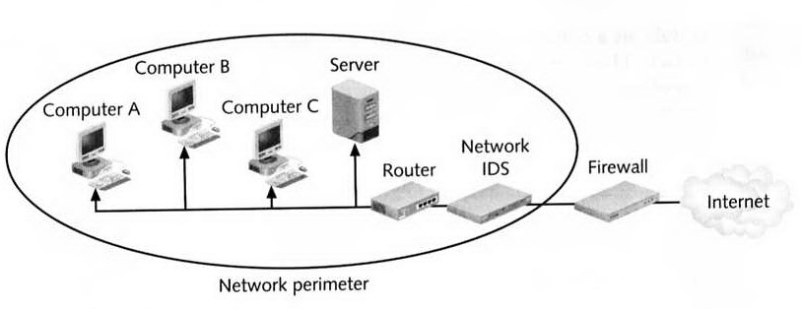
A Network with IDS

Slide 44
Secure Network Topology
Security Zones
The number of attacks can be reduced by separating secure users from outsiders.
This can be done by setting up security zones : DMZ (demilitarized zone), intranet, and extranet.
DMZ is a separate network that sits outside the secure network. Outside users can access DMZ but not the secure network.

Slide 45
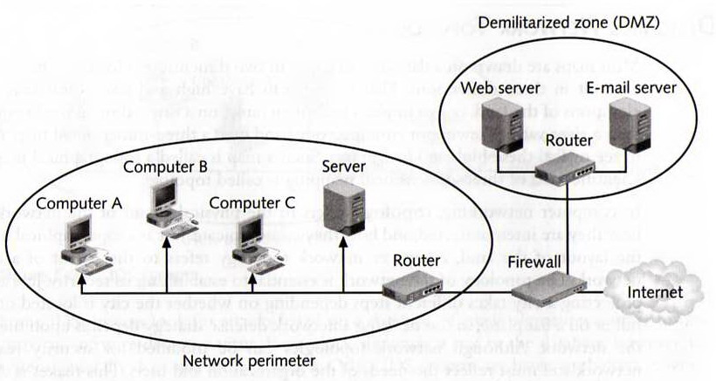
Secure Network Topology
A network with DMZ

Slide 46
Secure Network Topology
The types of server that should be located in the DMZ include :
Web servers
E-mail servers
Remote access servers
FTP servers (both outgoing and incoming)

Slide 47
Secure Network Topology
Intranets
An intranet is a network that uses same protocols (HTTP, HTTPS, etc.) as the public Internet, but is only accessible to trusted inside users.
Companies typically use an intranet to manage projects, provide employee information, and distribute company information.
The disadvantage of intranet is that it does not allow remote trusted users access to information.

Slide 48
Secure Network Topology
Extranets
An extranet is accessible to trusted external users.
An extranet is not accessible to the general public.
Extranet establishes a collaborative network to link businesses with their suppliers, customers or other businesses that share common goals.

Slide 49
Secure Network Topology
Network Address Translation
“You cannot attack what you do not see” is the philosophy behind NAT systems.
NAT refers to a process, not to a specific device.
A NAT hides the IP addresses of network devices from attackers.
In NAT networks, computers are assigned private IP addresses.
Private IP addresses are not assigned to any specific user or organization; instead anyone can use them on their own private internal network.
Without NAT, routers will drop any outgoing packets with private IP addresses.

Slide 50
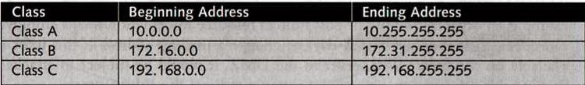
Secure Network Topology
Private IP addresses

Slide 51
Secure Network Topology
Network Address Translation
As a packet leaves a NAT network, NAT removes the private IP addresses and replace it with an alias IP addresses.
When a packet is returned to the NAT, the process is reversed.
It is difficult for an attacker to attack a computer in NAT network because the actual IP address cannot be determined.
Port Address Translation (PAT) is a variation of NAT which allows a single public IP address to be used by several users. Each outgoing packet is given the same public IP address but a different TCP port number.

Slide 52
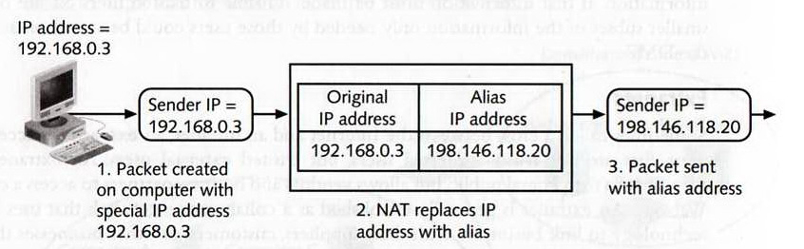
Secure Network Topology
Network Address Translation

Slide 53
Secure Network Topology
Honeypots
Honeypot is a network security technique which is intended to trap or trick attackers.
Honeypot is located in the DMZ and loaded with imitations of real data files and software which are not used by the organization
The honeypot is intentionally configured with security holes so that it is vulnerable to attacks.
Honeypot serves two purpose:
(1) keep attackers away from real data, and
(2) learn the technique used by the attackers

Slide 54
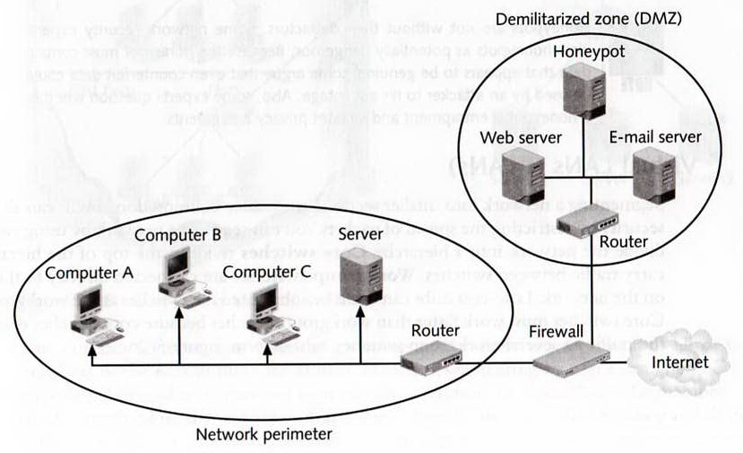
Secure Network Topology
Honeypot

Slide 55
Secure Network Topology
Network Segmentation
Reduce collision domain and benefit security by restricting the spread of packets.
A Network can be divided into a hierarchy of segments by using switches.
Workgroup switches are connected directly to network devices .
Core switches must be faster than workgroup switches because core switches must handle the traffic of several workgroup sitches

Slide 56
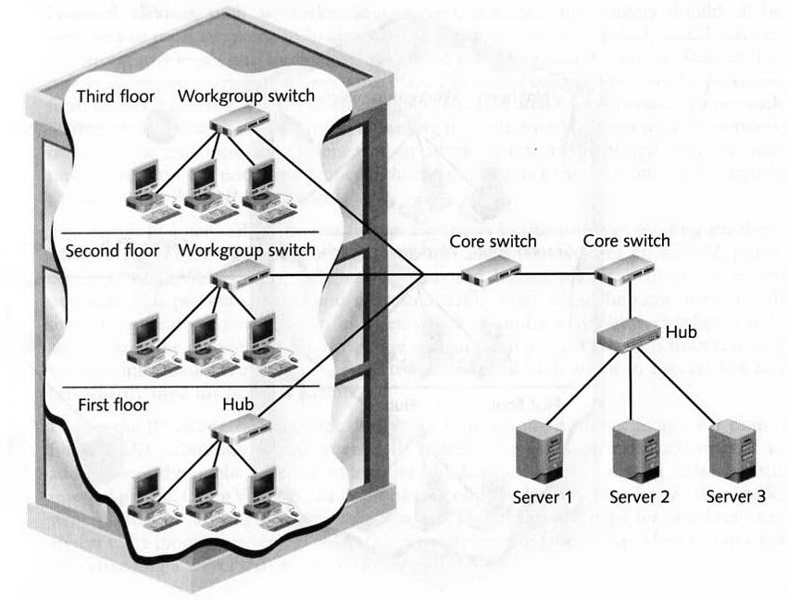
Secure Network Topology
Network Segmentation
-

Slide 57
Secure Network Topology
Virtual LANs (VLANs)
Network can also be segmented by grouping similar users together such as all of the members of the Accounting Department. ➔ logical network segmentation.
A VLAN allows scattered users to be logically grouped together, even though they may be attached to different switches.
When a packet is sent to a logical group members, only they receive it.
VLANs reduces network traffic and provides better security.

Slide 58
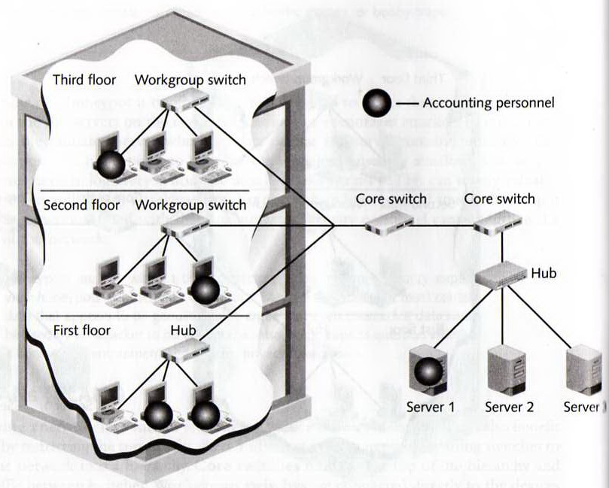
Secure Network Topology
Virtual LAN

Slide 59

SELF REVIEW QUESTIONS
Kindly click this link to self-review questions:
https://forms.gle/Zv7gwkMarWkUSWdq9

