Slide 1
Internet Security

Slide 2

Topics covered
Introduction
Types of Network Attacks
DDoS
Data Theft
Man-in-the-middle
Malware
Security Mechanisms
Firewall
IDS

Slide 3

Hacker vs Cracker

Slide 4

Hacker vs Cracker
Hacker
Cracker
Good guy
Hacker build things
Deploys to Secure
Helps secure the network and computers
For help or educational purposes
Bad guy
Break them
Deploys to destruct
Destructs and gains unauthorized control
For fun or bad intentions

Slide 5
What hacker/cracker might want?
Seek a challenge or revenge against a business
Gain bragging rights among peers
Steal information, such as credit card numbers, that they can sell
Hijack storage space on a computer or use Internet bandwidth provided by a network
Gain remote control of a computer to use in an attack against other servers.

Slide 6
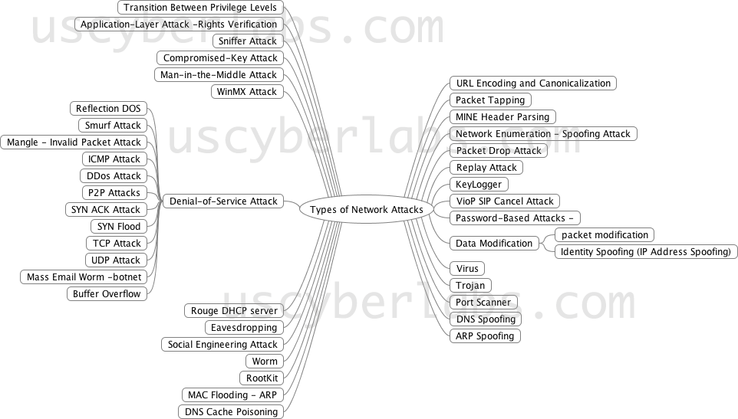
Types of Network attacks

Slide 7
Denial of Service (DoS) Attack

Slide 8
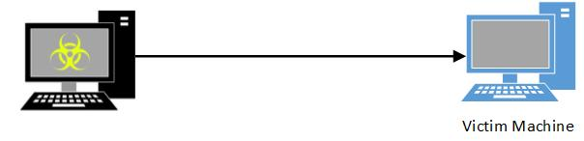
Denial of Service (DoS) Attack
A Denial-of-Service (DoS) attack is an attempt to make a machine or network resource unavailable to its intended users, such as to temporarily or indefinitely interrupt or suspend services of a server connected to the Internet.

Slide 9

distributed denial of service (DDoS)
A distributed denial-of-service (DDoS) is an extended/ new form of DoS where the attack source is more than one and often thousands of unique IP addresses.

Slide 10
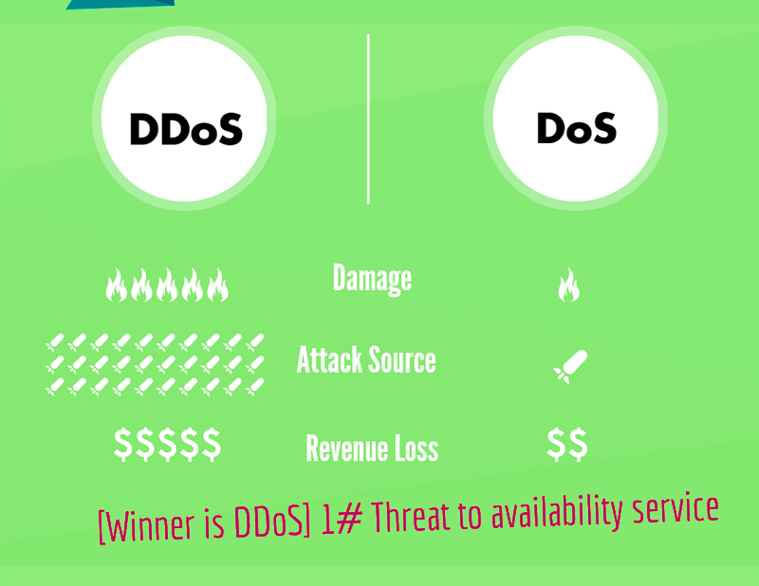
DDoS vs Dos

Slide 11
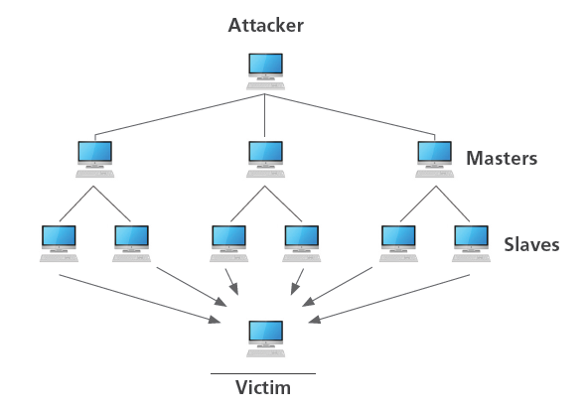
How DDoS Attack Works?
In a DDoS attack, a hacker (Attacker) has remote control of hundreds of computers (Master and Slaves) over a large geographical area and commands them to send false requests to a Internet device (victim) such as Web server.

Slide 12
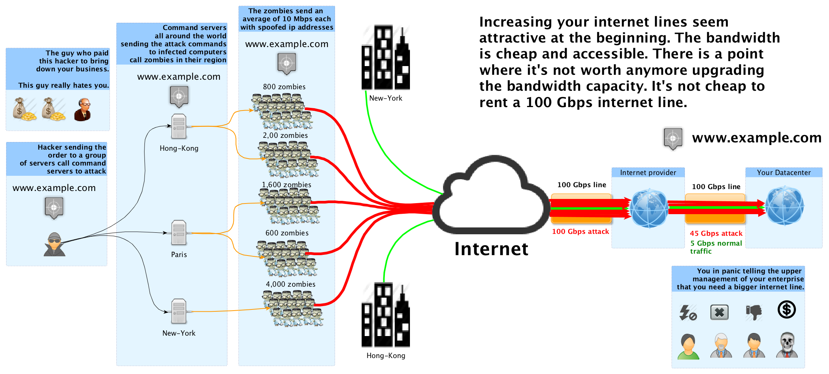
Example: Full loaded Bandwidth

Slide 13
Ping flooding
a.k.a ICMP flooding
Is a simple DoS attack that does not require a lot of special knowledge.
a host/victim is flooded and overwhelms with ICMP Echo Request packets.
As the host tries to respond to the requests, it get bogged down and cannot function, causing DoS.
It is most successful if the attacker has more bandwidth than the victim (for instance an attacker with a DSL line and the victim on a dial-up modem)

Slide 14
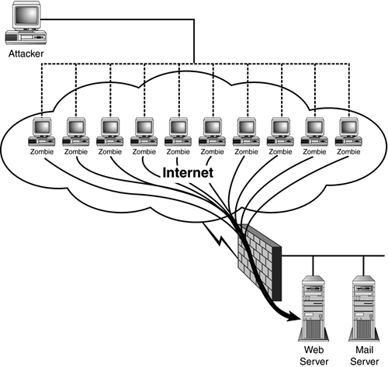

Slide 15
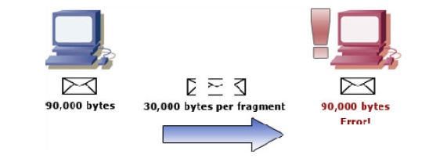
Ping of death
A variation of Ping flooding
uses the Ping protocol to send a malformed packet that is larger than the 65,536 bytes allowed by the IP protocol.
Some computer systems were never designed to properly handle a ping packet larger than the maximum packet size.
when the victim reassembles the malformed packet, a buffer overflow can occur, causing a system crash

Slide 16
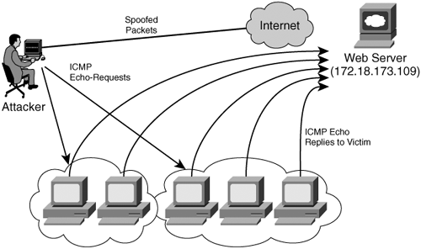
Smurf Attack
large numbers of ICMP packets with the intended victim's spoofed source IP are broadcast to a computer network using an IP Broadcast address.
Most devices on a network will, by default, respond to this by sending a ICMP Echo Reply packet to the source IP address.
If the number of machines on the network that receive and respond to these packets is very large, the victim's computer will be flooded with traffic.
This can slow down the victim's computer to the point where it becomes impossible to work on.

Slide 17
Syn Flooding
Attacker supplies an invalid IP address that cannot be accessed.
When the server responds with the SYNACK packet, it responds to an IP address that seems valid, but is not available

Slide 18
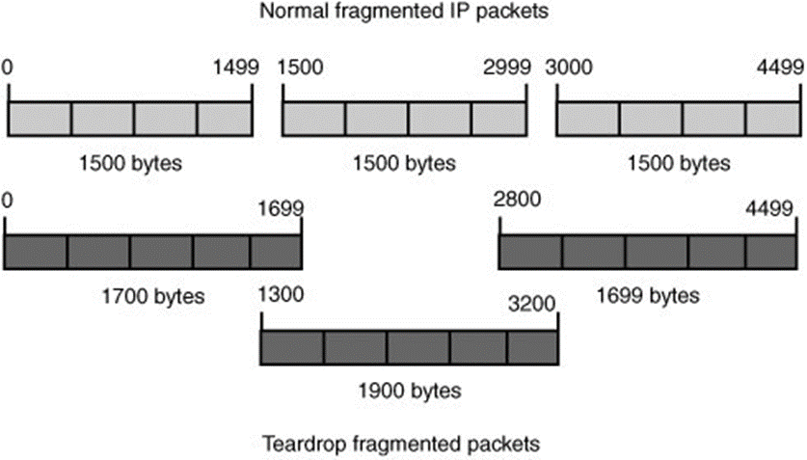
Teardrop
Teardrop packet fragments are sent in a jumbled and confused order.
As a result, the device is unable to reassemble the packet but continues to handle the invalid packets
Eventually, system resources are exhausted, causing the device to crash, hang, or reboot.

Slide 19

Mail Flooding
Mail flooding is when hackers send numerous huge e-mail messages to an e-mail server.
Spam is a form of mail flooding.
Mr wright Cain
To Recipients
21 Nov
I have a secured inheritance proposal for you worth of 2.5million dollars, Reply to my private email:wrightcain@email.ch

Slide 20
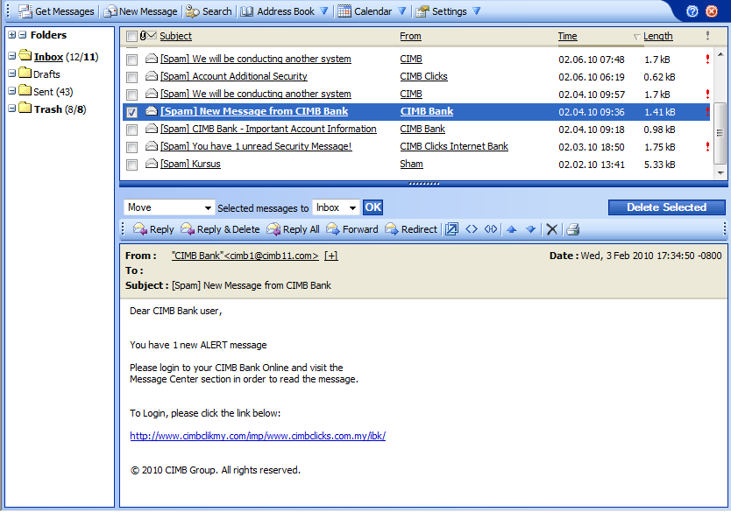

Slide 21
Man-in-the-middle

Slide 22

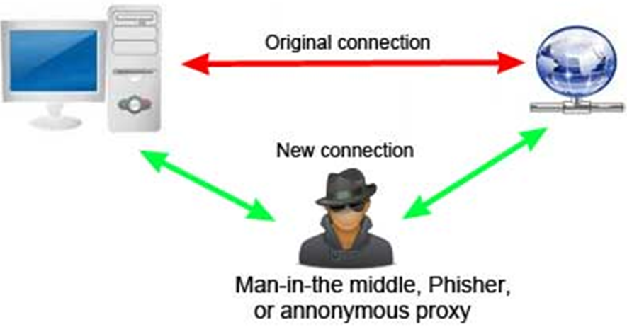
Man-in-the-middle
A type of intrusion involves the theft of network data.
If hackers find a working user ID and password, they can sign onto the network and appear as a legitimate user.
Hackers also try to intercept data (e-mail, files, chat dialogs, and data packets) as it is transmitted across the LAN, an attack known as man in the middle.

Slide 23
Data Theft

Slide 24

Data Theft
Data theft is the act of stealing computer-based information from an unknowing victim with the intent of compromising privacy or obtaining confidential information.
Data theft is increasingly a problem for individual computer users, as well as big corporate firms.
There is more than one way to steal data.
Guessing a password
Phishing -occurs when an individual pretending to be a legitimate business sends fraudulent e-mail messages in hopes of enticing users to reveal sensitive information, such as bank account information, Social Security numbers, or credit card numbers

Slide 25
Malware

Slide 26

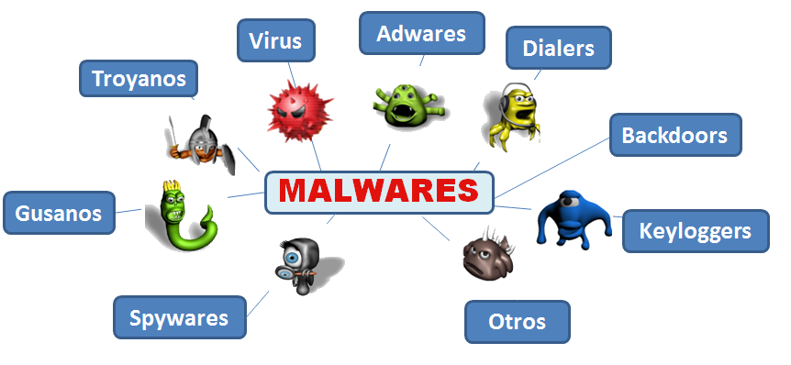
Malware
“Malware” is short for “malicious software” - computer programs designed to infiltrate and damage computers without the users consent.
“Malware” is the general term covering all the different types of threats to your computer safety such as viruses, worms, spyware, trojans, rootkits and so on

Slide 27
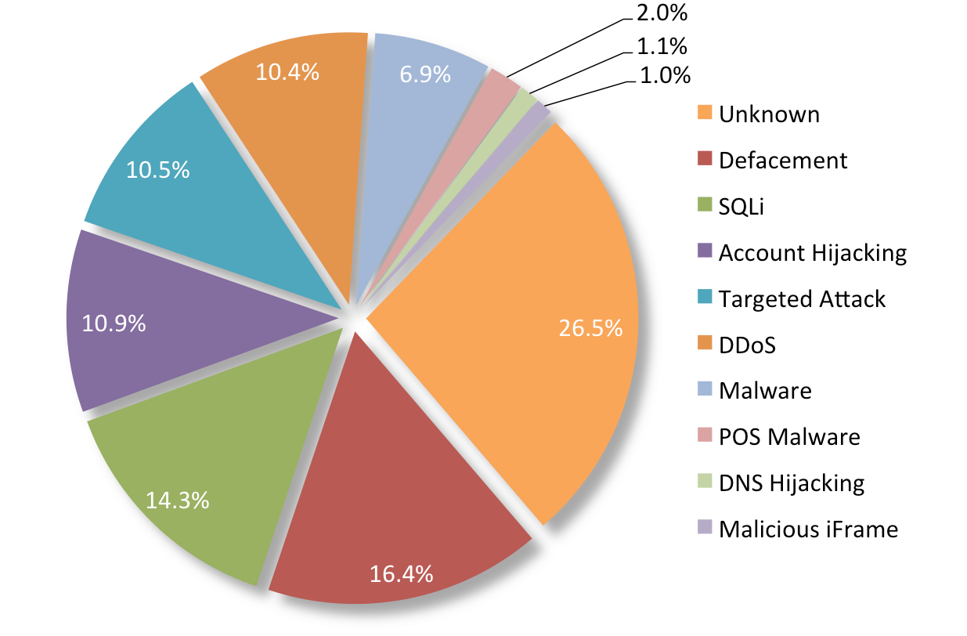
Top 10 Attack Techniques [2014]
#1

Slide 28
Security mechanism
Firewall and IDS

Slide 29
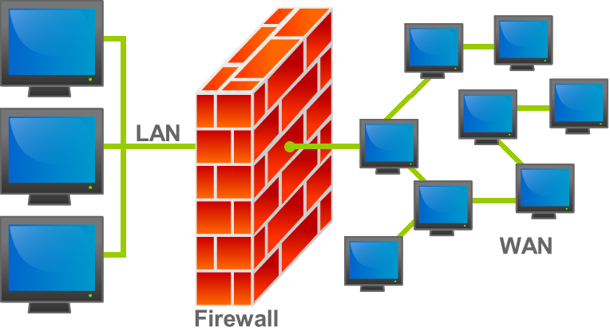
Firewalls
A firewall is hardware or software that can reside on the network’s gateway.
Separate your local network from the Internet
Protect the border between trusted internal networks and the untrusted Internet
Firewalls do packet filtering to filter unwanted packets that may harm the network.
Network administrator will configure the firewall and create rules (called policies) to allow or disallow packets and protocols.
In case a firewall detects unwanted traffic/ protocols, it will disallow the flow of the traffic to a halt.

Slide 30
Types of firewall
There are different types of firewalls depending on where the communication is taking place, where the communication is intercepted and the state that is being traced.
Network layer or packet filters
Application-layer
Proxies
Network address translation

Slide 31
Network layer or packet filters
Network layer firewalls, also called packet filters, operate at a relatively low level of the TCP/IP protocol stack, not allowing packets to pass through the firewall unless they match the established rule set.
The firewall administrator may define the rules; or default rules may apply.
Allow or deny packets based on
Incoming interface, outgoing interface
Source IP address, destination IP address
Source TCP/UDP port, destination TCP/UDP port, ICMP command
Protocol (e.g., TCP, UDP, ICMP, IGMP, RSVP, etc.

Slide 32
Application-layer
Application-layer firewalls work on the application level of the TCP/IP stack (i.e., all browser traffic, or all telnet or ftp traffic), and may intercept all packets traveling to or from an application.
They block other packets (usually dropping them without acknowledgment to the sender)
On inspecting all packets for improper content, firewalls can restrict or prevent outright the spread of worms and trojans.
The additional inspection criteria can add extra latency to the forwarding of packets to their destination.

Slide 33
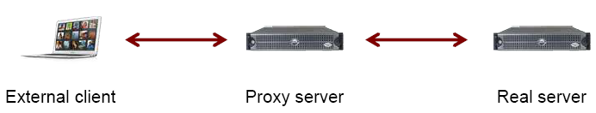
Proxies
Running either on dedicated hardware or as software on a general-purpose machine.
A proxy server may act as a firewall by responding to input packets (connection requests) in the manner of an application, while blocking other packets.
A proxy server is a gateway from one network to another for a specific network application, in the sense that it functions as a proxy on behalf of the network user.

Slide 34
Network Address Translation
Firewalls often have network address translation (NAT) functionality, and the hosts protected behind a firewall commonly have addresses in the "private address range“
Firewalls often have such functionality to hide the true address of protected hosts.
Originally, the NAT function was developed to address the limited number of IPv4 routable addresses that could be used or assigned to companies or individuals as well as reduce both the amount and therefore cost of obtaining enough public addresses for every computer in an organization.
Hiding the addresses of protected devices has become an increasingly important defense against network reconnaissance

Slide 35
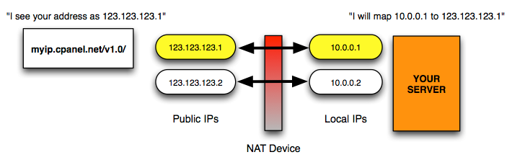

Slide 36
Intrusion Detection System [IDS]
An intrusion detection system (IDS) is a device or software application that monitors network or system activities for malicious activities or policy violations and produces reports to a management station.
Types of IDS
Network based (NIDS) intrusion detection systems
Host based (HIDS) intrusion detection systems.

Slide 37
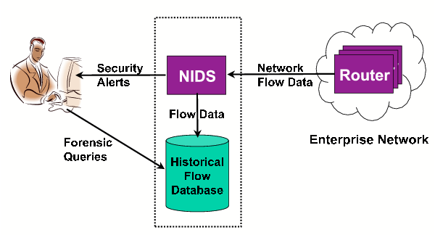
Network-based Intrusion Detection Systems (NIDS)
Network Intrusion Detection Systems (NIDS) are placed at a strategic point or points within the network to monitor traffic to and from all devices on the network)

Slide 38
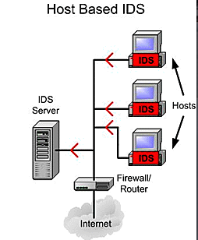
Host based (HIDS) intrusion detection systems
Host Intrusion Detection Systems (HIDS) run on individual hosts or devices on the network.
A HIDS monitors the inbound and outbound packets from the device only and will alert the user or administrator if suspicious activity is detected.

Slide 39
Statistical anomaly-based Technique
An IDS which is anomaly based will monitor network traffic and compare it against an established baseline.
The baseline will identify what is “normal” for that network- what sort of bandwidth is generally used, what protocols are used, what ports and devices generally connect to each other- and alert the administrator or user when traffic is detected which is anomalous, or significantly different, than the baseline.
The issue is that it may raise a False Positive alarm for a legitimate use of bandwidth if the baselines are not intelligently configured

Slide 40
Signature-based Technique
A signature-based IDS will monitor packets on the network and compare them against a database of signatures or attributes from known malicious threats.
This is similar to the way most antivirus software detects malware.
The issue is that there will be a lag between a new threat being discovered in the wild and the signature for detecting that threat being applied to the IDS.
During that lag time the IDS would be unable to detect the new threat.

Slide 41
Alert Type
True Positive: : Attack – Alert
A legitimate attack which triggers an IDS to produce an alarm
False Positive: : No attack – Alert
An event signaling an IDS to produce an alarm when no attack has taken place
False Negative: : Attack - No Alert
When no alarm is raised when an attack has taken place
True Negative: : No attack - No Alert
An event when no attack has taken place and no detection is made

Slide 42
DN
Any Questions?

