Slide 1


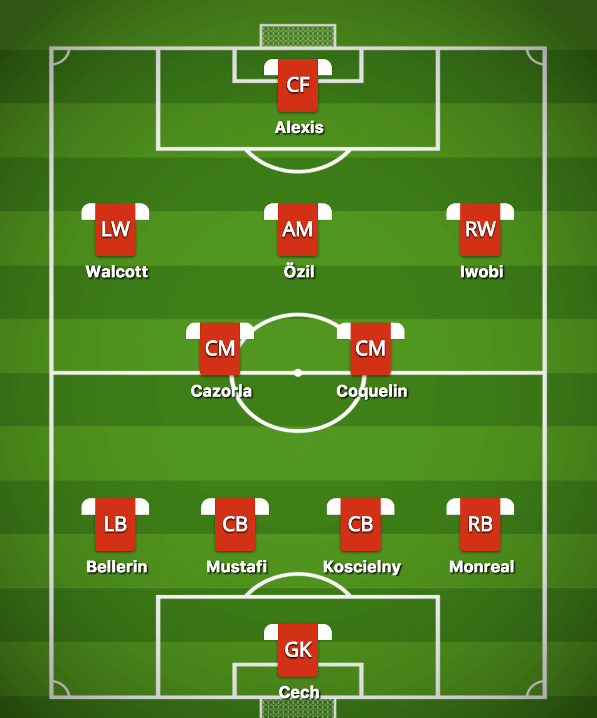
FORMATION
Starting Line Up
Substitution
Overview
Select Formation
4 - 4 - 2
4 - 2 – 3 - 1
4 - 4 - 2
4 - 4 - 2
4 - 4 - 2
4 - 4 - 2
4 - 4 - 2
4 - 4 - 2
4 - 4 - 2
Next >>

Slide 2
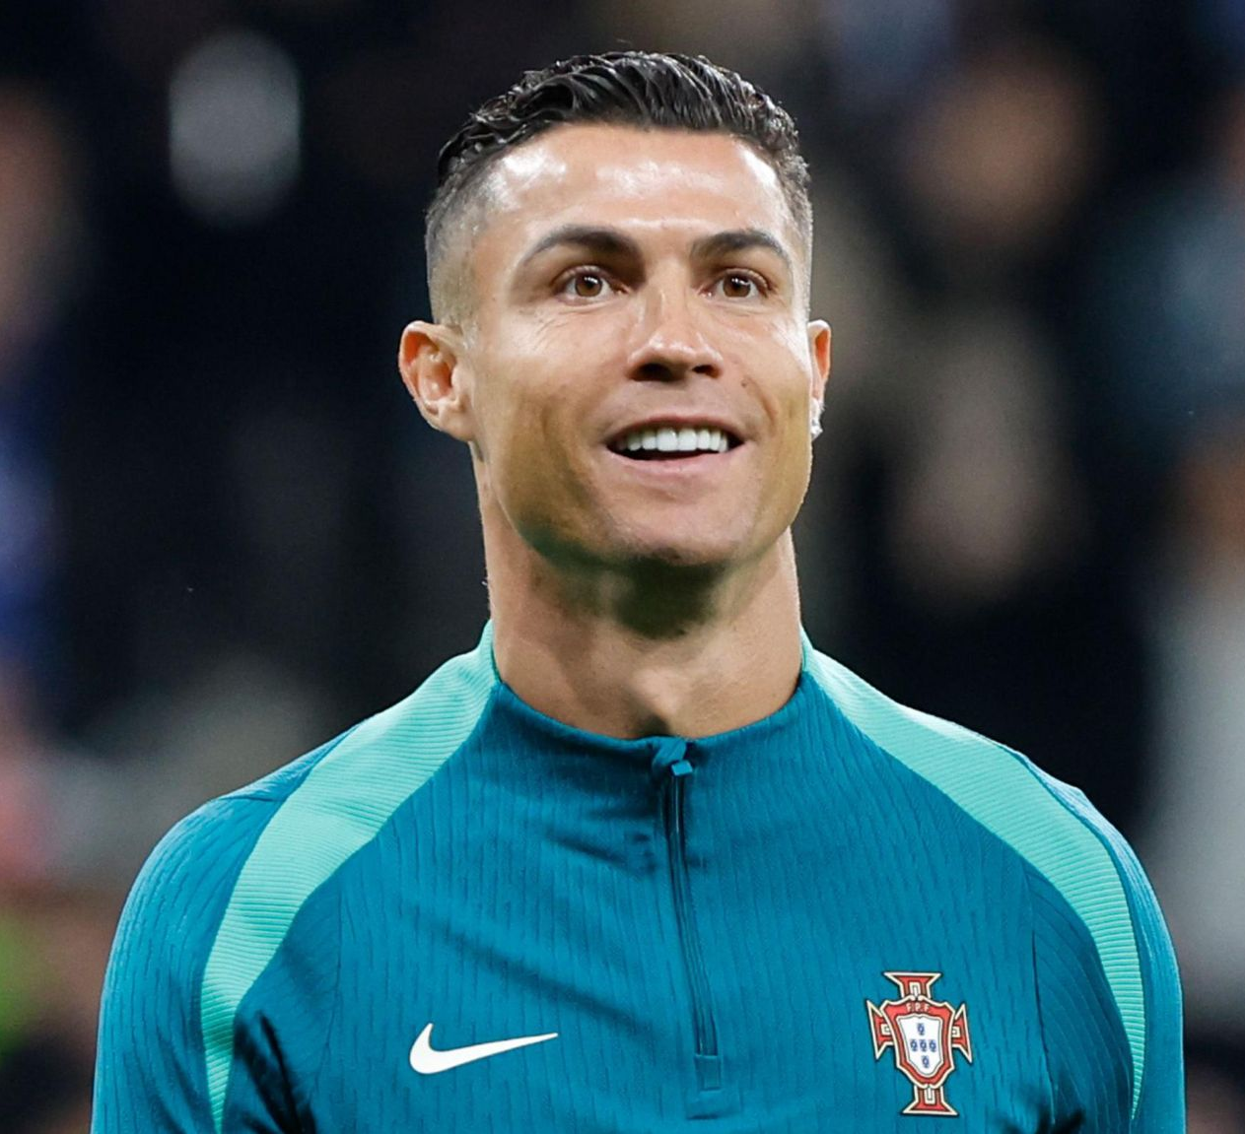
STARTING LINE-UP
Formation
Substitution
Overview
DMF
Search
position | Name
GK | Buffon
RCB | Pepe
LCB | Ramos
RB | Carvajal
LB | Alaba
DMF | Zidane
AMF | Modric
RW | Valverde
LW | Bellingham
RF | Vinicius
LF | Rodrigo
X
Ronaldo
Ronaldo
Ronaldo
Ronaldo
X
X
X
Post
DMF/LF
Post
DMF/LF
Post
DMF/LF
Post
DMF/LF
X
Age
27
Age
27
Age
27
Age
27
X
Ronaldo
Ronaldo
Ronaldo
Ronaldo
X
X
X
X
Post
DMF/LF
Post
DMF/LF
Post
DMF/LF
Post
DMF/LF
Age
27
Age
27
Age
27
Age
27
X
Next >>

Slide 3
SUBSTITUTION
Formation
Starting Line Up
Overview
DMF
Search
position | Name
GK | Buffon
RCB | Pepe
LCB | Ramos
RB | Carvajal
LB | Alaba
X
Ronaldo
Ronaldo
Ronaldo
Ronaldo
X
X
X
Post
DMF/LF
Post
DMF/LF
Post
DMF/LF
Post
DMF/LF
Age
27
Age
27
Age
27
Age
27
Ronaldo
Ronaldo
Ronaldo
Ronaldo
Post
DMF/LF
Post
DMF/LF
Post
DMF/LF
Post
DMF/LF
Age
27
Age
27
Age
27
Age
27
Next >>

Slide 4
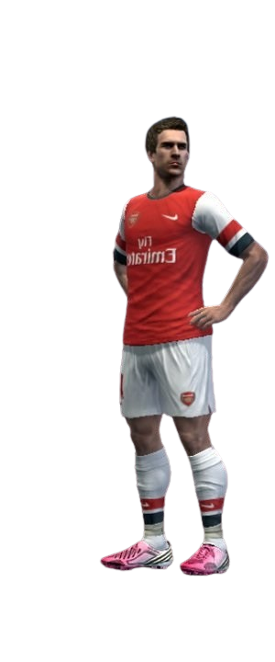
OVERVIEW
Formation
Starting Line Up
Substitution
position | Name
GK | Buffon
RCB | Pepe
LCB | Ramos
RB | Carvajal
LB | Robertson
DMF | Zidane
AMF | Modric
RW | Valverde
LW | Bellingham
RF | Vinicius
LF | Rodrigo
Subs
Leo
Paredes
3. Diaz
4. Romero

