Slide 1

Instructor: umerfarooq
1.1
Copyright © The McGraw-Hill Companies, Inc. Permission required for reproduction or display.
Notes:
1.#

Slide 2
1-1 DATA COMMUNICATIONS
The term telecommunication means communication at a distance. The word data refers to information presented in whatever form is agreed upon by the parties creating and using the data. Data communications are the exchange of data between two devices via some form of transmission medium such as a wire cable.
Topics discussed in this section:
Components of a data communications system
Data Flow
1.2
Notes:
1.#

Slide 3
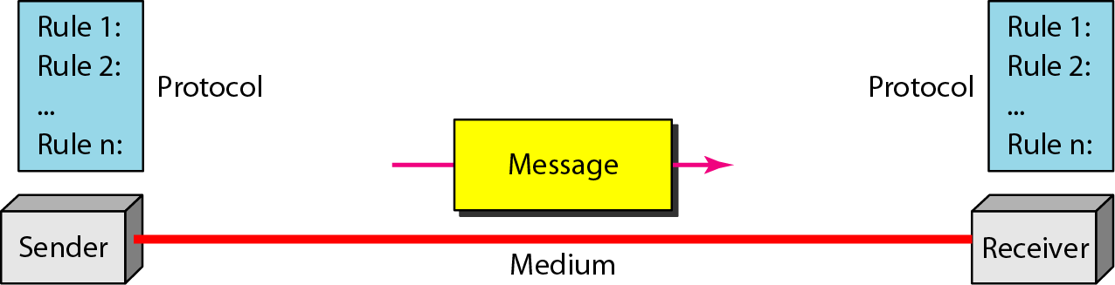
Figure 1.1 Components of a data communication system
1.3
Notes:
1.#

Slide 4
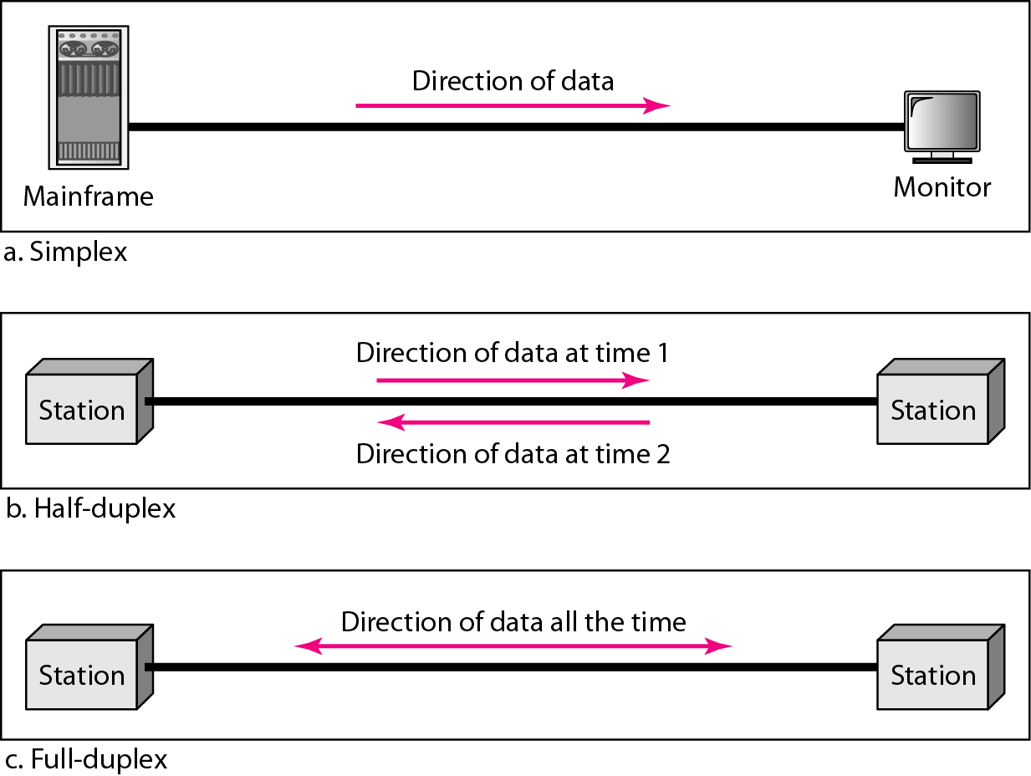
Figure 1.2 Data flow (simplex, half-duplex, and full-duplex)
1.4
Notes:
1.#

Slide 5
1-2 NETWORKS
A network is a set of devices (often referred to as nodes) connected by communication links. A node can be a computer, printer, or any other device capable of sending and/or receiving data generated by other nodes on the network. A link can be a cable, air, optical fiber, or any medium which can transport a signal carrying information.
Topics discussed in this section:
Network Criteria
Physical Structures
Categories of Networks
1.5
Notes:
1.#

Slide 6
1-2 NETWORKS
These are physical devices that facilitate the networking process.
End Devices
Computers (PCs, laptops), Server, Printers.
Network Devices
Router, Switch, Hub, Access point, Modem, Firewall.
Media
Wired Media (Cat5e, Cat6, Optical fiber, Ethernet)
Wireless (Radio waves, microwaves, or infrared signals)
1.6
Notes:
1.#

Slide 7
Network Criteria
Performance
Depends on Network Elements
Measured in terms of Delay and Throughput
Reliability
Failure rate of network components
Measured in terms of availability/robustness
Security
Data protection against corruption/loss of data due to:
Errors
Malicious users
1.7
Notes:
1.#

Slide 8
Physical Structures
Type of Connection
Point to Point - single transmitter and receiver
Multipoint - multiple recipients of single transmission
Physical Topology
Connection of devices
Type of transmission - unicast, mulitcast, broadcast
1.8
Notes:
1.#

Slide 9
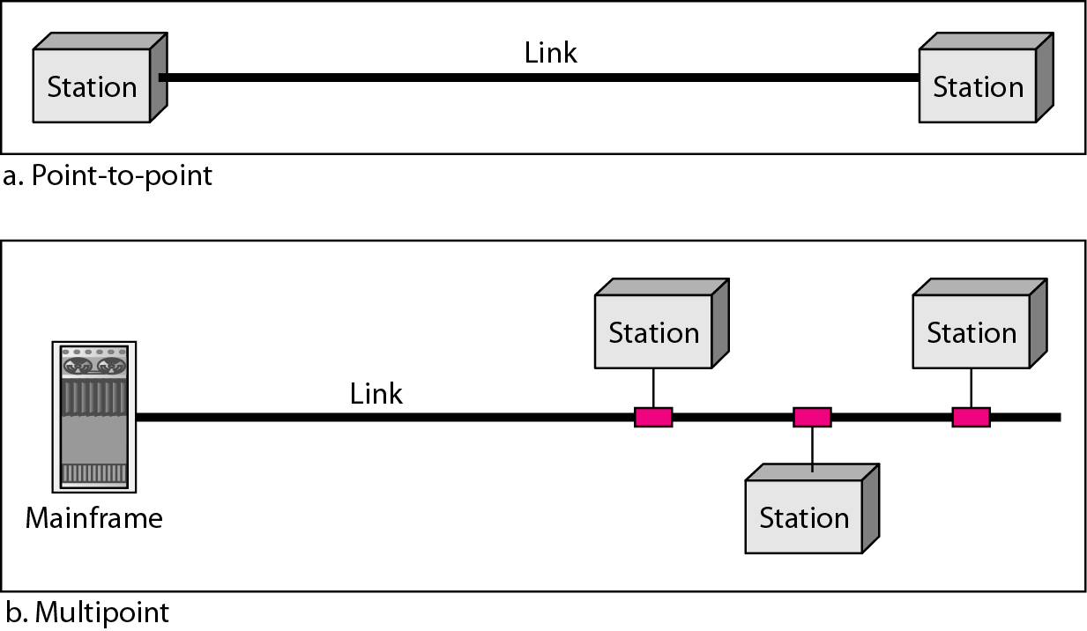
Figure 1.3 Types of connections: point-to-point and multipoint
1.9
Notes:
1.#

Slide 10
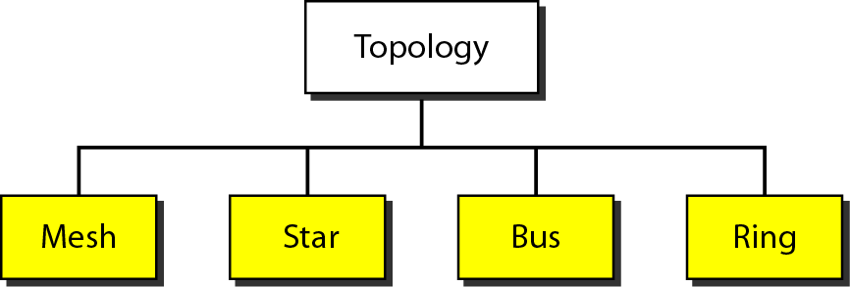
Figure 1.4 Categories of topology
1.10
Notes:
1.#

Slide 11
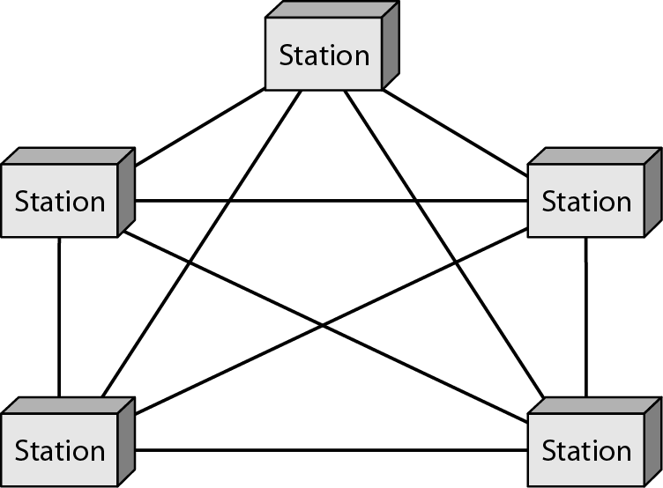
Figure 1.5 A fully connected mesh topology (five devices)
1.11
Notes:
1.#

Slide 12
Mesh Topology
Advantages
High-level traffic management of mesh topology.
Failure of one single device does not affect the network:
Data transmission consistency
Disadvantages
Increased workload in each node
High cost
Complex network
1.12
Notes:
1.#

Slide 13
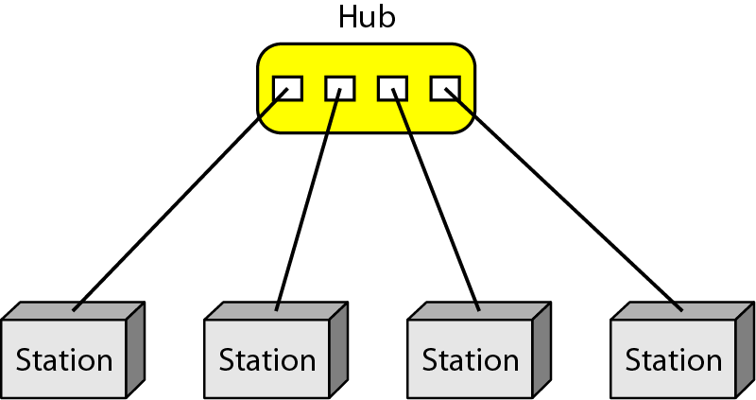
Figure 1.6 A star topology connecting four stations
1.13
Notes:
1.#

Slide 14
Star topology
Advantages
Centralized network.
No point-to-point connections.
Multiple stars can be created to extend the network’s reach.
Very reliable.
Disadvantages
Everything depends on the central device.
1.14
Notes:
1.#

Slide 15
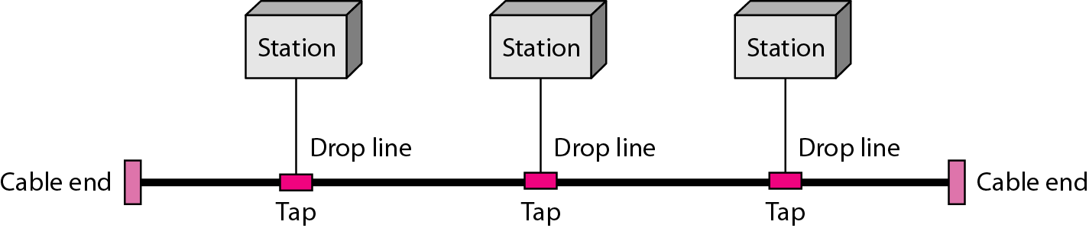
Figure 1.7 A bus topology connecting three stations
1.15
Notes:
1.#

Slide 16
Bus topology
Advantages
Low Cost
Easy to Expand
Easy to Troubleshoot.
Disadvantages
Limited Cable Length
Single Point of Failure
Limited Number of Devices
1.16
Notes:
1.#

Slide 17
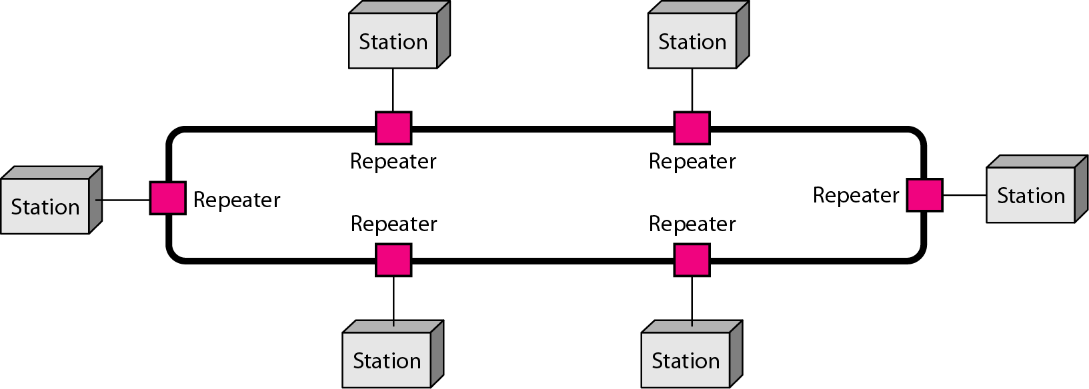
Figure 1.8 A ring topology connecting six stations
1.17
Notes:
1.#

Slide 18
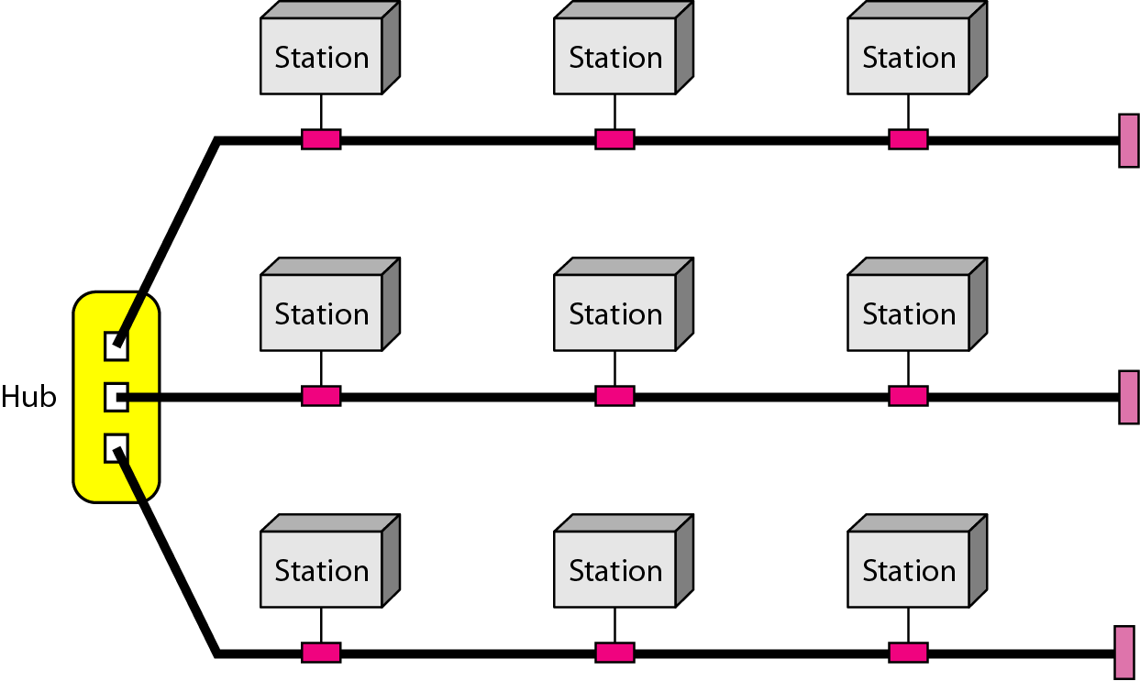
Figure 1.9 A hybrid topology: a star backbone with three bus networks
1.18
Notes:
1.#

Slide 19
Categories of Networks
Local Area Networks (LANs)
Short distances
Designed to provide local interconnectivity
Wide Area Networks (WANs)
Long distances
Provide connectivity over large areas
Metropolitan Area Networks (MANs)
Provide connectivity over areas such as a city, a campus
1.19
Notes:
1.#

Slide 20
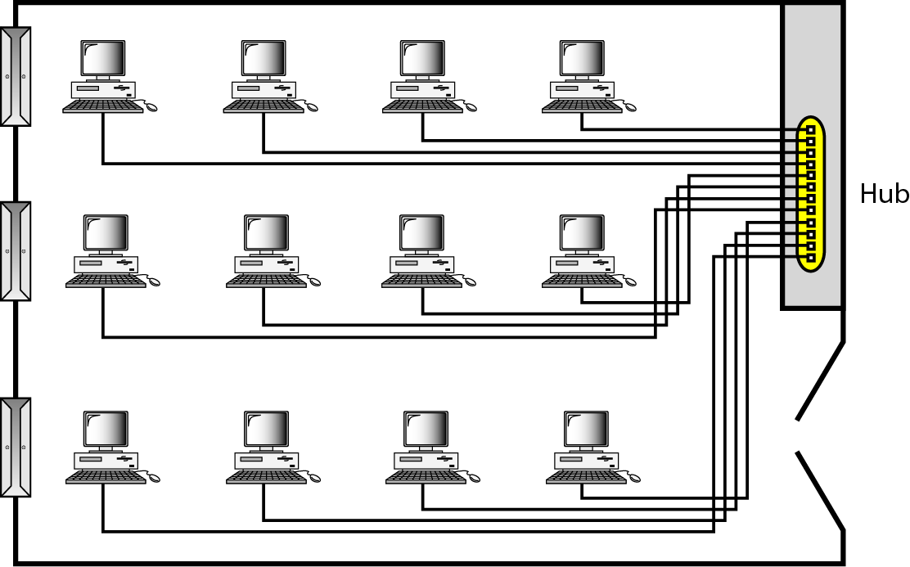
Figure 1.10 An isolated LAN connecting 12 computers to a hub in a closet
1.20
Notes:
1.#

Slide 21
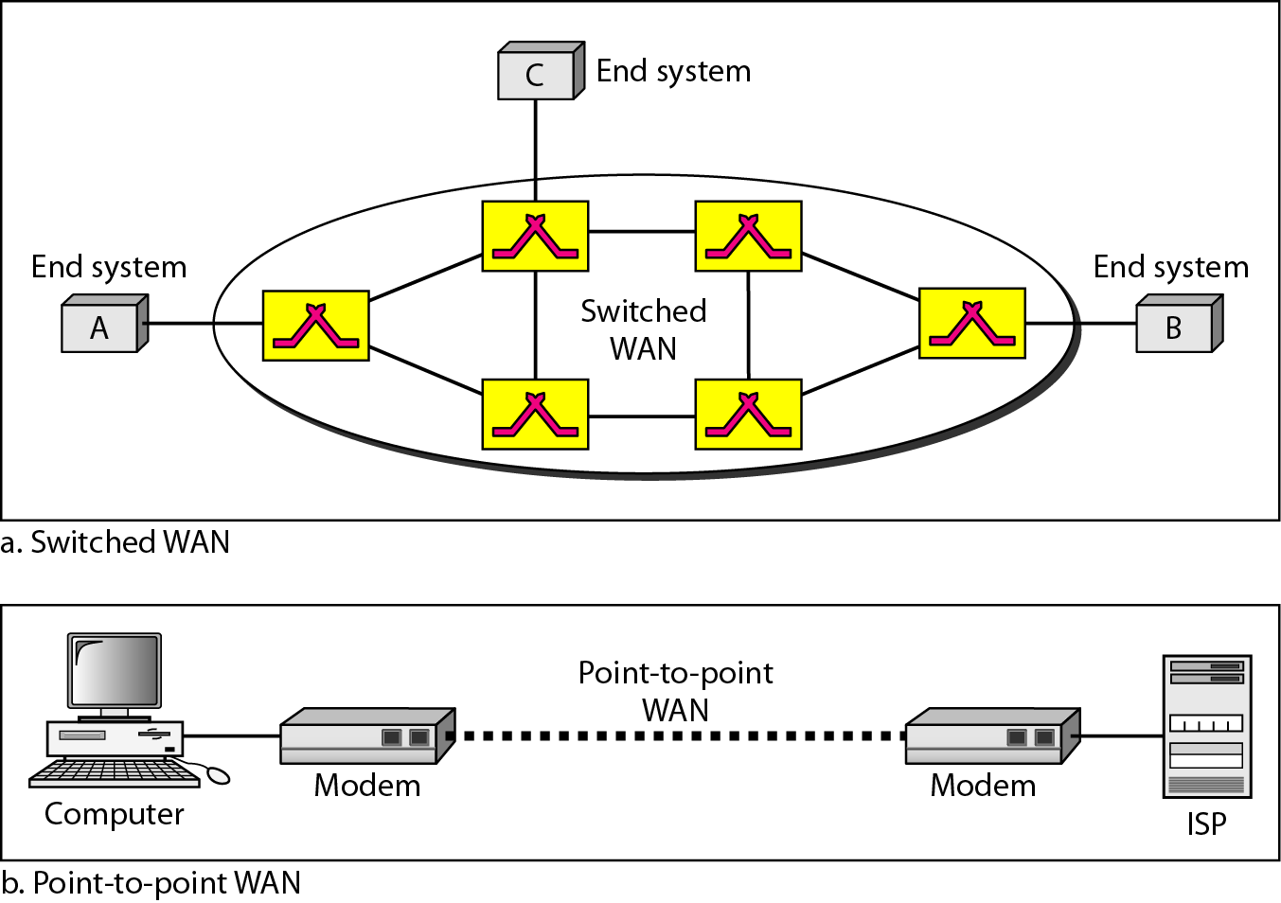
Figure 1.11 WANs: a switched WAN and a point-to-point WAN
1.21
Notes:
1.#

Slide 22
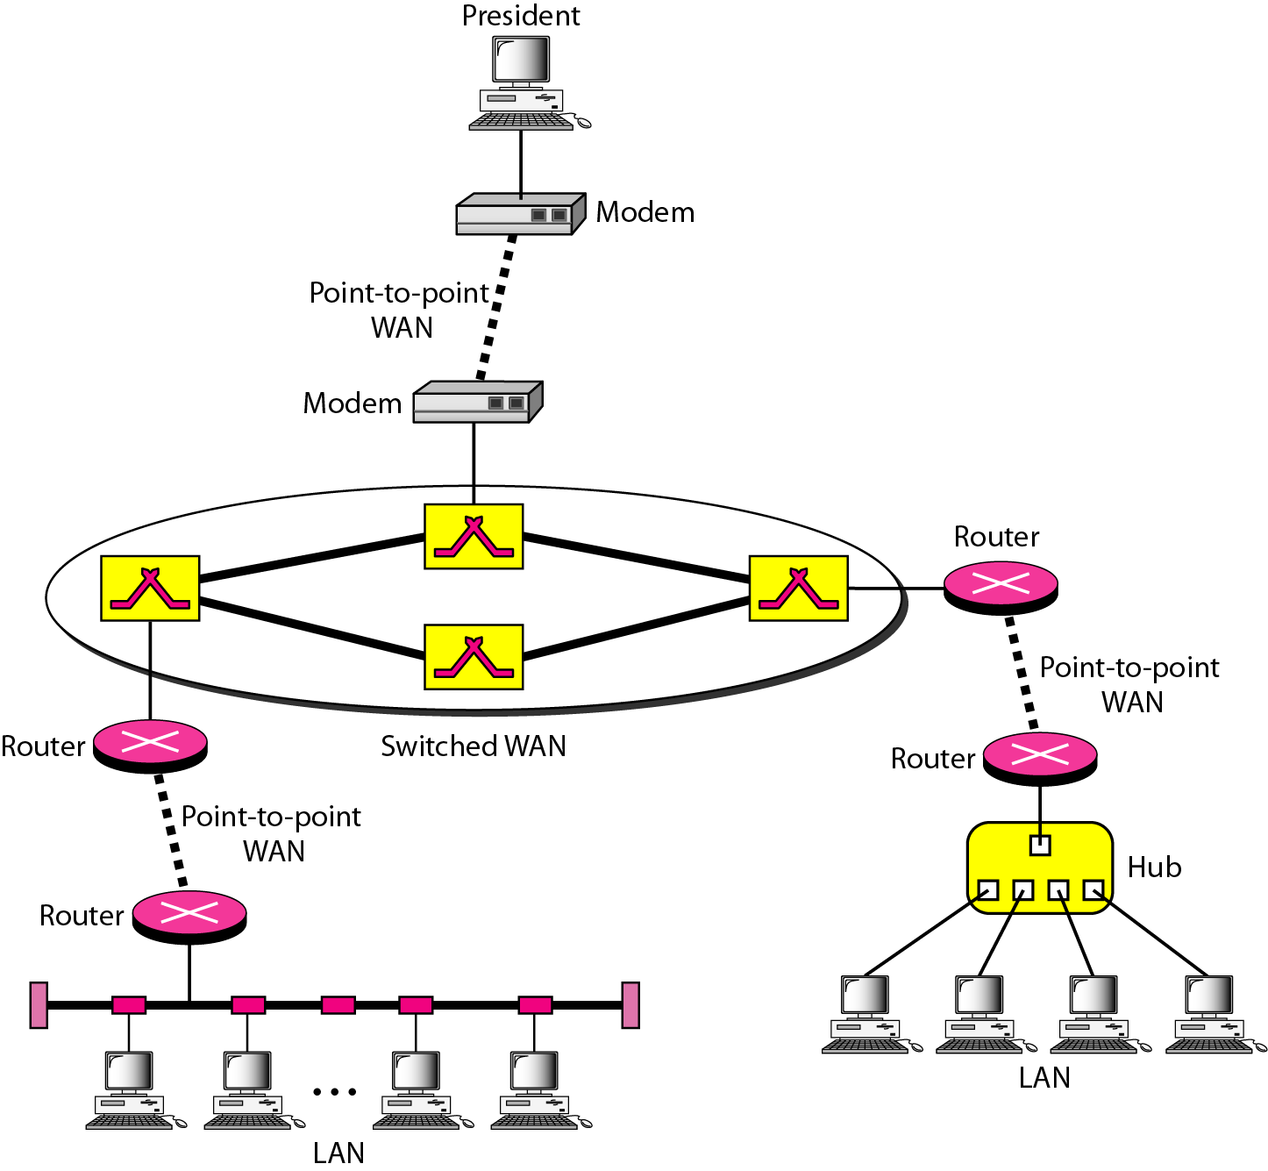
Figure 1.12 A heterogeneous network made of four WANs and two LANs
1.22
Notes:
1.#

