Slide 1
Algorithms and Problem Solving

Slide 2
The Concept of Algorithms
An algorithm is a step-by-step procedure or formula for solving a problem.
Well-defined computational procedure that takes input, processes it, and produces output.
Backbone of computer science for automating tasks.

Slide 3
Algorithms and Role of Algorithms
Algorithms help automate tasks and solve problems efficiently.
Applications range from sorting data to complex AI calculations.

Slide 4
Representations and Discovery
Algorithms can be represented using pseudocode, flowcharts, and programming code.
Discovery involves recognizing patterns and generalizing solutions.

Slide 5
Iterative and Recursive
Iterative: Repeats steps until a condition is met (e.g., loops).
Recursive: Solves smaller instances of the same problem (e.g., factorial calculation).

Slide 6
Iterative Example: Factorial
Problem: Calculate factorial of a number (n!).
Iterative Pseudocode:
1. Initialize result = 1.
2. For i = 1 to n:
a. Multiply result by i.
3. Return result.

Slide 7
Recursive Example: Factorial
Problem: Calculate factorial of a number (n!).
Recursive Pseudocode:
1. Base Case: If n = 0, return 1.
2. Recursive Step: Return n * factorial(n - 1).

Slide 8
Efficiency and Correctness
Efficiency: Minimizes time and resources (Time and Space Complexity).
Correctness: Produces correct output for all valid inputs and terminates.

Slide 9
Algorithm Efficiency and Correctness
Problem: Check if a list is sorted.
Efficiency:
1. Time Complexity: O(n) - Check each element once.
2. Space Complexity: O(1) - No extra space needed.
Correctness:
1. For i from 1 to n-1, if list[i] < list[i-1], return False.
2. If loop completes, return True.

Slide 10
Simple Algorithm Example
Problem: Find the maximum number in a list.
Steps:
1. Start with the first number as the maximum.
2. Compare each number with the maximum.
3. Update the maximum if the current number is larger.
4. Return the maximum.

Slide 11
Program Development Cycle and Tools
Steps: Problem Definition, Design, Coding, Testing, Debugging, Maintenance.
Tools: IDEs (e.g., Visual Studio, PyCharm), Debuggers, Git.

Slide 12
Machine Language
Lowest-level programming language with binary code (1s and 0s).
Directly understood by hardware.

Slide 13
Assembly Language
Low-level language with mnemonics representing machine instructions.
Closer to hardware but easier to understand than binary.

Slide 14
High-Level Language
Abstracted from hardware, designed for ease of use.
Examples: Python, C++, Java.

Slide 15
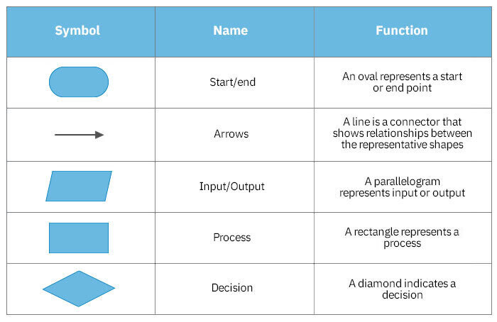
Flowcharts
Diagrams showing the flow of control in a program.
Uses symbols to represent operations and arrows for flow.

Slide 16
Pseudocode
Simplified, human-readable representation of algorithms.
Focuses on logic without syntax details.
function factorial(n): result = 1 for i = 1 to n do: result = result * i return result

Slide 17
Tips to Improve Logic in Programming
Break down problems into smaller parts.
Practice regularly and learn algorithms.
Write pseudocode before coding.
Use debugging tools and optimize solutions.

