Slide 1
1
RAGの基礎知識
©2026 OpenUp Next Engineer Inc. 7

Slide 2
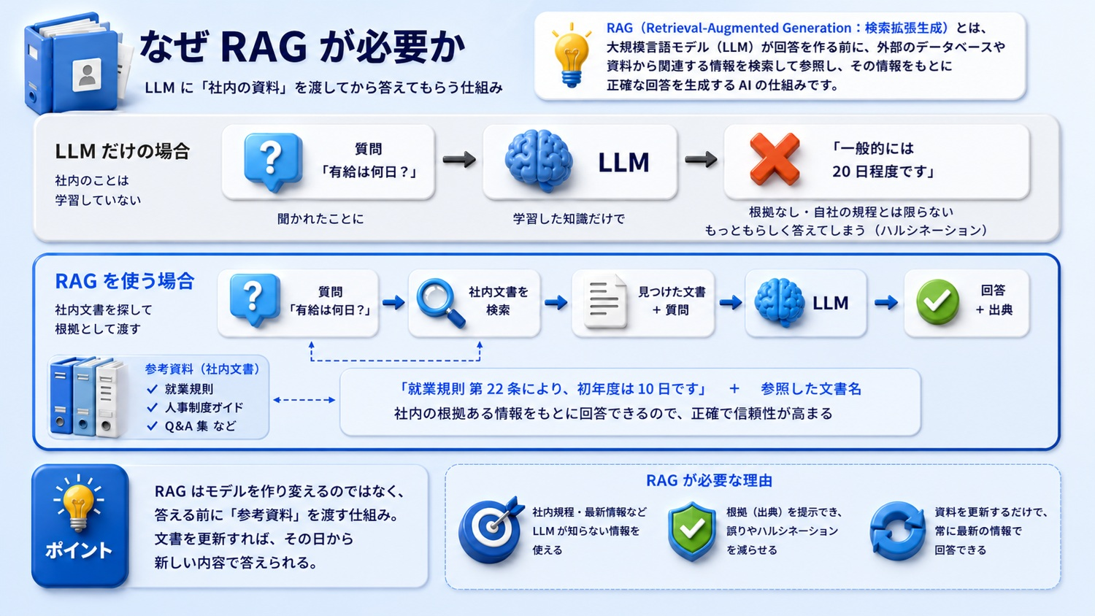
©2026 OpenUp Next Engineer Inc. 7

Slide 3
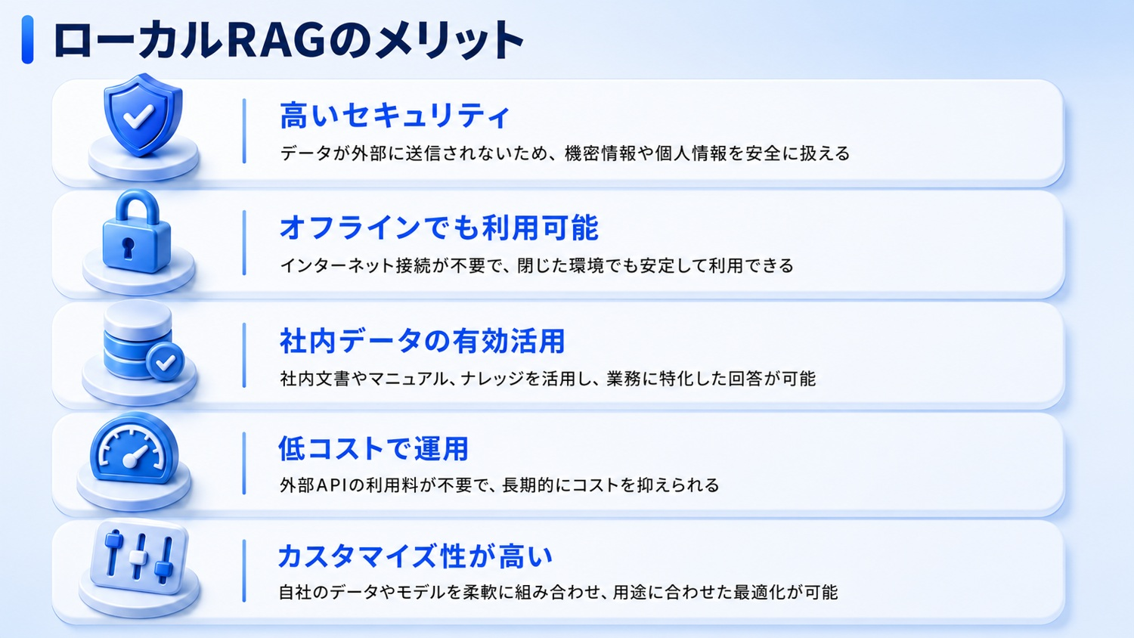
©2026 OpenUp Next Engineer Inc. 7

Slide 4
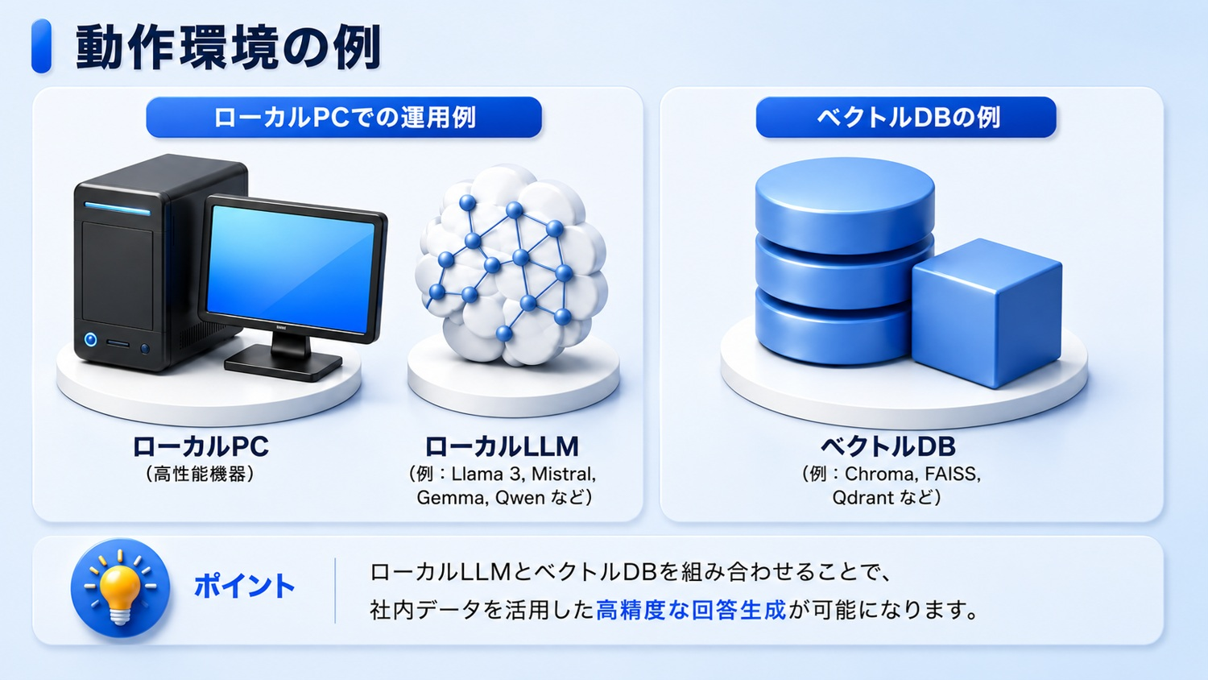
©2026 OpenUp Next Engineer Inc. 7

Slide 5
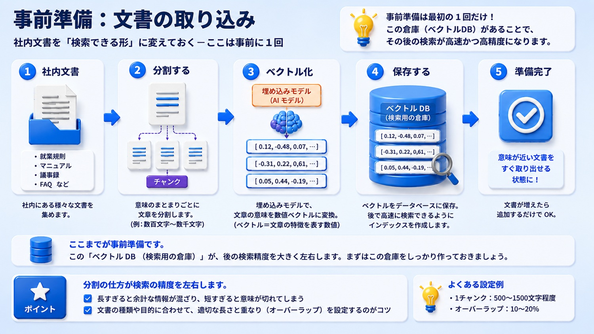
©2026 OpenUp Next Engineer Inc. 7

Slide 6
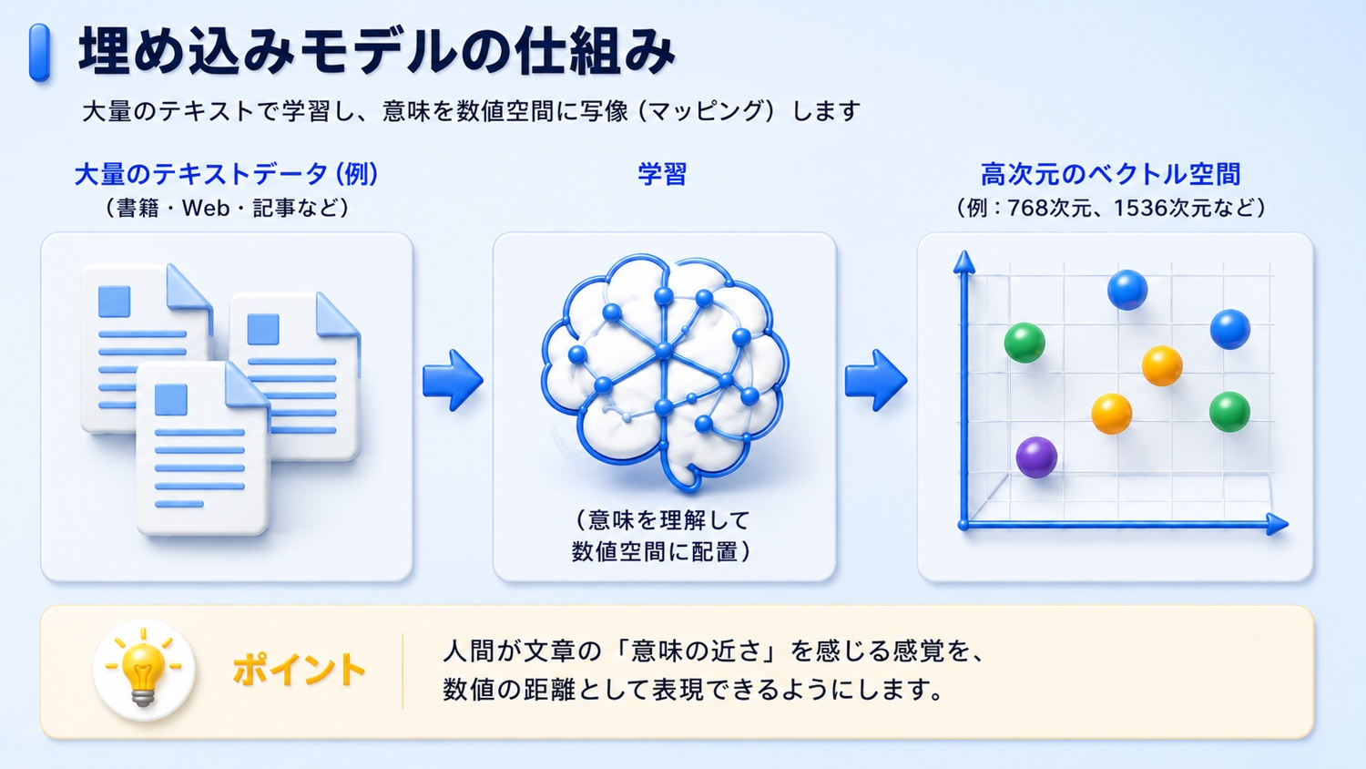
©2026 OpenUp Next Engineer Inc. 7

Slide 7
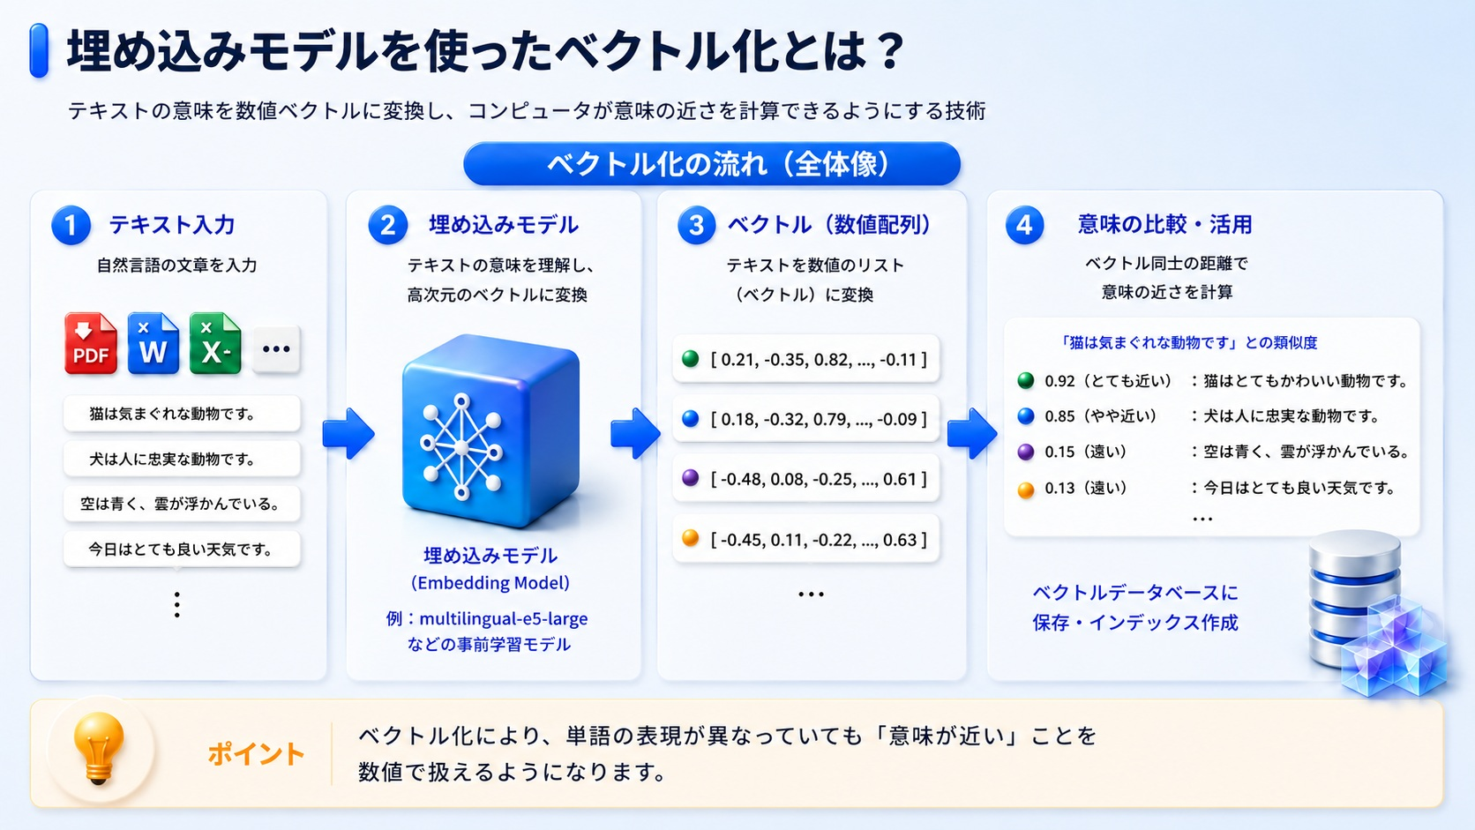
©2026 OpenUp Next Engineer Inc. 7

Slide 8
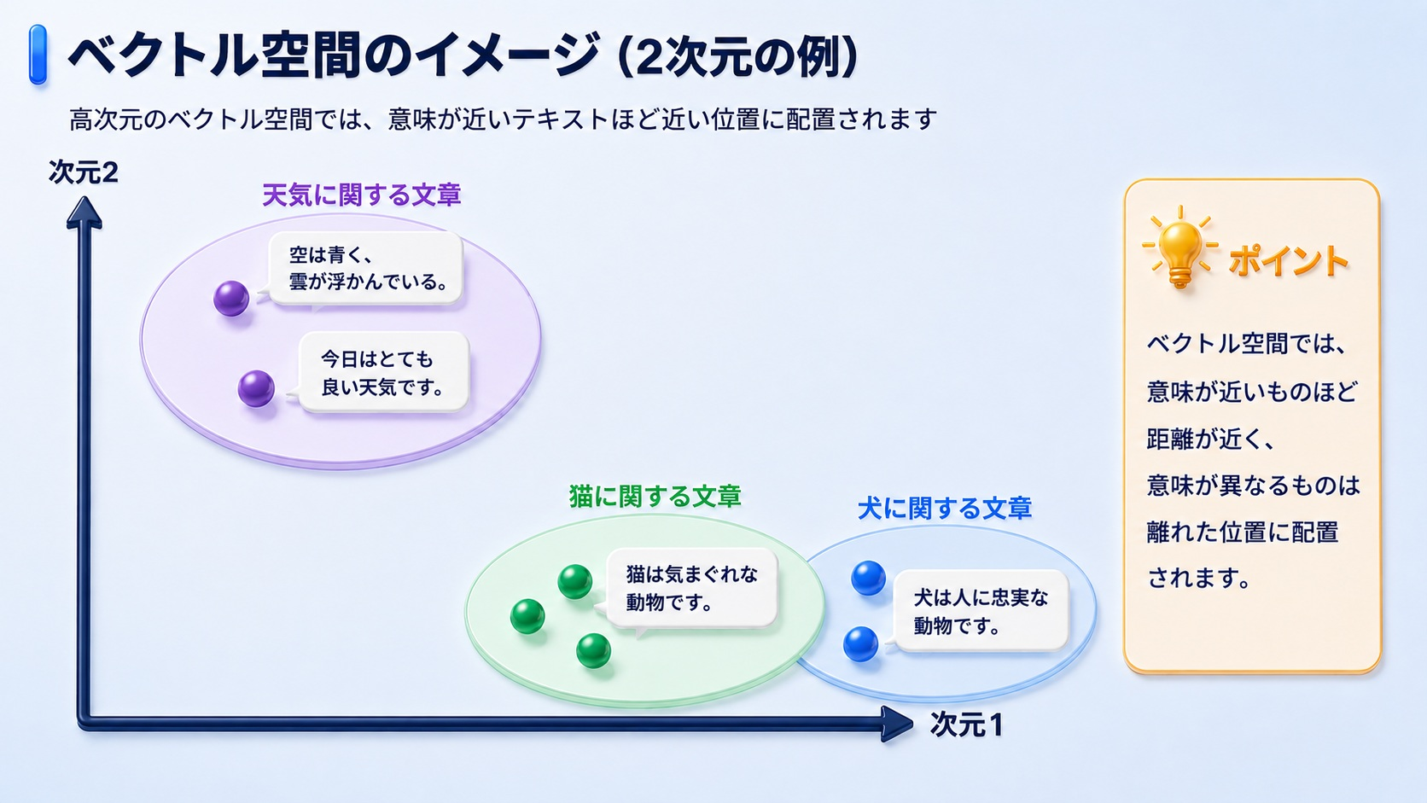
©2026 OpenUp Next Engineer Inc. 7

Slide 9
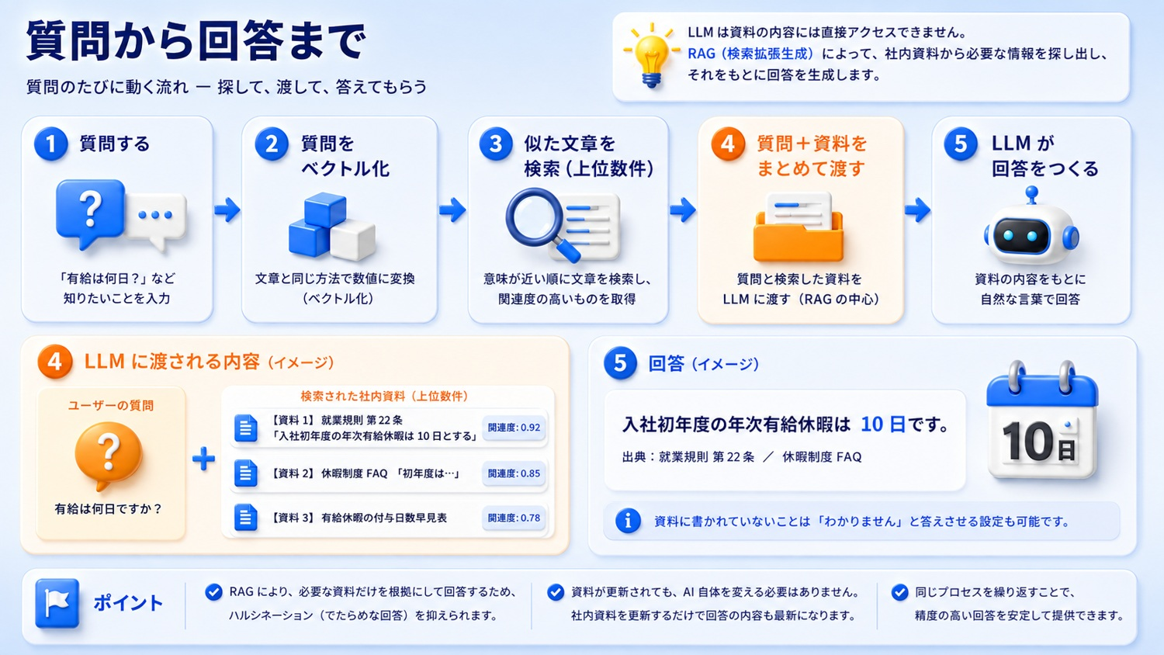
©2026 OpenUp Next Engineer Inc. 7

Slide 10
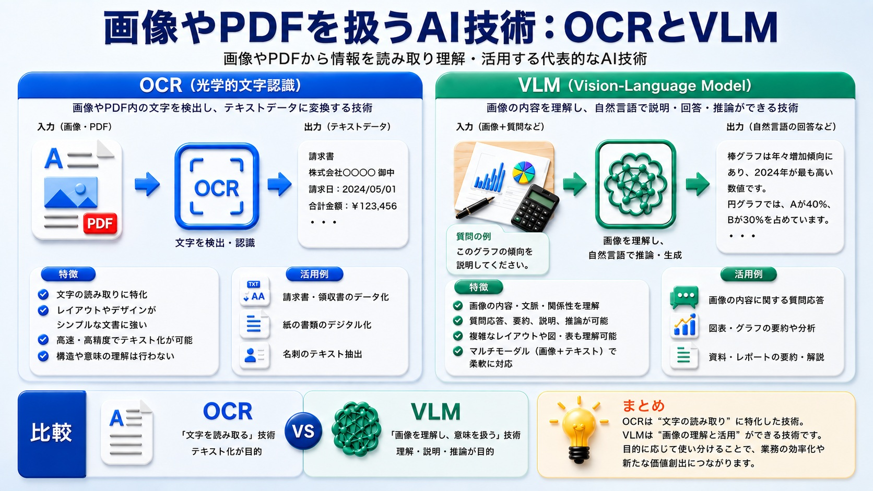
©2026 OpenUp Next Engineer Inc. 7

Slide 11
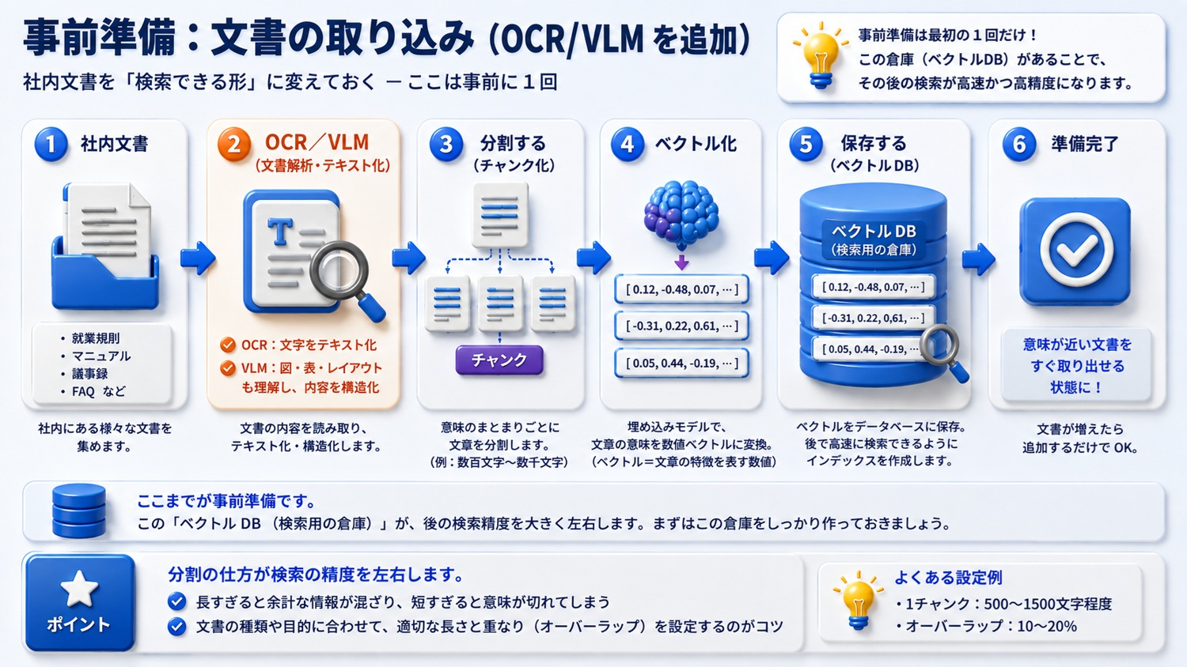
©2026 OpenUp Next Engineer Inc. 7

Slide 12
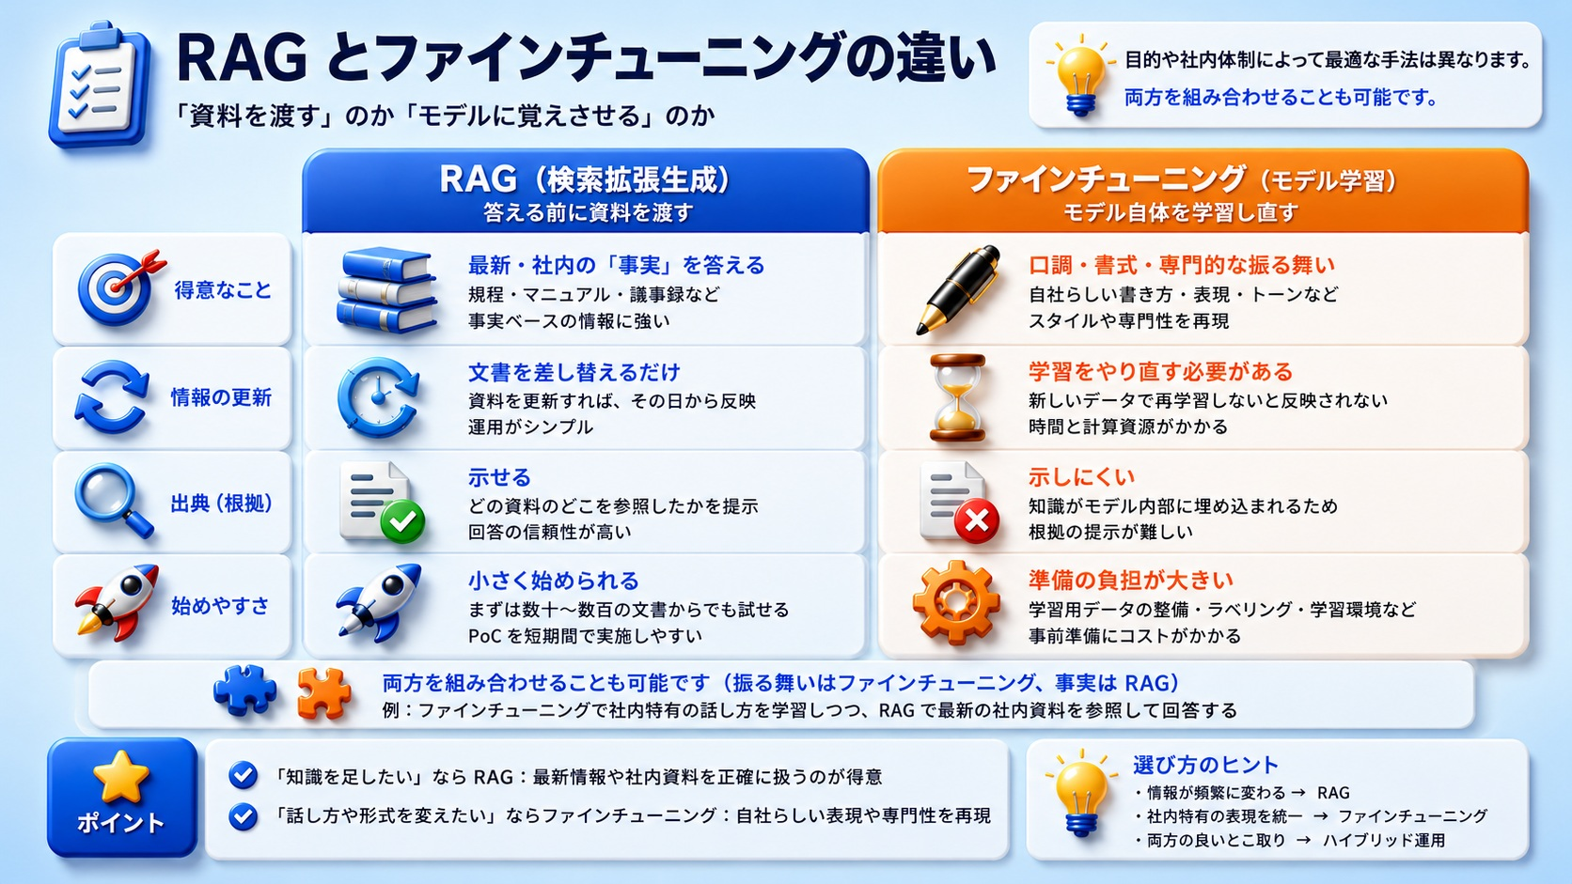
©2026 OpenUp Next Engineer Inc. 7

Slide 13
2
RAGの検索精度を上げる仕組み
©2026 OpenUp Next Engineer Inc. 7

Slide 14
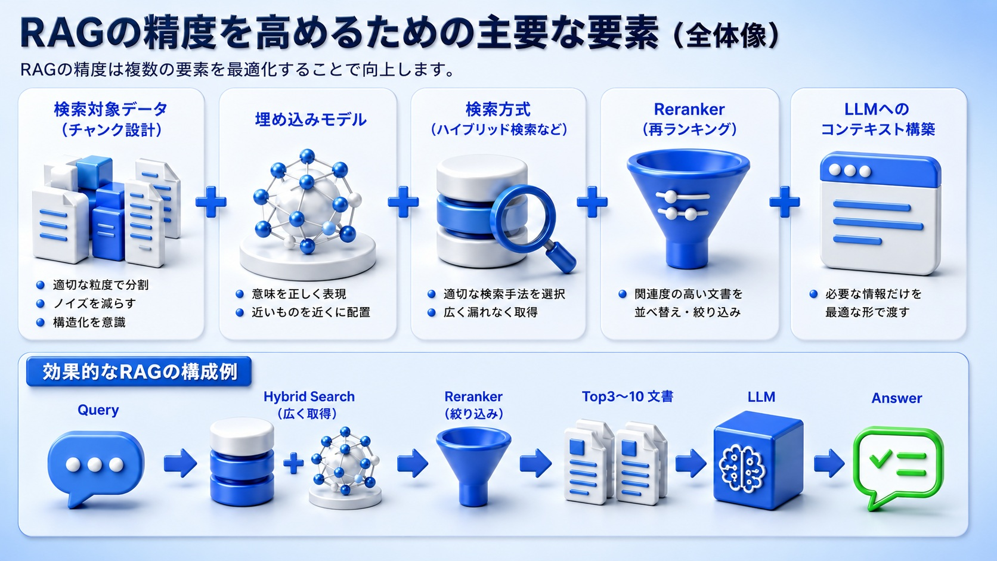
©2026 OpenUp Next Engineer Inc. 7

Slide 15
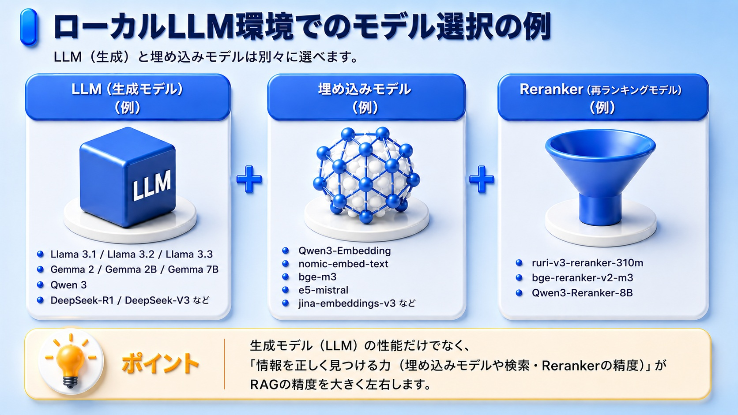
©2026 OpenUp Next Engineer Inc. 7

Slide 16
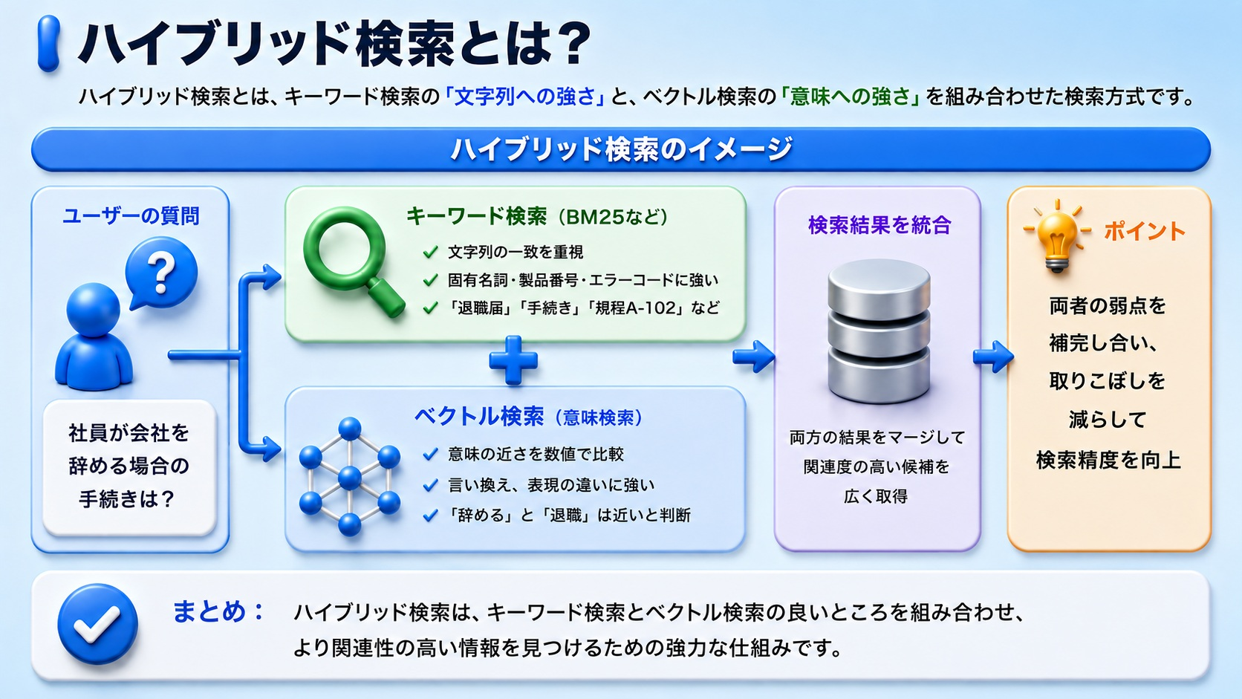
©2026 OpenUp Next Engineer Inc. 7

Slide 17
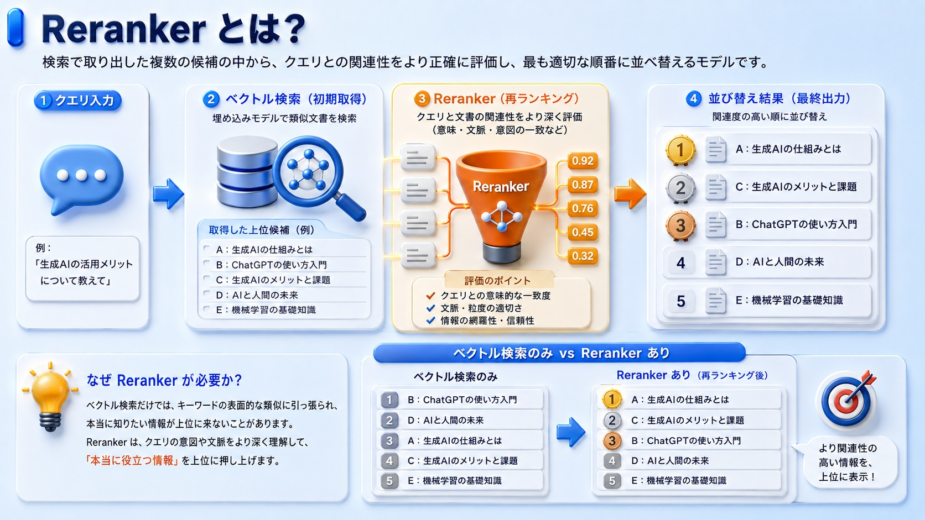
©2026 OpenUp Next Engineer Inc. 7

Slide 18
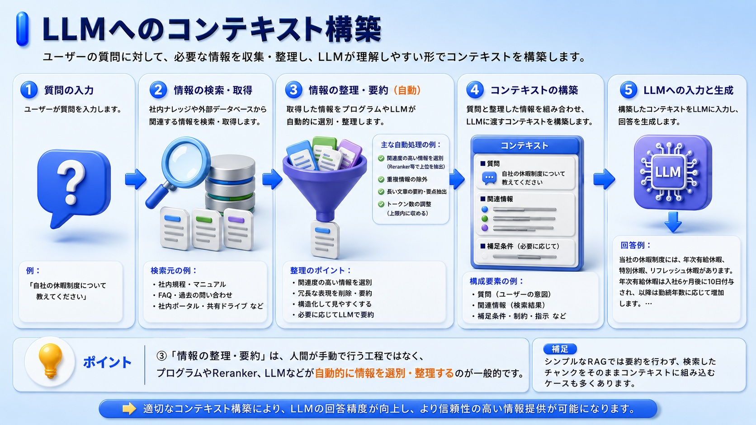
©2026 OpenUp Next Engineer Inc. 7

