Slide 1
1
ニューラルネットワークの基礎知識
©2026 OpenUp Next Engineer Inc. 7

Slide 2
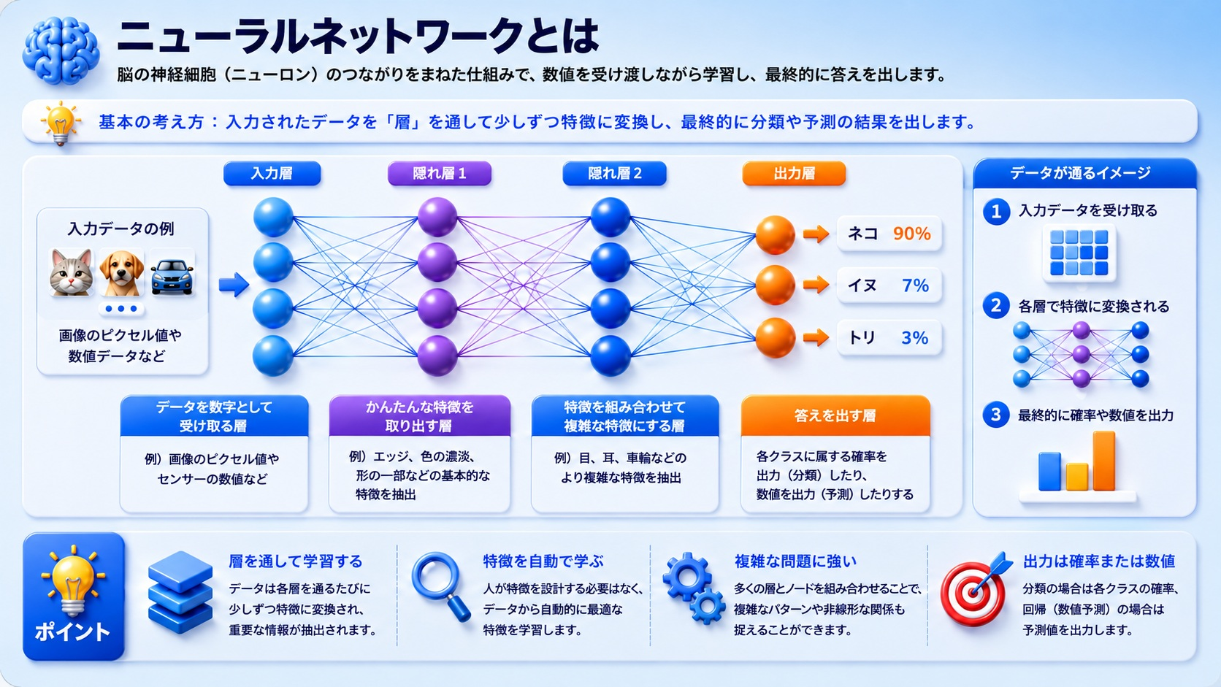
©2026 OpenUp Next Engineer Inc. 7

Slide 3
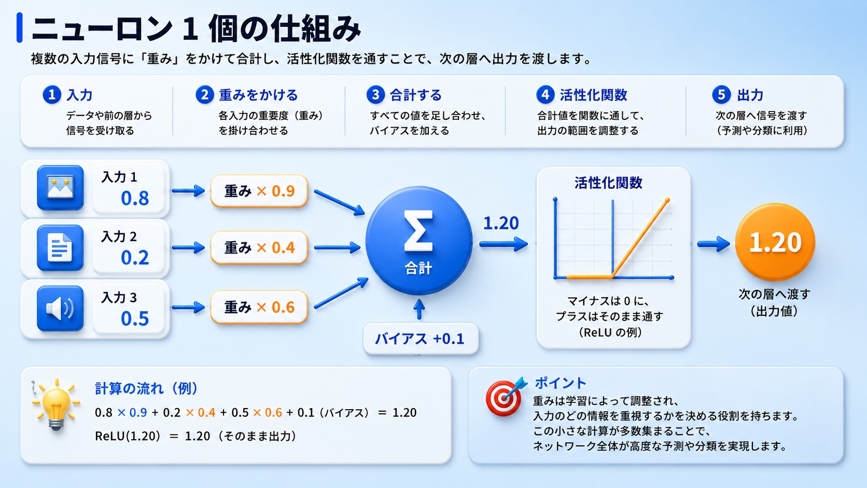
©2026 OpenUp Next Engineer Inc. 7

Slide 4
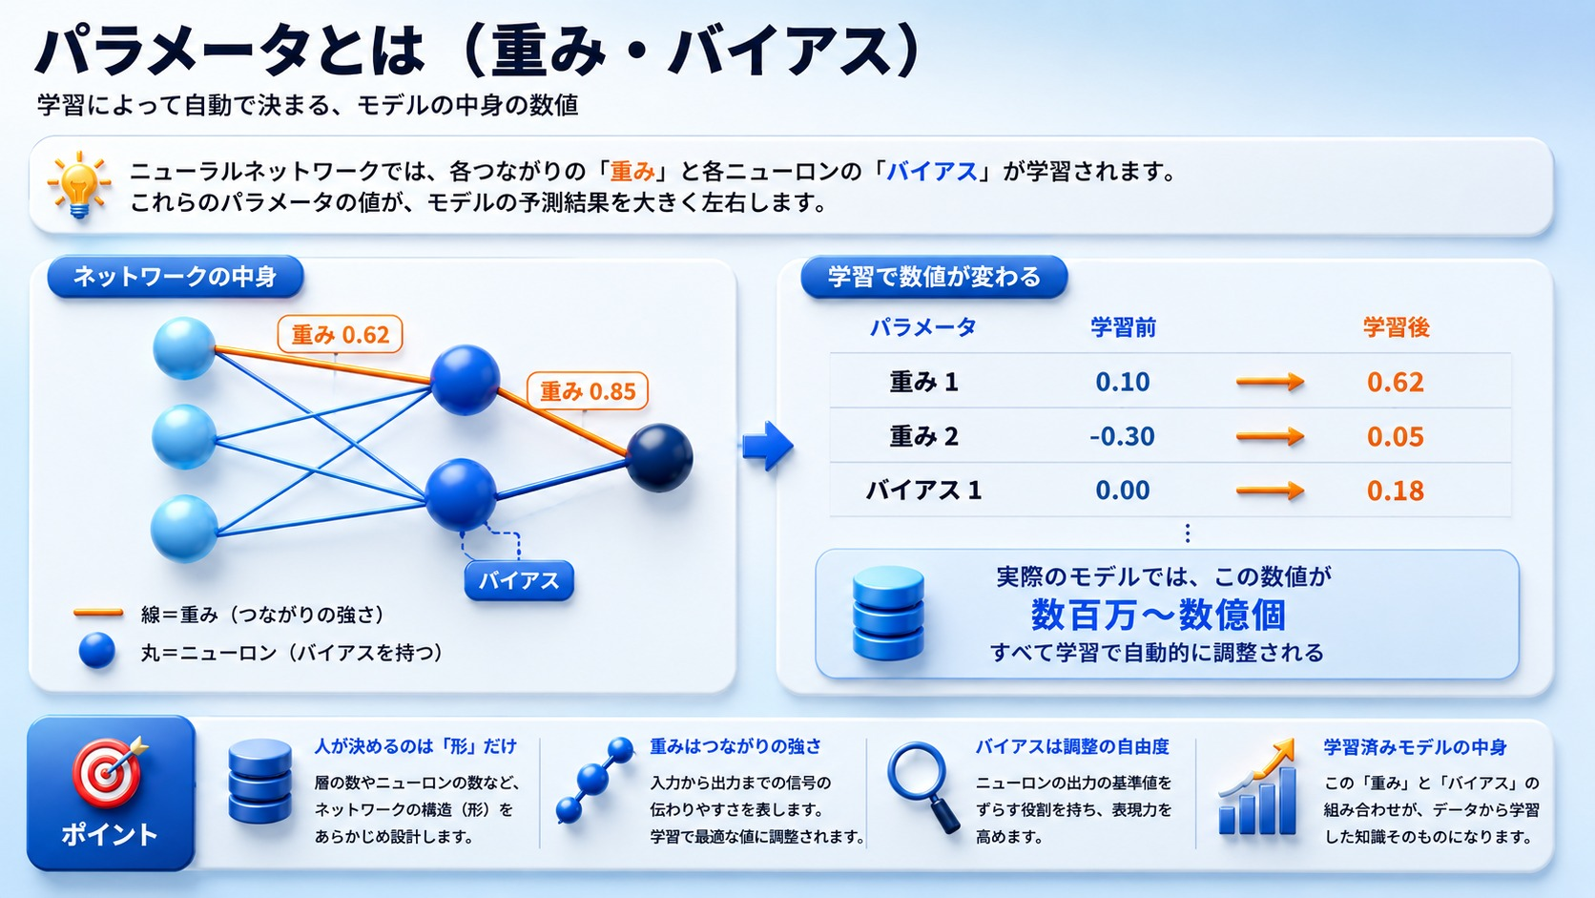
©2026 OpenUp Next Engineer Inc. 7

Slide 5
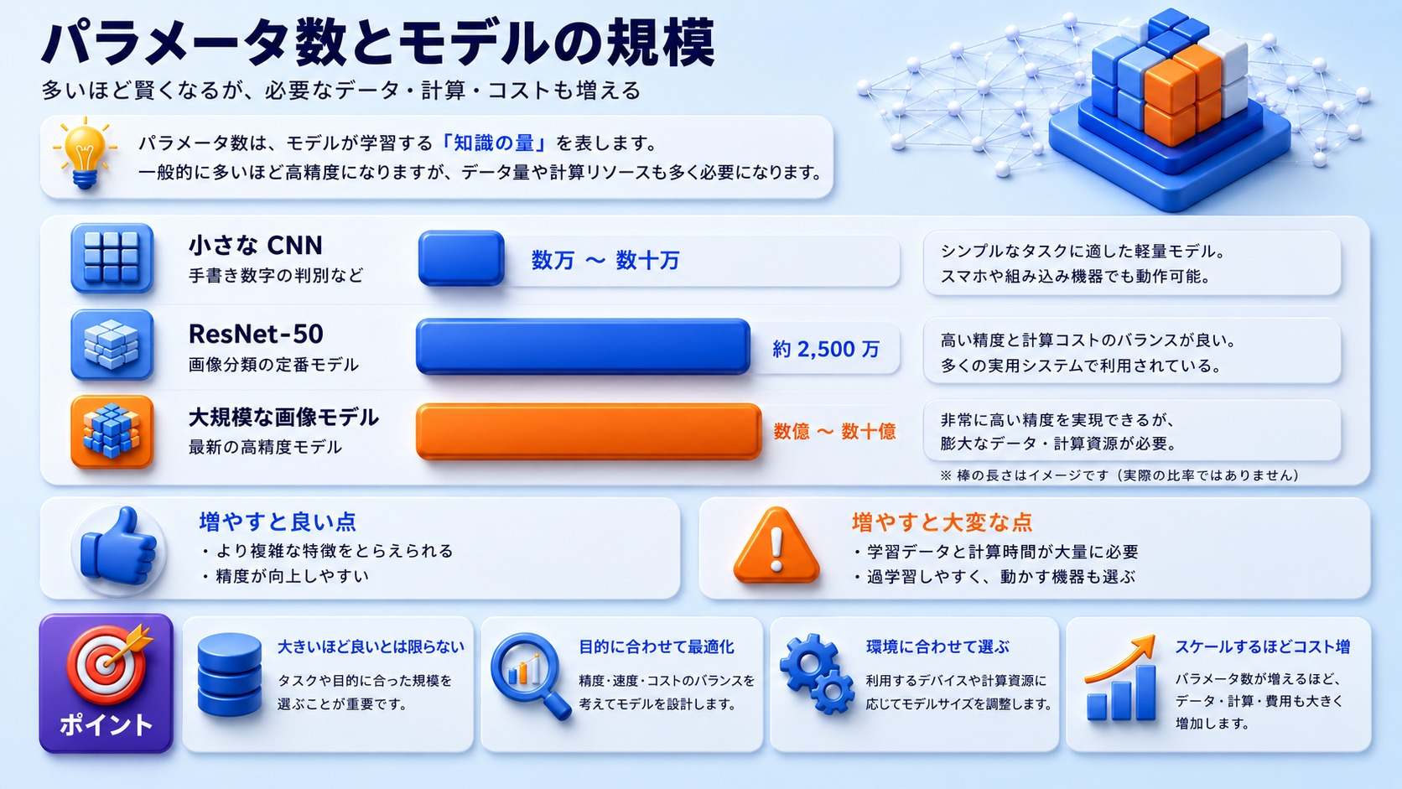
©2026 OpenUp Next Engineer Inc. 7

Slide 6
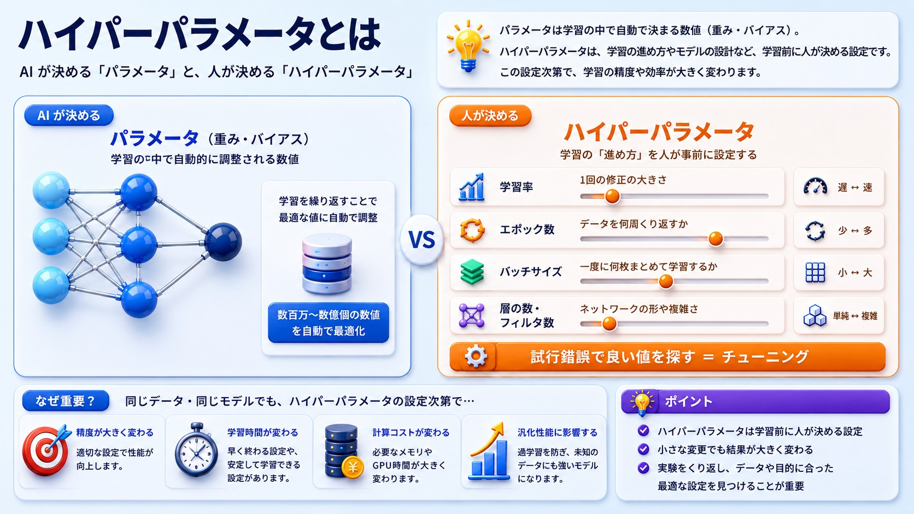
©2026 OpenUp Next Engineer Inc. 7

Slide 7
2
ニューラルネットワークの学習手法
©2026 OpenUp Next Engineer Inc. 7

Slide 8
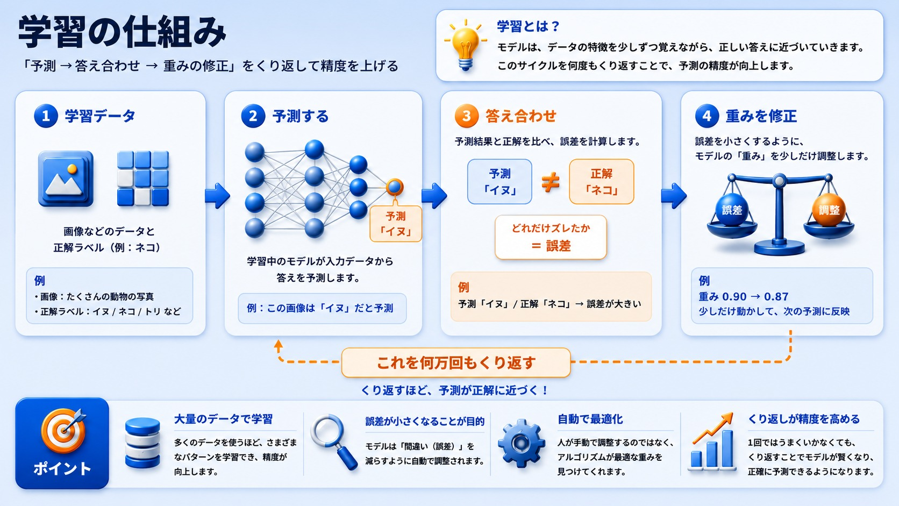
©2026 OpenUp Next Engineer Inc. 7

Slide 9
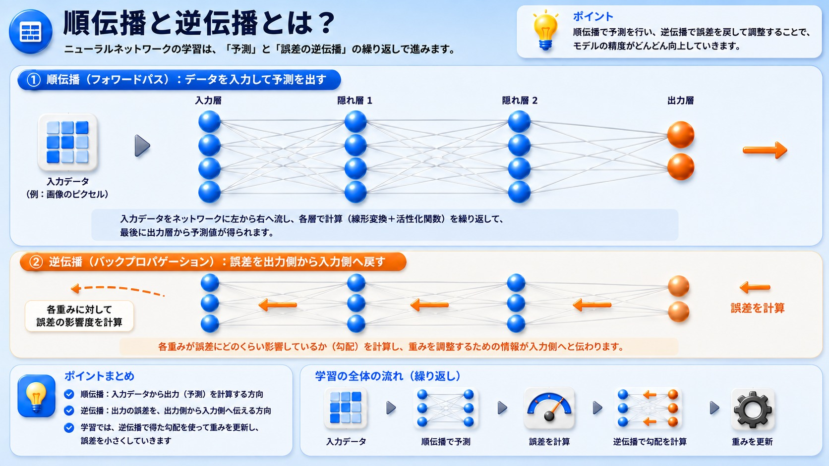
©2026 OpenUp Next Engineer Inc. 7

Slide 10
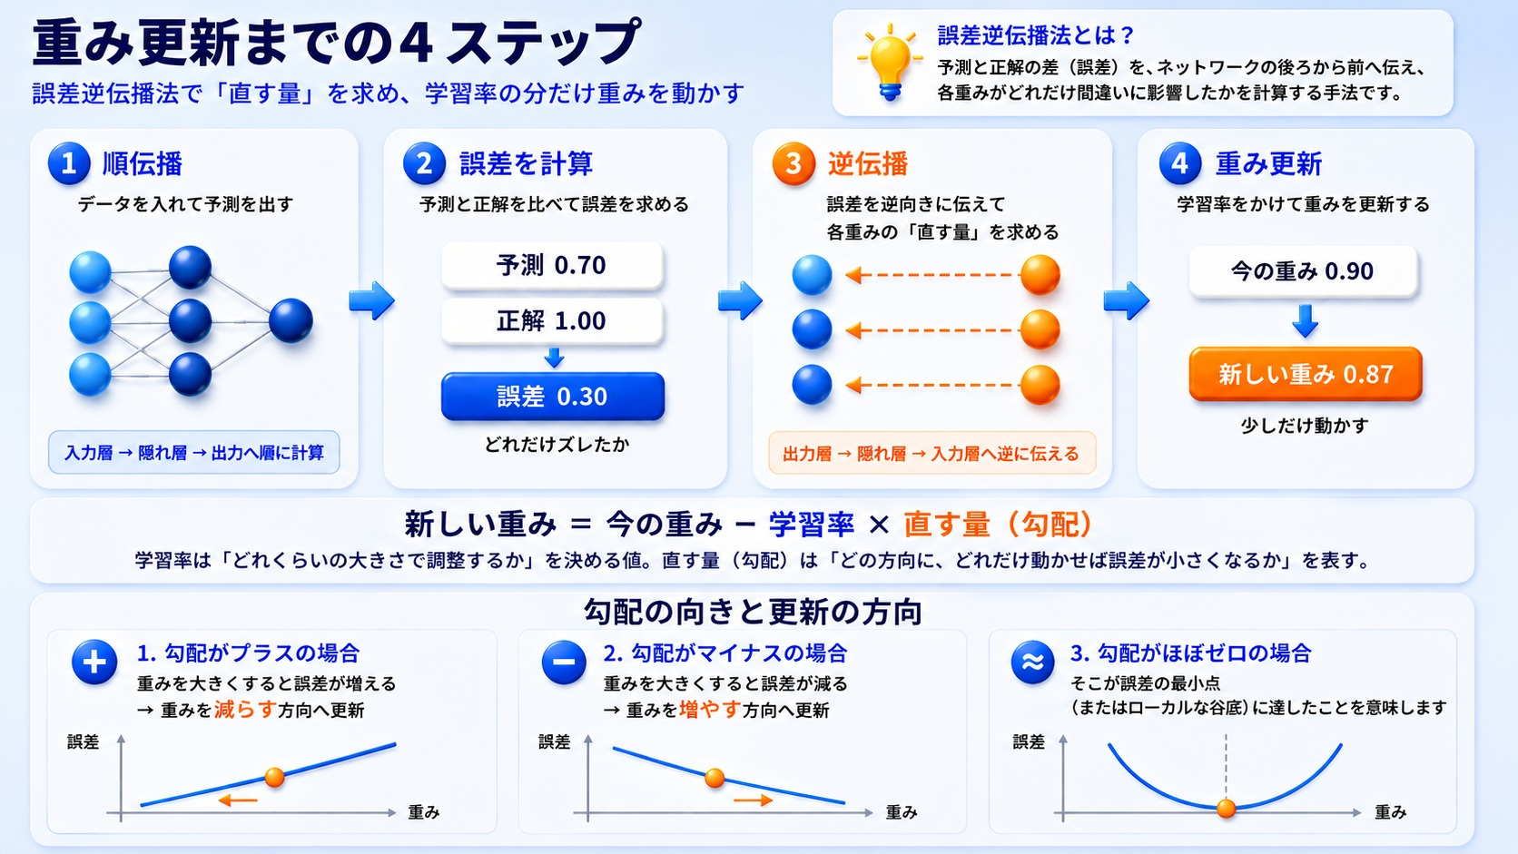
©2026 OpenUp Next Engineer Inc. 7

Slide 11
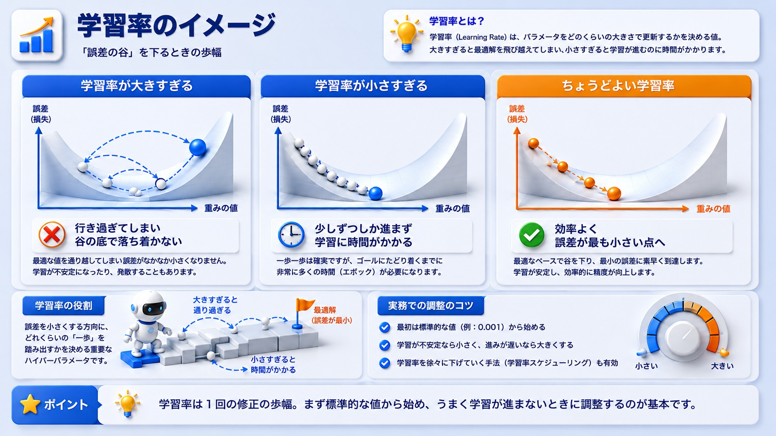
©2026 OpenUp Next Engineer Inc. 7

Slide 12
3
過学習とデータ拡張
©2026 OpenUp Next Engineer Inc. 7

Slide 13
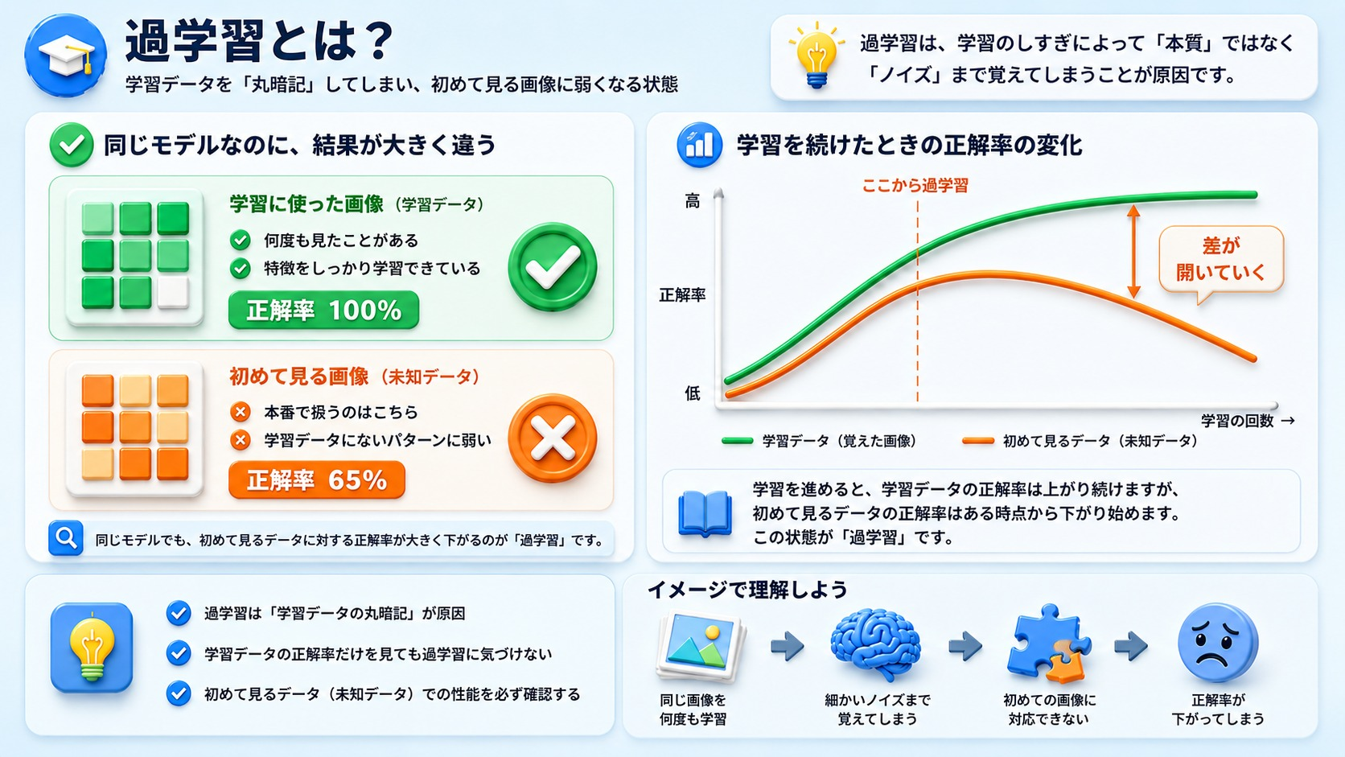
©2026 OpenUp Next Engineer Inc. 7

Slide 14
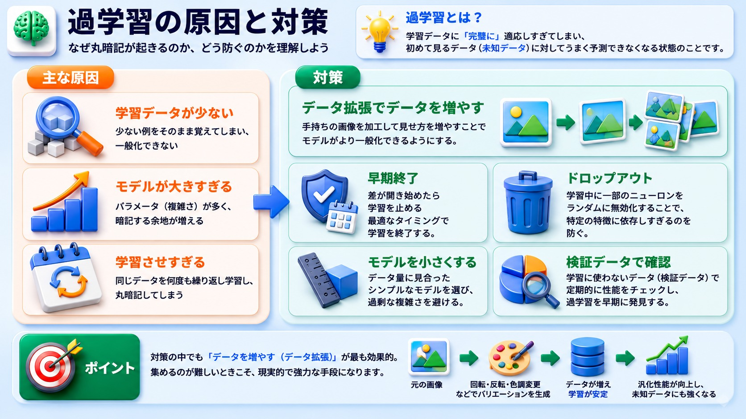
©2026 OpenUp Next Engineer Inc. 7

Slide 15
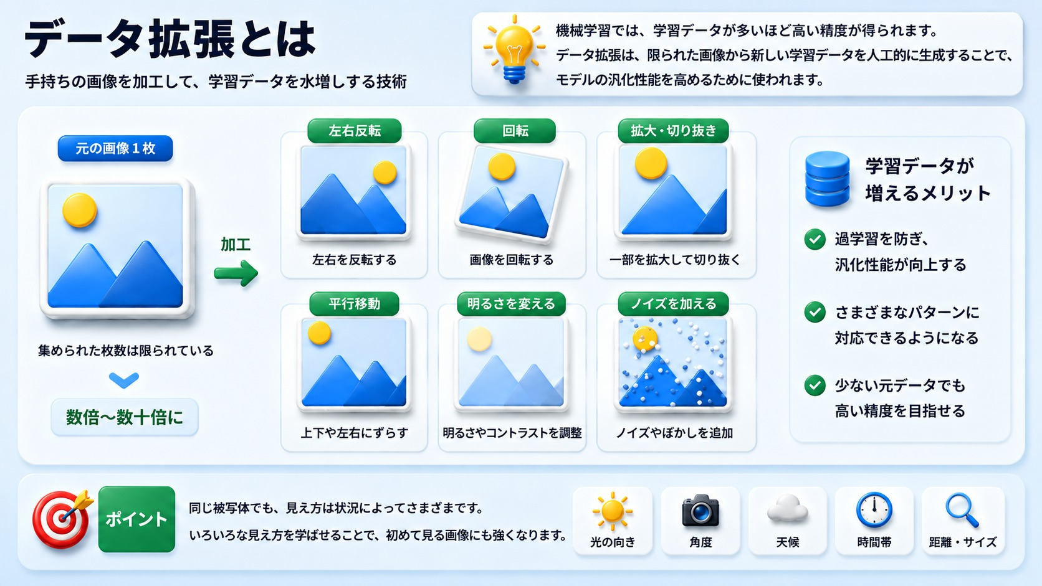
©2026 OpenUp Next Engineer Inc. 7

Slide 16
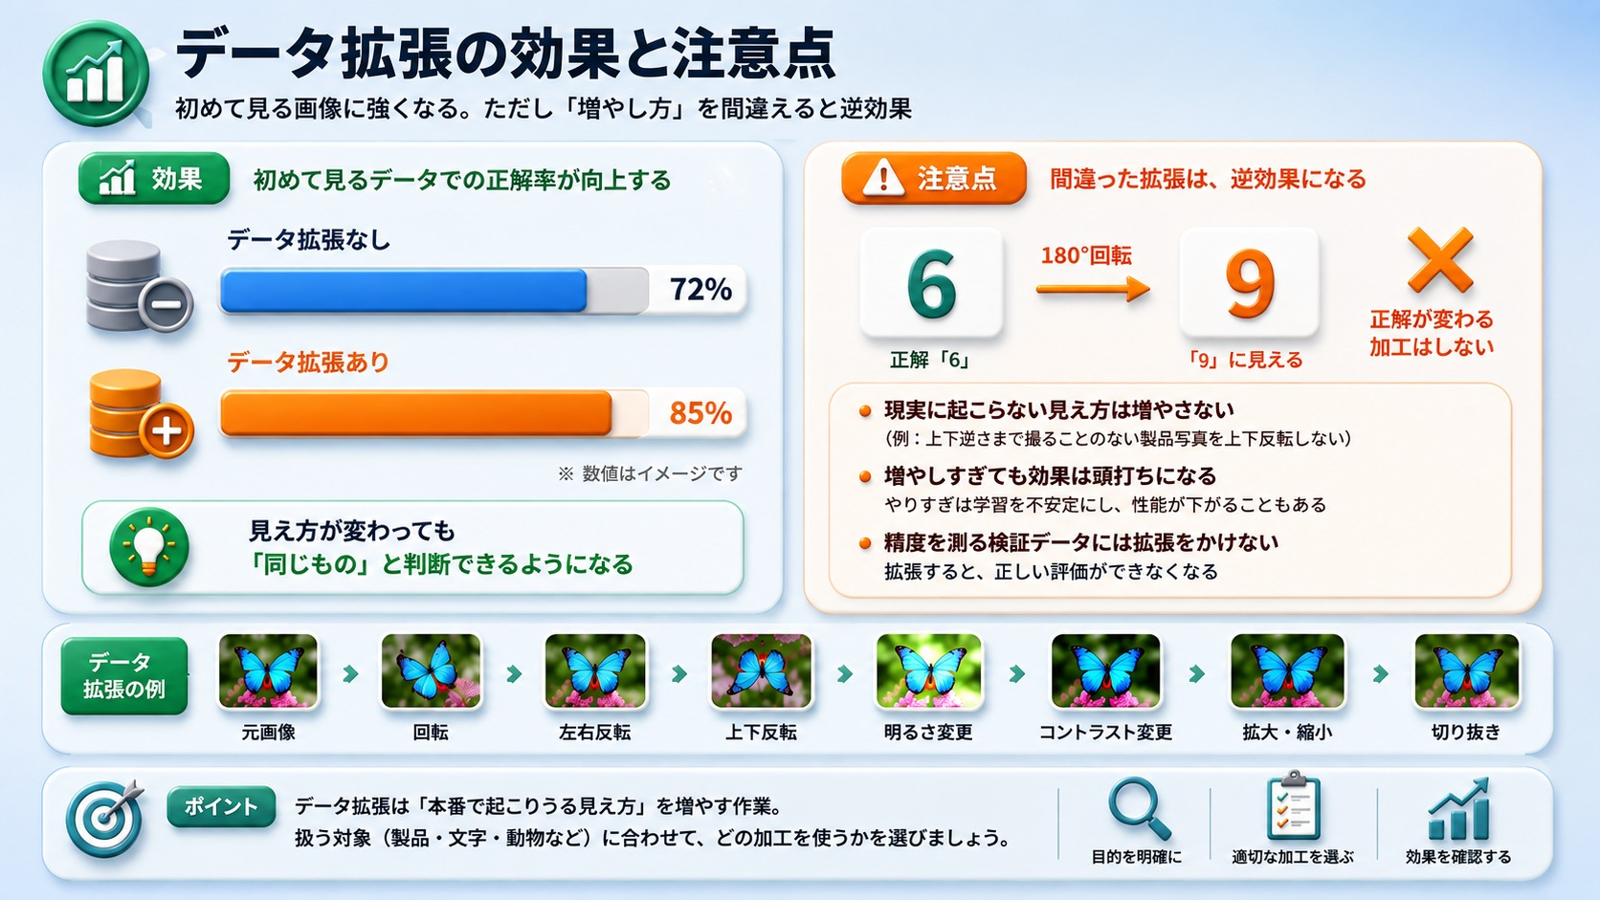
©2026 OpenUp Next Engineer Inc. 7

