Slide 1
1
マイコンとは
©2026 OpenUp Next Engineer Inc. 7

Slide 2
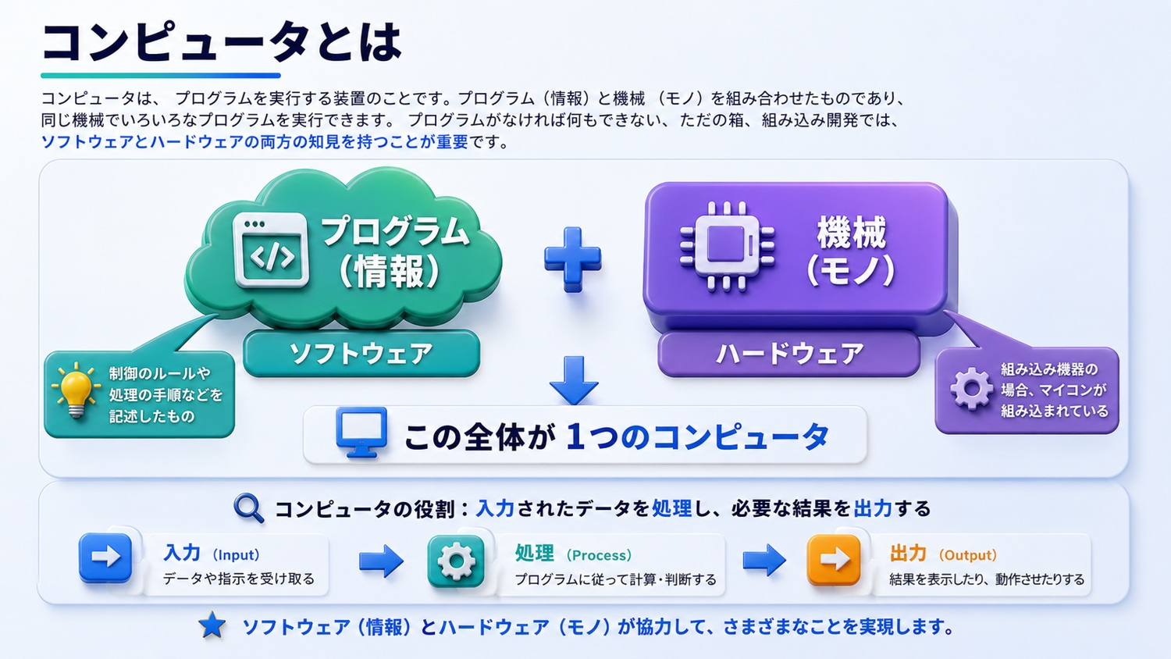
©2026 OpenUp Next Engineer Inc. 7

Slide 3
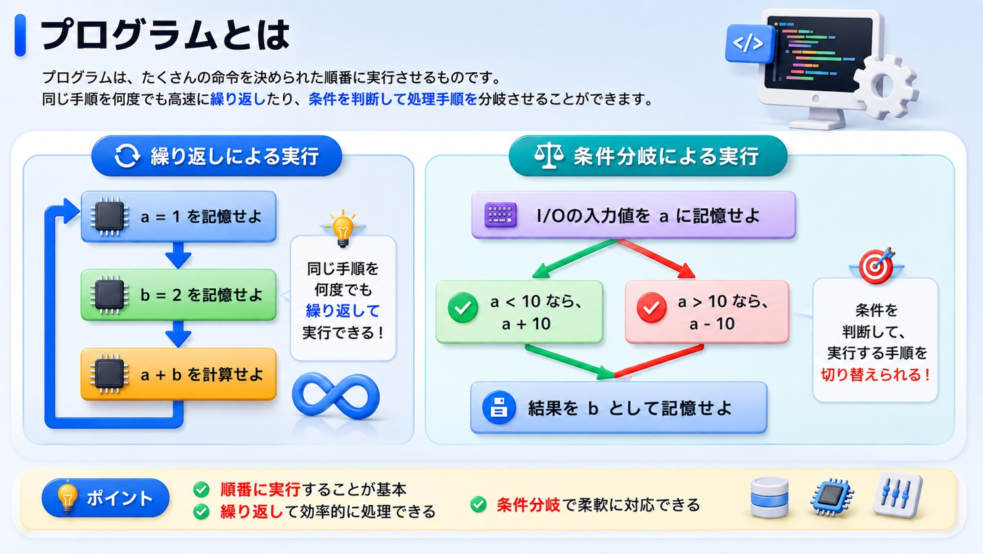
©2026 OpenUp Next Engineer Inc. 7

Slide 4
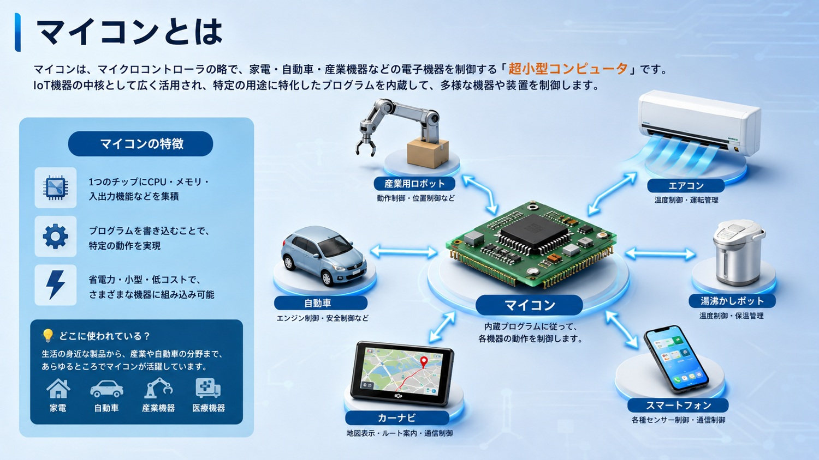
©2026 OpenUp Next Engineer Inc. 7

Slide 5
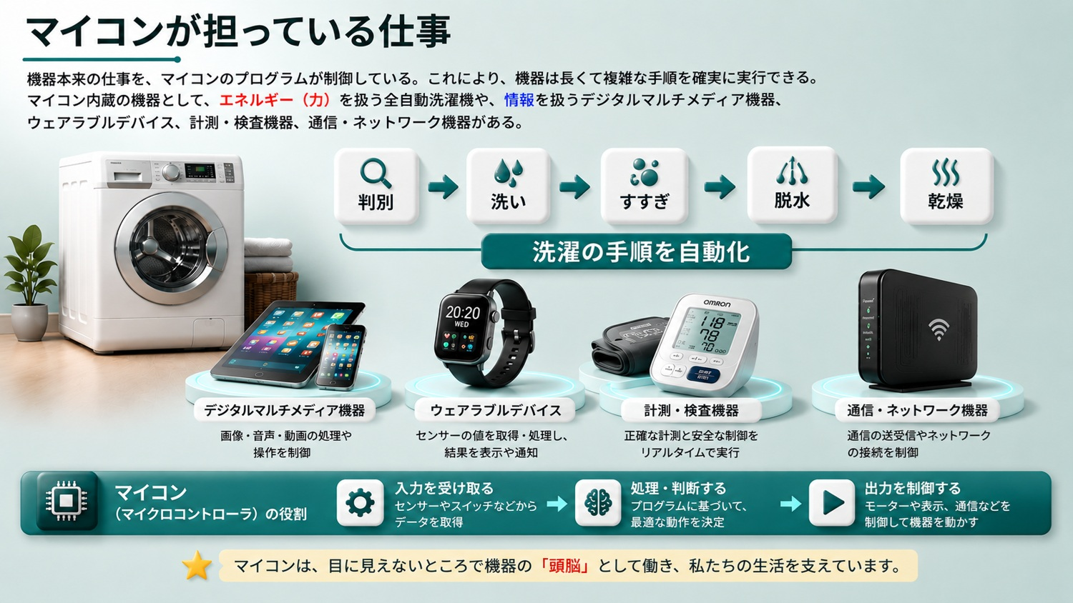
©2026 OpenUp Next Engineer Inc. 7

Slide 6
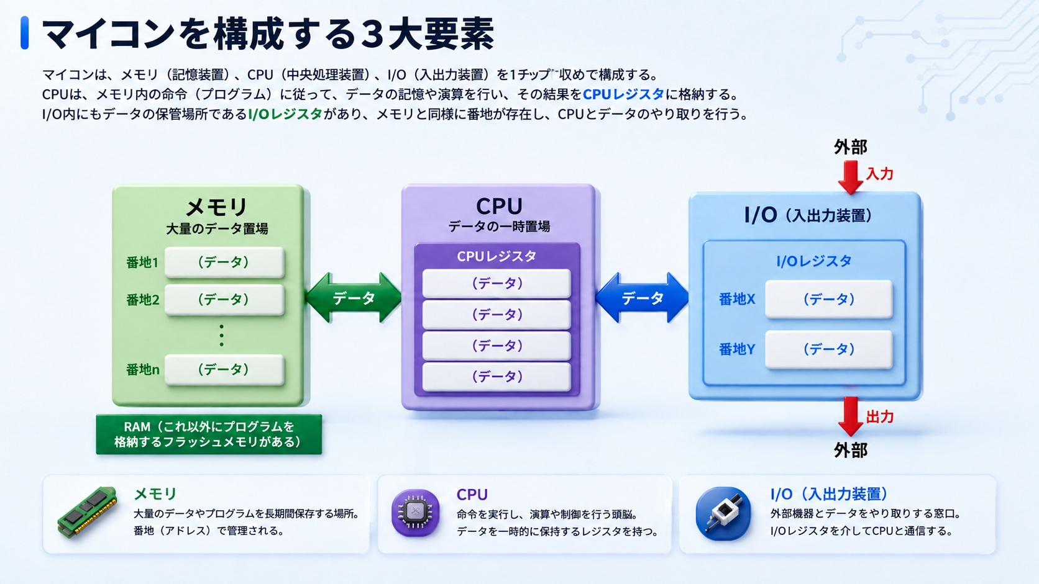
©2026 OpenUp Next Engineer Inc. 7

Slide 7
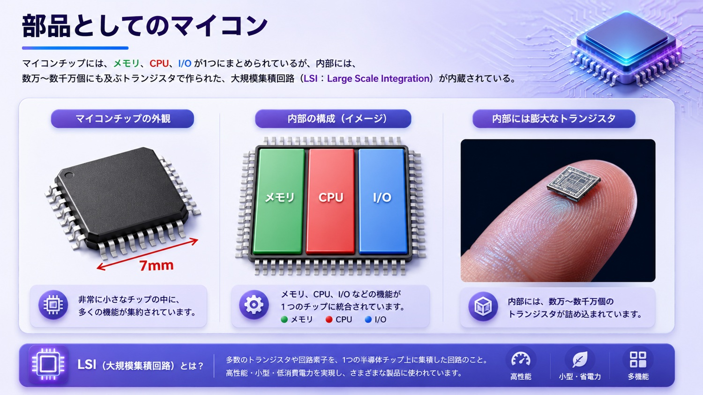
©2026 OpenUp Next Engineer Inc. 7

Slide 8
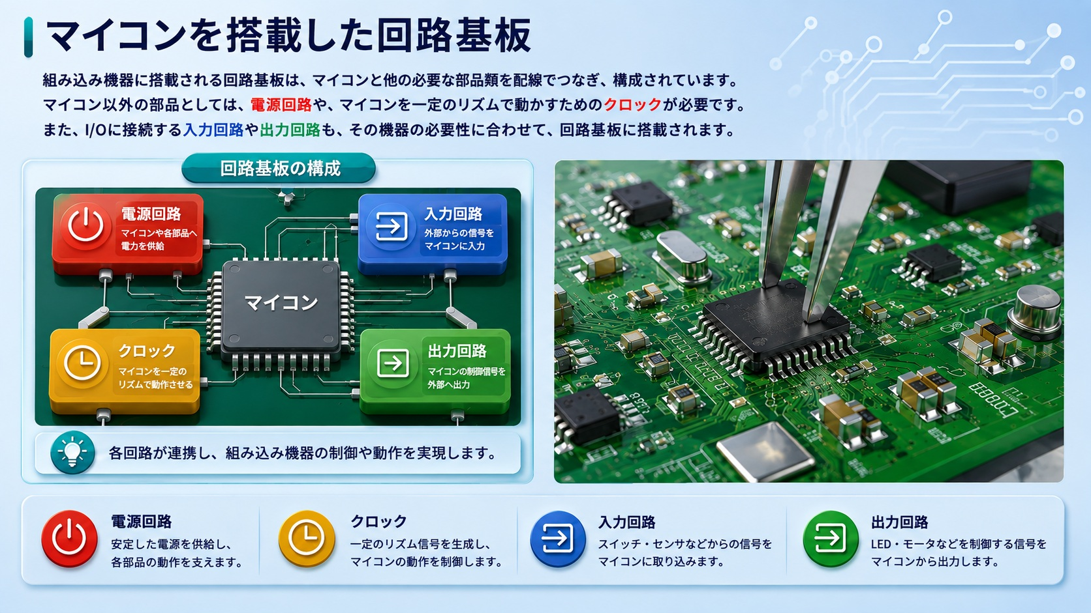
©2026 OpenUp Next Engineer Inc. 7

Slide 9
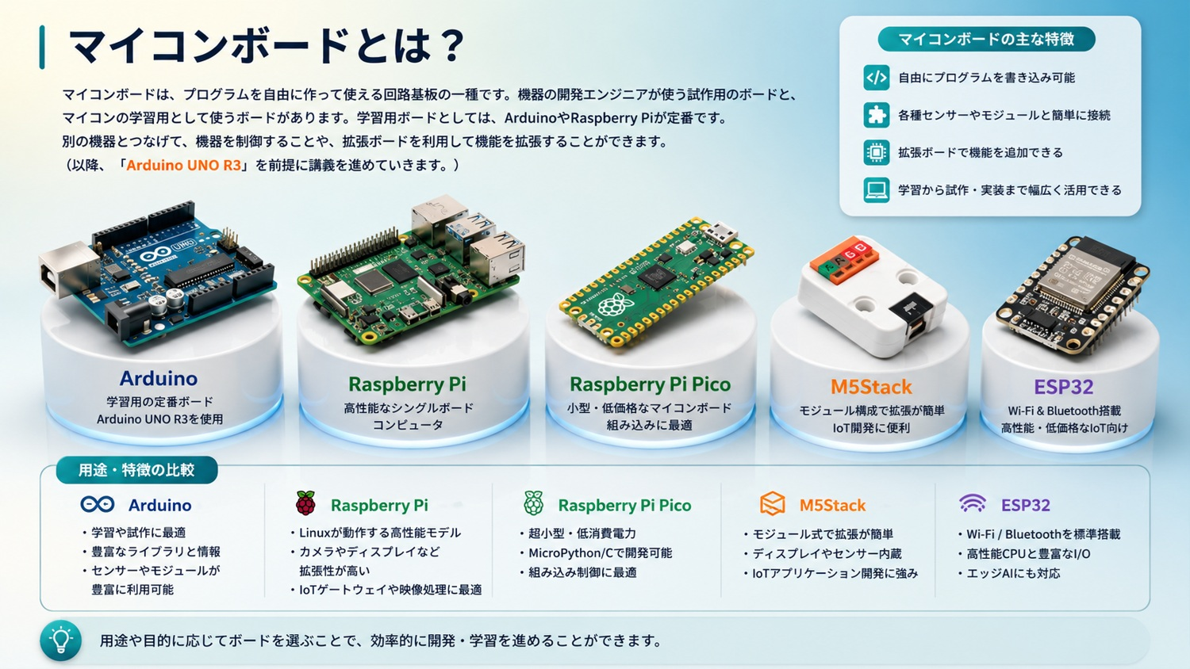
©2026 OpenUp Next Engineer Inc. 7

Slide 10
2
外部とやり取りするI/O
©2026 OpenUp Next Engineer Inc. 7

Slide 11
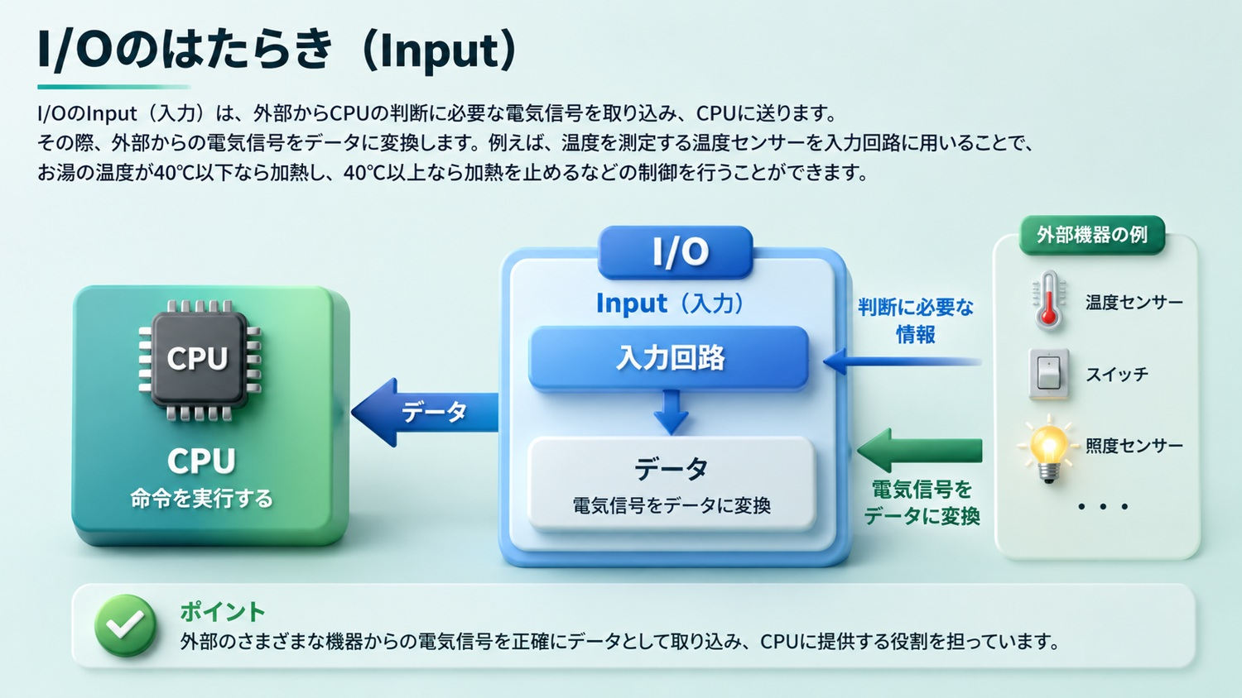
©2026 OpenUp Next Engineer Inc. 7

Slide 12
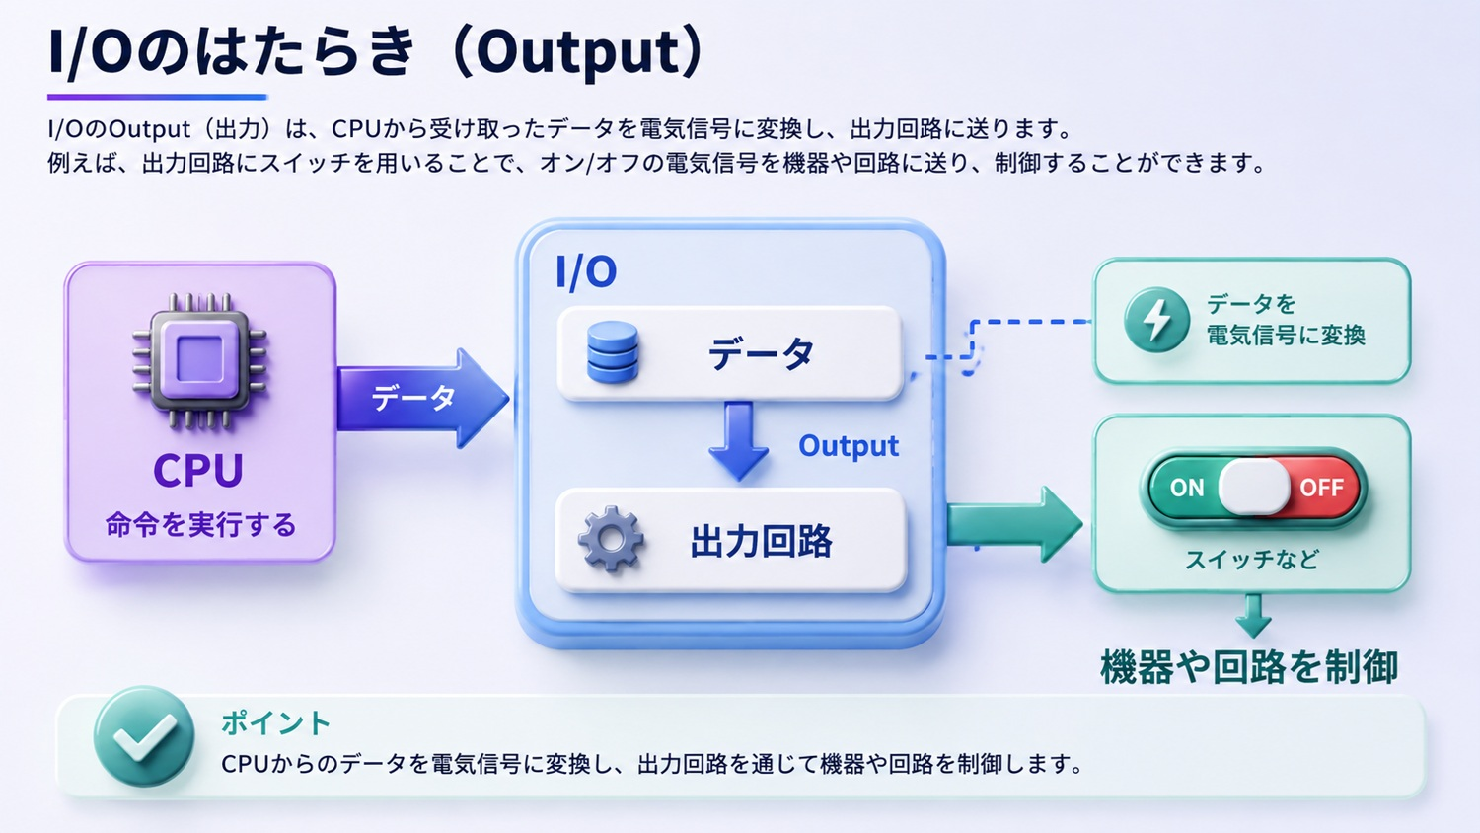
©2026 OpenUp Next Engineer Inc. 7

Slide 13
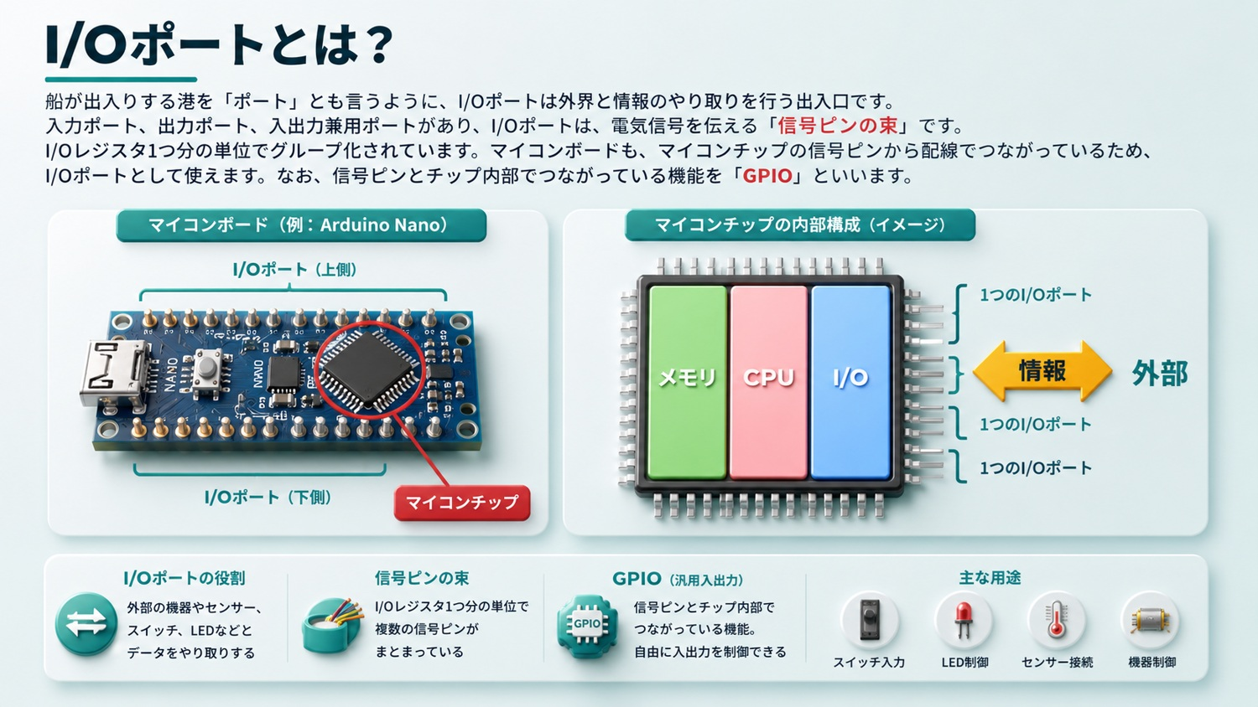
©2026 OpenUp Next Engineer Inc. 7

Slide 14
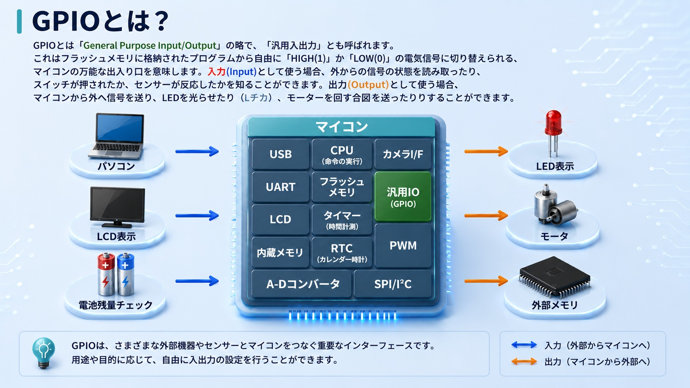
©2026 OpenUp Next Engineer Inc. 7

Slide 15
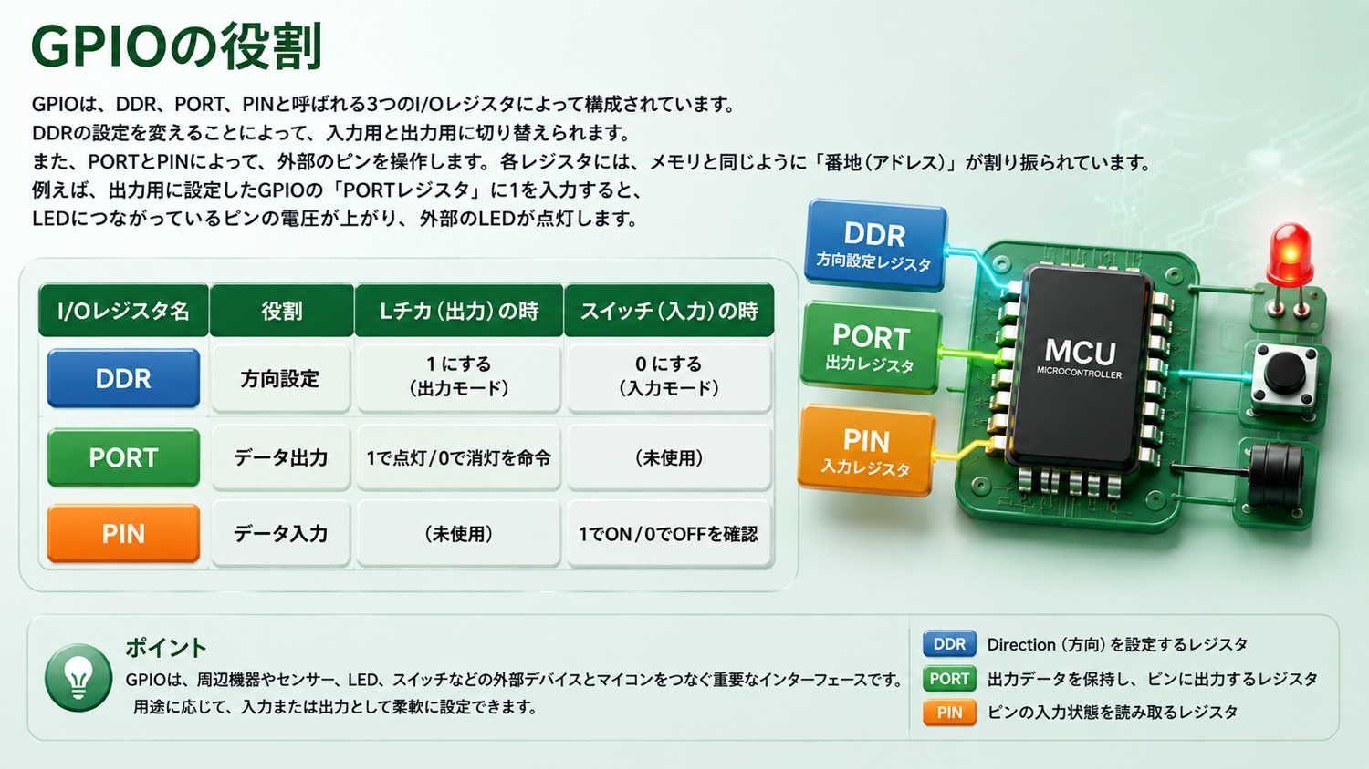
©2026 OpenUp Next Engineer Inc. 7

Slide 16
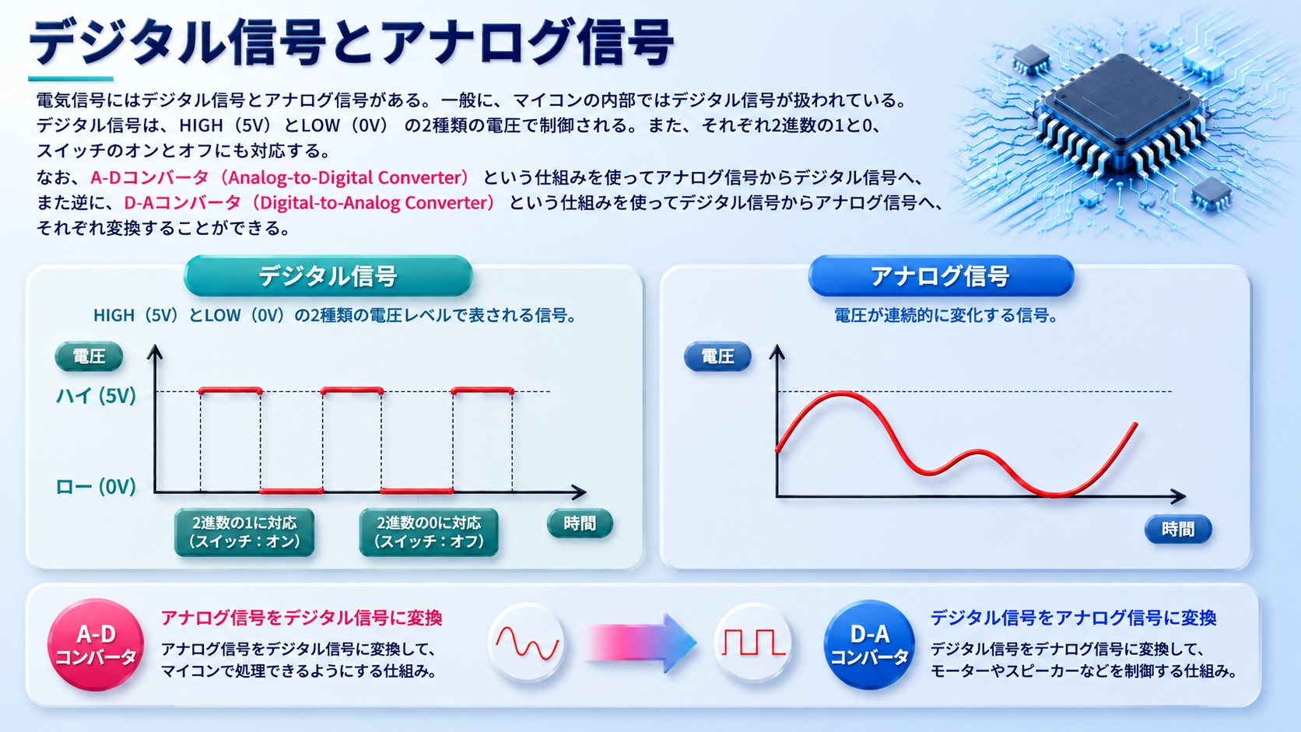
©2026 OpenUp Next Engineer Inc. 7

Slide 17
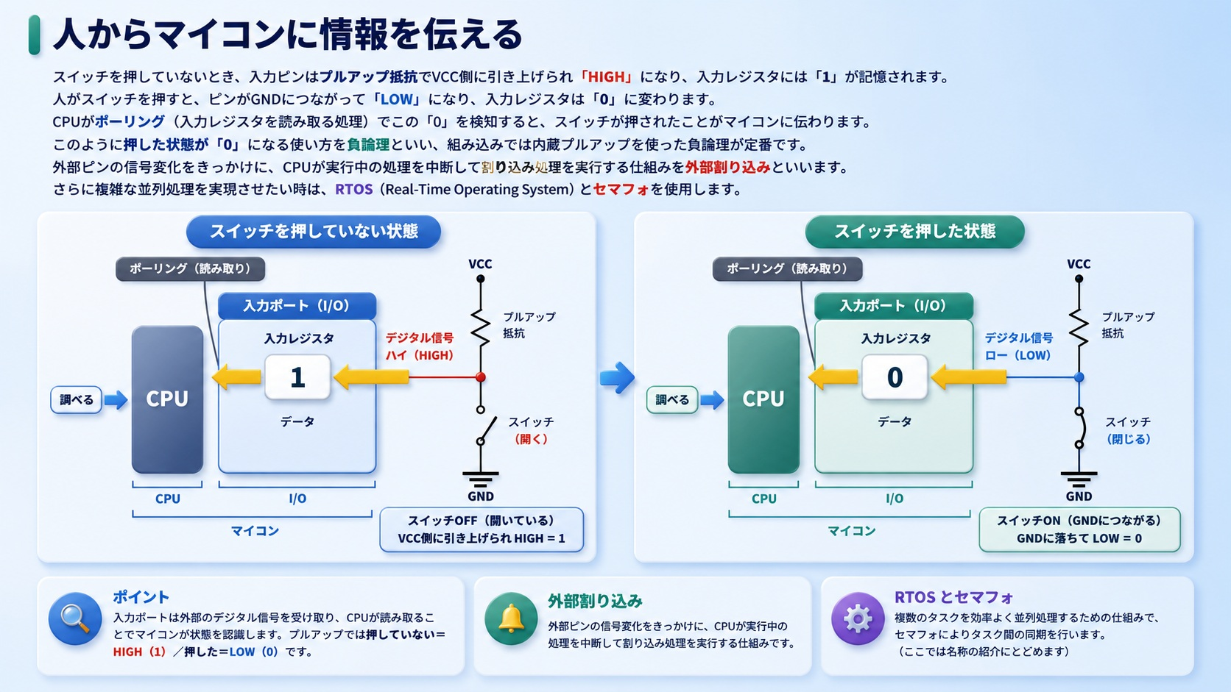
©2026 OpenUp Next Engineer Inc. 7

Slide 18
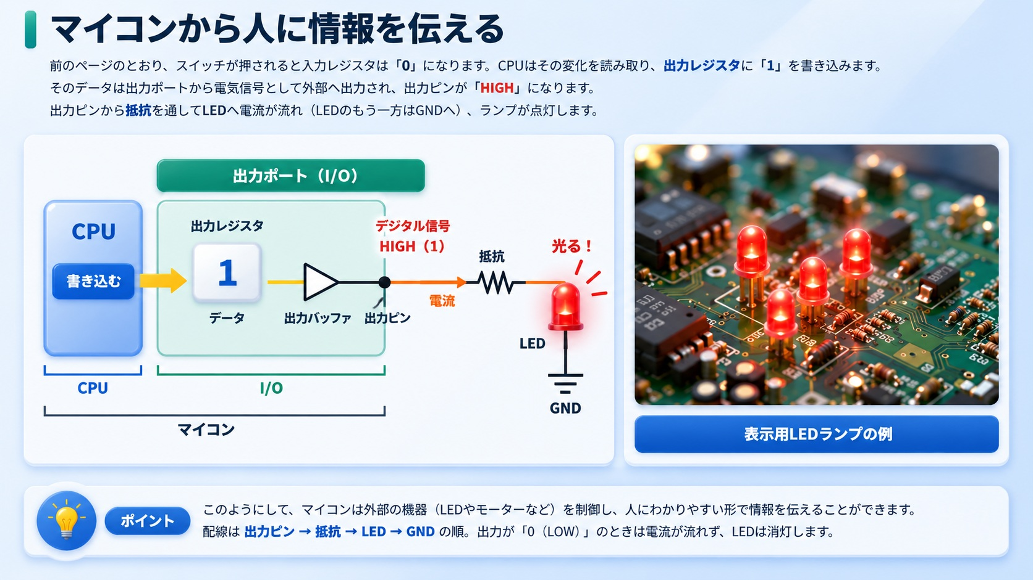
©2026 OpenUp Next Engineer Inc. 7

Slide 19
3
AIを活用したプログラム開発
©2026 OpenUp Next Engineer Inc. 7

Slide 20
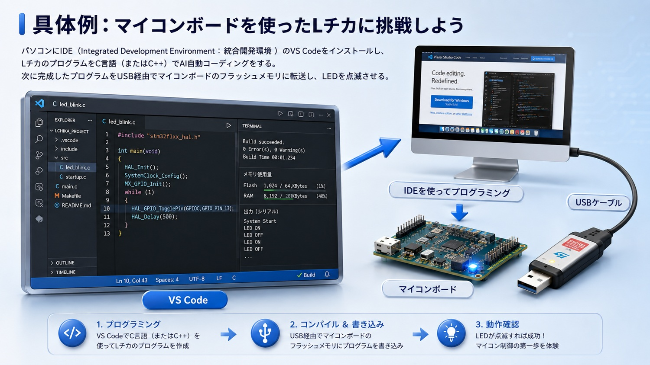
©2026 OpenUp Next Engineer Inc. 7

Slide 21
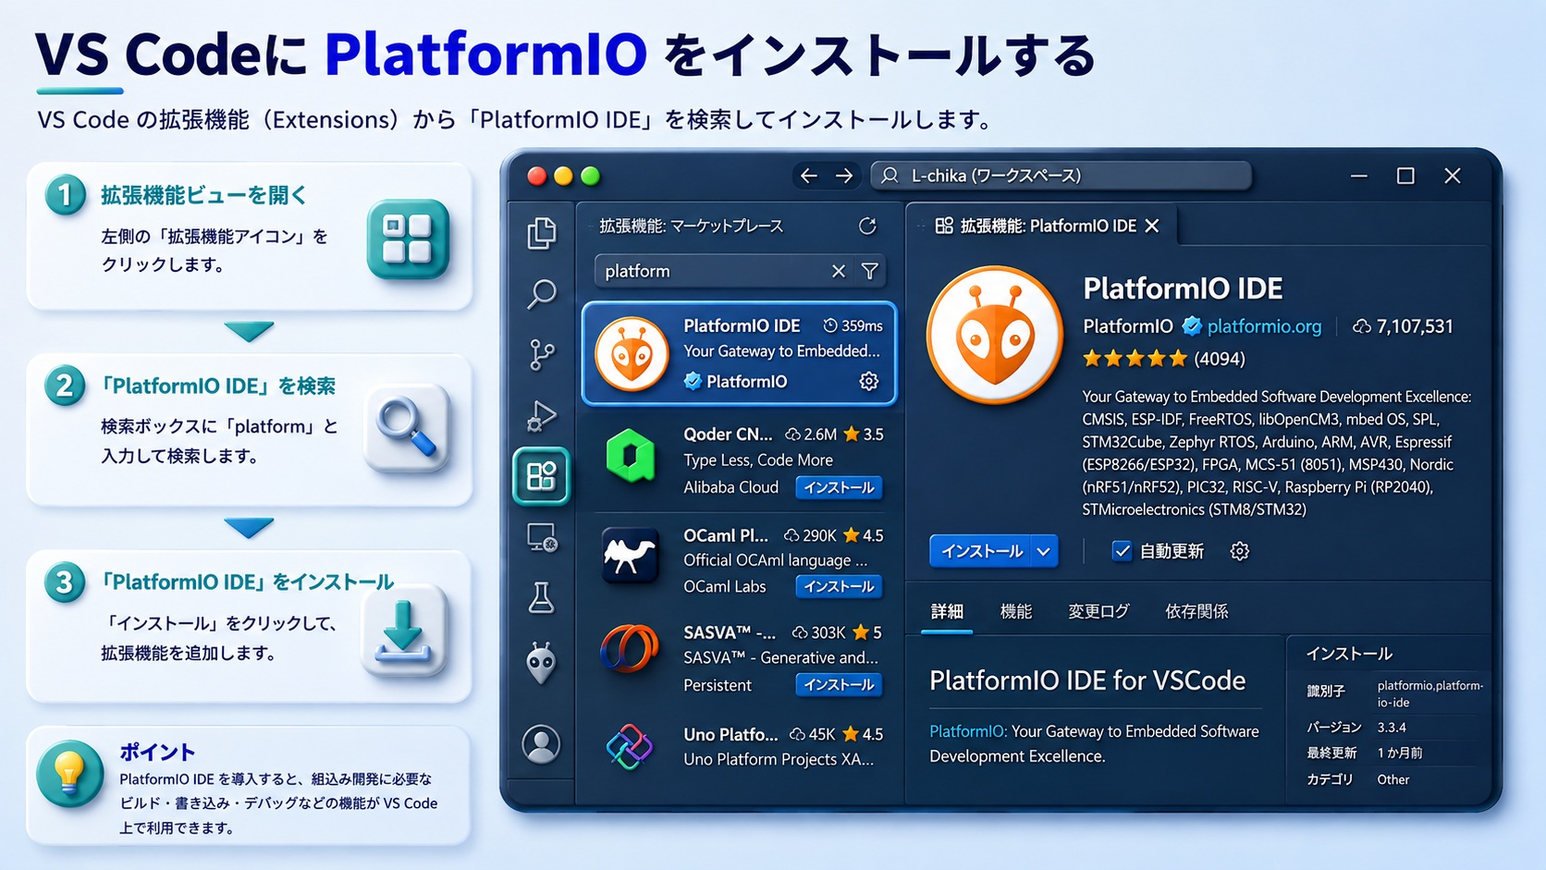
©2026 OpenUp Next Engineer Inc. 7

Slide 22
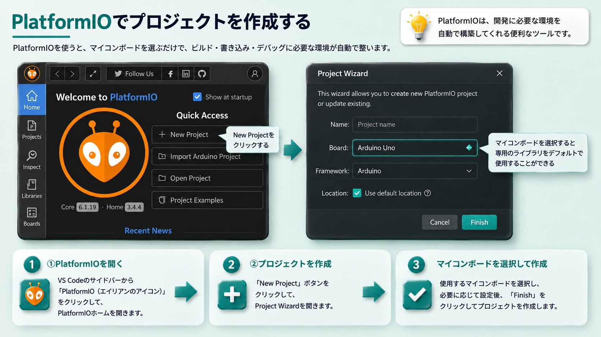
©2026 OpenUp Next Engineer Inc. 7

Slide 23
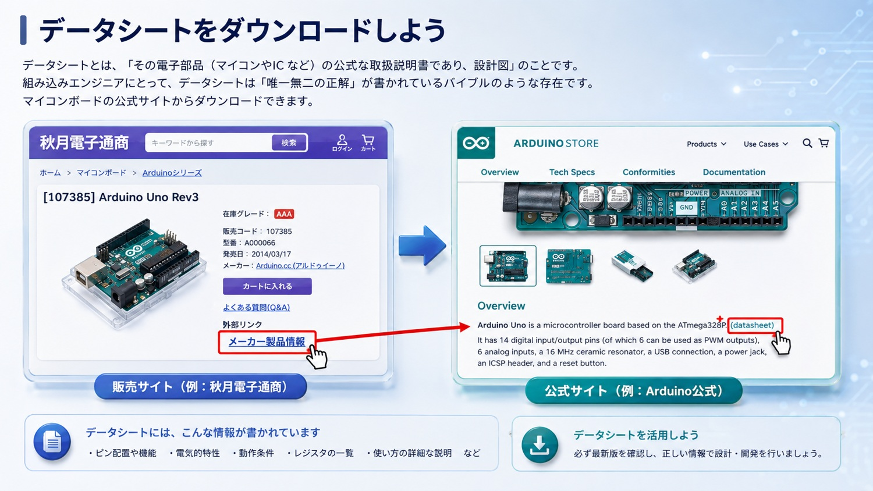
©2026 OpenUp Next Engineer Inc. 7

Slide 24
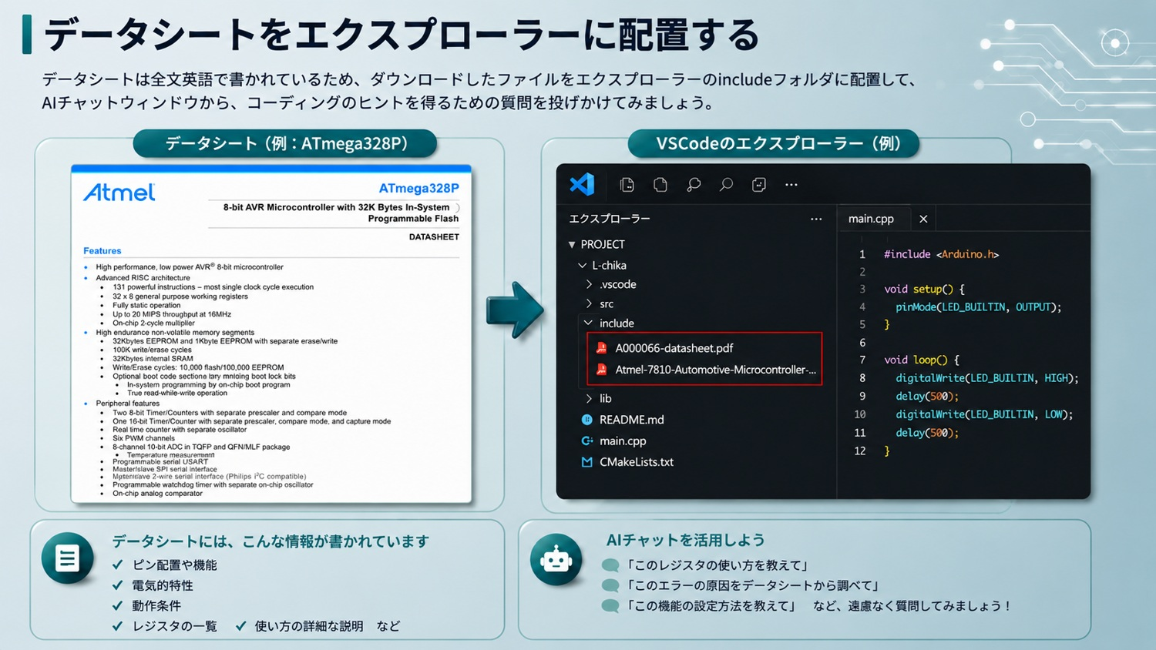
©2026 OpenUp Next Engineer Inc. 7

Slide 25
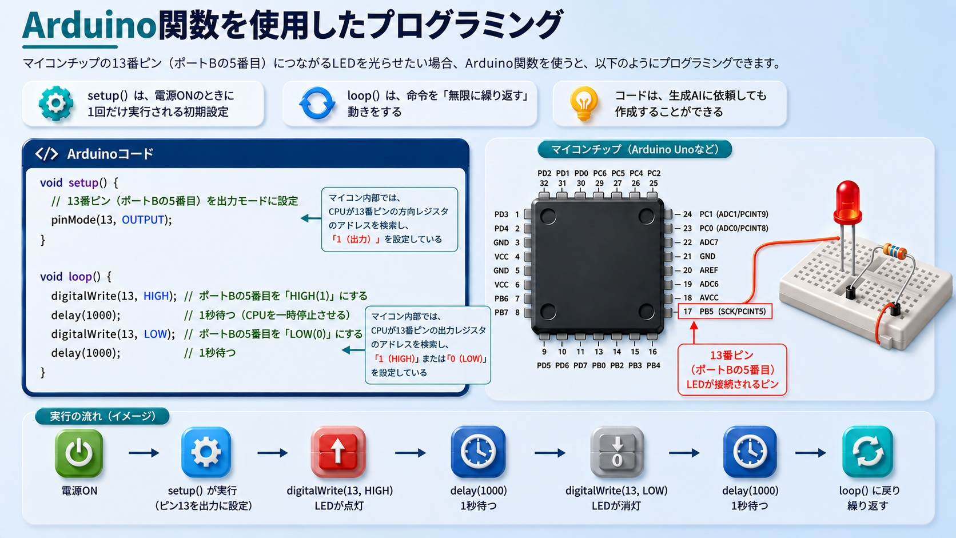
©2026 OpenUp Next Engineer Inc. 7

Slide 26
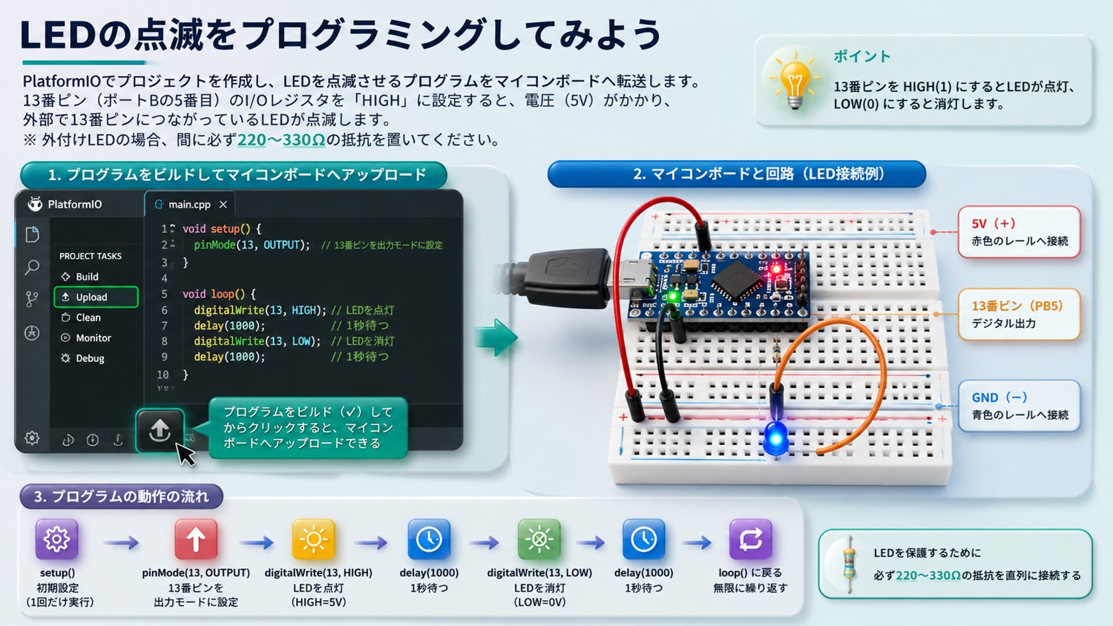
©2026 OpenUp Next Engineer Inc. 7

