Slide 1
Change HRO FFT
Hideaki Yokokawa (JP1BHH @Ebina)

Slide 2
Motivation
HRO FFT ‘s Writer is Mr OOKAWA
But HRO FFT is No longer Maintenance.
..may be.
HRO FFT is released for Windows 98 to XP
However execute Windows 10..
Source list is Non Free.. Written in Delphi.
Now. 1Board Microcom are spread.
ex. Raspberry Pi and CUBIE board and Pcduino..
There ,1Board Microcom OS use Linux!

Slide 3
Why use 1 Board Microcom?
These OS are Free..
ex. Raspbian (Debian , Ubuntu , Fedra)
Cheap and Any device can use! As Windows..
Language Environment :
GCC (gnu compiler collections)
Using C,C++,Java,Obj-C,Fortran… Almost language can use.

Slide 4
New HRO FFT
Using C language
Alsa library(audio)
FFTW package.
Threading
Plotter use Python(Numpy matplotlib)
For Ubuntu or Debian(Raspbian)

Slide 5
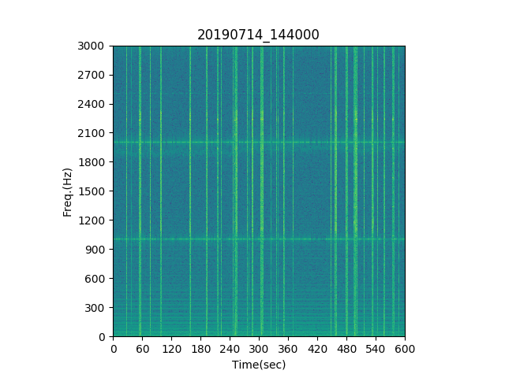
Observation Result
FM (packet com.)

Slide 6
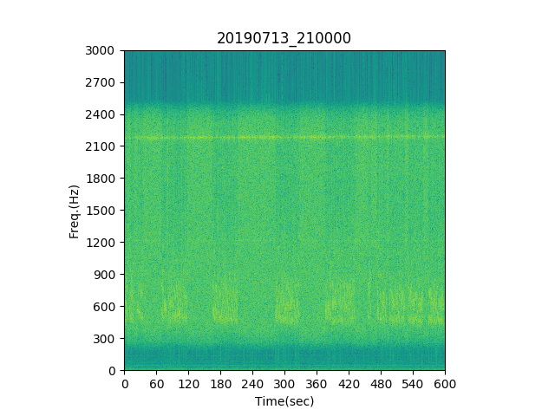
Observation Result
SSB (Speeach)

Slide 7
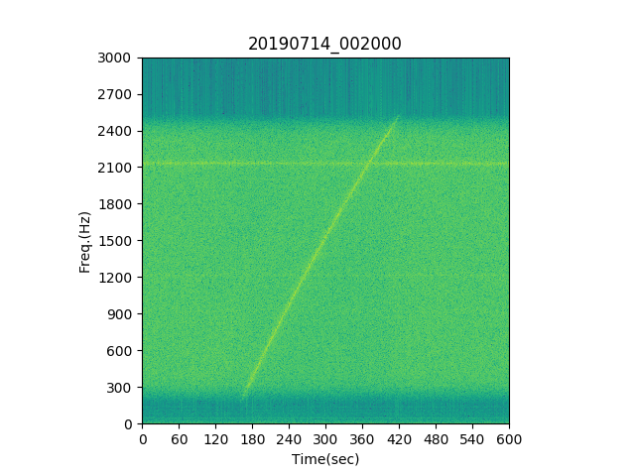
Observation Result
SSB (Beat??)

Slide 8
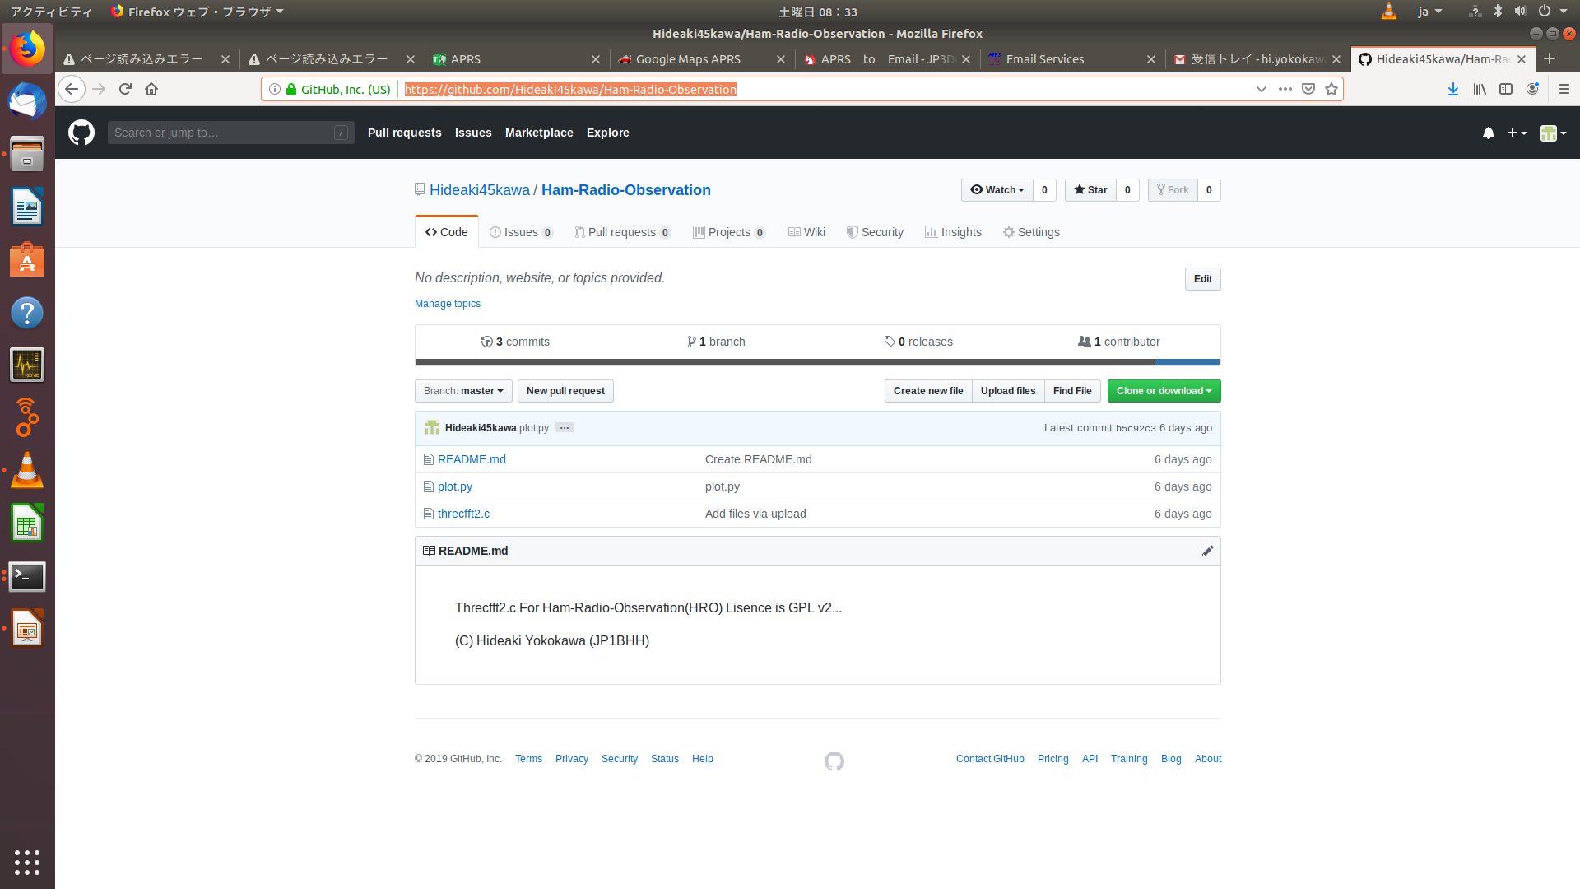
Sourcelist
https://github.com/Hideaki45kawa/Ham-Radio-Observation

