Slide 1
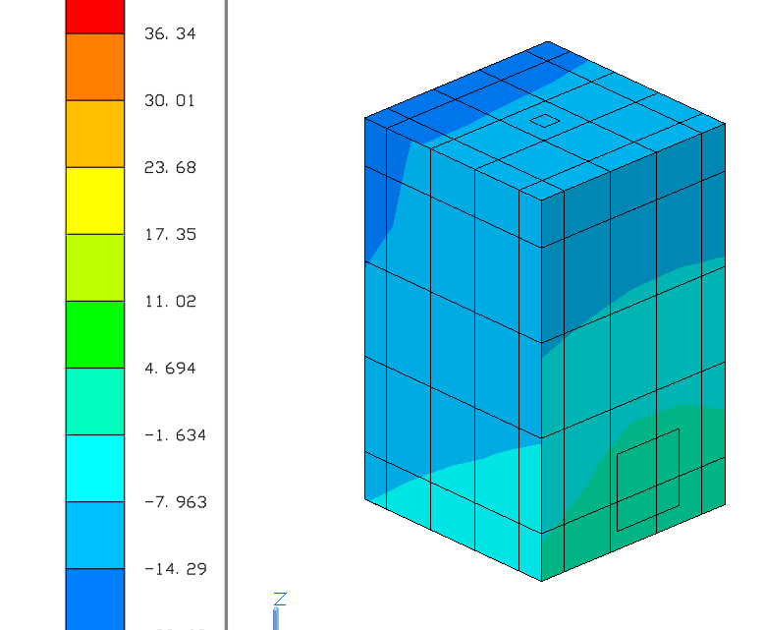
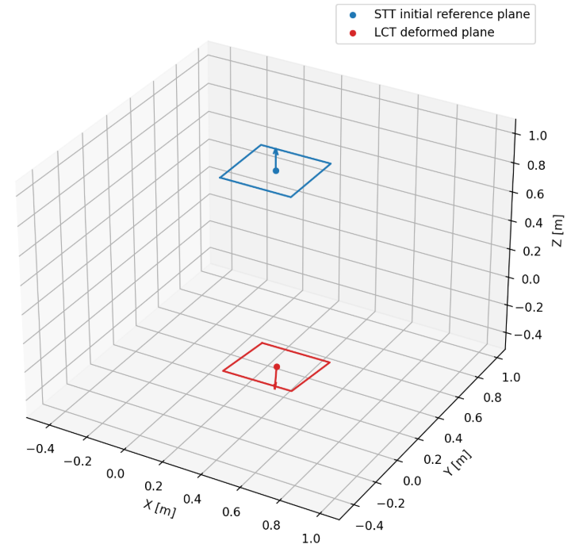
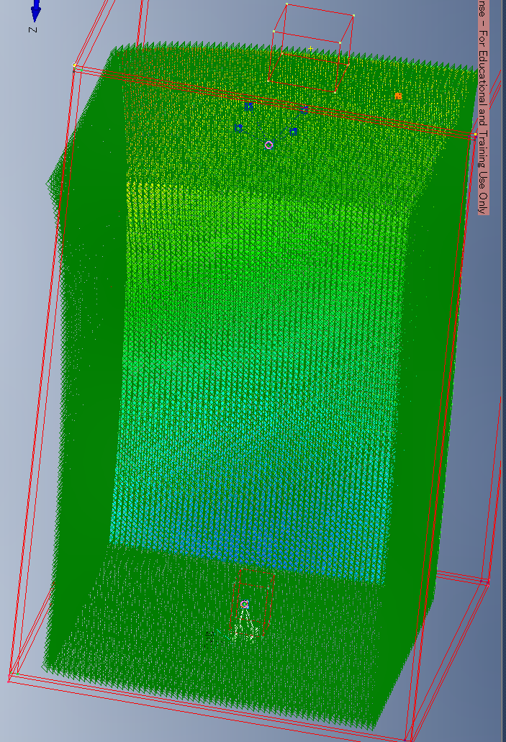


Orbit / attitude
heat & coating
Thermal Desktop
temperature
Femap / Nastran
rotation
STT–LCT
thermal LOS
Lightweight
model
PAT
scan center
・軌道
・姿勢
・コンポ構造配置
・衛星表面特性
・内部発熱位置/量
$$Δ\hat{θ}=b_{case}+a ΔT$$
$$θ=θ_{c} −Δ\hat{θ}$$
地上でのモデル構築
軌道上でのモデル運用および補正
• 軌道・姿勢・熱環境を入力
• TD/Femapで温度場・熱変形を計算
• STT–LCT相対LOSの参照時系列を生成
• 軽量モデルの学習・評価に使用
• 温度センサ・運用情報を入力
• 軽量モデルで熱LOSを予測
• Scan centerを補正
• 捕捉後残差でモデルを更新

Slide 2
Orbit / attitude
heat & coating
Thermal Desktop
temperature
Femap / Nastran
rotation
STT–LCT
thermal LOS
Lightweight
model
PAT
scan center
・Orbit
・Attitude
・Component and structural layout
・Satellite surface properties
・Location and magnitude of internal heat dissipation
$$Δ\hat{θ}=b_{case}+a ΔT$$
$$θ=θ_{c} −Δ\hat{θ}$$
On-orbit model operation and correction
On-ground model construction
・Input temperature-sensor readings and operational data
・Predict the thermal line of sight with the lightweight model
・Correct the scan center
・Update the model with the post-acquisition residual
・Input the orbit, attitude, and thermal environment
・Compute the temperature field and thermal deformation with Thermal Desktop / Femap
・Generate a reference time series of the STT–LCT relative line of sight
・Use it to train and evaluate the lightweight model

