Slide 1
ICSO 2026
Paper 293 · Oral
PAT and Receiver Technologies
Hierarchical Prediction and Feedforward Correction of
Time-Varying Thermal Line-of-Sight Bias for Coarse Acquisition
in Satellite Optical Communications
Hideki Takamoto, Kazuki Takashima, Yuki Kusano, Satoshi Ikari, and Ryu Funase
Department of Aeronautics and Astronautics, The University of Tokyo
1

Slide 2
Background and positioning
Thermal LOS bias can dominate the coarse-acquisition scan before optical feedback is available
Before optical feedback
Thermoelastic bias
Feedforward scan center
Attitude, orbit, alignment, and thermal errors define the search region.
Known illumination and dissipation drive bus deformation.
150 µrad to >1 mrad
Predict the thermal component before acquisition and subtract it from the scan center.
Representative prior work
Research stream | Thermal-state LOS prediction | Acquisition evaluation
Optical communication / PAT | Limited | Yes
Earth-observation & deep-space instruments | Yes | No
This work | Yes | Yes
This work connects thermal-state prediction to acquisition performance.
Representative sources: Kaushal 2017; Shi 2023; Zhang 2025; Hu 2022; Li 2025; Turella 2019/2021.
2

Slide 3
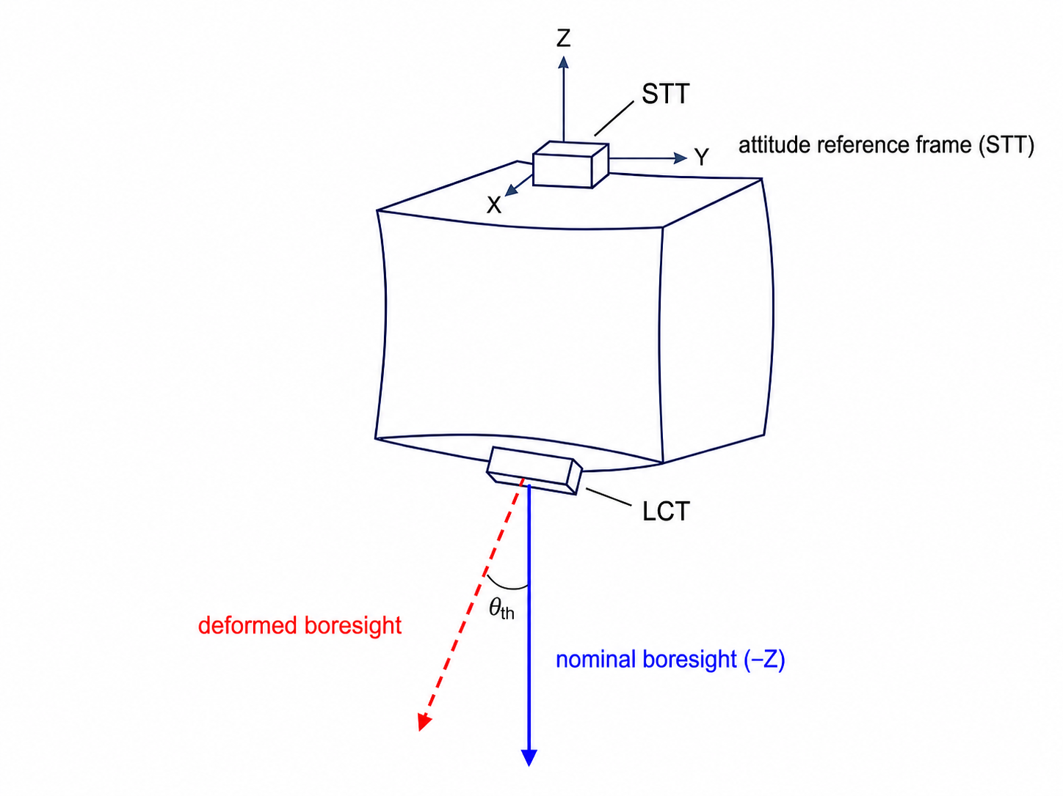
Problem definition
The relevant far-field quantity is the LCT optical-axis rotation relative to the STT
θ_{th} = θ_{LCT} − θ_{STT}
Attitude reference
Thermal rotation of the STT is absorbed into the estimated attitude frame.
Communication axis
The LCT rotation relative to that frame appears directly as scan-center error.
Centerline translation is negligible for the far-field link.
Paper §3, Figure 2.
3

Slide 4
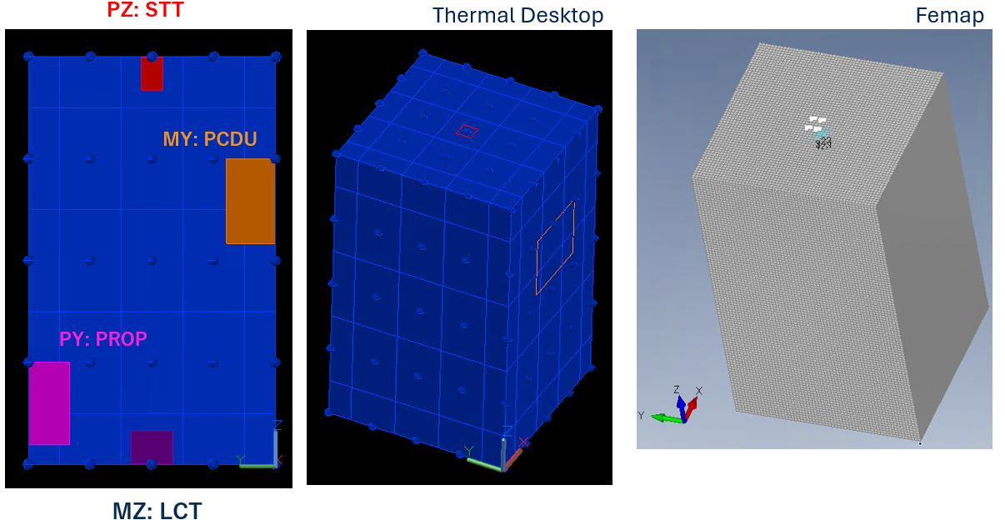
Thermoelastic analysis
A box-structure LEO bus is analysed across 21 operating conditions
Spacecraft model
0.6 × 0.6 × 1.0 m
A5052, reference 24 °C
STT on PZ · LCT on MZ
21 conditions
Sun face: MX / MY / PX / PY
Dissipation · surface · orbit variants
Common analysis chain
Thermal Desktop temperature field
→ Femap rotations
→ STT–LCT relative LOS
One fixed structure; operating conditions vary across cases.
Paper §4–5, Tables 2–4, Figure 3.
4

Slide 5
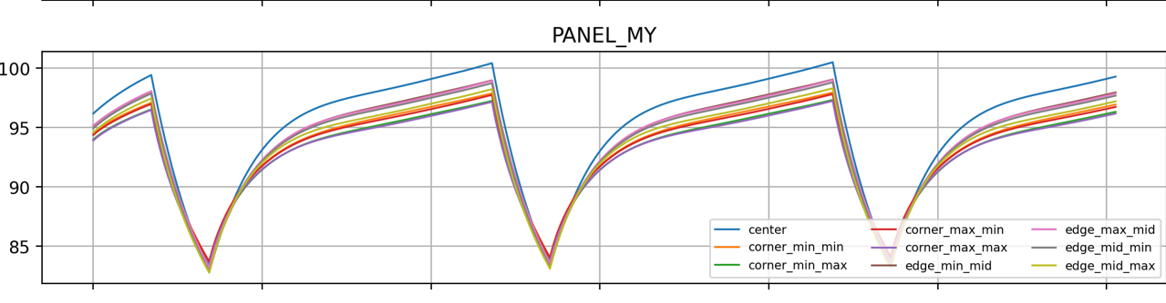
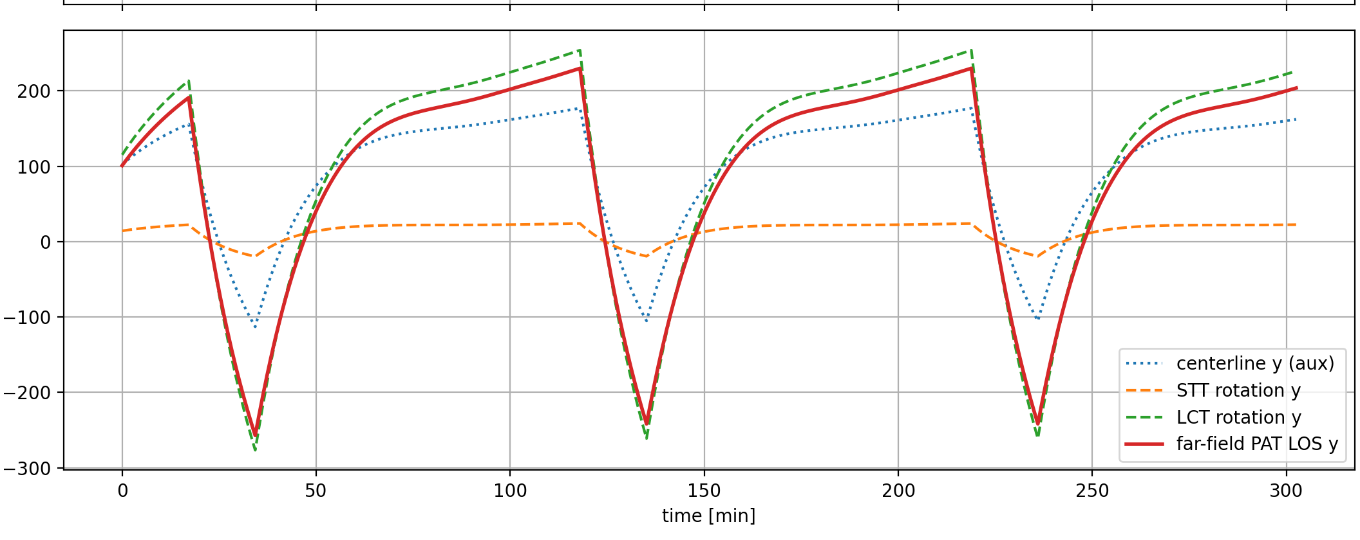
Observed structure
Thermal LOS follows the orbit; its dominant axis and DC offset follow the sun face
MY-panel temperature · Case 04
STT-relative LOS, dominant y axis
Same orbital period
Sun face sets the axis
Raw RMS: 150–1280 µrad
Temperature and thermal LOS repeat together.
MY/PY → y dominant
MX/PX → x dominant
Dissipation mainly shifts the case DC bias.
Paper §5, Figure 4. Plots are cropped from the final-paper source figures.
5

Slide 6
Hierarchical sun-face ΔT model
Orbital variation is a(sun)·ΔT; the DC term is predicted from sun face and dissipation
Onboard inputs
Hierarchical prediction
Predicted thermal LOS
Panel-center temperature difference
ΔT(t) = T(sun face) − T(opposite)
Sun face + dissipation flags
θ_{dom}(t) ≈ b_{case} + a(sun)·ΔT(t)
Two-axis scan-center correction
computed before acquisition
b_{case} ≈ b₀(sun) + c_{PROP} I_{PROP} + c_{PCDU} I_{PCDU}
16 fixed coefficients
Within-orbit variation
Across-condition DC
A shared sensitivity a(sun) maps ΔT(t) to the dominant-axis time variation.
Sun face and operating flags predict the case DC bias across conditions.
The first-order ΔT–LOS relation is known; the contribution here is bus-relative STT–LCT LOS, cross-condition DC prediction, and acquisition use.
Paper §6, Eqs. 3–6, Figure 5.
6

Slide 7
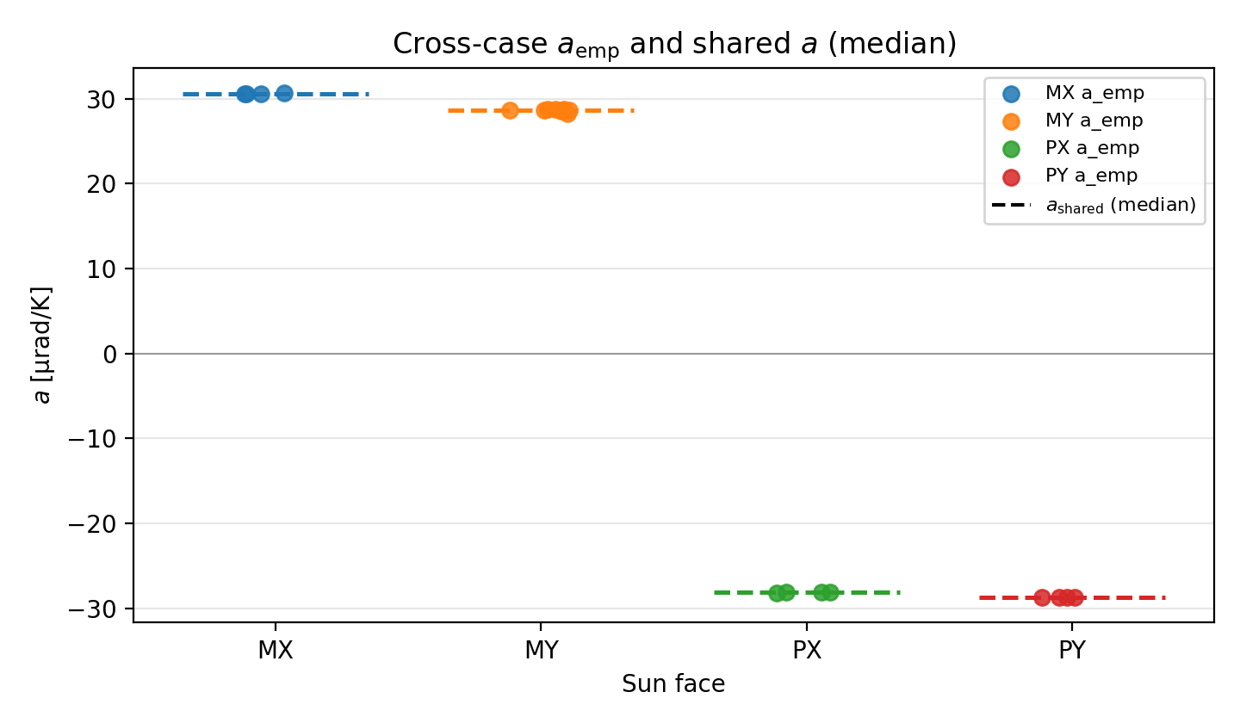
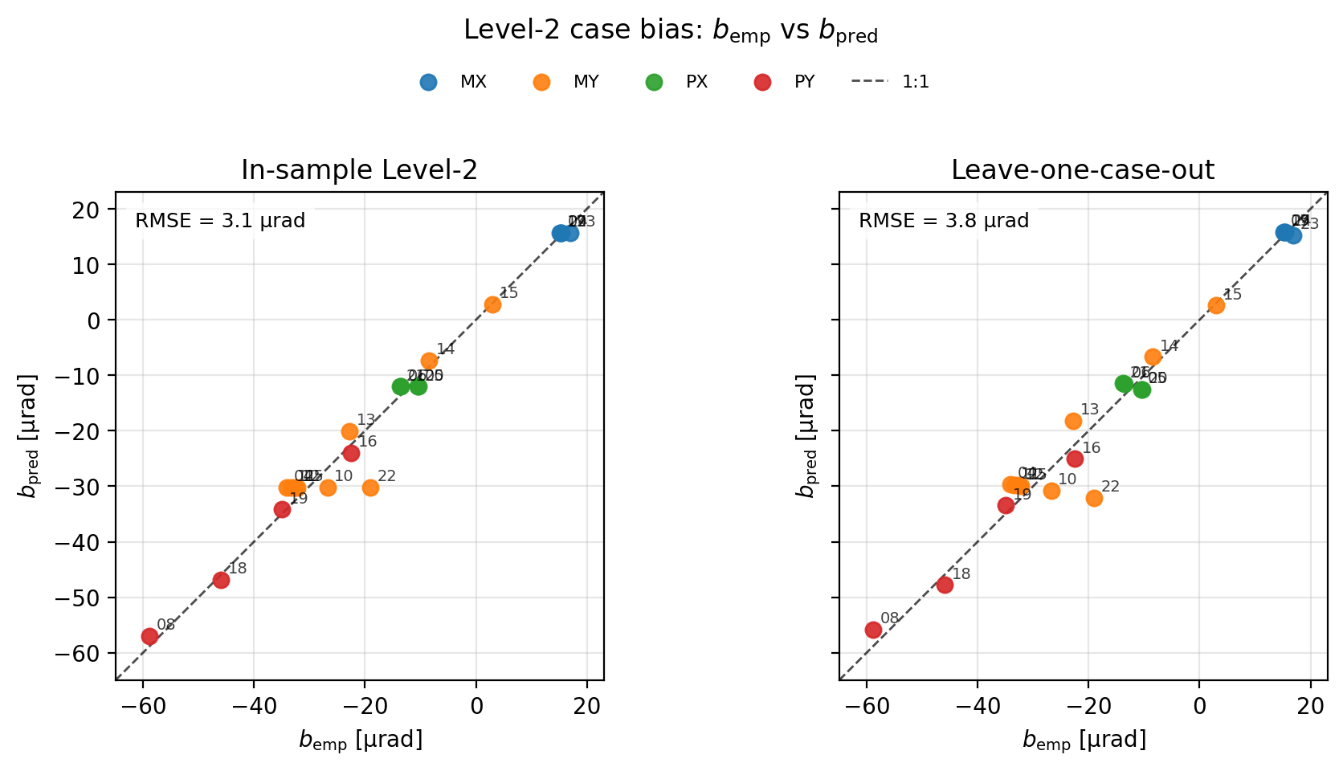
Cross-condition validation
Nested leave-one-case-out RMSE is 4.9 µrad against 615 µrad raw RMS
28–31 µrad/K
3.8 µrad
4.9 vs 615 µrad
shared sensitivity magnitude
LOO case-bias RMSE
median test RMSE vs raw RMS
21 cases; the test case is excluded from shared sensitivity and both Level-2 axis-bias estimates. Paper §6, Figure 6.
7

Slide 8
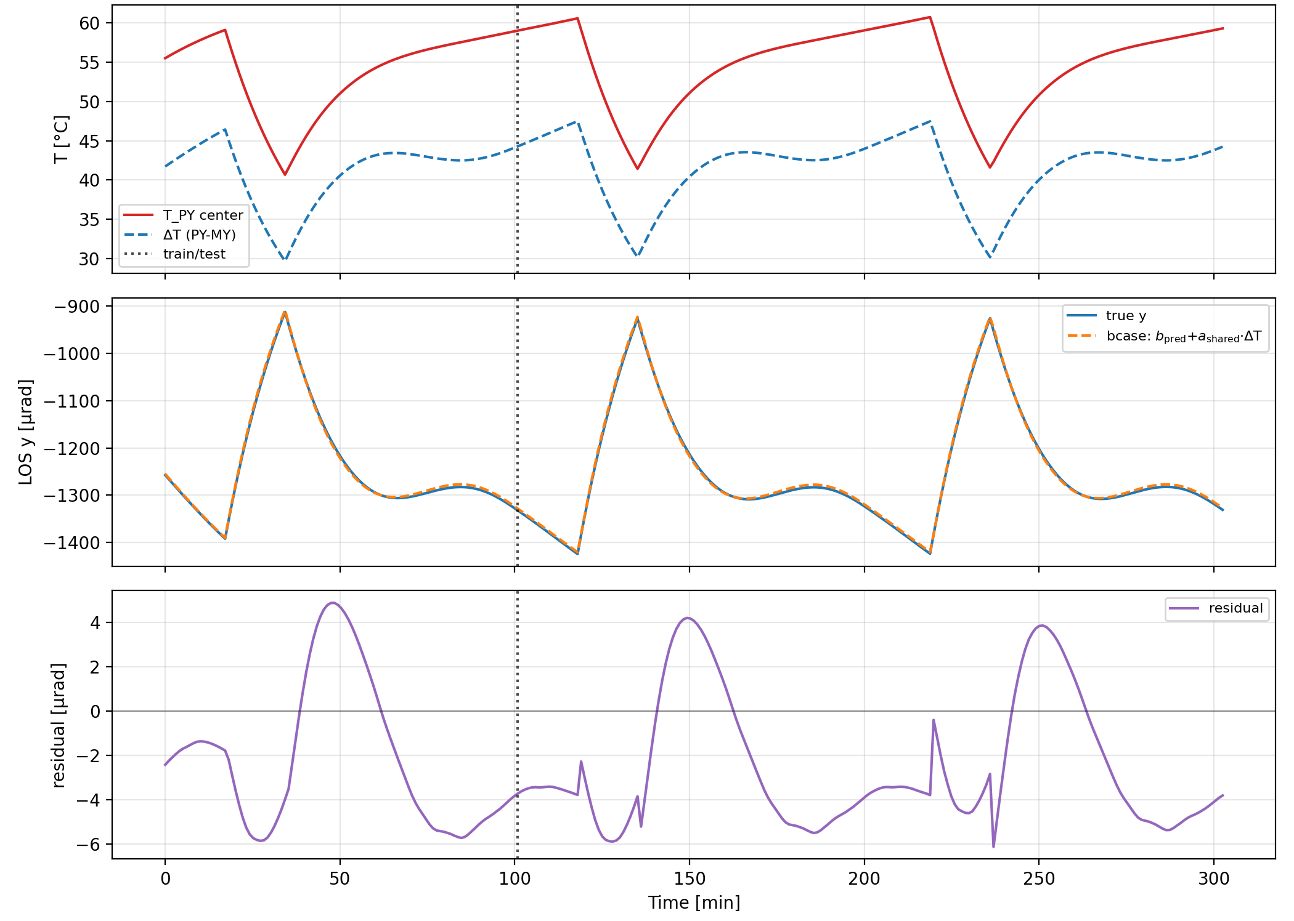
Time-series example
Case 08 (PY, all units on): 1250 µrad raw RMS falls to 3.9 µrad test RMSE
1250 µrad
raw dominant-axis RMS
3.9 µrad
nested-LOO test RMSE
What the model captures
The predicted case DC sets the offset; shared a(sun)·ΔT(t) follows the repeating orbital variation.
Prediction tracks the largest thermal case with a two-order-of-magnitude reduction.
Paper §6, Figure 7.
8

Slide 9
Coarse-acquisition evaluation
The prediction is subtracted from the scan center before the rectangular spiral starts
TD / Femap truth
Hierarchical model
Scan-center correction
Rectangular spiral
Thermal LOS
time series
Predicted thermal LOS
from ΔT and operating flags
Corrected center
= nominal − predicted thermal LOS
First point inside
detection radius
Acquisition time is used as a practical proxy for residual initial pointing uncertainty.
±1600 µrad
120 µrad
150 µrad
0.1 s
27 × 27
scan range
scan step
detection radius
dwell / point
maximum grid
No coverage holes: 120/√2 ≈ 85 µrad < 150 µrad.
Slew, settling, and stochastic detection are not modeled.
Paper §7.1, Table 6, Figures 8–9; beacon field basis: Shi et al. 2023.
9

Slide 10
PAT results · thermal only
With thermal error only, mean acquisition time falls from 14.6 s to 0.10 s
Mean acquisition time
9.3 µrad
No correction
14.6 s
mean two-axis thermal residual
Hierarchical ΔT
0.10 s
Thermal truth
0.10 s
100%
success for all three methods
Why one scan point is enough
9.3 µrad residual ≪ 150 µrad detection radius.
The prediction reaches the thermal-truth upper bound.
14 COLD baseline-surface cases · 301 epochs × 3 orbits per case
Paper §7.3, Table 7.
10

Slide 11
PAT results · with nonthermal error
With nonthermal error, the remaining search is no longer thermal: 19.2 s to 5.45 s
Mean acquisition time
−72%
No correction
19.2 s
mean acquisition time
Hierarchical ΔT
5.45 s
98 → 100%
acquisition success
After correction
Largest benefit: PY sun face
Mean initial error = 448 µrad
≈ synthesized nonthermal error floor
37.3–39.5 s and 88–97%
→ 1.3–1.8 s and 100%
The method removes predictable thermal bias; it does not claim to eliminate total pointing error.
One nonthermal-error seed per case; not a Monte Carlo ensemble. Paper §7.2–7.3, Table 7.
11

Slide 12
Scope and limitations
The present evaluation is numerical and structure-specific; several floors remain
Same simulation chain
LOS extraction proxy
Truth and reduced model use the same TD/Femap mechanics. LOO removes cases, not the shared structure.
Representative node rotations are used; a rigid-body fit over mounting interfaces remains to be tested.
Unmodeled operating factors
Simplified acquisition
Black coating, HOT orbit, and half-power dissipation raise the residual floor and are not explicit in Level 2.
Nonthermal error uses one seed; scan dynamics and stochastic detection are neglected; no ground test yet.
The measured sensitivity (~30 µrad/K) is specific to this structure, placement, and LOS definition; another spacecraft requires re-identification.
Paper §6 limitations, §7.4, §8.
12

Slide 13
Conclusion
Predictable thermal bias can be removed before acquisition; nonthermal error sets the remaining search
4.9 vs 615 µrad
14.6 → 0.10 s
19.2 → 5.45 s
nested-LOO RMSE vs raw RMS
thermal error only
with nonthermal error
Bus-relative STT–LCT thermal LOS
Shared coefficients across conditions
Feedforward coarse acquisition
Under the evaluated conditions, this reduces search burden before optical feedback is available.
Thank you
ICSO 2026 · Paper 293
13

Slide 14
BACKUP · Case matrix
The 21-case matrix separates sun face, dissipation, surface, and orbit effects
Case(s) | Purpose | Conditions
04–06, 08–09 | Sun face / baseline | MX/MY/PX/PY; all units or STT/LCT only
10 | Thermal environment | MY; HOT orbit with continuous illumination
11–12 | Surface properties | MY; Black sun face or Alodine surfaces
13–21 | Dissipation modes | PROP only / PCDU only / no additional dissipation
22 | Continuous power | MY; half PROP power (12.5 W) + PCDU
23–24 | MX dissipation | MX; PROP only or PCDU only
25 | Orbit condition | MY; LTAN18, 693 km
Evaluated IDs: 04–06 and 08–25. Cases 01–03 and 07 were MZ/setup runs and are excluded.
Paper Table 4.
B1

Slide 15
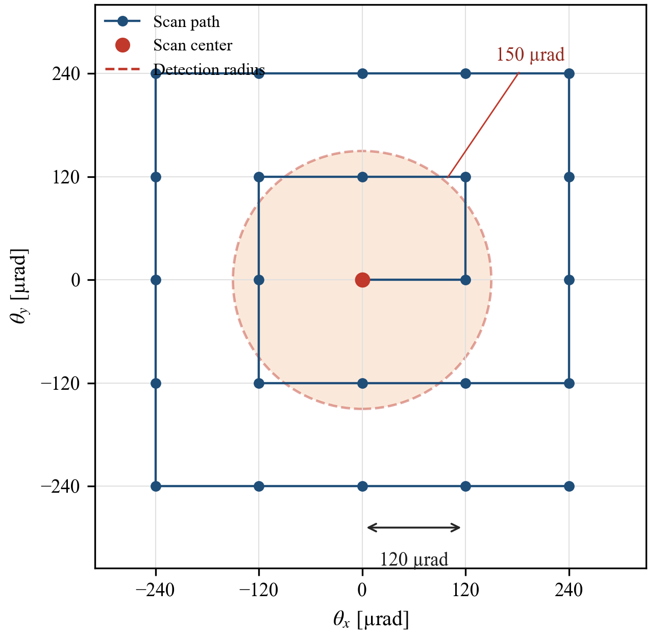
BACKUP · Scan geometry
A 120 µrad step with a 150 µrad detection radius leaves no coverage holes
Coverage condition
Half-diagonal = 120/√2 ≈ 85 µrad
85 µrad < 150 µrad detection radius
Full search
Range: ±1600 µrad
Grid: 27 × 27 = 729 points
Maximum: 72.9 s
Interpretation
The 150 µrad radius represents a coarse beacon field, not the narrow communication beam.
Paper §7.1, Table 6, Figure 9; field-of-view basis: Shi et al. 2023.
B2

Slide 16
BACKUP · Nonthermal error
The nonthermal synthesis combines orbit, alignment, attitude, and drift errors
Orbit prediction
Alignment residual
Latest Sentinel-1 TLE propagated by SGP4
vs precise POEORB, projected to link transverse plane
Constant two-axis residual
1σ = 50 µrad
Attitude error
Low-frequency drift
Random two-axis determination/control error
1σ = 50 µrad
Amplitude 30 µrad
Period 900 s
Thermal LOS and orbit error both contain near-orbital-period content; frequency alone cannot isolate the thermal term after acquisition.
One fixed seed per case; not a spacecraft-specific error budget or Monte Carlo ensemble. Paper §7.2.
B3

Slide 17
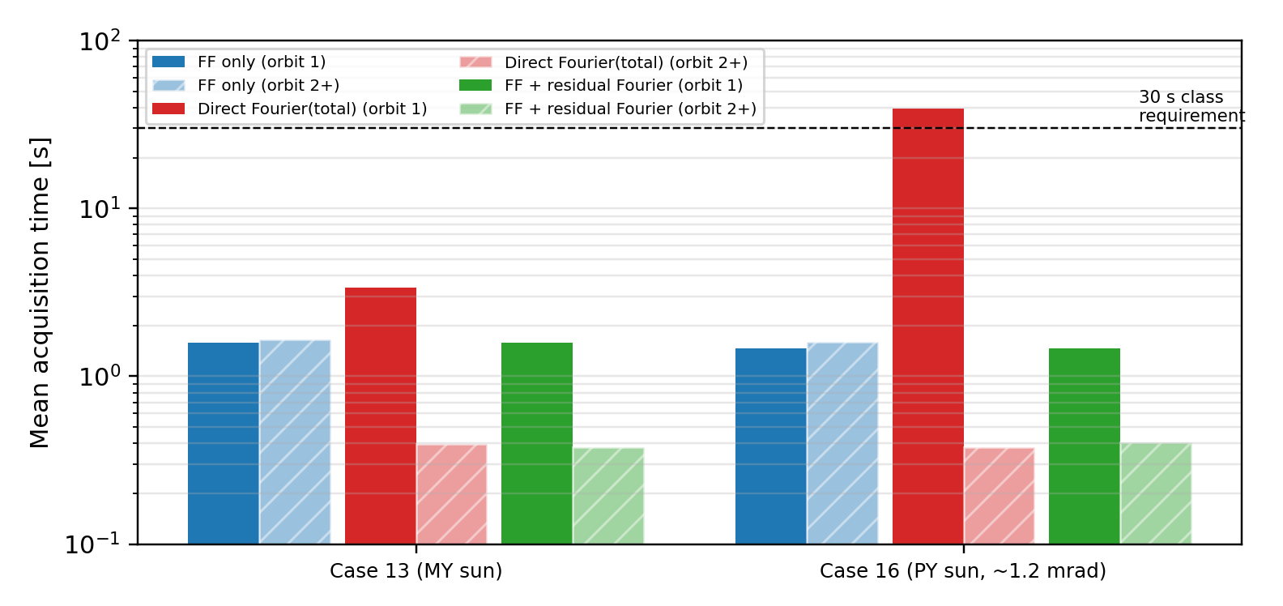
BACKUP · Preliminary residual update
A preliminary residual Fourier update preserves first-orbit FF and lowers later-orbit search
Causal update
K = 2 Fourier coefficients are fitted in orbit n and applied to orbit n+1.
Why FF first
Direct Fourier is uncorrected in orbit 0: Case 16 requires 39.5 s.
Preliminary only
Two cases; dense 60.5 s samples; failed-point residuals and receiver realization are not validated.
Paper §7.4, Figure 10.
B4

Slide 18
BACKUP · LOS extraction
Representative node rotations are a proxy for equipment attitude
Implemented
Thermal rotations at representative STT and LCT center nodes are differenced in the transverse axes.
Not yet implemented
Least-squares rigid-body attitude fitted over each mounting interface.
Implication
The present LOS definition and extraction method are shared by truth and reduced model.
Paper §4, analysis procedure.
B5

Slide 19
BACKUP · Hard cases
The largest residuals identify missing variables rather than model universality
Black coating
HOT orbit
Half PROP power
≈13 µrad test RMSE
Surface properties change orbital amplitude and residual floor.
Several-µrad DC residual
Continuous illumination is not explicit in Level 2.
≈16 µrad test RMSE
A binary dissipation flag cannot represent continuous power.
Next Level-2 variables
surface state · orbit/thermal environment · continuous dissipation
The model structure is portable; the present coefficients are not claimed to be universal.
Paper §6 discussion and limitations.
B6

Slide 20
BACKUP · Pending ablation
Constant-bias-only PAT comparison is reserved for a controlled ablation
PENDING ANALYSIS
Set ΔT(t) = 0 while retaining the predicted case DC bias.
This will quantify how much acquisition improvement comes from DC correction versus orbital variation.
No value from this pending ablation is used in the main-slide conclusions.
Reserved slot from the oral-slide outline; not yet computed.
B7

Slide 21
BACKUP · Prior work and positioning
This work connects thermal-state LOS prediction to optical-communication acquisition
Study | System / domain | Thermal treatment | Acquisition
Riesing 2023 | CubeSat optical PAT | Not modeled; absorbed by attitude system | Yes, in orbit
Rüddenklau 2026 | Optical terminal | FF of attitude / mounting errors | Yes
Shi 2023 | Optical-comm structure | Reduced by structural design | Yes
Zhang 2025 | Inter-satellite pointing | Finite-element assessment / guidance | Impact evaluated
Hu 2022 / Li 2025 | GEO / LEO Earth observation | Periodic model / neural network | No
Turella 2019/2021 | JUICE/JANUS camera | Wall-to-wall ΔT proportional model | No
This work | Optical-comm spacecraft bus | Hierarchical sun-face ΔT prediction | Yes
Novelty is not the first-order temperature–LOS relation itself; it is the bus-relative STT–LCT application, cross-condition DC prediction, and acquisition connection.
Paper §2 and related-work overview table.
B8

