Slide 1

Hierarchical Prediction and Feedforward Correction of Time-Varying Thermal Line-of-Sight Bias for Coarse Acquisition in Satellite Optical Communications
H. TAKAMOTO, K. Takashima, Y. Kusano, S. Ikari, R. Funase
(The University of Tokyo)
ICSO 2026 | October 15, 2026
Notes:
Good afternoon, everyone.
I’m Hideki Takamoto, a master’s student at the University of Tokyo.
Today, I’ll talk about predicting and correcting thermal pointing errors to improve acquisition in optical communications.

Slide 2
01
Background
Notes:
First, let me briefly explain the background and motivation of this study.

Slide 3
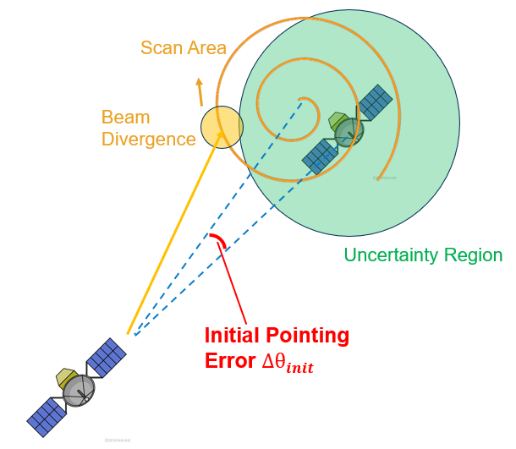
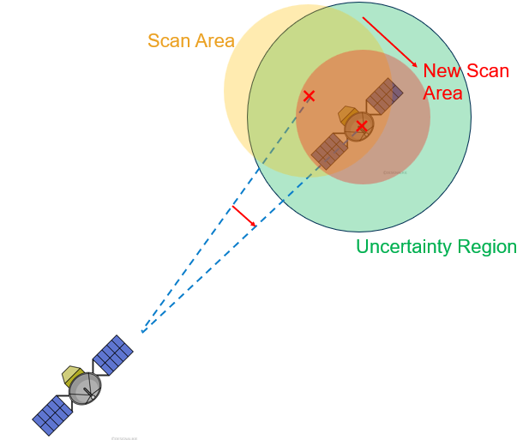
Reduce scan time by predicting thermal LOS error in optical communications
Background
Before optical feedback
Illumination / eclipse
/ dissipation
Our approach:
Pre-acquisition predictive correction
Search an uncertainty region including thermal LOS, attitude, and orbit errors
Temperature field
→ thermal expansion
→ spacecraft-bus distortion
Subtract thermal LOS
from the scan center
to reduce search time
Thermal LOS: 100 µrad to 1 mrad
satellite
LOS
ideal:
Thermal distortion
LOS
real:
satellite
Without modifying the spacecraft or LCT,
operationally remove only predictable thermal deformation from the initial LOS error.
Notes:
Before acquisition in optical communications, optical feedback is not yet available.
Therefore, the terminal has to search an uncertainty region that includes thermal LOS error, attitude error, and orbit-prediction error.
In particular, illumination, eclipse, and internal dissipation generate temperature gradients in the spacecraft.
These gradients cause thermal expansion and spacecraft-bus distortion, which can cause thermal LOS errors ranging from about 100 microradians to over 1 milliradian.
Our approach is to predict this thermal LOS error and use it to correct the scan center before acquisition.
This correction does not require any modification to the spacecraft structure or the laser communication terminal.

Slide 4
Background
Thermal LOS error can match or exceed orbit-prediction error—and cannot be optically separated before acquisition
Main contributors to scan-center LOS error during coarse acquisition
Error source | Approximate magnitude | Time variation
Thermal LOS | 150 µrad–1000 µrad (this analysis) | Orbital period (~100 min in LEO)
Orbit prediction | Several hundred µrad (TLE propagation vs. precise GPS ephemeris) | Orbital period (~100 min in LEO)
Attitude and calibrated alignment | Tens of µrad | DC to broadband
Mechanical vibration | Several to tens of µrad | High frequency (post-acquisition fine tracking)
* Thermal LOS and orbit-prediction error are from this analysis; other values are literature-based order-of-magnitude estimates.
Thermal LOS and orbit prediction share similar orbital periods
Frequency separation of post-acquisition residuals cannot isolate the thermal component
Do not separate thermal effects retrospectively from observations
Use temperature and operating state to subtract them before acquisition
2/17
Notes:
This table compares the main pointing error sources during coarse acquisition.
Thermal LOS error can be comparable to, or even larger than, orbit-prediction error.
Importantly, both errors vary on similar orbital time scales, making it difficult to separate them from pointing residuals based on frequency alone.
Therefore, we use temperature and operating-state information to predict and correct the thermal component before acquisition.

Slide 5
Background
Prior work on thermal-deformation LOS error prediction and this study
Aproach | Structural mitigation | Model-based LOS prediction | This study
References | Shi 2023; Zhang 2025; Gao 2025 | Hu 2022; Li 2025; Turella 2019/2021 | —
Approach to thermal deformation | Reduce deformation by structure, isolation, and placement, or quantify pointing error for layout and thermal control. | Predict or correct LOS from temperature difference, diurnal cycle, or observation geometry. | Predict bus-level LOS from panel ΔT and equipment state, with coefficients shared across cases.
Main target | Star sensor to laser terminal, and instrument-internal LOS | Instrument-internal or camera LOS | STT–LCT relative LOS across the spacecraft bus
Evaluation metric | Pointing or LOS stability; Shi 2023 also reports acquisition time | LOS error or image geolocation accuracy | Unseen-case LOS error, plus acquisition time and success rate
Remaining gap | These studies do not predict residual thermal LOS from an onboard thermal state. | These studies do not connect bus-level STT–LCT LOS to coarse acquisition. | Numerical only, on one simplified bus; not ground- or flight-validated.
This study predicts bus-level STT–LCT LOS.
We evaluates that prediction by coarse-acquisition time and success.
3/17
Notes:
Previous studies have addressed thermal LOS errors through different approaches.
First, structural mitigation aims to reduce thermal deformation through structural design, material selection, and equipment placement.
However, these studies mainly focus on reducing deformation, rather than predicting the remaining thermal LOS error from onboard measurements.
Second, model-based LOS prediction uses temperature differences, orbital phase, or observation geometry to predict and correct LOS variations.
However, the studies shown here mainly focus on individual optical instruments or cameras, without connecting spacecraft-bus LOS prediction to coarse-acquisition performance.
In this study, we predict the relative LOS between the STT and LCT across the spacecraft bus, using temperature and operating-state information.
We then apply this prediction to coarse acquisition and evaluate its impact on acquisition time and success rate.

Slide 6
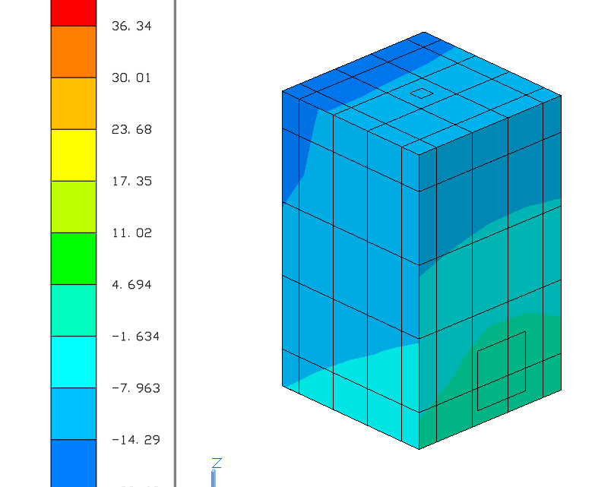
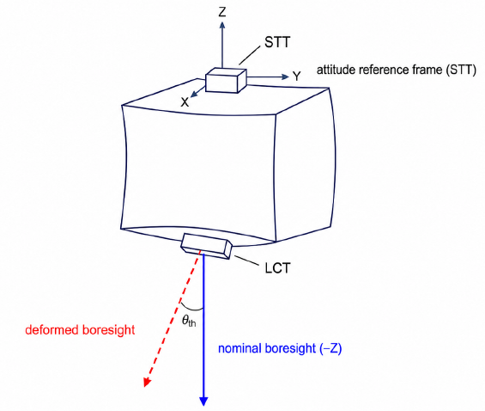
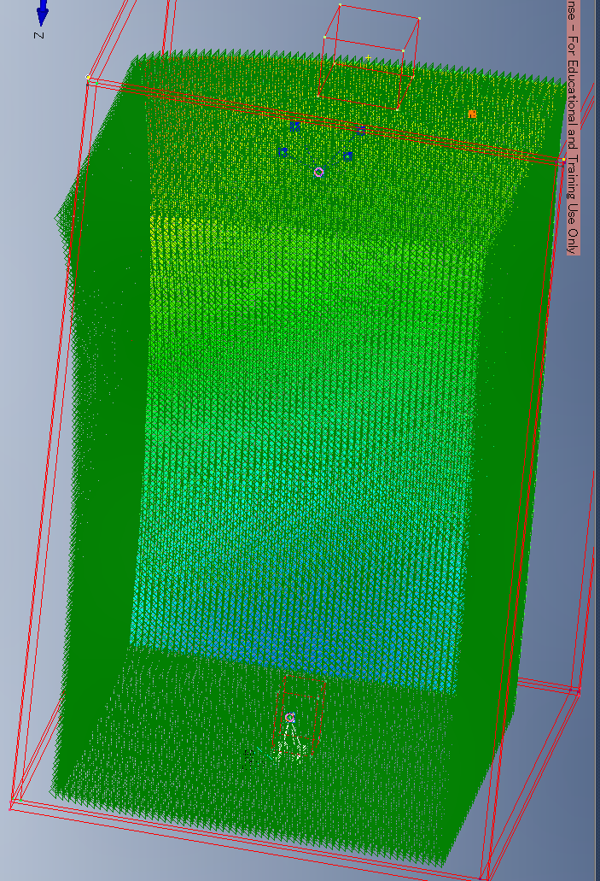
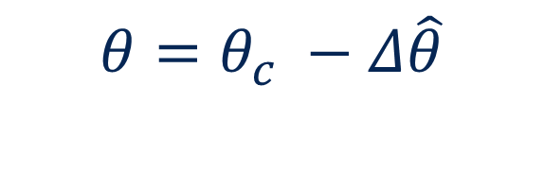
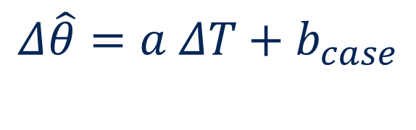
Background
Research overview: from thermoelastic truth generation and model construction to evaluation
Orbit / attitude
heat & coating
Thermal Desktop
temperature
Femap / Nastran
rotation
STT–LCT
thermal LOS
Reduced-order
model
PAT
scan center
• Orbit
• Attitude
• Equipment layout
• Surface properties
• Dissipation
$$Δ\hat{θ}=a ΔT+b_{case}$$
$$θ=θ_{c} −Δ\hat{θ}$$
Ground model development
On-orbit correction
• Input orbit, attitude, and thermal environment
• Compute temperature fields and thermoelastic deformation with TD/Femap
• Generate reference STT–LCT relative-LOS time series
• Train and evaluate the reduced-order model
• Temperature / operating state
• Predict thermal LOS
• Correct the scan center
• Include nonthermal errors
• Residual update
• TD/Femap runs only on the ground; only the reduced-order model runs onboard
• Evaluate LOS error, acquisition success, and acquisition time
4/17
Notes:
This slide shows the overall workflow of our study.
On the ground, Thermal Desktop and Femap generate reference thermal LOS data, which we use to develop a reduced-order model.
On orbit, the model predicts thermal LOS from temperature and operating-state information, and corrects the scan center before acquisition.
We then evaluate the model's prediction accuracy and its impact on acquisition performance.

Slide 7
02
Thermoelastic Analysis
Notes:
Next, I will explain how we evaluate thermal deformation and the resulting LOS error using thermo-structural analysis.

Slide 8
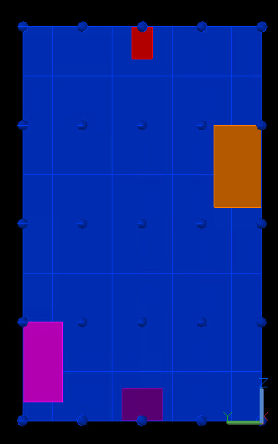
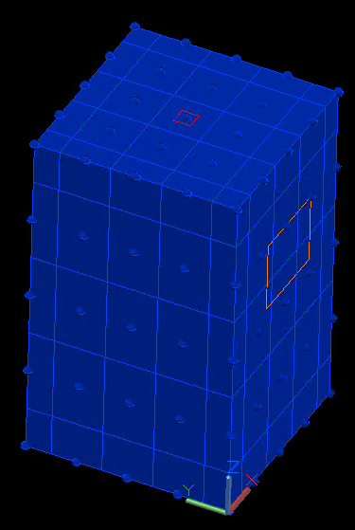
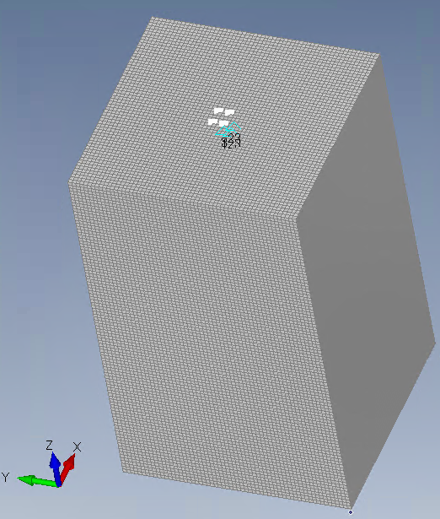
Thermoelastic analysis
We evaluate a box-structure LEO spacecraft with the STT and LCT on different panels
PZ: STT
Thermal Desktop
Femap
Main analysis-model settings
Item | Setting
Bus dimensions | 590 × 600 × 990 mm
Panels | 10-mm-thick shell elements
Material | A5052
LCT | Center of MZ panel
STT | Center of PZ panel
MY: PCDU
PY: PROP
MZ: LCT
Not a specific-spacecraft design review.
Fixed structure; sun face and dissipation vary.
LOS
Boresight ≈ −Z
5/17
Notes:
We evaluate a simple box-structure LEO spacecraft as a test model, with the star tracker and the laser communication terminal mounted on opposite panels.
The spacecraft bus is modeled as a 1meter-class satellite, using aluminum shell elements, on both of thermal desktop and Femap.

Slide 9
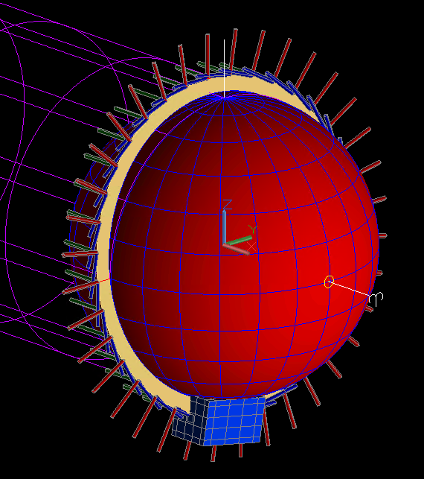
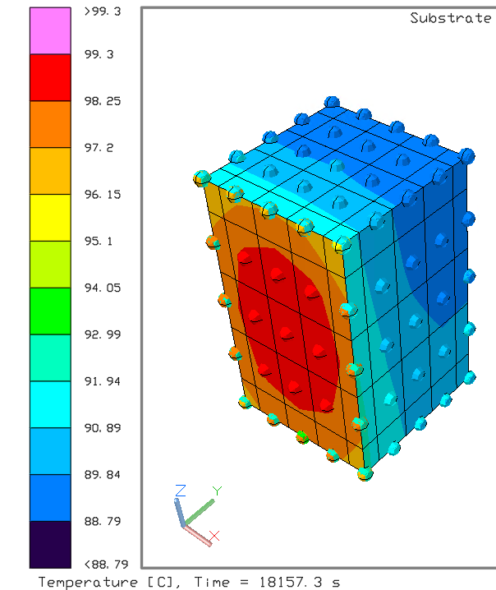
Thermoelastic analysis
Thermal Desktop generates temperature-field time series from orbit, attitude, surface, and dissipation inputs
Main thermal-analysis inputs
Input | Setting
Orbit | Sun-synchronous, LTAN06 / h = 800 km
Period | ≈6050 s (≈101 min)
Analysis duration | ≈18,157 s (3 orbits)
Sampling | Every ≈60.5 s, 301 points
Illumination | Eclipse / continuous illumination
Sun face | MX / MY / PX / PY
Number of nodes | 125
Environmental conditions varied by case
• Orbital Conditions
• Sun-facing panel
• Optical properties of panels
• Internal Equipment dissipation
Output: panel temperature field T(t), computed on the ground.
6/17
Notes:
First, we use Thermal Desktop to calculate the spacecraft temperature distribution over time.
We consider different orbital conditions, sun-facing panels, surface panel properties, and internal equipment dissipation.
The resulting temperature fields are then used as inputs for thermoelastic structural analysis.

Slide 10
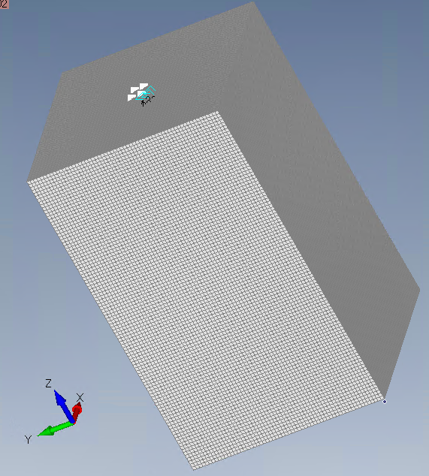
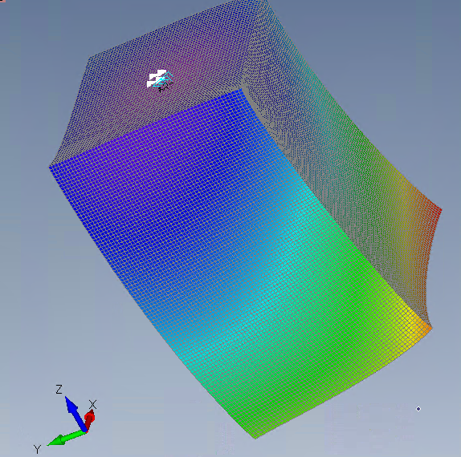
Thermoelastic analysis
The temperature field is mapped into Femap to obtain STT and LCT translations and rotations
Main structural-analysis settings
Structural-analysis setting | Value
Material | Aluminum A5052
Young's modulus | 70.327 GPa
Poisson's ratio | 0.33
Coefficient of thermal expansion | 2.376×10⁻⁵ /K
Density | 2685 kg/m³
Reference temperature | 23.9 ℃
Constraint | Small region near the STT
Thermal Desktop and Femap generate training data on the ground.
T(t,x) from TD
7/17
Notes:
Next, we transfer the temperature fields from Thermal Desktop to Femap for thermoelastic structural analysis.
Using the material properties shown here, we calculate the thermal deformation of the spacecraft structure.
From the results, we obtain the translations and rotations at the STT and LCT mounting locations.

Slide 11
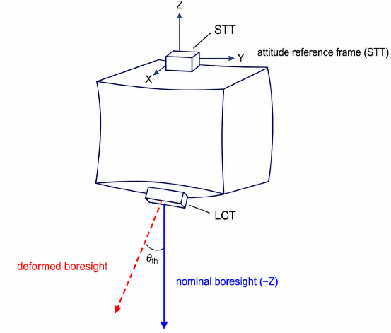
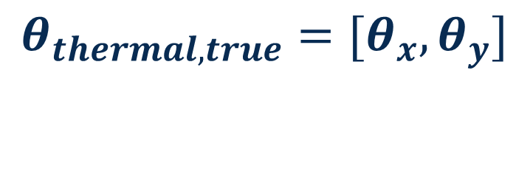
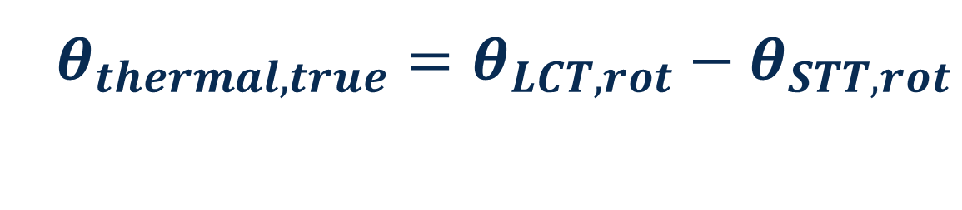
Thermoelastic analysis
Calculate thermal LOS error through rotation of STT and LCT
STT
LOS-error definition
• LCT optical-axis rotation − STT reference rotation
• STT thermal rotation is absorbed into attitude
• Directly gives far-field scan-center error
• Excludes translation-induced tilt
$θ_{thermal,true}=θ_{LCT, rot}−θ_{STT, rot}$
$θ_{thermal,true}={[θ}_{x}, θ_{y}]$
LCT
Far-field LOS error = STT-relative LCT optical-axis rotation, not translation
8/17
Notes:
For a far-field optical link, the relevant quantity is not the translation of the mounting points, but their relative rotation.
We define the thermal LOS error, as the rotation of the LCT optical axis, relative to the STT attitude reference.
The thermal rotation of the STT itself is absorbed into the attitude reference.

Slide 12
Thermoelastic analysis
We evaluate 21 cases across four thermal and operating conditions
21 cases
Thermoelastic analysis across different operating conditions
Sun-facing panel
Internal dissipation
MX / MY / PX / PY
Equipment ON/OFF states
Surface properties
Orbital environment
Baseline / Black / Alodine
Eclipse / Continuous illumination
Same spacecraft structure and LOS definition across all cases.
Validation across operating conditions, not across different spacecraft structures.
9/17
Notes:
With the spacecraft structure and LOS definition fixed, we vary four groups of conditions.
These are the sun-facing panel, internal equipment dissipation, surface properties, and orbital thermal environment.
In total, we analyze 21 cases.
The important point is that these are different thermal and operating conditions within the same spacecraft configuration.

Slide 13
03
Reduced-order model
Notes:
Based on these analysis results, we develop a simplified model to predict thermal LOS error using onboard temperature measurements.

Slide 14
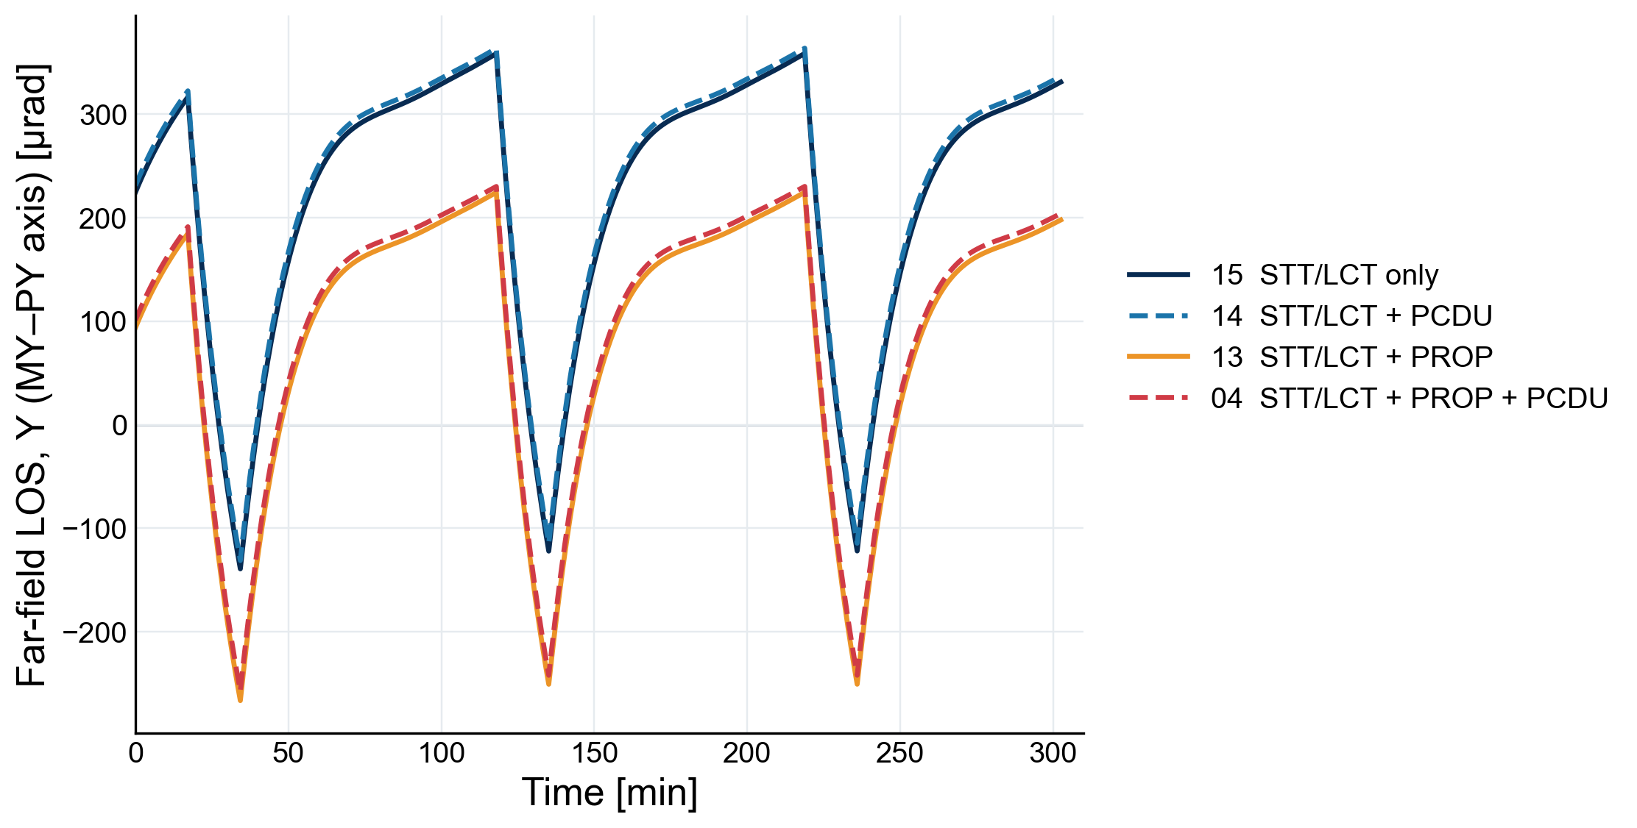
Reduced-order model
Thermal LOS shows similar orbital variations but different offsets across operating conditions
Observation
Similar within-orbit waveform, different mean offsets
Interpretation
Orbital variation is largely shared:
Equipment dissipation shifts the mean level
Same sun face, different dissipation states
Modeling choice
Thermal LOS = Time-varying term + Case-dependent bias
10/17
Notes:
Here, I compare four cases with the same sun-facing panel but different equipment dissipation states from the numerical simulation by TD and Femap.
As you can see, the within-orbit waveforms are very similar, while their mean LOS levels differ substantially between cases.
This suggests that thermal LOS error can be separated into two components: a time-varying component within each orbit and a case-dependent offset.
We therefore aim to predict these two components separately using a reduced-order model.
So, how can we predict the time-varying component?

Slide 15
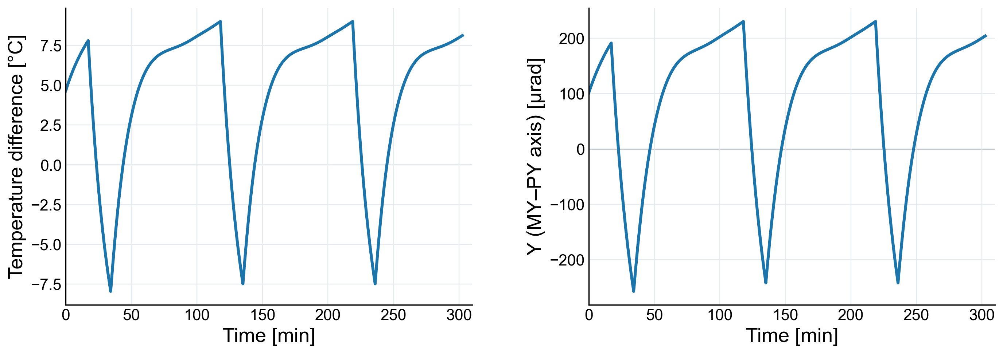
Thermoelastic analysis
Thermal LOS variation closely follows the sun-facing–opposite-panel temperature difference
MY center - PY center
Far-field LOS, Y axis (MY-PY)
Observation
Interpretation
Panel ΔT and thermal LOS show nearly identical orbital variations.
Panel ΔT is a promising predictor of time-varying thermal LOS.
Time-varying thermal LOS ∝ Panel ΔT
11/17
Notes:
To answer this question, we focus on the temperature difference between the sun-facing and opposite panels.
The left figure shows the temperature difference between the sun-facing and opposite panels, while the right figure shows the corresponding thermal LOS error.
As you can see, both signals follow almost the same waveform.
This suggests that the panel temperature difference can be used to predict the time-varying thermal LOS component.

Slide 16
Reduced-order model
A hierarchical model predicts thermal LOS using panel ΔT and operating states
$$θ_{dom}\left(t\right)≈ a_{sunface} · ΔT\left(t\right)+b_{case}$$
Time-varying component Case-dependent offset
Time-varying component
Case-dependent offset
$$ΔT\left(t\right)= T_{sunface}\left(t\right)− T_{opposite}\left(t\right)$$
$$b_{case} ≈ b_{0,sunface} + c_{PROP}I_{PROP} + c_{PCDU}I_{PCDU}$$
Thermal sensitivity is shared across cases with the same sun-facing panel.
Baseline offset by sun face + equipment ON/OFF states
Dominant LOS axis depends on the sun-facing panel:
MX/PX → x-axis, MY/PY → y-axis
Non-dominant axis: Case-dependent offset only
12/17
Notes:
Based on these observations, we developed a hierarchical temperature-difference model.
The model predicts thermal LOS error as the sum of two components.
The first component describes the time-varying error using the temperature difference between the sun-facing and opposite panels. The thermal sensitivity “a” is shared across cases with the same sun-facing panel.
The second component is a case-dependent offset “b”, modeled using the sun-facing panel and the ON/OFF states of two onboard units.
The dominant LOS axis depends on the sun-facing panel. For MX and PX, it is the x-axis, while for MY and PY, it is the y-axis.
For the non-dominant axis, the time variation is much smaller. Therefore, we model it using only a case-dependent offset, without the temperature-difference term.
This simple model allows us to predict thermal LOS error using onboard temperature measurements and operating-state information.

Slide 17
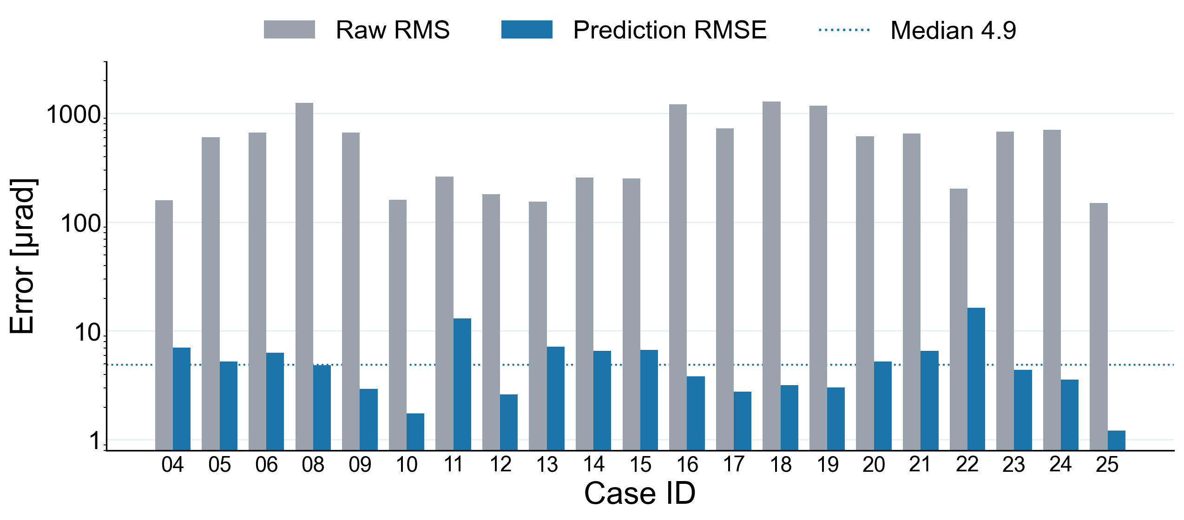
Reduced-order model
The hierarchical model predicts unseen thermal LOS with a median RMSE of 4.9 µrad
Leave-one-case-out validation: each test case is excluded from all coefficient estimation.
The next two orbits are then predicted using the fixed model.
615 µrad
Median raw dominant-axis RMS
4.9 µrad
Median prediction RMSE on unseen cases
The prediction residual is roughly one to two orders of magnitude smaller than the raw thermal LOS.
Evaluated within the same spacecraft structure and LOS definition.
13/17
Notes:
Here I summarize the prediction performance of the hierarchical model under unseen operating conditions.
We evaluate the model using leave-one-case-out validation. In each trial, the test case is completely excluded from all coefficient estimation, and its next two orbits are predicted using the fixed model.
The bar chart compares the raw dominant-axis thermal LOS RMS with the prediction RMSE for each case.
Across the evaluated cases, the median raw thermal LOS is 615 microradians, while the median prediction RMSE is only 4.9 microradians.
This shows that the reduced-order model can predict thermal LOS under unseen operating conditions with residual errors of only a few microradians.

Slide 18
04
Coarse-acquisition evaluation
Notes:
Next, we evaluate how the predicted thermal LOS correction improves coarse-acquisition performance.（ここまで9分）

Slide 19
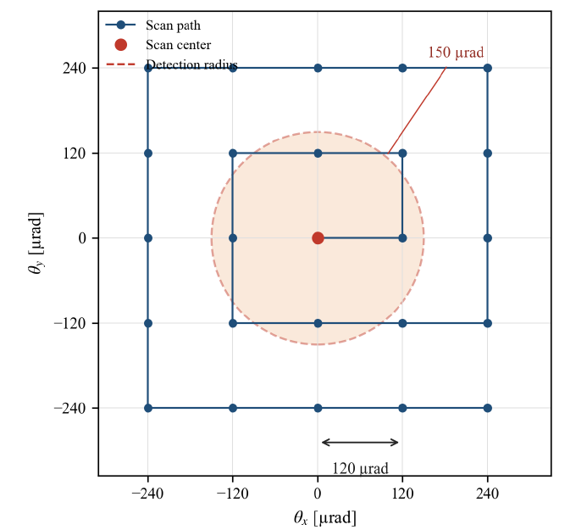
Acquisition conditions
Feedforward thermal correction reduces the scan-center error before acquisition
$$e_{scan\left(t\right)}= e_{nonthermal\left(t\right)}+ θ_{thermal, true}\left(t\right)− {\hat{θ}}_{thermal}\left(t\right)$$
Scan-center error ·Nonthermal pointing errors True thermal LOS · Predicted thermal LOS
Thermal LOS residual
+ nonthermal errors
Rectangular spiral scan
Acquisition time and success
±1600 µrad
120 µrad
150 µrad
0.1 s / point
Scan range
Scan step
Detection radius
Dwell time
No coverage holes: half the grid diagonal ≈ 85 µrad < 150 µrad detection radius.
Inter-point slew, settling time, and stochastic detection are neglected.
14/17
Notes:
The predicted thermal LOS is used to correct the center of a rectangular spiral scan.
The remaining pointing error consists of the thermal prediction residual and nonthermal errors.
We evaluate acquisition time and success rate using the scan conditions shown here
This is a simplified scan model, so the acquisition times should be interpreted as comparative results under the same conditions.

Slide 20
Acquisition conditions
We include orbit, alignment, attitude, and drift errors in the acquisition evaluation
$$e_{nonthermal}= e_{orbit}+ e_{alignment}+ e_{attitude}+ e_{drift}$$
Error source | Magnitude
Orbit prediction | Mean 280–700 µrad
Alignment | 50 µrad/axis (1σ)
Attitude | 50 µrad/axis (1σ)
Drift | 30 µrad amplitude
Representative GNSS-denied LEO scenario — not a spacecraft-specific error budget.
Orbit error: TLE/SGP4 prediction vs. Sentinel-1 precise ephemeris.
15/17
Notes:
In addition to the thermal LOS error, we include four nonthermal pointing-error components in the acquisition evaluation.
These are orbit-prediction error, alignment error, attitude error, and low-frequency drift.
The orbit-prediction error is generated by comparing Sentinel-1 TLE propagation using SGP4 with precise POEORB ephemeris data,
and projecting the difference onto the link trans-verse plane.
The other components are modeled as a constant alignment error, random attitude error, and sinusoidal(サイナソイダル) drift.
The orbit-prediction error is relatively large, with a mean magnitude of approximately 280 to 700 microradians depending on the link geometry.
This is not a spacecraft-specific error budget. Instead, it represents a generic GNSS-denied small-LEO scenario.
The numerical evaluation uses one random seed per case, so statistical variation across different noise realizations is not assessed.

Slide 21
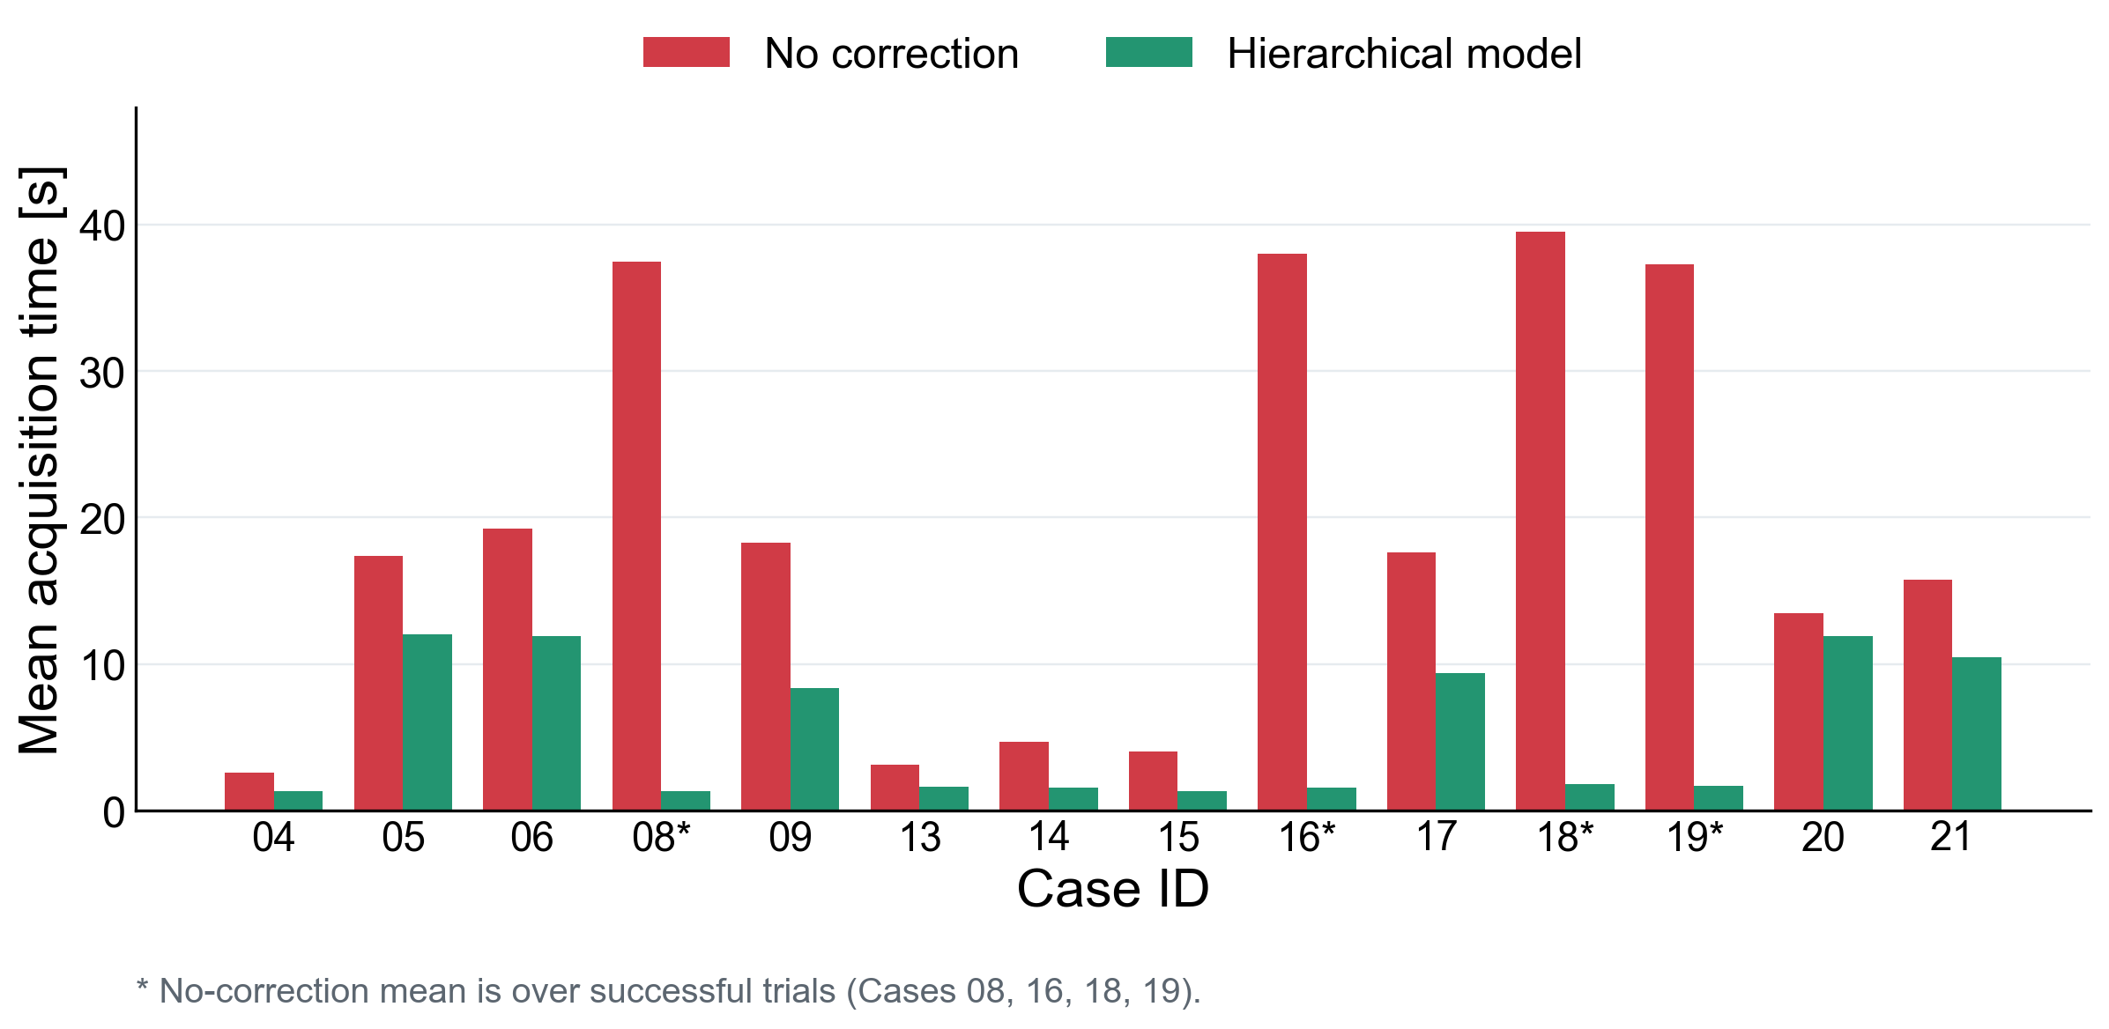
Acquisition results
Feedforward thermal correction reduces acquisition time across operating conditions
19 → 5.5 s
Mean acquisition time
−72%
Reduction in mean acquisition time
Success rate: 98% → 100%
Thermal correction reduces acquisition time even when nonthermal pointing errors remain.
After correction, the residual pointing error is dominated by nonthermal components.
16/17
Notes:
Finally, I present the acquisition results with nonthermal pointing errors included.
This graph compares acquisition time across fourteen operating cases.
The red bars show the results without correction, and the green bars show the results with our hierarchical model.
Without thermal correction, the mean acquisition time is 19 seconds.
With the hierarchical model, it decreases to 5.5 seconds, corresponding to a 72 percent reduction.
The acquisition success rate also increases from 98 percent to 100 percent.
The improvement is particularly large for the PY sun-facing cases, where the thermal LOS error is approximately 1.2 milliradians. In these cases, acquisition time decreases from around 40 seconds to approximately 1 to 2 seconds.
After correction, the remaining pointing error is dominated by nonthermal components.
Therefore, our approach does not eliminate all pointing errors, but significantly reduces the acquisition burden by removing the predictable thermal component before optical feedback becomes available.

Slide 22
05
Summary
Notes:
Finally, let me summarize the main findings and limitations of this study.

Slide 23
Summary
Thermal LOS prediction improves coarse acquisition, with further validation needed for flight applications
Key Findings
A physics-informed reduced-order model predicts thermal LOS from panel temperatures and operating states, enabling feedforward correction before optical feedback.
4.9 µrad median prediction RMSE | 72% reduction in mean acquisition time
Future work 01: Model generalization
Future work 02: Onboard adaptation
Current limitation
Current limitation
Numerically validated on one simplified box bus with a fixed STT–LCT placement.
Fixed coefficients rely on ground-based thermo-structural predictions.
Next step
Next step
Test whether panel ΔT plus a case bias still holds for realistic structures and different equipment placements and validate it by ground testing.
Update the model using post-acquisition observations while separating thermal and nonthermal pointing errors.
Thermal distortion can be treated as a predictable bias—not merely an acquisition uncertainty.
Thank you for your attention.
17/17
Notes:
To summarize, we developed a physics-informed reduced-order model to predict thermal LOS error before optical acquisition.
The model achieved a median prediction RMSE of 4.9 microradians under unseen operating conditions, and reduced the mean acquisition time by 72 percent in our numerical evaluation.
However, two important challenges remain.
First, the model has only been validated numerically for a simplified spacecraft structure and a fixed STT–LCT configuration.
We need to examine whether the same model structure works, for more realistic spacecraft and different equipment placements,
and validate the predictions through ground testing.
Second, the model currently relies on fixed coefficients identified on the ground. For practical onboard use, we need adaptive updates based on post-acquisition measurements, while distinguishing thermal error from other pointing errors.
Our main message is that thermal deformation can be treated as a predictable bias and corrected before optical feedback becomes available.
(泊置く)
Thank you for your attention. I'd be happy to take any questions.

Slide 24
B
Appendix
Notes:
Section A: Appendix

Slide 25
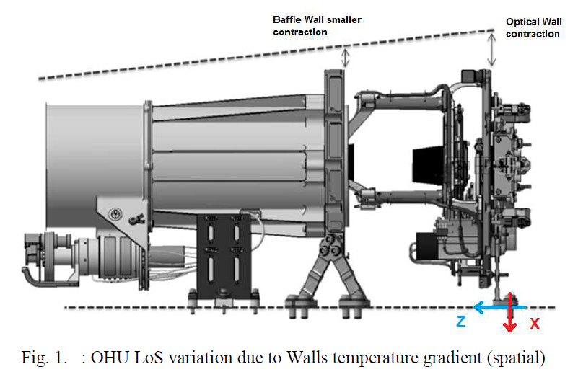
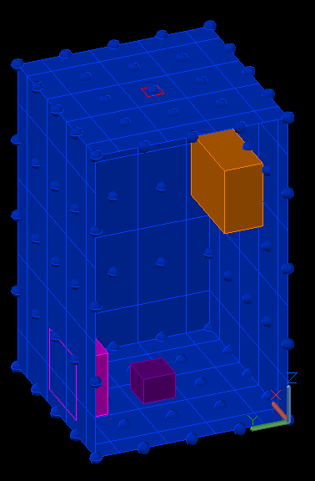
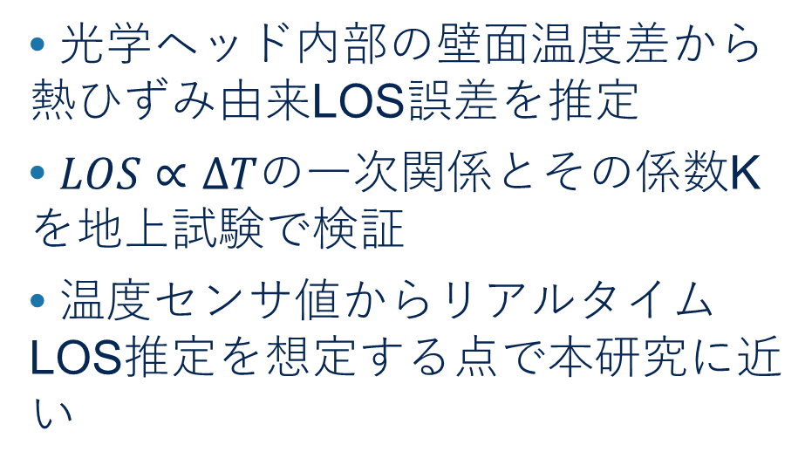
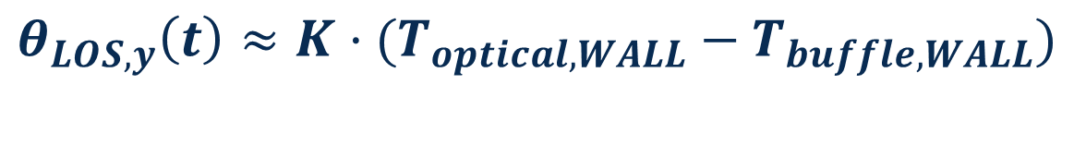

Positioning & limitations
先行研究の存在：温度差とLOSの一次関係は光学機器内でも報告されている
JANUS / prior art
This work
Buffle Wall
Optical Wall
• 光学ヘッド内部の壁面温度差から熱ひずみ由来LOS誤差を推定
• $LOS∝ΔT$の一次関係とその係数Kを地上試験で検証
• 温度センサ値からリアルタイムLOS推定を想定する点で本研究に近い
• 衛星バス上のSTT–LCT相対LOSを対象
• 太陽指向面–反対面温度差から軌道内変動を予測
• 発熱・被覆・軌道条件によるケースDCを階層化
• 予測LOSをscan center補正へ入力 捕捉成功率・捕捉時間まで評価
• ※非支配軸・別構造・飛行実証は未評価
25 cm程度
$$θ_{LOS, y}\left(t\right)≈K·(T_{optical, WALL}−T_{buffle, WALL})$$
$$θ_{dom}\left(t\right)≈ a_{sunface} · ΔT\left(t\right)+b_{case} ,$$
$$b_{case} ≈ b_{0,sunface} + c_{PROP}I_{PROP} + c_{PCDU}I_{PCDU}$$
本研究の貢献は、
温度差–LOSの一次関係を衛星バス上のSTT–LCT相対LOS予測へ拡張し、粗捕捉性能改善まで接続した点にある
Notes:
ΔT一次関係はJANUSにある。差分はバス相対LOS、階層DC、粗捕捉性能への接続。

Slide 26
PAT simulation conditions
粗捕捉は矩形スパイラルの離散走査として簡略化する
パラメータ | 設定値
走査範囲 | ±1600 µrad
点間隔 | 40 µrad
検出半径 | 25 µrad
滞在時間 | 0.1 s / 点
総走査点数 | 6561点
最大走査時間 | 656.1 s
※妥当な検出半径またはstepは後で再検討する
簡略化：点間移動・整定時間・受光強度の確率変動は考慮しない
各走査点を独立な捕捉機会として評価する
真の指向誤差が検出半径内に入った最初の走査点を捕捉時刻とする
Notes:
平均捕捉時間は成功試行のみの条件付き平均。成功率を併記する。

Slide 27

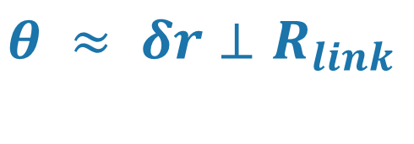
Orbit prediction error
軌道予測誤差：自身の位置誤差をリンクLOS横断面へ投影し、衛星の座標系 STT/body x–yへ変換する
Sun | Partner / link | Status
MY | along-track ISL 800 km | ready
PY | anti-along ISL 800 km | ready
PX | nadir ground ~695 km | ready
MX | zenith proxy 800 km | unrealistic
$$δr⊥ = δr − (δr·ℓ ̂)ℓ ̂$$
$$θ ≈ δr⊥R_{link}$$
• orbit catalogから姿勢を構成
• STT/body x–yへ射影
• 熱LOSと同じ2成分で加算
※ LCTの指向面ごとに、通信相手は地上局/衛星をそれぞれ設定
※ MXは角度計算可能だが、LCTが天頂方向のため、現実的リンクではない
Notes:
以前の任意ECEF-Z基底からSTT/bodyへ接続。MX proxyに注意。

Slide 28
Appendix
Limitations of this study ＆ Future work
Validation scope
Model applicability
Numerical evaluation: same structure and LOS definition
No ground test; flight relevance of the analysis model and sensitivities remains unvalidated
LOS extraction
Acquisition evaluation
Representative-node rotations; no interface rigid-body fit or internal STT/LCT deformation
One nonthermal seed; simplified scan dynamics
Future Work: ground-test validation, coefficient re-identification for real spacecraft,
and onboard adaptation using post-acquisition residuals
Oral presentation at ICSO 2026 on October 15
Thank you for your attention
Notes:
There are several limitations to the current study.
First, the validation is entirely numerical and is limited to the same spacecraft structure and LOS definition.
Second, ground-test validation has not yet been performed, so the flight relevance of the thermo-structural model and the identified thermal sensitivities remains to be demonstrated.
Third, the LOS is calculated using representative-node rotations.
A rigid-body fit of the mounting interface and internal thermal deformation of the STT and LCT are not included.
Finally, the acquisition simulation uses one nonthermal-error realization and simplified scan dynamics.
There are three main directions for future work.
First, we plan to validate the thermo-structural sensitivities through ground thermal testing.
Second, for application to an actual spacecraft, the coefficients must be re-identified for the real structure and mounting configuration, while we investigate whether the same model structure can be retained.
Third, after successful acquisition, optical pointing residuals could be used to adapt or update the prediction for repeated links.
Thank you very much for your attention.

Slide 29
Reduced-order model
The test case is excluded from all coefficient estimates to evaluate prediction under unseen conditions
① Fit each case
② Share within each sun face
③ Test an unseen case
Use the first orbit of each case
to estimate its sensitivity a
and mean b
Median a within each sun face
becomes the shared sensitivity
Fit mean b across cases from
sun face and dissipation flags
nested leave-one-case-out
Exclude the test case from shared sensitivity
and both-axis mean models
Evaluate its next two orbits
Evaluate how well fixed shared coefficients predict unseen operating conditions
Across-condition evaluation within the same structure and LOS definition
Notes:
Let me briefly explain how the coefficients a and b are determined.
First, for each analysis case, we use the first orbit to fit the relationship between the panel temperature difference and the thermal LOS.
This gives a case-specific thermal sensitivity, a, and a mean offset, b.
Next, the thermal sensitivity a is shared across cases with the same sun-facing panel.
We use the median sensitivity of those cases as the shared coefficient.
The mean offset b is treated differently.
Instead of assigning an independent offset to every case, we model it using the sun-facing panel and equipment ON/OFF states.
Therefore, the final onboard model does not require independent coefficients for every operating condition.
To evaluate prediction under unseen conditions, we use a nested leave-one-case-out procedure.
The test case is completely excluded from both the shared thermal-sensitivity estimation and the DC-bias model.
Then, using only the fixed coefficients obtained from the remaining cases, we predict the excluded case and evaluate its next two orbits.
So, this evaluates generalization to an unseen operating condition within the same spacecraft configuration.

Slide 30
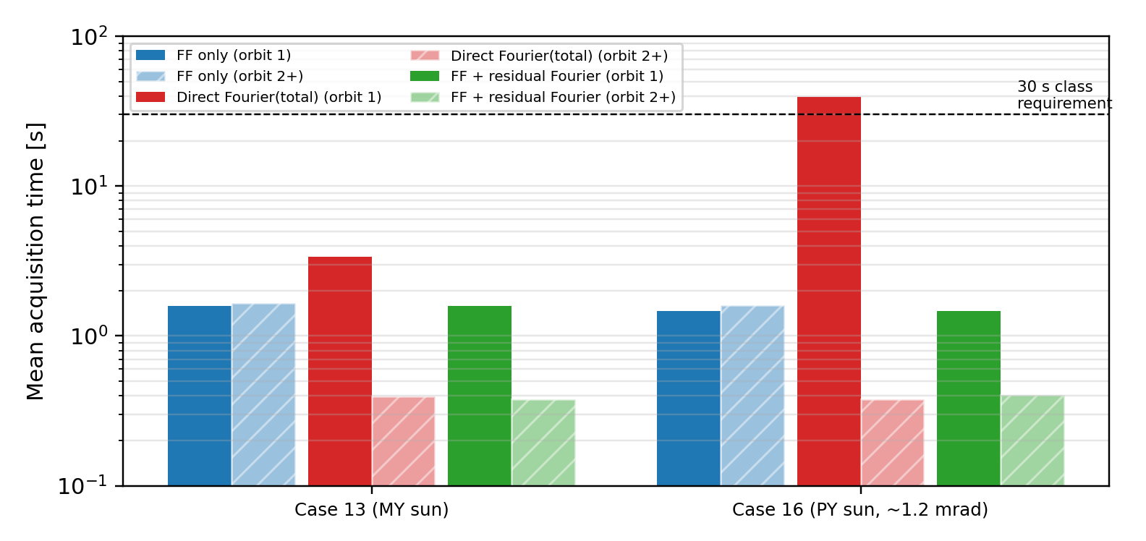
Acquisition results
Temperature prediction helps the first acquisition; residual updates lower the later-orbit floor
Case 16 (PY) | First orbit | Orbit 1 onward
Direct Fourier fit to total error | 39.5 s | 0.38 s
Hierarchical model + residual Fourier | 1.47 s | 0.40 s
A constant residual update is insufficient
Case 13, orbit 1 onward: 1.66 → 1.35 s;
above the 0.38 s Fourier result.
Scope of this section
Primary result: temperature/operating-state feedforward.
Repeated links may reduce the floor further.
Thermal-model coefficients are fixed.
Preliminary update of total pointing residual
after acquisition (two cases, dense sampling).
Notes:
Finally, as a preliminary extension, we also examined the use of post-acquisition pointing residuals for repeated links.
For the first acquisition, temperature-based prediction is important because previous optical residuals may not be available.
After successful acquisition, however, periodic information contained in the residual can be used to reduce the remaining error in later orbits.
In the two numerical cases shown here, combining the feedforward thermal model with a Fourier model of the residual reduces later-orbit acquisition time further.
However, this is only a preliminary study.
The thermal-model coefficients themselves are not updated, and the analysis currently uses only two cases with densely sampled residual data.
Therefore, the primary result of this work remains the pre-acquisition feedforward correction based on temperature and operating-state information.

Slide 31
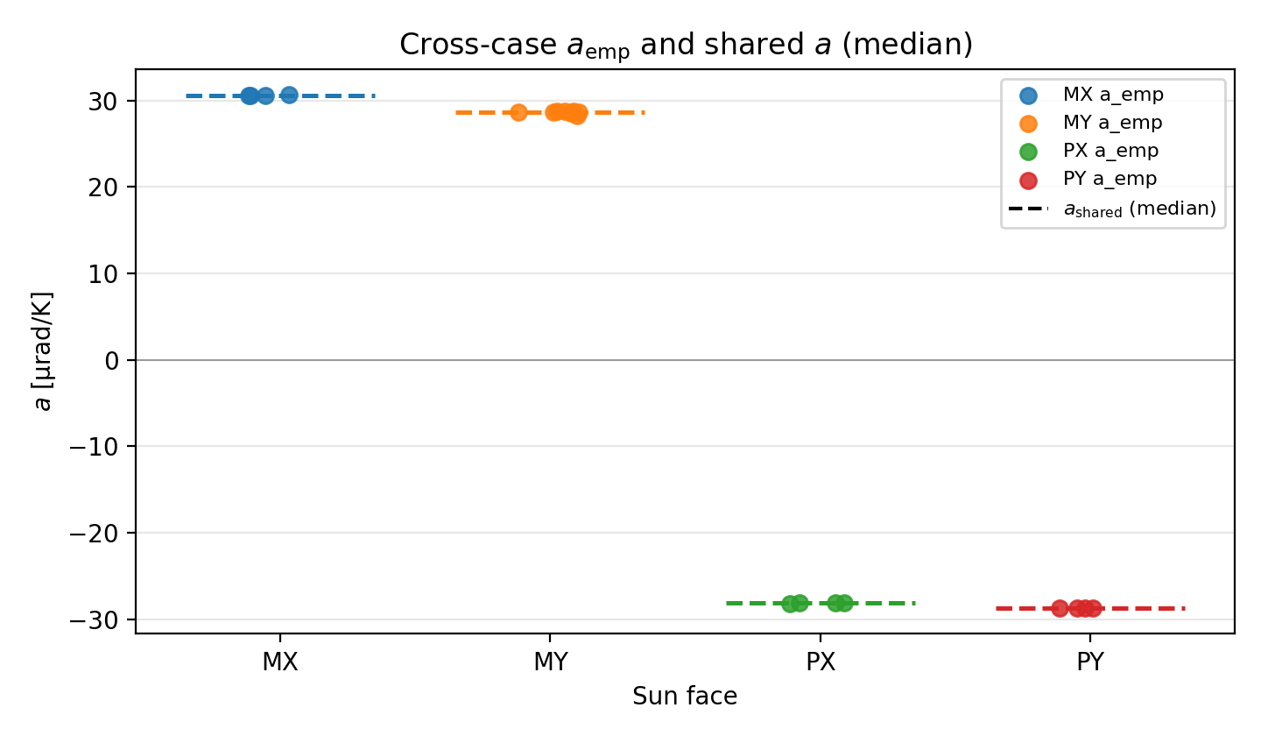
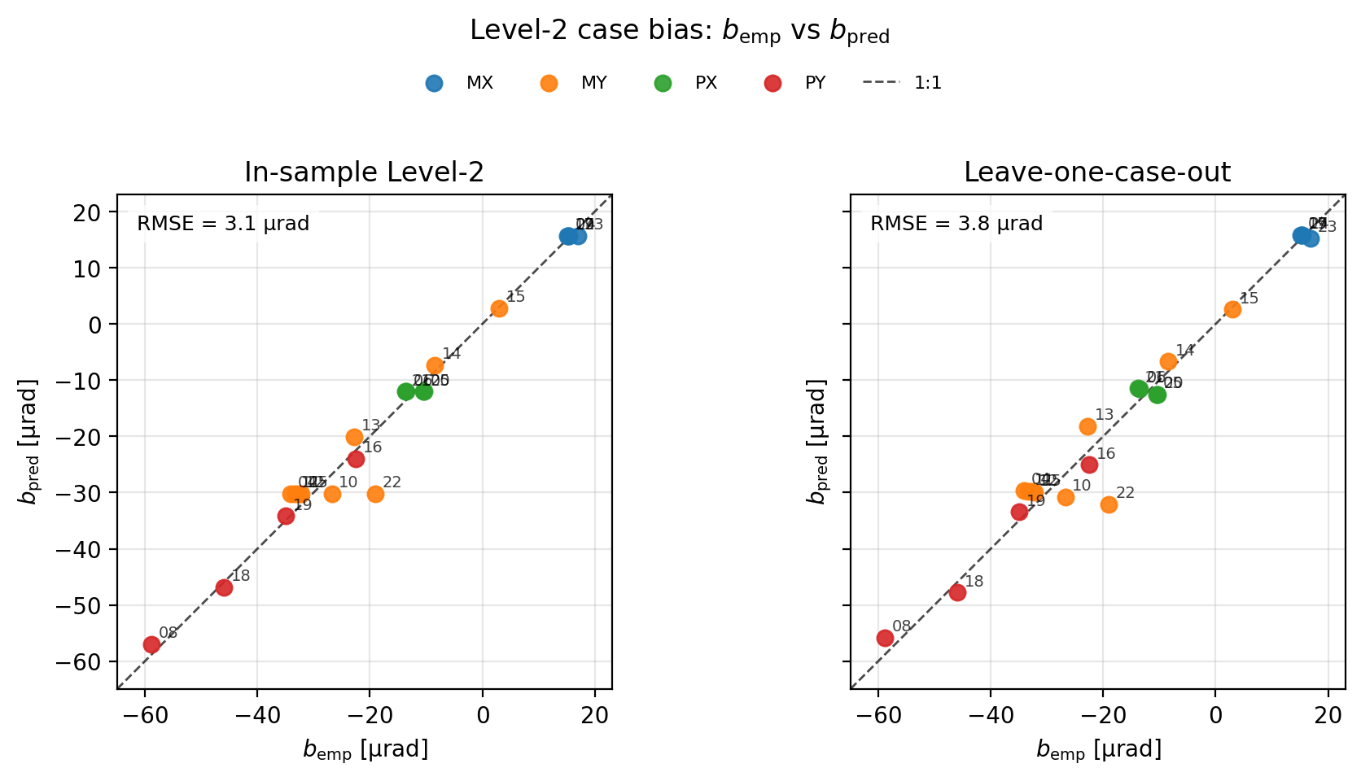
Appendix
Shared sensitivity and the predicted case bias
Sun-face sensitivities a (case-specific and shared)
Case bias b: empirical versus predicted
Shared sensitivity: MX +30.6 / MY +28.6 / PX −28.1 / PY −28.7 µrad/K
Notes:
Appendix. These plots check the shared sun-face sensitivity and the case bias predicted from the sun face and the dissipation flags.

Slide 32
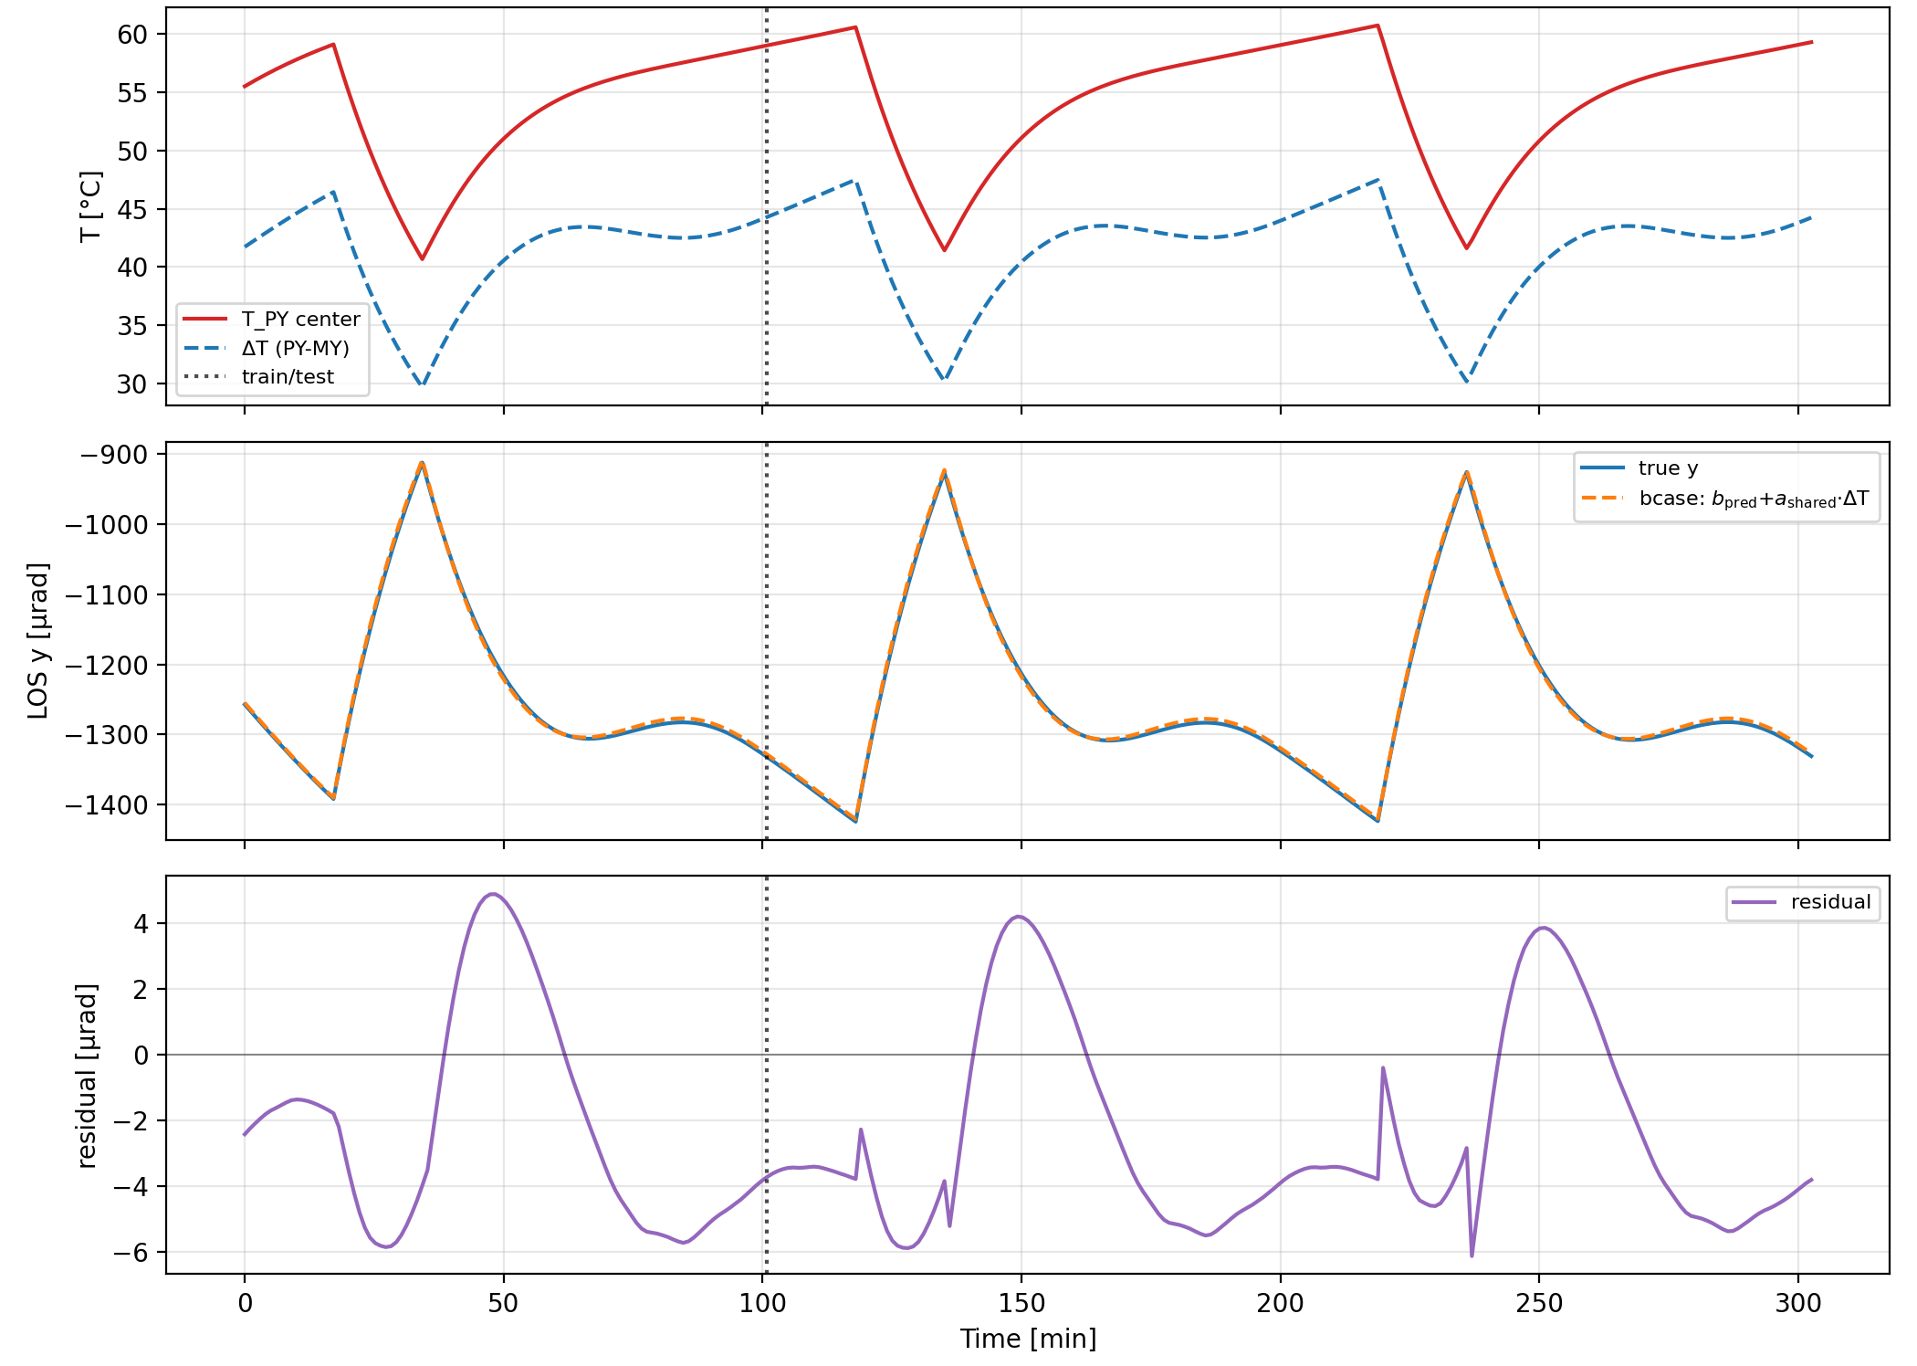
Appendix
Even for the Case with one of the largest thermal LOS errors, 1250 µrad falls to 3.9 µrad
1250 µrad
Raw dominant-axis RMS
3.9 µrad
Test RMSE for an unseen case
First scan point is sufficient
Corrected residual is well below
the 150 µrad detection radius
ΔT follows the within-orbit variation
Case 08 (PY sun face, all units dissipating)
Notes:
Appendix. Case 08 is one of the largest raw thermal LOS cases. The fixed model predicts its next two orbits with a test RMSE of 3.9 microradians.

Slide 33
Appendix
With nonthermal LOS error, the mean drops from 19.2 to 5.45 s; the residual is governed by nonthermal error
No correction
19.2 s
−72%
Mean acquisition time
Hierarchical model
5.45 s
Metric | No correction | Hierarchical model (feedforward)
Success rate | 98% | 100%
Mean acquisition time | 19.2 s | 5.45 s
Mean initial error after correction | — | 448 µrad (almost entirely nonthermal)
PY sun face (thermal ≈1.2 mrad) | 37.3–39.5 s / 88–97% | 1.3–1.8 s / 100%
Predicting and removing thermal error shifts the coarse-acquisition limit from thermal to nonthermal error
Notes:
I show the acquisition result when the nonthermal errors are included.
Without thermal correction, the mean acquisition time is 19.2 seconds, with a success rate of 98 percent.
With the feedforward thermal correction, the mean acquisition time decreases to 5.45 seconds.
This corresponds to a 72 percent reduction, and the success rate increases to 100 percent.
For the PY sun-facing cases, where the thermal LOS reaches approximately 1.2 milliradians, the acquisition time decreases from around 40 seconds to approximately 1 to 2 seconds.
After correction, the remaining initial pointing error is about 448 microradians and is almost entirely determined by the nonthermal components.
Therefore, the role of this method is not to eliminate every pointing error.
Instead, it removes the predictable thermal component before optical feedback becomes available, shifting the dominant acquisition limitation from thermal error to nonthermal error.

Slide 34
Acquisition results
With thermal LOS error only, mean acquisition time drops from 14.6 to 0.10 s, matching thermal-truth correction
Correction | Success rate | Mean acquisition time
No correction | 100% | 14.6 s
Hierarchical model | 100% | 0.10 s
Thermal truth | 100% | 0.10 s
No correction
14.6 s
Hierarchical model
0.10 s
Thermal-truth upper bound
0.10 s
9.3 µrad
Mean thermal residual after correction
The residual is far below the 150 µrad detection radius, so acquisition occurs in one dwell.
Mean over 14 COLD baseline-surface cases; the main result includes nonthermal error on the next slide.
Notes:
First, I show the acquisition result when only thermal LOS error is included.
Without correction, the mean acquisition time is 14.6 seconds.
With the hierarchical reduced-order model, the mean acquisition time decreases to 0.10 seconds.
This is the same acquisition time obtained when the true thermal LOS is directly removed.
However, this does not mean that the predicted waveform is perfectly identical to the thermal truth.
It simply means that the remaining thermal residual, about 9 microradians on average, is already well inside the 150-microradian detection radius.

Slide 35
補足
B1｜21ケースの内訳と評価ID
ケース | 太陽指向面 | 発熱・条件
04, 13–15 | MY | 全発熱 / +PROP / +PCDU / STT・LCTのみ
08, 16, 18, 19 | PY | 全発熱 / STT・LCTのみ / +PROP / +PCDU
05, 06, 20, 21 | PX | 全発熱 / STT・LCTのみ / +PROP / +PCDU
09, 17, 23, 24 | MX | 全発熱 / STT・LCTのみ / +PROP / +PCDU
10–12 | MY | 全日照 / 太陽面Black / 全面Alodine
22 | MY | PROP 12.5 W（半電力）
25 | MY | LTAN18 / 高度693 km
評価IDは 04–06 と 08–25。01–03 と 07 はMZ太陽や設定確認のケースで除外
PZ/MZを太陽面にするケースは、その面にSTT/LCTがあるので設定しない
捕捉時間の見出しは、COLD・標準表面の14ケース（04–06, 08–09, 13–21）
B1
Notes:
Appendix: 全解析ケースの設計

Slide 36
補足
B2｜矩形スパイラル走査の幾何
パラメータ | 設定値
走査範囲 | ±1600 µrad
点間隔 | 120 µrad
検出半径 | 150 µrad
滞在時間 | 0.1 s / 点
総走査点数 | 27 × 27 = 729点
最大走査時間 | 72.9 s
格子対角の半分 120/√2 ≈ 85 µrad < 検出半径 150 µrad なので掃き残しは無い
真の指向誤差が検出半径内に入った最初の走査点を捕捉時刻とする
簡略化：点間移動・整定時間・受光強度の確率変動は考慮しない
各走査点を独立な捕捉機会として評価する
B2
Notes:
平均捕捉時間は成功試行のみの条件付き平均。成功率を併記する。

Slide 37
補足
B3｜軌道予測誤差の作り方と、リンク横断面への射影
太陽指向面 | 通信相手とリンク | 扱い
MY | 進行方向の衛星（高度800 km） | 評価に使う
PY | 逆進行方向の衛星（高度800 km） | 評価に使う
PX | 直下の地上局（約695 km） | 評価に使う
MX | 天頂側に置いた仮想の相手（800 km） | 幾何のみ・非現実的
$$δr⊥ = δr − (δr·ℓ ̂)ℓ ̂$$
$$θ ≈ δr⊥R_{link}$$
• 真値は Sentinel-1 の高精度暦 POEORB
• 予測は直近のTLEを SGP4 で前方伝播
• 差をリンク横断面へ射影し、x–y の2成分にする
• 熱LOSと同じ2成分で足し合わせる
• 時系列の不連続は、TLEが更新された時刻
※ LCTの指向面ごとに、通信相手は地上局/衛星をそれぞれ設定
※ MXは角度計算可能だが、LCTが天頂方向のため、現実的リンクではない
B3
Notes:
以前の任意ECEF-Z基底からSTT/bodyへ接続。MX proxyに注意。

Slide 38
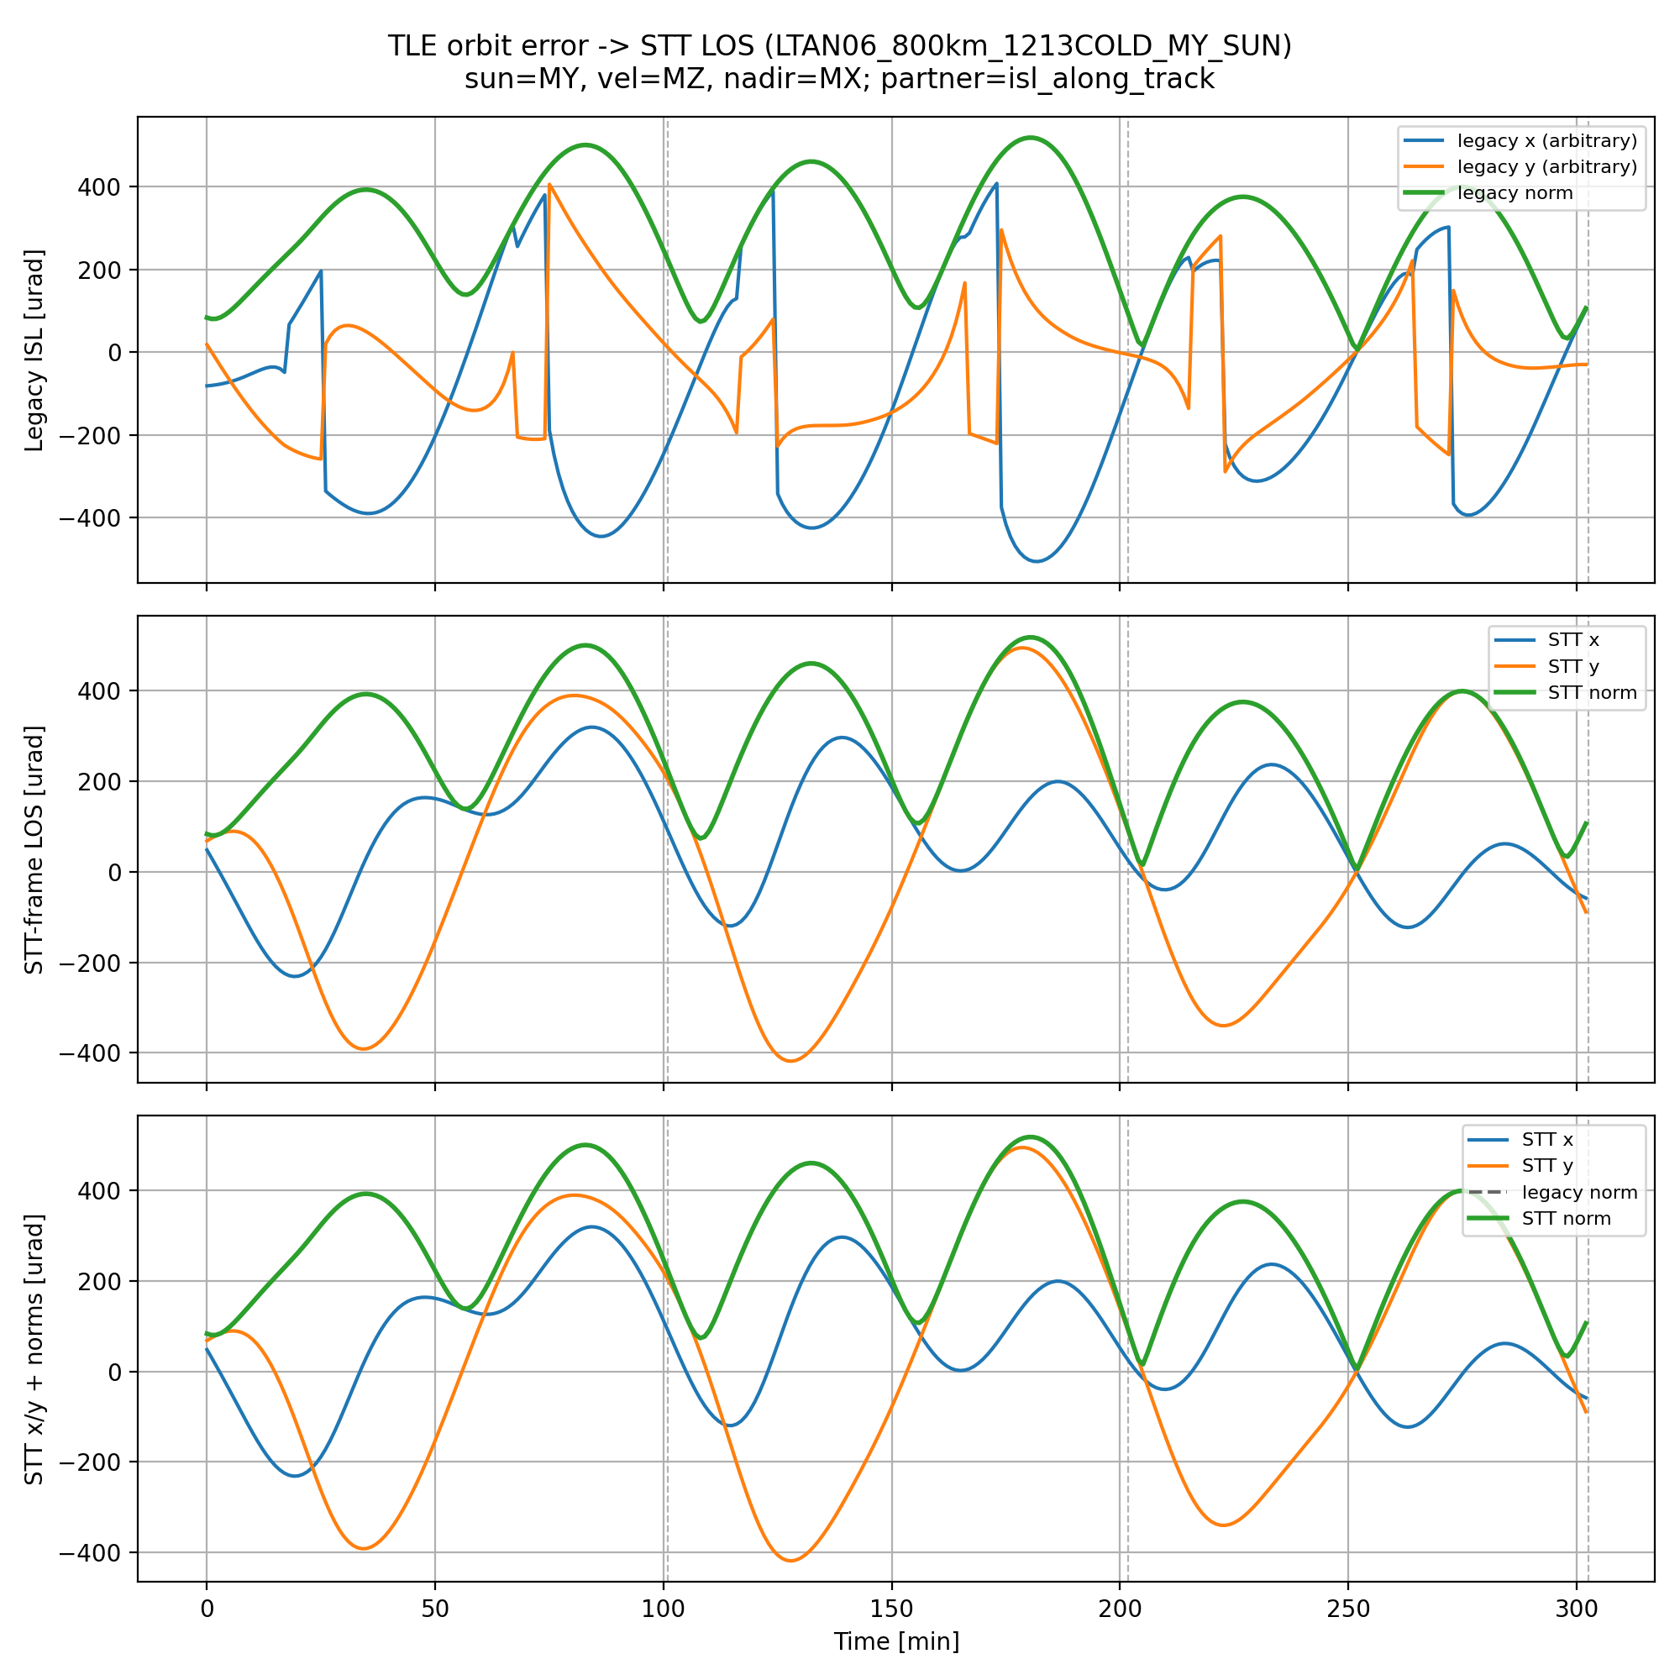
補足
B4｜熱と軌道予測は同じ軌道周期。周波数では分けない
リンク | 位置誤差の平均
MY：進行方向の衛星 | 約285 µrad
PY：逆方向の衛星 | 約285 µrad
PX：直下の地上局 | 約694 µrad
MX：天頂側の仮想 | 約612 µrad
熱：約101分
軌道予測：約101分 と約50分
熱ひずみと軌道予測誤差は、大きさも周波数帯も同程度
『低周波＝熱』という分離は主張しない。温度という別入力で捕捉前に引く
B4
Notes:
熱も軌道も軌道位相依存。低周波残差を熱として取り込む説明は修正する。

Slide 39
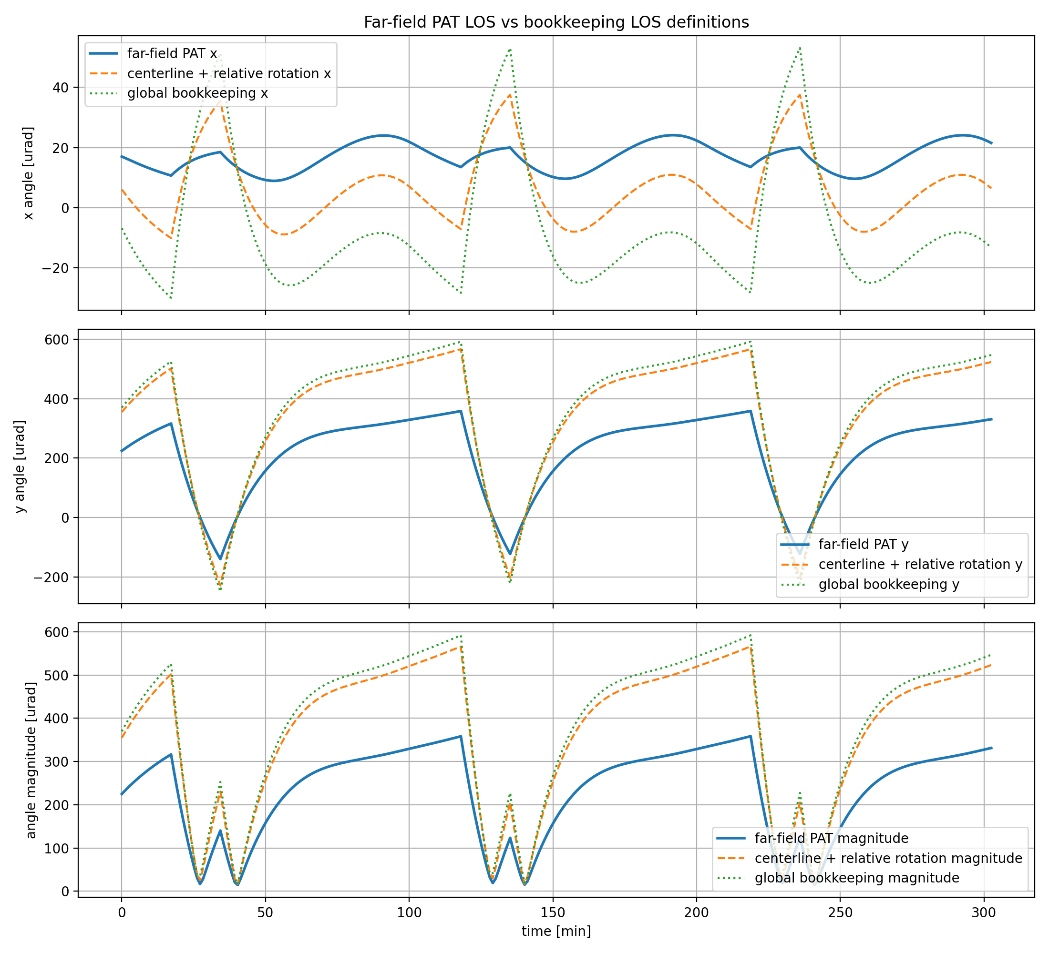
補足
B5｜LOS定義の比較と、並進を入れない理由
代表節点の回転を機器姿勢の代理にしている。取付面全体の剛体フィットは今後
代表点間の並進による傾きは、衛星間距離で割ると小さいので捕捉評価には入れていない
B5
Notes:
Appendix: LOS定義の比較

Slide 40
補足
B6（1/2）｜モデルが難しいケース
ケース | 残差 | 何が表せていないか
太陽面Black被覆 | 約13 µrad | 被覆を変えると感度と変動幅が動く。係数は標準表面で決めている
PROP半電力（12.5 W） | 約16 µrad | ON/OFFの二値フラグでは25 Wと12.5 Wを区別できない
全日照（HOT）軌道 | DCが数µrad | 蝕がなく熱がほぼ一定。平均の予測が軌道条件の外へ出ている
共通する構図
主結果の範囲
時変の項ではなく、ケース平均の側が外れている。
被覆・軌道・連続発熱量はいまの入力に入っていない
標準COLD・標準表面の条件で、固定16係数のまま
1〜2桁の低減。被覆・軌道・連続量の明示は今後
B6
Notes:
被覆や半電力を聞かれたときの枚。発熱の係数を太陽面に依らず共有している点は、まだ検証していないと正直に言う。

Slide 41
補足
B6（2/2）｜取付点の温度を足すと係数が壊れる
試したこと
解釈
LOS = b + a·ΔT
+ c·(Tattach−Tref)
効いていたのは軌道内の変動ではなく
ケース平均のDCだった
• 温度差と取付点温度の相関が 0.995
• 取付点まわりの温度のばらつきは 0.1 K 程度
• 係数が巨大化し、ケース間で不安定になる
→ b_case 側へ分離した
RMSEだけでなく、係数の安定性と運用上の解釈でモデルを選んだ
B6
Notes:
見かけのRMSE改善より、共線で係数解釈が壊れることを問題視した。

Slide 42
補足
B7｜平均だけを引いた場合（定数バイアスのみ）は未計算
未計算
ΔT(t) を 0 とし、予測したケース平均DCだけを引いた場合の捕捉時間は、
今回の走査条件ではまだ計算していない
この列が示すはずのこと
7月に出した秒は流用しない
改善のどれだけが平均の除去で、
どれだけが軌道内の時変項によるのかを分ける
あのときの走査は点間隔と検出半径が
通信ビーム級に細かく、今日の条件とは別
本編の結論には、この未計算の列の数字を一切使っていない
B7
Notes:
聞かれたら、平均だけを引いた列は未計算だと答える。7月の静的バイアス補正の秒は、点間隔40 µrad・検出半径25 µradの旧走査のもので、今日の条件では比較にならない。

Slide 43
補足
B8｜先行研究の位置づけ（2軸で見る）
研究 | 熱状態からLOSを予測するか / 粗捕捉時間を評価するか
Riesing 2023（TBIRD） | 熱は明示せず姿勢系で吸収 / 軌道上で捕捉を評価
Shi 2023 | 構造設計で熱変形を小さくする / 捕捉時間を評価
Hu 2022（GEO） | 周期モデルで熱LOSを補正 / 粗捕捉は評価しない
Li 2025（LEO） | ニューラルネットで熱LOSを補正 / 粗捕捉は評価しない
JANUS（Turella） | 壁面温度差に比例する一次式 / 粗捕捉は評価しない
本研究 | 太陽面温度差と運用フラグで予測する / 捕捉時間まで評価する
新しいのは一次関係そのものではなく、バス上のSTT–LCTへの適用、条件横断の係数共有、捕捉時間への接続
B8
Notes:
何が新しいのかを聞かれたときの枚。予測するか、捕捉時間まで見るか、の2軸で置く。

Slide 44
補足
B9｜解析モデルの妥当性をどう検証するか
今日の主張の範囲
入っていないもの
同一の解析チェーン（Thermal Desktop / Femap）の中での数値評価である。
外しているのはケースであって、構造やLOS定義ではない
打上げ後のアライメント変化、実機の剛性差、組立公差、
軌道上での経年変化
今後の検証
地上の熱真空試験で温度と変位を同時に測り、感度 a を実測で確かめる。
係数の取り直しが前提であり、式の形が移せるかを見る
主張を『解析を真値として完璧に当てる』に置いていない
B9
Notes:
5月に出たモデルの妥当性の問いへの答え。同じ解析の中の評価であることを認めた上で、地上試験で感度を確かめる筋を示す。

Slide 45
補足
B10｜姿勢の前提と、変わる頻度
前提
ジンバルの場合
本体指向を想定し、ケース内では太陽指向面を固定している。
通信中に構体の太陽面が入れ替わる時系列は解析していない
構体姿勢がほぼ一定なら、このケース行列の中では同じ扱いになる。
熱はバス側の温度場で決まるため
未解析
相手を追い続ける body pointing の時系列、および軌道の途中で発熱機器の電源が入る過渡。どちらも温度場の履歴が変わるため、別に解析が要る
B10
Notes:
姿勢の頻度を聞かれたときの枚。ケース内で太陽面を固定している前提を先に言い、変わる場合は別解析が要ると答える。

Slide 46
補足
B11｜残差Fourier更新の数値（予備）
条件 | 全区間 | 初周 | 周1以降
Case 13（MY）全誤差を直接Fourier | 1.39 s | 3.37 s | 0.39 s
Case 13（MY）階層モデル＋残差Fourier | 0.79 s | 1.60 s | 0.38 s
Case 16（PY）全誤差を直接Fourier | 13.2 s | 39.5 s | 0.38 s
Case 16（PY）階層モデル＋残差Fourier | 0.76 s | 1.47 s | 0.40 s
Case 16 の直接Fourier は成功率 98.7%。他は 100%
定数の残差更新との差
限界
Case 13 の周1以降は 1.66 → 1.35 s までしか落ちない。軌道周期の山が残る
2ケースのみ。causal、K=2。60秒刻みの全点を使っており、実センサの疎な成功点では未検証
熱モデルの係数は更新していない。捕捉後の全指向残差に対する予備実験
B11
Notes:
5月に構想した適応補正がどこまで進んだかを聞かれたときの枚。本編Slide 21の数値の全文。

Slide 47
補足
B12｜前に聞いた秒と、今日の秒の対応
いつ | 何の秒だったか | 今日の秒と違う理由
2026-05 全体輪講 | 仮想の熱バイアスでの捕捉時間と成功率 | 熱構造解析ではなく、置いた値での試算だった
2026-07 光通信RG | 密な走査での捕捉時間 | 点間隔と検出半径が通信ビーム級で、走査の格子に穴があった
2026-08-16 中間メモ | 17ケース集計での捕捉時間 | 提出稿はCOLD標準表面の14ケースに絞ったあとの数字が正
今日（提出稿） | 14.6 → 0.10 s、19.2 → 5.45 s | ±1600 µrad・120 µradステップ・検出半径150 µrad、14ケース平均
走査条件が違えば秒は変わる。比べてよいのは、同じ走査条件の中での補正方式どうし
旧い秒はスクリーンに出さない。対応は口頭で答える
B12
Notes:
旧い秒を聞かれたときの手元用。5月は2.43 s → 0.74 s・成功率97.5%で仮想バイアス。7月光RGは124.6 s と 156.9 → 59.6 s で、点間隔40 µrad・検出半径25 µradの密走査。8月16日のメモは12.1 s と 16.3 → 4.75 s で17ケース集計。いずれも走査条件かケース集合が今日と違う。

