Slide 1
Table of contents
Numerical simulation of optical pumping with 556 nm
Rate equation for spin relaxation
Simplify Expression
Ideal case of pure polarization
Introduce impurity of polarization
Introduce differential lightshift between g1 and g2
Lightshift vs Pumping fidelity

Slide 2
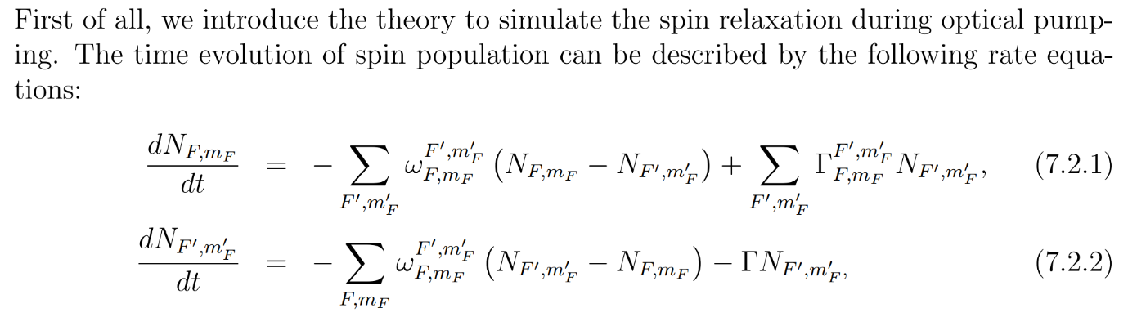
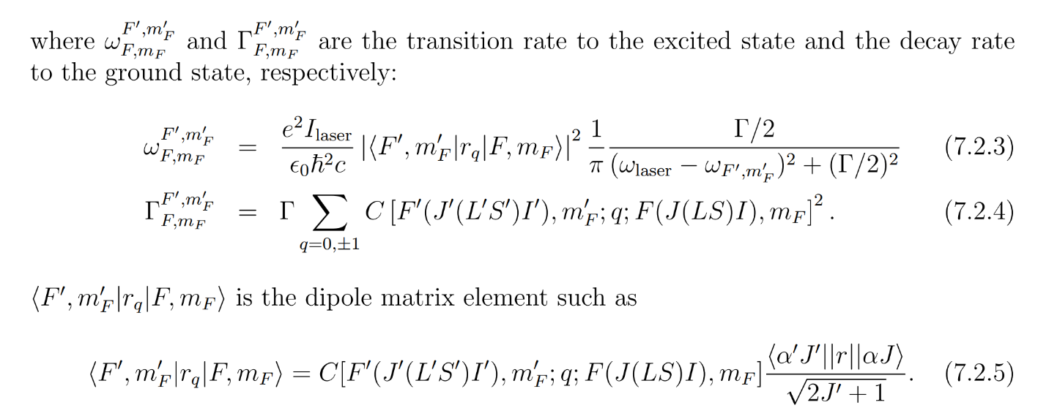
Rate equation for spin relaxation

Slide 3
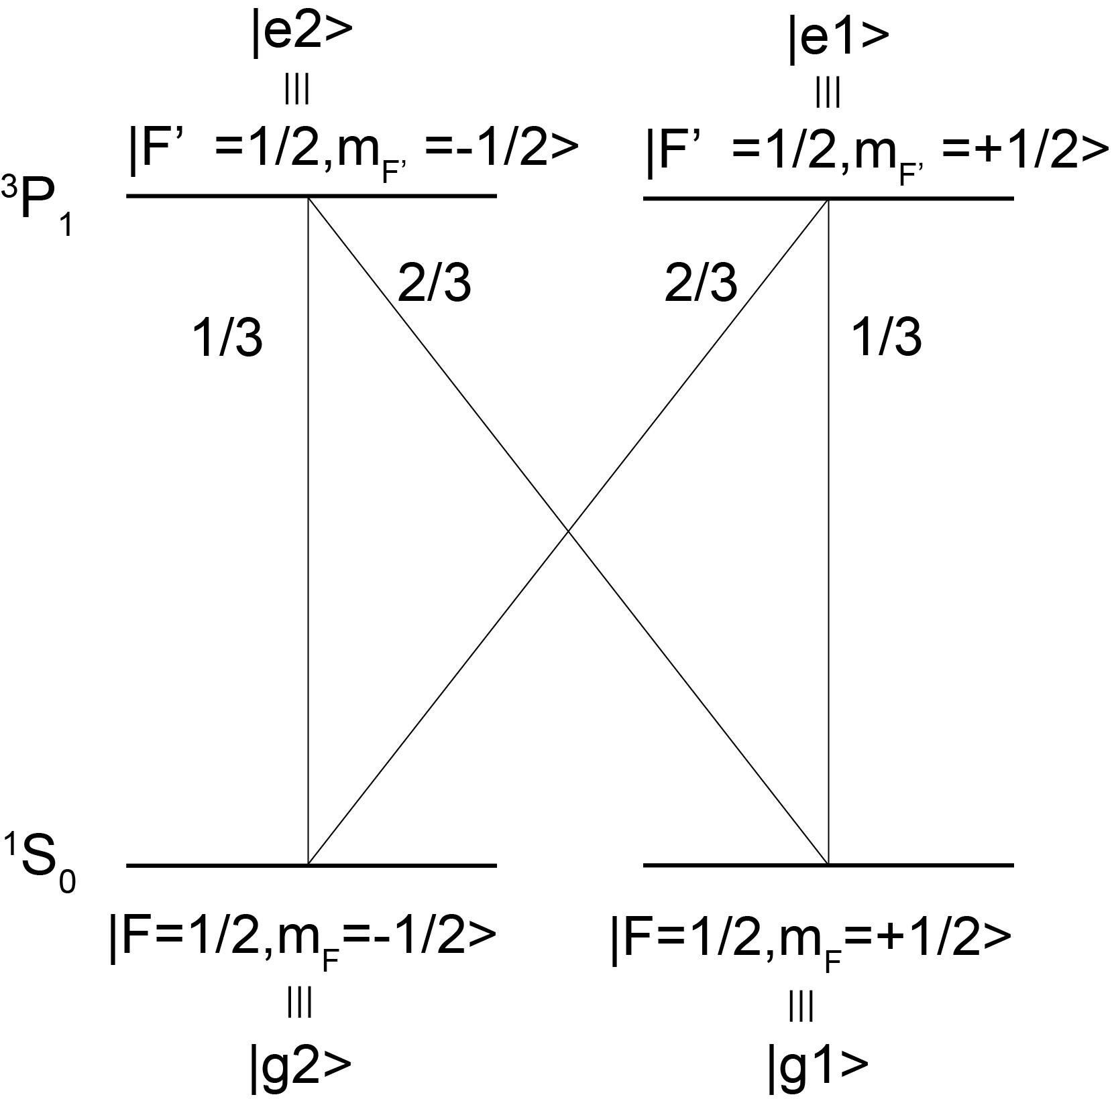
Simplify Expression
The fractions mean normalized CG coefficients.

Slide 4
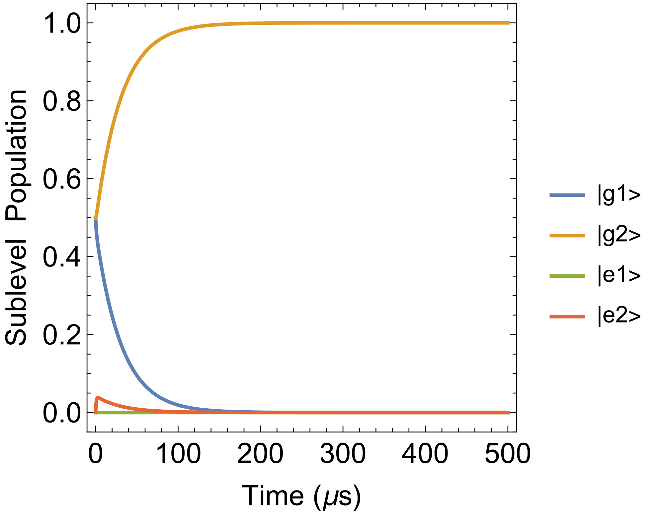
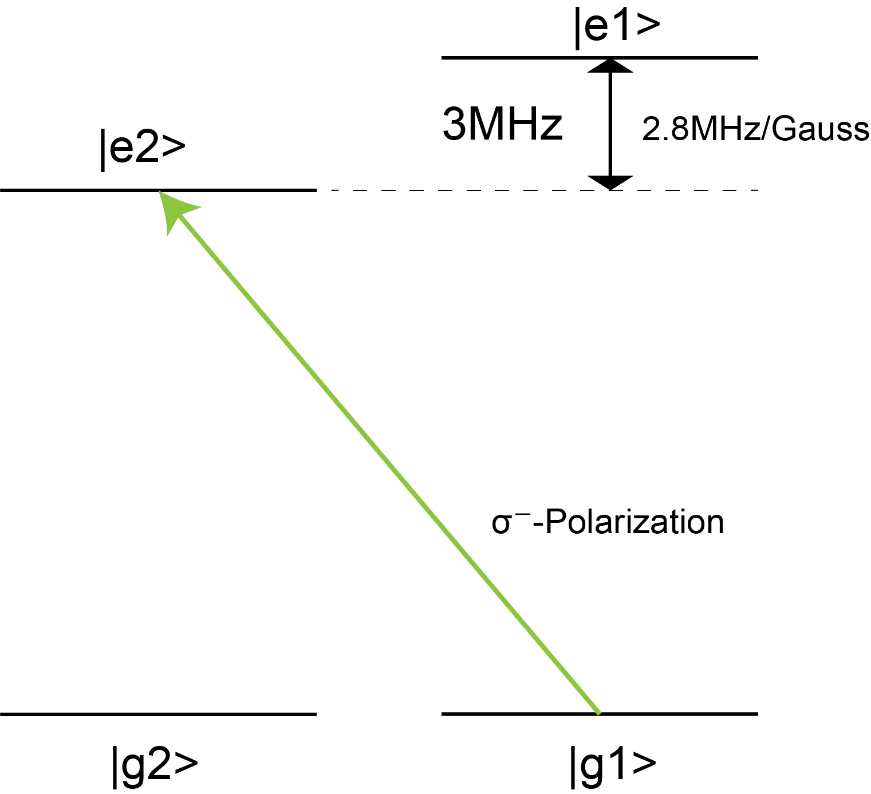
Ideal situation; Pure polarization
Parameters
w₀=100 um, P=20 nW
I/Is = 8.92
Initial state: (g1,g2) = (1/2,1/2)
Simplified schematic
Population at g2 = 1.

Slide 5
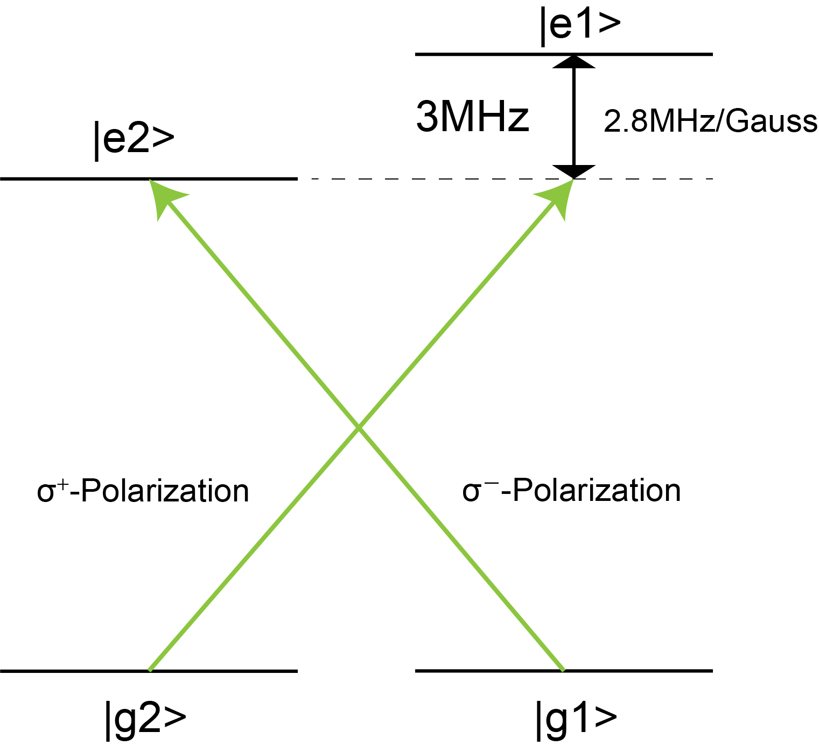
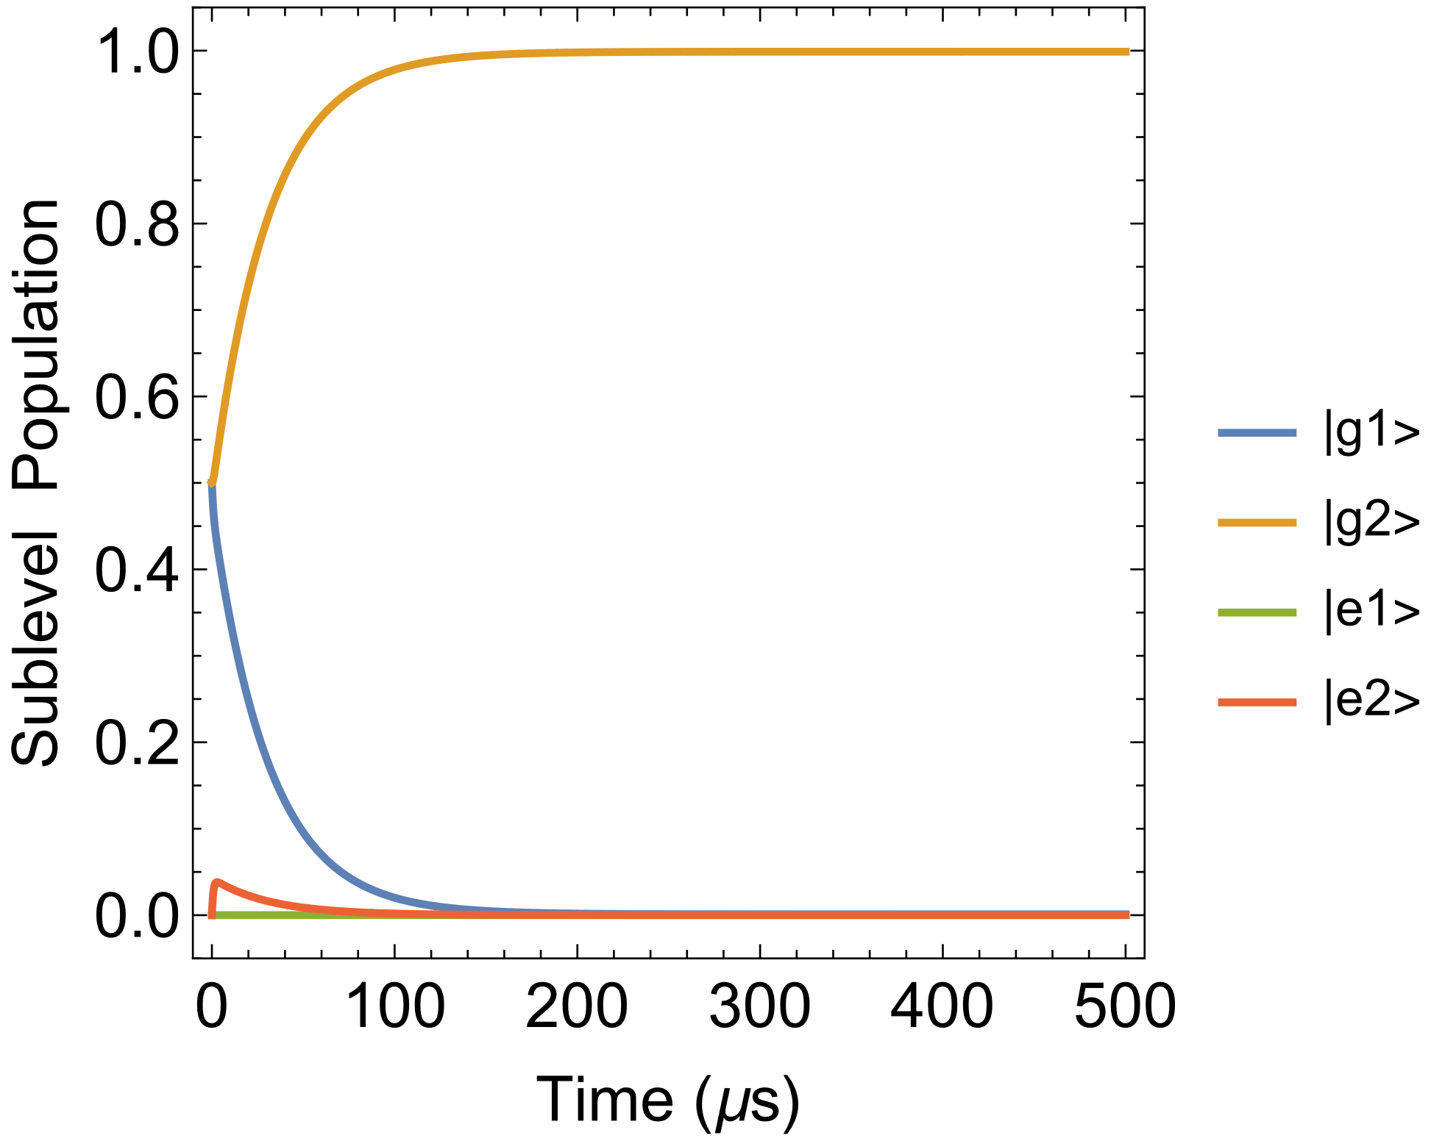
Introduce impurity of polarization ①
Parameters
w₀=100 um, P=20 nW for σ±
Initial state: (g1,g2) = (1/2,1/2)
0.998812

Slide 6
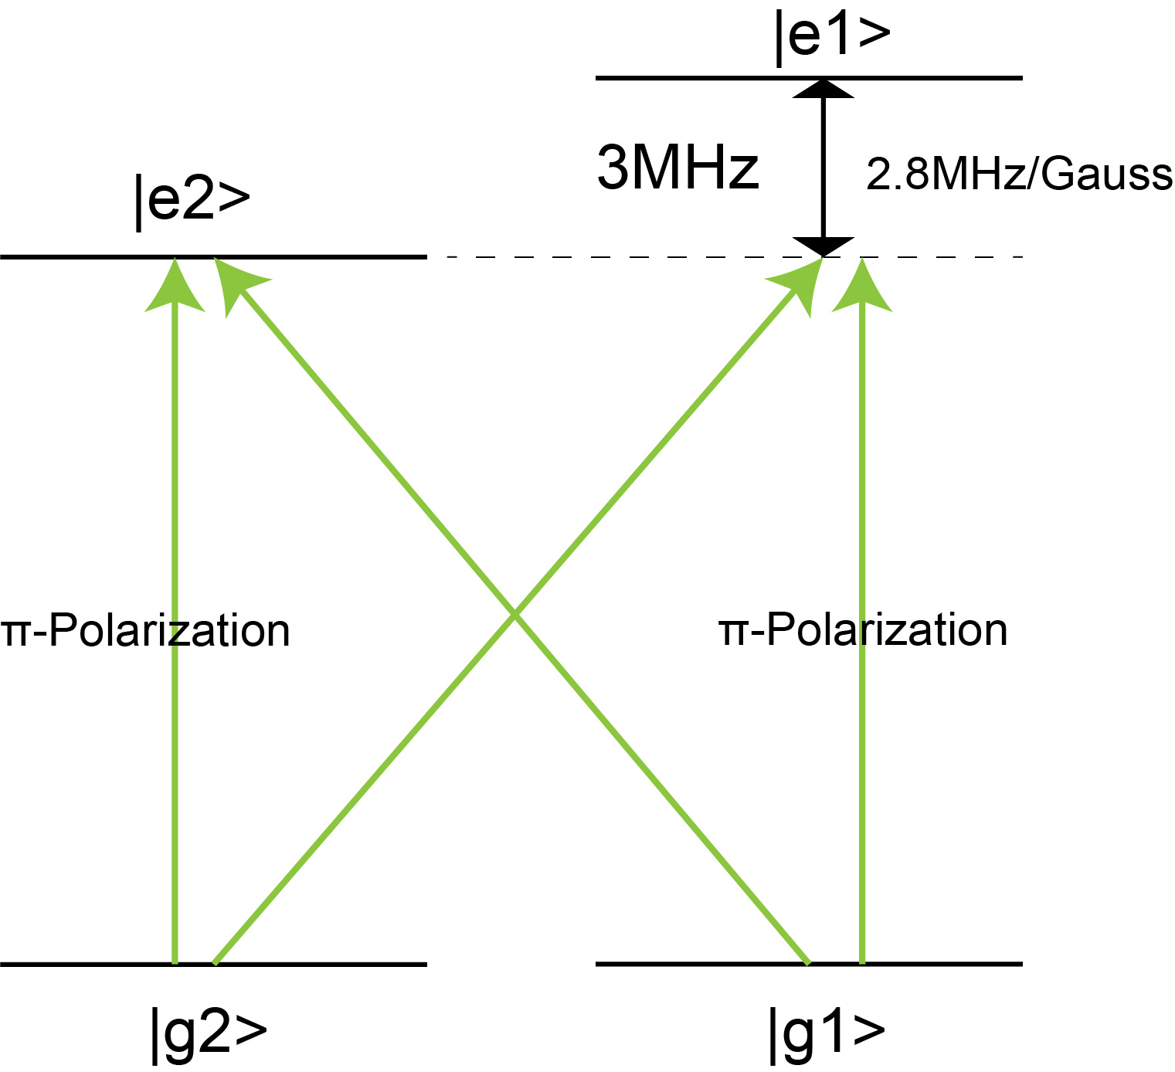
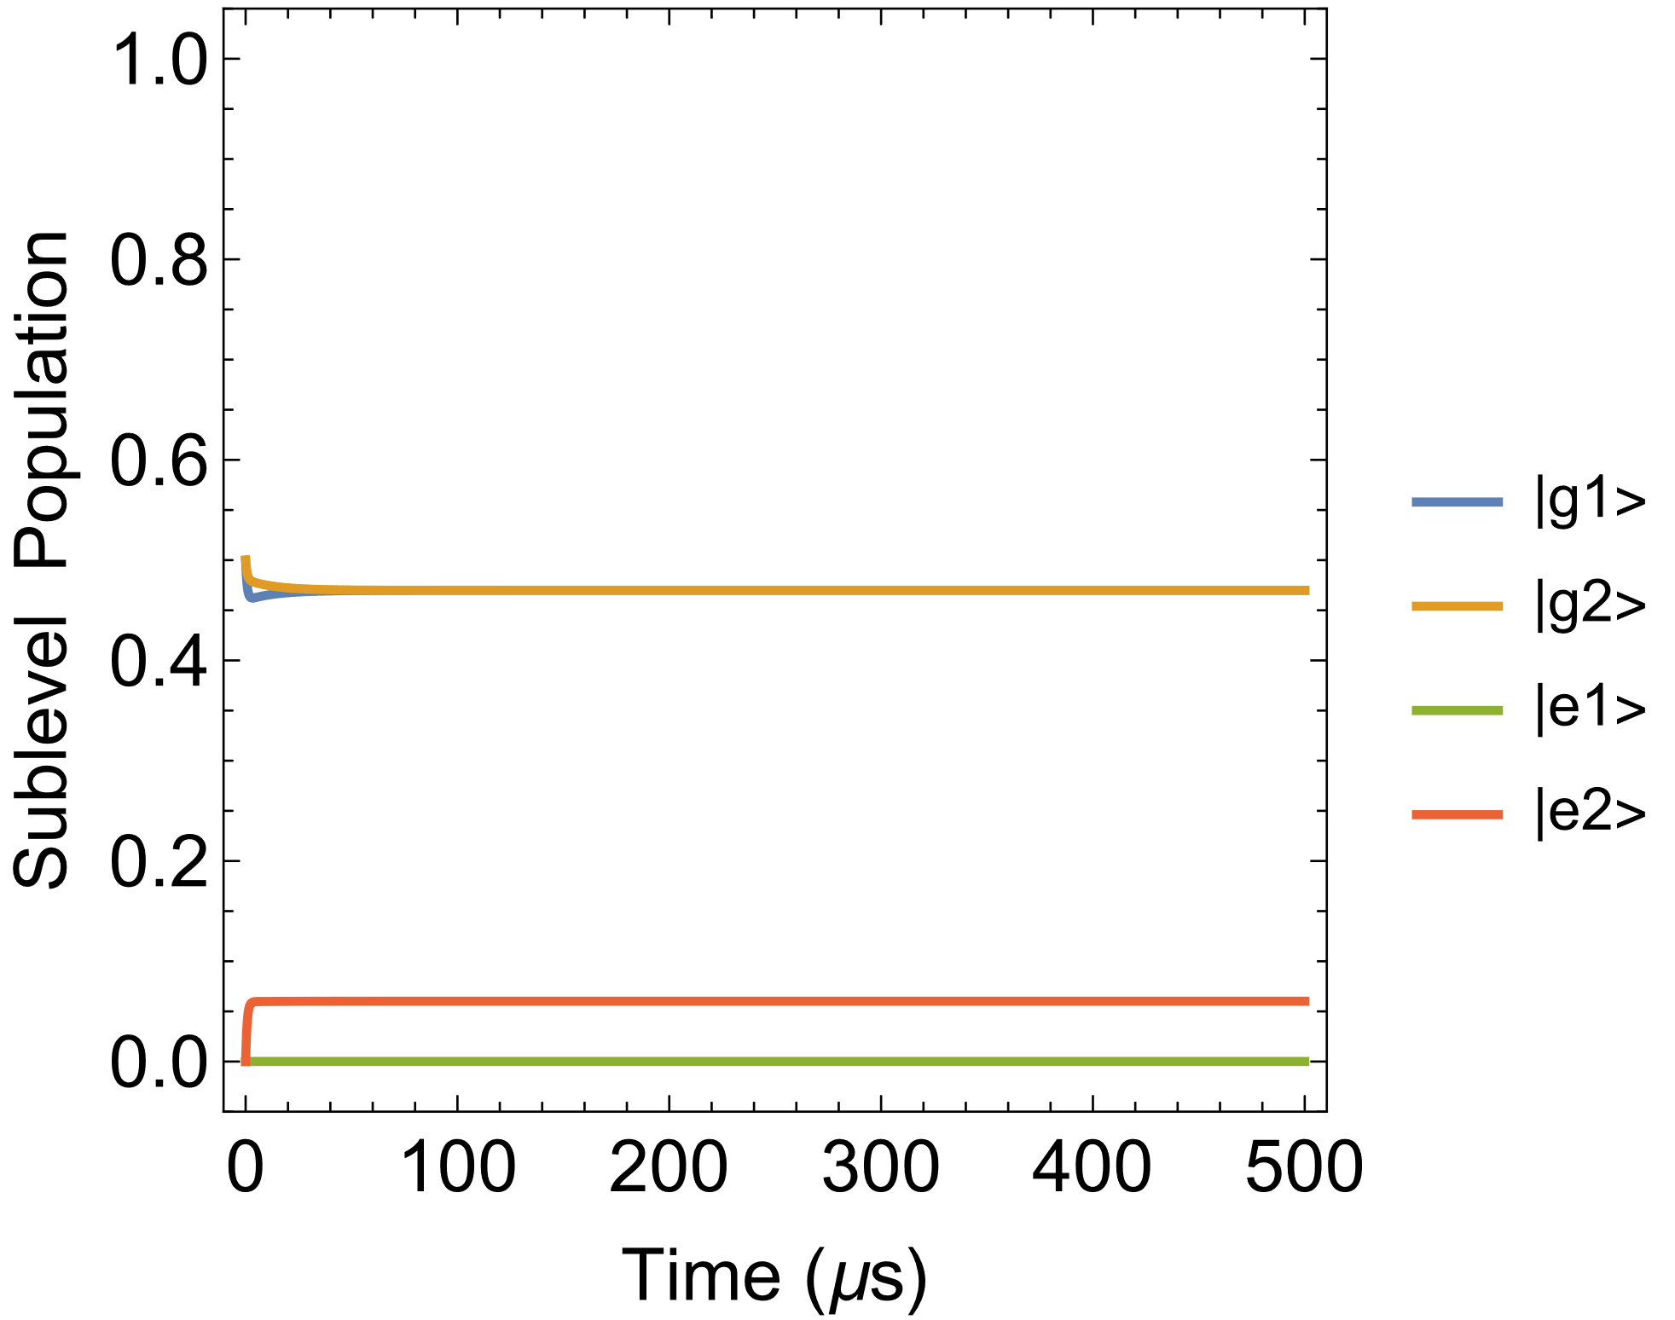
Introduce impurity of polarization ②
Parameters
w₀=100 um, P=20 nW for σ±,π
Initial state: (g1,g2) = (1/2,1/2)

Slide 7
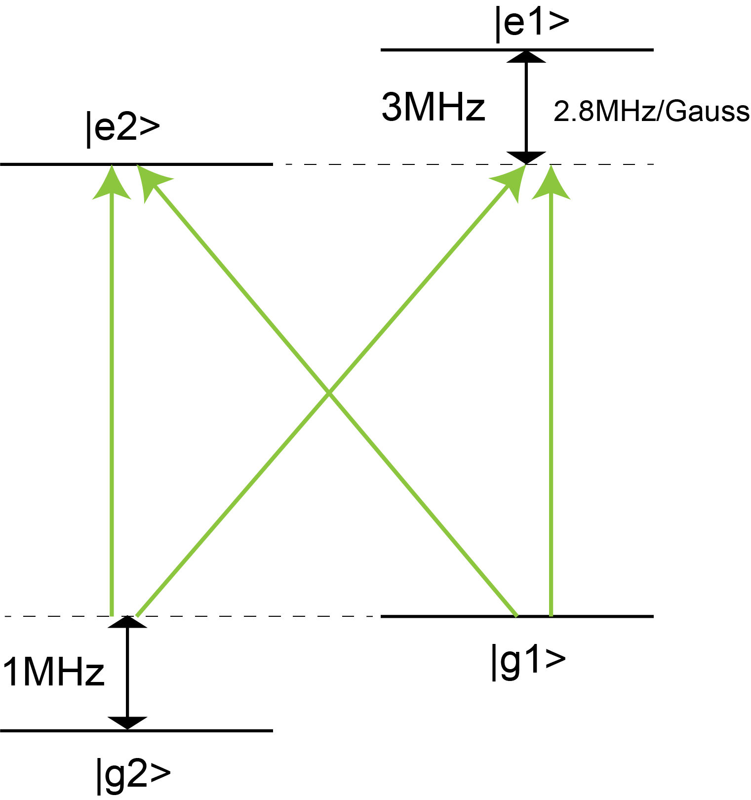
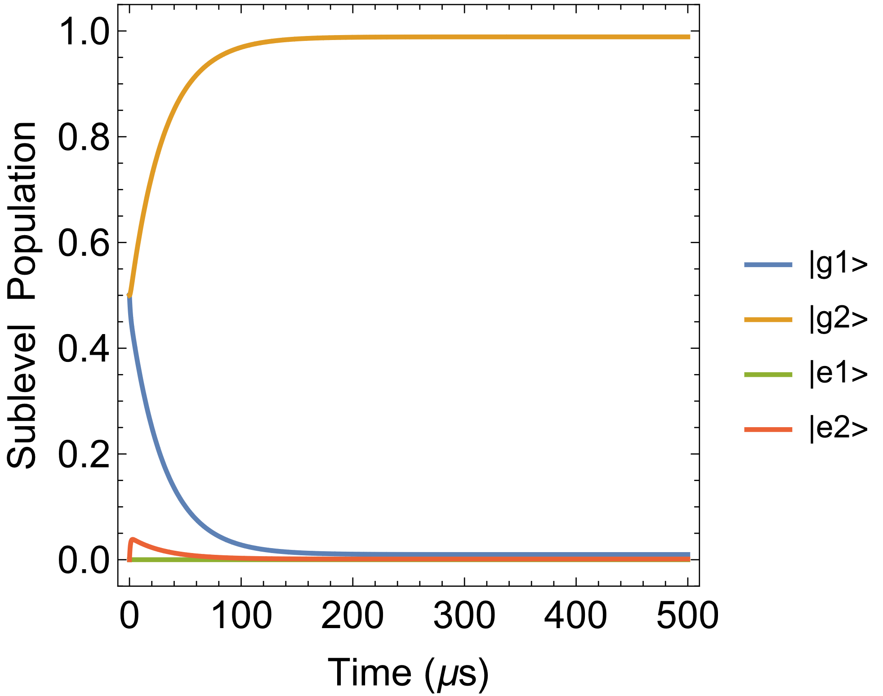
Introduce differential light shift
Parameters
w₀=100 um, P=20 nW for σ±,π
Initial state: (g1,g2) = (1/2,1/2)
0.988857

Slide 8
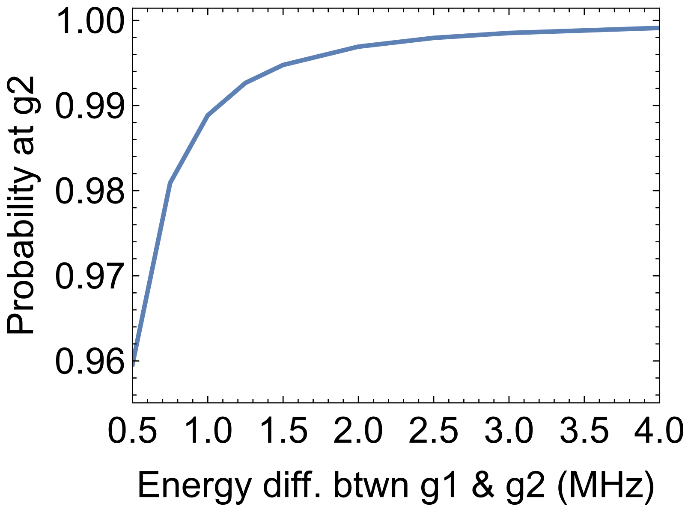
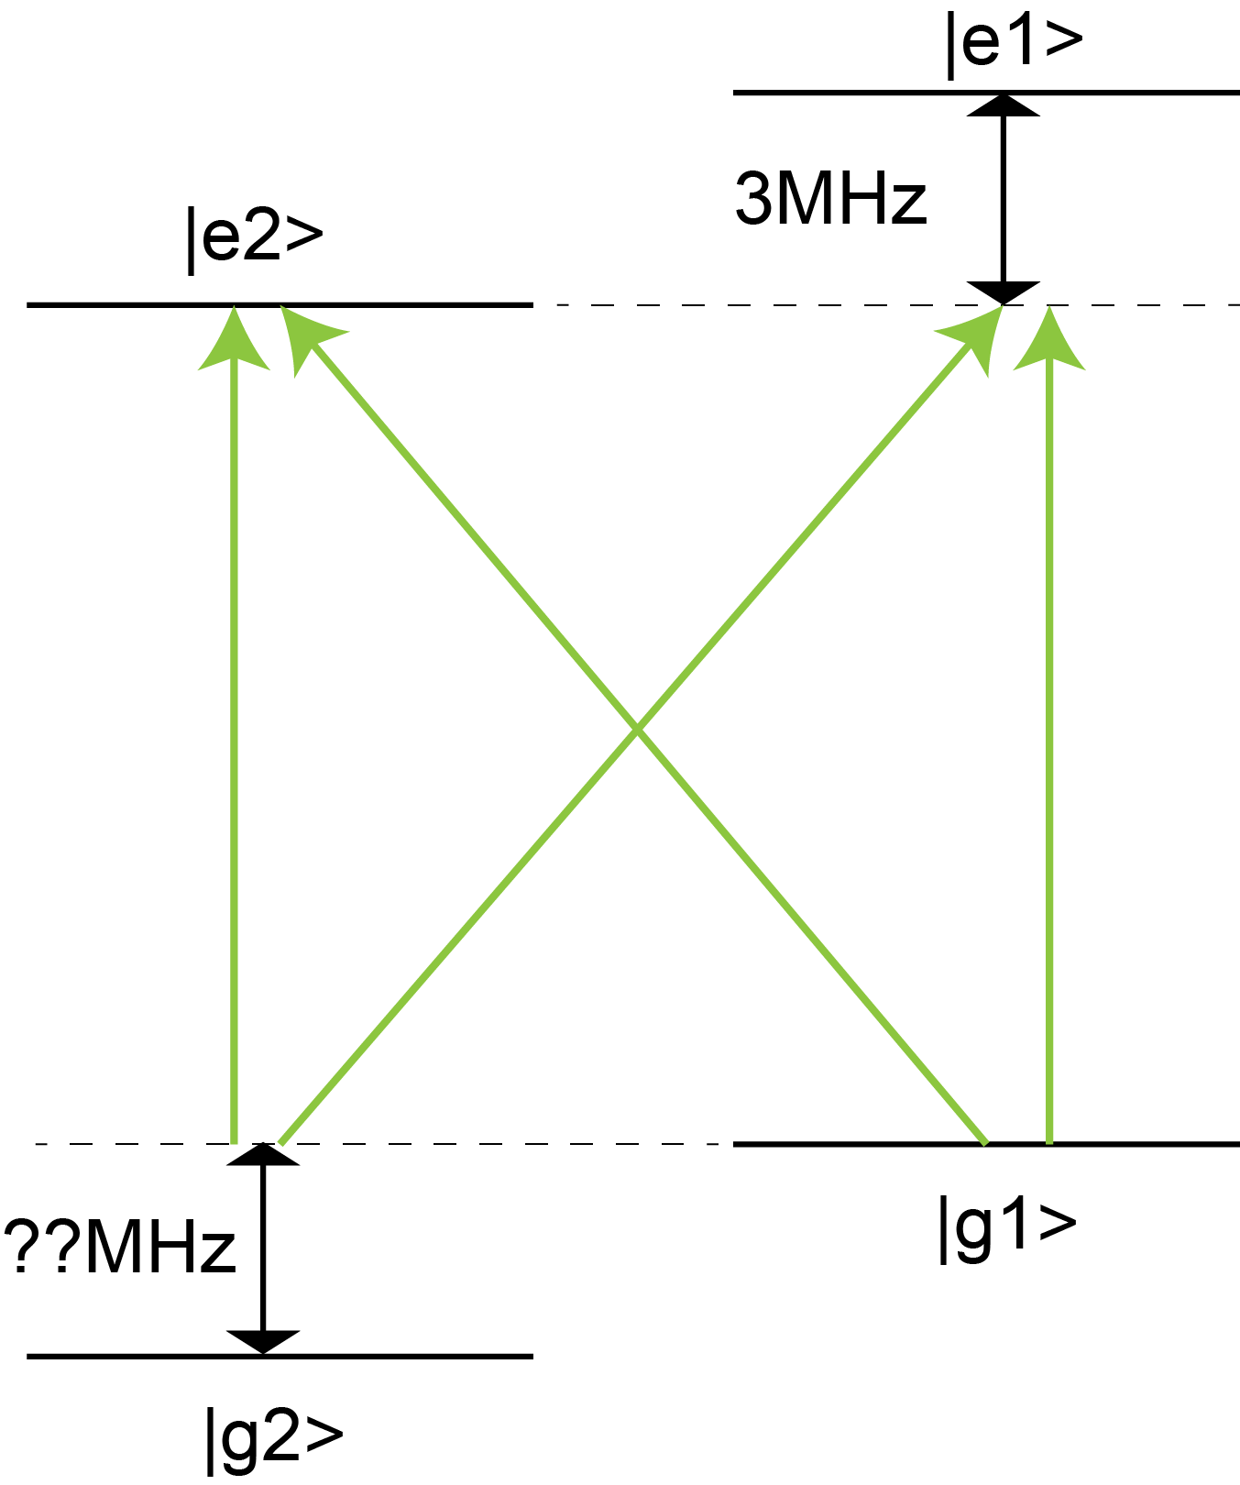
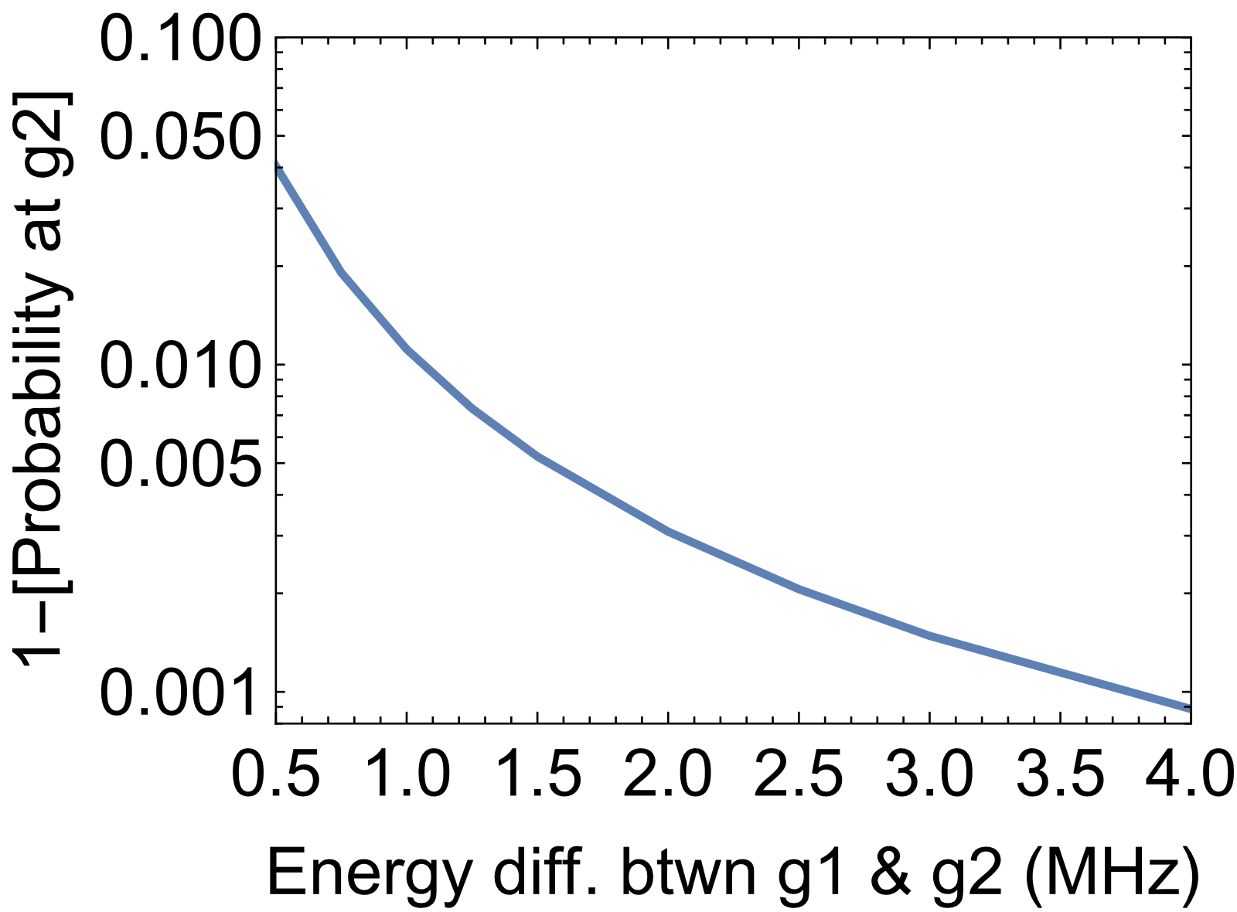
Light shift vs.
Pumping fidelity
Time = 500us

Slide 9
Mathematica Code
Github repository

