Slide 1
Origin
master
A
B
C
D
Your repository
git fetch
origin/master
git merge
origin/master
C
D
A
B
X
Y
M
master

Slide 2
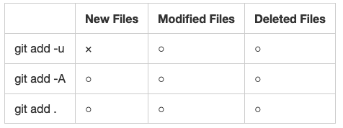
https://stackoverflow.com/questions/572549/difference-between-git-add-a-and-git-add/26039014#26039014

Slide 3
First Status
Working Directory
project
hoge
foo
Index
file1 file2
Object Strage
master
hoge
foo

Slide 4
1. Edit file
2. git add .
2a. Add “quux”
to object strage
2b. Update index
Working Directory
project
hoge
1. Edit file
quux
foo
Index
2a. Add “quux”
to obeject strage.
file1 file2
Object Strage
master
2b. Update index.
hoge
foo
quux

Slide 5
1. Edit file
2. git add .
2a. Add “quux”
to object strage
2b. Update index
3. git commit 3a. Convert index
into a tree object
3b. Create a commit object
3c. Update a reference
of the branch.
Working Directory
project
quux
foo
Index
file1 file2
3a. Convert index into a tree object
3c. Update a reference of the branch
Object Strage
master
3b. Create a commit object
hoge
foo
quux

Slide 7
If you are in the hoge branch,
hoge
hoge~2
hoge~
hoge^
hoge~4
ORIG_HEAD
HEAD
master^1
master^2~3
Master
master^2~
master^2

