Slide 1


A Study on Few-Shot Style Transfer for Handwriting Chinese Synthesis Using Conditional GAN
1-011
Student
Liangyu Liu ^{1,2}, Yusuke Tanimura ^{2,1}, Hidemoto Nakada ^{2,1} 1: The University of Tsukuba
2: The National Institute of Advanced Industrial Science and Technology (AIST)
Abstract
The goal is synthesizing handwritten fonts with few samples.
Zi2Zi[1] which achieve this with Conditional GAN suffered from occasional badly-formed results.
We try to cope with this problem by increasing training fonts while keeping the size of training dataset.
SSIM and PSNR score showed that the modified parameter is effective.

Slide 2
Conditional GANs
Extended from generative adversarial network by feeding an extra information to both generator and discriminator.
Extra information
Real
or
fake
Noise
Generator
Fake images
Discriminator
Real images

Slide 3
Method
zi2zi model based on pix2pix
True or False
Discriminator
Category
embedding
T
Category
loss
S
E
D
F
L1 loss
E
Constant
loss
Character
embedding

Slide 4


Method
Analysis of badly generated samples in related work
Stroke weight varies in different
styles.
Some of commonly used parts are shown
too many times in the same style
Our method
Avoid learning commonly used characters in too many different styles.
Use hard-tipped pen calligraphy as training set since their stroke weights are similar.
Loss function
g loss for generator
d loss for discriminator
L1 loss

Slide 5
Experiment
Dataset
Training set Original: 30 fonts, 500 samples. Training set Ours: 50 fonts, 300 samples.
Use all hard-tipped pen calligraphy as training data.
Process
Training set
.ttf
Paired images
Model
Font to image
Testing set

Slide 6
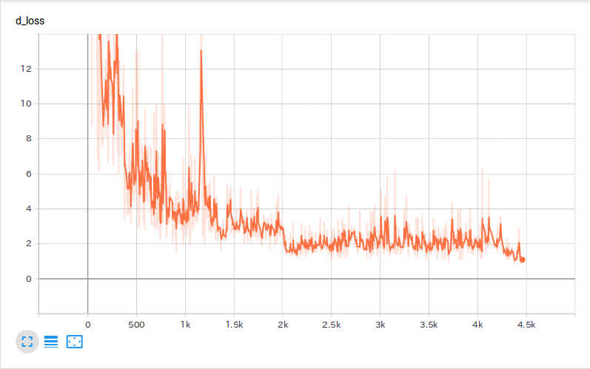
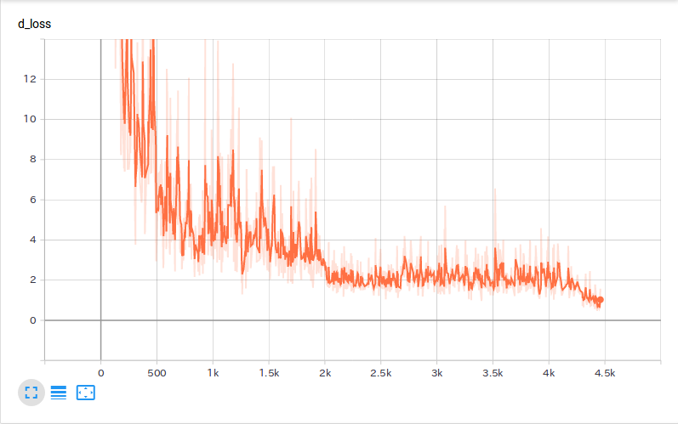
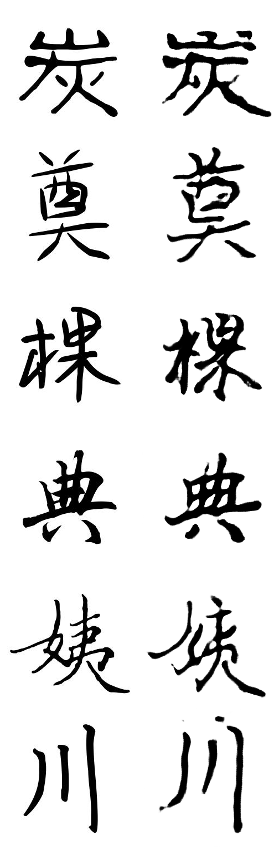
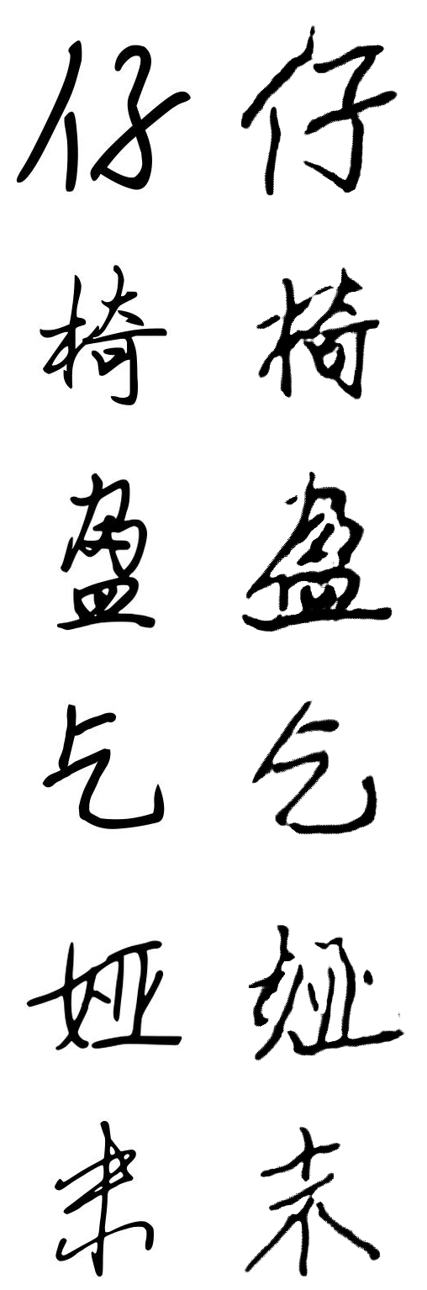
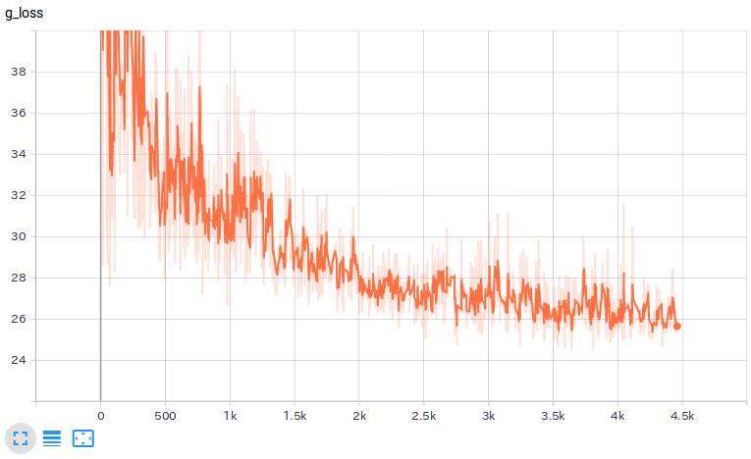
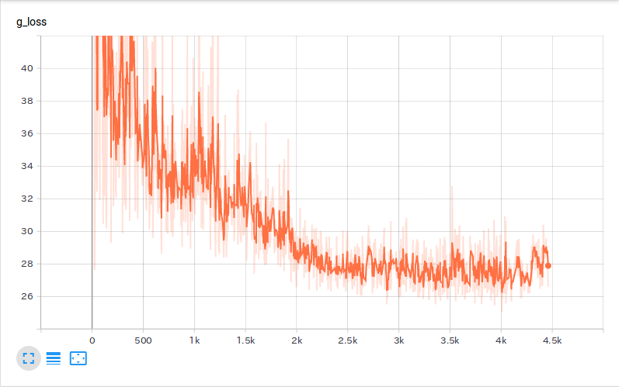
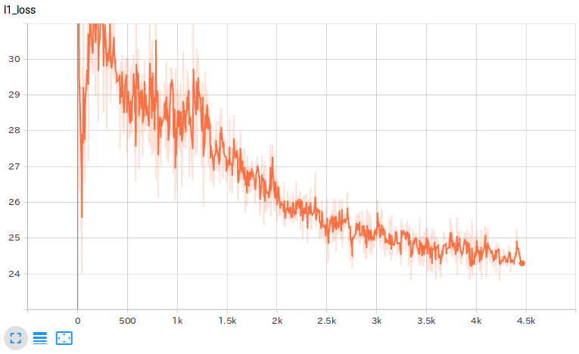
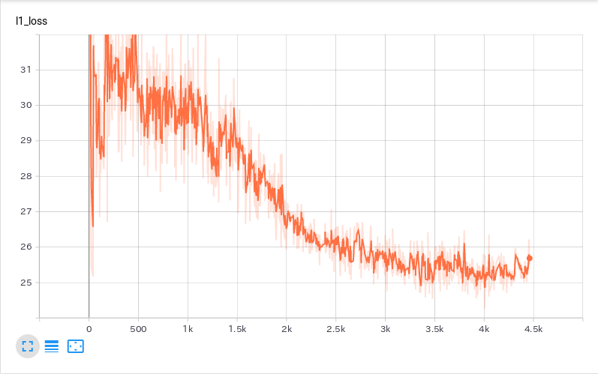
Result
Loss
Generated samples
Original
Ours
d_loss
g_loss
L1_loss
Original
ours

Slide 7

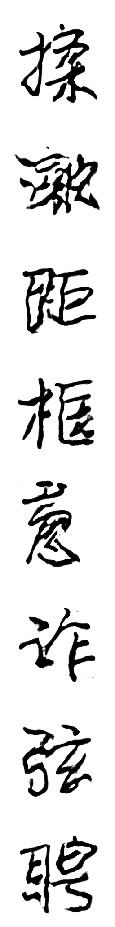

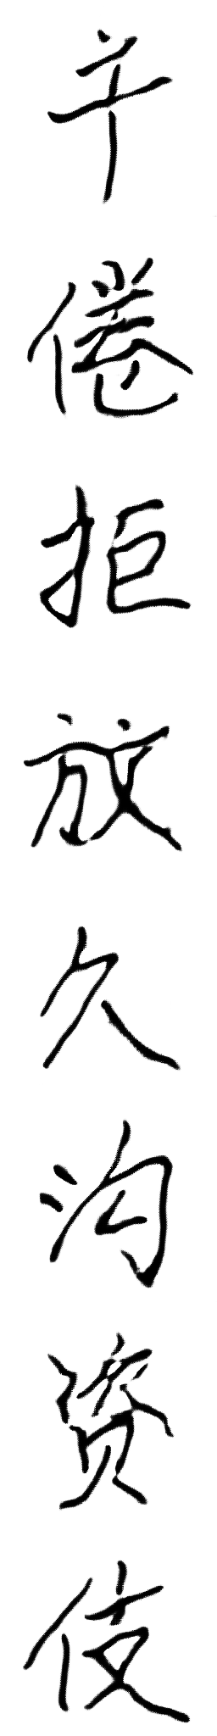
Result
Test
Evaluation
Original
Ours
 | SSIM | PSNR
Original | 0.5433 | 8.8846
Ours | 0.5476 | 9.8267
Ground truth
Generated
Ground truth
Generated

Slide 8
Conclusion
The initial results showed that the modified parameter is effective to improve the performance in handwritten fonts synthesis.
For future work, we plan to try more training methods and datasets to do more comparisons. Furthermore, we plan to use the model to create .ttf format fonts.
Reference:
[1] Learning Chinese Character style with conditional GAN
https://github.com/kaonashi-tyc/zi2zis
This paper is based on results obtained from a project commissioned by the New Energy and Industrial Technology Development Organization (NEDO).
This work was supported by JSPS KAKENHI Grant Number 19K11994.

