Slide 1
A Prototype Implementation of Computing Continuum Testbed using Public Cloud Container Service
Yunzhi Dong, Hidemoto Nakada, Yusuke Tanimura

Slide 2
Background
Number of IoT sensors explodes
Simple device-cloud configuration is not feasible
Device-edge-cloud configuration is required
Problem
It is not easy to setup testbed for such an environment
with 100+ - 1000+ sensors
Real system was proposed as Grid5000, it is difficult to maintain.
Simulators are mainly for network evaluation, not for software components.

Slide 3
Goal and contribution
Goal
Proposes a method that leverages the public container service.
Amazon EKS: managed Kubernetes service
Full control of the setting up the environment from a jupyter notebook.
Contribution
Demonstrate the feasibility of the proposed method

Slide 4
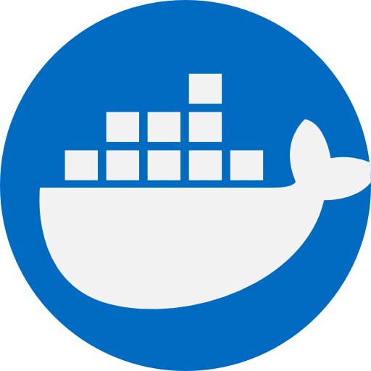
Kubernetes
Container Orchestrator
Control plane
Worker Nodes
Each Node hosts multi-pods
Pod – IP address
Each Pod hosts multi-containers
Kubernetes Cluster
Control Plane
Node 1
Node 2
Client Tool
API Server
kubelet
kubelet
Controller Manager
kube-proxy
kube-proxy
Scheduler
pod
pod
etcd

Slide 5

Amazon EKS
Managed Kubernetes Environment
AWS manages control plane for us
Easy to maintain
AWS Cloud
Availability zone 1 (region)
Availability zone 2 (region)
VPC
Cluster
Kubernetes Nodes
Kubernetes Nodes
Pod
Pod
Pod
Pod
Pod
Pod
Pod
Pod
Pod
…
Pod
Pod
Pod
…
Pod
Pod
Pod
Pod
Pod
Pod
…
…

Slide 6
Target Environment
Goal: inspect the load of the relay server component.
N relay servers,
M sensors / relay server
MxN sensors in total

Slide 7


Mapping onto Kubernetes
4 Container types
Sensor
Broker
Relay
Receiver
Use N+1 Node
1 Node as a cloud
N Nodes as a Edge + sensors
Sensor Pod
Node
Edge Broker
Relay Pod
……
M
Sensor Pod
Node
Cloud Broker
Receiver
Sensor Pod
Node
Edge Broker
Relay Pod
……
M
Sensor Pod
……
Sensor Pod
Node
Edge Broker
Relay Pod
……
M
Sensor Pod

Slide 8


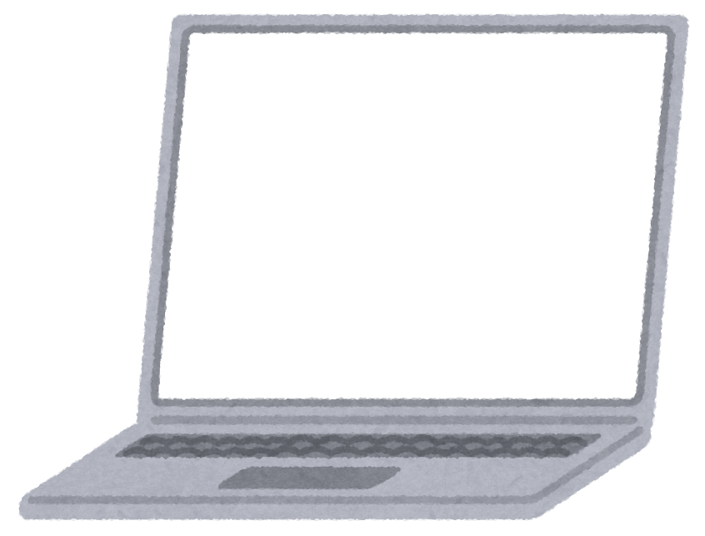
Proposed System
We provide Jupyter notebook
Users can control their environment with simple commands
Docker Hub
Docker Hub
Container
Image
Amazon EKS
Kubectrl
User
yaml
file

Slide 9
Evaluation
We have not measured yet, sorry
Approximately, it takes 40sec to startup 10x10 sensors environment.
More numbers are coming.

Slide 10
Conclusion
Summary
Proposed a device-edge-cloud testbed on Amazon EKS
Confirmed that it takes just a few seconds to setup the env.
Future work
Evaluation for larger environmnent.
Add network emulation, such as latency injection, bandwidth capping.

Slide 11

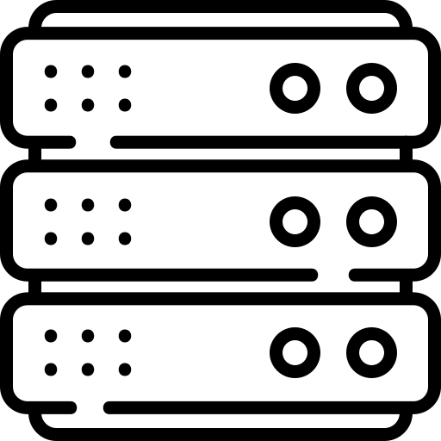

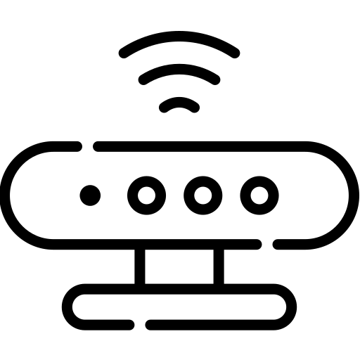
MQTT
MQTT Subscriber
MQTT Publisher
MQTT Broker
Publish
Subscribe

