Slide 1
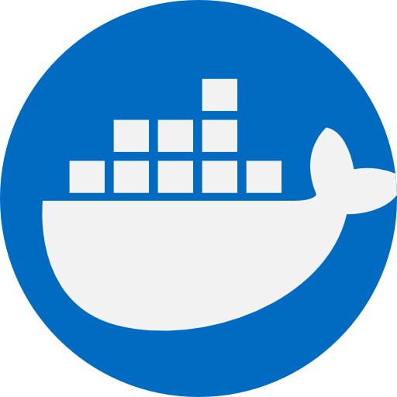
Kubernetes Cluster
Node 1
Node 2
Control Plane
kubelet
kubelet
API Server
kube-proxy
kube-proxy
Controller Manager
pod
pod
Scheduler
etcd

