Slide 1
all

Slide 2

AWS Cloud
Availability zone 1 (region)
Availability zone 2 (region)
VPC
Cluster
Kubernetes Nodes
Kubernetes Nodes
Pod
Pod
Pod
Pod
Pod
Pod
Pod
Pod
Pod
…
Pod
Pod
Pod
…
Pod
Pod
Pod
Pod
Pod
Pod
…
…

Slide 3


帯域幅
Local Server 2
1Gbps
Local Server 1
1Gbps
Cloud Server

Slide 4


Sensor
Cloud Server
.
.
.
.
.
.

Slide 5
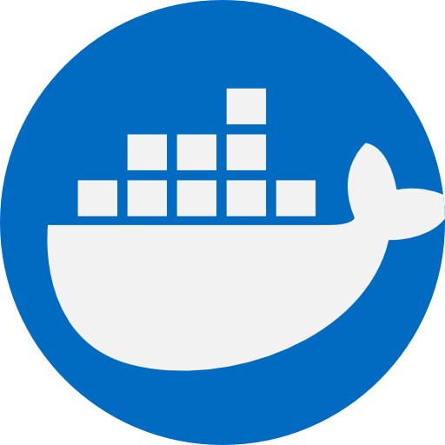
Kubernetes Cluster
Node 1
Node 2
Control Plane
kubelet
kubelet
API Server
kube-proxy
kube-proxy
Controller Manager
pod
pod
Scheduler
etcd

Slide 6
Kubernetes Cluster
Control Plane
Node 1
Node 2
Client Tool
API Server
kubelet
kubelet
kube-proxy
kube-proxy
Controller Manager
pod
pod
Scheduler
etcd

Slide 7
QoS 1
Publisher
Broker
Subscriber
送信時刻を記録
受信時刻を記録
時刻の流れ

Slide 8




MQTT Subscriber
MQTT Publisher
MQTT Broker
Publish
Subscribe

Slide 9
Publishers
Pub/Sub
message broker
Subscribers
Sub 1
msg 1
msg 1
msg 1
Pub 1
Topic 1
Sub 2
msg 1
Pub 2
Sub 3
msg 2
msg 3
msg 2
msg 3
Pub 3
Topic 2
Sub 4
msg 2
msg 3
Sub 5

Slide 10
QoS 1 : At least once
Publisher
Broker
Subscriber
Store(Msg)
PUBLISH(QoS 1, Msg)
Store(Msg)
PUBLISH(QoS 1, Msg)
PUBACK
Delete(Msg)
PUBACK
Delete(Msg)
Publisher
Broker
Subscriber

Slide 11

Local Server
Publisher
Cloud Server
Broker Subscriber
……

Slide 12

AWS EKS Server
Publisher
AWS EKS Server
Broker Subscriber
……

Slide 13

Local Server1
Publisher
Local Server2
Broker Subscriber/Publisher
Cloud Server
Broker Subscriber
……

Slide 14
AWS EKS Server
Publisher
AWS EKS Server
Broker Subscriber/Publisher
AWS EKS Server
Broker Subscriber
.
.
.
……

Slide 15
Node
Sensor Pod
Edge Broker
Relay Pod
……
M
Sensor Pod
Node
Cloud Broker
Receiver
Node
Sensor Pod
Edge Broker
Relay Pod
……
M
Sensor Pod
……
Node
Sensor Pod
Edge Broker
Relay Pod
……
M
Sensor Pod

Slide 16
Local Server1
Publisher
Local Server2
Broker Subscriber
……

Slide 17



Docker Hub
Docker Hub
Container
Image
Amazon EKS
Kubectrl
ユーザ
yaml
file

Slide 18




Sensor
Relay Server
Cloud Server
Protocol: MQTT
Protocol: MQTT
Data pre-processing
Queuing
Data packing
Timed sending

