Slide 1



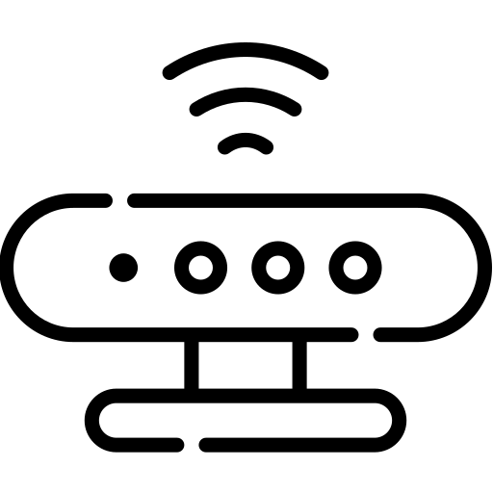
MQTT Subscriber
MQTT Publisher
MQTT Broker
Publish
Subscribe

