Slide 1





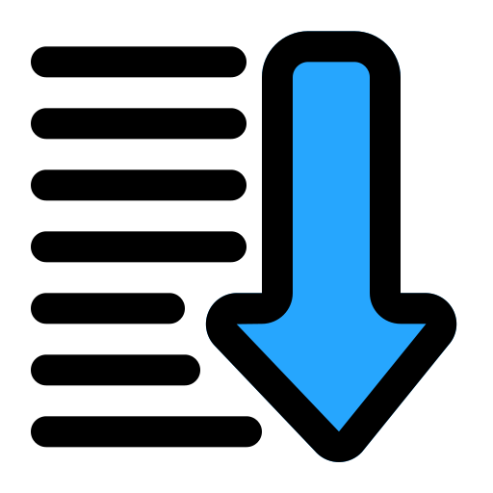
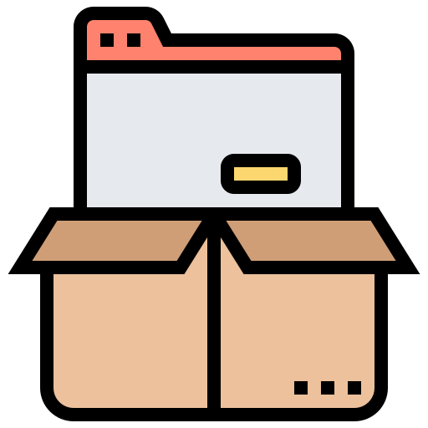
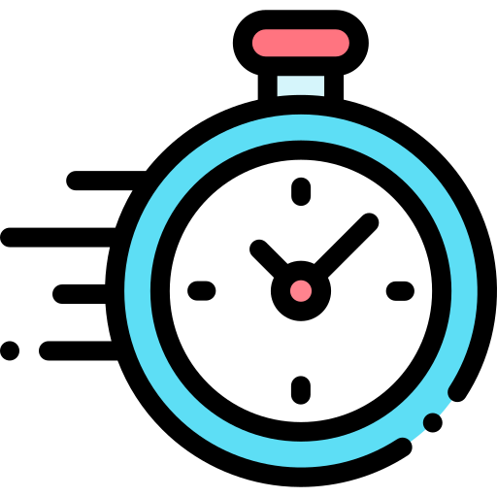
Sensor
Relay Server
Cloud Server
Protocol: MQTT
Protocol: MQTT
Data pre-processing
Queuing
Data packing
Timed sending

