Slide 1
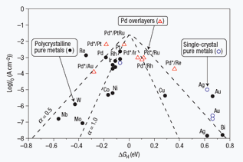
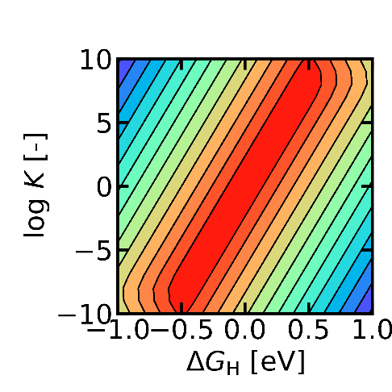
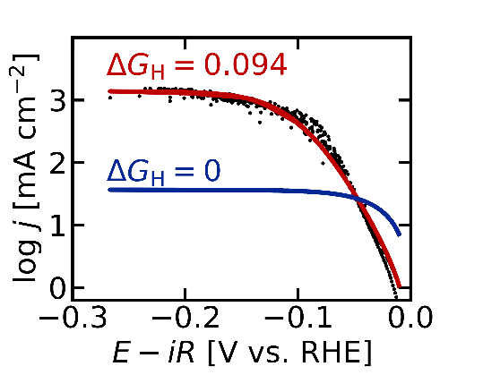
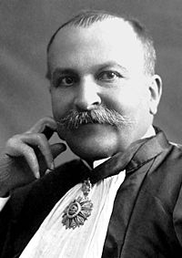
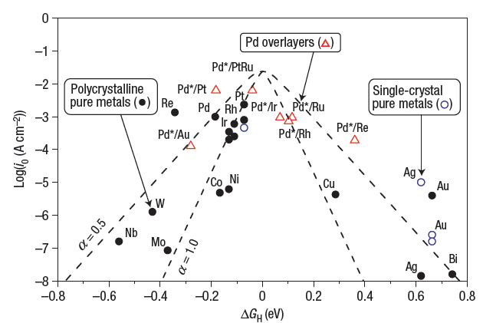
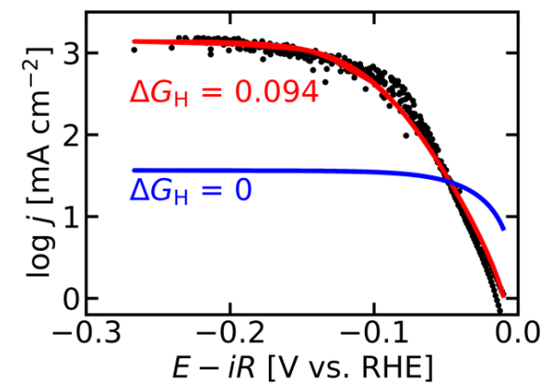
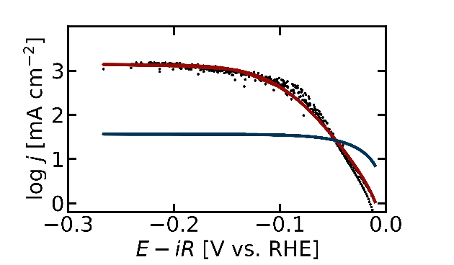
#0658DC
#D90DA4
#C000000
0074E1
97889B
#042796
F79E02
#C00000
4484CE
#F48153
FC4A1A
0074E1
Equilibrium
Non-Equilibrium
#033453
Sabatier Principle：Optimize the Binding Energy
Activity
?
Numerical Simulations
Experimental Verification
#2D8183
#2D8183
#033453
#042796
#F7E8D5
#F7E8D5
#910C07
#C00000
#F48153
#F48153
Greeley et al., Nat. Mater. 2006, 5, 909 – 913.
Driving Force（ΔG）
ACS Catal., 2021, 9, 6298–6303. JPCL 2019, 10, 6706-6713.
Paul Sabatier
#033453
#2D8183
#2D8183
#033453
#033453
#F7E8D5
#F7E8D5
1
#910C07
#C00000
#F48153
#F48153

Slide 2

Substrate
Product
Substrate
Product
k₋₁+k₂
K_{m}
Catalyst
≒
Enzyme
＝
k₁
$$v=\frac{k_{1}k_{2}[S]−k_{1r}k_{2r}[P]}{k_{1}[S]+k_{1r}+k_{2}+k_{2r}[P]}$$
Common Rate Law:

Slide 3

基質
生成物
基質
生成物
k₋₁+k₂
K_{m}
酵素
＝
≒
k₁
触媒
$$v=\frac{k_{1}k_{2}[S]−k_{1r}k_{2r}[P]}{k_{1}[S]+k_{1r}+k_{2}+k_{2r}[P]}$$
共通の速度式:

