Slide 1


This sample provided by Writers Per Hour.
Paper writing service. Our team comprises reliable writers to provide you with high-quality custom papers 24/7.
>> Writersperhour.com <<

Slide 2
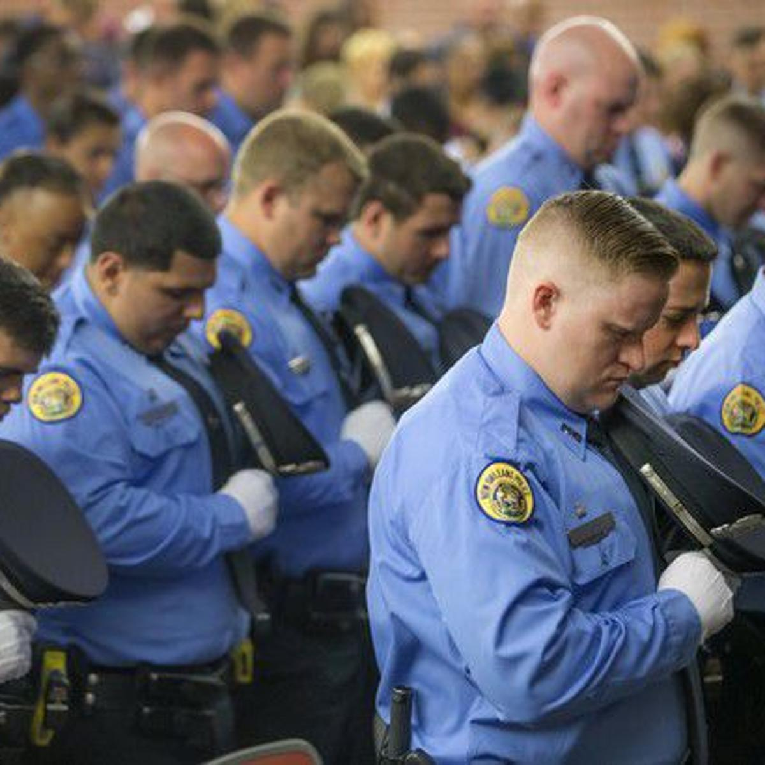
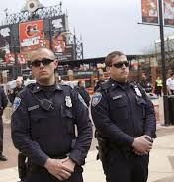


Baltimore PD Corruption VS New Orleans PD Corruption
Class: PSC 321.01 (Hybrid)– Police Ethics
31st march 2020
BY: 1. student name
2. student name
3. student name
4. student name

Slide 3
OVERVIEW OF BALTIMORE & NEW ORLEANS COMMUNITIES
BALTIMORE
NEW ORLEANS
Total City Population of 602,495 people.
African Americans 61.3%, Native White Americans 27.7 %, Hispanic/Latino 5.49%, Asian 2.57%, Mixed Race 2.5%, American Indian 0.24%.
Median age of 35.5 years
286,050 employed
Poverty Rate of 22.4%
Median Poverty Value of $167,800
Total City Population of 391,006 people.
African Americans 58.8%, Native White Americans 30.5%, Hispanic/Latino 5.62%, Asian 2.78%, Mixed Race 1.59%, American Indian 0.132%.
Median age of 37.3 years
176,055 employed
Poverty Rate of 25.4%
Median Poverty Value of $242,900

Slide 4
OVERVIEW OF BALTIMORE & NEW ORLEANS PD’s
BALTIMORE PD
NEW ORLEANS PD
Total of 3,100 civilian and sworn personnel.
8th Largest municipal police force in the United States.
Jurisdiction covers Maryland’s largest city Baltimore with a population of 602,495 people.
Total of 1,165 officers
37th largest municipal police force in the United States.
Covers 8 police districts
Serves a population of 391,006 people.
Struggling to attract new recruits, hence its lean number of officers

Slide 5
HIRING PRACTICES OF BALTIMORE & NEW ORLEANS
BALTIMORE
NEW ORLEANS
All hiring of recruits determined by PD Commissioner of Police.
Applicants apply online and are advised via email on other steps.
Applicants sign up for police exam administered by the National Testing Network.
Applicants taken through fitness test, background investigation, polygraph exam, physical exam and psychological exam.
Successful applicants become recruits and trained at Baltimore Police Academy
All hiring of recruits determined by PD Superintendent.
Applicants apply online and are advised via email on other steps.
Applicants sign up for police exam administered by the National Testing Network.
Applicants taken through fitness test, background investigation, polygraph exam, physical exam and psychological exam.
Successful applicants become recruits and trained at New Orleans Police Academy

Slide 6
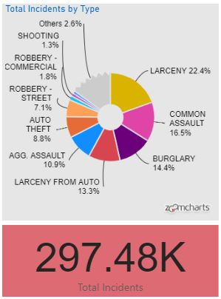
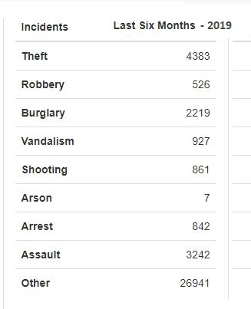
CRIME STATS FOR BALTIMORE & NEW ORLEANS PD’s
BALTIMORE PD
NEW ORLEANS PD
Source; Dutelle (2019)

Slide 7
HISTORICAL SLIDE OF MARYLAND & BALTIMORE PD
The State of Maryland adopted a Declaration of Rights and a state constitution in 1776
The state officially became a state in the Union in 1778
The Baltimore Police department was initiated in 1867 as the Baltimore City Police Force.
Has a long history of corruption. Baltimore PD officers terrorized more than 200 African American homes in 1964, causing riots.
Source; Rushin (2017)

Slide 8
REPORTING CORRUPT POLICE BEHAVIOUR
The Baltimore Police Department has a clear process for reporting corrupt police behavior via a non-emergency contact 311.
Mass complaints of police corruption can also be channeled via mediaRelations@baltimorepolice.org.

Slide 9
CORRUPTION SCANDALS, MISCONDUCT AND INTEGRITY
On January 5, 2018, Sergeant Wayne Earl Jenkins, age 37 Pleaded Guilty To Racketeering, Robberies, Overtime Fraud And Planting Evidence
At least 20 Baltimore police officers arrested, sentenced or suspended in 2019, due to scandals including the Gun Trace Task Force scandal.
Baltimore PD officer Arthur Williams was found guilty of second-degree assault in 2019 after body-camera footage showed him punching a man, on a sidewalk in East Baltimore breaking his jaw, ribs and injuring his stomach.
Source; Dutelle (2019)

Slide 10
CONCLUSION ON MARYLAND & NEW ORLEANS PD’s
Baltimore Police Department has a history of huge corruption and it is evident it is still riddled with corruption.
Baltimore PD has deep-seated corruption that will take a thorough clean-up to root out.
New Orleans PD seems to be a model

Slide 11
RECOMMENDATIONS FOR BALTIMORE PD CLEAN-UP
The Baltimore Police Department should implement consent decrees more stringently. The consent degrees impose court oversight over police roles and helps eliminate individual cases of civil rights abuses by officers against civilians.
The Baltimore PD should also establish strong internal mechanisms to advocate for and encourage higher levels of integrity among its staff. It could come up with a Baltimore PD Internal Affairs Unit to warn and discipline errant officers even for the slightest of misdemeanors.

Slide 12
REFERENCES
Barrow, L. M., & Rufo, R. A. (2014). Police and profiling in the United States: Applying theory to criminal investigations.
Dempsey, J. S., & Forst, L. S. (2012). An introduction to policing. Clifton Park, NY: Delmar Cengage Learning.
Dutelle, A. W., & Becker, R. F. (2019). Criminal investigation. Burlington, MA : Jones & Barlett Learning, [2019]
Langworthy, R. H., & Academy of Criminal Justice Sciences. (1995). Law enforcement recruitment, selection and training: A survey of major police departments in the U.S. Highland Heights, Ky: Academy of Criminal Justice Sciences, Police Section.

Slide 13
REFERENCES
Millie, A., & Das, D. K. (2008). Contemporary issues in law enforcement and policing. Boca Raton: CRC Press.
Newman, G. R., Clarke, R. V. G., & United States. (2008). Policing terrorism: An executive's guide. Washington, DC: U.S. Dept. of Justice, Office of Community Oriented Policing Services, Center for Problem -Oriented Policing.
Rushin, S. (2017). Federal intervention in American police departments. Cambridge, United Kingdom ; New York, NY, USA : Cambridge University Press, 2017.

Slide 14

Thank you for checking our sample!
Read our blog
Help Center

