Slide 1
Bootstrap
Class : Web Development
Instructor: Eugeniu Burianov
Presenter: Hien Ho

Slide 2
What is bootstrap?
bootstrap is a CSS framework
the most popular CSS framework
allows for fast and easy web development
it's open source
a collection of CSS classes and JavaScript. No need to worry about writing code to achieve basic functionality.
created by a designer and developer at Twitter
released on August 19, 2011

Slide 3
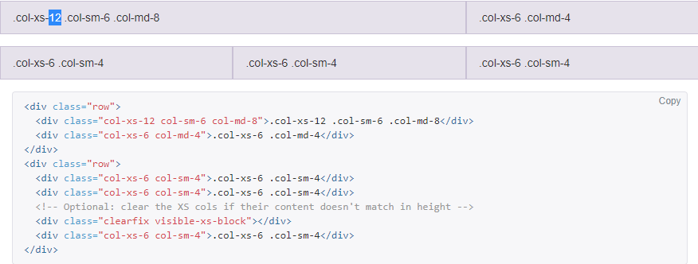
Why we should use bootstrap
Responsive CSS
bootstraps CSS adjusts to phones, tablets and desktop

Slide 4
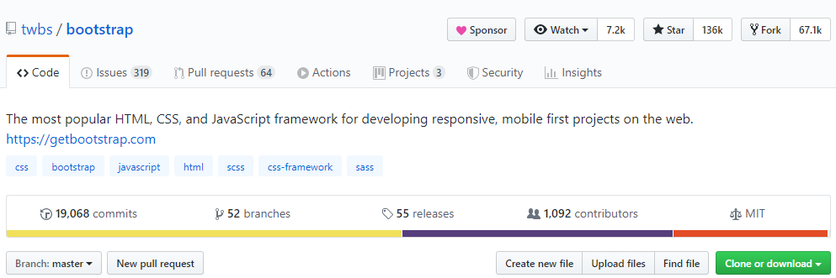
Why we should use bootstrap
2. Open Source
- it's free to use

Slide 5
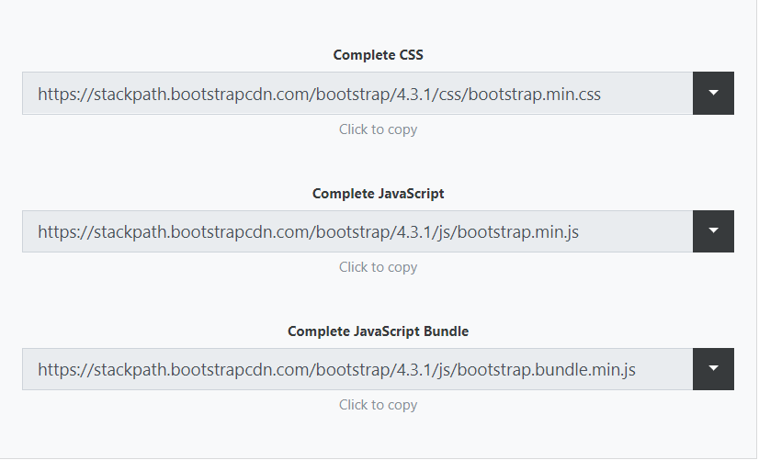
Why we should use bootstrap
3. Easy set up
- bootstrap can be used by using their CDN (Content Delivery Network) - just copy and paste the links, not required to download
https://www.bootstrapcdn.com/

Slide 6
Why we should use bootstrap
4. Customization
Fully customizable
Default values, such as colors, can be overwritten using: http://getbootstrap.com/customize/

Slide 7
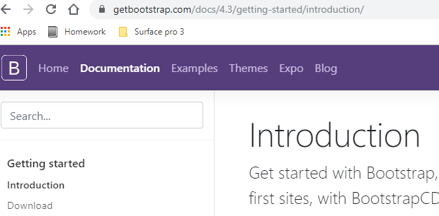
Why we should use bootstrap
5. Documentation
- excellent documentation - easy to find information and examples of how to use bootstrap

Slide 8

Why we should use bootstrap
6. Cross Browser Support
- handles a lot of issues that can arise when dealing with different browsers - not all browsers display CSS equally, bootstrap deals with that for you
https://getbootstrap.com/docs/4.0/getting-started/browsers-devices

Slide 9
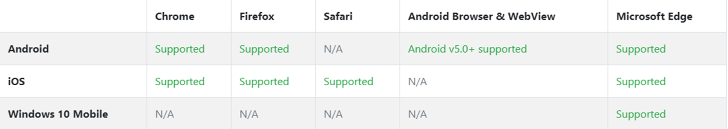
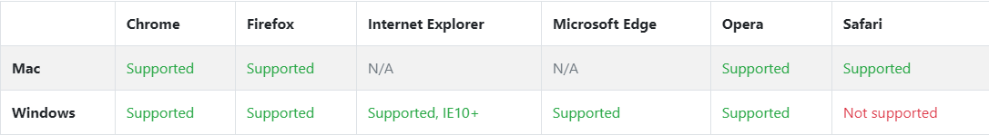
Mobile devices
Desktop browsers

Slide 10

Why we should use bootstrap
7. Consistency
- by using bootstrap the basic structure of each webpage you work on will be similar
- this makes it so you don't have figure out what all the CSS is doing if you already know bootstrap

Slide 11
Why we should use bootstrap
8. JavaScript Components
- bootstraps comes with several useful JavaScript components - easy to add things like tooltips, modal popups and carousels without having to write any JavaScript
- requires jQuery: https://code.jquery.com/

Slide 12
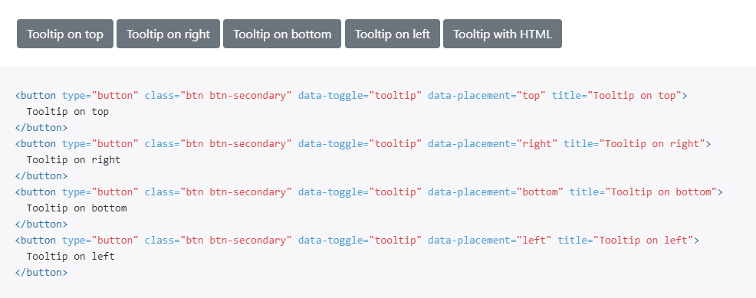

Slide 13
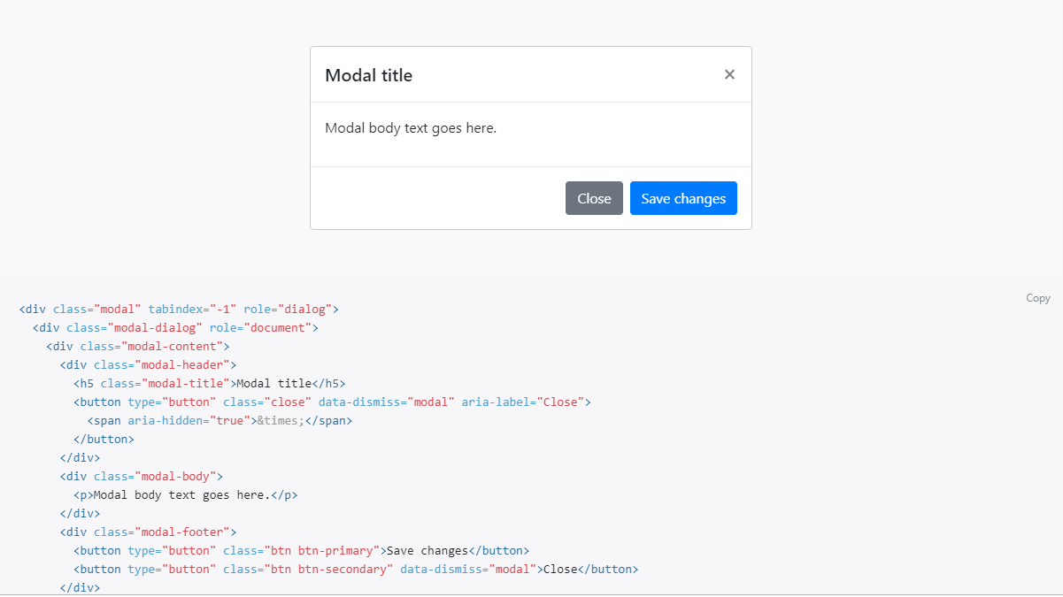
Modal popups

Slide 14

Carousels

Slide 15
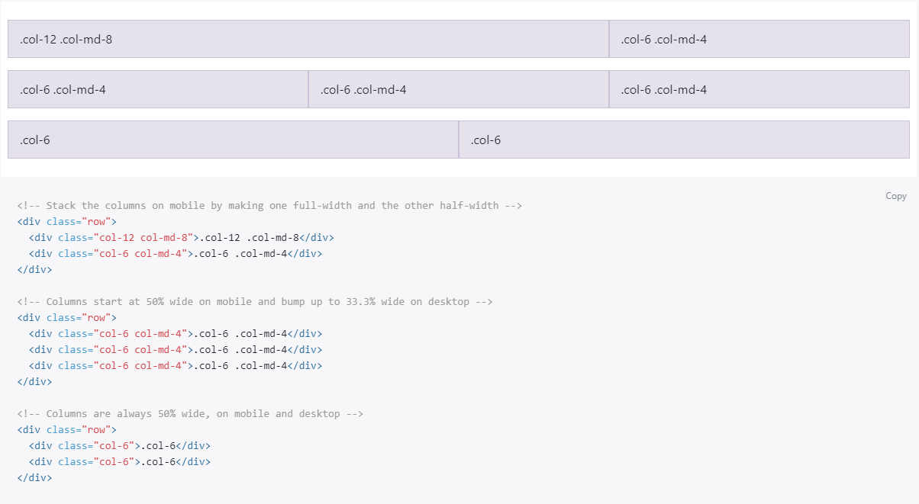
Why we should use bootstrap
9. Grid System
- bootstraps grid system makes page layouts easy to create for both mobile and desktop
https://getbootstrap.com/docs/4.0/layout/grid/

Slide 16
Why should we use bootstrap
10. Themes and Templates
- Lots of templates available to download, use these to get started. You can customize these templates as you build your site
- https://startbootstrap.com/themes/

Slide 17
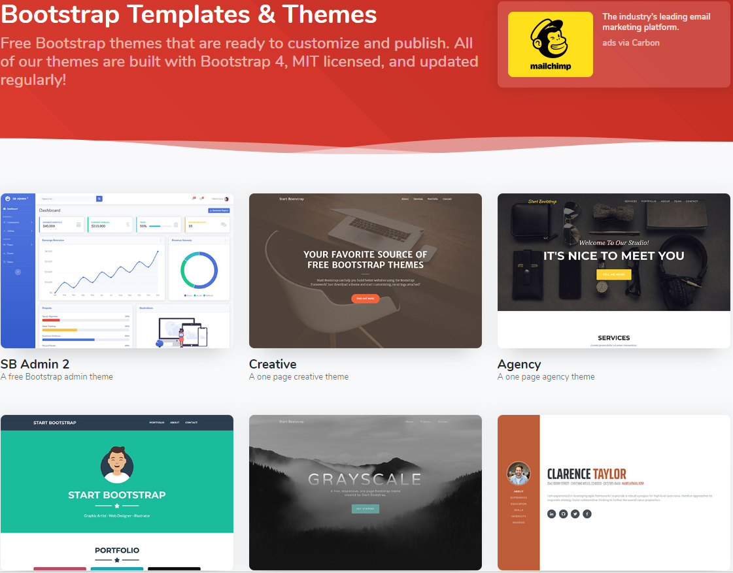

Slide 18
Example code

