Slide 1
Report
Parking Guidance System Solution

Slide 2

Project Information
Project name: Parking Guidance System Solution
Project Code: PGSS
Product Type: Internet of Things Application
Start Date: 3-Jan-2017
End Date:

Slide 3
Proposed Solution
A wireless Parking Guidance System utilize RF.
A server to keep track of data and information
A mobile app provides a simple and intuitive geolocation for drivers
Our proposed solution is to build a parking guidance system with RF modules. The RF modules provide wireless communication directly between Central Control Unit and Detectors, Indicator LED, Information LED Displays so there is no need for the Zone Control Units.

Slide 4
Feature Functions
A Mobile Application
Detector using Triple Axis Digital Compass Sensor
Information LED Displays for Main entrance and internal junction
Reservation Barrier
Indicator LED with RGB

Slide 5
Boundaries of the system

Slide 6
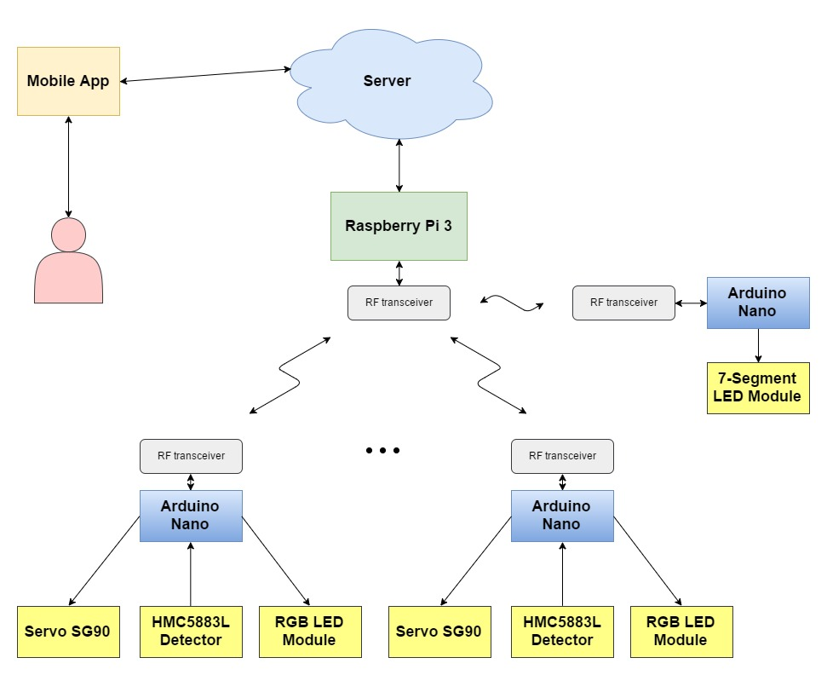
Block Diagram

Slide 7
Use Case

Slide 8
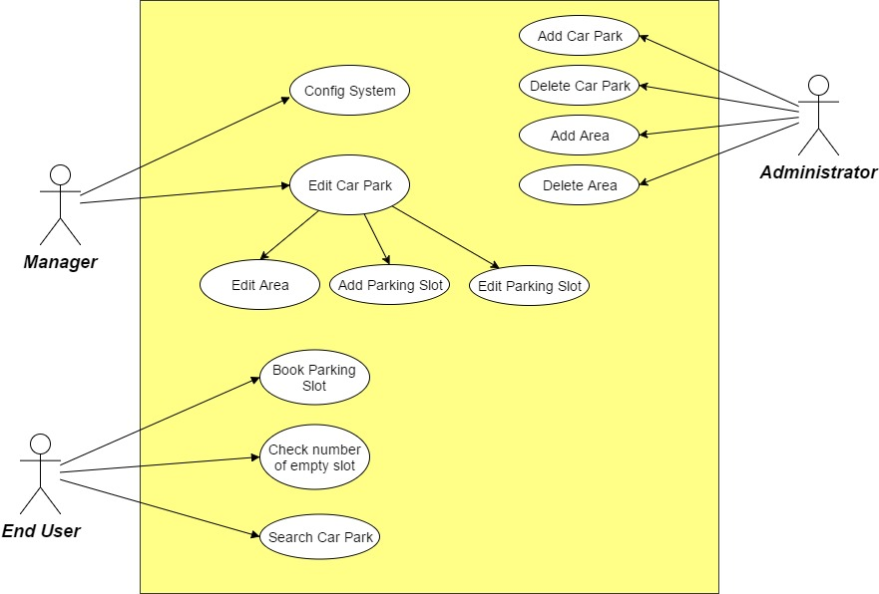
System Overview Use Case

Slide 9
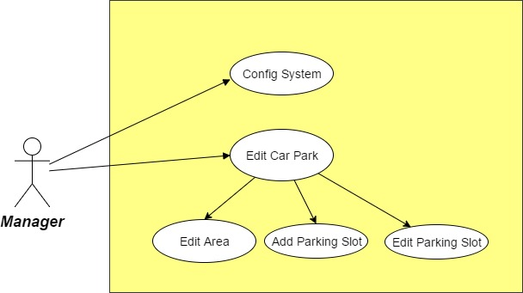
Manager Use Case

Slide 10
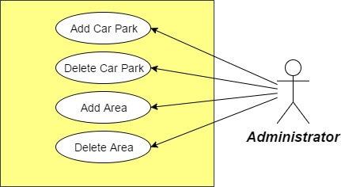
Administrator Use Case

Slide 11
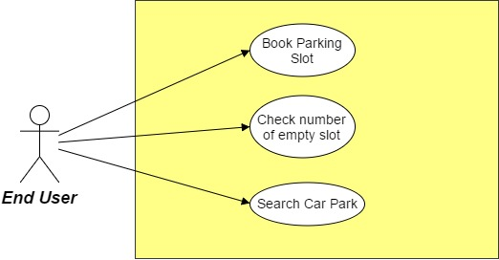
End User Use Case

Slide 12
Start
Change RGB LED to red
Setup nRF24L01+, read data from HMC5883L multiple times to get stabilized data, setup RGB led
Yes
Car in range? 1st time
Reserved?
No
Read data from HMC5883L
No
Change RGB LED to green
Read data from nRF24L01+

Slide 13
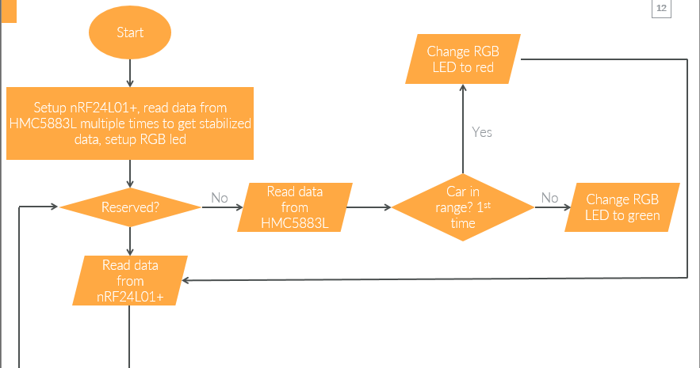
No
Receive package?
Yes
No
Validated package?
Yes
Send ACK
Switch command

Slide 14
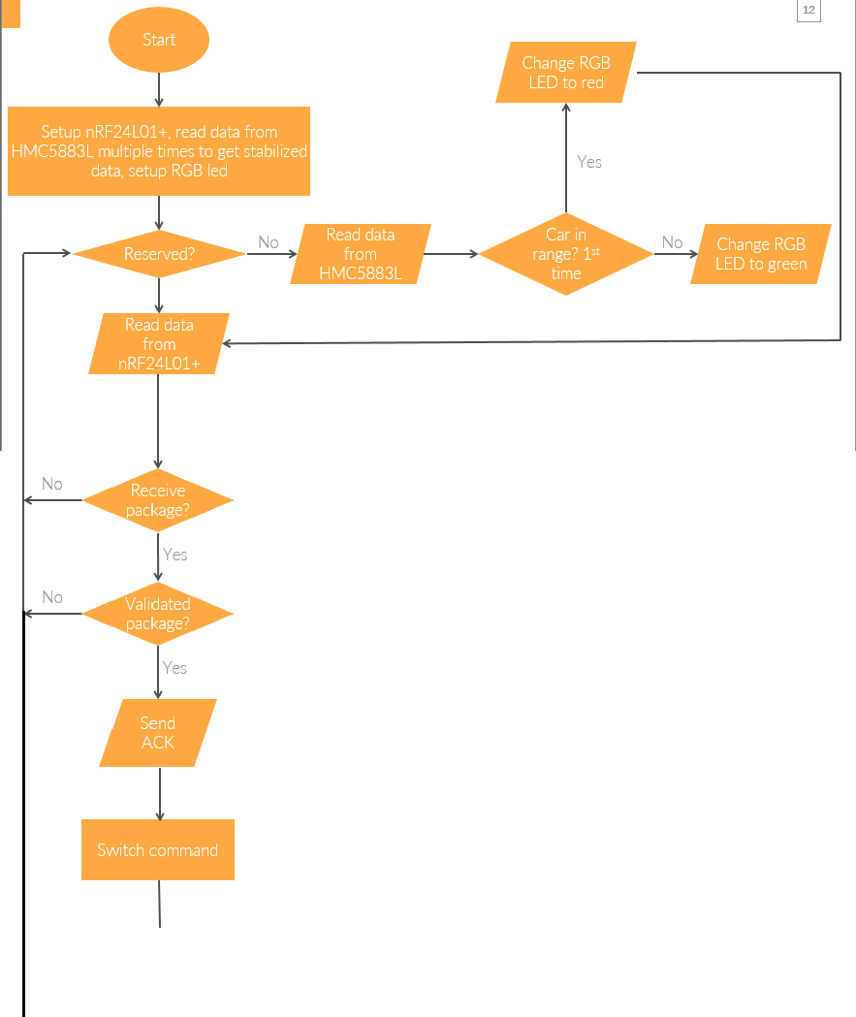
Yes
Resend 15 times?
Yes
No
Case LOT_Status
Send lot status package and wait for ACK
Received ACK?
Yes
Yes
No
Case RESERVE
Raise servo, update status to reserved, change RGB LED to red
Yes
No
Case UNRESERVE
Lower servo, update status to not reserved, change RGB LED to red
Yes

Slide 16
Start
Setup nRF24L01
Start polling all parking lot
No
Exists parking lot need to poll status
Received ACK?
Not timeout?
Yes
Send check status package, wait for ACK
Yes
Yes
Start polling at information display

Slide 17
Received package?
Validated package?
Update lot status and area available lot
Send pubnub message and update server
Read data from nRF24L01+
Yes
Yes
No
No

Slide 18
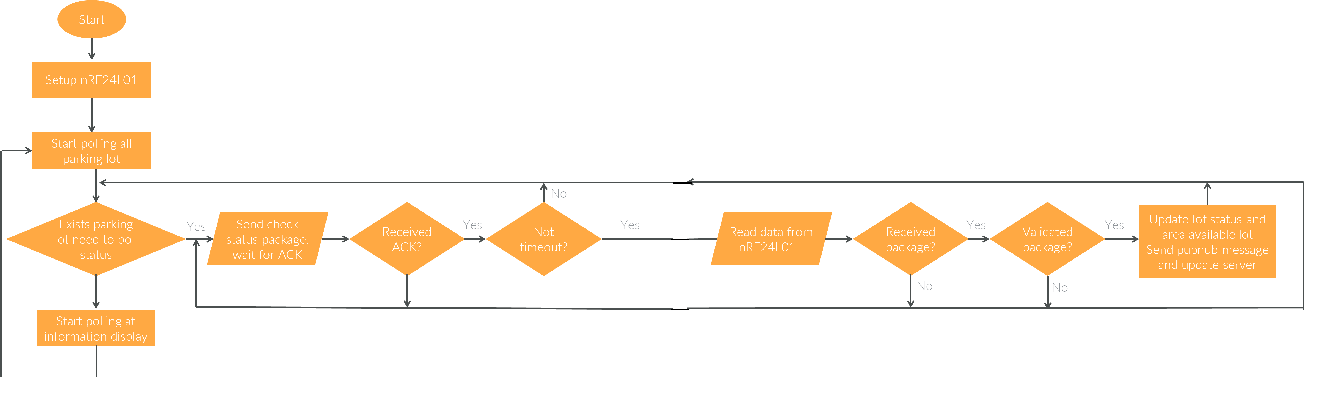
Exists one need to be updated
No
Yes
Send update information package, wait for ACK
Receive ACK?
Yes
No
Resend 15 times
Yes

