Slide 1
PGSS

Slide 2
About Us

Slide 3
Outline
Problem
Solution
How the system works
Hardware
Firmware & Software Implement
Advantages & Disadvantages
Future Plan
Demo

Slide 4
Problem

Slide 5
Solution

Slide 6
How the system works
Này là miêu tả tổng quan hệ thống

Slide 7
Hardware

Slide 8
Implement Firmware

Slide 9
Implement Mobile

Slide 10
Implement Service API

Slide 11
Advantage

Slide 12
Disadvantage

Slide 13

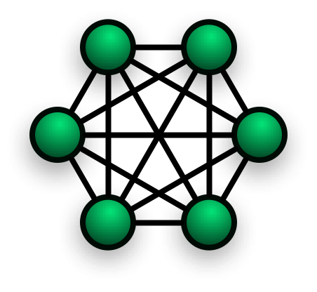
Future Plan
Star
Mesh
Algorithm

Slide 14
Demo

