Slide 1
Parking Guidance System Solution

Slide 2
About Us
Mr.Nguyễn Đức Lợi
Supervisor
Trần Nguyễn Minh Trung
Firmware: System architecture & interface protocol
Software: Android Application
Bùi Phú Hiệp
Nguyễn Đỗ Phương Huy
Hardware: Design & Implement
Software: Web Server
Hardware: Implement
Testing: Design and Execute

Slide 3
Outline
Problem
Solution
How the System Works
Web Service
Hardware
Firmware & Software Implement
Advantages & Disadvantages
Future Plan
Demo

Slide 4
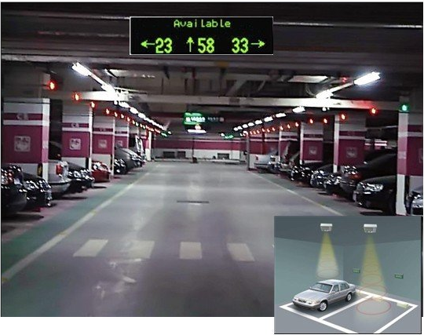
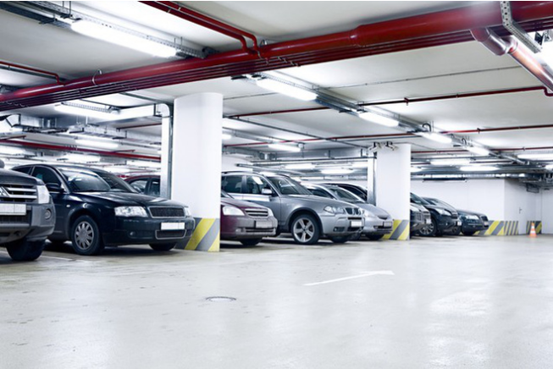
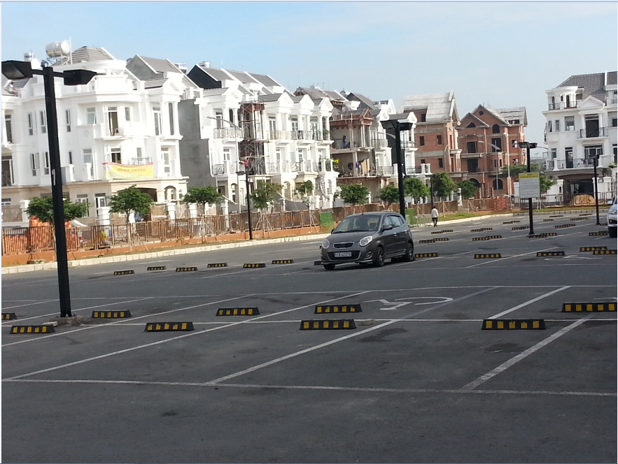
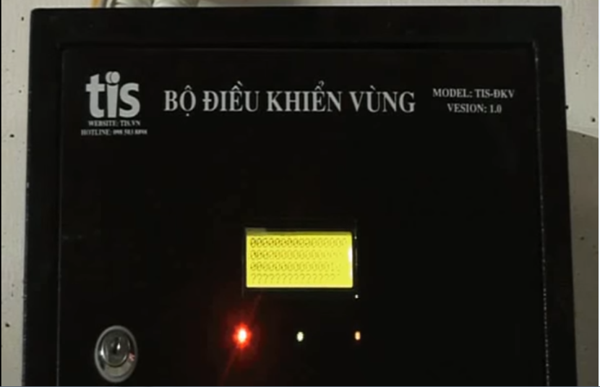
Problem

Slide 5
Problem
Limited number of monitored parking lots
Complicated planning of wired system
Incompatible with outdoor system
Limited information provided to drivers

Slide 6
Solution

Slide 7
How the system works

Slide 8


Web Service
Database
Web server

Slide 9
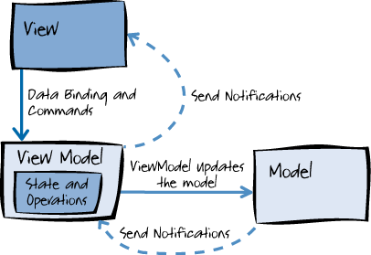
Web Service

Slide 10
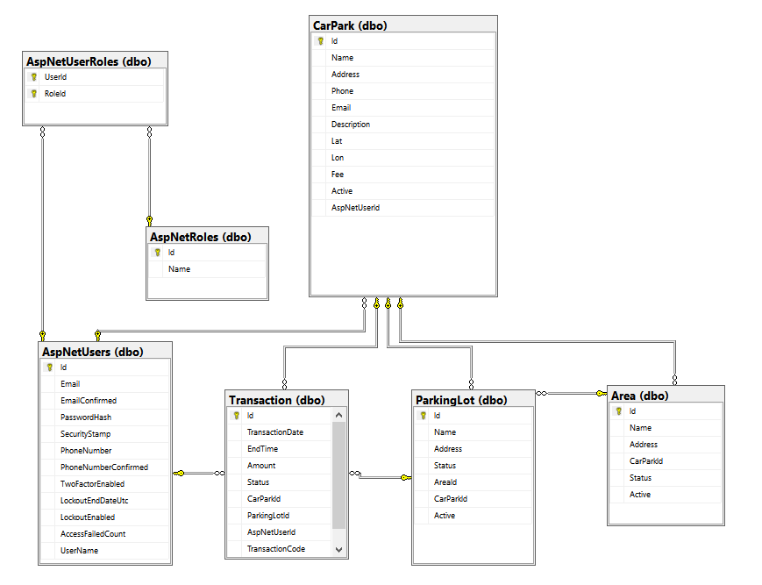
Web Service

