Slide 1
Report
Parking Guidance System Solution

Slide 2

Project Information
Project name: Parking Guidance System Solution
Project Code: PGSS
Product Type: Internet of Things Application
Start Date: 3-Jan-2017
End Date:

Slide 3
Proposed Solution
A wireless Parking Guidance System utilize RF.
A server to keep track of data and information
A mobile app provides a simple and intuitive geolocation for drivers
Our proposed solution is to build a parking guidance system with RF modules. The RF modules provide wireless communication directly between Central Control Unit and Detectors, Indicator LED, Information LED Displays so there is no need for the Zone Control Units.

Slide 4
Feature Functions
A Mobile Application
Detector using Triple Axis Digital Compass Sensor
Information LED Displays for Main entrance and internal junction
Reservation Barrier
Indicator LED with RGB

Slide 5
Boundaries of the system

Slide 6
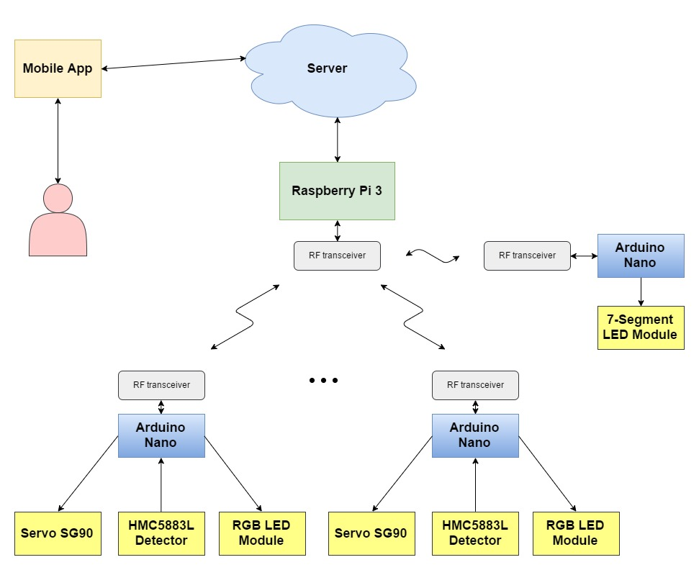
Block Diagram

Slide 7
Use Case

Slide 8
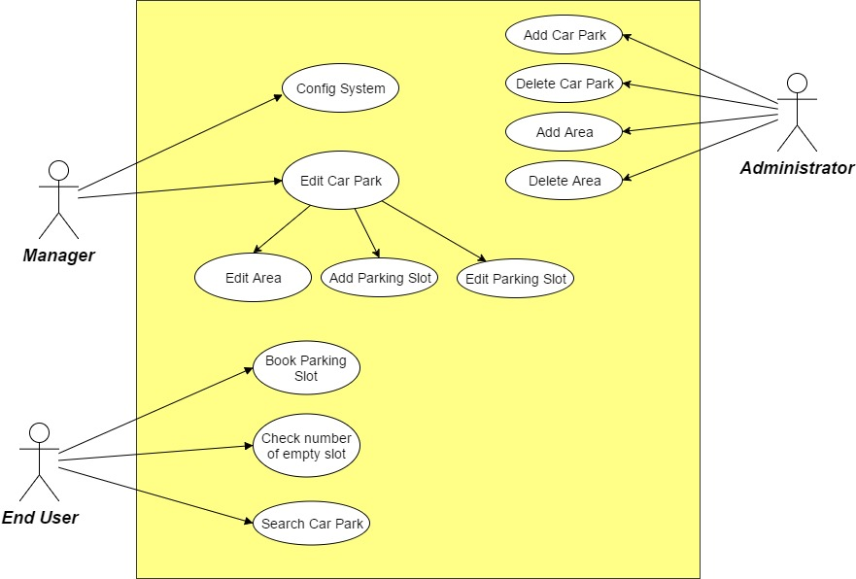
System Overview Use Case

Slide 9
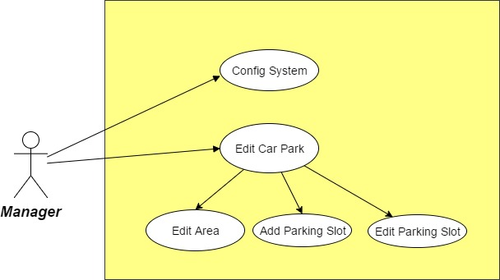
Manager Use Case

Slide 10
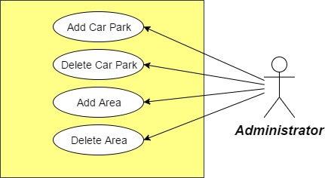
Administrator Use Case

Slide 11
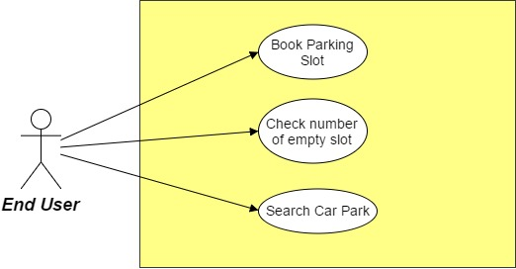
End User Use Case

Slide 12
Start
Change RGB LED to red
Setup nRF24L01+, read data from HMC5883L multiple times to get stabilized data, setup RGB led
Yes
Car in range? 1st time
Reserved?
No
Read data from HMC5883L
No
Change RGB LED to green
Read data from nRF24L01+

