Slide 1
PGSS

Slide 2
About Us

Slide 3
Outline
Problem
Solution
How the system works
Hardware
Firmware & Software Implement
Advantages & Disadvantages
Future Plan
Demo

Slide 4
Problem

Slide 5
Solution

Slide 6

How the system works

Slide 7

How the system works

Slide 8

How the system works

Slide 9

How the system works

Slide 10
How the system works
Collect Data

Slide 11
How the system works
Update Information

Slide 12

How the system works
Send data

Slide 13
How the system works
Receive command

Slide 14
How the system works
Update Status

Slide 15
How the system works

Slide 16
How the system works
Collect Data

Slide 17

How the system works
Get Information

Slide 18
How the system works
Issue a command

Slide 19
How the system works
Send Command

Slide 20
How the system works

Slide 21
Hardware

Slide 22
Implement Firmware

Slide 23
Implement Mobile

Slide 24
Implement Service API

Slide 25
Advantage

Slide 26
Disadvantage

Slide 27

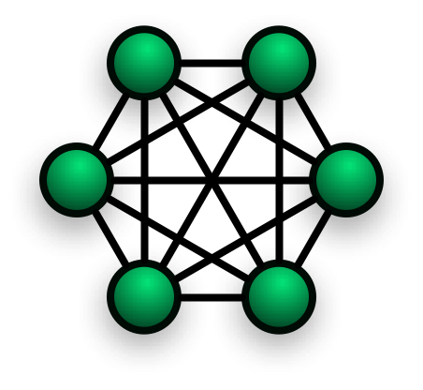
Future Plan
Star
Mesh
Algorithm

Slide 28
Demo

