Slide 1
Optimizing the Compiler (torch-spyre) for Dataflow-architecture AI Accelerators
Haoyang Zhang
Manager: Olivier Tardieu
Mentor: David Grove
Hybrid Cloud
Notes:
Thanks — I am Haoyang, and for the last stretch I have been working inside torch-spyre, the
PyTorch backend for the Spyre accelerator, on the middle of the compiler.
The one-line version of this talk: I built an analytical cost model that predicts how long a
compiled kernel will take before anything runs, derived it from measurements on the card
rather than from a datasheet, and then tested whether it is good enough to make a real
compiler decision. Along the way the measurements turned up two things about this hardware
that are worth knowing regardless of the model.
I will be explicit throughout about which parts are measured, which are fitted, and which are
still open — including the places where the model is plainly wrong.

Slide 2
PART 1
A cost model as a compiler pass
What it reads, what it prints, and what another pass could do with it.

Slide 3
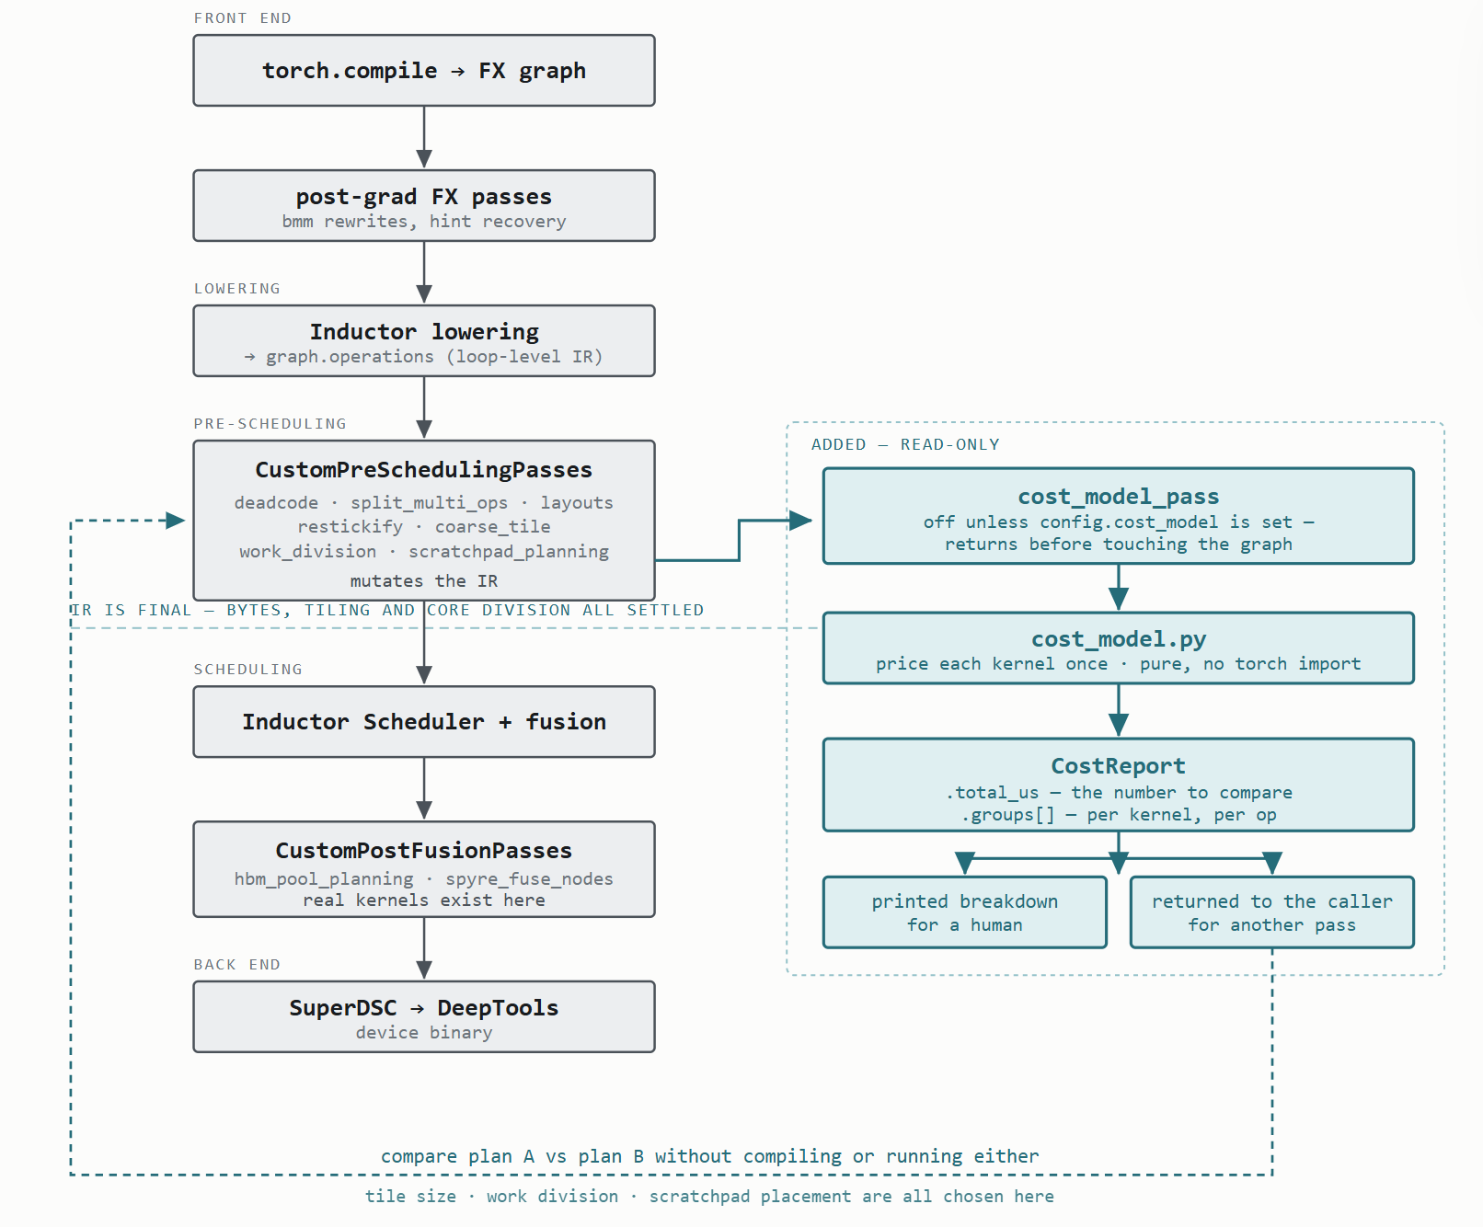
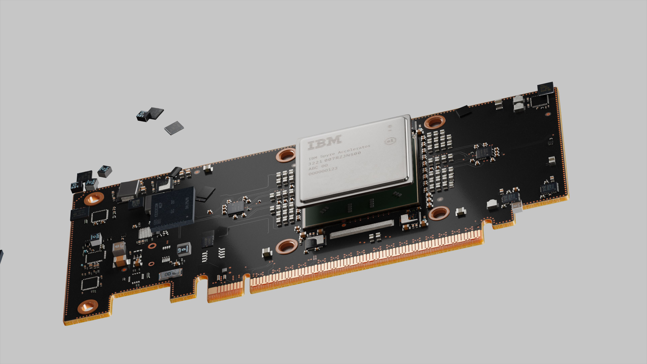
Motivation Better understand the compiler workflow and Spyre’s performance features; Using it to explore optimizing directions, without needing to run blind sweeps on actual hardware. Input The loop-level IR after all prescheduling passes. Outputs The predicted performance of the program. Coverage All different types of Ops (Pointwise, Reductions, Broadcasts, Transportation, MatMul) and support special fusion (coarse tiling). Verified with several real programs, including a small example of flash_attn.
An Analytical Cost Model for Spyre Kernels as a New Compiler Pass
Notes:
Let me set up what the thing is before any numbers.
The motivation is that the compiler makes several decisions — how to tile an operation, how to
divide work across cores, which buffers stay in the scratchpad — and today it makes them with
heuristics that have no notion of time. Some have no objective function at all. To do better
you need to be able to compare two candidate plans, and on this hardware you cannot simply
compile and run both: hardware is scarce, a compile is minutes, and the search space is large.
So you need to be able to price a plan cheaply, from the compiler's own data structures.
That is what this is. The input is the loop-level IR after every pre-scheduling pass — the
point where the program's shape is final. The output is a predicted runtime for the whole
program, printed for a human and returned as a value another pass can read.
On coverage: it prices all the ordinary op classes — pointwise, reductions, broadcasts,
transports and matmul — and it handles coarse tiling, which is the compiler's special fusion
where one operation becomes a loop. It is verified end to end on flash attention, which is
useful precisely because flash attention has no fitted term of its own: it is priced purely
from the parts.
One thing it is not. It is off by default and it is read-only. It prints and it returns;
nothing in the compiler consumes it yet. The second half of the talk is the evidence about
whether it deserves to.

Slide 4
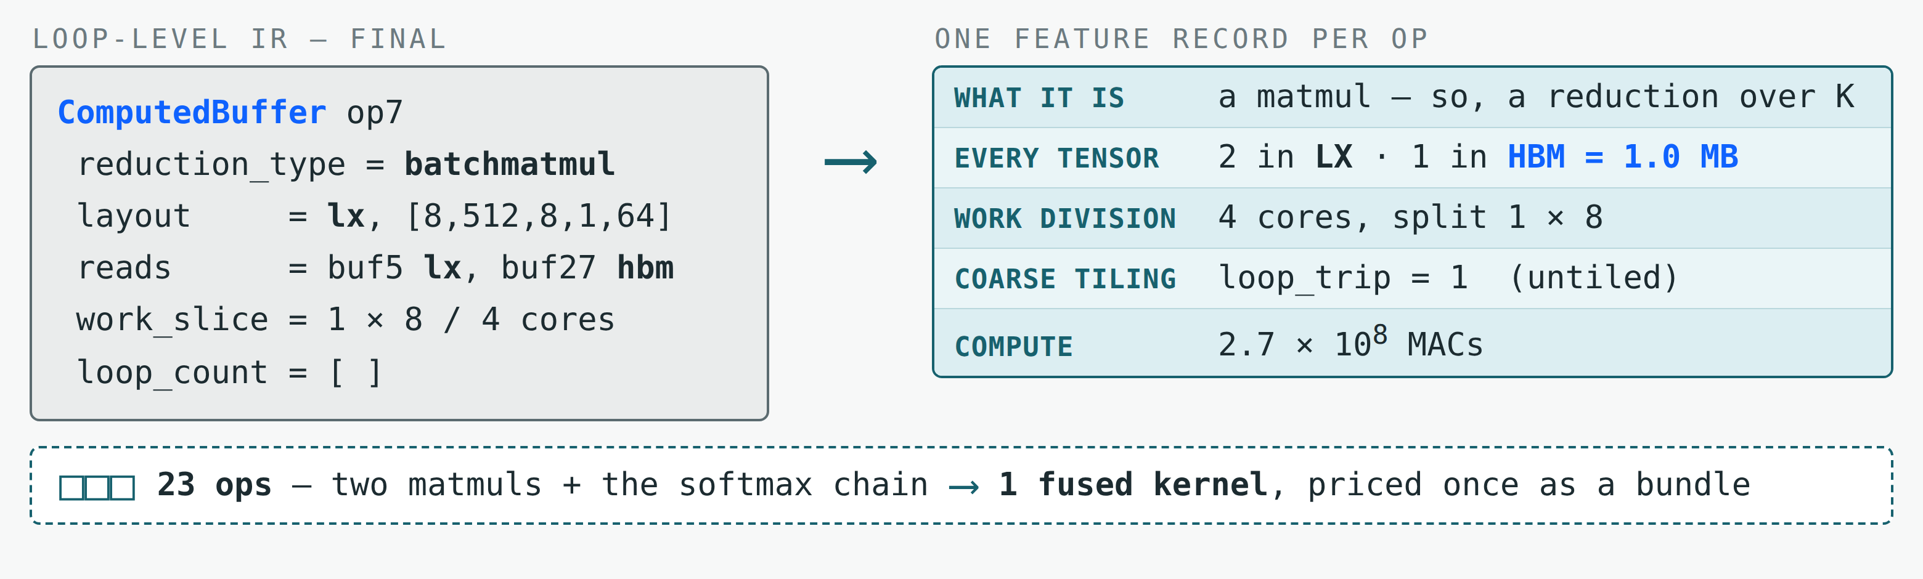
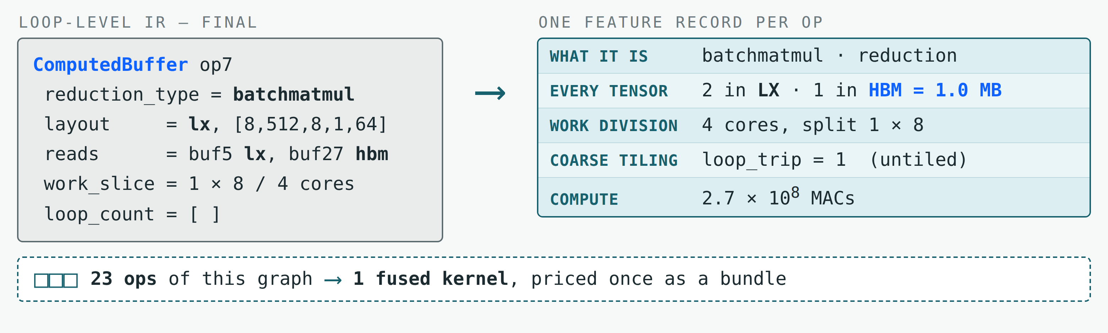
The Input Is Read Straight Off the Final IR — Nothing Is Inferred
The pass runs where the IR is final — layouts, tiling, work division and scratchpad placement are all settled.
Residency is the field that matters most — it decides whether a tensor's bytes are charged at all.
Notes:
This is the input side, and the short version is that we do not model the program — we read
it.
The pass sits at one specific place: immediately after the last pre-scheduling pass. That
position is the whole trick. By then the compiler has already chosen every tensor's layout,
whether coarse tiling applies and with what trip count, how work is divided across cores, and
which buffers live in the LX scratchpad. Nothing later changes what the program moves or
computes. So every quantity the model needs already exists — we pick it up rather than
re-derive it, which is what makes the estimate describe the plan that will actually run.
On the left is one real operation as the IR leaves it: the query-times-key matmul from a
flash-attention kernel. On the right is the record we extract, and I have grouped the fields
by what they are for. What the op is picks whether there is an arithmetic term. The tensor
list carries the field that matters most — LX or HBM. Here two of the three tensors are
already on chip, so only one megabyte is charged; the other two are free. Then the work
division, which gives the per-core tile shape, the tiling loop, and the multiply count, which
is the only quantity in the model that is not bytes.
The strip along the bottom is the step people miss. A fused kernel is the only thing that can
be measured — there is no per-operation timing inside one — so the pass first reconstructs the
kernels the backend will fuse. This whole graph is twenty-three operations that become one
kernel, and it is priced once as a bundle. That matters because pricing is not additive: an
input shared by several operations in the bundle is charged once, not once per consumer. If
you add up the per-op numbers you will not get the kernel number, and that is deliberate.

Slide 5
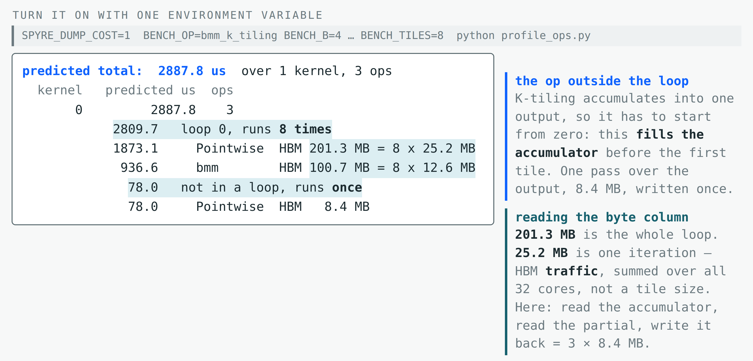
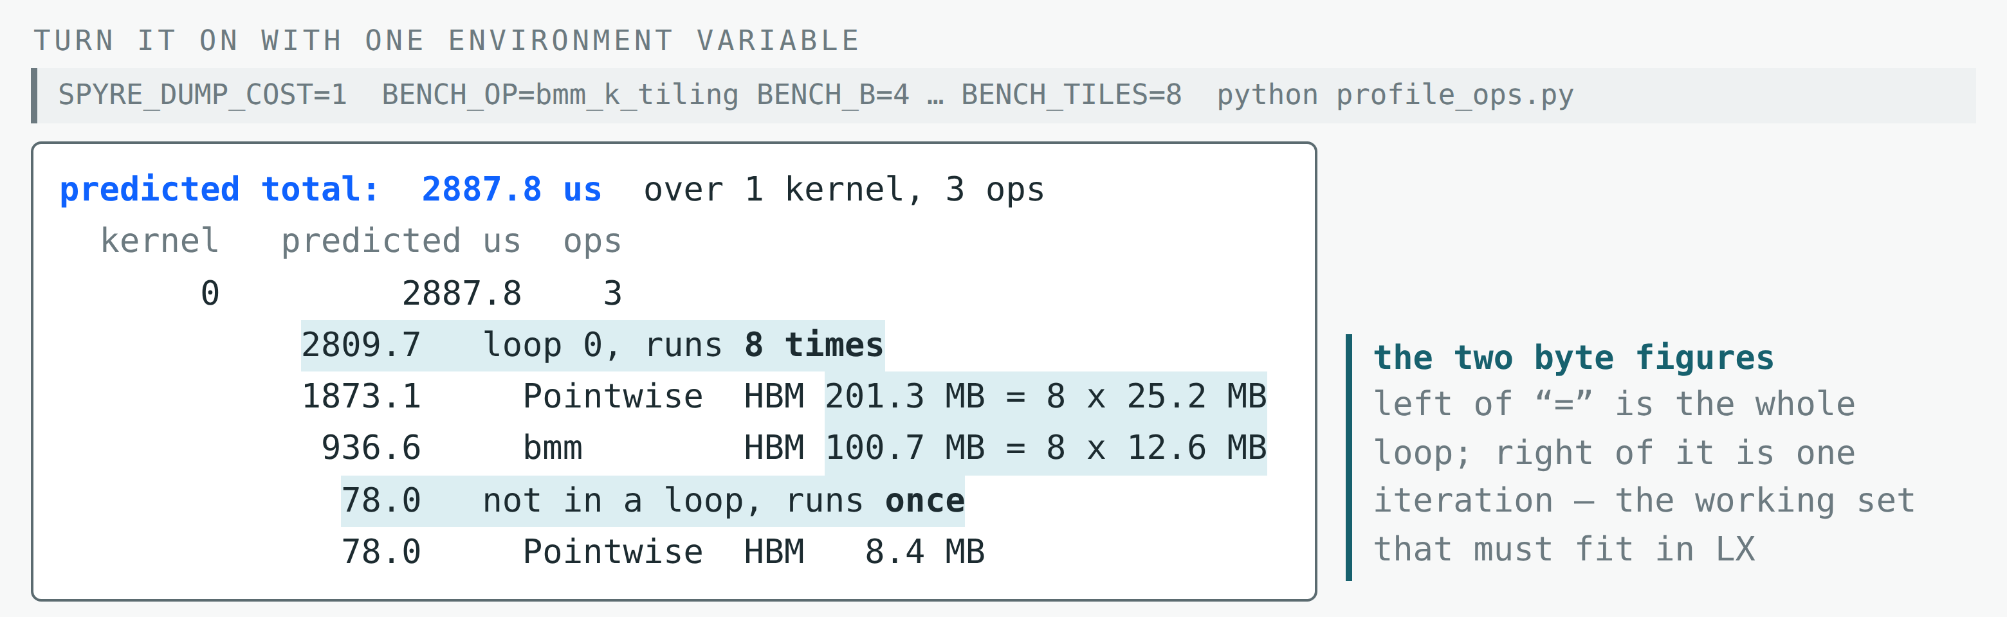
It Prints a per-Kernel Breakdown, in Microseconds
Off by default; it adds nothing to a normal compile.
The output is grouped by “loops”, which are formed from coarse tiling.
Notes:
Turning it on is one environment variable, and by default the pass returns before touching
the graph, so a normal compile pays nothing for it.
The example is a batched matmul whose contraction dimension has been split into eight tiles.
Read from the top: the first line is the number to compare, then one row per kernel with its
operations indented underneath.
Two things are worth pausing on. First, a kernel does not have one iteration count. The matmul
and the combine run eight times here, but the fill that initialises the accumulator sits
outside the loop and runs once — which is why the count is printed on a block header rather
than as a column.
Second, the byte column, because it is easy to misread. Before the equals sign is the
operation's total HBM traffic across the whole loop — 201 megabytes. After it, the same figure
broken out as eight times 25.2, so 25.2 megabytes is what one iteration moves. That is
traffic, not a tile size, and it is summed over the whole machine, not per core. Concretely:
this row is the accumulate step, the output is four by 1024 by 1024 in half precision, which
is 8.4 megabytes, and each iteration reads the accumulator, reads the new partial result and
writes the accumulator back. Three times 8.4 is the 25.2.
The per-iteration figure is the one that moves when you change the tile count, which is why
both scales are printed rather than just the total.
One thing I have trimmed for space: the real printout carries a second pair of columns for
scratchpad traffic. Those are a different quantity — LX bytes are already per-tile, because a
scratchpad buffer is allocated per tile. This slide is only telling you about main memory.
And one honest note: this kernel measures about six thousand microseconds, so the prediction
is roughly half. Batched matmul is the model's worst case, and I will come back to why.

Slide 6
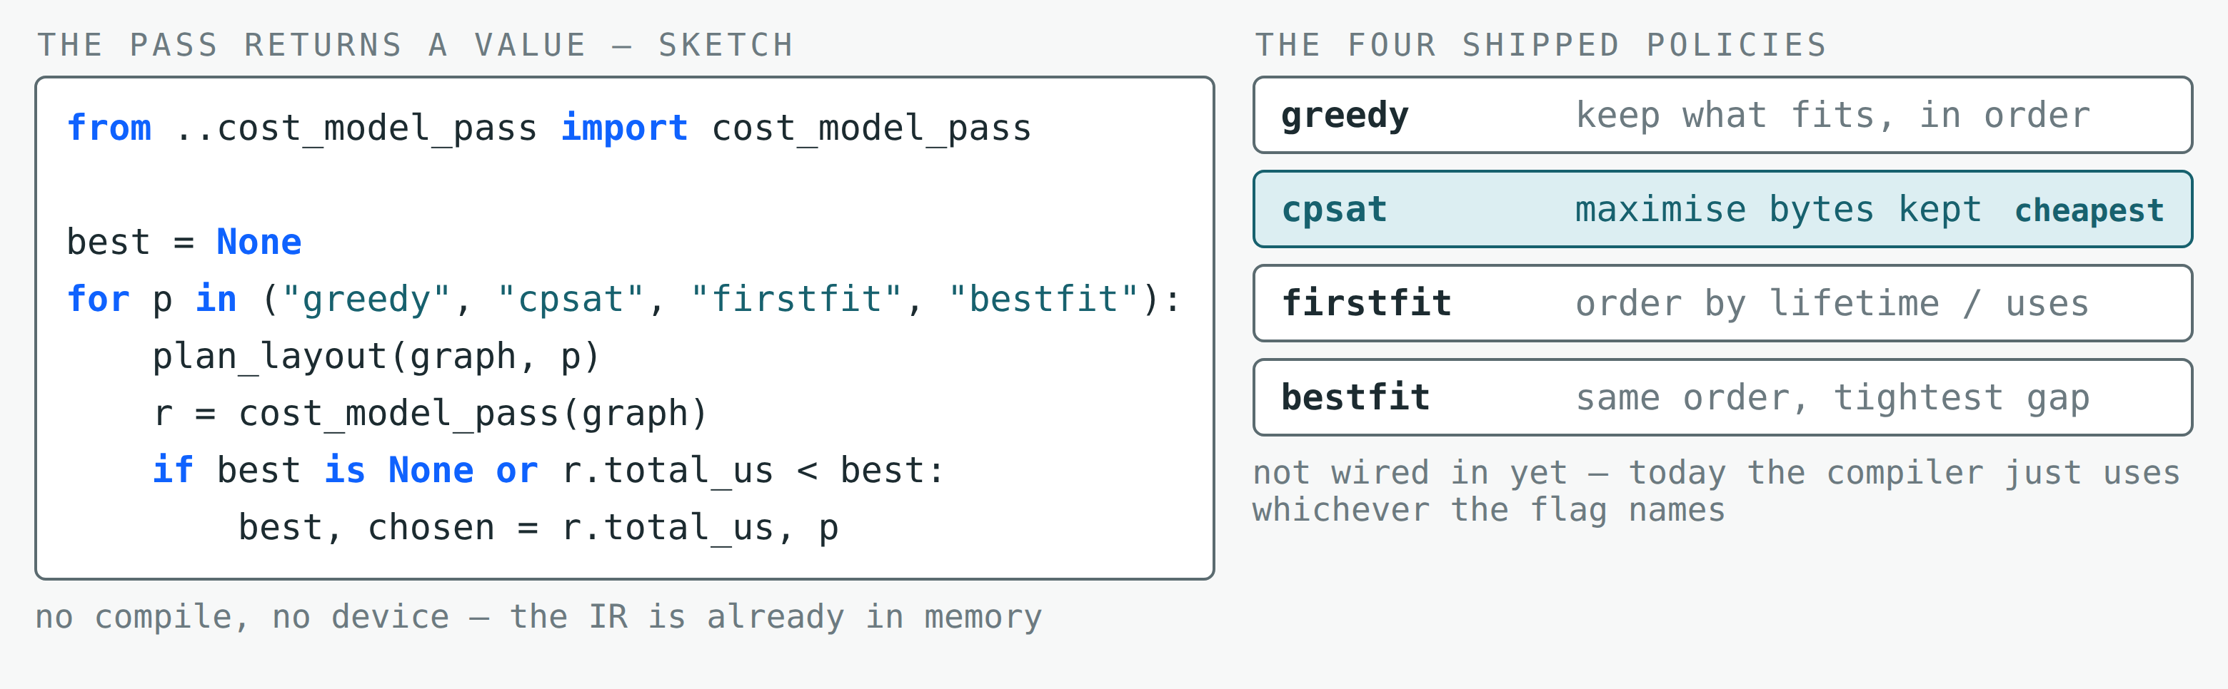
The Performance Estimate Is Also a Value Another Pass Can Act On
Example: LX planning
Four candidate plans could be priced without compiling or running any of them.
Notes:
This is the part that makes it a compiler feature rather than a debugging print.
The pass returns a report object. It has a total, which is the number to compare, and a
per-kernel breakdown underneath it. Any other pre-scheduling pass can call it and read that
total, because by the time it runs, everything the estimate depends on has been decided.
The example on the right is the one we actually care about — scratchpad allocation. The
compiler ships four solvers that decide which buffers stay on chip, and today it simply uses
whichever one the flag names. With the model, a planner can run each of them, price the
program it produced, and keep the cheapest. Four candidate plans, and not one of them is
compiled or run — the whole loop is a few hundred milliseconds of Python over an IR that is
already in memory.
I want to be precise about the status. This loop is not wired into the compiler today. The
pass is read-only: it prints, and it returns, and nothing consumes the return value yet. What
I will show in the second half is the experiment that asks whether it deserves to be wired in
— whether the ordering it produces actually matches what the hardware does when you run all
four policies for real.
The other thing to note is that the same hook works for any decision made before scheduling,
not just allocation. Tile size and work division are chosen in the same place, which is why
the next steps at the end are about pricing those jointly.

Slide 7
PART 2
How the model was built
Isolate one effect at a time — and explain the outliers rather than fitting them away.

Slide 8
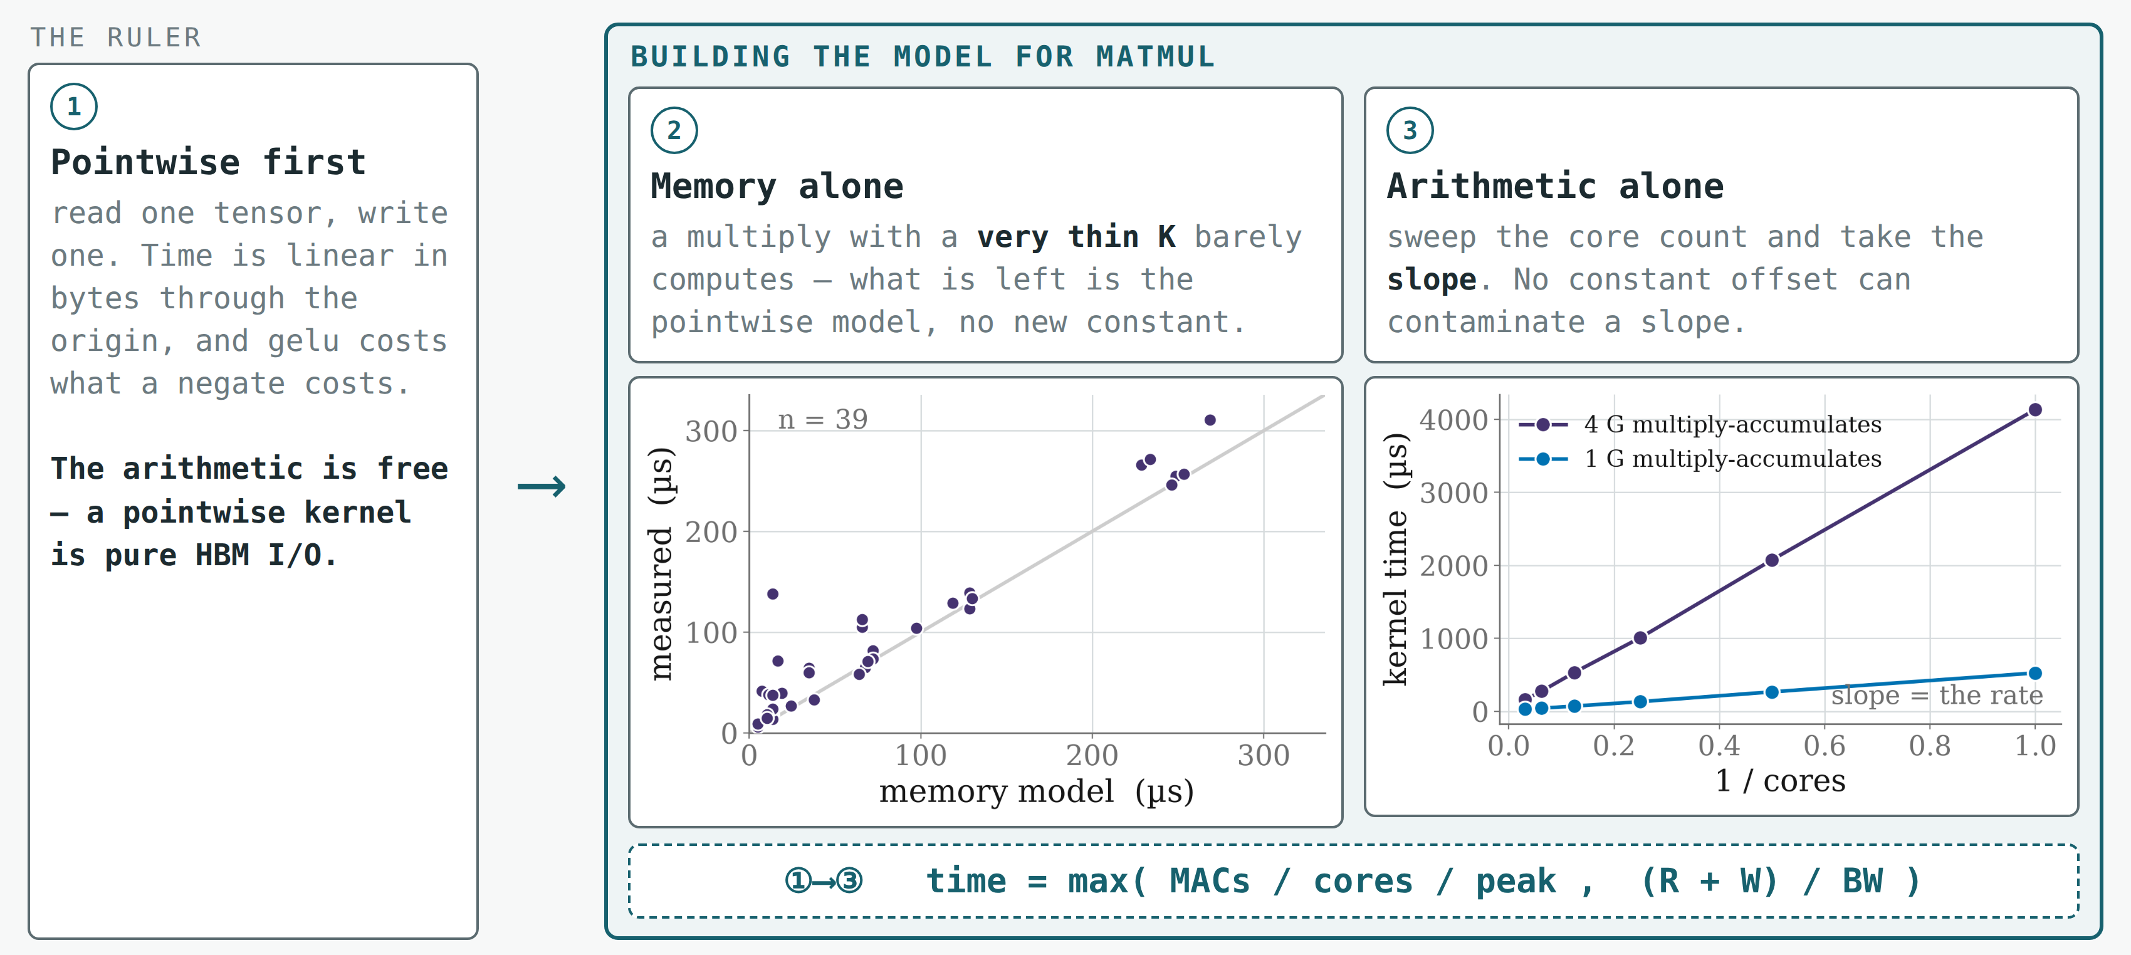
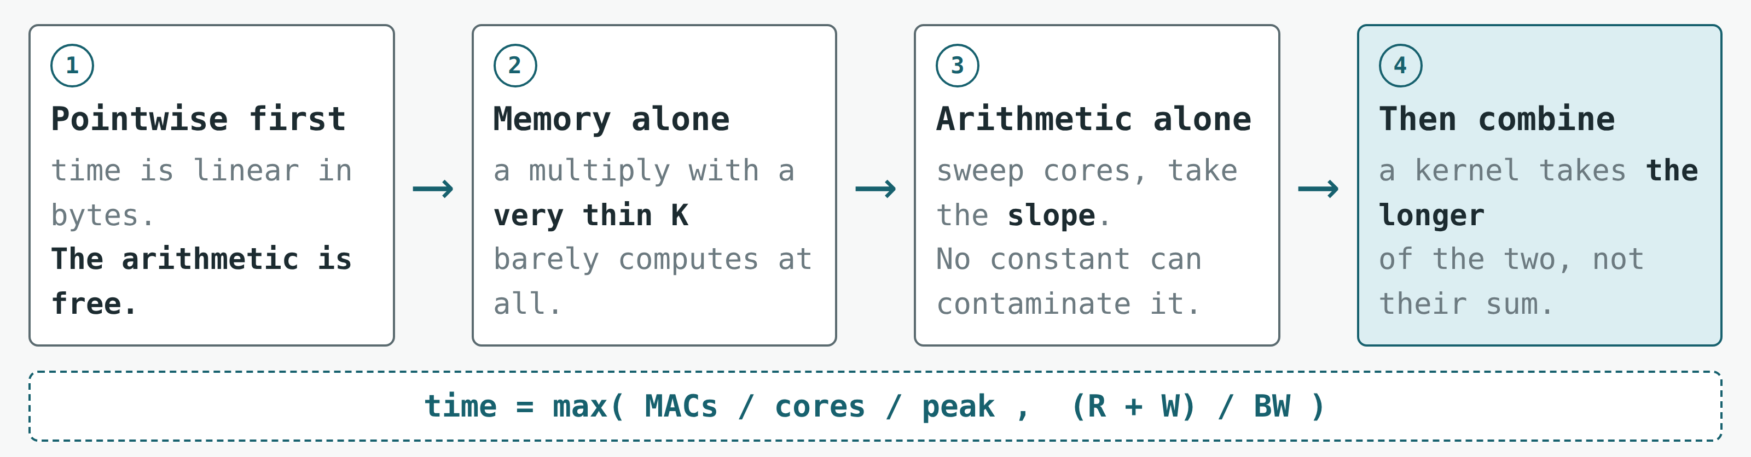
Every Term Is Measured Where Nothing Else Can Move
Built from scratch against profiler time on the card — and every term measured where nothing else can move.
A pointwise kernel is purely an HBM I/O model — which is what makes it the ruler for everything after it.
Notes:
Two slides on how this was built, because a model is only worth as much as the procedure
behind it.
The first rule was to start from scratch and trust only measured device time from the
profiler. No datasheet peak, no vendor number — every constant in the model is fitted against
kernels we timed on the card.
The second rule is the one on this slide: never measure two effects at once. Read it left to
right. We start with pointwise kernels, the simplest thing the device does — read a tensor,
apply a function, write a tensor. Time is linear in bytes and passes through the origin, with
an R-squared of five nines, and gelu costs the same as a negate at the same size. So the
arithmetic is free and a pointwise kernel is purely a memory model. That gives us a ruler.
Then a matmul. It has two costs, and if you sweep ordinary shapes you can never separate
them. So we do not. For the memory term we use multiplies with a very thin contraction
dimension, which do almost no arithmetic — what is left is memory, and it turns out to be the
pointwise model again, with no new constant. For the arithmetic term we sweep the core count
and take the slope of time against one over cores. A slope is immune to any constant offset,
which matters enormously here, because the thing we do not yet understand — how compute and
memory overlap — is exactly such an offset. It cannot contaminate a slope.
Only then do we combine them. The array computes on one block of operands while the next
streams in, so the kernel takes the longer of the two rather than their sum. That is the
mechanism, and I will be honest on the accuracy slide about where it is not enough.

Slide 9
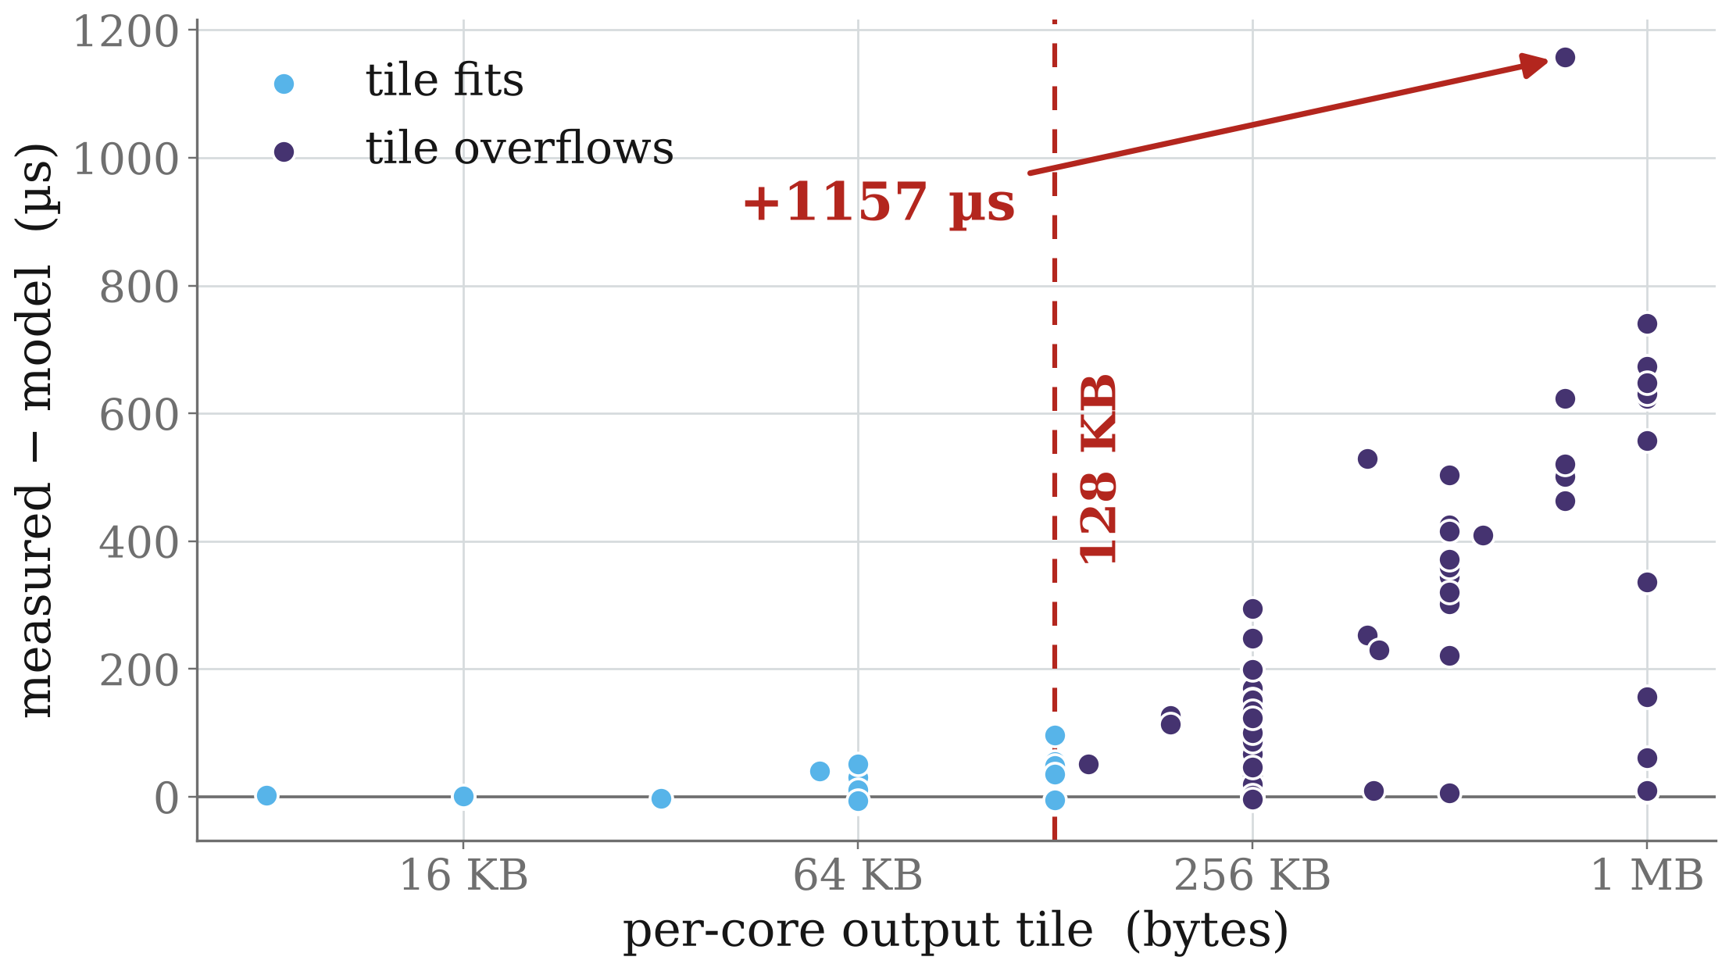
Sweep Wide, Then Explain the Outliers — Never Fit Them Away
A matmul slows down once each core's output tile passes 128 KB — and it is not the scratchpad filling up.
What overflows
The array holds the running output in an accumulator. While the whole per-core tile fits there, each operand is streamed in once.
128 KB is 65,536 fp16 elements — a 256 × 256 tile. Past that the tile no longer fits, and both operands have to be streamed again for reuse.
The knee is measured, not taken from a datasheet.
The threshold is measured; the curve drawn over it is fitted — and we keep those two apart.
Notes:
The second strategy is the opposite of the first. Rather than designing an experiment, sweep
a very wide range, look at where the model is worst, and only then go looking for a mechanism.
Each point here is a real matmul on 32 cores. The vertical axis is measured time minus what
the model predicts without this term. Below about 128 kilobytes of per-core output tile the
residual sits on zero. Above it, it climbs, and at the largest tiles it passes a millisecond.
That is a big, structured miss, and the shape of it says something changes state at a
threshold rather than degrading smoothly.
The obvious guess is the LX scratchpad. It is not: the compiled programs show a matmul
allocating none of it. What overflows is on the compute side — the accumulator the systolic
array holds the running output in. While a core's whole output tile fits there, each operand
is streamed in once and reused from the accumulator. 128 kilobytes is 65,536 half-precision
elements, which is a 256 by 256 tile; past that the tile no longer fits, so both operands
have to be streamed again to finish the reuse. That is the extra traffic we are seeing.
I want to be careful about what is measured and what is fitted. The knee is measured — its
location is consistent across the sweep, and we established what it is not before deciding
what it is. The curve drawn over it above the knee is fitted. Those are different kinds of
claim and we keep them apart, in the model and in the write-up. Where a coefficient existed
only to absorb a residual with no mechanism behind it, we deleted it rather than shipped it.

Slide 10
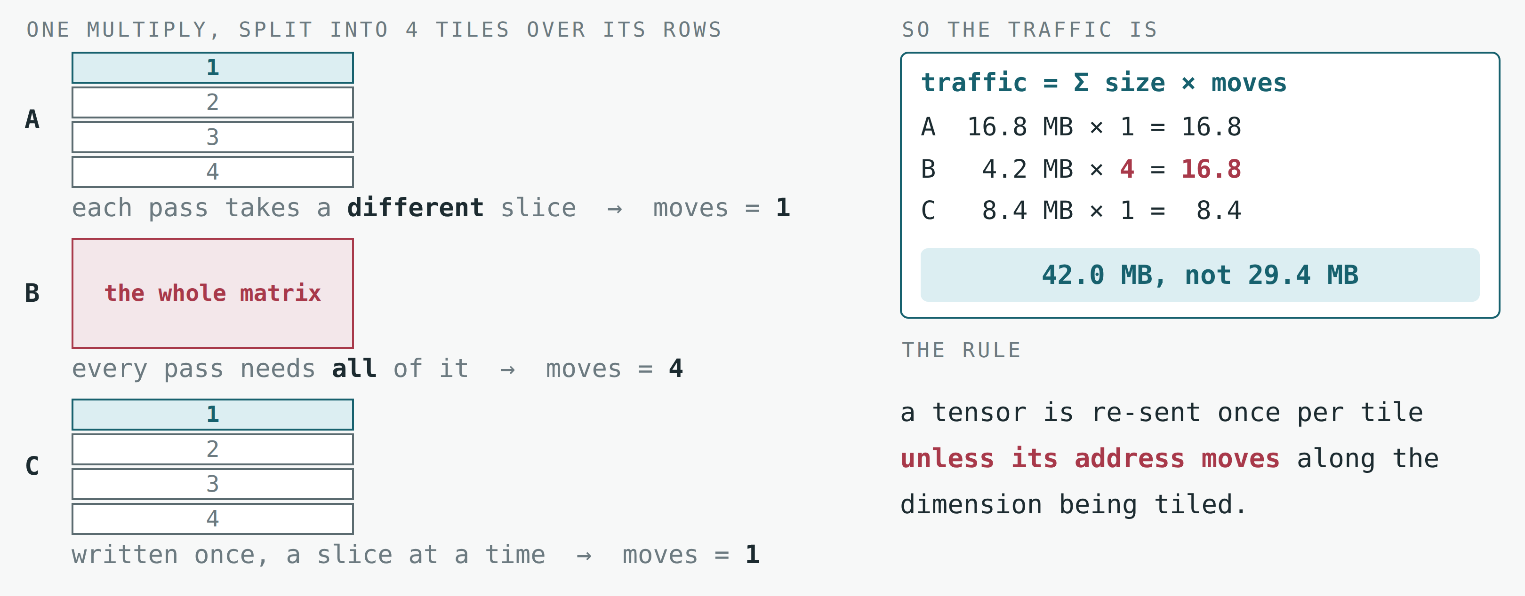
Coarse Tiling: Special Fusion, the Model Count How Often a Tensor Moves
One matrix multiply — 4096×2048 by 2048×1024 — with its output rows split into four tiles.
Read off the compiled loop, not fitted — and it is why the loop, not the operation, is the unit we price.
Notes:
This one matters for everything in the second half, so I want to spend a moment on it.
The example is a single matrix multiply: a 4096 by 2048 matrix times a 2048 by 1024 one, with
the output rows split into four tiles. Coarse tiling turns that one operation into a loop of
four smaller ones so each step's working set fits on chip. The arithmetic is identical either
way. The traffic is not, and the reason is not obvious.
Look at each operand and ask one question: as the loop advances, does this tensor's address
move along the dimension being tiled? For A, yes — each pass takes a different block of rows,
so across the whole loop A is transferred exactly once. For the output C, the same. But for B,
no. Every pass needs the entire B matrix, because every output row multiplies against all of
it. So B is re-sent once per tile — four times here.
Traffic is then the sum over tensors of size times moves. In this example that is 42 megabytes
rather than the 29 you would get by counting each tensor once. And notice which tensor
dominates: B is the smallest of the three at 4.2 megabytes, and it ends up costing as much as
the 16.8-megabyte A.
Two practical notes. Deciding this needs both halves of the compiled program — the tiling
metadata says which dimension is tiled and how often, the addressing says which operands
follow it, and the addressing alone proves nothing because it is character-for-character
identical before and after tiling. And when the loop tiles a reduction instead, the compiler
inserts helper steps to initialise and accumulate, and those carry about a third of the
traffic. Which is why the unit we price is the loop, not the operation.

Slide 11
PART 3
Two things the card taught us
Two effects larger than the model's own error, and neither is in any pass today.

Slide 12
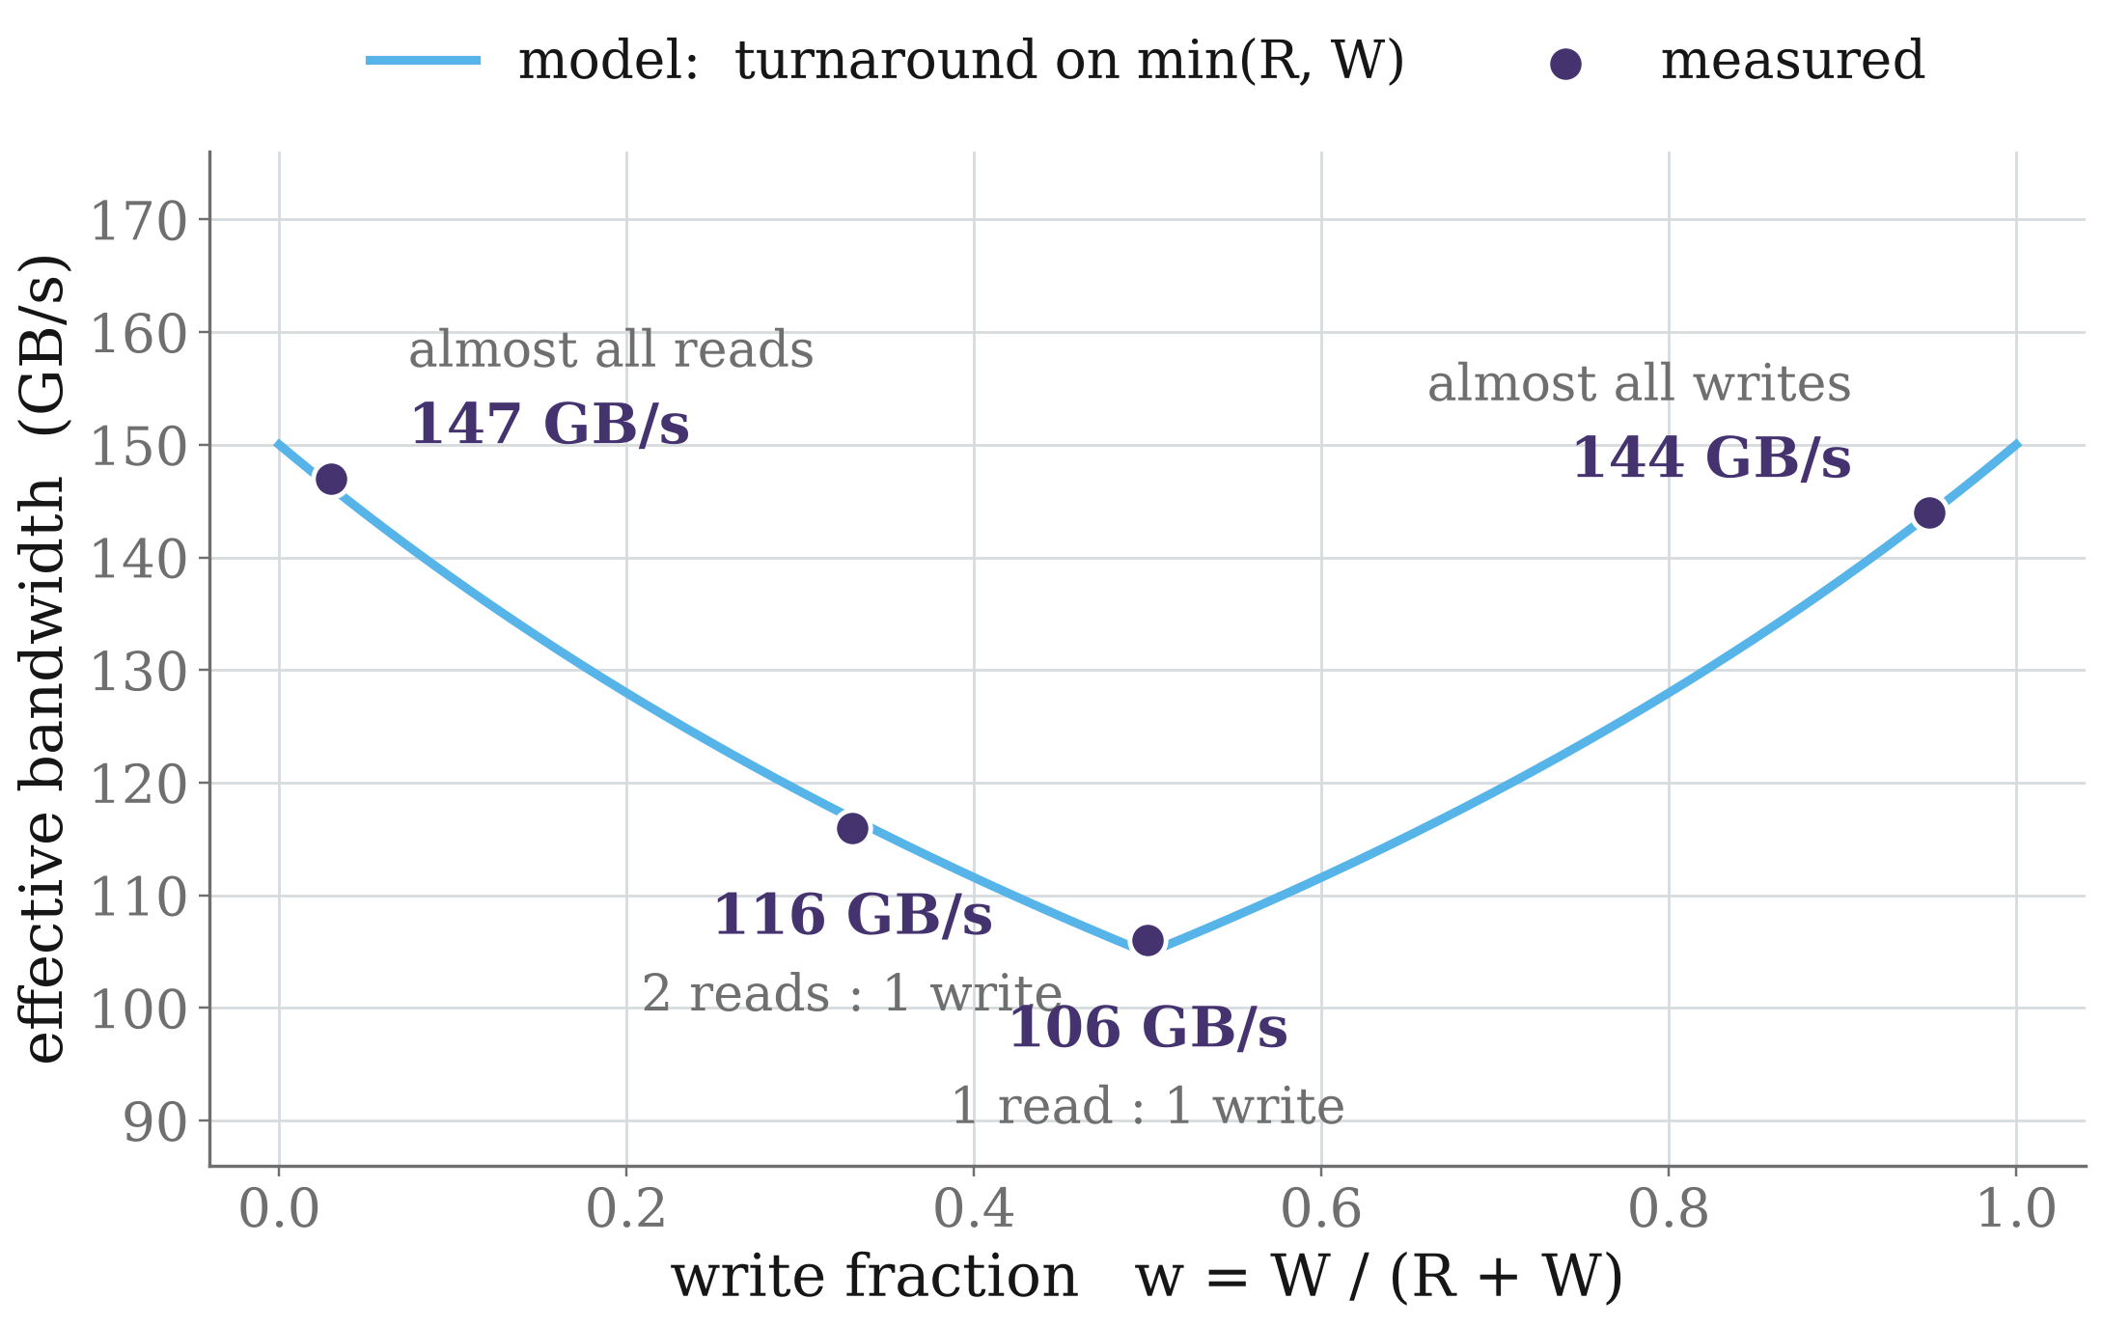
The Same Bytes Move Faster When They All Move the Same Way
Why
HBM is a shared bus, and it pays a turnaround cost every time it switches direction.
So the penalty falls on min(R, W) — zero when traffic runs one way, largest when it is balanced.
Both ends of the valley reach the same height, so reads and writes share one rate.
A single bandwidth constant would have been wrong by 40 % across this sweep alone.
Notes:
Two findings from the measurement campaign that were not what we expected, and that are
useful beyond this model. This is the first.
We started with one bandwidth number. It does not exist. Sweeping only the traffic mix — at a
single tensor height, so size cannot confound it — the effective bandwidth moves between about
106 and 147 gigabytes per second. A kernel that almost only reads runs at 147. A kernel that
reads one tensor and writes one runs at 106. That is a forty per cent spread from nothing but
the ratio of reads to writes.
The shape is the giveaway. It is a symmetric valley: fastest at both ends, slowest in the
middle. That is what a shared bus paying a turnaround cost looks like — the penalty is
proportional to how often the direction changes, which is set by the smaller of the read and
write volumes. It is zero for one-directional traffic and largest when the two are balanced.
So the model carries one peak bandwidth plus a term on min of R and W, and the fitted
turnaround is about six picoseconds per byte.
Two things worth taking away beyond the model. First, both ends of the valley reach the same
height — 147 reading, 144 writing — so reads and writes share one rate and we do not need
separate constants. Second, this is a compiler-visible effect: a pass that changes how much a
kernel writes relative to what it reads is moving the effective bandwidth, not just the byte
count. Fusion decisions do exactly that.

Slide 13
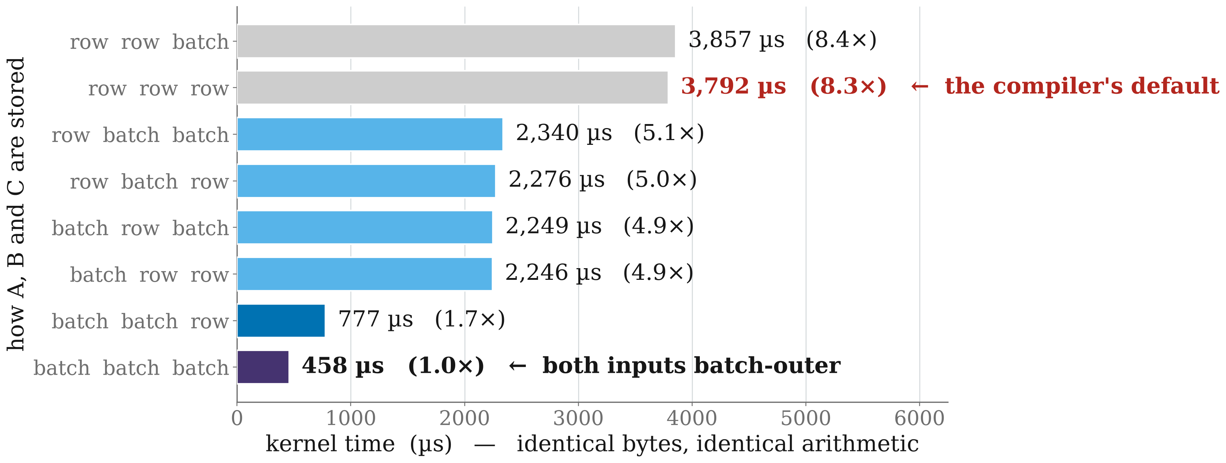
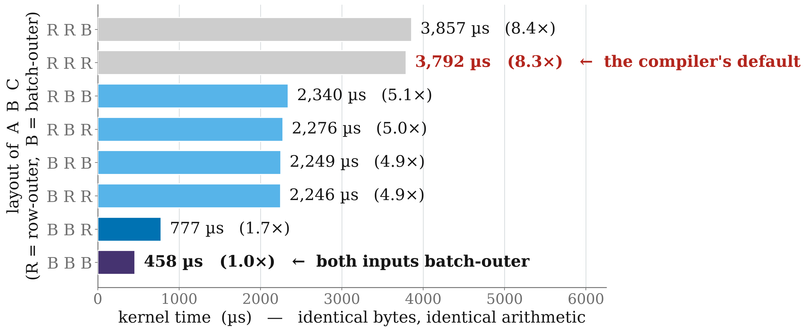
A Batched Multiply Runs 8x Slower Purely Because of Operand Layout
torch.bmm(A, B) → C. Each operand is stored either row-outer — the compiler's default — or batch-outer. Same bytes, same arithmetic, no re-layout copy.
Why
It is arithmetic, not memory: time per multiply is flat across the whole default group, so a traffic explanation is ruled out.
The default order walks the batch on the inside, so consecutive batches share no operand locality and the array is starved.
Converting one input buys 1.7x; converting both buys 4.9x — a partial rollout captures far less than half.
Notes:
The second finding is larger, and it surprised us.
A batched matrix multiply on this hardware runs up to eight times faster or slower depending
only on how its three operands are laid out in memory. Every bar on this chart moves the same
bytes and performs the same arithmetic. There is no re-layout copy inserted between them —
both orders keep the 64-element stick axis in place, so switching is free. The only difference
is which of the remaining axes is slowest-varying: the row, or the batch.
Row-outer is what the compiler emits by default, and it is the slowest of the eight
arrangements. The fastest — both inputs and the output batch-outer — is 8.3 times quicker.
Two details matter for anyone who wants to act on this. The inputs do not act independently:
converting A alone is worth 1.7, converting B alone 1.7, and if those combined independently
you would expect about 2.8. You actually get 4.9. So converting one operand captures far less
than half the available speedup. And the output layout is worth nothing at all until both
inputs are already batch-outer, at which point it is worth another 1.7.
Why does it happen? It is arithmetic, not memory. Time per unit of arithmetic is flat at about
215 microseconds per billion multiply-accumulates across the whole default-layout group,
across sixteen shapes and a sixteen-fold range. A memory effect would track each shape's ratio
of bytes to arithmetic; it does not. The default order walks the batch dimension on the
inside, so consecutive batches share no operand locality and the systolic array is starved.
One honest caveat: these are build-specific numbers. The ratio itself moved between compiler
builds during this work, so the cube should be re-measured rather than quoted forward.

Slide 14
PART 4
Does it hold up?
Accuracy by operation class, then a real allocation decision.

Slide 15
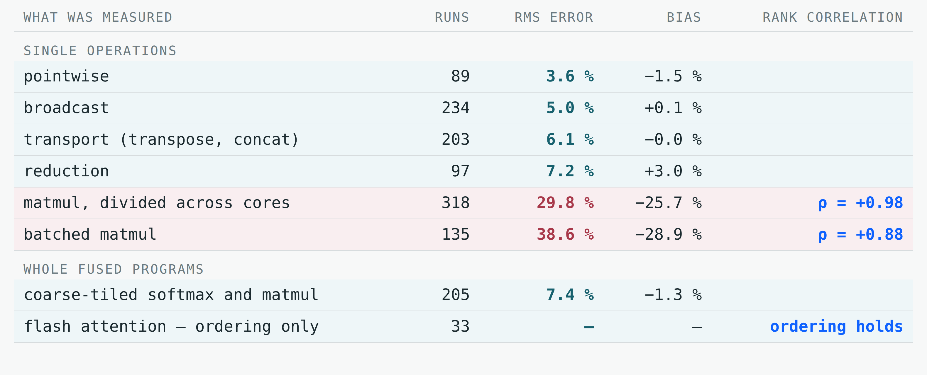
Memory-Bound Ops Land Inside 10 %; Matmul Is Low but Ordered
The matmul error is a one-sided offset, not scatter — we charge max(compute, memory) and nothing charges for the part of the shorter stream that fails to hide.
Notes:
So how good is it. This table is the whole answer, and I want to be straightforward about the
bad half as well as the good.
Everything memory-bound sits inside ten per cent RMS: pointwise at 3.6, broadcast at 5,
transport at 6, reduction at 7. Those are hundreds of measured kernels, not a handful, and the
bias is essentially zero — the errors scatter around the measurement rather than sitting to
one side.
Matmul is the weak half. Divided matmuls read thirty per cent, batched matmuls thirty-nine.
And the mean tells you it is not scatter: minus twenty-six and minus twenty-nine. We are
systematically under-predicting.
We know why, and we chose not to paper over it. Compute and memory overlap, so a kernel takes
the longer of the two rather than their sum. That is the right mechanism — adding them
over-predicts everywhere. But the overlap is not perfect: part of the shorter stream fails to
hide behind the longer, and nothing in the model charges for it. We had a fitted coefficient
that closed most of the gap. It had no derivation, different populations wanted different
values in opposite directions, so we removed it. A coefficient that exists only to absorb an
unexplained residual makes a model look better understood than it is.
What survives is the ranking, and that is the column on the right. Rank correlation with
measured time is 0.98 on divided matmuls and 0.88 on batched ones. The error is an offset, so
the ordering is intact. Which means: use this to choose between two plans, do not use it to
promise a wall-clock number. Everything in the rest of the talk is a ranking claim.

Slide 16
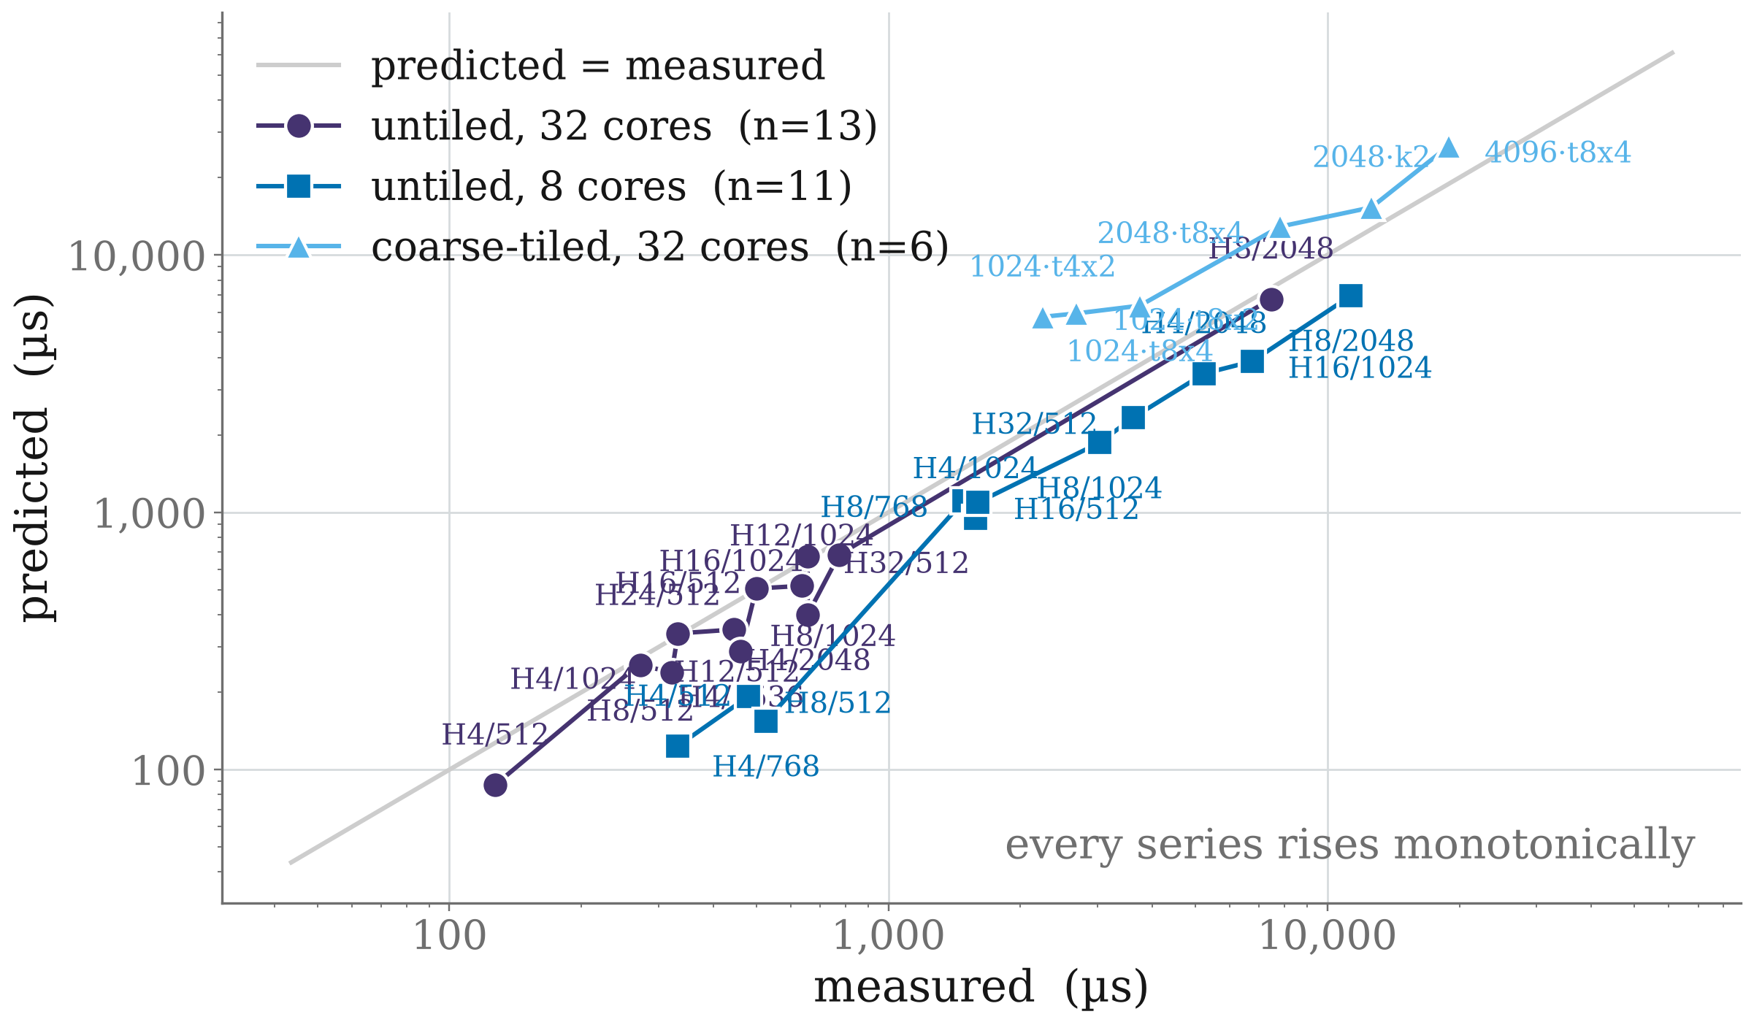
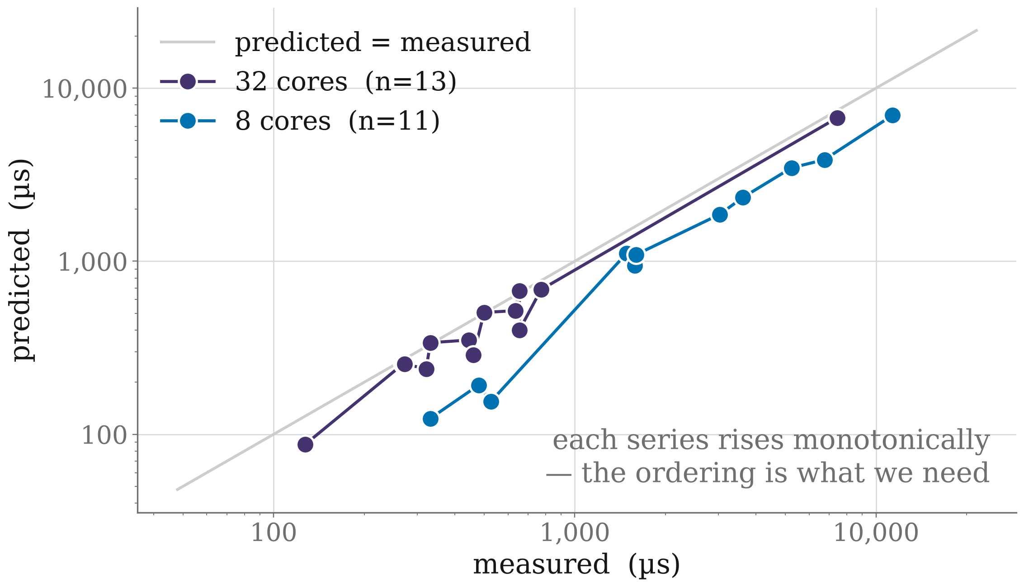
Across All 30 Flash-Attention Configurations, the Ordering Holds
Head dim 128 and Lq = Lk throughout; batch 1 except four points at batch 2. Only heads, sequence length, core count and tiling vary.
What this is
Flash attention is the one workload the model does not have a fitted term for — it is priced from its parts.
Absolute times run low. But every series rises monotonically, so a planner comparing two configurations gets the right answer.
The three series are never compared against each other: the coarse-tiled runs are from an older compiler build.
Notes:
Here is the first test of that. Flash attention is the hardest case in the deck for a good
reason: it is the one workload with no fitted term of its own. It is a fused kernel of
twenty-odd operations, and the model prices it purely from the parts we derived earlier —
bytes, moves, residency, and the arithmetic rate.
Each point is one configuration: a head count, a sequence length and a core count. The
horizontal axis is what the card measured, the vertical is what the model said before anything
ran. The grey diagonal is where a perfect predictor would sit.
Two things to read off it. The points sit below the diagonal — we under-predict, exactly as
the previous slide said we would. But within each core count the series rises monotonically:
as the measured time goes up, so does the prediction, without crossings. That is the property
a planner needs. If you ask "is this configuration faster than that one", the model answers
correctly, even though it will tell you both are quicker than they really are.
The two bands are the two core counts, and that separation is itself informative — it is a
scale offset between eight and thirty-two cores rather than a ranking error inside either. It
is also a known gap: the memory term has no core-count scaling below thirty-two cores, and we
have deliberately not fitted one, because the experiment that would settle it — a core ladder
with repeats at matched shape — has not been run. Fitting it on the three core counts we have
would be fitting, not explaining.

Slide 17
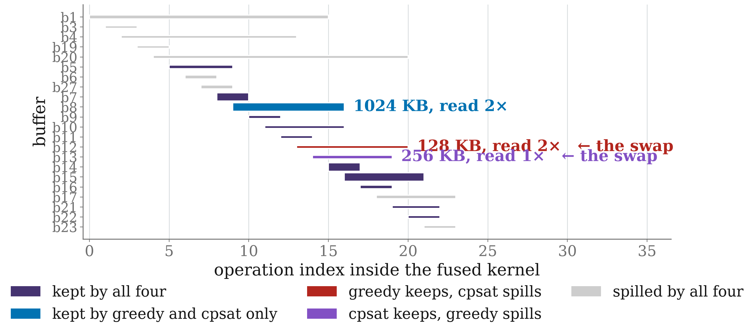
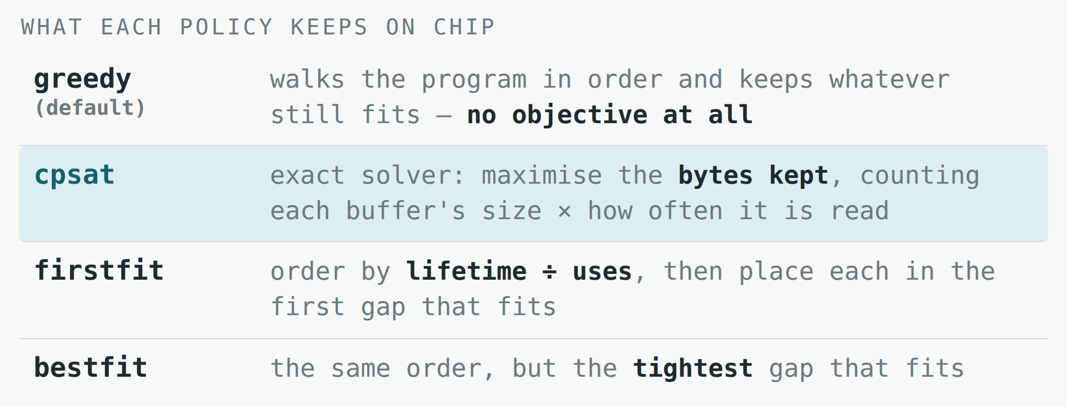
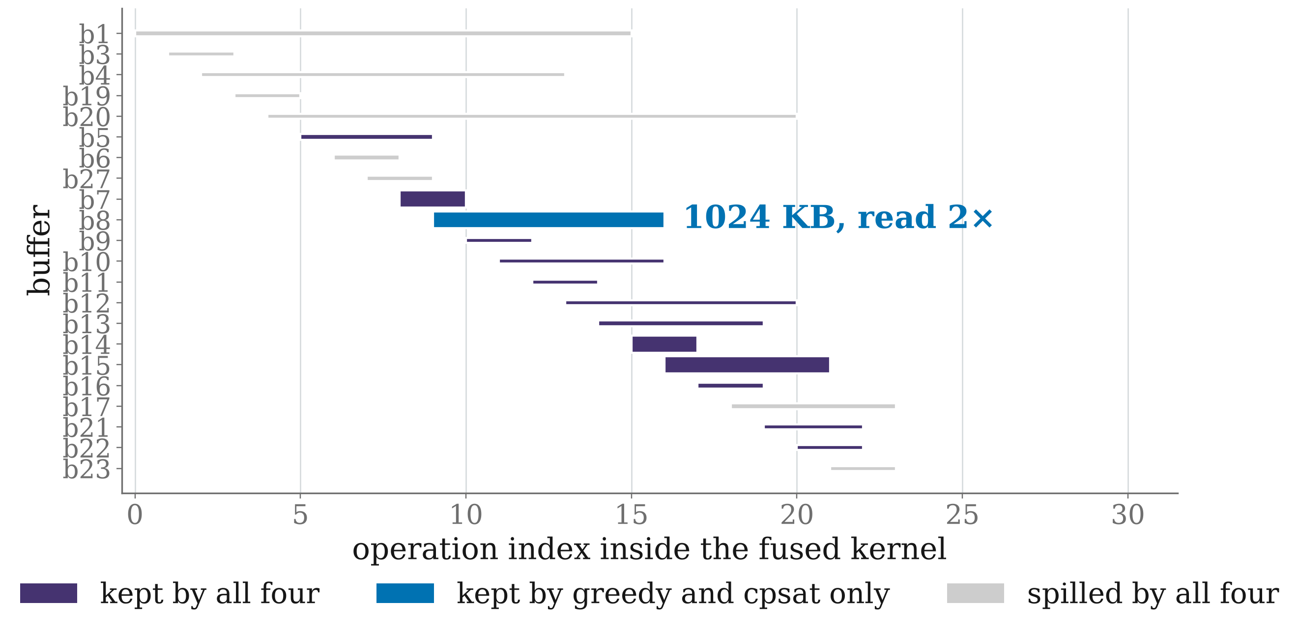
Four Shipped Policies, Disagreeing in Two Different Ways
Flash attention, 8 heads · Lq = Lk = 512 · head dim 128 · batch 1 · 8 cores. One compile per policy, driven by the real solver — residency and time from the same run.
Two disagreements
greedy and cpsat keep the same 12 and simply trade one buffer for another — 481.7 against 480.3 µs, inside run-to-run spread.
firstfit and bestfit drop a third buffer as well, keep 11, and take 596.6 µs — 1.24×. On wider shapes the same choice reaches 2.2×.
Notes:
Now the experiment I most wanted to run: does the model help with a real compiler decision?
The decision is scratchpad allocation. Each core has about 1.6 megabytes of LX. When a fused
kernel's intermediates do not all fit, something has to choose which stay on chip, and the
compiler ships four solvers to make that choice. They are on the right. Greedy is the default
and it has no objective function at all — it walks the program in order and keeps whatever
still fits. CP-SAT is an exact solver maximising the bytes kept, weighting each buffer by how
often it is read. Firstfit and bestfit share an ordering — lifetime divided by uses — and
differ only in which gap they drop a buffer into.
The example is one flash-attention kernel: sixteen heads, sequence length 1024, on 32 cores.
Every row is a separate compile with the solver flag set, and the residency, the features and
the measured time all come from that same compile. Nothing is reconstructed offline. An
earlier version of this work simulated what each policy would choose, and every one of those
reconstructions differed from what the compiler actually did.
The chart draws every movable buffer across the operations it is live for, with height
proportional to per-core size. Purple is kept by all four policies, grey is spilled by all
four, and the single blue bar is the entire disagreement. That buffer is a megabyte per core
and it is read twice. Greedy and cpsat keep it and run 778 microseconds; firstfit and bestfit
spill it and take 1,592. So on this shape the policy choice is worth roughly a factor of two,
and the whole difference is one decision about one tensor.

Slide 18
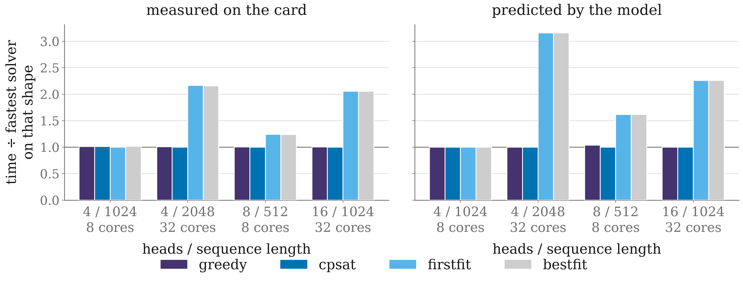
The Model Orders Every Comparable Solver Pair Correctly — 13 of 13
Four flash-attention shapes, labelled heads / sequence length with the core count beneath. Head dim 128, Lq = Lk, batch 1.
The two panels have the same shape — that is the result. It over-states the penalty (3.2x predicted against 2.2x measured) and still picks the right plan.
Notes:
And here is whether the model saw it coming.
Left panel: what the card measured, each solver divided by the fastest solver on that shape.
Right panel: what the model predicted, normalised the same way, computed from each solver's
own compile before anything ran.
The two panels have the same shape. That is the whole claim. On every shape the model
separates the fast pair from the slow pair, and across the four shapes that is thirteen
comparable pairs ordered correctly out of thirteen.
It is not perfect and I would rather show you where it is not. It over-states the penalty: on
the widest gap it predicts 3.2 times where the card measured 2.2. And in absolute terms it
runs between 0.39 and 0.97 of measured — the systematic under-prediction from the accuracy
slide, showing up again. If you asked it how long the kernel takes, it would be wrong. If you
ask it which policy to use, it is right every time here.
One more thing worth saying, because it is a negative result and those tend to go unreported.
We looked for a case where the default policy loses to cpsat and found none — on all four
shapes cpsat is fastest or tied, and on three of them it picks the byte-identical allocation
to greedy. An offline enumeration over 419 tile configurations agrees: the byte objective is
never strictly worse. So this experiment does not argue for changing the default. What it does
establish is that the model can be trusted to rank allocations, which is the property a
planning pass would need.
One question you should ask: I said earlier that plans could be priced without compiling, and
here I compiled four times. That is deliberate. An earlier version of this experiment
reconstructed each policy's allocation offline instead of running it, and every one of those
reconstructions was wrong — they kept buffers the compiler spills. So the honest version runs
the real solver. Querying the solver in-pass, rather than through a full compile, is the first
piece of engineering that would follow.

Slide 19
PART 5
Where this goes next
Decisions priced jointly, and an on-chip ring nobody is using.

Slide 20
Next: Price the Decisions Jointly, and Use What the Sweeps Found
Drive real passes with it
LX allocation and coarse tiling are chosen in the same place, and HBM traffic is still the bottleneck. Tile count, tile size and residency interact — pricing them together is a far larger space than the four policies shown here.
Spend the findings elsewhere
Read/write ratio, operand layout and work division each move performance by more than the model's own error. They belong in the passes that choose them, not only in a report.
Close the two known gaps
The core-count offset below 32 cores, and the overlap residual on matmul. Both need a controlled sweep with repeats rather than another coefficient.
Notes:
Three directions, roughly in order of how ready they are.
The first is to actually drive a pass with this. Scratchpad allocation and coarse tiling are
both chosen in the same place in the pipeline, and HBM traffic is still what dominates these
kernels — so this is where the model would pay. But the case I just showed is deliberately the
easy version: four policies, one program, everything else held fixed. The real decision is
larger. How many tiles, how big each tile is, and which buffers stay resident are not
independent — a smaller tile spills less but moves more, and the best allocation depends on
the tiling you chose. Pricing those together is a much bigger space than four candidates, and
it is exactly the kind of space a cheap analytical model is for.
The second is that the findings are worth more than the model. Read-write ratio moves
effective bandwidth by forty per cent. Operand layout moves a batched multiply by eight times.
Work division changes both. Each of those is larger than the model's own error, and each is
decided by a pass that currently cannot see it. That is true whether or not anyone ever wires
the cost model in.
The third is the honest maintenance list: the core-count offset below thirty-two cores, and
the overlap residual on matmul. Both are known, both are one-sided, and both need a controlled
sweep with repeats rather than another fitted coefficient. I would rather carry a stated gap
than a number nobody can explain.

Slide 21
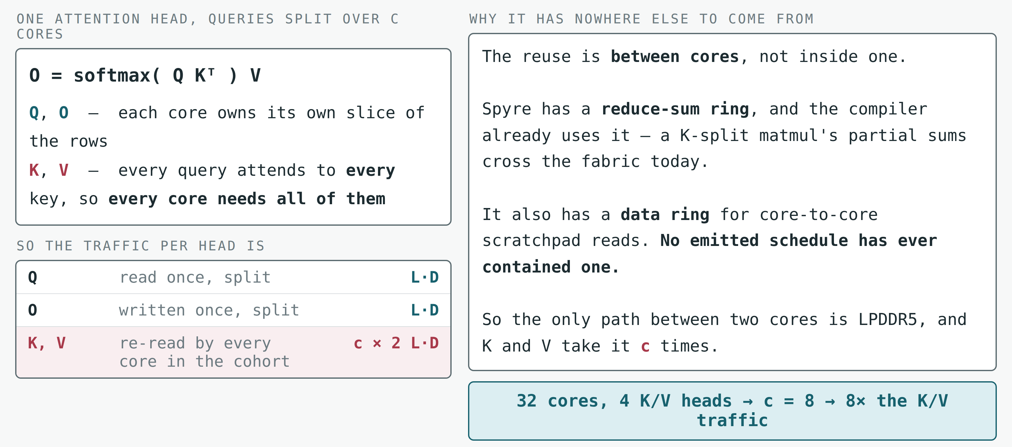
Flash Attention Re-Reads K and V Once per Core
The one tensor pair that every core needs is the one we send over the bus the most — that is the opportunity the fabric is not being used for.
Notes:
I want to close on a direction that came out of this work sideways, and to be specific about
the arithmetic rather than waving at a diagram.
Take one attention head. The output is softmax of Q K-transpose, times V. Now split the work
across cores the way the compiler does when there are fewer heads than cores: each core takes
a slice of the query rows. Q is split, and so is the output — each core owns its own rows and
reads and writes them once.
K and V are different. Every query attends to every key, so every core in that cohort needs
all of K and all of V. They are not split; they are shared. And the sharing is between cores,
not inside one. So the traffic per head is L by D for Q, L by D for the output, and c times
two L by D for K and V, where c is how many cores share the head. At 32 cores with four
key-value heads, c is eight — we move K and V across the memory bus eight times.
Now, Spyre has a bi-directional ring, and in fact two of them. The reduce-sum ring is in use
today: when the compiler splits a matmul's contraction dimension, the partial sums cross the
fabric, and there is even a pass that permutes core IDs so the collaborating cores land next
to each other. The data ring — core-to-core scratchpad reads — has never been emitted. Not
once, in any schedule.
So the situation is this. The one tensor pair that every core in the cohort needs is precisely
the one we send over the external bus the most, and the on-chip path that could carry it
between cores exists and is unused. That is the opportunity, and it is arithmetic, not
speculation.

Slide 22
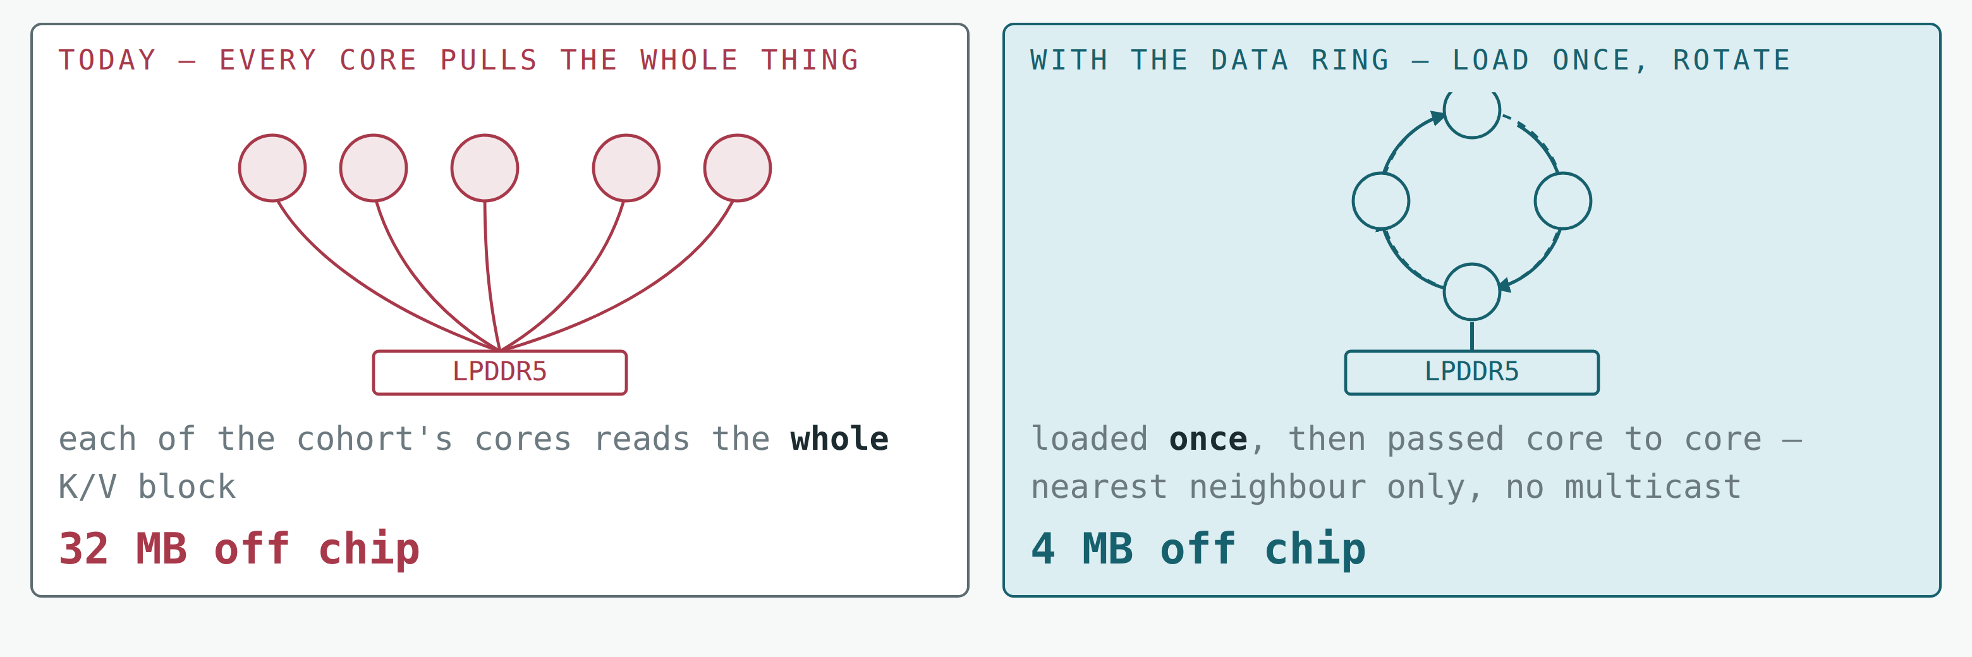
Ring Attention Turns That Re-Read into One Load and a Rotation
The online softmax carries a running max and sum, so the K/V blocks can be consumed in any order — which is exactly what lets them move between cores.
Give each of the c cores 1/c of K and V, then take c−1 steps: compute against the block you hold, pass it on. Every core sees every block, and K/V crosses the bus once.
Notes:
Here is what would collect it.
The key licensing fact is in FlashAttention itself. The online softmax keeps a running maximum
and a running sum and rescales as it goes, which means the K/V blocks can be consumed in any
order and you still get the identical result. That associativity is normally used to stream
blocks from memory one at a time. It equally permits the blocks to arrive from a neighbouring
core.
So: give each of the c cores one c-th of K and V rather than all of it. Then take c minus one
steps. At each step every core computes its partial attention against the block it currently
holds, updates its running max and sum, and passes that block to its ring neighbour. After the
last step every core has seen every block, and K and V have crossed the external bus exactly
once instead of c times. On the left of the figure is what we do now — the whole block pulled
per core. On the right is the rotation. At a realistic configuration that is 32 megabytes of
off-chip traffic against four.
The primitive this needs is the weakest one on the list: send to your neighbour. It is not a
multicast — a ring would be genuinely bad at multicast, and if the win required one I would not
be showing you this. Every link is busy at once, and the exchange costs about one block time
regardless of how many cores are in the ring.
I will end on the honest limit, because it splits the idea in two. Rotation is the ring's best
case. An arbitrary re-shuffle — which is the general case the scratchpad planner keeps hitting
— is its worst: a ring's bisection is two links, so a full permutation could be slower than
going through memory. So the decision is per-instance, it depends on the access pattern, and
it needs a model that knows both the pattern and the topology. Which is roughly where this
talk started.

