Slide 2

RASA FRAMWORK
From Intents to Intelligence:
A Hands-on Journey with Rasa CALM

Slide 3
Learning Objectives
Get introduced to Rasa and understand its key advantages
Comprehend the architecture of Rasa and its main components
Install and configure a development environment for building assistants with Rasa
Build and test a simple chatbot through hands-on practice

Slide 4
Why Use Rasa?
Open-source framework for conversational AI
Focus on:
Customization
Privacy & control
Production-grade deployment
Widely used in:
Banking & Insurance
Healthcare
E-commerce
Rasa CALM: New flow-based architecture optimized for LLM integration

Slide 5
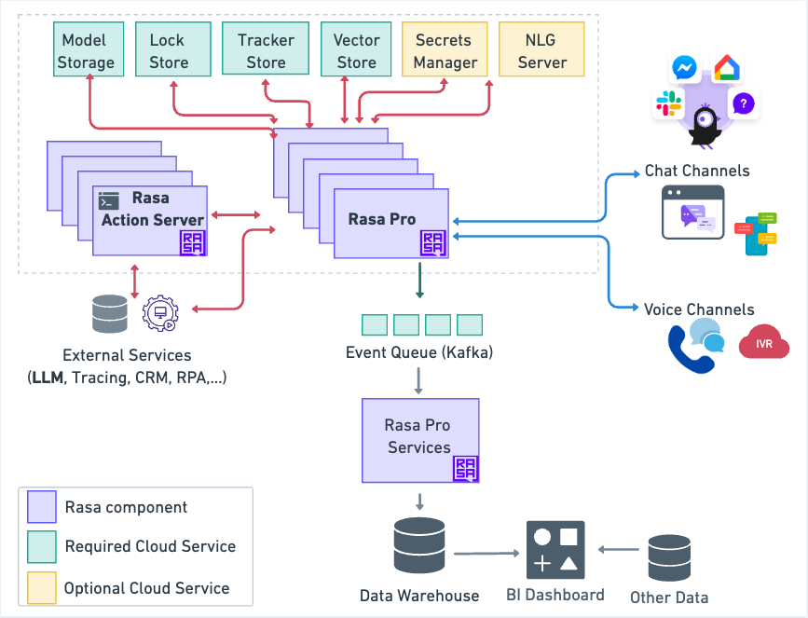
Overview of Rasa's Architecture
rasa docs

Slide 6
Project Introduction: AI Travel Booking Assistant
AI Travel Booking Assistant is a hands-on project built using Rasa CALM, aiming to develop a conversational assistant that supports users in the following tasks:
Searching for available flight information
Booking flight tickets to specific destinations
Checking details of previously booked flights
Cancelling flights when cancellation is permitted
This project showcases how to apply key features of Rasa CALM, including:
Flow-based dialogue management for handling conversation logic
Custom actions for implementing backend operations
Integration with large language models (LLMs) to enable natural and context-aware interactions
This practical session will guide participants through designing, building, and testing a complete travel booking assistant.

Slide 7
Project Objectives
By the end of this session, participants will be able to:
Understand how to design a conversational assistant using flow-based dialogue
Learn how to use Rasa CALM and integrate it with an LLM
Build and execute custom actions to handle flight booking logic
Connect Rasa to external data sources (e.g., CSV files or a mock database)

Slide 8
Use Case Overview
The assistant will guide users through common travel-related tasks, including:
Searching for available flight information
Booking flight tickets to selected destinations
Checking details of existing bookings
Cancelling bookings when cancellation is allowed

Slide 9
System Architecture
This project is built on a modular architecture that includes the following key components:
Rasa Core & NLU: Manages dialogue flow and understands user intents and entities
Rasa Actions: Handles custom logic such as retrieving flight data, booking tickets, or processing cancellations
CSV Files / Mock Database: Simulates backend storage for available flights and bookings
LLM Integration via Rasa CALM: Enhances conversation quality with natural language understanding and generation using a large language model

Slide 10
Install and Setup
Setup evironment
Download miniconda
Create new rasa-env using python 3.9: conda create --name rasa-env python=3.9
Activate the virtual environment
conda activate rasa-env
Deactivate an activate environment
conda deactivate
Install rasa-pro with: pip install rasa-pro

Slide 11
Install and Setup
2. Obtain and Set Up the Rasa Pro License
Request a License Key
For Temporary Use:
Set the License Key as an Environment Variable:
window powershell $env:RASA_PRO_LICENSE="your_license_key"
macos/linux: export RASA_PRO_LICENSE=your_license_key
For Persistent Use:
window powershell
[System.Environment]::SetEnvironmentVariable('RASA_PRO_LICENSE', 'your_license_key', 'User')
macos/linux:
echo "export RASA_PRO_LICENSE=your_license_key" >> ~/.bashrc
source ~/.bashrc

Slide 12
Install and Setup
3. Initializing a New Rasa Project
Create new directory named:
mkdir rasa_project
Navigate into rasa_project folder:
cd rasa_project
Initialize the Rasa project:
rasa init: create an NLU-based assistant
rasa init --template calm: create a CALM assistant

Slide 13
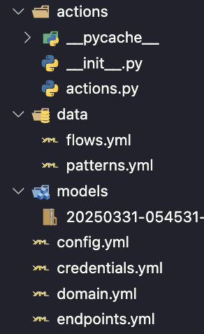
Project Directory Structure
Key Files and Directories:
data/: Contains training data for NLU and Core.​
models/: Stores trained models.​
domain.yml: Defines intents, entities, slots, responses, and actions
config.yml: Configures the processing pipeline and policies.​
endpoints.yml: Sets up endpoints for action servers and trackers.​
flows.yml: Define the business logic rules of your assistant.
actions.py: Write the actual code of the custom actions.

Slide 14
Flows
What Are Flows?
Flows are structured sequences of steps that encapsulate the business logic required to achieve specific user goals, such as blocking a credit card, changing an address, or adding a payee.​
By isolating business logic from the broader conversation, Flows offer:​
Clarity: Each Flow is dedicated to a single task or outcome.
Reusability: Flow logic can be invoked from other Flows or initiated independently.
Maintainability: Modifications to Flow logic can be made without impacting the overall conversation design.

Slide 15
Basic Structure of a Flow
Defining a Flow in flows.yml:
Each Flow is specified using YAML syntax with key attributes:​
Flow ID: A unique identifier for the Flow.
Name (optional): A human-readable name for the Flow.
Description: A brief explanation of the Flow's purpose.
Steps: A list of actions or information requests within the Flow.
NLU Trigger property: used to add intents that can start the Flow.
If property: A field is used to add flow guards.

Slide 16
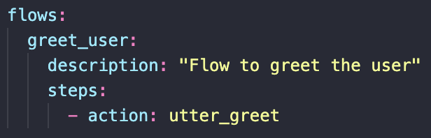
Basic Structure of a Flow
Example of a Simple Flow:
A Flow to greet the user:

Slide 17


Key Components of a Flow
Collect Step (collect): Requests specific information from the user and stores it in slots.​
*Note: The assistant will not proceed to the next step until the slot is filled.
Action Step (action): Executes a specific action, such as calling a custom action or sending a response.

Slide 18


Key Components of a Flow
Set Slots Step (set_slots): Updates the values of slots based on business logic.
*Note: You can set a slot to null to clear its value. Can set multiple slots
Call or Link Step (call or link): Invokes another Flow as part of the current process.​

Slide 19
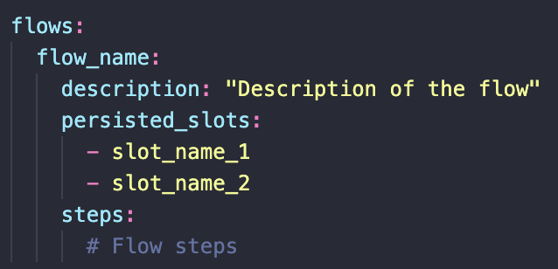
Managing Slots After Flow Completion
Default Behavior:
Slots set through collect and set_slots are reset when a Flow completes.
Persisting Slot Values:
Use the persisted_slots attribute to specify which slots should retain their values after the Flow ends.
*Note: Only slots set through collect or set_slots should be added to persisted_slots. Slots set by custom actions are automatically retained unless explicitly reset.

Slide 20
Domain
What is the Domain?
The domain defines the universe in which your assistant operates. It specifies the intents, entities, slots, responses, forms, and actions your bot should know. ​
Key Components of the Domain:
Intents: User goals or purposes expressed in their inputs.​
Entities: Specific data extracted from user inputs.​
Slots: Variables that store information to be remembered throughout the conversation.​
Responses: Predefined messages the assistant can send to users.​
Actions: Operations the assistant can perform, including custom actions.

Slide 21
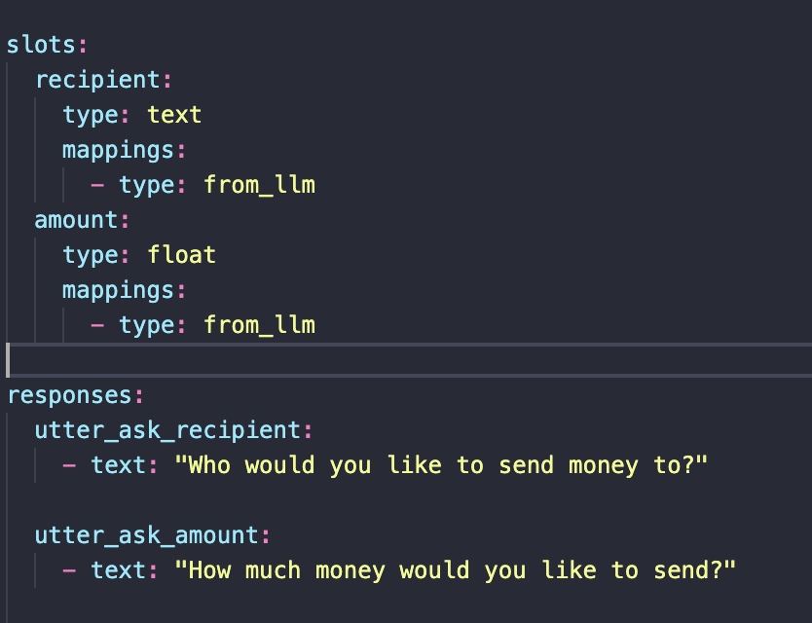
Domain
Defining the Domain:
The domain is typically defined in a YAML file named domain.yml

Slide 22
Custom Actions
What are Custom Actions?
Custom actions allow your assistant to execute arbitrary code, enabling operations like calling external APIs, querying databases, or performing calculations.
When to Use Custom Actions:
Fetching real-time data from external sources.​
Performing complex business logic not handled by standard responses.​
Interacting with databases or other backend systems.​

Slide 23
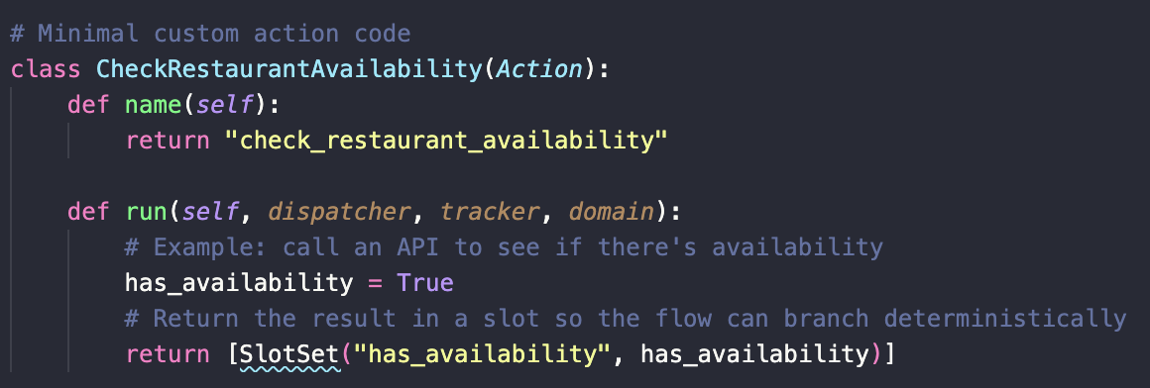
Custom Actions
Implementing Custom Actions:
Create the Action Class:
Define a Python class that inherits from Action.
Implement the name method to specify the action's identifier.
Implement the run method to execute the desired functionality.
Register the Action:
List the action in the actions section of your domain.yml.
Run the Action Server: rasa run actions

Slide 24
Rasa NLU
Introduction to Rasa NLU:
What is Rasa NLU? (Natural Language Understanding)
Role of Rasa NLU in extracting intents and entities from user messages.
Overview of intents, entities, and training data.
Components of Rasa NLU:
Intents: Define what the user wants to do (e.g., book a flight).
Entities: Extract relevant information (e.g., from_city, to_city, date).
Training

Slide 25
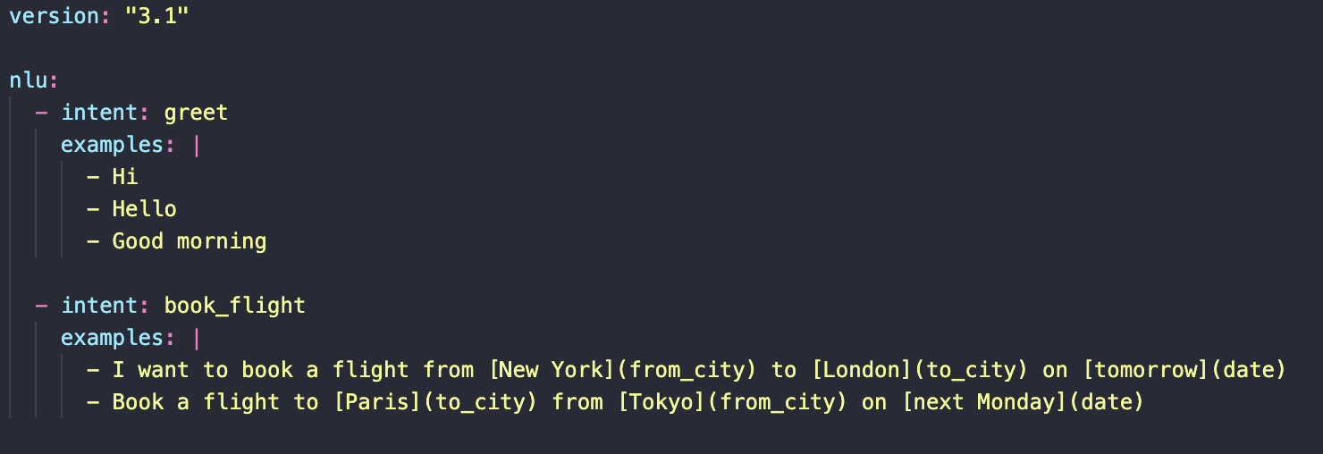
Rasa NLU
Create NLU training data in data/nlu.yml file with intents like greet, book_flight, flight_info

Slide 26
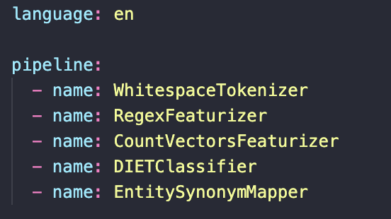
Rasa NLU
Configuring NLU Pipeline:
Explanation of config.yml with pipeline components:
Training and Testing NLU Model:
Training model use: rasa train nlu
Testing model use: rasa shell nlu
Checking intents and entities extraction from user messages

Slide 27
Practical Exercise
Build and train a basic NLU model for flight booking
Test with sentences like:
"Tôi muốn đặt vé máy bay từ Hà Nội đến Đà Lạt"
"Đặt vé từ Đà Nẵng tới Huế vào thứ hai"

Slide 28
From Rasa NLU to Rasa CALM
Previous Slides:
You may have worked with Rasa NLU pipelines (e.g., intent classification, entity extraction using config.yml)
In This Practical Session:
We are using Rasa CALM → Focused on Flow-based dialogue, not intent-based → No NLU pipeline is required

Slide 29
Introduction to Rasa CALM
What is Rasa CALM?
Rasa CALM (Conversational AI with Language Models) is an enterprise-grade conversational AI framework built on top of Rasa Open Source, providing advanced features for developing, deploying, and managing complex AI assistants.
Unlike Rasa Open Source, Rasa CALM is specifically designed for enterprise use cases with enhanced tools and integrations.

Slide 30
Key Features of Rasa CALM
LLM Integration
Seamless connection to GPT-4, open-source, or custom fine-tuned models
Improves both language understanding and response generation
Flow-based Dialogue Management
Define structured conversations using flows
Supports:
Multi-turn dialogues
Conditional logic
Dynamic slot handling

Slide 31
Key Features of Rasa CALM
Enterprise Search Capabilities
Integrates with FAISS, Milvus, Qdrant
Enables context-aware responses from large datasets
Customization & Fine-Tuning
Train and fine-tune LLMs for domain-specific tasks
Improve precision for specialized use cases
Enterprise-Ready Scalability
Built to handle high-load deployments
Includes tools for:
Monitoring
Maintenance
Performance optimization

Slide 32
Searching for Flights: Functional Requirements
The user wants to search for available flights based on:
Departure City (from_city)
Destination City (to_city)
Travel Date (travel_date)
The assistant should:
Collect the required information (slots) if missing
Read flight data from a CSV file
Filter and return a list of matching flights
Return a fallback message if no flights are found

Slide 33
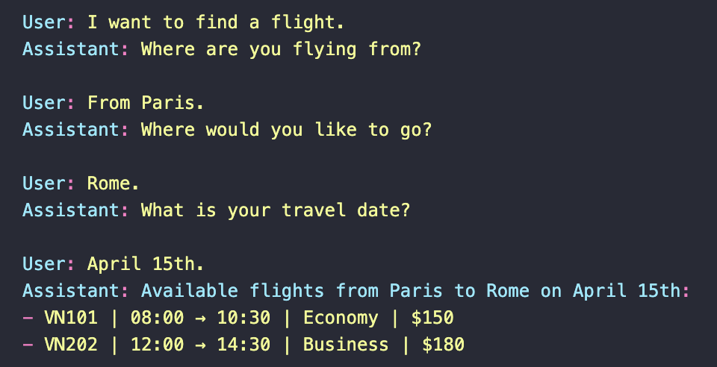
Searching for Flights: Expected Result

Slide 34
Searching for Flights: Step-by-Step Implementation
Step 1: Define Slots & Responses in domain.yml
Define the 3 required slots:
from_city: the departure location
to_city: the destination location
travel_date: the desired date of travel
Create appropriate responses:
Ask for missing information (e.g., "Where are you flying from?")
Display fallback message if no flights match the query

Slide 35
Searching for Flights: Step-by-Step Implementation
Step 2: Create Flow flows/search_flight.yml
Build a flow to manage the dialogue steps:
When the intent search_flight is detected, check if the required slots are filled
If any slot is missing, ask for it using the corresponding utter_ask_* response
Once all slots are filled, trigger a custom action (action_search_flights) to perform the actual search and return flight options

Slide 36
Searching for Flights: Step-by-Step Implementation
Step 3: Prepare Flight Data File
Download a CSV file ( flight_data.csv) or automatically create files containing flight information
Required fields in the file should include:
flight_code: unique code for each flight
departure_time, arrival_time: time of departure and arrival
from_city, to_city: origin and destination cities
available_seats: number of remaining seats
price: ticket price
class: flight class (e.g., Economy, Business)

Slide 37
Searching for Flights: Step-by-Step Implementation
Step 4: Write Custom Action
In the action_search_flights custom action:
Load the CSV file containing flight data
Normalize and parse the travel_date into a consistent format (e.g., YYYY-MM-DD)
Filter the dataset based on:
Matching from_city and to_city values
Flights that still have available seats (available_seats > 0)
Format and return the matching flights in a readable message
If no suitable flights are found, return a response informing the user accordingly

Slide 38
Testing Your Rasa Assistant
Step 1: Train Your Assistant
Ensure your assistant is trained with the latest data:​
rasa train
Step 2: Launch Rasa Inspector
Use Rasa Inspector for an interactive, browser-based testing experience:​
rasa inspect
This command opens a browser window featuring:​
Chat Widget: Engage in conversations with your assistant.
Flow View: Visualize active flows and their current steps.
Stack View: Monitor the sequence of activated flows.
Tracker State: Inspect slot values, events, and conversation history.

Slide 39
Booking Flights: Functional Requirements
The user wants to book a flight by:
Providing a flight code and number of tickets
Entering personal information for each passenger, including:
Full name
ID number
Phone number
The system should:
Loop through the number of passengers
Collect and store each passenger’s information
Once all passengers are collected, confirm the booking and return a booking code

Slide 40
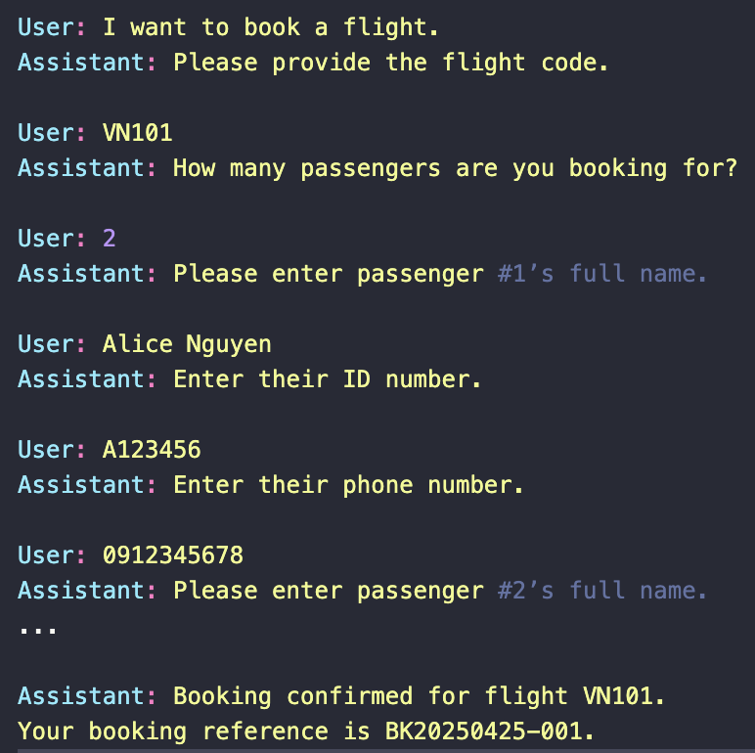
Booking Flights: Expected Result

Slide 41
Booking Flights: Step-by-Step Implementation
Step 1: Define Required Slots in domain.yml and flow.yml
You’ll need the following slots:
flight_code: stores the flight identifier
num_tickets: stores the number of passengers to collect info for
passenger_info: list of passenger dictionaries (name, ID, phone)
current_passenger_index: to keep track of the current passenger being processed
Temporary slots for each passenger:
passenger_name
passenger_id
passenger_phone

Slide 42
Booking Flights: Step-by-Step Implementation
Step 2: Collect Passenger Info with Sequential Custom Actions
Use a chain of custom actions to collect and store passenger details in order:
Ask for the passenger’s name using the current index
After the user replies, store the name and follow up with a prompt for ID number
Store the ID and ask for the phone number
Once the phone number is received:
Store the complete passenger info
Increase the passenger index
If more passengers remain → repeat the process
If finished → proceed to final booking step

Slide 43
Booking Flights: Step-by-Step Implementation
Step 3: Store Passenger Data
After each passenger’s full data is collected:
Append it to the passenger_info slot
Clear temporary slots (passenger_name, passenger_id, etc.)
Update current_passenger_index
When all passengers are collected:
Inform the user that passenger input is complete
Trigger a follow-up action (e.g. action_book_selected_flight) to finalize the booking

Slide 44
Booking Flights: Step-by-Step Implementation
Step 4: Confirm Booking and Return Result
Once all data is collected, the final action should:
Check if the flight exists and has enough seats
Confirm the booking
Generate a booking reference code
Return a success message with a summary

Slide 45
Check Booking Infor: Functional Requirements
The user wants to review the details of a booking by providing a booking code
The system should:
Ask for the booking code if it's not already provided
Look up the booking information (from database, CSV, or in-memory mock data)
Return the relevant booking details such as:
Flight code
Passenger list
Departure & destination cities
Travel date
Number of passengers

Slide 46
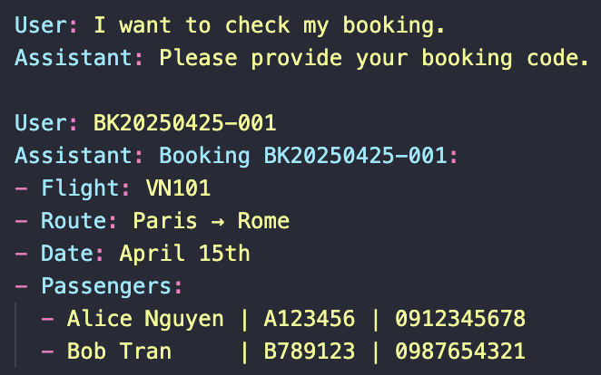
Check Booking Infor: Expected Result

Slide 47
Check Booking Infor: Step-by-Step Implementation
Step 1: Define Slot & Responses in domain.yml and create flow check_booking
Define the following slot:
booking_code: to capture the booking reference
Define responses:
utter_ask_booking_code: ask user to provide the booking code
utter_booking_not_found: response if no matching booking is found
You may also define utter_booking_details or return message in custom action

Slide 48
Check Booking Infor: Step-by-Step Implementation
Step 2: Implement Custom Action action_check_booking
Retrieve the slot booking_code
Check the booking data:
If stored in memory (e.g., domain slot or global variable), scan the list of bookings
If stored in CSV file, read the file and find the matching booking row
Once a match is found:
Parse flight details: flight code, route, date
Parse passenger list (name, ID, phone)
Construct a summary message
If no match is found, return utter_booking_not_found

Slide 49
Cancel Booking: Functional Requirements
The user wants to cancel a flight booking
The system should:
Ask for the booking code if it’s not provided
Retrieve the booking details
Verify:
Whether the ticket class allows cancellation (e.g., Economy may not be refundable)
Whether the current date is before the flight date
If valid → cancel the booking and confirm
If invalid → explain why cancellation is not allowed

Slide 50
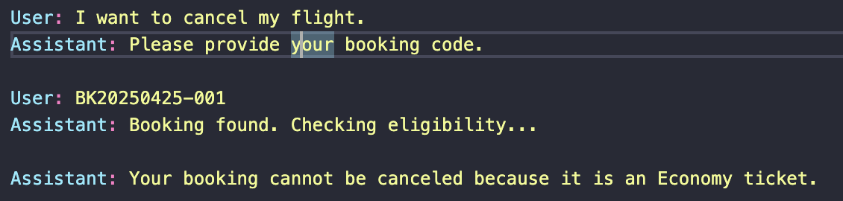
Cancel Booking: Expected Result

Slide 51
Cancel Booking: Step-by-Step Implementation
Step 1: Define Slot & Responses in domain.yml and create flow cancel_flight
Define:
booking_code slot
Create responses:
utter_ask_cancel_code: prompt for booking code
utter_cancellation_successful: confirmation if cancel is valid
utter_cancellation_denied: if cancelation fails due to rules
Optionally: utter_booking_not_found if the code is invalid

Slide 52
Cancel Booking: Step-by-Step Implementation
Step 2: Logic in Custom Action action_cancel_booking
Inside the action:
Retrieve booking_code from the tracker
Find the booking record (from in-memory list or CSV file)
Check these 2 cancellation rules: 1. Class Type Rule
Business, Premium → allowed to cancel
Economy → not allowed to cancel
2. Flight Date Rule
Only allow cancellation if today’s date < travel date
(You can use datetime.strptime() and datetime.now() to compare)
Based on the result:
If both conditions are met → confirm cancellation + optionally remove or mark booking as canceled
Else → inform user that cancellation is not allowed (specify reason)

Slide 53
THANK YOU !

