Slide 1
Stacks (Algorithms and Data Structures)

Slide 2
Stacks
it is an abstract data type – and it can be implemented either with arrays or with linked lists
it has a so-called LIFO structure – the last item we inserted is the first item we take out
basic operations arepop(), push() and peek()
most of the modern programming languages are stack-oriented
they define most basic operations (adding two numbers) as taking their arguments from the stack and placing any return values back on the stack

Slide 3
Stacks

Slide 4
Stacks
10

Slide 5
Stacks
8
10

Slide 6
Stacks
12
8
10

Slide 7
Stacks
4
12
8
10

Slide 8
Stacks
4
12
8
10

Slide 9
Stacks
12
8
10

Slide 10
Stacks
8
10

Slide 11
Stacks
10

Slide 12
Stacks

Slide 13
Stacks Applications
in stack-oriented programming languages
graph algorithms rely heavily on stacks such as depth-first search can be implemented with stacks
finding Eulerian cycles in a G(V,E) graph
finding strongly connected components in a given G(V,E) graph

Slide 14
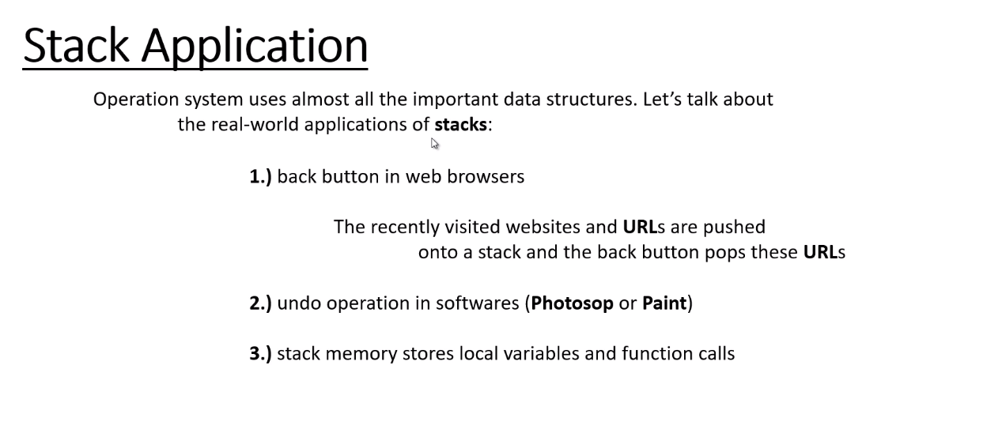
Stacks Applications

Slide 15
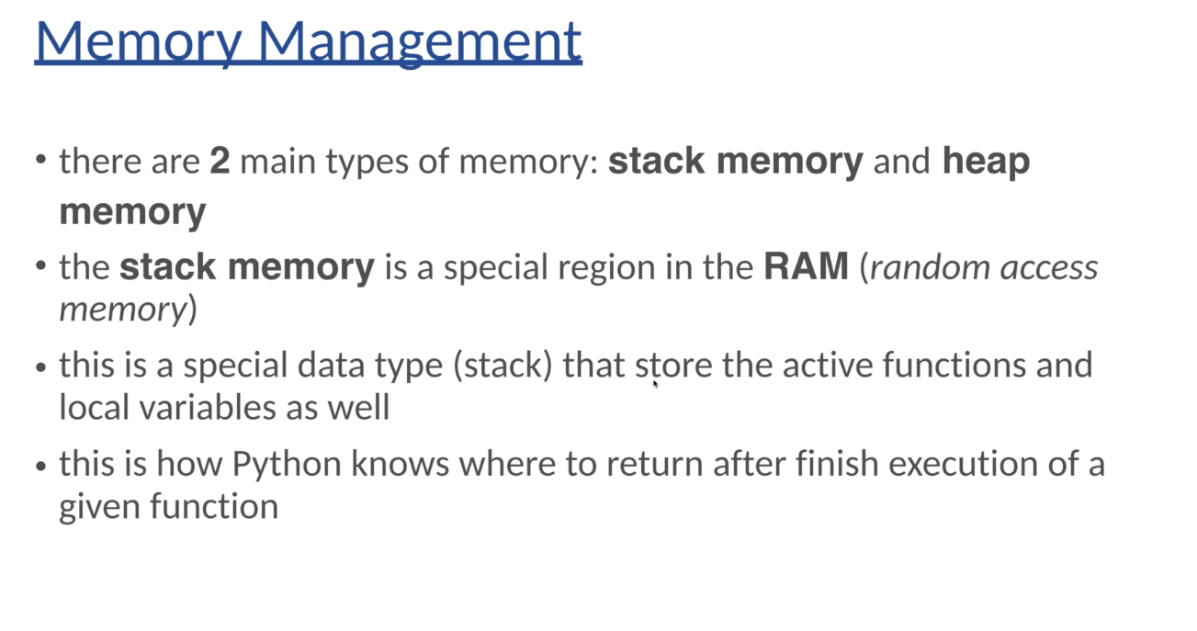

Slide 16
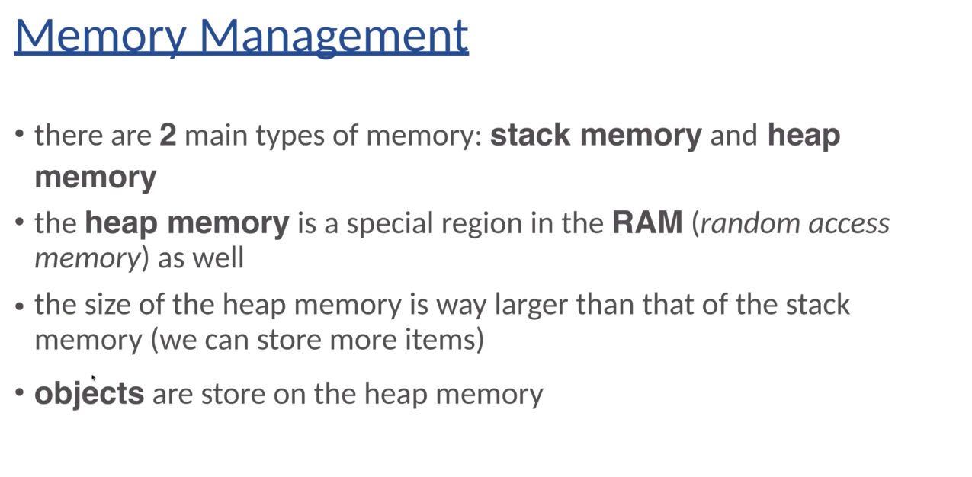

Slide 17
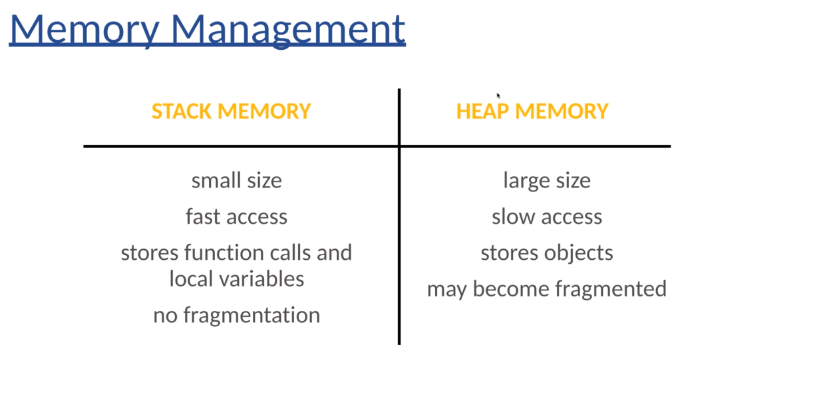

Slide 18
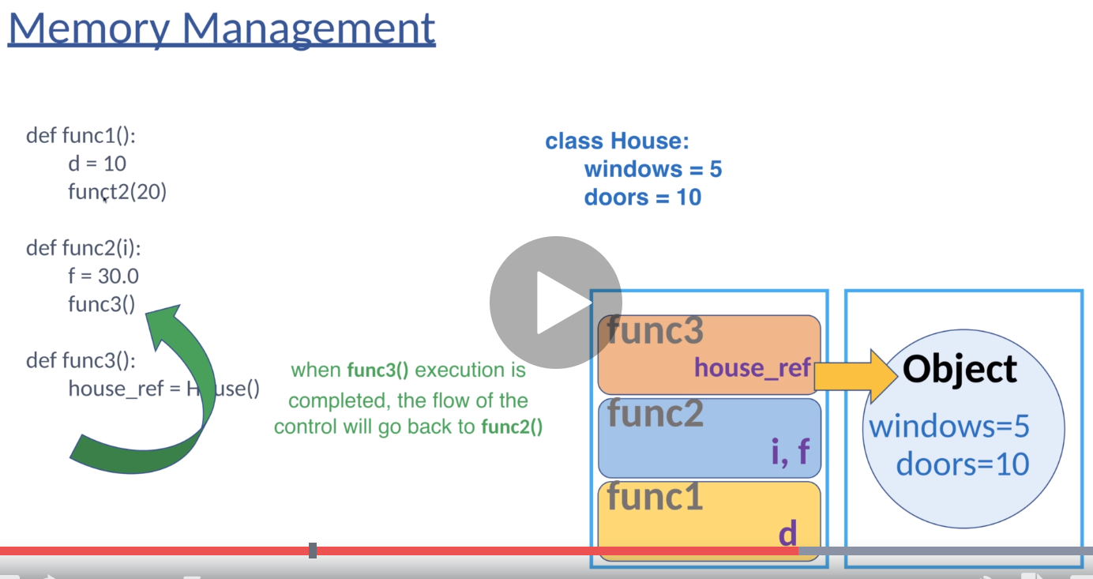

Slide 19
