Slide 1

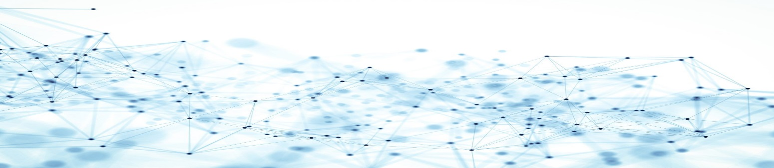
An Gentle Introduction to Graph Convolution Network (GCN)
Hugh Nguyen
Data Scientist Co-op
RBC – Joint Security Operations Center
Date: 2018/12/06

Slide 2
AGENDA
Outstanding Questions:
What is a graph? Why do we even bother using it?
What is Convolution Neural Network? Why does it fail on graph?
What is Graph Convolution Network and some of its applications?
Semi-supervised Nodes Classification Performance Review
Graph Convolution Network (GCN)
Graph Overview

Slide 3
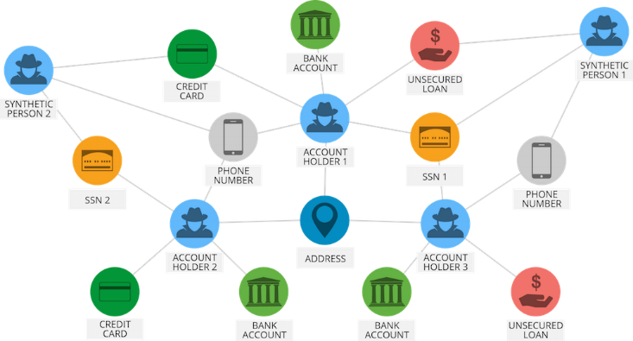
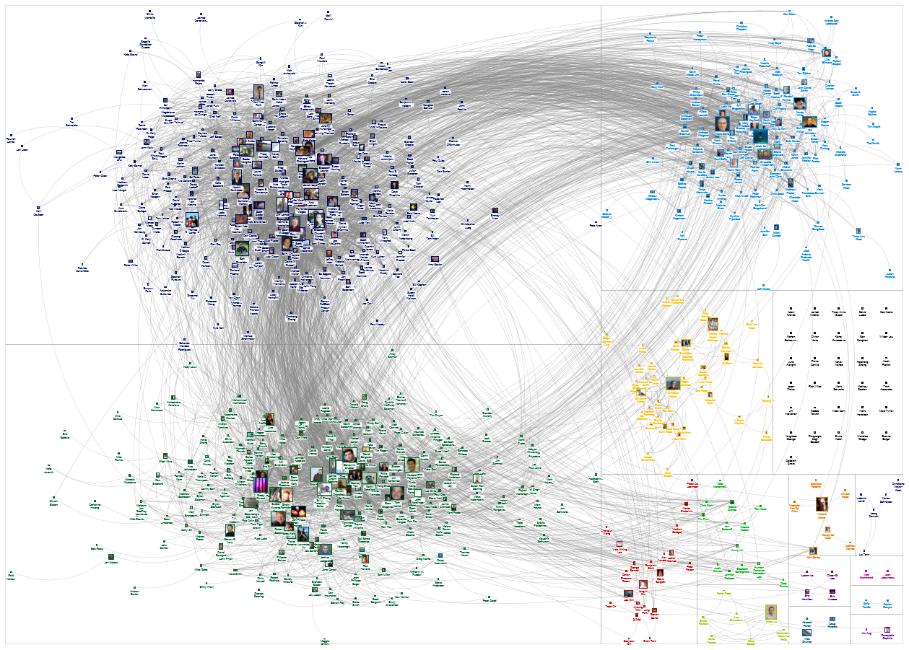
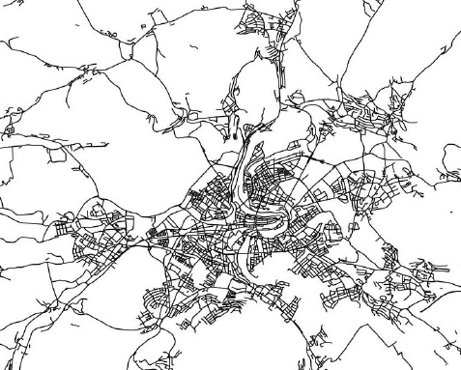
WHAT’S THE PROBLEM?
Graph Convolution Network (GCN)
Graph Overview

Slide 4

Convolutional Neural Network (CNN)

Slide 5
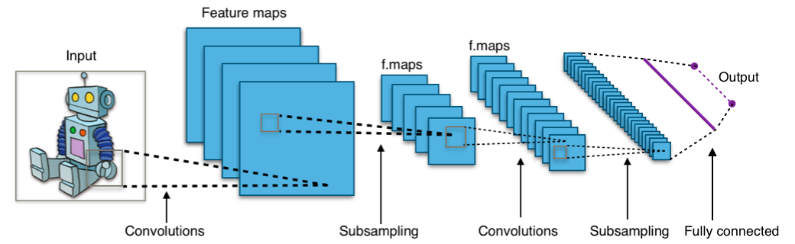
CONVOLUTION NEURAL NETWORK (CNN)
.92
X
Convolution
ReLU
Convolution
ReLU
Pooling
Fully
connected
Fully
connected
Convolution
ReLU
Pooling
O
.51
Graph Convolution Network (GCN)
Source: Brandon Rohrer (Facebook)
CNN Architecture

Slide 6
FILTERING
Consider this image: (2D Matrix)
Graph Convolution Network (GCN)
Source: Brandon Rohrer
CNN Architecture

Slide 7
FILTERING OPERATION
Features match pieces of the image
Graph Convolution Network (GCN)
Source: Brandon Rohrer
CNN Architecture

Slide 8
FILTERING OPERATION
Graph Convolution Network (GCN)
Source: Brandon Rohrer
CNN Architecture

Slide 9
FILTERING OPERATION
Graph Convolution Network (GCN)
Source: Brandon Rohrer
CNN Architecture

Slide 10
FILTERING OPERATION
Graph Convolution Network (GCN)
Source: Brandon Rohrer
CNN Architecture

Slide 11
FILTERING OPERATION
1 x 1 = 1
Graph Convolution Network (GCN)
Source: Brandon Rohrer
CNN Architecture

Slide 12
FILTERING OPERATION
-1 x -1 = 1
Graph Convolution Network (GCN)
Source: Brandon Rohrer
CNN Architecture

Slide 13
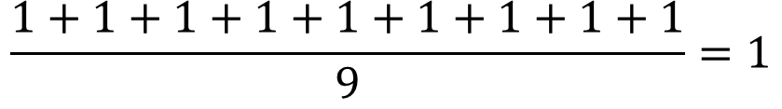
FILTERING OPERATION
$$\frac{1+1+1+1+1+1+1+1+1}{9}=1$$
Graph Convolution Network (GCN)
Source: Brandon Rohrer
CNN Architecture

Slide 14
FILTERING OPERATION
Graph Convolution Network (GCN)
Source: Brandon Rohrer
CNN Architecture

Slide 15
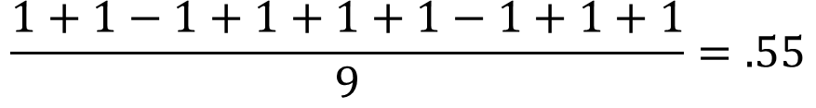
FILTERING OPERATION
$$\frac{1+1−1+1+1+1−1+1+1}{9}=.55$$
.55
Graph Convolution Network (GCN)
Source: Brandon Rohrer
CNN Architecture

Slide 16
FILTERING OPERATION
Graph Convolution Network (GCN)
Source: Brandon Rohrer
CNN Architecture

Slide 17
FILTERING OPERATION
=
Graph Convolution Network (GCN)
Source: Brandon Rohrer
CNN Architecture

Slide 18
FILTERING OPERATION
=
Graph Convolution Network (GCN)
Source: Brandon Rohrer
CNN Architecture

Slide 19
FILTERING OPERATION
=
=
=
Graph Convolution Network (GCN)
Source: Brandon Rohrer
CNN Architecture

Slide 20
CONVOLUTION LAYER
A stack of filters forms a convolution layer
Graph Convolution Network (GCN)
Source: Brandon Rohrer
CNN Architecture

Slide 21
POOLING OPERATION
Select a pooling window size; normally 2 to 3
Select a stride; normally 2
A stack of filters forms a convolution layer
A stack of filters forms a convolution layer
Graph Convolution Network (GCN)
Source: Brandon Rohrer
CNN Architecture

Slide 22
POOLING OPERATION
maximum
Graph Convolution Network (GCN)
Source: Brandon Rohrer
CNN Architecture

Slide 23
POOLING OPERATION
maximum
Graph Convolution Network (GCN)
Source: Brandon Rohrer
CNN Architecture

Slide 24
POOLING OPERATION
maximum
Graph Convolution Network (GCN)
Source: Brandon Rohrer
CNN Architecture

Slide 25
POOLING OPERATION
max pooling
Graph Convolution Network (GCN)
Source: Brandon Rohrer
CNN Architecture

Slide 26
POOLING OPERATION
Graph Convolution Network (GCN)
Source: Brandon Rohrer
CNN Architecture

Slide 27
ACTIVATION FUNCTION – ReLU
Graph Convolution Network (GCN)
Source: Brandon Rohrer
CNN Architecture

Slide 28
ACTIVATION FUNCTION – ReLU
Graph Convolution Network (GCN)
Source: Brandon Rohrer
CNN Architecture

Slide 29
ACTIVATION FUNCTION – ReLU
Graph Convolution Network (GCN)
Source: Brandon Rohrer
CNN Architecture

Slide 30
SO FAR …
Graph Convolution Network (GCN)
Source: Brandon Rohrer
CNN Architecture

Slide 31
SO FAR …
Convolution
ReLU
Convolution
ReLU
Pooling
Convolution
ReLU
Pooling
Graph Convolution Network (GCN)
Source: Brandon Rohrer
CNN Architecture

Slide 32
FULLY CONNECTED LAYER
X
O
Graph Convolution Network (GCN)
Source: Brandon Rohrer
CNN Architecture

Slide 33
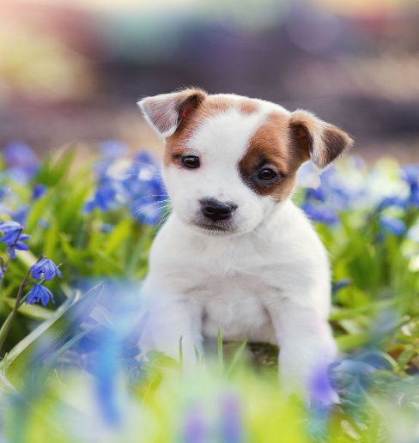
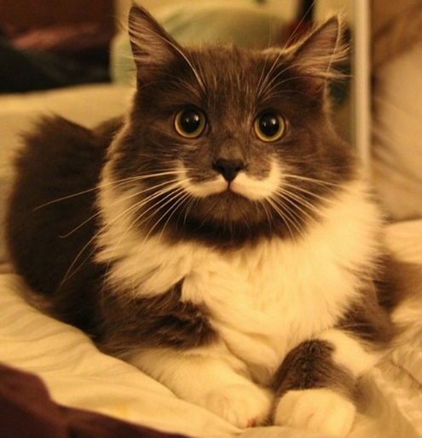

CNN FULL STACK
.95
X
Convolution
ReLU
Fully
connected
Fully
connected
Convolution
ReLU
Convolution
ReLU
Pooling
Pooling
O
.11
Graph Convolution Network (GCN)
Source: Brandon Rohrer
CNN Architecture

Slide 34
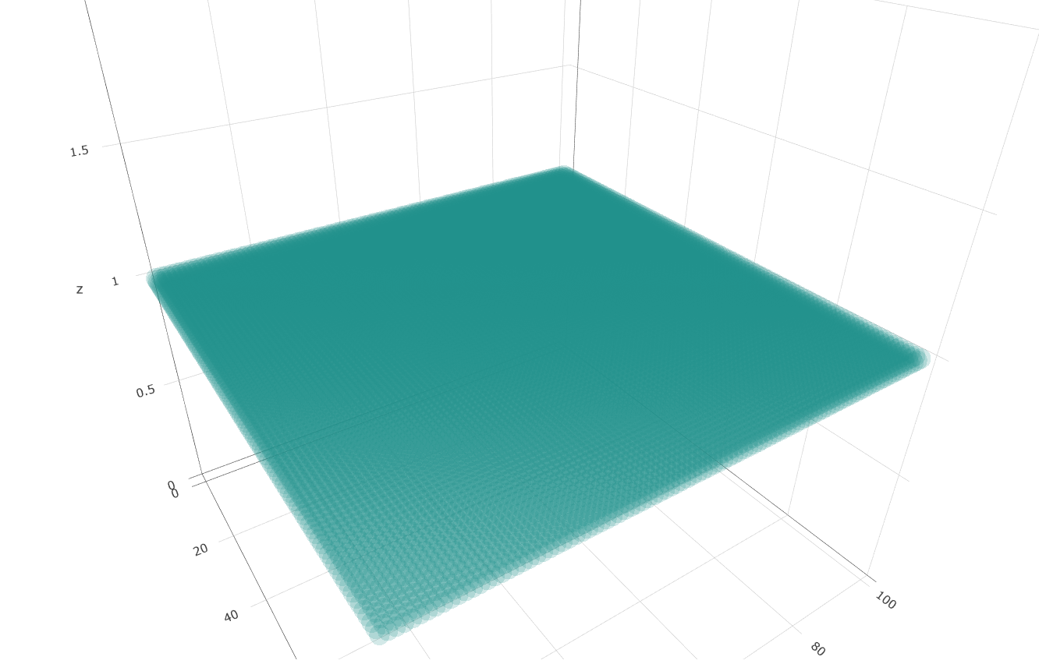
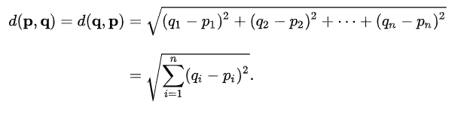
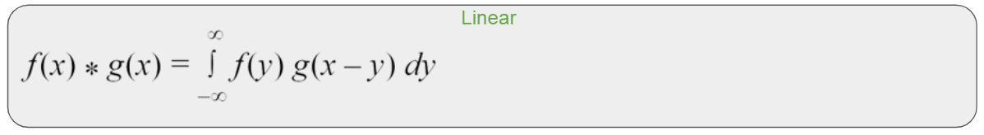
CNN PROS
Graph Convolution Network (GCN)
CNN Architecture

Slide 35
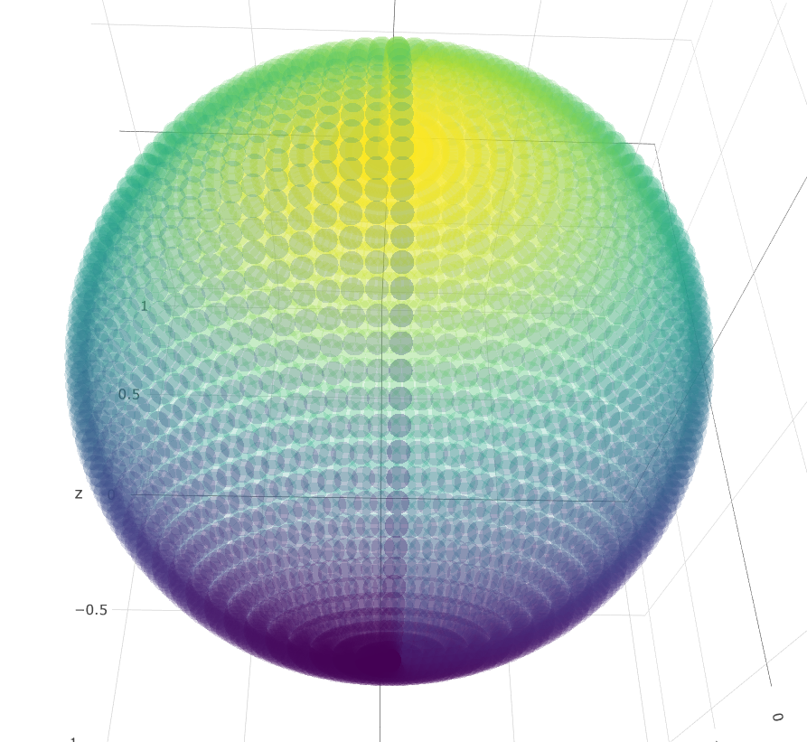
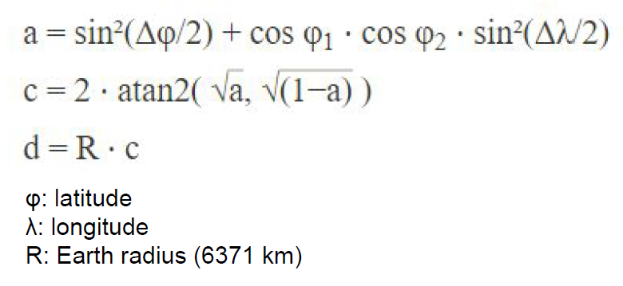
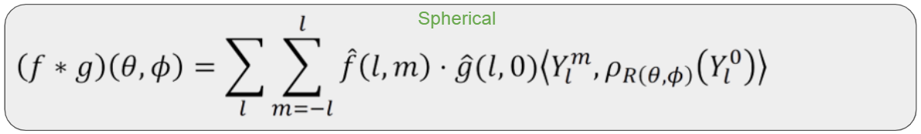
CNN PROS
Graph Convolution Network (GCN)
CNN Architecture

Slide 36
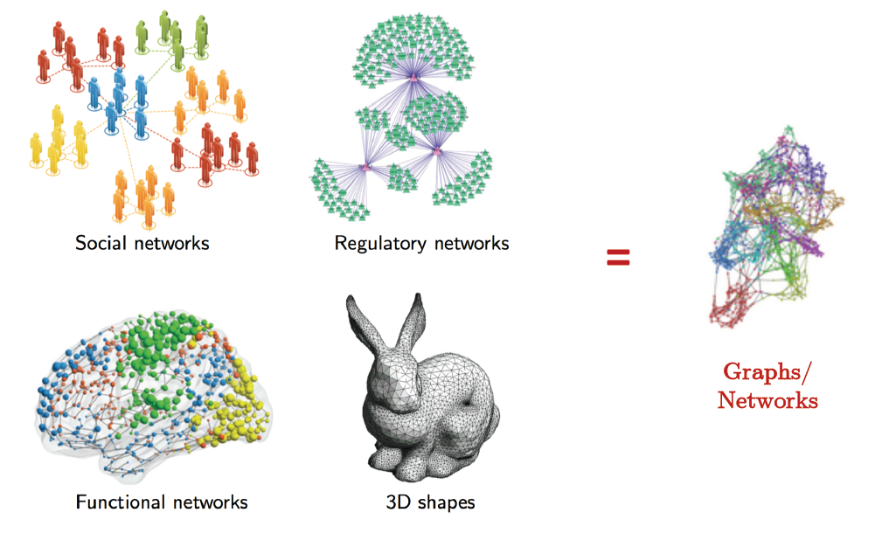
CNN CANNOT HANDLE NON-EUCLIDEAN DOMAIN
Graph Convolution Network (GCN)
CNN Architecture

Slide 37
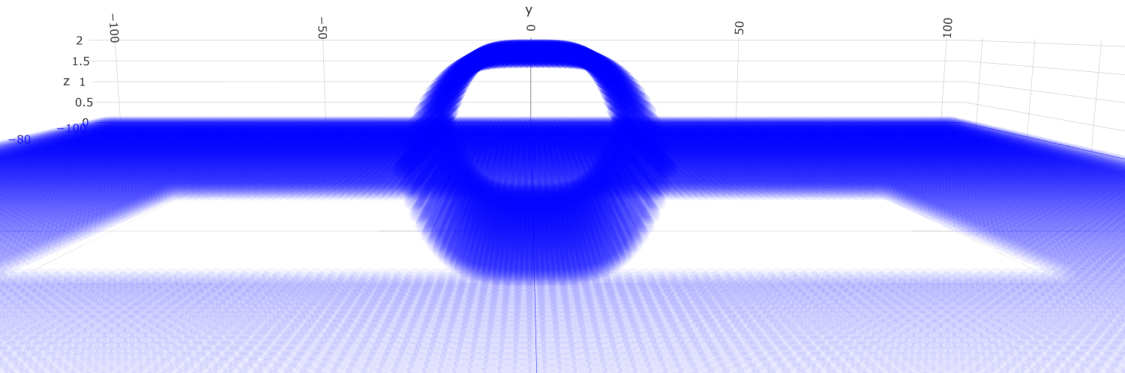
CNN CANNOT HANDLE NON-EUCLIDEAN DOMAIN
Graph Convolution Network (GCN)
CNN Architecture

Slide 38
Graph Theory 101

Slide 39
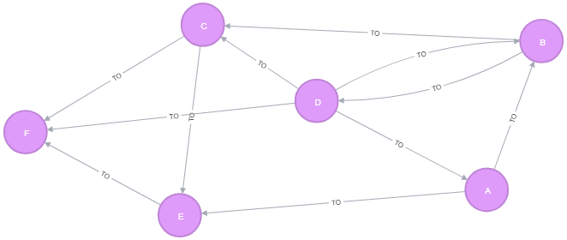
WHAT IS A GRAPH?
Graph Convolution Network (GCN)
Graph Overview

Slide 40
Graph Convolution Network (GCN)
Source: Brandon Rohrer
CNN Architecture

Slide 41
Graph Convolution Network (GCN)

