Slide 1







logo here
Company Organizational
A picture is worth a thousand words
It serves a variety of purposes, making presentations powerful tools for convincing and teaching.
Speaker name:XXX
Date:20xx.01.01

Slide 2


Table Of Contents
1
2
3
4
Company Introduction
Team Introduction
Product
Current Status&Award
Making Powerful Tools For Convincing
Making Powerful Tools For Convincing
Making Powerful Tools For Convincing
Making Powerful Tools For Convincing
Part
Part
Part
Part

Slide 3

logo here
01
Company Introduction
It serves a variety of purposes, making presentations powerful tools for convincing and teaching.

Slide 4

Company Introduction
A picture is worth a thousand words
Title here
It serves a variety of purposes, making presentations
It serves a variety of purposes, making presentations powerful tools for convincing and teaching. It serves a variety of purposes, making presentations powerful tools.
Title here
It serves a variety of purposes, making presentations

Slide 5


Company Introduction
Title Here
Title Here
It serves a variety of purposes, making powerful tools for convincing and teaching.
It serves a variety of purposes, making powerful tools for convincing and teaching.
Title Here
Title Here
It serves a variety of purposes, making powerful tools for convincing and teaching.
It serves a variety of purposes, making powerful tools for convincing and teaching.

Slide 6
logo here
02
Team Introduction
It serves a variety of purposes, making presentations powerful tools for convincing and teaching.

Slide 7

Team Introduction
Title here
Title here
Title here
A
B
Making powerful tools for convincing and teaching.
Making powerful tools for convincing and teaching.
80%
It serves a variety of purposes, making presentations powerful tools for convincing and teaching.
Title here
95%
It serves a variety of purposes, making presentations powerful tools for convincing and teaching.

Slide 8


Team Introduction
Title here
Title here
It serves a variety of purposes, making presentations powerful tools for convincing and teaching.
It serves a variety of purposes, making presentations powerful tools for convincing and teaching.
Title here
Title here
Title here
Title here
It serves a variety of purposes, making presentations powerful tools for convincing and teaching.
It serves a variety of purposes, making presentations powerful tools for convincing and teaching.

Slide 9
logo here
03
Product
It serves a variety of purposes, making presentations powerful tools for convincing and teaching.

Slide 10

Product
Title here
It serves a variety of purposes, making presentations powerful
It serves a variety of purposes, making powerful tools for convincing and teaching.
Title here
It serves a variety of purposes, making presentations powerful
It serves a variety of purposes, making powerful tools for convincing and teaching.
Title here
It serves a variety of purposes, making presentations powerful
It serves a variety of purposes, making powerful tools for convincing and teaching.
Title here
It serves a variety of purposes, making presentations powerful
It serves a variety of purposes, making powerful tools for convincing and teaching.

Slide 11


Product
Title here
Title here
Title here
It serves a variety of purposes, making powerful tools for convincing
It serves a variety of purposes, making powerful tools for convincing
It serves a variety of purposes, making powerful tools for convincing

Slide 12
logo here
04
Current Status&Award
It serves a variety of purposes, making presentations powerful tools for convincing and teaching.

Slide 13

Current Status&Award
01
Title here
Title here
04
It serves a variety of purposes, making powerful tools for convincing
It serves a variety of purposes, making powerful tools for convincing
02
Title here
Title here
05
It serves a variety of purposes, making powerful tools for convincing
It serves a variety of purposes, making powerful tools for convincing
03
Title here
Title here
06
It serves a variety of purposes, making powerful tools for convincing
It serves a variety of purposes, making powerful tools for convincing

Slide 14
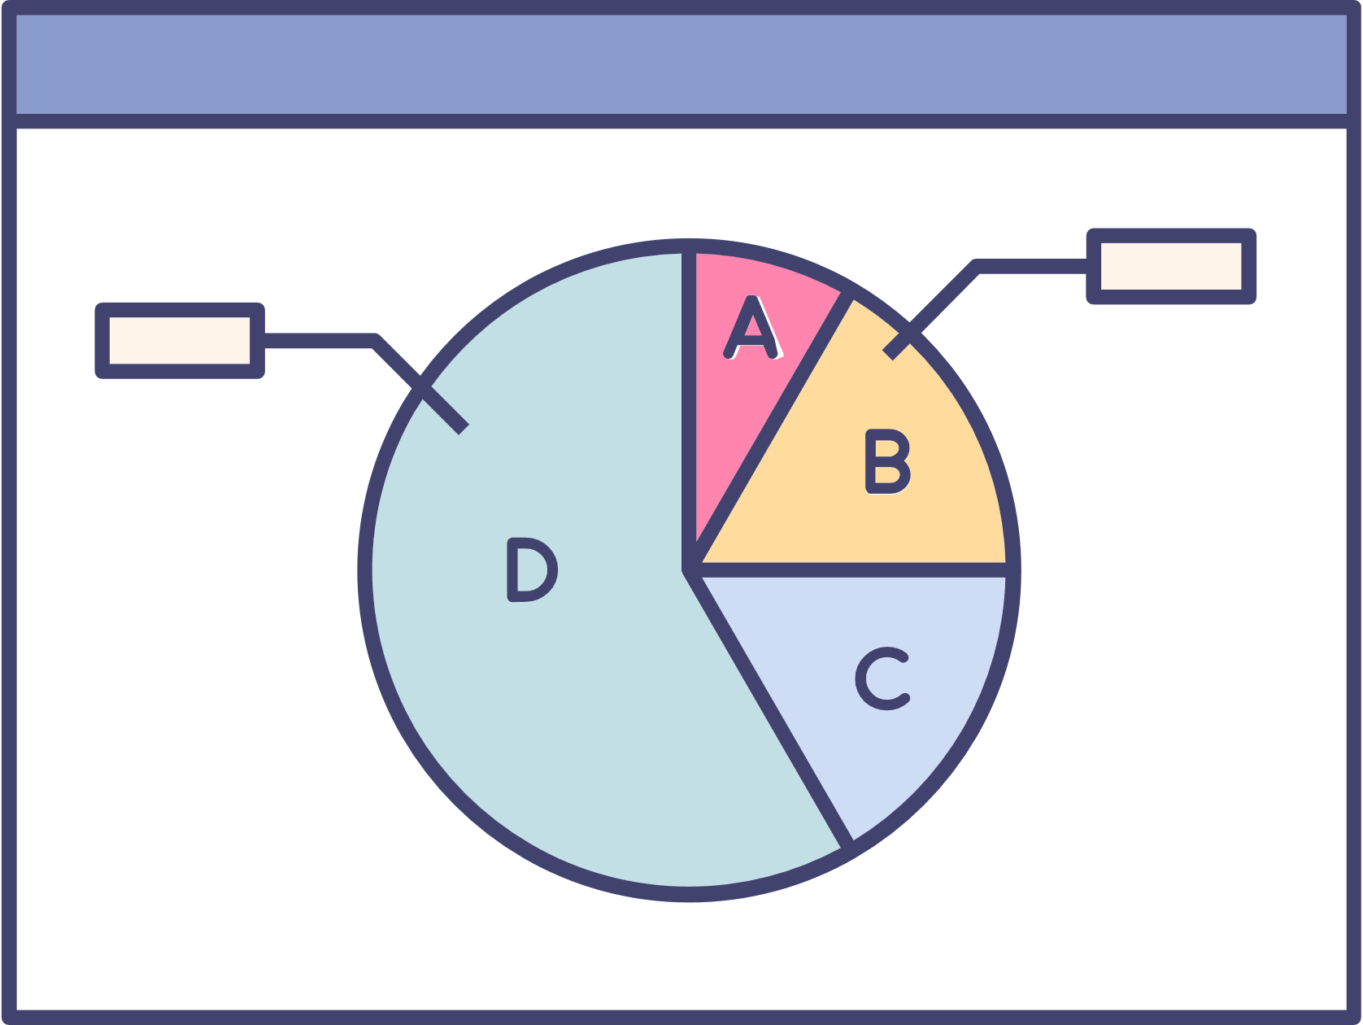

Current Status&Award
Add a short description
750K
250k
500k
Presentation are communication tools that can be used as demontrations, lectures, reports, and more. it is mostly presented before an audience.It serves a variety of purposes, making presentations powerful tools

Slide 15
logo here
Company
THANK YOU
A picture is worth a thousand words
It serves a variety of purposes, making presentations powerful tools for convincing and teaching.
Speaker name:XXX
Date:20xx.01.01

