Slide 1
FRF04 – MOCK_BOOTLOADER GROUP – 5
Teacher & Mentor : Nguyen Van Nghia – NghiaNV16
Member :
1 – Tran Trung Hieu
2 – Le Trung Kien
3 – Nguyen Van Tinh

Slide 2
BOOTLOADER
Overview
Program Implementation

Slide 3

Bootloader - overview
Memory Structure ?
What is Boot Program ?
How ‘re they operate ?
Update Firmwre ?

Slide 4

Boot program
Bootloader here is a special software that is loaded into the computer's memory before booting.
Computers also use microprocessors, and the Bootloader here is no different from a firmware preloaded in that microprocessor, and is called every time the computer boots.

Slide 5
Boot program
Our microcontroller also uses the microprocessor core, and when it starts, it also needs to know where to start executing?
If there is a Bootloader program loaded into the microcontroller, it will first jump into this Bootloader program, do some work and then switch to the application program to execute.

Slide 6
Boot program – load firmware
To develope a product for users, updating Firmware is very important.
With embedded/IOT products, we cannot let the code loading pins go out and go to the place to reload the Firmware, we need another method of updating Firmware, for example via wireless network.
=> Bootloader is the key - core of the problem.

Slide 7
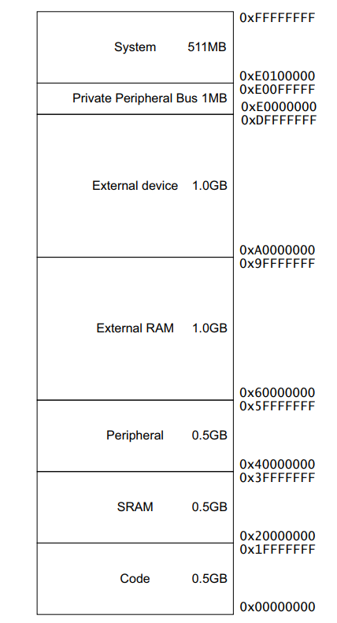
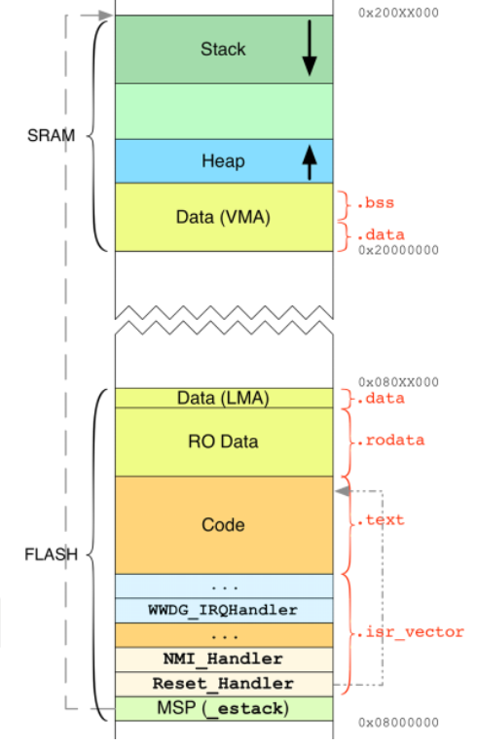
Memory Structure
0x00000000

Slide 8
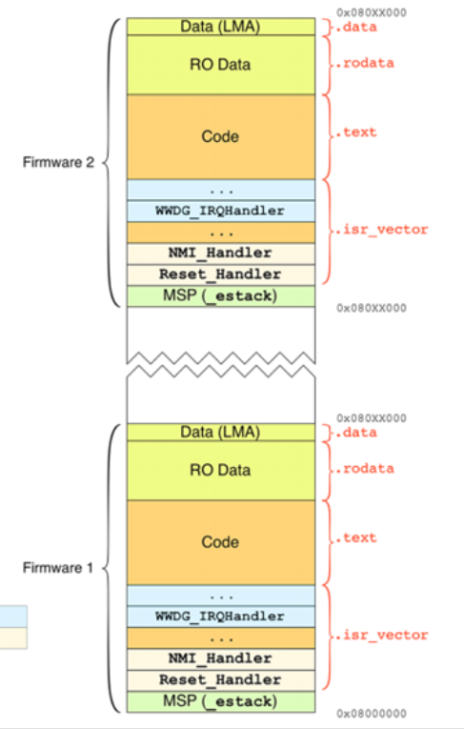
Flash memory – update firrmware
The firmware we will write here includes the Bootloader program, and the application program we use, maybe 2 application programs for us to test the firmware update feature.
We will use the first memory area on flash memory at address 0x00 to store the bootloader code, part of the memory to store Firmware Code 1, and part of the memory to store Firmware Code 2.
Here the Bootloader program is designed to convert between Firmware 1 and Firmware 2. Assuming the Microcontroller is running Firmware 1, we press the update button and the program will reset and switch to Firmware 2.
0x00030000
0x00020000

Slide 9
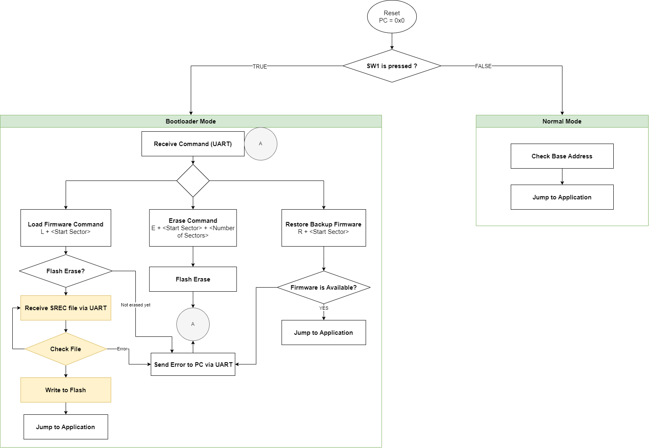
Boot program algorithm

Slide 10
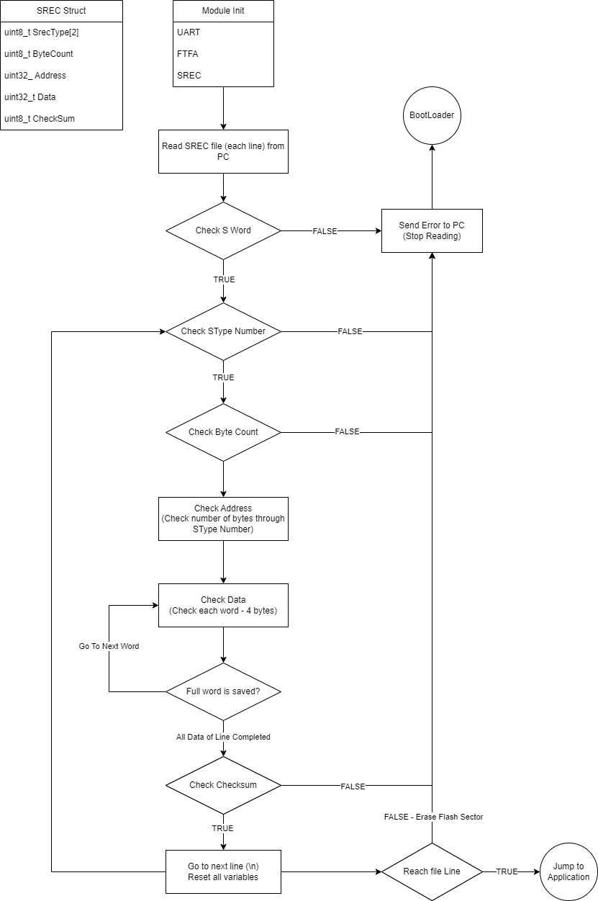
Algorithm to Receive data from s_record file & write into flash memory

Slide 11
The end

