Slide 1
FLOW Game Design Document
BlueMoon
20-11-2016

Slide 2
Overview
Flow is a match -3 puzzle game focusing on the continuity.
Goal
Score as much as possible by making the longest line of flow.
Features
One-touch control
Minimalist graphics
Modified match-3 mechanics.
Information
Genre : Puzzle
Age : 3+
Gender: Male and Female

Slide 3
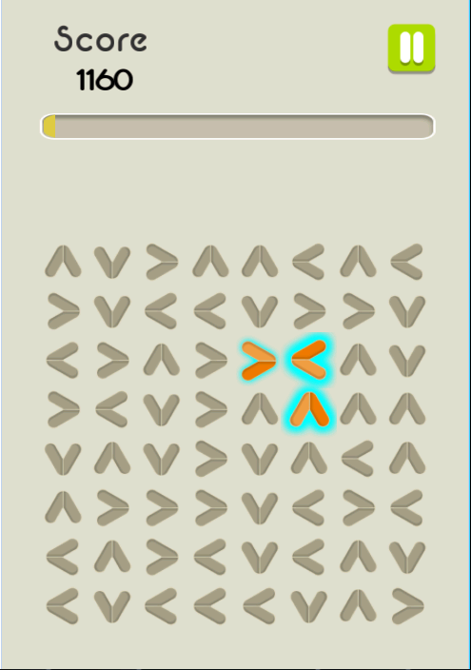
Core Gameplay How to Play
Play by tapping any tile
The flow moves until it meets a tile with an opposite direction or hits the border.

Slide 4
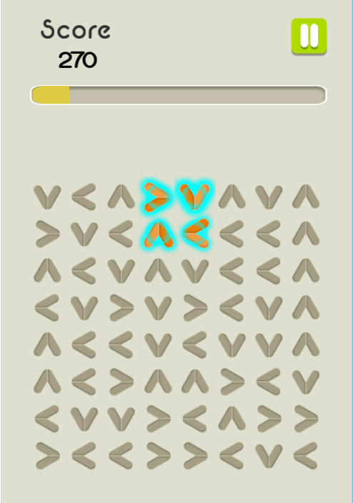
Core Gameplay Special Flow
When the flow meets its head , a “square” is formed.
All tiles within and surrounding the square will be destroyed.

Slide 5


Score
$$Point=10 x NumberofTiles x Bonus$$
$$Bonus=NumberofTiles−3$$

Slide 6
Mode
Time
Player starts with 30 seconds.
300 points = 1 additional second
Out of time, game over.

Slide 7
Game Flow
Main Menu
Credits
Credits
Tutorial
Tutorial
Play
Out of Time
Game Over
Play Again

Slide 8
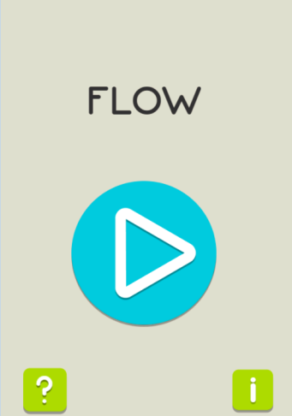
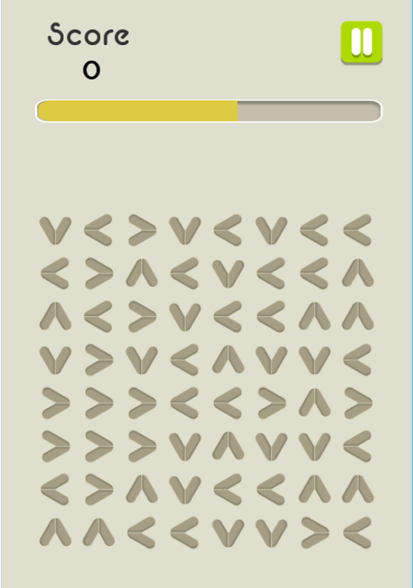
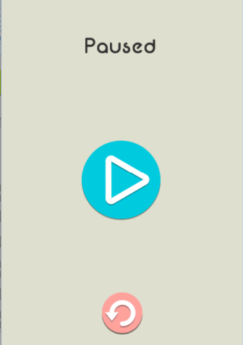
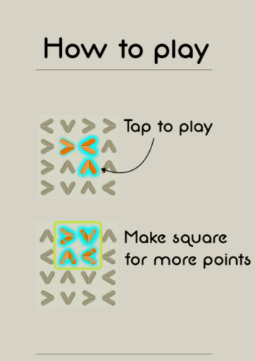
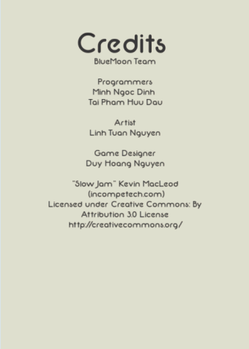
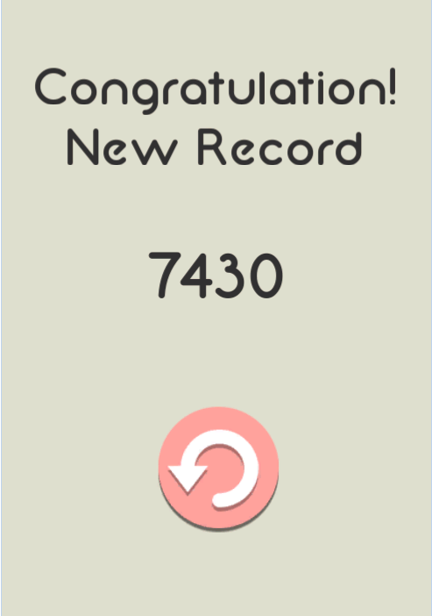
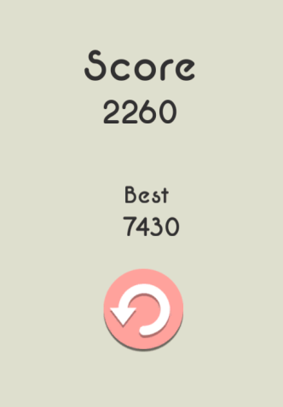
Menu Flow
Tap
Tap
High score ?
Reset Game
Yes
No

Slide 9

Next version
New Tile
Split
Divides flow in 2 (horizontally, vertically) or 4.
New Mode
Move
Unlimited time and 30 moves.
Each tap is considered a “move”.
Out of Move, game over.

Slide 10
End of Document

