Slide 1
Boto3 is the Amazon Web Services (AWS) SDK for Python. It’s enable Python Developers to create, configure, and manage AWS services, such as Amazon Elastic Compute Cloud (Amazon EC2) and Amazon Simple Storage Service (Amazon S3). The SDK provides an object-oriented API as well as low-level access to AWS services. For more details, access the link below: https://boto3.amazonaws.com/v1/documentation/api/latest/guide/quickstart.html#using-boto3

Slide 2
Try using boto3:
To use Boto3, you must first import it and indicate which service or services you’re going to use:
import boto3
# Let's use Amazon S3
s3 = boto3.resource('s3’)
Now that you have an s3 resource, you can make send requests to the service. The following code uses the buckets collection to print out all bucket names:
# Print out bucket names
for bucket in s3.buckets.all():
print(bucket.name)
You can also upload and download binary data. For example, the following uploads a new file to S3, assuming that the bucket my-bucket already exists:
# Upload a new file
data = open('test.jpg', 'rb’)
s3.Bucket('my-bucket').put_object(Key='test.jpg', Body=data)

Slide 3
List all the objects in all S3 Buckets:
import boto3
s3 = boto3.resource('s3')
for bucket in s3.buckets.all():
my_bucket = s3.Bucket(bucket.name)
for file in my_bucket.objects.all():
print(f"Bucket: {bucket.name} Key: {file.key}")
_________________________________________________
Bucket.name -> print the name of the current bucket
File.key -> print the name of the objects in the current path

Slide 4
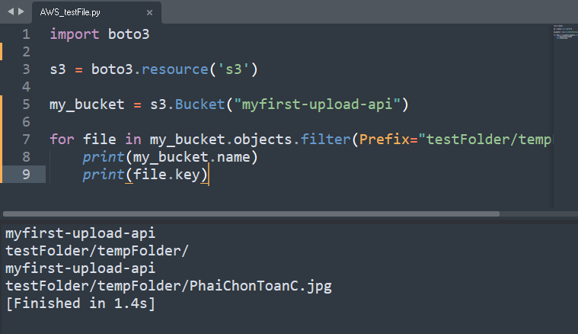
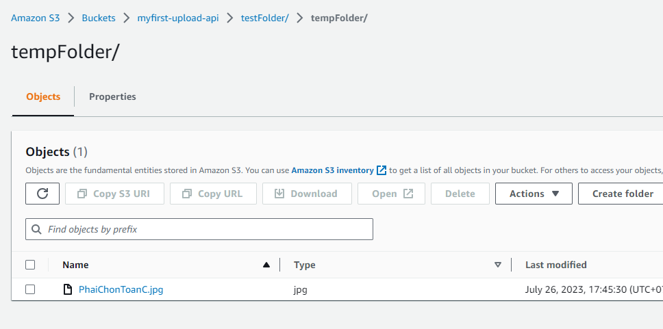
Work with particular bucket (Filter Objects in S3 Buckets):
(bucket.objects.filter(Prefix = <folder_path_1>), bucket.objects.filter(Prefix = <folder_path_2>), …)
import boto3
s3 = boto3.resource('s3')
my_bucket = s3.Bucket("myfirst-upload-api")
for file in my_bucket.objects.filter(Prefix="testFolder/tempFolder/"):
print(my_bucket.name)
print(file.key)

Slide 5
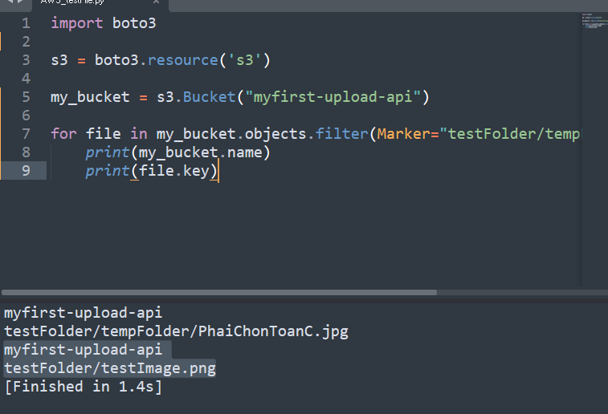
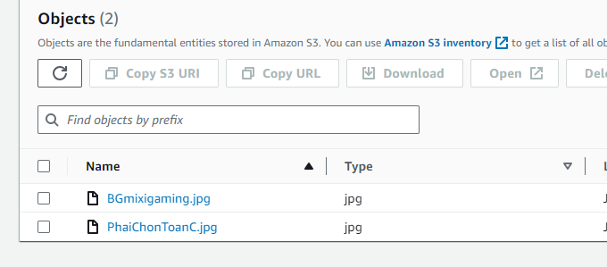
List Objects Starting From Specific Objects: (1)
import boto3
s3 = boto3.resource('s3')
my_bucket = s3.Bucket("myfirst-upload-api")
for file in my_bucket.objects.filter(Marker="testFolder/tempFolder/BGmixigaming.jpg"):
print(my_bucket.name)
print(file.key)

Slide 6
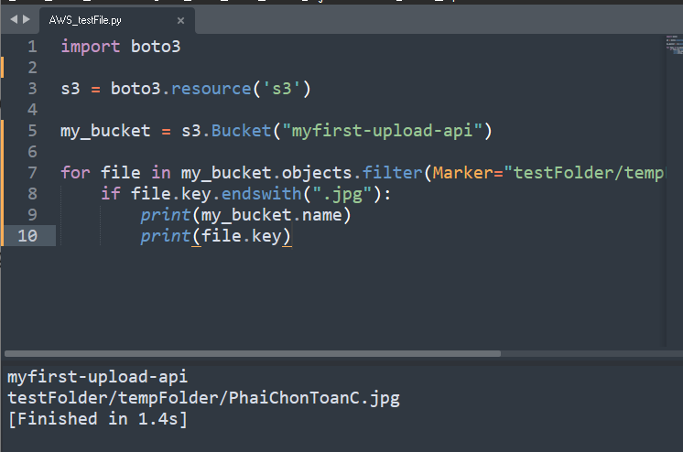
List Objects Starting From Specific Objects: (2)
-> List files with certain “.<…>” file, ignore other files => use pure python
import boto3
s3 = boto3.resource('s3')
my_bucket = s3.Bucket("myfirst-upload-api")
for file in my_bucket.objects.filter(Marker="testFolder/tempFolder/BGmixigaming.jpg"):
if file.key.endswith(".jpg"):
print(my_bucket.name)
print(file.key)

Slide 7
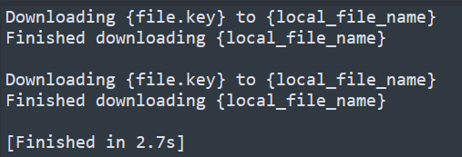
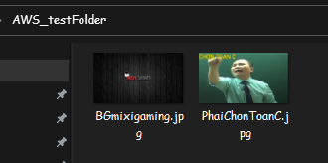
Download Objects from S3 with Boto3: my_bucket.download_file(Key, Local_filename)
import boto3
import os # os module help to interact with Operating System
s3 = boto3.resource('s3')
my_bucket = s3.Bucket("myfirst-upload-api")
local_path = r"C:\Users\ADMIN\OneDrive - Unicorn\Desktop\AWS_testFolder“
for file in my_bucket.objects.filter(Prefix="testFolder/tempFolder/"):
if file.key.endswith(".jpg"):
local_file_name = os.path.join(local_path, file.key.split("/")[2])
print("Downloading {file.key} to {local_file_name}")
my_bucket.download_file(file.key, local_file_name)
print("Finished downloading {local_file_name}\n")

Slide 8
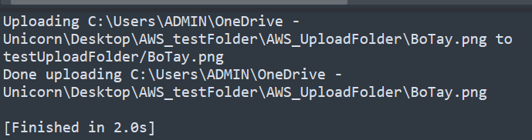
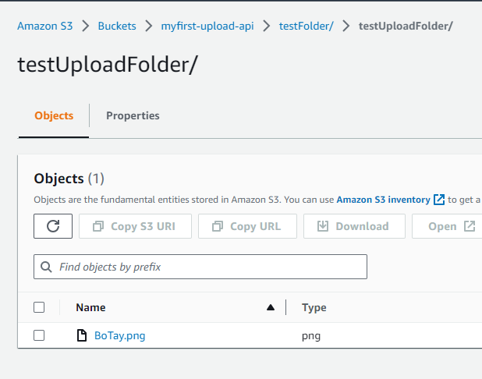
Upload Objects to S3 with Boto3: my_bucket.upload_file(‘/local/file/here.txt’, ‘folder/sub/path/to/s3key’)
(Local file at first and where you want to put it)
import boto3
import os # os module help to interact with Operating System
s3 = boto3.resource('s3')
my_bucket = s3.Bucket("myfirst-upload-api")
local_upload_dir = r"C:\Users\ADMIN\OneDrive - Unicorn\Desktop\AWS_testFolder\AWS_UploadFolder"
for images in os.listdir(local_upload_dir):
full_upload_path = os.path.join(local_upload_dir, images)
#print(full_upload_path)
print(f"Uploading {full_upload_path} to testUploadFolder/{images}")
my_bucket.upload_file(full_upload_path, f"testFolder/testUploadFolder/{images}")
# Cause we're connecting to a particular bucket (my_bucket),
# so it's assuming that it's in that bucket and we don't have to tell it which bucket in the path
# And if we don't have that foler on the S3 bucket, it's automatically create a new folder with that name
print(f"Done uploading {full_upload_path}\n")

Slide 9
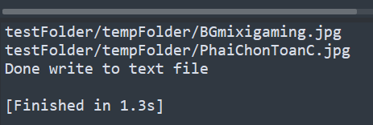
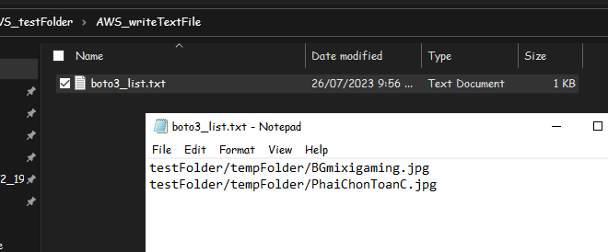
List All Objects and Write to Text File:
import boto3
import os # os module help to interact with Operating System
s3 = boto3.resource('s3')
my_bucket = s3.Bucket("myfirst-upload-api")
text_file_dir = r'C:\Users\ADMIN\OneDrive - Unicorn\Desktop\AWS_testFolder\AWS_writeTextFile\boto3_list.txt'
with open(text_file_dir, 'a') as text_file: # "text_file" is optional, any name
# "a" means append, it means if theres a stuff in that file, it'll write at the bottom of the file
# if we use "w" means write, it'll overwrite every time we run
for file in my_bucket.objects.filter(Prefix="testFolder/tempFolder/"):
if file.key.endswith(".jpg"):
print(file.key)
text_file.write(file.key + '\n')
print("Done write to text file\n")

Slide 10
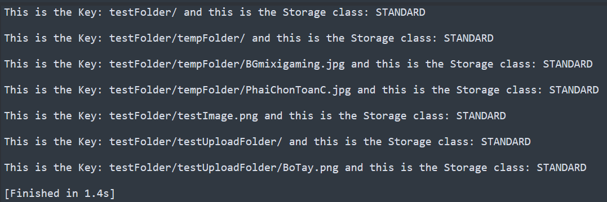
Query S3 Storage Class using Python and Boto3 :
(1)
import boto3
s3 = boto3.resource('s3')
my_bucket = s3.Bucket("myfirst-upload-api")
for bucket_obj in my_bucket.objects.all():
object_name = bucket_obj.key
storage_class = bucket_obj.storage_class
print(f"This is the Key: {object_name} and this is the Storage class: {storage_class}\n")

Slide 11
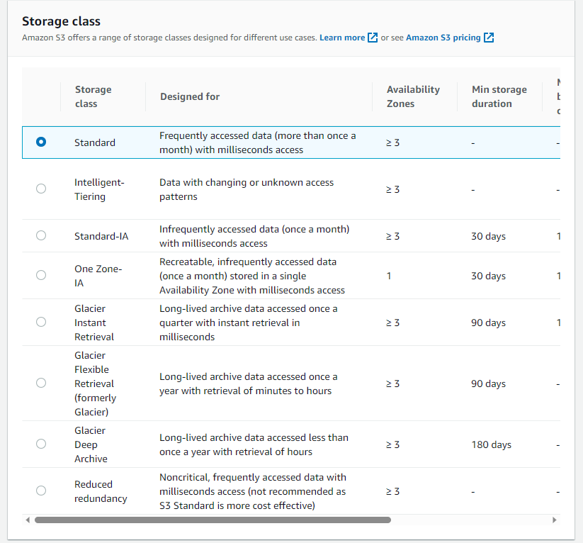
Query S3 Storage Class using Python and Boto3 :
(2)

