Slide 1
Introduction to pattern recognition
Associate Prof. Huỳnh Trung Hiếu

Slide 2
Pattern Recognition?
“The assignment of a physical object or event to one of several pre-specified categories” -- Duda & Hart
A pattern is an object, process or event
A class (or category) is a set of patterns that share common attribute (features) usually from the same information source
During recognition (or classification) classes are assigned to the objects.
A classifier is a machine that performs such task

Slide 3
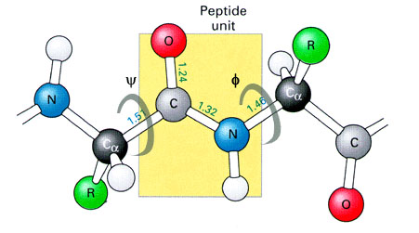

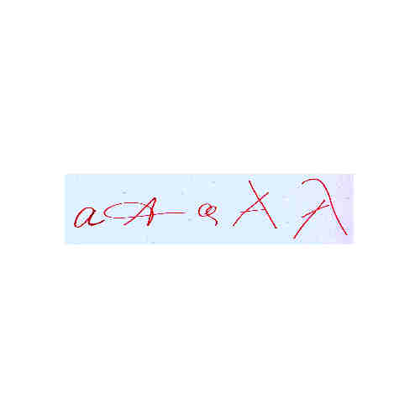
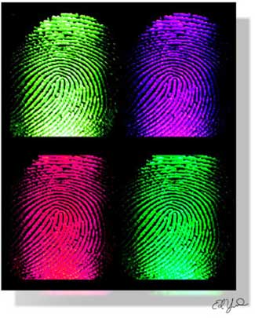


What is a pattern?
“A pattern is the opposite of a chaos; it is an entity vaguely defined, that could be given a name.”

Slide 4
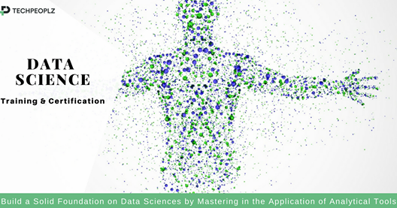
Applications of pattern recognitions

Slide 5
Applications of pattern recognitions
Can be found any where.
Examples:
disease categorization
prediction of survival rates for patients of specific disease
fingerprint verification
face recognition
iris discrimination
chromosome shape discrimination
optical character recognition
texture discrimination
speech recognition
and etc

Slide 6
Shape Discrimination

Slide 7
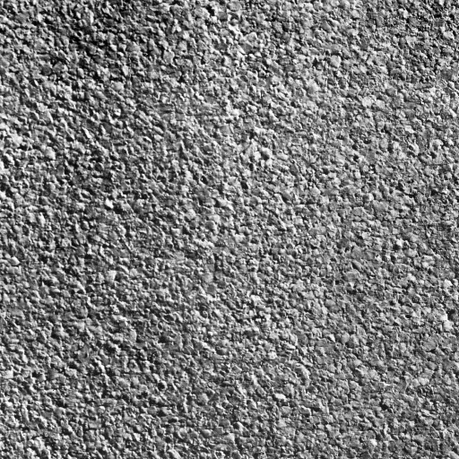
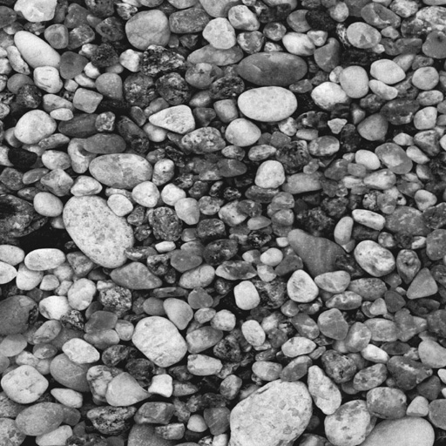
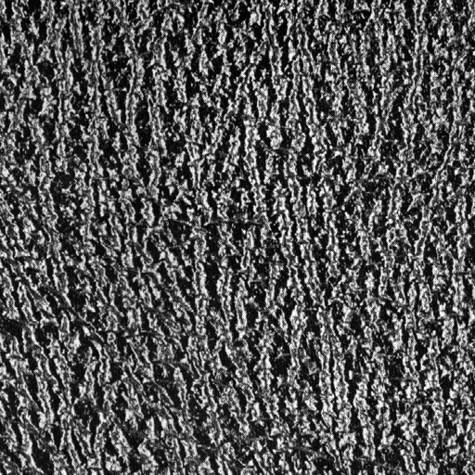

Texture Discrimination

Slide 8

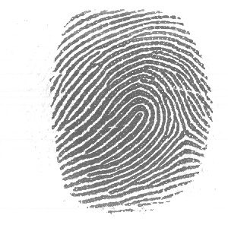
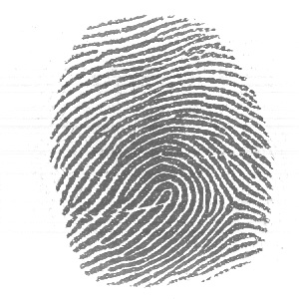
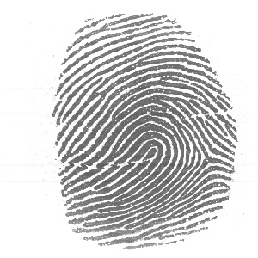
Are They From the Same Person?

Slide 9
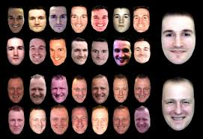

Slide 10
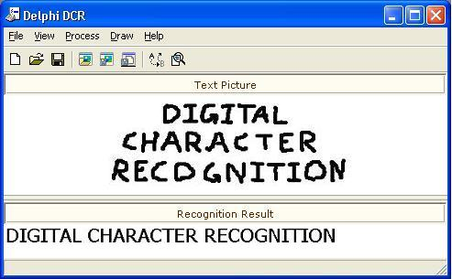
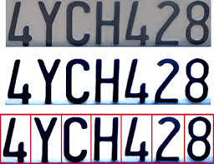

Slide 11
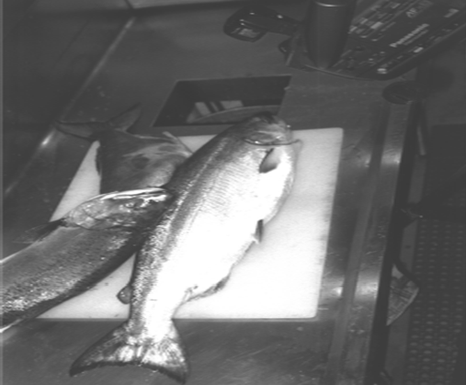

Slide 12
Examples of Applications
Handwritten: sorting letters by postal code, input device for PDA‘s.
Printed texts: reading machines for blind people, digitalization of text documents.
Optical Character Recognition (OCR)
Biometrics
Diagnostic systems
Military applications
Face recognition, verification, retrieval.
Finger prints recognition.
Speech recognition.
Medical diagnosis: X-Ray, EKG analysis.
Machine diagnostics, waster detection.
Automated Target Recognition (ATR).
Image segmentation and analysis (recognition from aerial or satelite photographs).

Slide 13
Pattern recognition System??

Slide 14
Pattern recognition system

Slide 15
Recognition system
Sensing
Transducer such as a camera or a microphone array
Segmentation and grouping
For reliable feature extraction
Can handle overlapping sample or coarticulation
One of the deepest problems in pattern recognition
Feature extraction
Properties for robust features
Invariance: translation, rotation, scale, rate

Slide 16
Recognition system
Classification
Classifier design problem – training problem
Noise problem
Noise is any property of the sensed pattern which is not due to the true underlying model but instead to randomness in the world or the sensor.
What is the best performance that is possible?
Missing feature problem
Post processing
Recommendation for action with classifier results
Risk minimization rather than error rate minimization
Exploitation of context and multiple classification results

Slide 17
Test?
The values of features for nine samples from class A are 1,2,3,3,4,4,6,6,8. Nine samples from class B had x values of 4,6,7,7,8,9,9,10,12. Find a decision boundary (threshold) that minimizes the total number of misclassifications.
Solutions:????

Slide 18
Histogram
Definitions?

Slide 19
Histogram
A histogram is an accurate graphical representation of the distribution of numerical data. It is an estimate of the probability distribution of a continuous variable(quantitative variable). It is a kind of bar graph.
To construct a histogram, the first step is to "bin" the range of values—that is, divide the entire range of values into a series of intervals—and then count how many values fall into each interval.
Mathematical definitions???

Slide 20
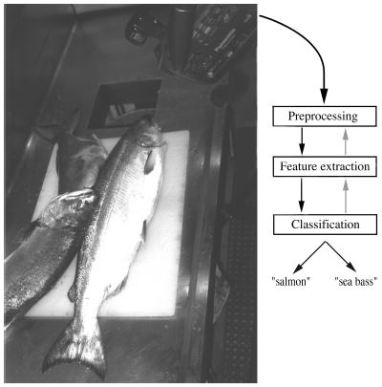
Example
Sensor : Camera

Slide 21
Example
Preprocessing
Light level adjustment
Image thresholding to remove the background of the conveyor belt
Some kind of segmentation
Feature extraction
Length of a fish – from the experience of a person
Obtaining critical value of a length we can classify the fish depending upon ( sea bass > salmon )
Critical value based on training samples of the different types of fish

Slide 22
Example
Histograms for the length feature
Poor results : necessity of new features

Slide 23
Example
Additional feature : lightness
Elimination of illumination variations
Unsuitability of symmetric cost
What is the best decision?
Decision cost -> decision theory

Slide 24
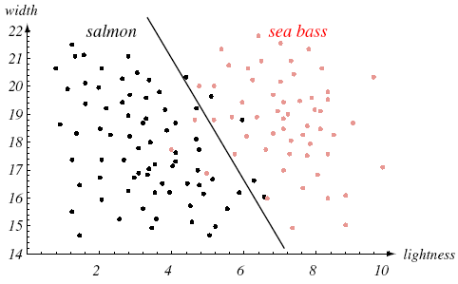
Example
Using two features
Lightness and width ( sea bass > salmon )
Two dimensional feature space
Linear decision boundary

Slide 25
Quiz?
Invent a set of numeric features that could be used for identifying the models of automobiles from side-view photographs of unknown scale?

Slide 26
Design cycle

Slide 27
Design cycle
Data collection
How do we know when we have collected an adequately large and representative set of examples for training and testing the system?
Feature choice
Prior knowledge – a priori information
Features that is simple to extract, invariant to irrelevant transformations, insensitive to noise, and useful for discrimination patterns in different categories
How do we combine prior knowledge and empirical data to find relevant and effective features?

Slide 28
Design cycle
Model choice
How are we to know to reject a class of models and try another one? Random and tedious trial and error?
Incorporation with prior knowledge also
Training
Process of using data to determine the classifier
No universal methods
The most effective methods for developing classifiers involve learning from examples

Slide 29
Design cycle
Evaluation
System performance measurement
Identification of the need for improvements
Adjustment of the complexity of the model
Overfitting with complicated model
Poor classification with not too complex model
Computational complexity
What is the trade off between computational ease and performance?
(How an algorithm scales as a function of the number of features, number or training examples, number patterns or categories?)

Slide 30
Learning and adaptation
Learning: some form of algorithm for reducing the error on a set of training data
Supervised learning
Labeled or categorized training pattern
Unsupervised learning
Unlabeled patterns
Natural groupings of the input patterns: cost function
Different clusters from different clustering algorithms
Reinforcement learning
No feedback how it is wrong: true or false
How can the system learn from such feedback?

