Slide 1
Maximum-likelihood and Bayesian Parameter Estimation
Dr. Huỳnh Trung Hiếu

Slide 2
Introduction
To design an optimal classifier we need P(w_{i}) and p(x| w_{i}), but usually we do not know them.
Solution – to use training data to estimate the unknown probabilities. Estimation of class-conditional densities is a difficult task.

Slide 3
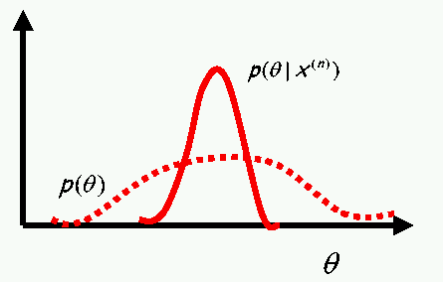
Introduction
  Maximum likelihood estimation:
    The parameters are regarded as quantities whose values are fixed but unknown.
  Bayesian learning:
    The parameters are regarded as random variables having some known prior distribution.

Slide 4

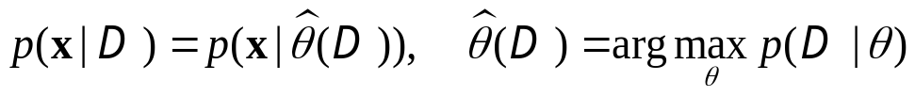
Introduction
  Maximum likelihood estimation:
    Choose parameter value that makes the data most probable (i.e., maximizes the probability of obtaining the sample that has actually been observed)
  Bayesian learning:
    Observation of the samples converts this to a posterior density
    A typical effect of observing additional samples is to sharpen the a posteriori density function: Bayesian learning

Slide 5
Maximum-Likelihood Estimation
  Has good convergence properties as the sample size increases
  Simpler than any other alternative techniques
  General principle
  Assume we have c classes and
    P(x | ω_{j}) ~ N( μ_{j}, Σ_{j})
    P(x | ω_{j}) ≡ P (x | θ_{j}) where:

Slide 6
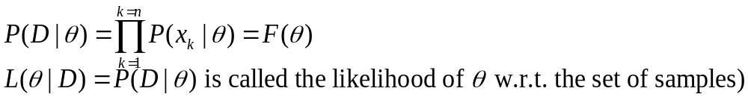
Maximum-Likelihood Estimation
Use the information provided by the training samples to estimate θ = (θ₁, θ₂, …, θ_{c}), each θ_{i} (i = 1, 2, …, c) is associated with each category
Suppose that D contains n samples, x₁, x₂,…, x_{n} (independent and identically distributed-idd)
ML estimate of θ is, by definition the value that maximizes P(D | θ)
“It is the value of θ that best agrees with the actually observed training sample”

Slide 7
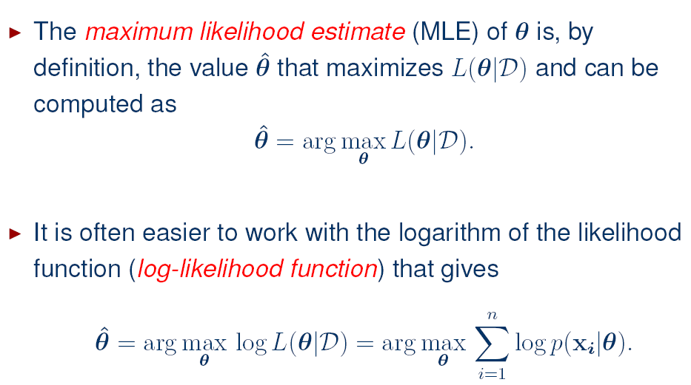
Maximum-Likelihood Estimation

Slide 8
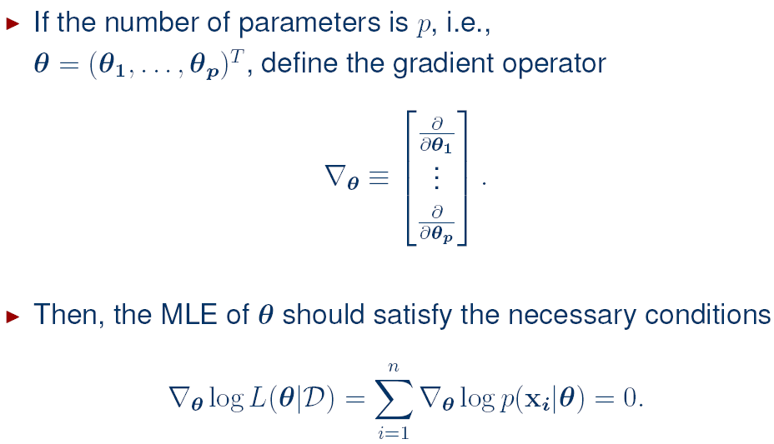
Maximum-Likelihood Estimation

Slide 9
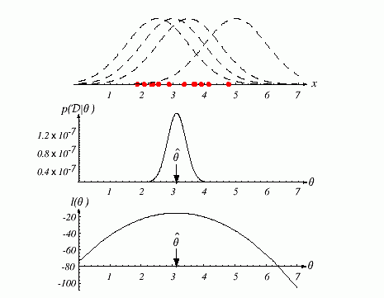
Log-Likelihood Illustration
The top graph shows several training points in one dimension, known or assumed to be drawn from a Gaussian of a particular variance, but unknown mean. Four of the infinite number of candidate source distributions are shown in dashed lines.
The middle figure shows the likelihood p(D|θ) as a function of the mean. If we had a very large number of training points, this likelihood would be very narrow. The value that maximizes the likelihood is marked θˆ; it also maximizes the logarithm of the likelihood—that is, the log-likelihood l(θ), shown at the bottom. Note that even though they look similar, the likelihood p(D|θ) is shown as a function of θ whereas the conditional density p(x|θ) is shown as a function of x. Furthermore, as a function of θ, the likelihood p(D|θ) is not a probability density function and its area has no significance.

Slide 10
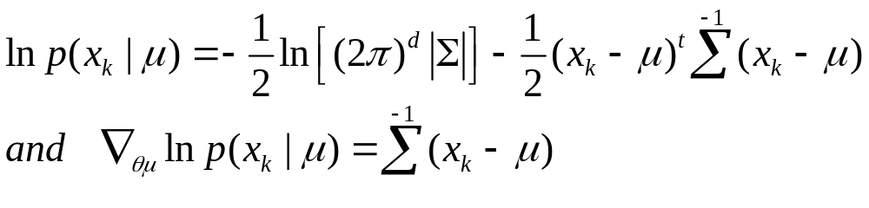
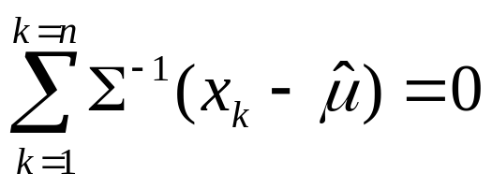
Example of a specific case: unknown μ
  P(x_{i} | μ) ~ N(μ, Σ)
  (Samples are drawn from a multivariate normal population)
  θ = μ therefore:
    The ML estimate for μ must satisfy:

Slide 11
Example of a specific case: unknown μ
  P(x_{i} | μ) ~ N(μ, Σ)
  (Samples are drawn from a multivariate normal population)
  μ=????

Slide 12
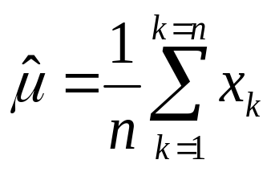
Example of a specific case: unknown μ
    Multiplying by Σ and rearranging, we obtain:
    (Just the arithmetic average of the samples of the training samples!)
    Conclusion:
    “If P (x_{k}|ω_{j}) (j = 1, 2, …, c) is supposed to be Gaussian in a d-dimensional feature space; then we can estimate the vector θ = (θ₁, θ₂, …, θ_{c})^{t} and perform an optimal classification !”

Slide 13
Example of a specific case: unknown μ, Σ
  P(x_{i} | μ) ~ N(μ, Σ)
  (Samples are drawn from a univariate normal population)
  μ=?, Σ=?

Slide 14
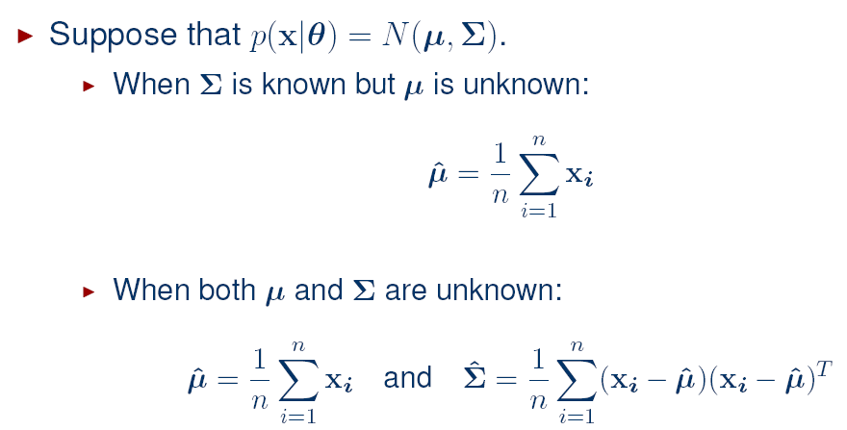
Gaussian case

Slide 15
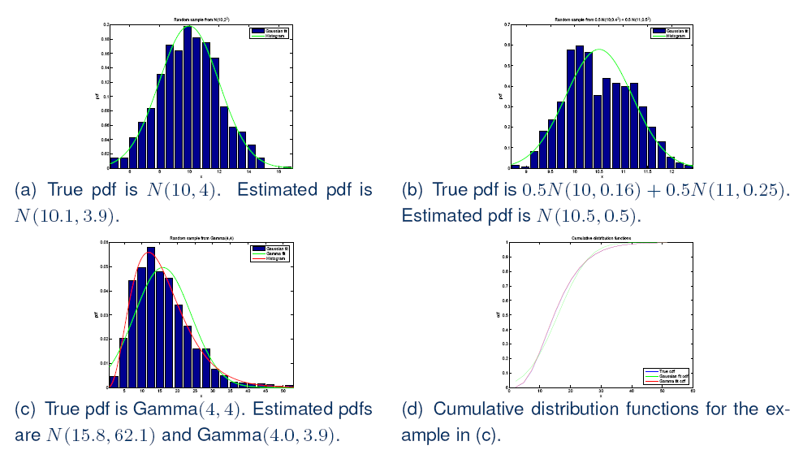
Maximum Likelihood Estimation Examples

Slide 16
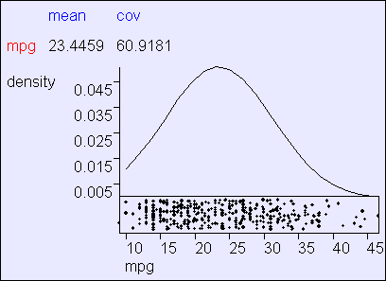
Maximum Likelihood Estimation Examples
Using R=392 cars from the “MPG” UCI dataset supplied by Ross Quinlan

Slide 17
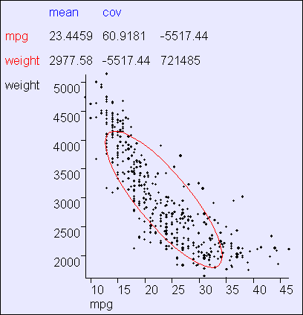
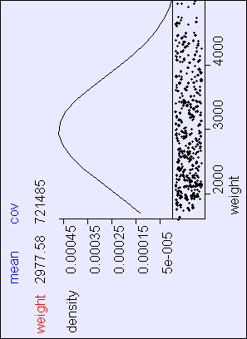
Maximum Likelihood Estimation Examples

Slide 18
Bayesian Estimation

Slide 19
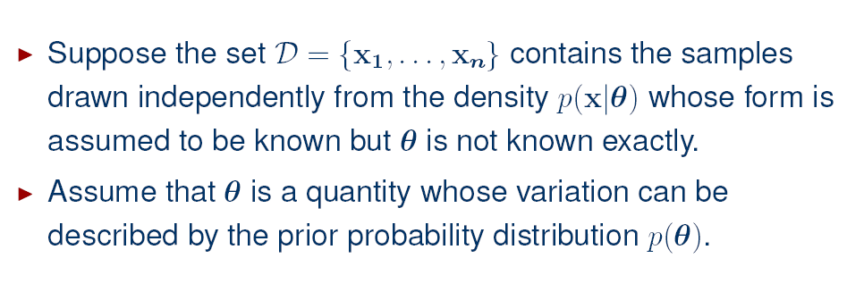
Bayesian Estimation

Slide 20
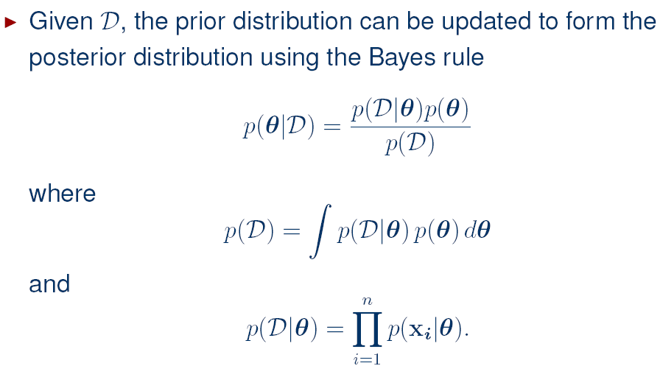
Bayesian Estimation

Slide 21
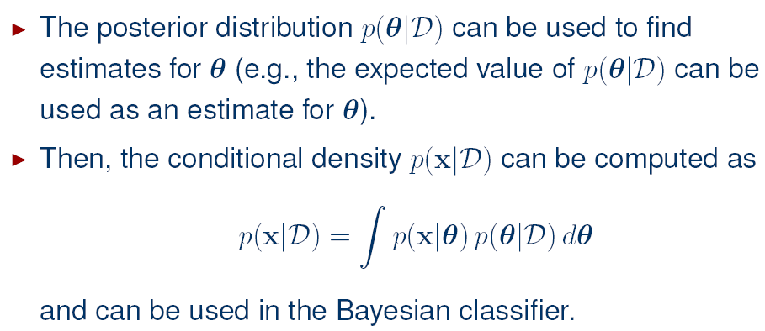
Bayesian Estimation

Slide 22
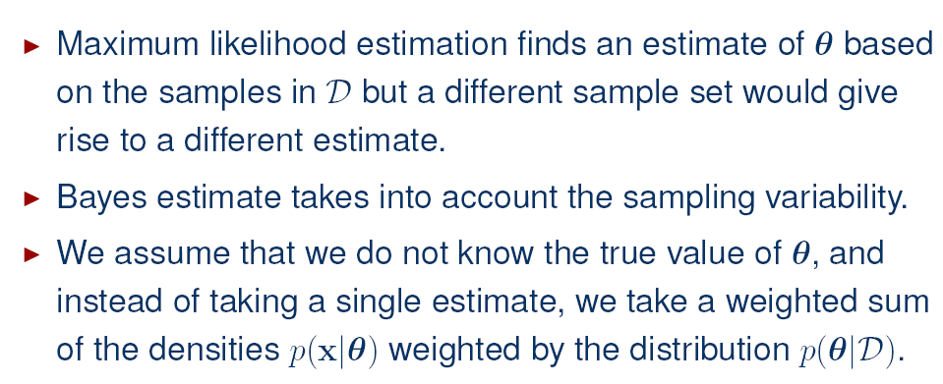
MLEs vs. Bayesian Estimations

Slide 23
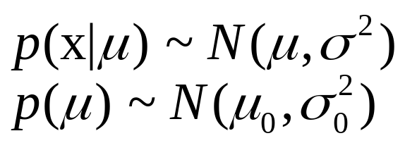
Bayesian Parameter Estimation: Gaussian Case
  The univariate case: p(μ | D)
  μ is the only unknown parameter
  (μ₀ and σ₀ are known!)

Slide 24
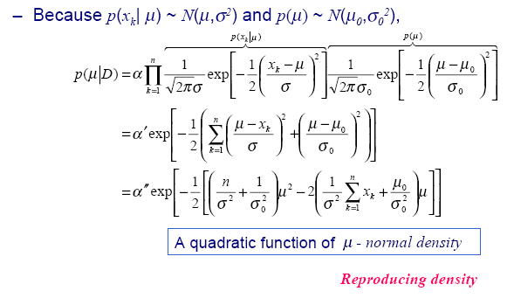
Bayesian Parameter Estimation: Gaussian Case

Slide 25
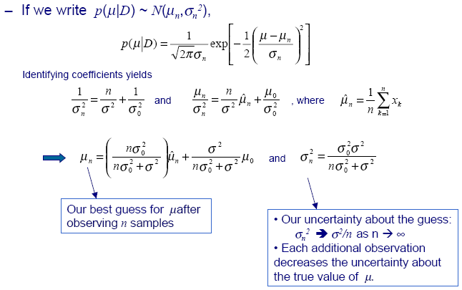
Bayesian Parameter Estimation: Gaussian Case

Slide 26
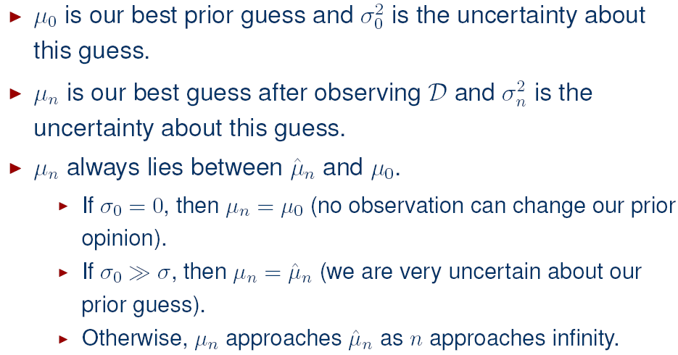
Bayesian Parameter Estimation: Gaussian Case

Slide 27
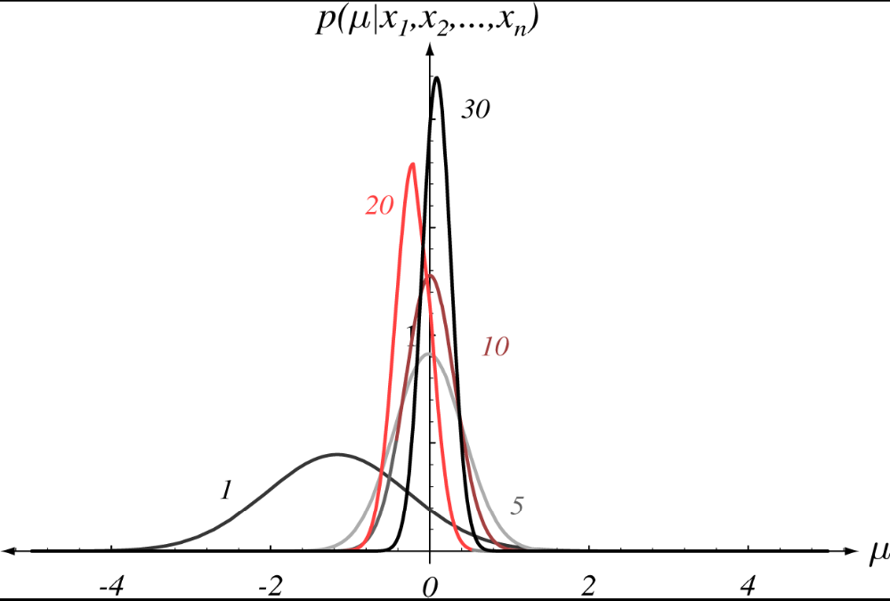
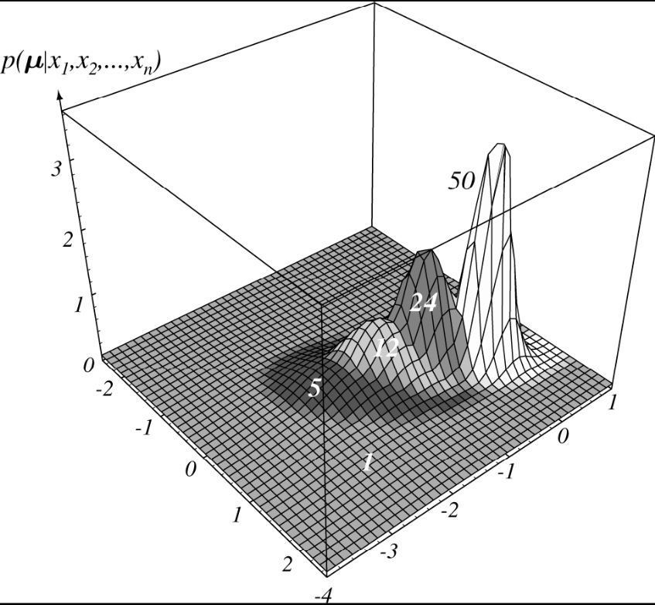
Bayesian Parameter Estimation: Gaussian Case
The posterior distribution estimates are labeled by the number
of training samples used in the estimation.

Slide 28
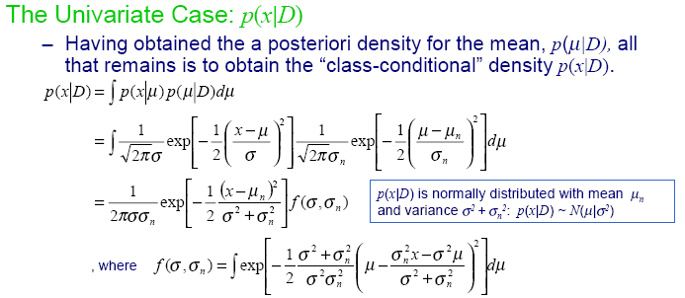
Bayesian Parameter Estimation: Gaussian Case

Slide 29
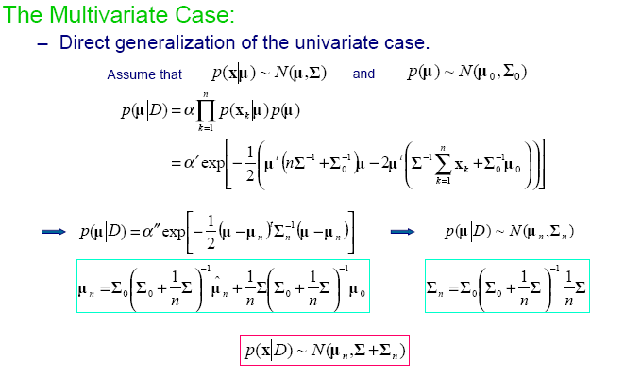
Bayesian Parameter Estimation: Gaussian Case

Slide 30
Bayesian Parameter Estimation: General Theory
The basic assumptions are:
  The form of p(x | θ) is assumed known, but the value of θ is not known exactly
  Our knowledge about θ is assumed to be contained in a known prior density p(θ)
  The rest of our knowledge θ is contained in a set D of n random variables x₁, x₂, …, x_{n} that follows p(x)

Slide 31
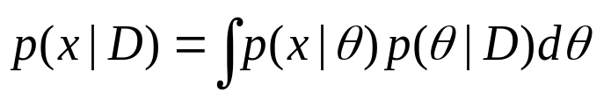
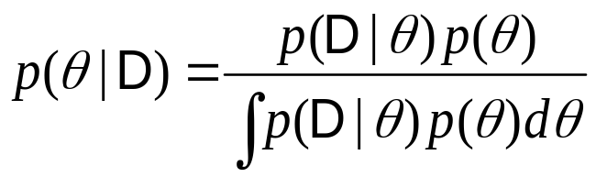
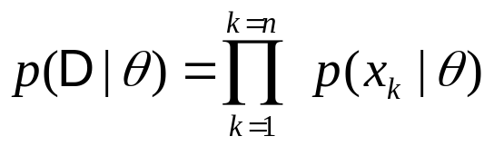
Bayesian Parameter Estimation: General Theory
The basic problem is:
“Compute the posterior density p(θ | D)” then “Derive p(x | D)”
Using Bayes formula, we have:
And by independence assumption:

Slide 32
Maximum-likelihood vs. Bayesian
ML and Bayesian estimations are asymptotically equivalent and “consistent”. They yield the same class-conditional densities when the size of the training data grows to infinity.
ML is typically computationally easier: in ML we need to do (multidimensional) differentiation and in Bayesian (multidimensional) integration.
ML is often easier to interpret: it returns the single best model (parameter) whereas Bayesian gives a weighted average of models.
But for a finite training data (and given a reliable prior) Bayesian is more accurate (uses more of the information).
Bayesian with “flat” prior is essentially ML; with asymmetric and broad priors the methods lead to different solutions.

