Slide 1
Problems of Dimensionality
Dr. Huỳnh Trung Hiếu

Slide 2
PROBLEMS OF DIMENSIONALITY
There are two issues that must be confronted:
  How classification accuracy depends on the dimensionality and amount of training data.
  The computational complexity of designing the classifier

Slide 3
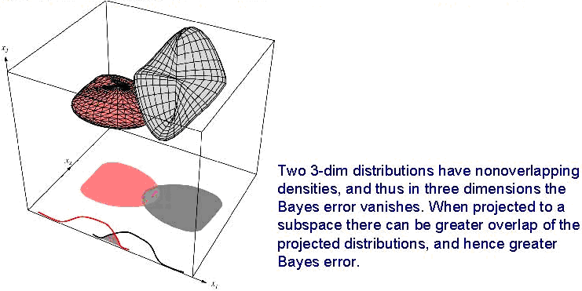
How classification accuracy depends on the dimensionality and amount of training data
  Most useful features are the ones for which the difference between the means is large relative to the standard deviation
  It is natural to consider adding new features, if the performance obtained with a given set of features is inadequate.

Slide 4
How classification accuracy depends on the dimensionality and amount of training data
Increasing the number of features increases the cost and complexity.
It has frequently been observed in practice that, beyond a certain point, the inclusion of additional features leads to worse rather than better performance: we have the wrong model !

Slide 5
Component Analysis and Discriminants

Slide 6
Component Analysis and Discriminants
Goal: Combine features in order to reduce the dimension of the feature space
Two classical approaches for finding “optimal” linear transformation
  PCA (Principal Component Analysis) “Projection that best represents the data in a least- square sense”
  MDA (Multiple Discriminant Analysis) “Projection that best separates the data in a least-squares sense”

Slide 7

Principal component analysis(PCA)
The problem of representing all of the vectors in a set of n d-dimensional samples x₁,…,x_{n} by a single vector x₀.
The squared-error criterion function J₀(x₀)
The value of x₀ that minimizes J₀ is given by x₀=m, where m is the sample mean

Slide 8
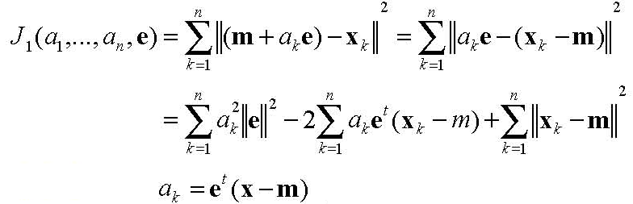
Principal component analysis(PCA)
One-dimensional representation by projecting the data onto a line running through the sample mean
  Let e be a unit vector in the direction of the line
  x=m+ae
  where scalar a corresponds to the distance of any point x from the mean m.
  If we present x_{k} by m+a_{k}e

Slide 9
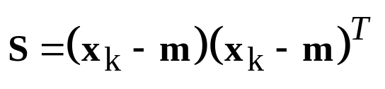
Principal component analysis(PCA)
The more interesting problem of finding the best direction e for the line
  Scatter matrix S defined by
  The vector e must be an eigenvector of the scatter matrix corresponding to the largest eigenvalue of the scatter matrix.

Slide 10

Principal component analysis(PCA)
Extension to a d’-dimensional projecttion
The vectors e₁,…e_{d’} must be eigenvectors of the scatter matrix having the largest eigenvalues.
Geometrically, if we picture the data points x₁,…,x_{n} as forming a d-dimensional, hyperellipsoidally shaped cloud, then the eigenvectors of the scatter matrix are the principal axes of that hyperellipsoid.

Slide 11
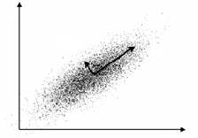
Principal component analysis(PCA)
PCA reduces the dimensionality of feature space by restricting attention to those directions along which the scatter of the cloud is greatest

Slide 12
Fisher Liner Discriminant
The directions that are discarded by PCA might be exactly the directions that are needed for distinguishing between classes
We might be able to find an orientation for which the projected samples are well separated.
Projecting data from d-dimensions onto a line
y=w^{t}x
The direction of w is important, and the magnitude of w is of no real significance

Slide 13
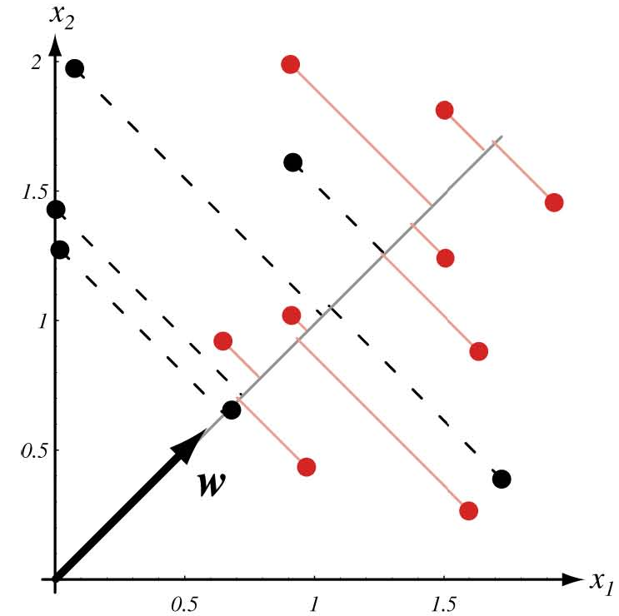
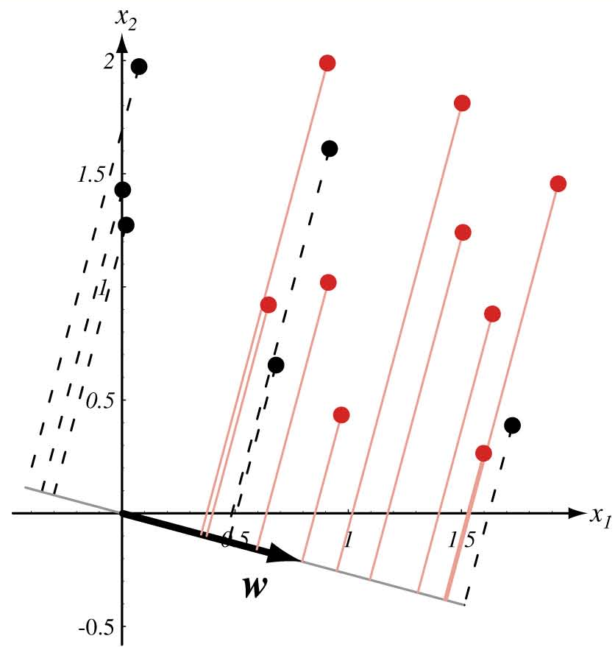
Fisher Liner Discriminant
Projection of the same set of samples onto two different line in the directions marked w. The figure on the right shows greater separation between the red and black projected points

Slide 14
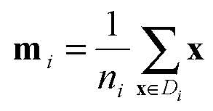
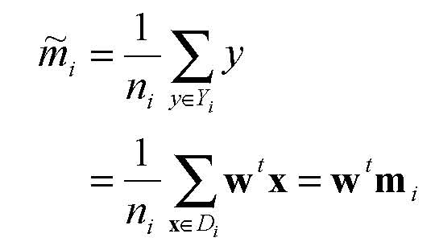
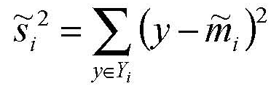
Fisher Liner Discriminant
d-dimensional sample mean
The sample mean for the projected points
The scatter for projected samples

Slide 15
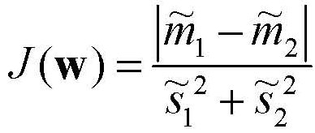
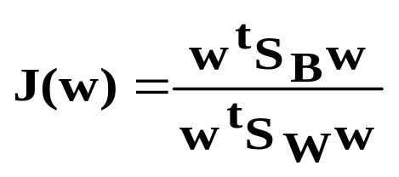
Fisher Linear Discriminant
The Fisher linear discriminant employs that linear function w^{t}x for which the criterion function
is maximum
We have
We obtain (page 119-120)
w=S_{w}⁻¹(m1-m2)
where S_{w} is within-class scatter matrix of samples

Slide 16
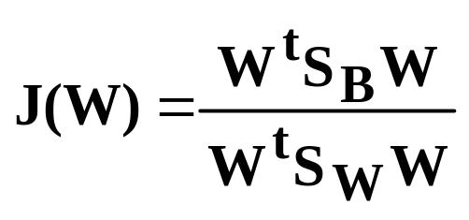
Fisher Linear Discriminant
Multiple Discriminant Analysis
  The generalization of Fisher linear discriminant function to c-class problem
  Criterion function
  Find the matrix W that minimize J(.)
  The columns of an optimal W are the generalized eigenvectors that correspond to the largest eigenvalues in
    S_{B}w_{i}=λ_{i}S_{W}w_{i}

