Slide 1
Domestic Hot Water Problem
Group 4 郭嘉茗 柳煜辰 乌鑫亮 夏悦然 郁程

Slide 2
Field Research&
Insights
Problem
STEP 1
STEP 2
STEP 3
STEP 4
STEP 5
Topic
Desk Research
HMW

Slide 3
Why do we choose this topic ?

Slide 4
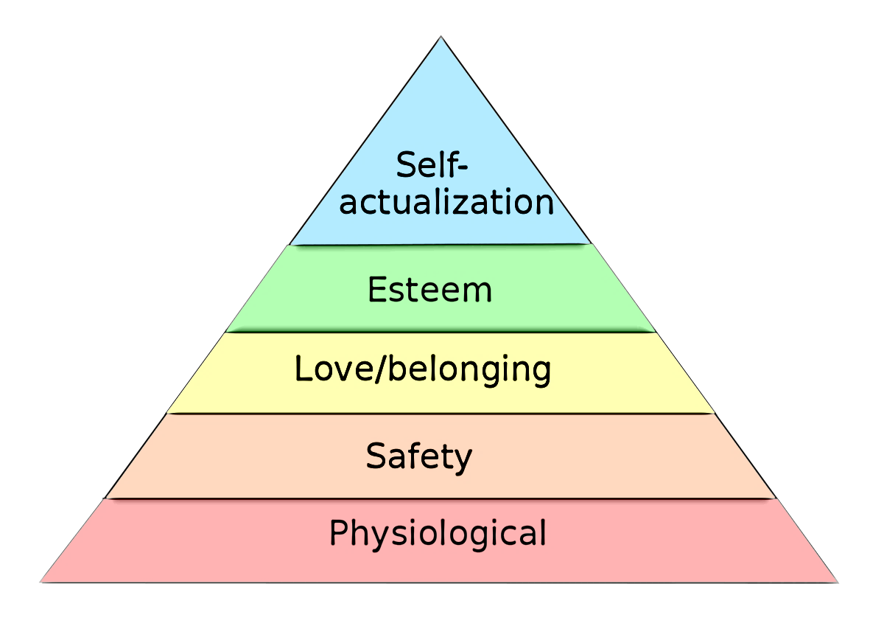
Maslow's hierarchy of needs

Slide 5
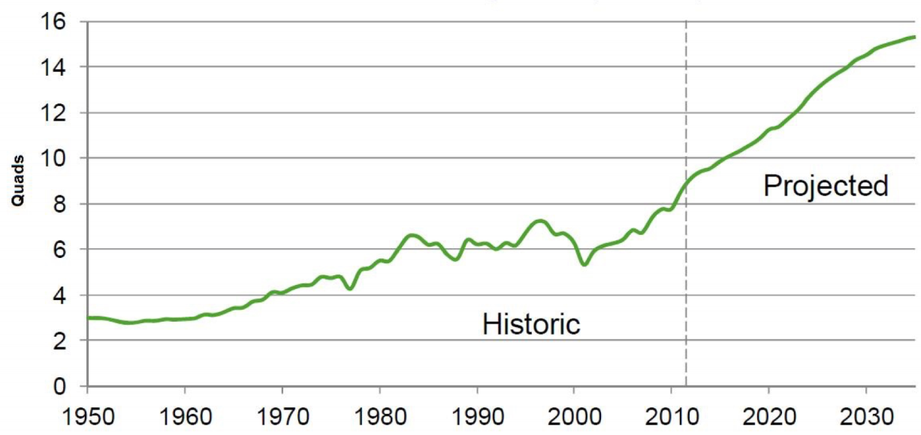
Human demand for resources

Slide 6
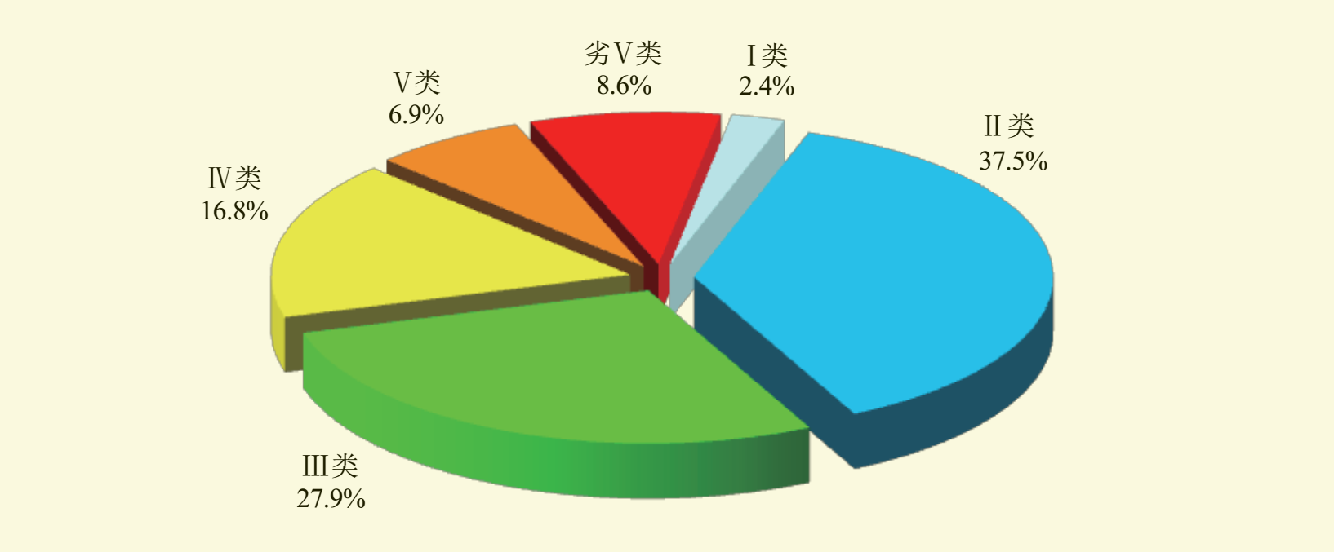
The ratio of national surface water quality classification in 2016

Slide 7
Find the specific problem

Slide 8
Universality
Importance
Wicked

Slide 9
Desk Research

Slide 10
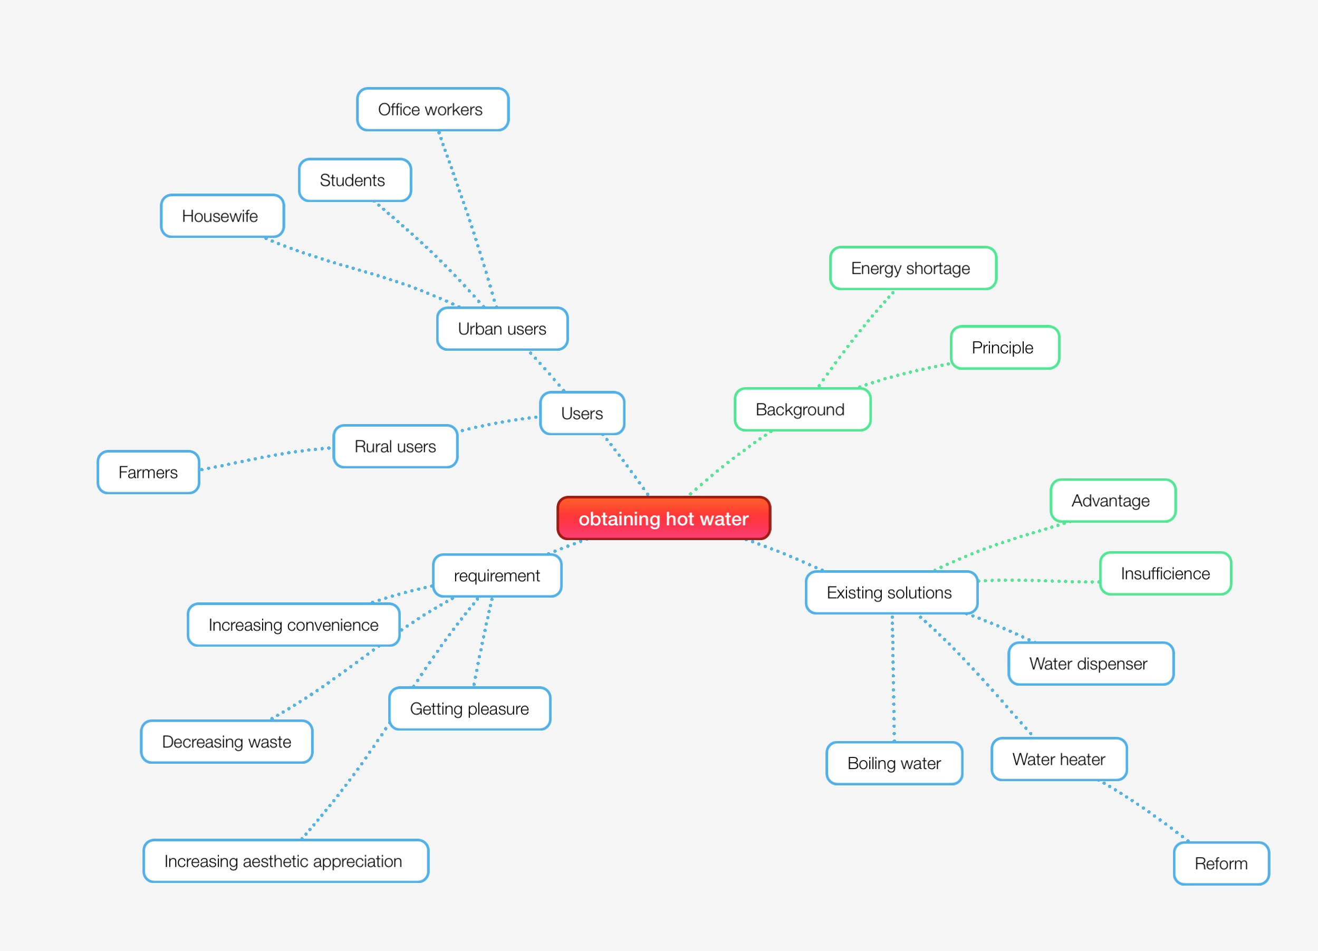

Slide 11
Current Situation of Renewable Energy
Consumer Psychology
Types of Water Heaters
Imperfect Existing Solution

Slide 12
Field Research & Insights

Slide 13
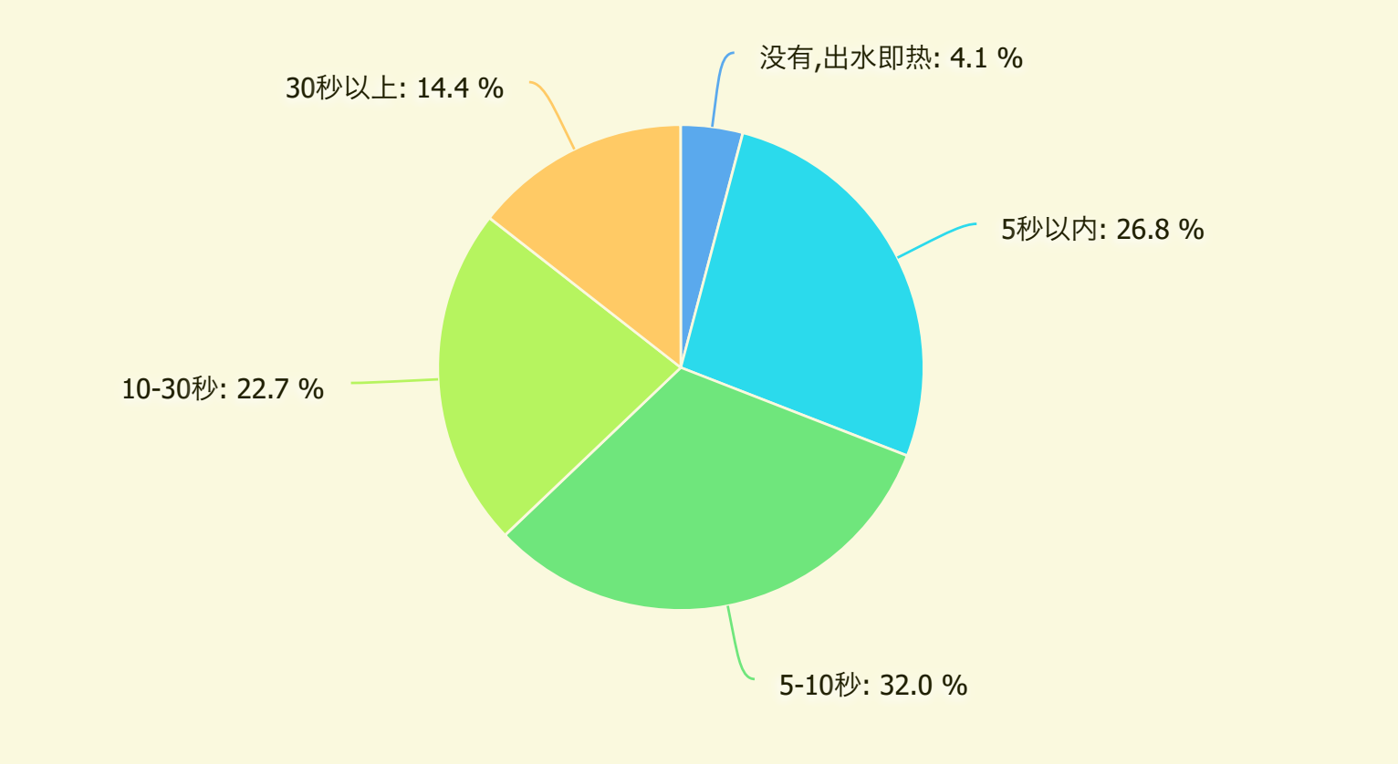
The time before hot water starts to flow

Slide 14
assumptions
Consumers are unwilling to pay to solve the problem.

Slide 15
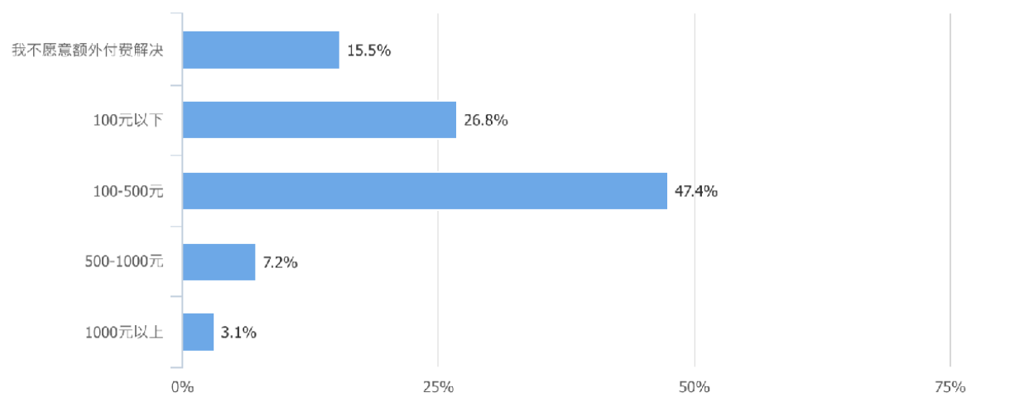
The price customers are willing to pay to solve the problem

Slide 16
assumptions
Consumers are unwilling to pay to solve the problem.
real case
Actually, 74.2% consumers are willing to pay but with limited money.

Slide 17
assumptions
Consumers are willing to save water.

Slide 18
——Which is more important?
——Puzzled

Slide 19
assumptions
Consumers are willing to save water.
real case
Waste water costs little about which some consumers don’t care.

Slide 20
assumptions
Consumers complain most about unboiled water of water heaters.

Slide 21
Consumers' ideal water heater
fast heating
less energy consumption
easy to clean
with low price

Slide 22
assumptions
Consumers complain most about unboiled water of water heaters.
real case
The inability to handle multiple heating water tasks is to be resolved.

Slide 23
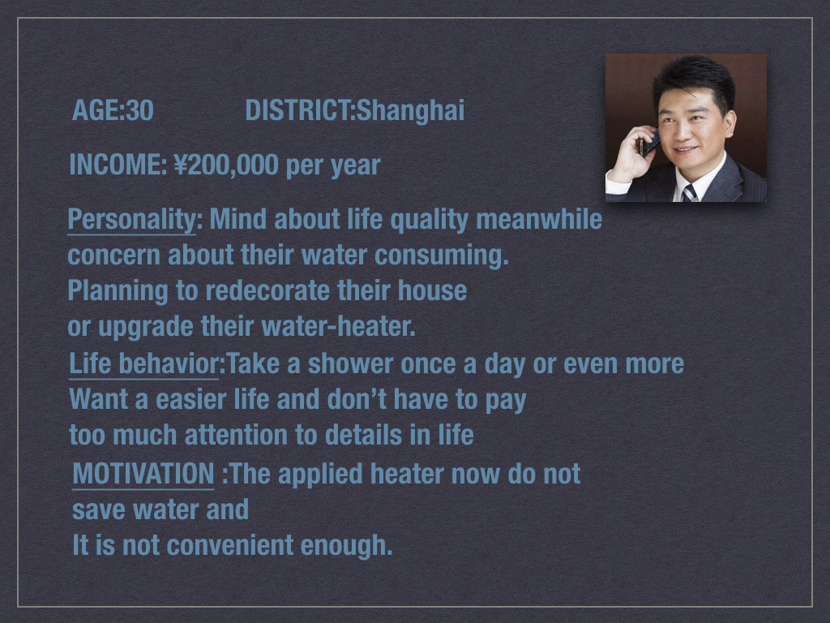
Min Wang

Slide 24
HMW
How to save water resource at relatively low price?
How to reduce time waiting for hot water?
How to handle multiple heating water tasks?

Slide 25
to be continued · · · · ·

Slide 26
Thanks for watching!
Group 4 郭嘉茗 柳煜辰 乌鑫亮 夏悦然 郁程

